Slide 1
Navigating the Global Music Streaming Landscape
Strategic Insights and Market Opportunities Across Developed, Emerging, and Frontier Markets
Jingbin Cao
Sep 4, 2023

Slide 2
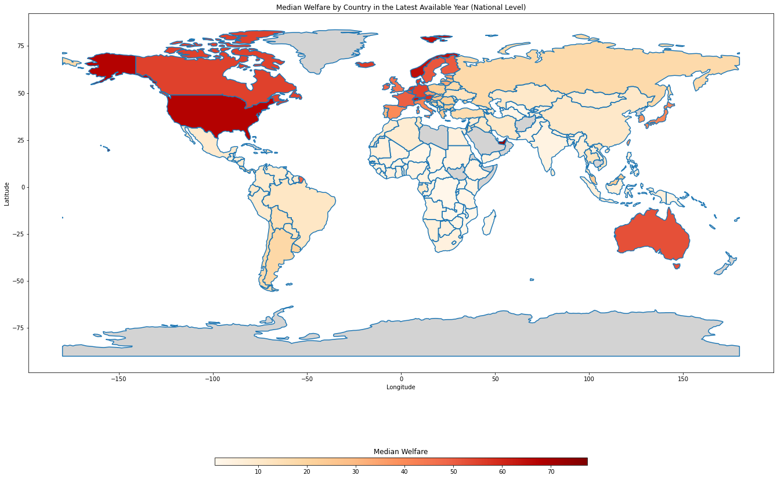
Welfare
Geographic Wealth Disparities: A notable concentration of higher median welfare levels can be observed in North America, Western and Northern Europe, as well as Australia, reinforcing their status as economically developed regions.
Global South Inequality: There are discernible gaps in median welfare levels, particularly in African countries where data is either missing or indicates lower economic standing.
Currency Perspective: Median welfare levels are represented in daily USD, providing a standardized metric.
National-Level Insights: The median welfare statistics are aggregated at a national level, which may mask intra-country disparities but provides a general view of economic health by region.
Data Source: Poverty and Inequality Platform (PIP): Percentiles | Data Catalog

Slide 3
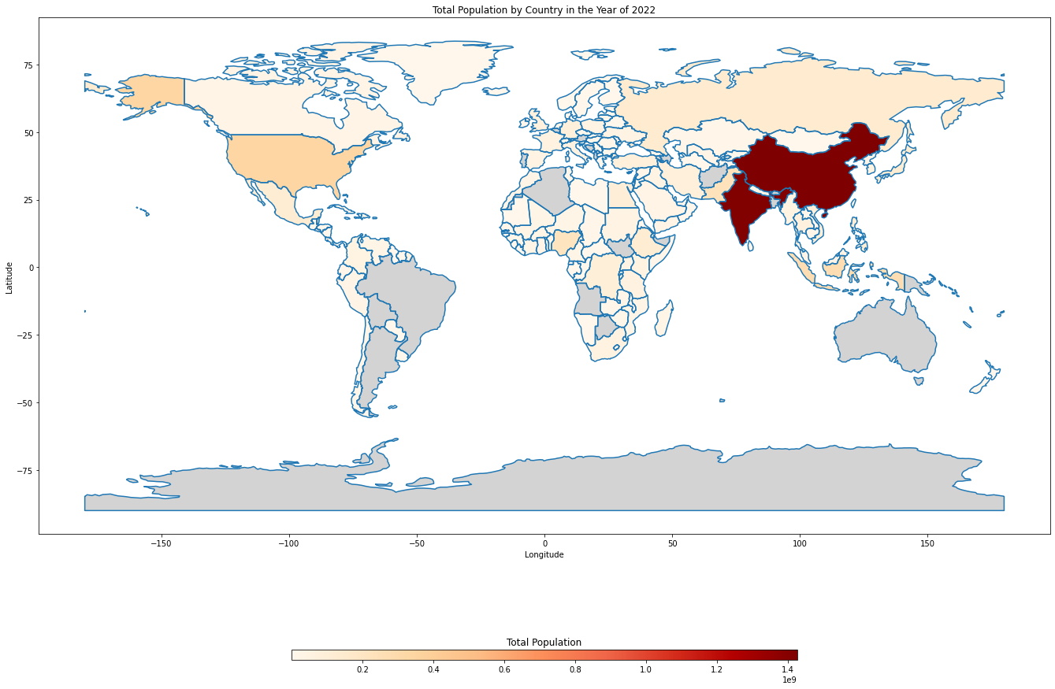
Population
Population Density in Emerging Markets: Substantial populations are observed in emerging and frontier markets, particularly in Southeast Asia and other parts of Asia, indicating a ripe environment for market expansion.
Data Gaps: Missing population data for regions like South America, Australia, and South Africa necessitate additional data collection for a more comprehensive analysis.
Demographic Giants: China and India stand out for their significantly larger populations, serving as potential focal points for market strategies due to the sheer size of their consumer base.
Temporal Context: The analysis utilizes population estimates for the year 2022, offering a current snapshot of demographic distributions across the globe.
Aggregated Age Data: The population figures include all age groups, providing a broad but non-segmented view of potential market size by country.
Data Source: World Population Prospects - Population Division - United Nations

Slide 4
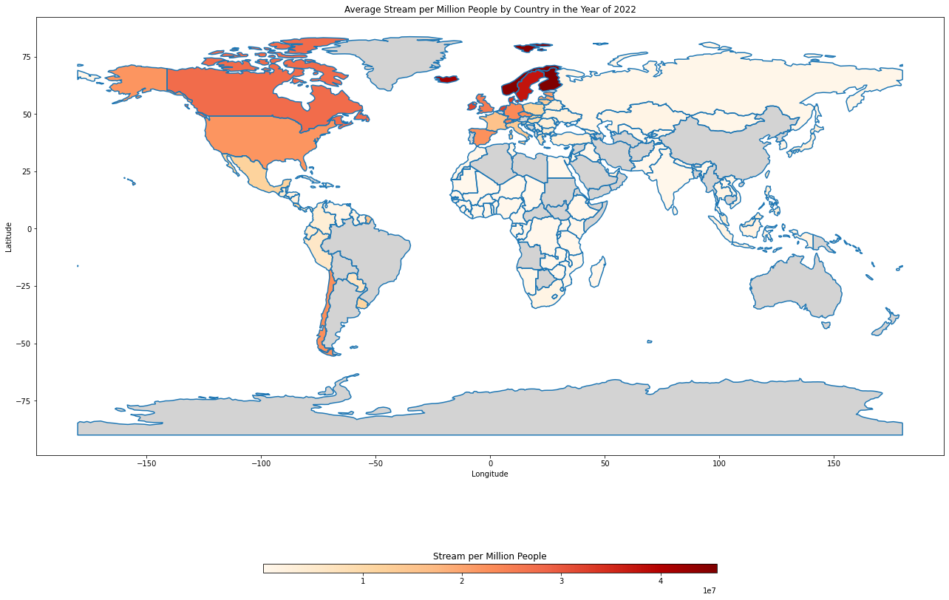
Streams
Streaming Concentration in Developed Markets: Developed countries exhibit higher numbers of streams (WMG tracks) highlighting untapped potential in emerging and frontier markets.
Incomplete Data Landscape: Notable data gaps exist in regions such as South Africa, South America, Asia, and Australia, indicating a need for additional data sourcing to achieve a more exhaustive understanding of global streaming behaviors.
Regional Leaders: Northern Europe distinguishes itself with high stream counts, while North America and Europe also maintain elevated levels of streaming, serving as benchmarks for other markets.
Current State of Streaming: Data is derived from the aggregated streams for the year 2022, offering a recent snapshot of consumer streaming patterns.
Streams per Capita: The data is normalized by national population to yield streams per person, facilitating a more accurate and comparable metric for assessing country-level music consumption behaviors.
Data Source: WMG Streaming Data in Datalab, df_prod.dap.fact_audio_streaming_agg_yearly, df_prod.dap.dim_consumer_details

Slide 5
Deep Dive for Spotify and WMG in Developed and Emerging Markets
Objective:
To provide strategic insights that can enhance user experience for Spotify and drive business growth for Warner Music Group (WMG) in Developed Markets (DM), Emerging Markets (EM), and Frontier Markets (FM).
Market Overview:
Developed Markets (DM): Comprises selected countries in Europe and North America.
Emerging Markets (EM): Includes targeted countries in Southeast Asia (SEA).
Frontier Markets (FM): Includes targeted countries in Sub-Saharan Africa (SSA).
Data Metrics:
Yearly Streams per Person: Measured as total streams divided by population, and categorized by country, age, and Spotify membership status (Free or Paid).
Population Estimates for 2022: Summarized in tables and grouped by country and age demographics.
Monthly Median Welfare: Denominated in USD and grouped by each country.
Spotify User Experience Analysis:
Potential User Adoption: Identifying market segments where there is untapped potential for new Spotify downloads and usage.
Membership Conversion: Strategies to educate and transition Free users to Paid memberships.
Personalized Services: Tailoring the user experience according to different age groups.
Future-proofing: Considering demographic trends to formulate long-term strategies.
WMG Analysis:
User Engagement: Aiming to increase the frequency of music-listening among users.
Product & Marketing Insights: Strategies to synergize WMG's product & marketing offerings with Spotify's user experience for optimal engagement.
Through this comprehensive analysis, we aim to uncover actionable insights that can be leveraged for informed decision-making and strategy planning.

Slide 6
Developed Market (DM): Europe and North America
Market Saturation: Norway and Finland set the industry standard with robust streaming numbers per person. Despite generally large streams per person across the board, the leadership of Norway and Finland underscores room for growth and market penetration in other developed markets.
Paid vs Free Accounts
Membership Efficacy: Paid accounts are generally associated with higher streams. Noteworthy exceptions like Canada, the U.S., and Ireland indicate untapped opportunities for converting free to paid accounts.
Age-Neutral Trends: Stream counts across different age groups are similar, suggesting a broader opportunity for membership conversion strategies.
Age Group Strategy: Lower streams in user > 35, present an opportunity for specialized UI experiences, akin to a digital record store and offering high-fidelity music (e.g., Qobuz).
Economic Capacity: A high median welfare above 1300 USD per month indicates a strong potential market for premium memberships.
WMG Focus: Target Age Groups for Product Development
For age > 35, emphasize content designed to extend listening durations.
Age groups 18-22 and 23-27 show the highest per capita streams, warranting tailored products and marketing strategies to engage them further.
Population of Each Age Group and Monthly Welfare by Country
Age Group | Canada | Denmark | Finland | France | Germany | Iceland | Ireland | Netherlands | Norway | Sweden | United Kingdom | United States
<18 | 7,216,960 | 1,151,342 | 1,025,326 | 13,488,877 | 13,892,813 | 82,728 | 1,183,660 | 3,293,672 | 1,101,184 | 2,225,468 | 14,139,852 | 74,152,038
18-22 | 2,227,095 | 355,333 | 301,133 | 3,819,172 | 4,157,890 | 22,894 | 325,013 | 1,091,657 | 325,154 | 594,518 | 3,777,694 | 22,178,758
23-27 | 2,590,867 | 395,354 | 324,526 | 3,499,240 | 4,770,188 | 26,958 | 305,606 | 1,121,651 | 349,686 | 618,570 | 4,273,641 | 22,185,470
28-34 | 3,795,993 | 548,909 | 506,197 | 5,176,460 | 7,476,341 | 42,655 | 422,011 | 1,606,680 | 534,759 | 1,075,476 | 6,381,072 | 32,943,401
35-44 | 5,221,822 | 681,253 | 713,320 | 8,092,938 | 10,556,500 | 51,583 | 758,590 | 2,114,266 | 717,320 | 1,332,984 | 8,725,298 | 44,536,371
45-59 | 7,448,639 | 1,191,874 | 1,025,708 | 12,582,304 | 17,728,134 | 67,887 | 1,000,149 | 3,599,572 | 1,090,954 | 1,994,495 | 13,187,990 | 62,966,094
60+ | 9,952,951 | 1,558,196 | 1,644,536 | 17,967,636 | 24,787,977 | 78,192 | 1,028,080 | 4,736,517 | 1,315,263 | 2,707,835 | 17,023,388 | 79,327,726
Population Grand Total | 38,454,327 | 5,882,261 | 5,540,746 | 64,626,627 | 83,369,843 | 372,897 | 5,023,109 | 17,564,015 | 5,434,320 | 10,549,346 | 67,508,935 | 338,289,858
Monthly Medium Welfare (in USD) | 1,657 | 1,684 | 1,527 | 1,493 | 1,656 | 1,688 | 1,468 | 1,756 | 1,950 | 1,545 | 1,377 | 2,026

Slide 7
Emerging Market (EM): Southeast Asia (SEA)
Market in Development:
Streaming Gap: Streams per person in SEA are markedly lower compared to DM, by more than a 10-fold difference.
Demographic Opportunity: Large total population with significant concentrations in younger age groups (<18) and middle age groups (45-59), indicating a potential market for future strategies.
Paid vs Free Accounts: Free accounts dominate streaming due to generally lower welfare levels. The number of streams from paid accounts surges for users over the age of 23, except in economically challenged nations like East Timor and Myanmar.
Age Group Strategy: Similar to DM, target users over 35 for converting to paid services.
WMG Focus:
Current Target Age Range: Aim at users below the age of 59 due to the demographic distribution.
Future Planning: Given the young and sizable population, long-term strategies should be considered.
Population of Each Age Group and Monthly Welfare by Country
Age Group | East Timor | Indonesia | Laos | Malaysia | Myanmar | Philippines | Thailand | Vietnam
<18 | 561,208 | 83,116,376 | 2,748,674 | 9,287,562 | 16,062,557 | 41,700,629 | 13,574,786 | 26,160,804
18-22 | 150,313 | 21,889,273 | 719,434 | 2,766,884 | 4,575,246 | 10,551,565 | 4,294,584 | 6,889,592
23-27 | 125,944 | 21,727,535 | 695,840 | 2,897,624 | 4,427,698 | 9,978,420 | 5,007,772 | 7,143,246
28-34 | 137,932 | 29,013,996 | 896,577 | 4,268,115 | 6,009,432 | 12,620,408 | 7,046,734 | 11,466,929
35-44 | 134,009 | 40,869,125 | 992,700 | 5,377,754 | 8,037,746 | 14,730,789 | 10,311,109 | 15,337,824
45-59 | 134,154 | 48,966,054 | 935,538 | 5,459,674 | 9,238,176 | 16,070,612 | 15,688,758 | 17,596,572
60+ | 97,735 | 29,918,980 | 540,712 | 3,880,609 | 5,828,451 | 9,906,585 | 15,773,288 | 13,591,889
Population Grand Total | 184,411 | 39,509,566 | 1,073,280 | 4,828,574 | 7,739,901 | 16,561,244 | 10,097,827 | 13,875,067
Medium Monthly Welfare (in USD) | 86 | 172 | 142 | 720 | 163 | 166 | 385 | 354

Slide 8
Frontier Market (FM): Sub-Saharan Africa (SSA)
Market Awareness & User Onboarding
Low Streaming Engagement: Extremely limited streams per person compared to Developed Markets highlight the necessity for raising market consciousness and user onboarding.
Untapped Potential: A predominantly young population provides a wide-open space for market expansion, contingent upon effective educational and awareness campaigns.
Paid vs Free Accounts
Monetization Challenges: Due to low welfare levels and other potential factors, Free accounts outweigh Paid accounts in streaming volume.
Economic Considerations: Few countries like Cape Verde and South Africa show better economic conditions, offering some potential for promoting Paid accounts.
Age Group Strategy
Initial Demographic Focus and Future Consumer Base: High streaming volumes in the 18-22 age group recommend this demographic as the starting point for educational and conversion activities. This age segment is set to become the main consumer bracket in 4-5 years, necessitating preemptive strategic planning.
WMG Focus
Short-Term Age Targeting: Prioritize users younger than 22, in line with the region's youthful demographic distribution.
Long-Term Considerations: The limited older population mandates inclusion of other variables like life expectancy in long-range strategic planning.
Population of Each Age Group and Monthly Welfare by Country
Age Group | Cape Verde | Congo (Congo-Brazzaville) | Ethiopia | Ghana | Kenya | Malawi | Mali | Mauritania | Namibia | Nigeria | Rwanda | South Africa | South Sudan | Zambia | Zimbabwe
<18 | 187,383 | 2,837,317 | 57,299,346 | 14,467,325 | 24,238,459 | 10,210,591 | 12,242,672 | 2,296,081 | 1,077,610 | 108,730,887 | 6,247,018 | 20,148,160 | 5,616,800 | 9,970,618 | 7,718,127
18-22 | 52,868 | 543,488 | 12,810,522 | 3,154,363 | 5,581,920 | 2,140,190 | 2,192,157 | 463,913 | 234,373 | 21,154,392 | 1,390,240 | 4,505,776 | 1,163,411 | 2,002,432 | 1,728,200
23-27 | 56,787 | 452,852 | 11,137,990 | 2,682,934 | 4,677,112 | 1,724,529 | 1,699,385 | 389,372 | 228,660 | 17,297,541 | 1,163,814 | 4,919,488 | 685,281 | 1,706,328 | 1,381,135
28-34 | 79,440 | 555,257 | 12,704,518 | 3,471,874 | 5,664,764 | 1,933,512 | 1,908,516 | 444,627 | 301,232 | 19,591,690 | 1,448,115 | 7,812,764 | 725,649 | 1,991,998 | 1,507,703
35-44 | 86,126 | 673,613 | 12,324,446 | 4,229,662 | 6,189,106 | 2,157,006 | 2,082,163 | 467,253 | 285,546 | 21,935,462 | 1,633,356 | 8,967,206 | 1,053,283 | 2,125,055 | 1,907,190
45-59 | 78,851 | 632,202 | 11,004,750 | 3,503,272 | 5,198,664 | 1,456,419 | 1,636,266 | 432,912 | 281,956 | 19,453,262 | 1,176,077 | 8,326,665 | 1,145,641 | 1,617,794 | 1,298,395
60+ | 51,696 | 275,694 | 6,098,354 | 1,966,441 | 2,477,460 | 783,068 | 832,431 | 241,980 | 157,638 | 10,377,977 | 718,077 | 5,213,827 | 523,098 | 603,449 | 779,786
Population Grand Total | 84,754 | 633,207 | 18,234,946 | 4,708,960 | 7,707,390 | 3,053,314 | 3,195,794 | 662,494 | 376,131 | 30,447,421 | 1,905,323 | 8,417,580 | 1,559,023 | 2,969,904 | 2,364,402
Medium Monthly Welfare (in USD) | 200 | 89 | 91 | 111 | 92 | 46 | 112 | 158 | 168 | 88 | 62 | 141 | 45 | 46 | 79

Slide 9
Summary
Comparing the unique challenges and opportunities in Developed Markets (DM), Southeast Asia (SEA), and Sub-Saharan Africa (SSA) for both Spotify and WMG:
Market Awareness
DM: High streams per person, led by Norway and Finland, reveal untapped growth in other developed markets.
SEA: Low streams per person, pointing to an unexploited, youth-heavy market.
SSA: Extremely low streaming rates necessitate market education and awareness campaigns.
Paid vs Free Account Dynamics
DM: High conversion rates from free to paid accounts, especially in countries like Canada, U.S., and Ireland.
SEA: Free accounts dominate, but there's an uptick in paid subscriptions post-age 23.
SSA: Free accounts prevalent due to lower welfare; potential for paid accounts in economically stronger countries like Cape Verde and South Africa.
Age Demographics and Strategy
DM & SEA: Age-neutral streaming trends but opportunities for specialization in the >35 age group.
SSA: Immediate focus on the high-streaming 18-22 age group, with long-term strategies for an increasingly youthful population.
WMG Strategy Alignment
DM: Tailored content for age >35, and high-streaming age groups 18-22 and 23-27.
SEA: Targeting under 59 based on current demographic distribution.
SSA: Short-term focus on <22; long-term strategies accounting for life expectancy and other demographic factors.

Slide 10
Future Work
Data Limitations
Additional Data Sources:
Macro level data: Integration of more diverse data types like macro-level factors (e.g., life expectancy) for better trend prediction.
Multiple DSP Data: Currently only utilizing Spotify streaming data. Incorporation of other platforms can provide a comprehensive view of the competitive landscape.
Third-Party Data: Enhance analysis quality by including additional external data sources.
Track-Level and Artist-Level Data: Extracting data such as track and artist popularity via Spotify API can refine segmentations.
Real-time Market Sentiment: Utilize Python-based web scraping to collect real-time music market data from different countries.
Unrepresented Countries: Investigate alternative data sources for countries lacking in the current dataset regarding streams, population, and welfare.
Data Integrity: Current welfare data is not complete, and manipulations were required. Collaborations with research institutions or international organizations for more robust data are advisable.
Research Opportunities
Regional and Historical Data: The dataset includes tables for various regions and historical data for population, welfare, and streams. Future work could focus on historical trends and machine learning predictions to inform long-term strategies.
Temporal Coverage: Current focus is on 2022 data, but the code can potentially pull data from 1950 to 2100.
Percentile of Welfare Data: Exploration of other welfare percentiles or percentile groups could enrich the analysis.
Covid-19 Consideration: 2022 activities are still impacted by the pandemic, and this may require special contextual analysis for future strategy plannings.
Code Parameters for Future Analysis: Parameters like 'Year', 'Welfare Percentile', 'Country / Region Code' are built into the existing code for flexible future research, including integration with alternative geographical systems (e.g., Google Map data) for improved visualization.
By acknowledging these limitations and opportunities, future research can aim to deliver a more comprehensive and nuanced understanding of the global music streaming landscape.

