Slide 1
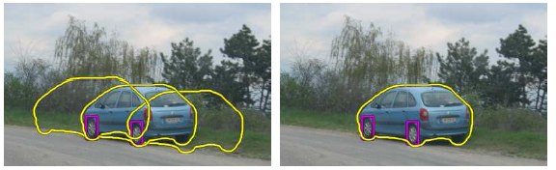
Fitting: Voting and the Hough Transform
Devi Parikh
Georgia Tech
Disclaimer: Many slides have been borrowed from Kristen Grauman, who may have borrowed some of them from others. Any time a slide did not already have a credit on it, I have credited it to Kristen. So there is a chance some of these credits are inaccurate.
Slide credit: Kristen Grauman

Slide 2
Announcements
Project proposals
Due last week
Midterm / first update
Due in ~2 weeks!
PS3
Due October 24th
Slide credit: Adapted by Devi Parikh from Kristen Grauman

Slide 3
Topics overview
Intro
Features & filters
Multiple views and motion
Grouping & fitting
Segmentation and clustering
Hough transform
Deformable contours
Recognition
Video processing
Slide credit: Kristen Grauman

Slide 4
Summary
Segmentation to find object boundaries or mid-level regions, tokens.
Bottom-up segmentation via clustering
General choices -- features, affinity functions, and clustering algorithms
Grouping also useful for quantization, can create new feature summaries
Texton histograms for texture within local region
Example clustering methods
K-means
Mean shift
Graph cut, normalized cuts
Slide credit: Kristen Grauman

Slide 5
Topics overview
Intro
Features & filters
Multiple views and motion
Grouping & fitting
Segmentation and clustering
Hough transform
Deformable contours
Recognition
Video processing
Slide credit: Kristen Grauman

Slide 6
Topics overview
Intro
Features & filters
Multiple views and motion
Grouping & fitting
Segmentation and clustering
Hough transform
Deformable contours
Recognition
Video processing
Slide credit: Kristen Grauman

Slide 7
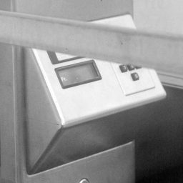
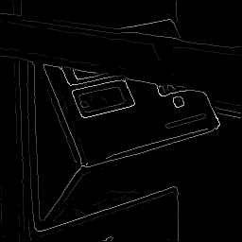
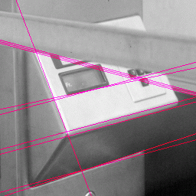
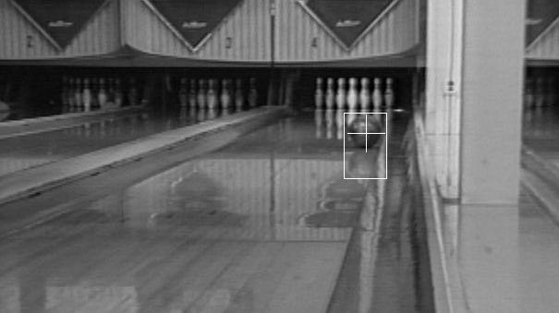
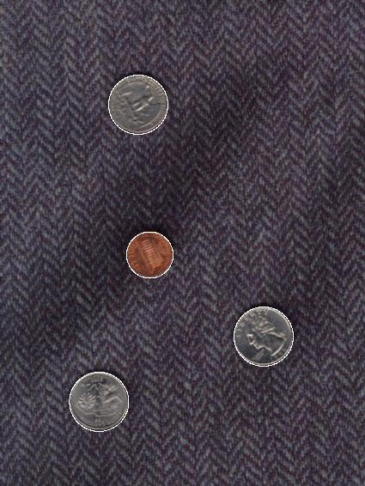
Now: Fitting
Want to associate a model with observed features
[Fig from Marszalek & Schmid, 2007]
For example, the model could be a line, a circle, or an arbitrary shape.
Kristen Grauman

Slide 8
Fitting: Main idea
Choose a parametric model to represent a set of features
Membership criterion is not local
Can’t tell whether a point belongs to a given model just by looking at that point
Three main questions:
What model represents this set of features best?
Which of several model instances gets which feature?
How many model instances are there?
Computational complexity is important
It is infeasible to examine every possible set of parameters and every possible combination of features
Slide credit: L. Lazebnik

Slide 9
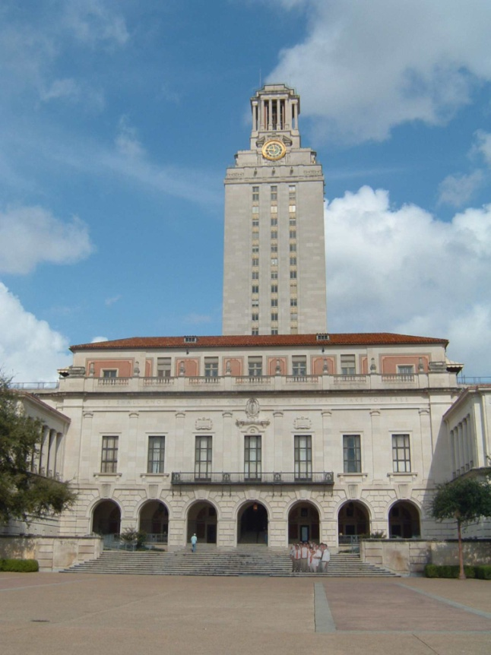
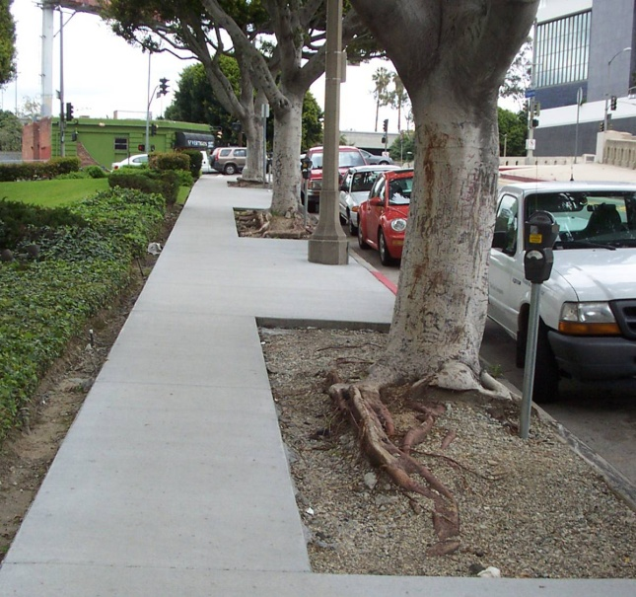
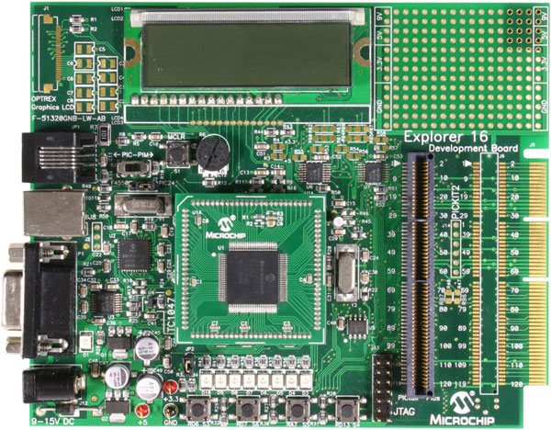
Example: Line fitting
Why fit lines?
Many objects characterized by presence of straight lines
Wait, why aren’t we done just by running edge detection?
Kristen Grauman

Slide 10
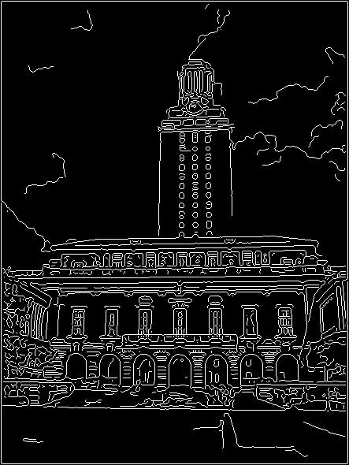
Difficulty of line fitting
Extra edge points (clutter), multiple models:
which points go with which line, if any?
Only some parts of each line detected, and some parts are missing:
how to find a line that bridges missing evidence?
Noise in measured edge points, orientations:
how to detect true underlying parameters?
Kristen Grauman

Slide 11
Voting
It’s not feasible to check all combinations of features by fitting a model to each possible subset.
Voting is a general technique where we let the features vote for all models that are compatible with it.
Cycle through features, cast votes for model parameters.
Look for model parameters that receive a lot of votes.
Noise & clutter features will cast votes too, but typically their votes should be inconsistent with the majority of “good” features.
Kristen Grauman

Slide 12
Fitting lines: Hough transform
Given points that belong to a line, what is the line?
How many lines are there?
Which points belong to which lines?
Hough Transform is a voting technique that can be used to answer all of these questions.
Main idea:
1. Record vote for each possible line on which each edge point lies.
2. Look for lines that get many votes.
Kristen Grauman

Slide 13

Finding lines in an image: Hough space
Equation of a line?
y = mx + b
y
b
b₀
x
m₀
m
image space
Hough (parameter) space
Connection between image (x,y) and Hough (m,b) spaces
A line in the image corresponds to a point in Hough space
To go from image space to Hough space:
given a set of points (x,y), find all (m,b) such that y = mx + b
Slide credit: Steve Seitz

Slide 14

Finding lines in an image: Hough space
y
b
y₀
x₀
x
m
image space
Hough (parameter) space
Connection between image (x,y) and Hough (m,b) spaces
A line in the image corresponds to a point in Hough space
To go from image space to Hough space:
given a set of points (x,y), find all (m,b) such that y = mx + b
What does a point (x₀, y₀) in the image space map to?
Answer: the solutions of b = -x₀m + y₀
this is a line in Hough space
Slide credit: Steve Seitz

Slide 15
Finding lines in an image: Hough space
y
b
(x₁, y₁)
y₀
(x₀, y₀)
b = –x₁m + y₁
x₀
x
m
image space
Hough (parameter) space
What are the line parameters for the line that contains both (x₀, y₀) and (x₁, y₁)?
It is the intersection of the lines b = –x₀m + y₀ and b = –x₁m + y₁
Slide credit: Kristen Grauman

Slide 16
Finding lines in an image: Hough algorithm
y
b
x
m
image space
Hough (parameter) space
How can we use this to find the most likely parameters (m,b) for the most prominent line in the image space?
Let each edge point in image space vote for a set of possible parameters in Hough space
Accumulate votes in discrete set of bins; parameters with the most votes indicate line in image space.
Slide credit: Kristen Grauman

Slide 17
Polar representation for lines
Issues with usual (m,b) parameter space: can take on infinite values, undefined for vertical lines.
Image columns
[0,0]
: perpendicular distance from line to origin
: angle the perpendicular makes with the x-axis
Image rows
Point in image space → sinusoid segment in Hough space
Kristen Grauman

Slide 18
https://gmarty.github.io/hough-transform-js/
Slide credit: Kristen Grauman

Slide 19
Hough transform algorithm
Using the polar parameterization:
Basic Hough transform algorithm
Initialize H[d, θ]=0
for each edge point I[x,y] in the image
for θ = [θ_{min} to θ_{max} ] // some quantization
H[d, θ] += 1
Find the value(s) of (d, θ) where H[d, θ] is maximum
The detected line in the image is given by
H: accumulator array (votes)
d
θ
Source: Steve Seitz

Slide 20

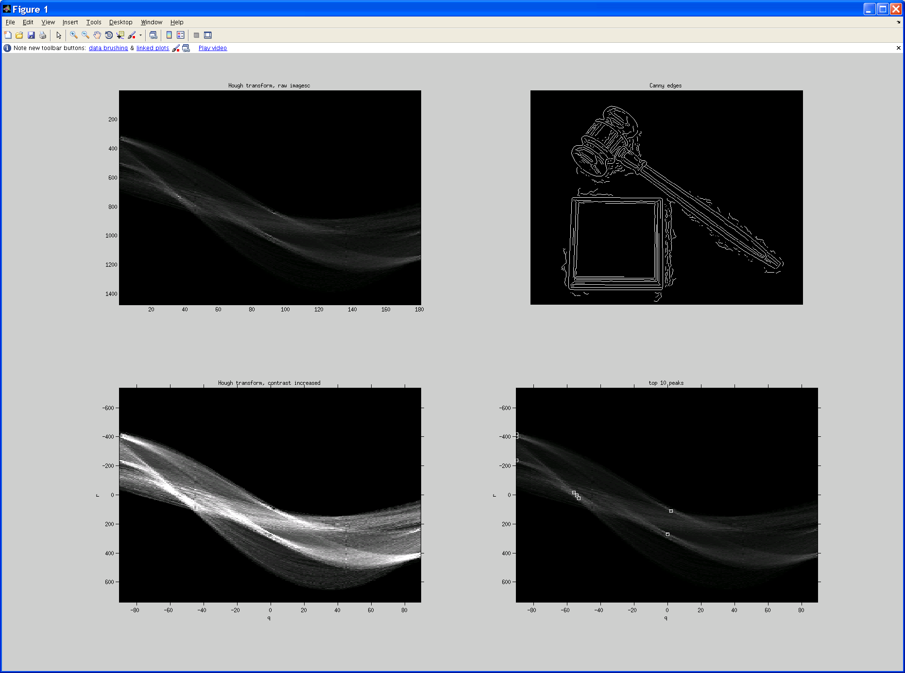
Original image
Canny edges
Vote space and top peaks
Kristen Grauman

Slide 21
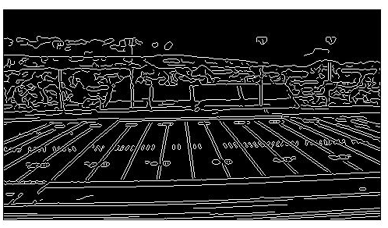
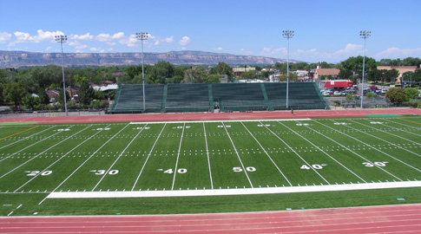
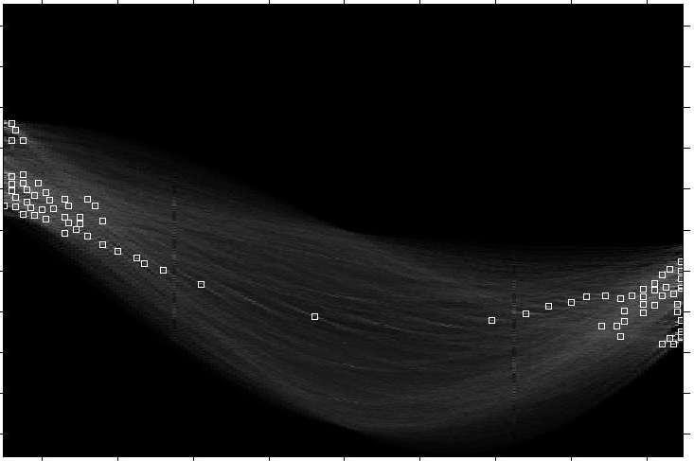
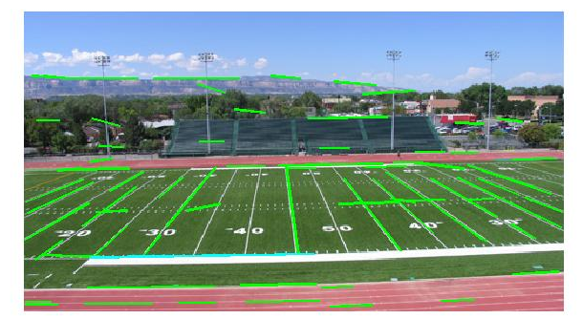
Showing longest segments found
Kristen Grauman

Slide 22
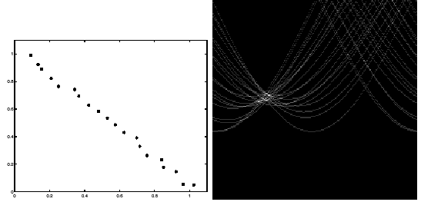
Impact of noise on Hough
y
d
x
θ
Image space
edge coordinates
Votes
What difficulty does this present for an implementation?
Slide credit: Kristen Grauman

Slide 23
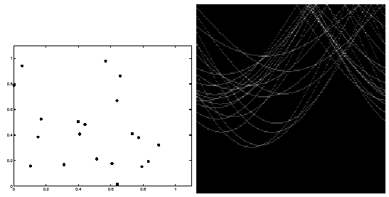
Impact of noise on Hough
Image space
edge coordinates
Votes
Here, everything appears to be “noise”, or random edge points, but we still see peaks in the vote space.
Slide credit: Kristen Grauman

Slide 24
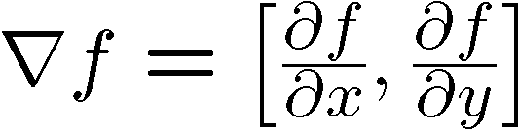
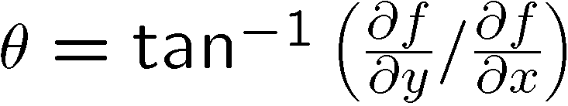
Extensions
Extension 1: Use the image gradient
same
for each edge point I[x,y] in the image
θ = gradient at (x,y)
H[d, θ] += 1
same
same
(Reduces degrees of freedom)
Extension 2
give more votes for stronger edges
Extension 3
change the sampling of (d, θ) to give more/less resolution
Extension 4
The same procedure can be used with circles, squares, or any other shape
Slide credit: Kristen Grauman

Slide 25
Extensions
Extension 1: Use the image gradient
same
for each edge point I[x,y] in the image
compute unique (d, θ) based on image gradient at (x,y)
H[d, θ] += 1
same
same
(Reduces degrees of freedom)
Extension 2
give more votes for stronger edges (use magnitude of gradient)
Extension 3
change the sampling of (d, θ) to give more/less resolution
Extension 4
The same procedure can be used with circles, squares, or any other shape…
Source: Steve Seitz

Slide 26
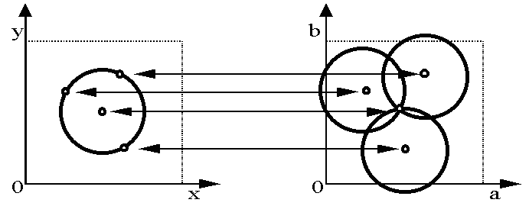
Hough transform for circles
Circle: center (a,b) and radius r
Equation of circle?
For a fixed radius r
Equation of set of circles that all pass through a point?
Image space
Hough space
Adapted by Devi Parikh from: Kristen Grauman

Slide 27
Hough transform for circles
Circle: center (a,b) and radius r
For a fixed radius r
Intersection: most votes for center occur here.
Image space
Hough space
Kristen Grauman

Slide 28
Hough transform for circles
Circle: center (a,b) and radius r
For an unknown radius r
r
?
b
a
Image space
Hough space
Kristen Grauman

Slide 29
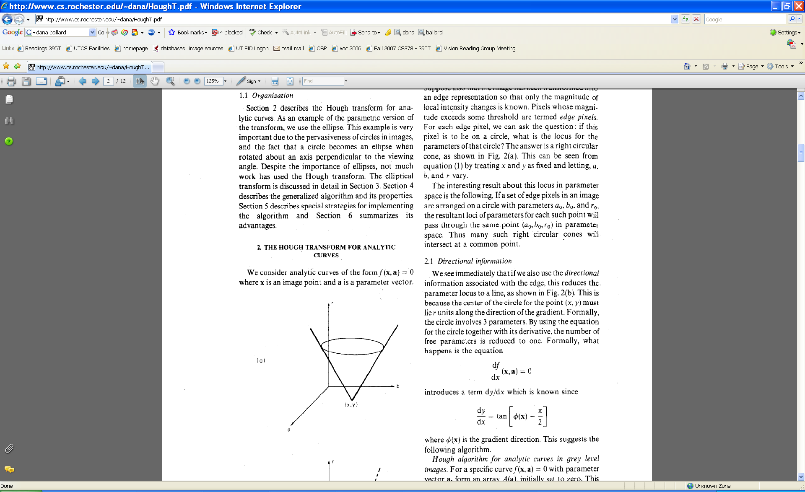
Hough transform for circles
Circle: center (a,b) and radius r
For an unknown radius r
r
b
a
Image space
Hough space
Kristen Grauman

Slide 30
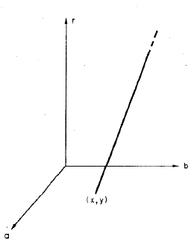
Hough transform for circles
Circle: center (a,b) and radius r
For an unknown radius r, known gradient direction
x
θ
Image space
Hough space
Kristen Grauman

Slide 31
Hough transform for circles
For every edge pixel (x,y) :
For each possible radius value r:
For each possible gradient direction θ:
// or use estimated gradient at (x,y)
a = x – r cos(θ) // column
b = y + r sin(θ) // row
H[a,b,r] += 1
end
end
Check out online demo : http://www.markschulze.net/java/hough/
Kristen Grauman

Slide 32
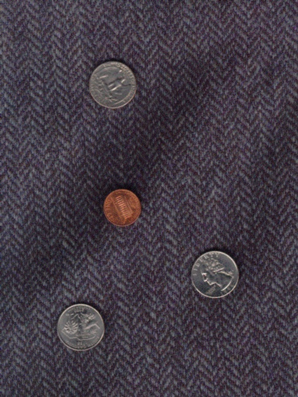
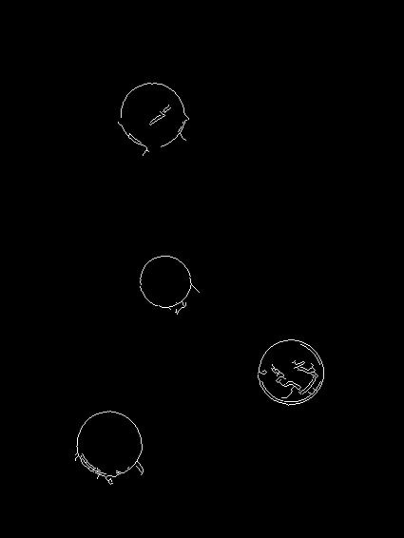
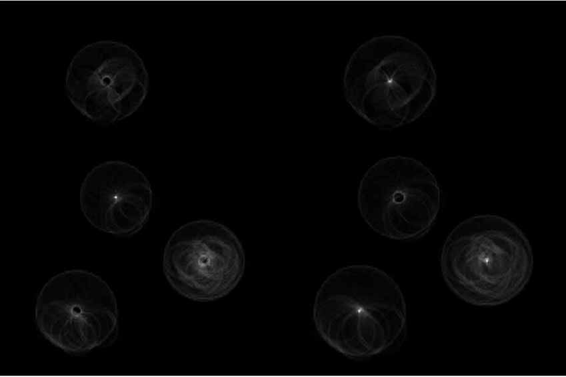
Example: detecting circles with Hough
Original
Edges
Votes: Penny
Note: a different Hough transform (with separate accumulators) was used for each circle radius (quarters vs. penny).
Slide credit: Kristen Grauman

Slide 33
Example: detecting circles with Hough
Original
Combined detections
Edges
Votes: Quarter
Slide credit: Kristen Grauman
Coin finding sample images from: Vivek Kwatra

Slide 34
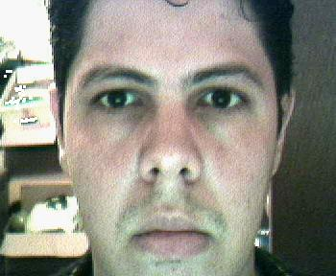
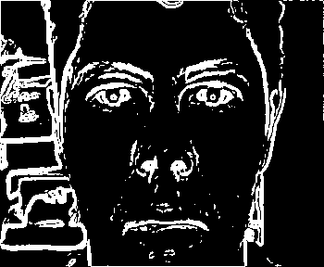
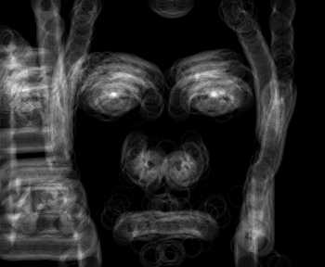

Example: iris detection
Gradient+threshold
Hough space (fixed radius)
Max detections
Hemerson Pistori and Eduardo Rocha Costa http://rsbweb.nih.gov/ij/plugins/hough-circles.html
Kristen Grauman

Slide 35
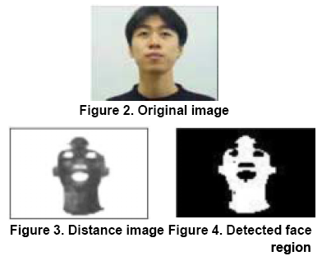
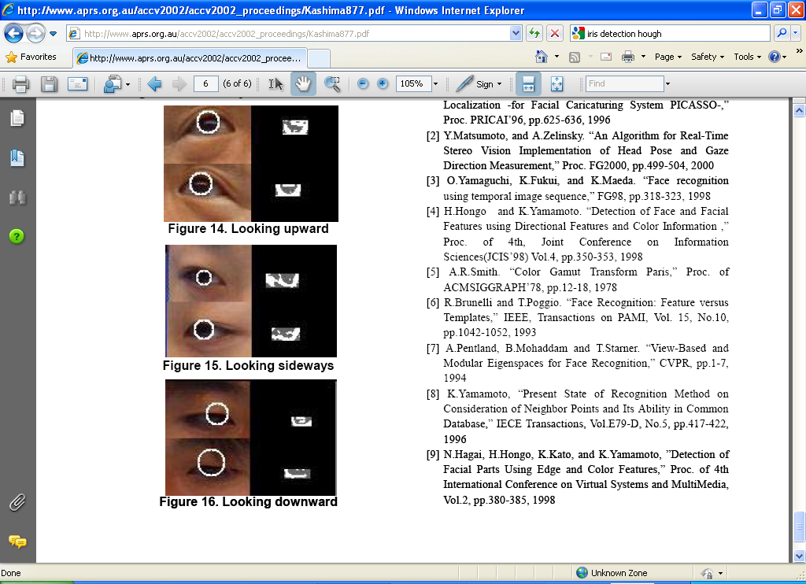
Example: iris detection
An Iris Detection Method Using the Hough Transform and Its Evaluation for Facial and Eye Movement, by Hideki Kashima, Hitoshi Hongo, Kunihito Kato, Kazuhiko Yamamoto, ACCV 2002.
Kristen Grauman

Slide 36
Voting: practical tips
Minimize irrelevant tokens first
Choose a good grid / discretization
Vote for neighbors, also (smoothing in accumulator array)
Use direction of edge to reduce parameters by 1
To read back which points voted for “winning” peaks, keep tags on the votes.
Too fine
?
Too coarse
Kristen Grauman

Slide 37

PS3
Regarding detecting circles
Origin in MATLAB/Python vs. math
Consider trying code on a simple image first
Slide credit: Adapted by Devi Parikh from Kristen Grauman

Slide 38
Hough transform: pros and cons
Pros
All points are processed independently, so can cope with occlusion, gaps
Some robustness to noise: noise points unlikely to contribute consistently to any single bin
Can detect multiple instances of a model in a single pass
Cons
Complexity of search time increases exponentially with the number of model parameters
Non-target shapes can produce spurious peaks in parameter space
Quantization: can be tricky to pick a good grid size
Kristen Grauman

Slide 39
Generalized Hough Transform
What if we want to detect arbitrary shapes?
Intuition:
Displacement vectors
x
x
x
Ref. point
x
x
Model image
Novel image
Vote space
Now suppose those colors encode gradient directions…
Kristen Grauman

Slide 40
Generalized Hough Transform
Define a model shape by its boundary points and a reference point.
Offline procedure:
x
a
At each boundary point, compute displacement vector: r = a – p_{i}.
Store these vectors in a table indexed by gradient orientation θ.
θ
θ
p₁
p₂
Model shape
θ
…
θ
…
…
[Dana H. Ballard, Generalizing the Hough Transform to Detect Arbitrary Shapes, 1980]
Kristen Grauman

Slide 41
Generalized Hough Transform
Detection procedure:
x
For each edge point:
Use its gradient orientation θ to index into stored table
Use retrieved r vectors to vote for reference point
x
θ
x
x
x
θ
θ
p₁
θ
θ
Novel image
θ
…
θ
…
…
Assuming translation is the only transformation here, i.e., orientation and scale are fixed.
Kristen Grauman

Slide 42

Generalized Hough for object detection
Instead of indexing displacements by gradient orientation, index by matched local patterns.
“visual codeword” with displacement vectors
training image
B. Leibe, A. Leonardis, and B. Schiele, Combined Object Categorization and Segmentation with an Implicit Shape Model, ECCV Workshop on Statistical Learning in Computer Vision 2004
Source: L. Lazebnik

Slide 43
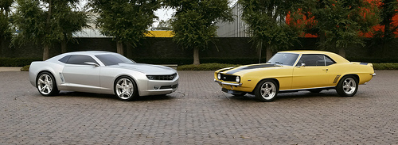
Generalized Hough for object detection
Instead of indexing displacements by gradient orientation, index by “visual codeword”
test image
B. Leibe, A. Leonardis, and B. Schiele, Combined Object Categorization and Segmentation with an Implicit Shape Model, ECCV Workshop on Statistical Learning in Computer Vision 2004
Source: L. Lazebnik

Slide 44
Summary
Grouping/segmentation useful to make a compact representation and merge similar features
associate features based on defined similarity measure and clustering objective
Fitting problems require finding any supporting evidence for a model, even within clutter and missing features.
associate features with an explicit model
Voting approaches, such as the Hough transform, make it possible to find likely model parameters without searching all combinations of features.
Hough transform approach for lines, circles, …, arbitrary shapes defined by a set of boundary points, recognition from patches.
Kristen Grauman

Slide 45
Questions?

