Slide 1
Causal Modeling with a Variational Autoencoder
Zhengye Wang
Jingci Wang

Slide 2
Project Goal
Train a supervised VAE model using dSprites dataset
Make inference

Slide 3
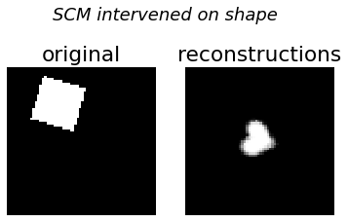
Dataset
Sample Image
A dataset of 2D shapes procedurally generated from 5 ground truth independent latent factors.
Latent factors:
Shape: 3 values
Scale: 6 values
Orientation: 40 values
Position X: 32 values
Position Y: 32 values

Slide 4
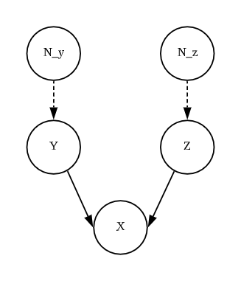
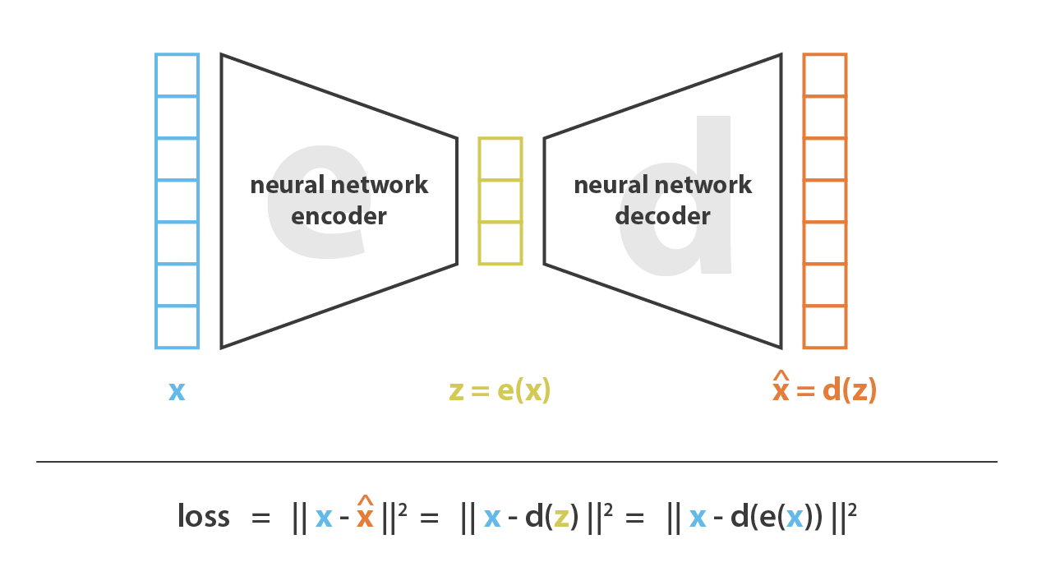
Model Structure
VAE
SCM

Slide 5
Results
Condition on one factor will result other factors taking the mean value
Intervention works well on all factors with some blur in the reconstruction images
Intervention on shape

