Slide 1
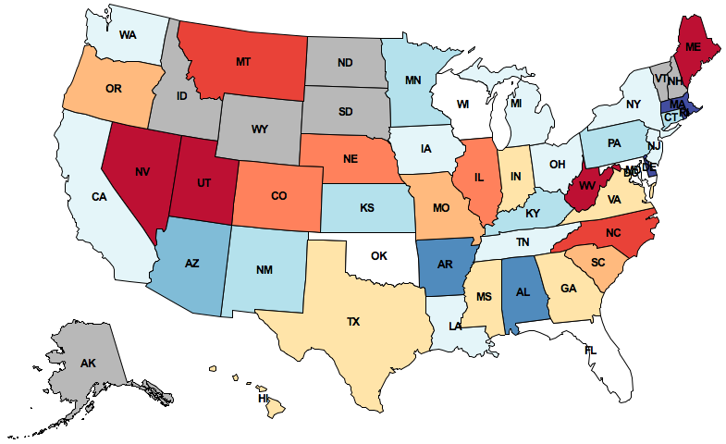
Twitter Trends: Who would win the election?

Slide 2
Use Twitter Streaming API to get real time tweets.
Use Spark Streaming to analyze the real time tweets
What is the percentage of tweets are talking about “Hillary Clinton”, “Donald Trump”, “Ted Cruz”;
Where are these tweets from;
Word cloud;
Assigning a sentiment (positive or negative) to each tweet, based on all of the words it contains (MLlib)
Aggregating tweets by the state and coloring the graph
Other interesting results found during data mining

Slide 3
Goals for this project
Play with Twitter API
Learn Spark Ecosystem
Play with spark streaming, Mllib, GraphX

Slide 4
Time line
Setup Spark working environment (Cloudera? AWS? ) now - 3.25
Play with basic Spark API, implement basic functions like word count. 3.26 – 4. 15
Twitter trends. 4.16 – end of semester

