Slide 1
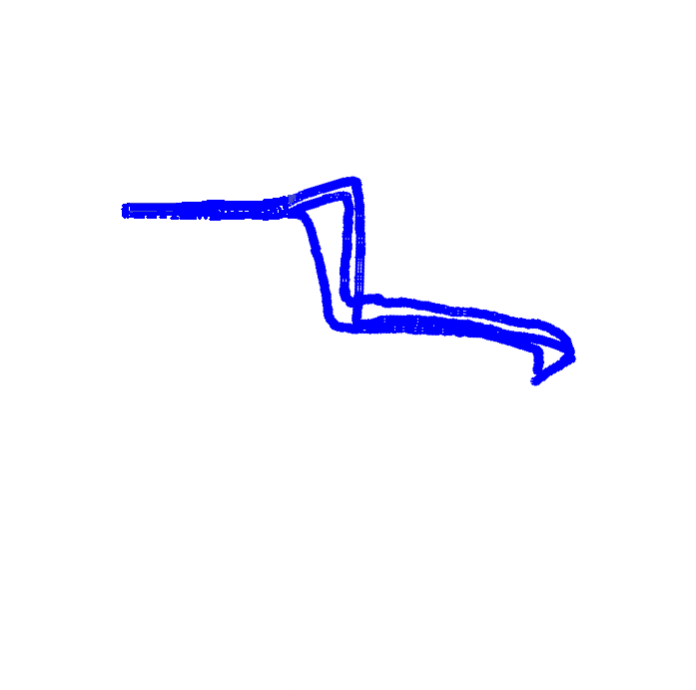
M
K
A
B
N
J
C
D
E
F
G
L
H

Slide 2
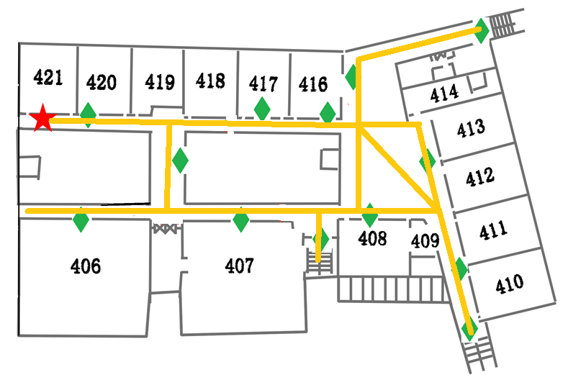
120m
M
K
A
F1
B
N
F2
F3
J
80m
C
D
E
F
G
L
H

Slide 3
Name: Jingle
Next Hop: 1
Route:1,3,4,9
ENTR/EXIT
Name: Allen
Next Hop: 1
Route:3,4,9
8
M
K
7
Name: Jack
Next Hop: 7
Route:7,8
1
5
6
A
B
N
F1
J
11
F2
3
F3
4
10
2
C
D
E
F
G
12
6
E
ENTR/EXIT
13
H
ENTR/EXIT

Slide 4
Name: Jingle
Next Hop: 1
Route:1,5,6,7,8
ENTR/EXIT
8
M
K
7
1
5
6
A
B
N
F1
J
11
DANGER
3
4
10
2
C
D
E
F
G
12
6
E
ENTR/EXIT
13
H
ENTR/EXIT

Slide 5
EXIT
Name: Bob
Next Hop: 3
Route:3,4,9
8
M
K
7
1
5
6
A
B
N
F1
J
11
F2
3
F3
4
10
2
C
D
E
F
G
12
6
E
ENTRANCE
13
H
ENTRANCE

Slide 6
EXIT
8
M
K
7
Name: Jack
Next Hop: 7
Route:7,8
1
5
6
A
B
N
F1
J
11
F2
3
F3
4
10
2
C
D
E
F
G
12
6
E
ENTRANCE
13
H
ENTRANCE

Slide 7


Receiver

Slide 8
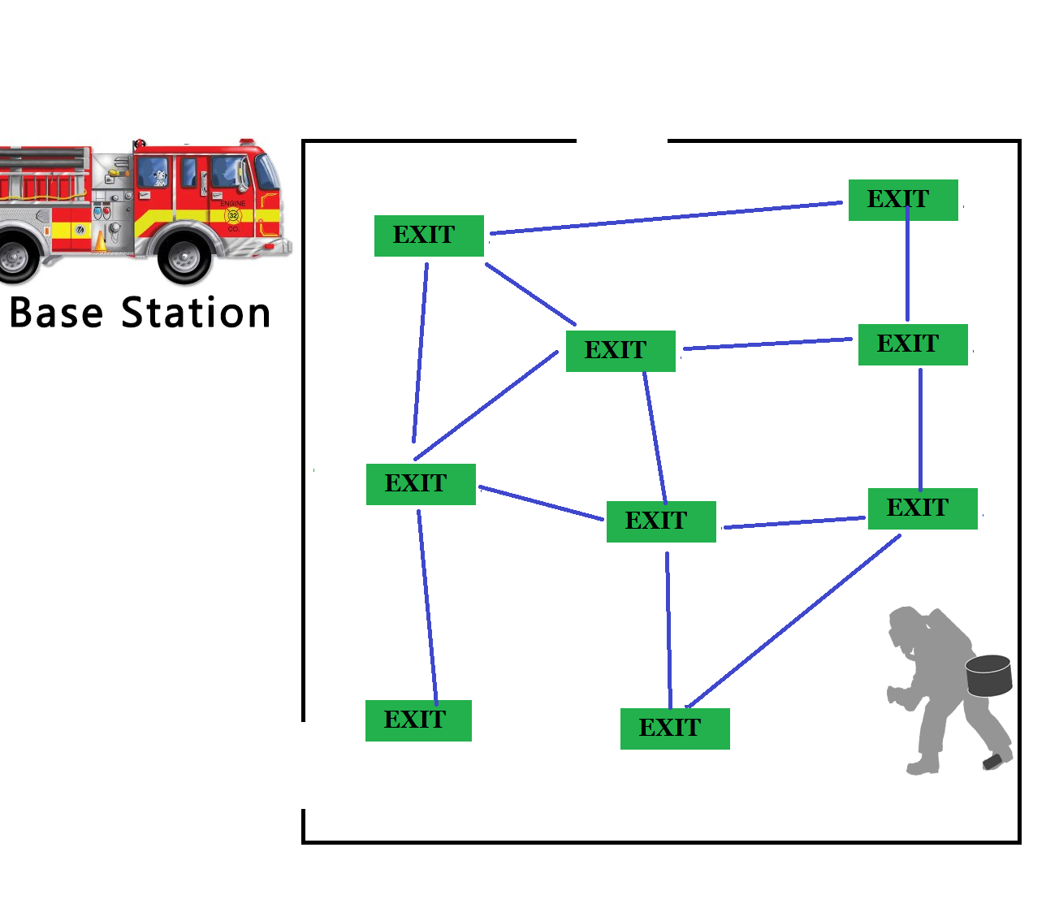
Instructions
ENTR/EXIT
ENTR/EXIT

Slide 9
ENTR/EXIT
A
B
C
ENTR/EXIT
E
F
G
H
J
K
Route intersections
Exit sign
Route segment

Slide 10
Start
D
ENTR/EXIT
B
w3
w1
w7
w4
w11
ENTR/EXIT
A
C
w5
w8
F
w2
w9
w10
E
w6
G

Slide 11
Name: Jack
Next Hop: 1
Route:1,3,4,9
Name: Jack
Next Hop: 1
Route:3,4,9
8
M
K
7
1
5
6
Name: Jack
Next Hop: 7
Route:7,8
A
B
N
J
3
2
4
10
C
D
E
F
G
6
E
Name: Jack
Next Hop: 3
Route:3,4,9
H

Slide 12
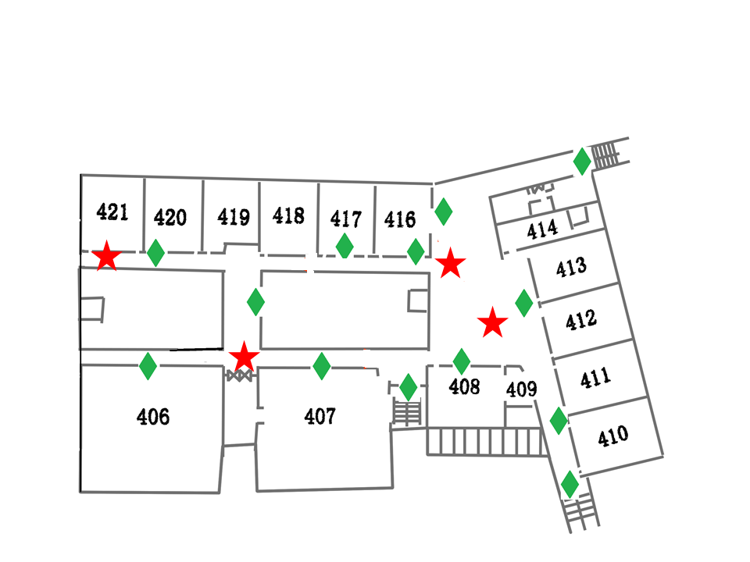
M
K
A
B
N
J
C
D
E
F
G
L
H

Slide 13
ENTR/EXIT
B
w3
E
w1
w4
w7
w11
D
w5
C
w8
F
ENTR/EXIT
w9
w2
w10
A
w6
G

