Slide 1

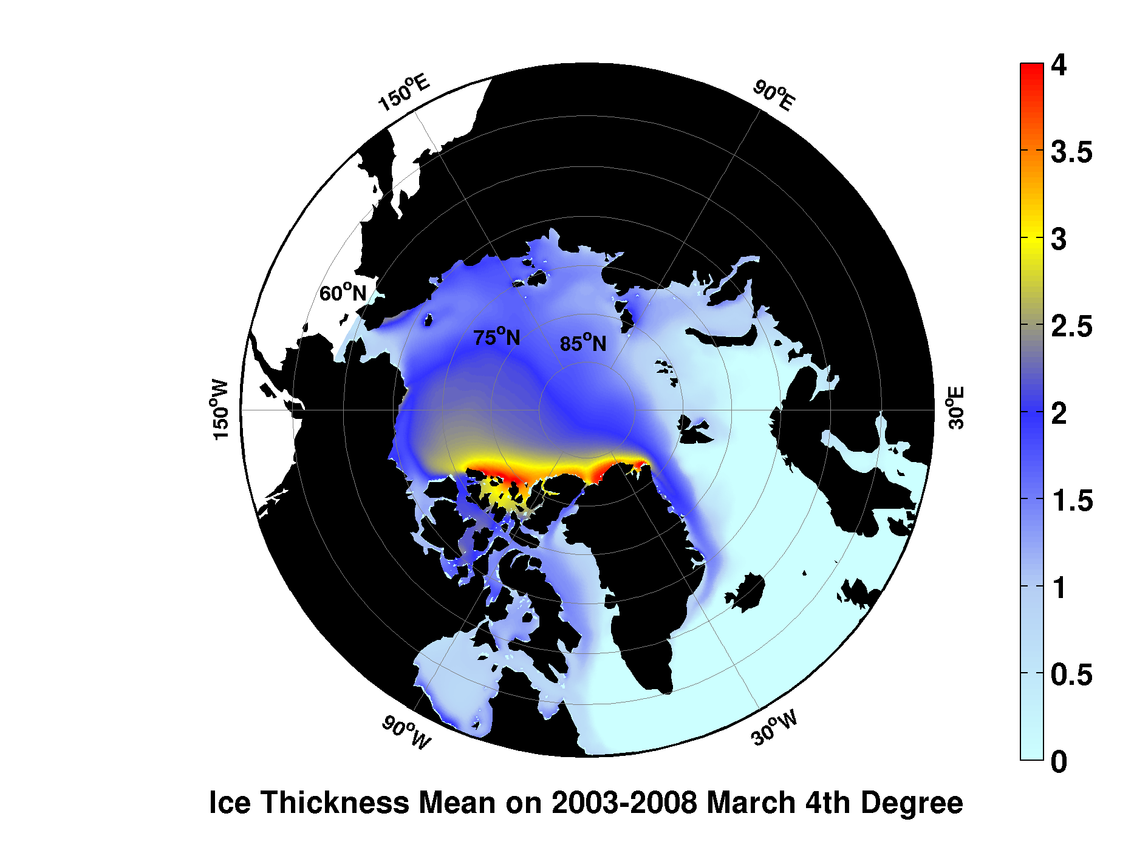

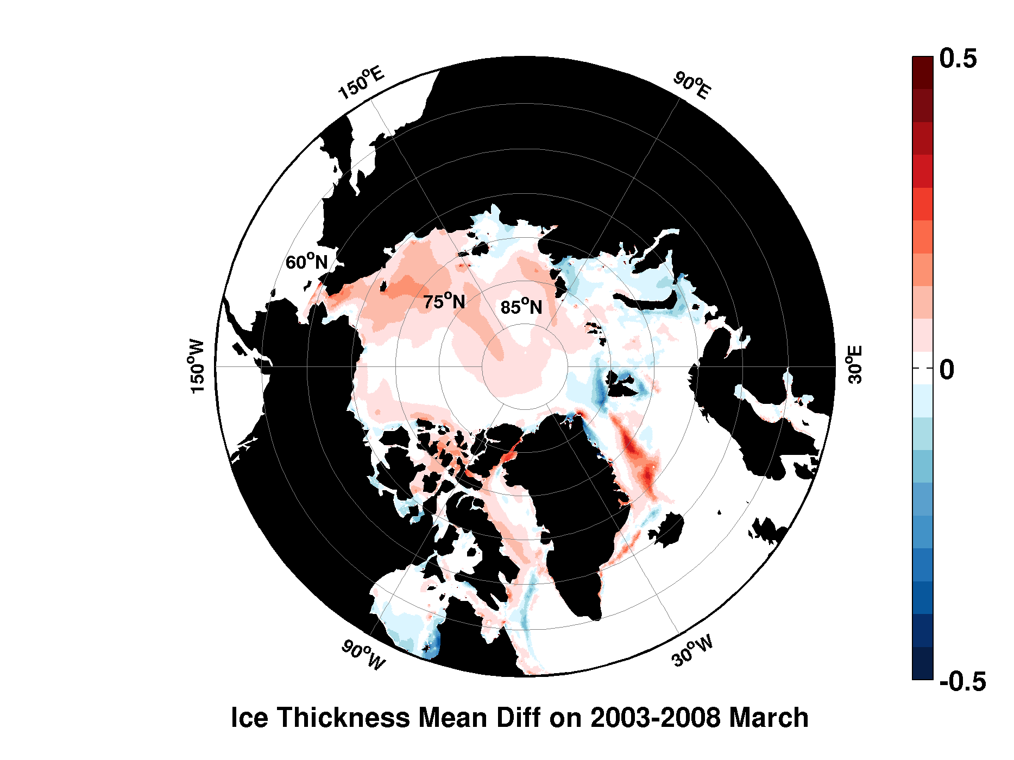
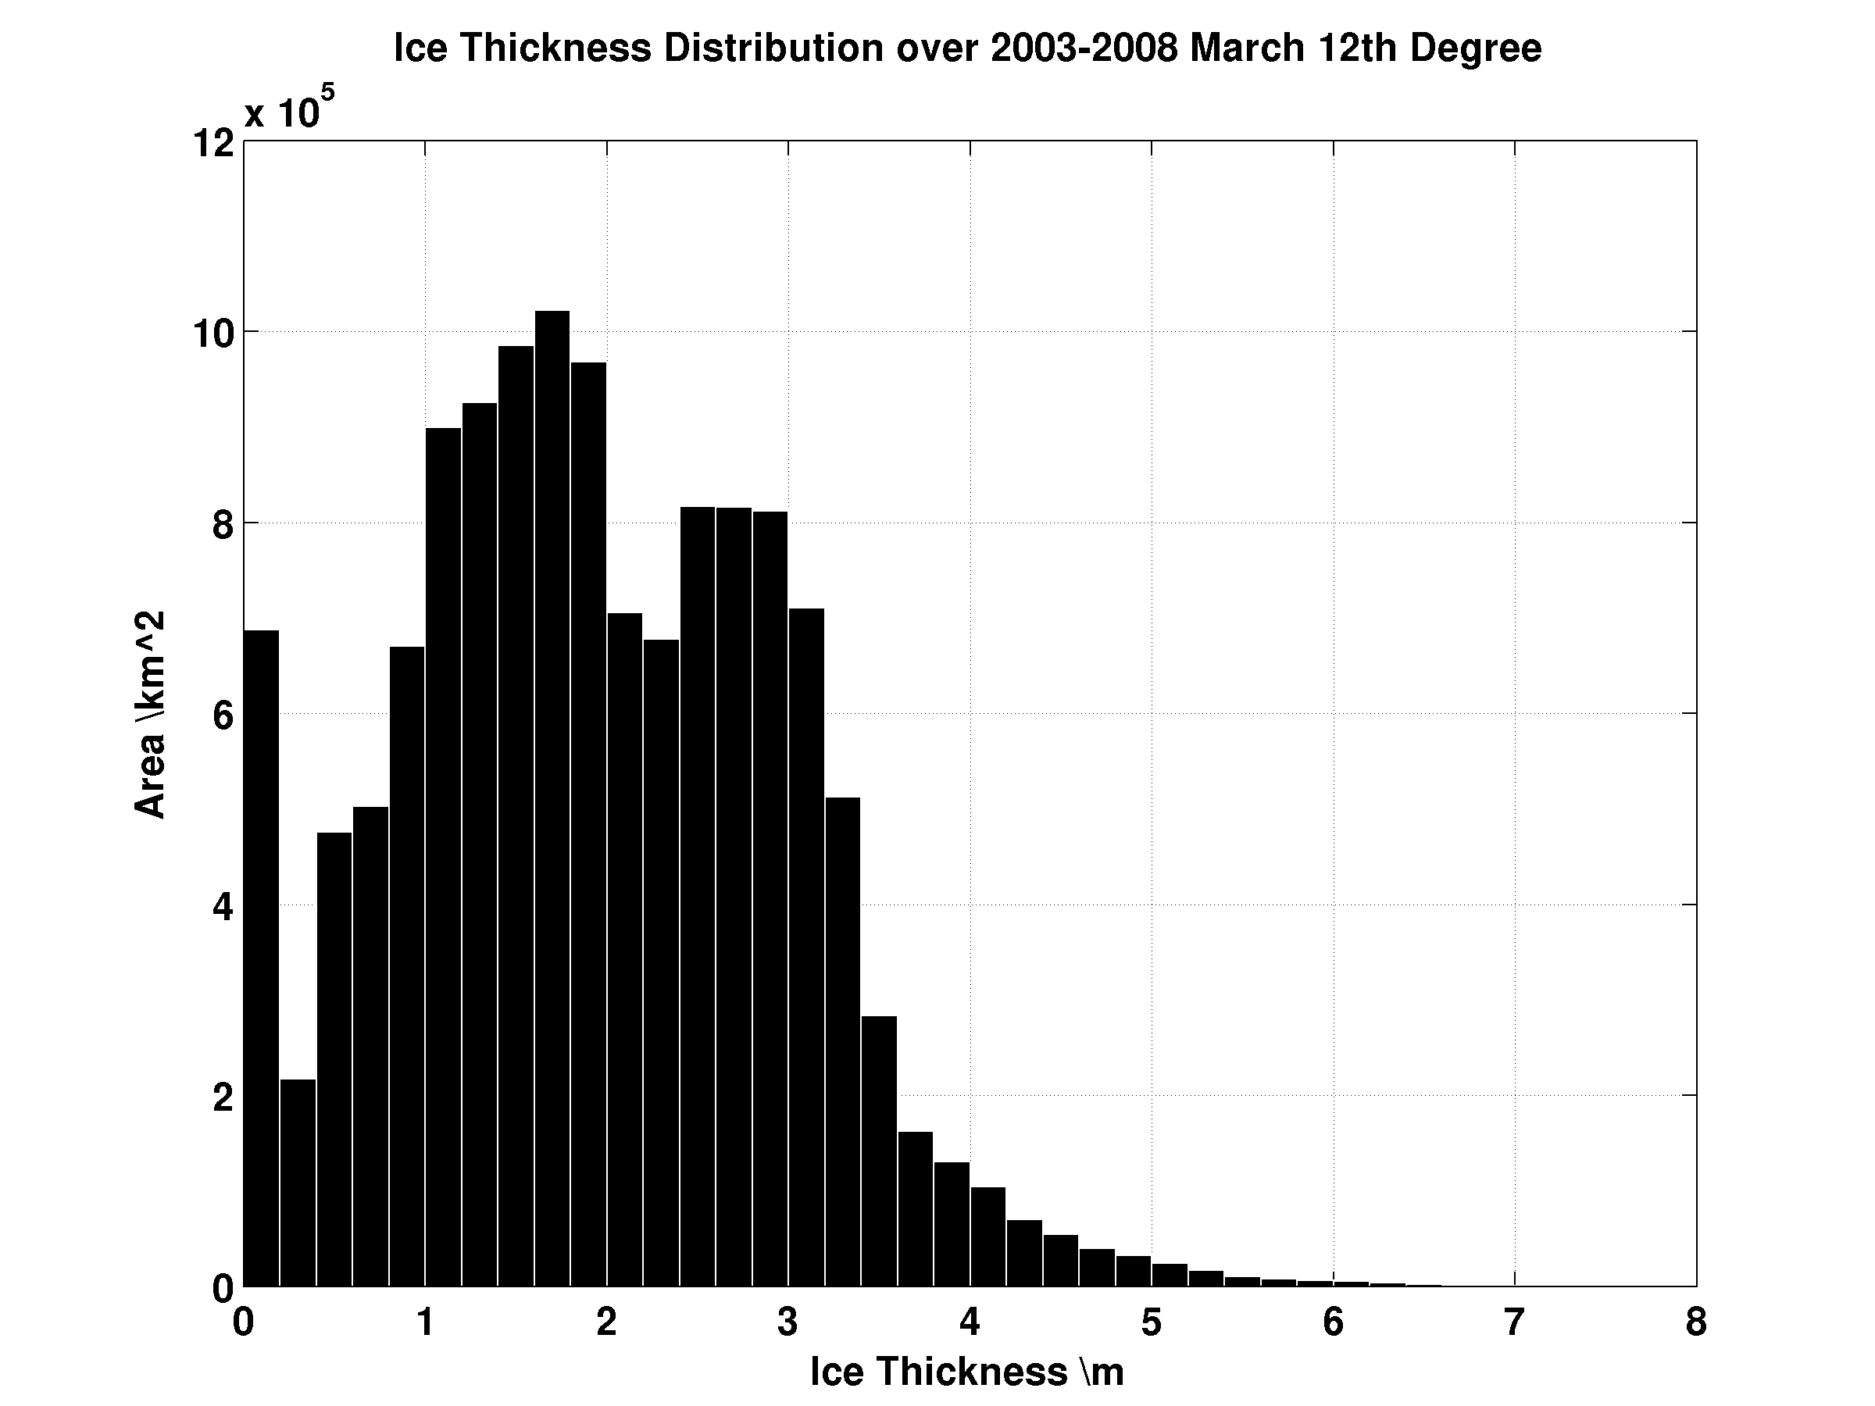
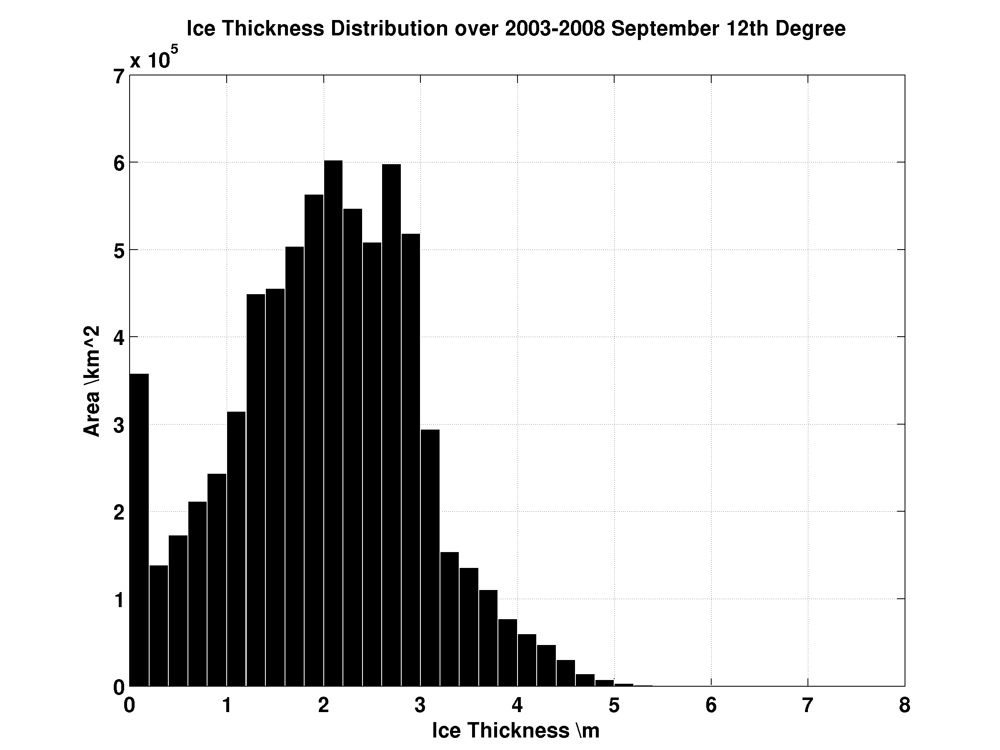
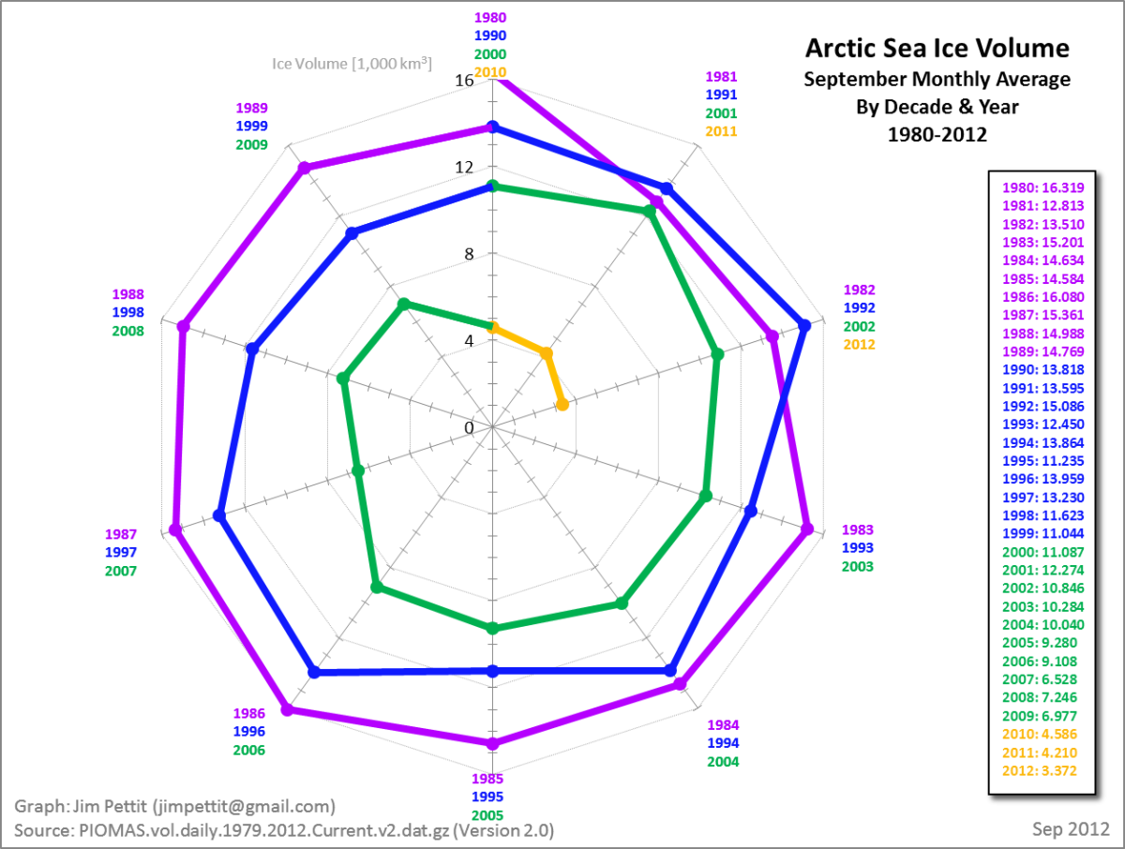
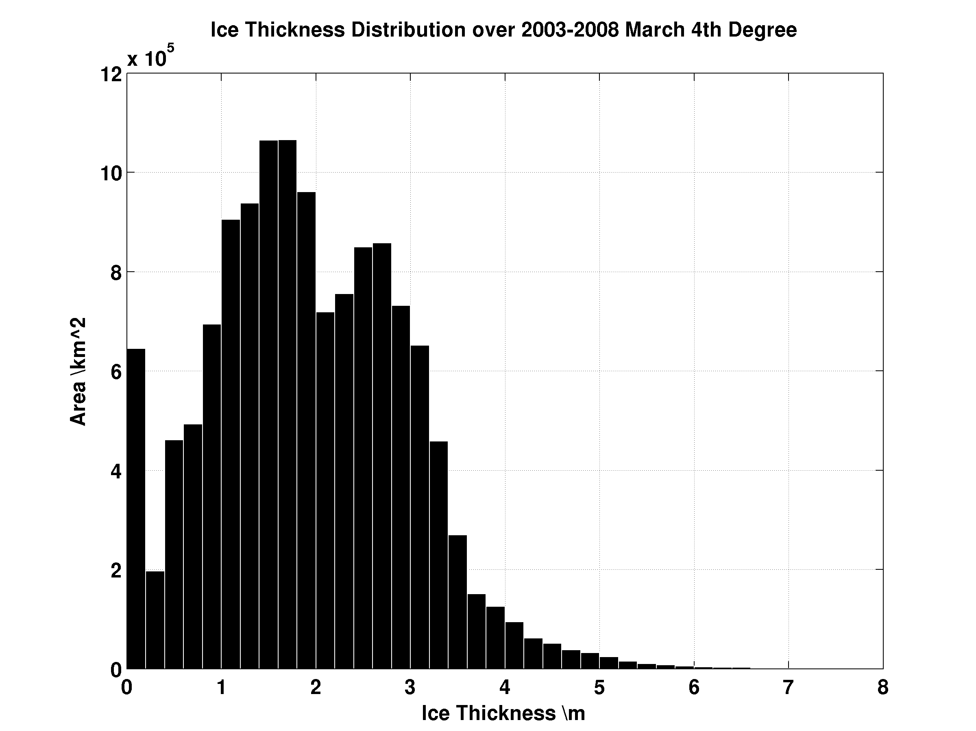
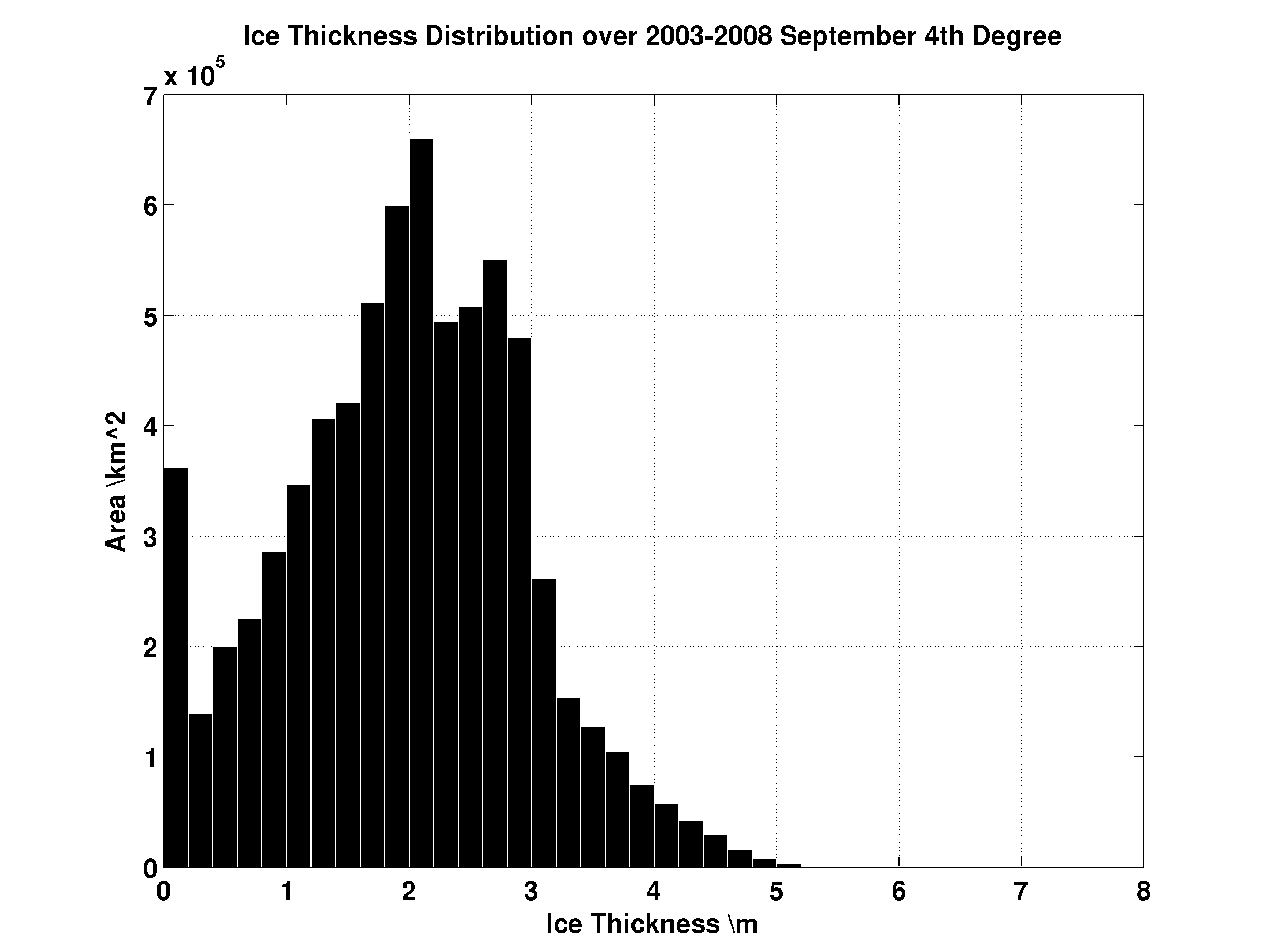
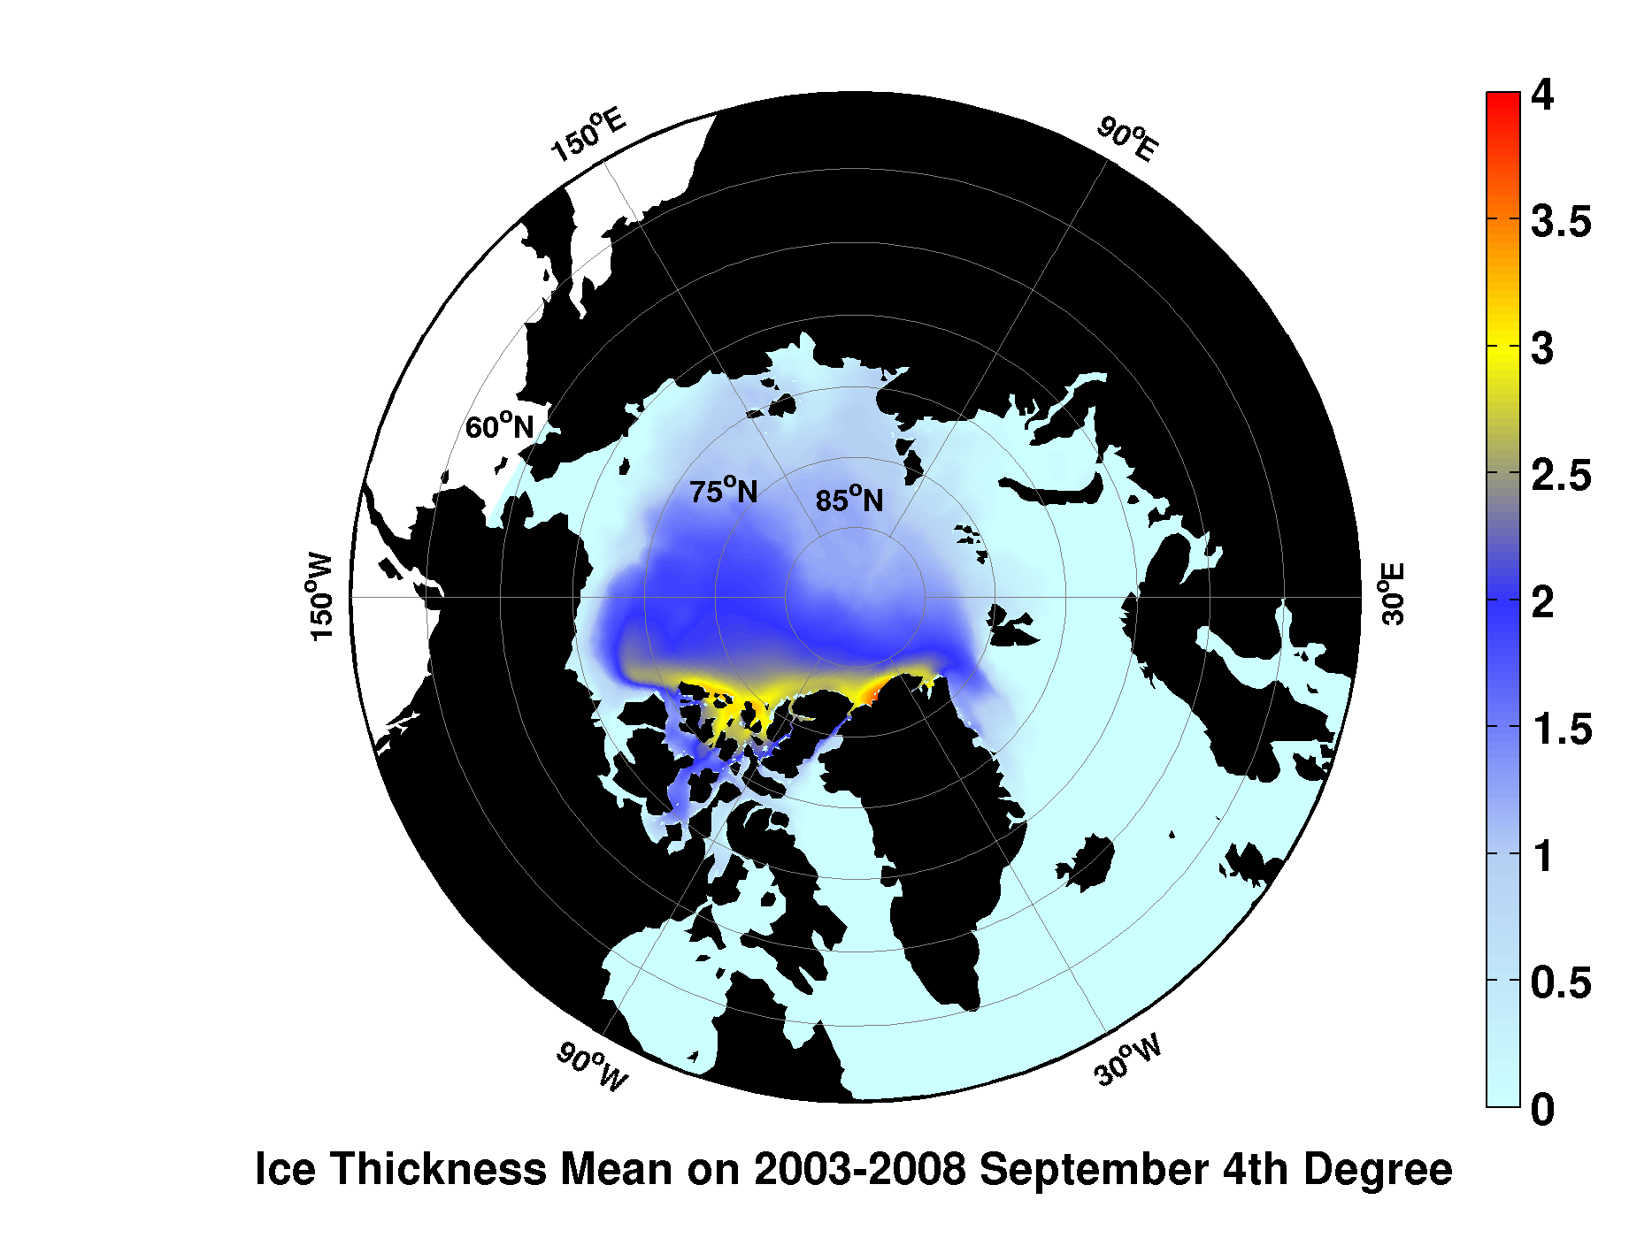
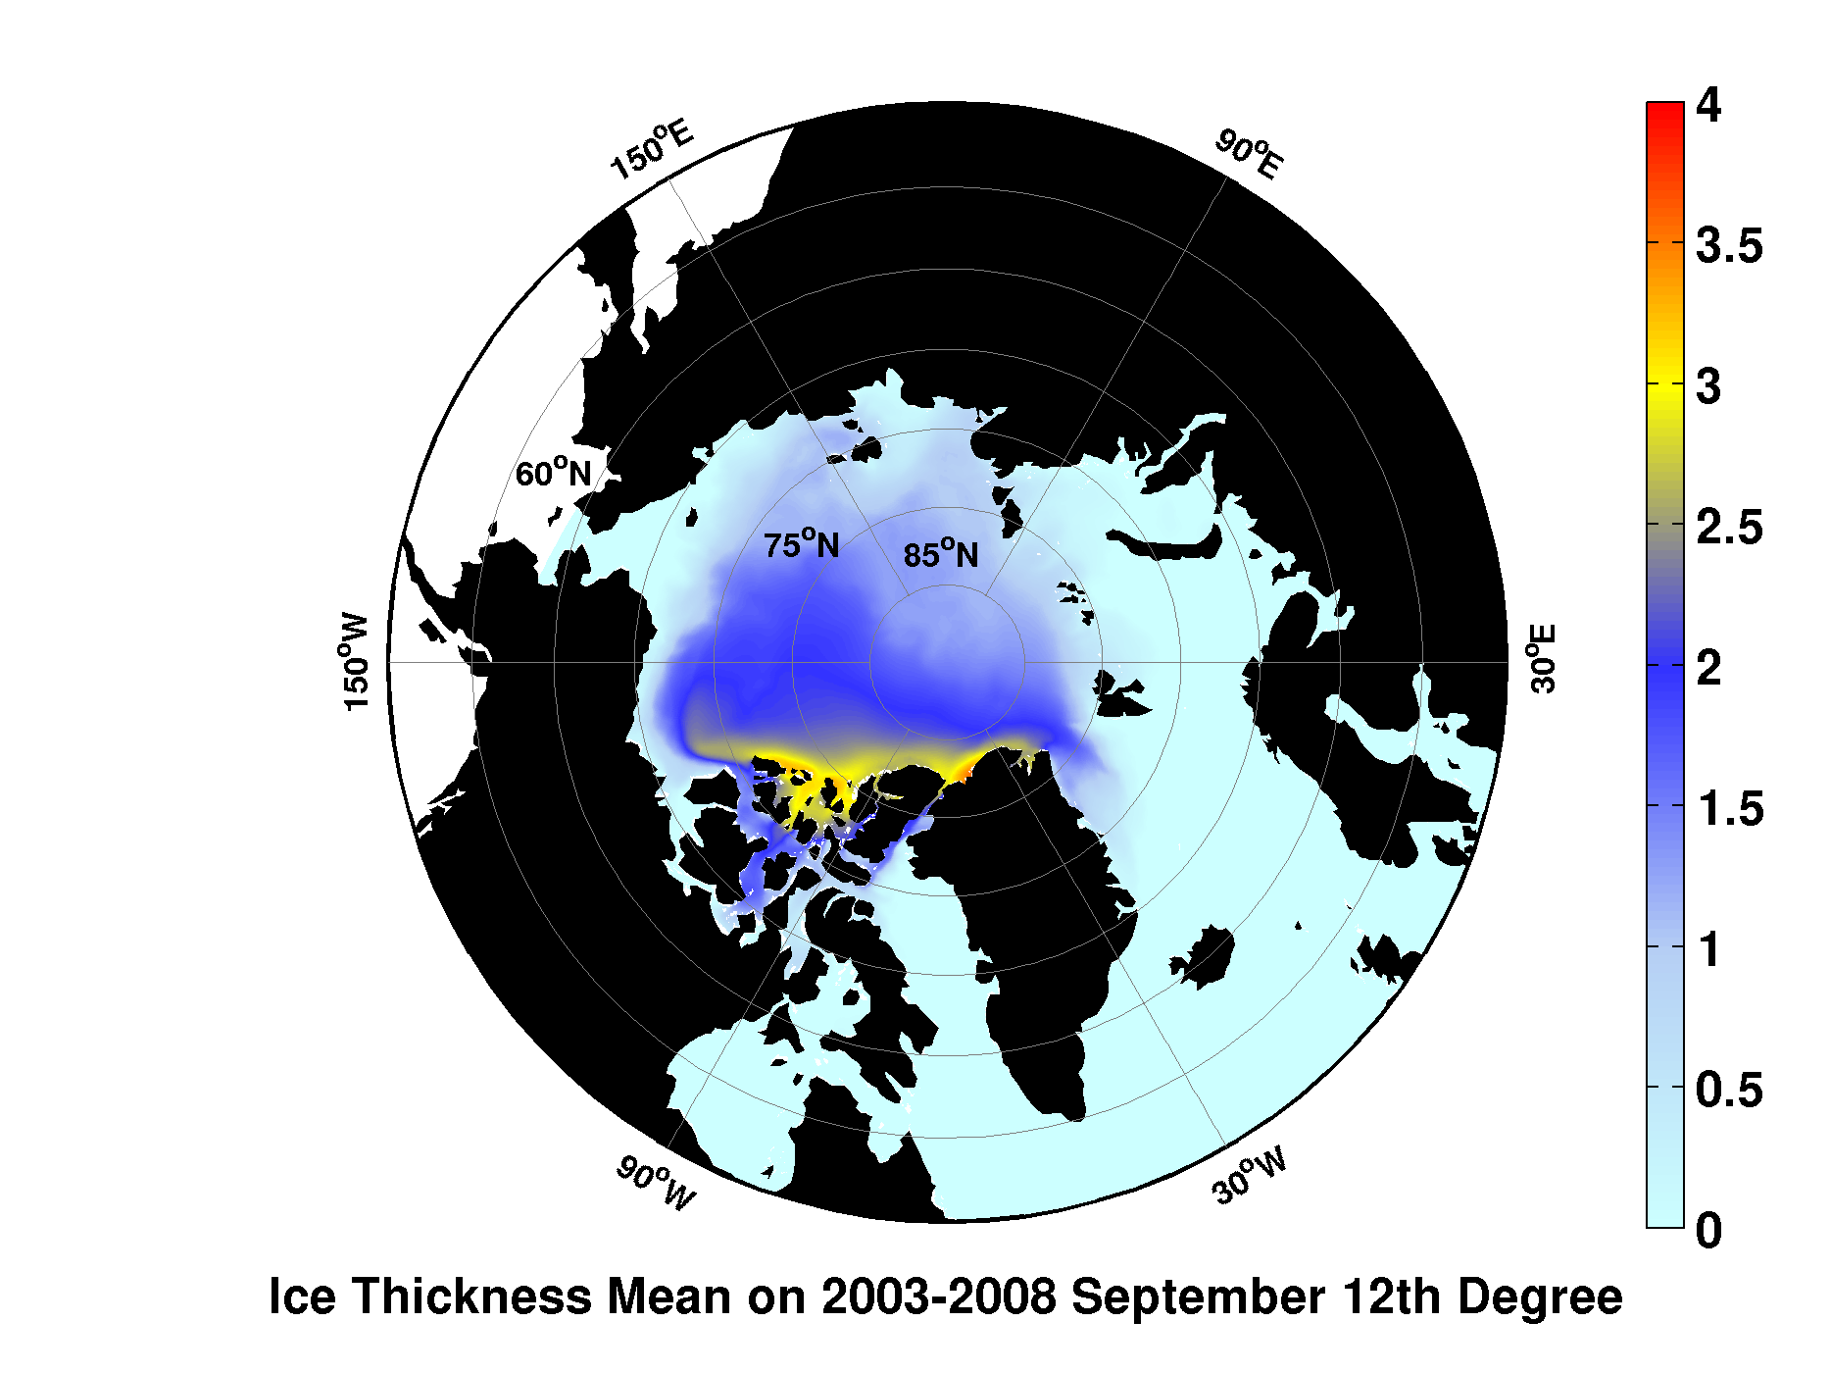
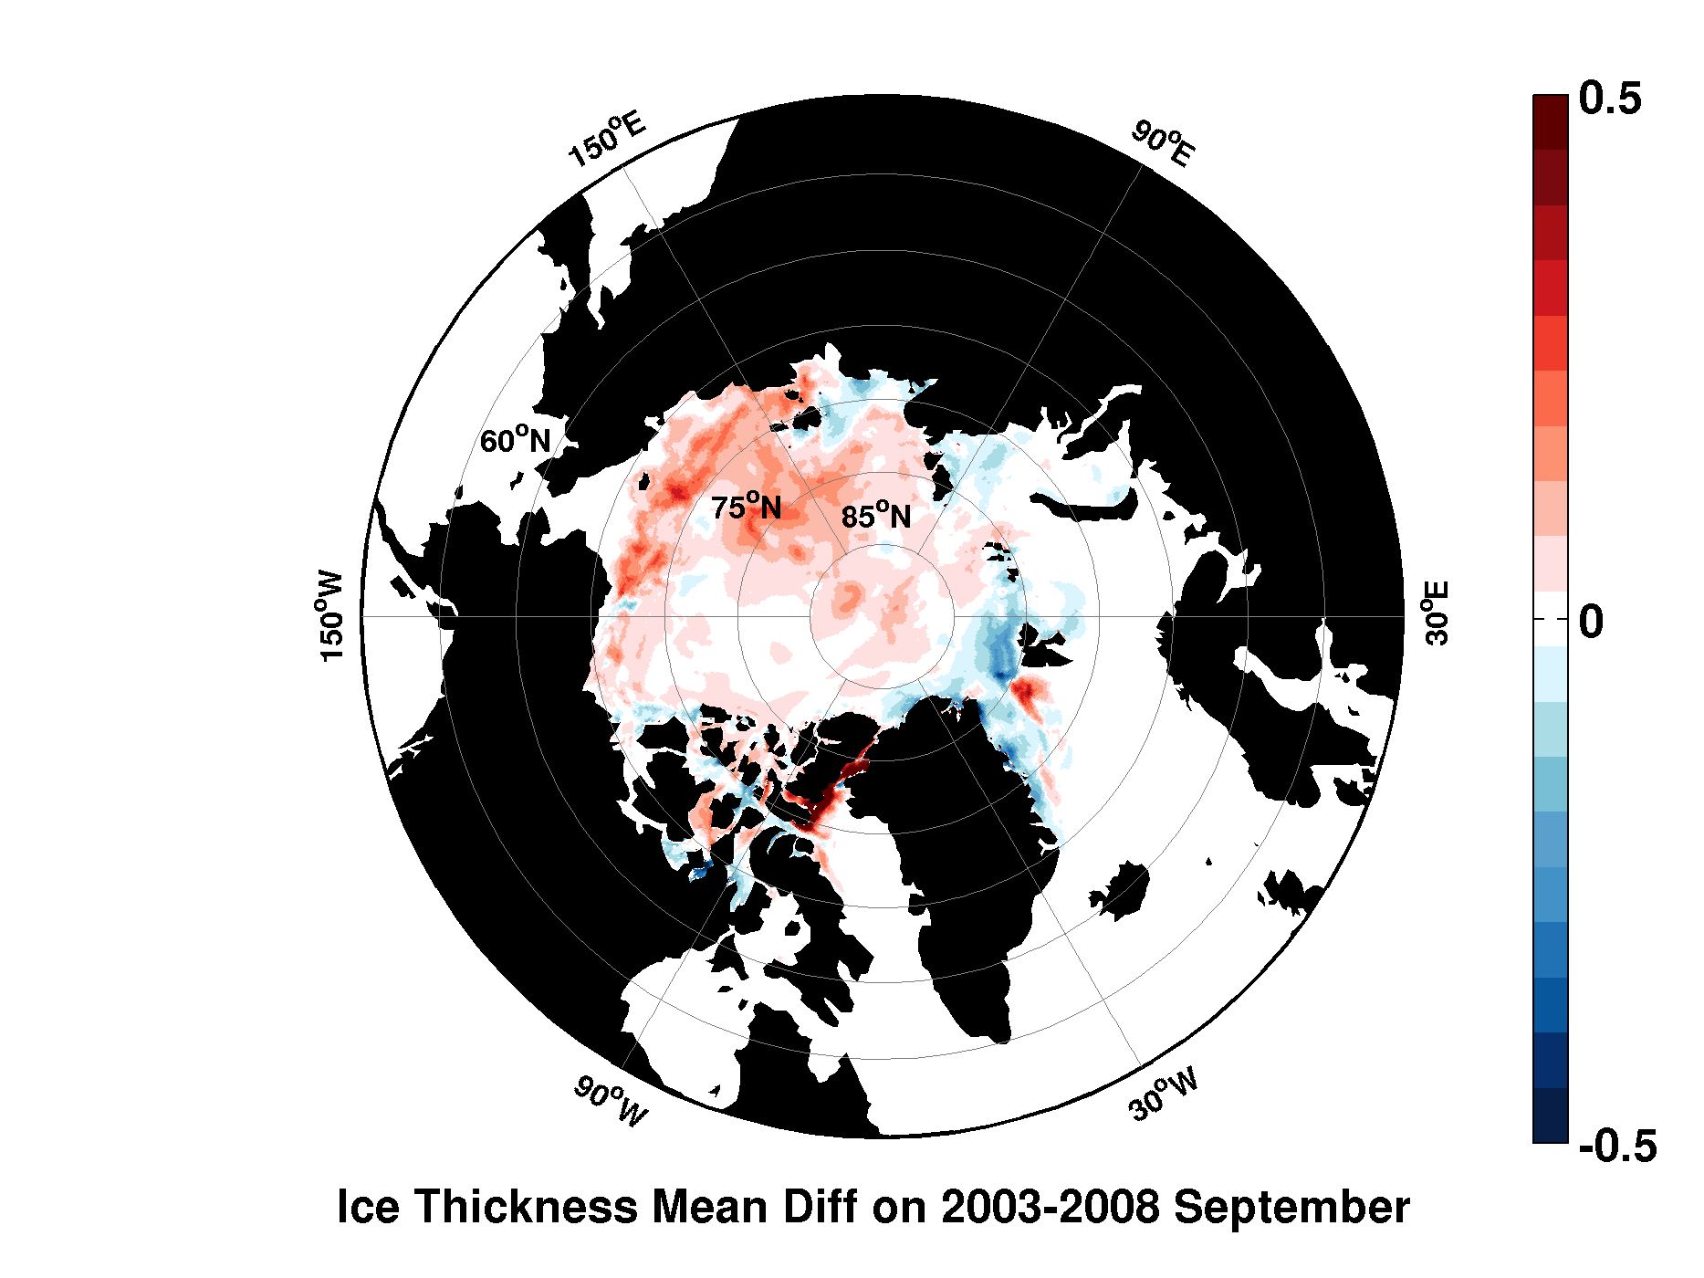
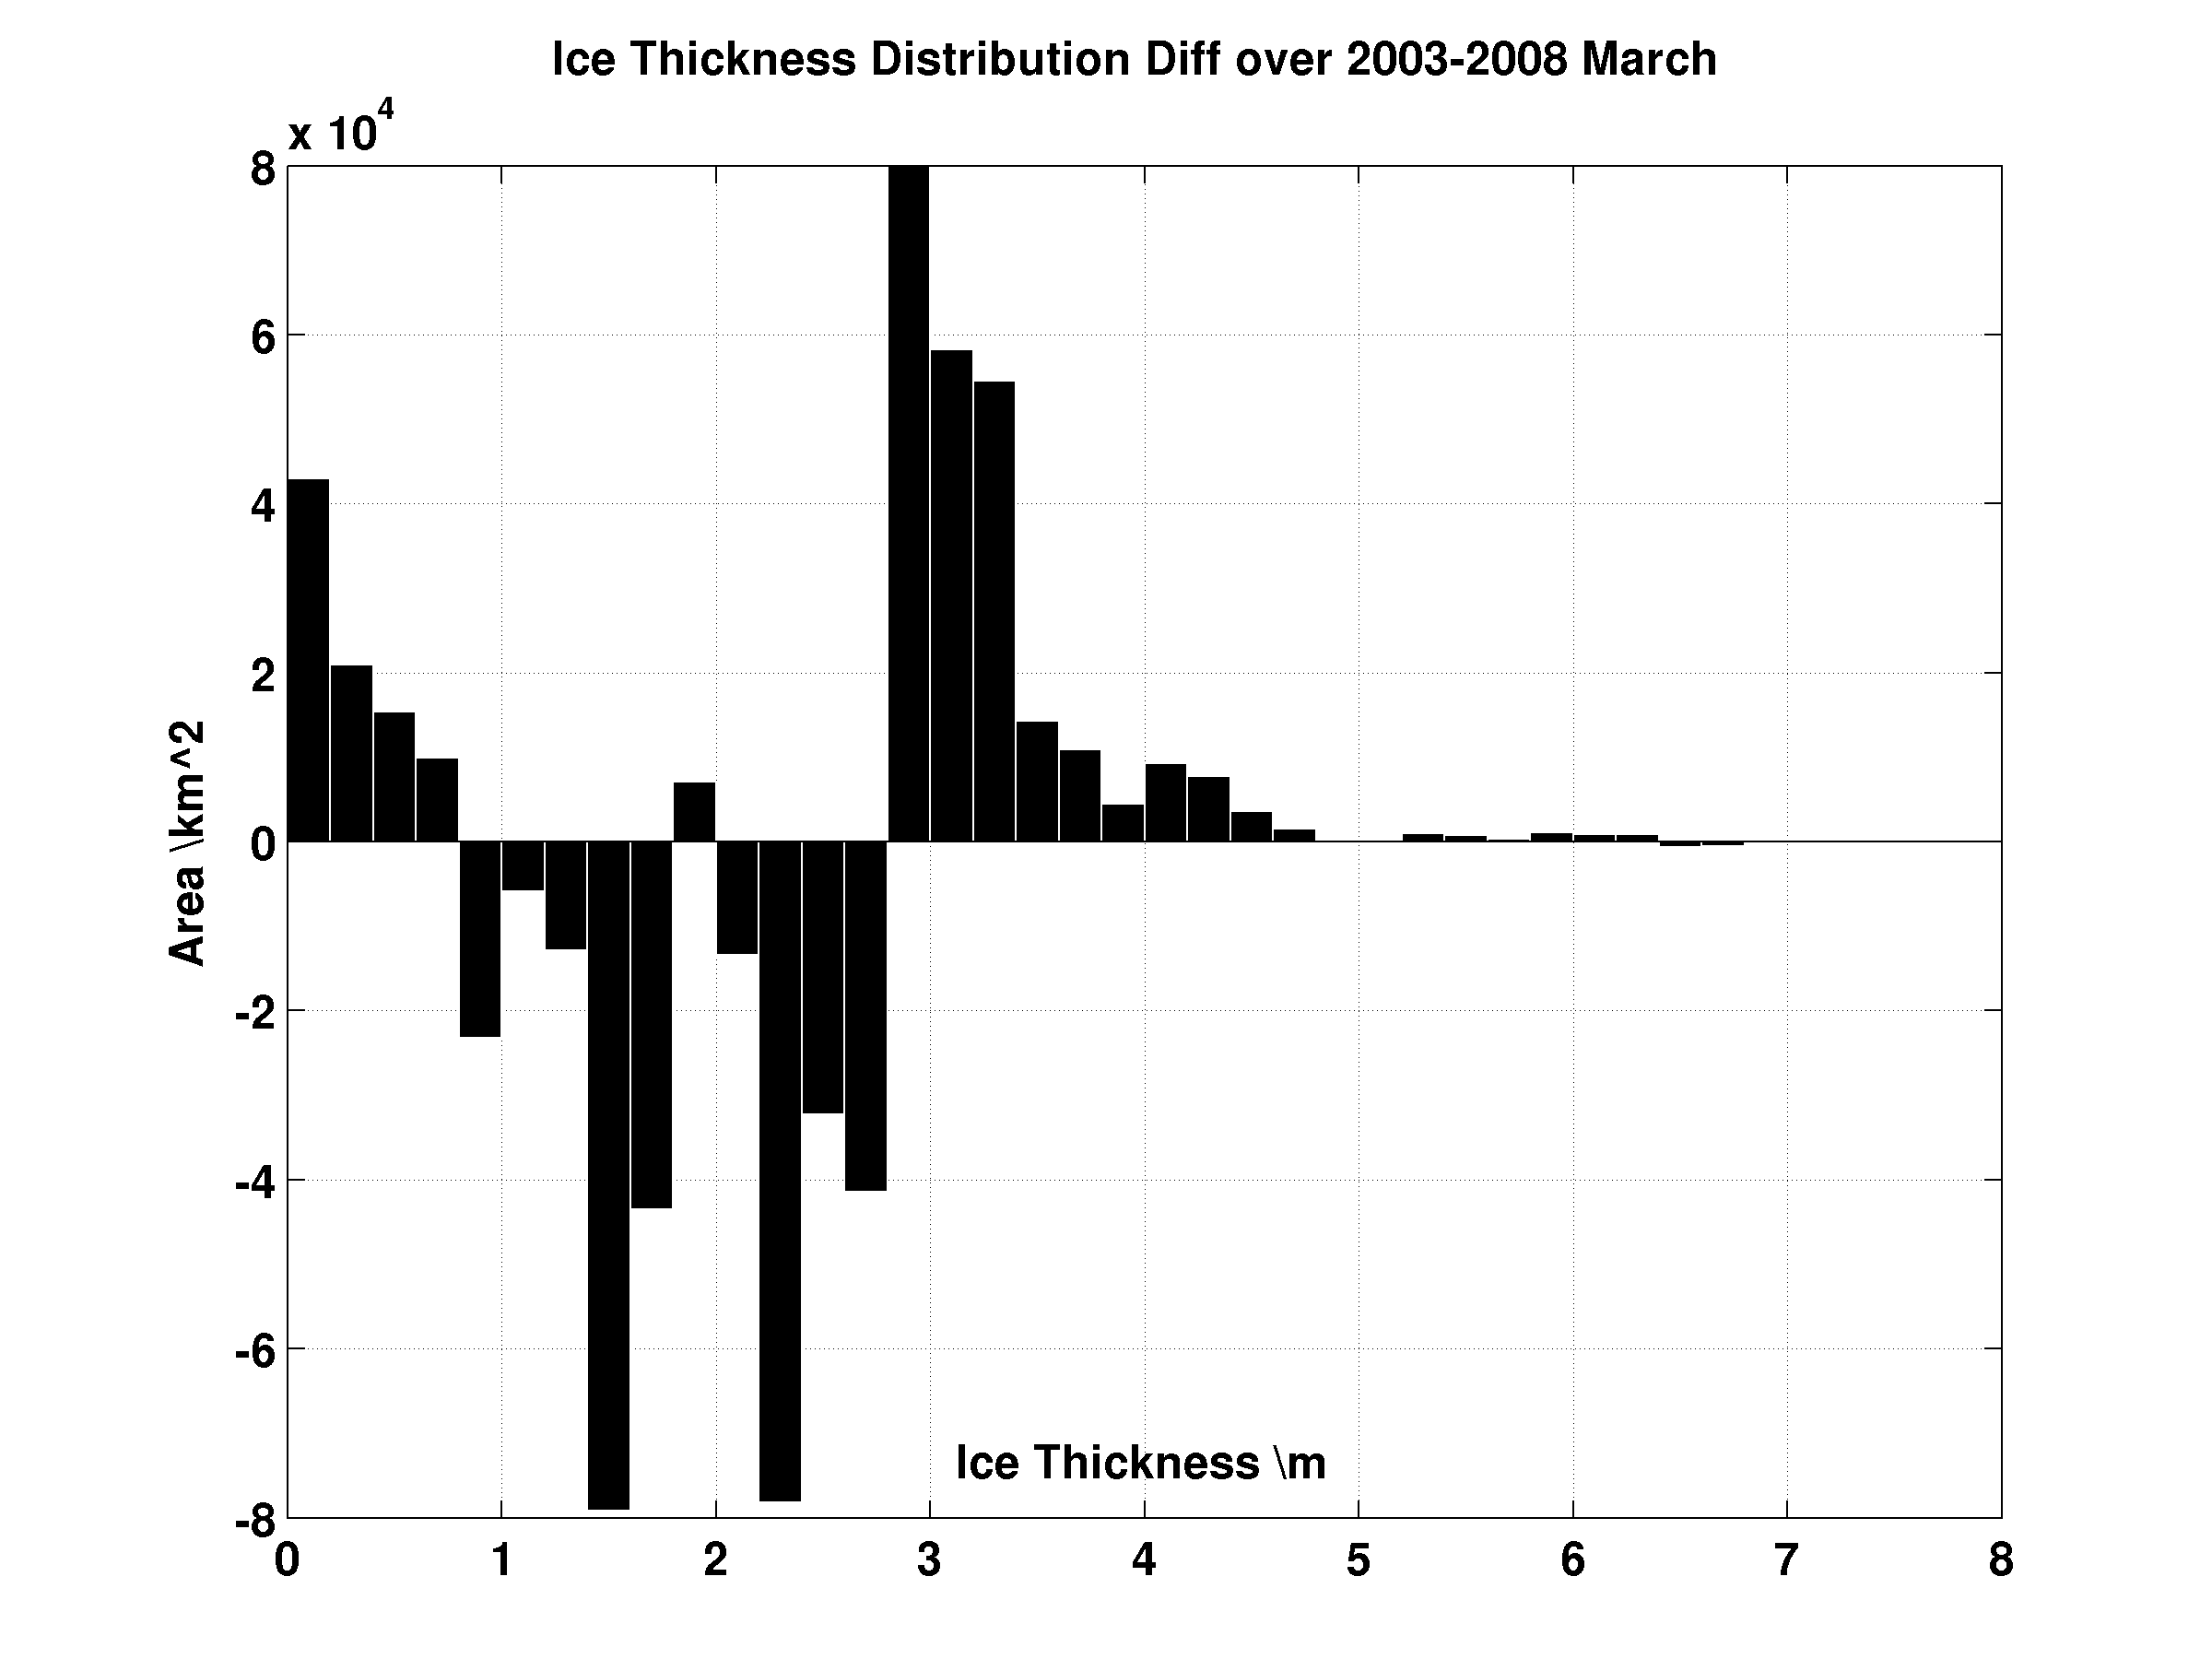
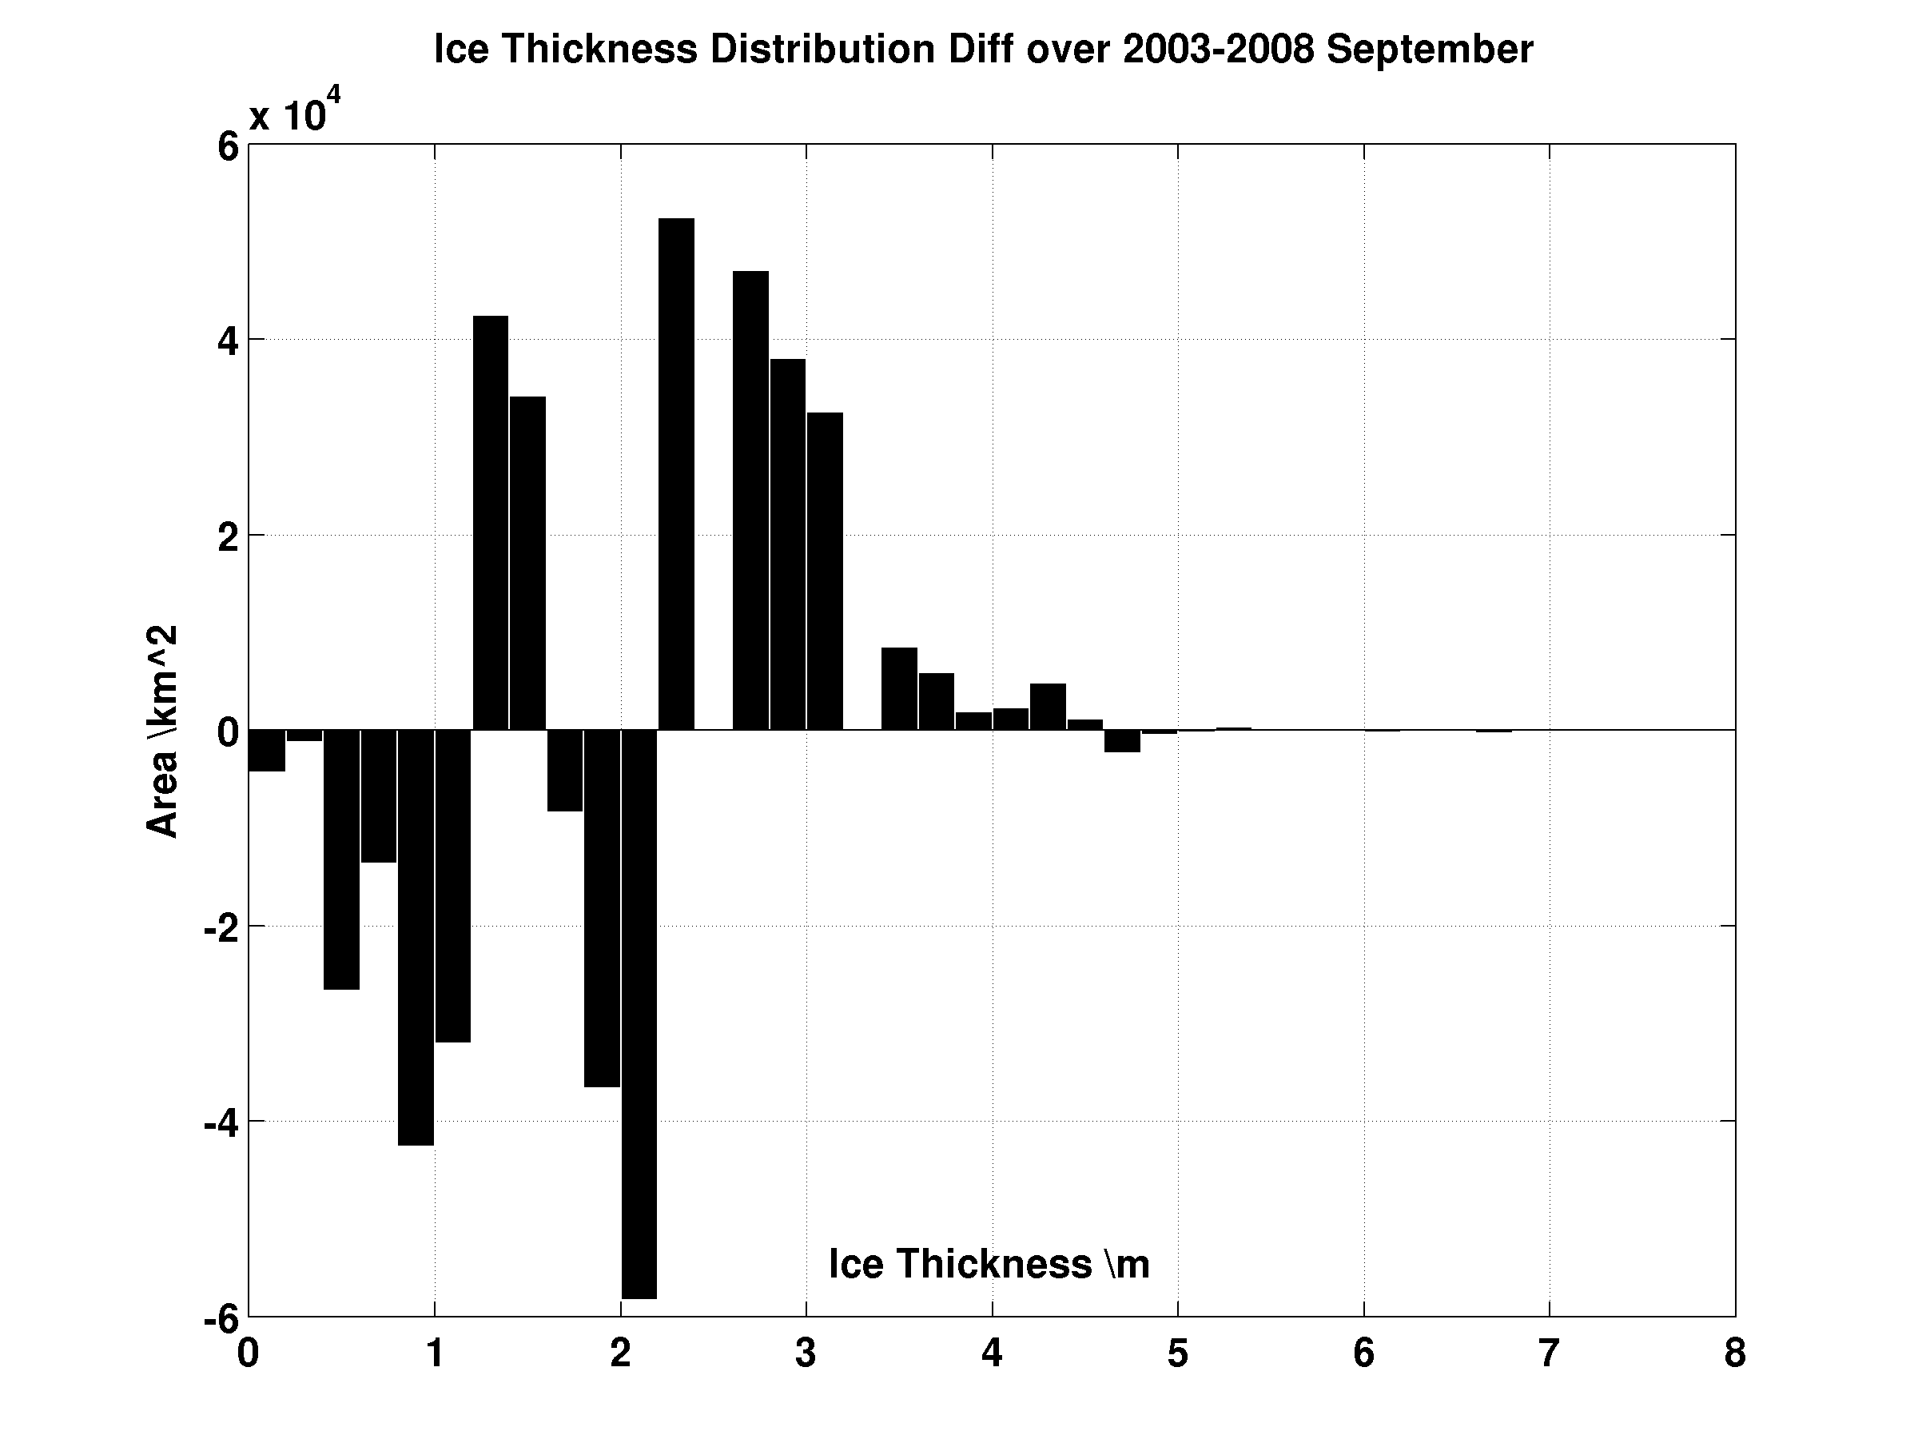
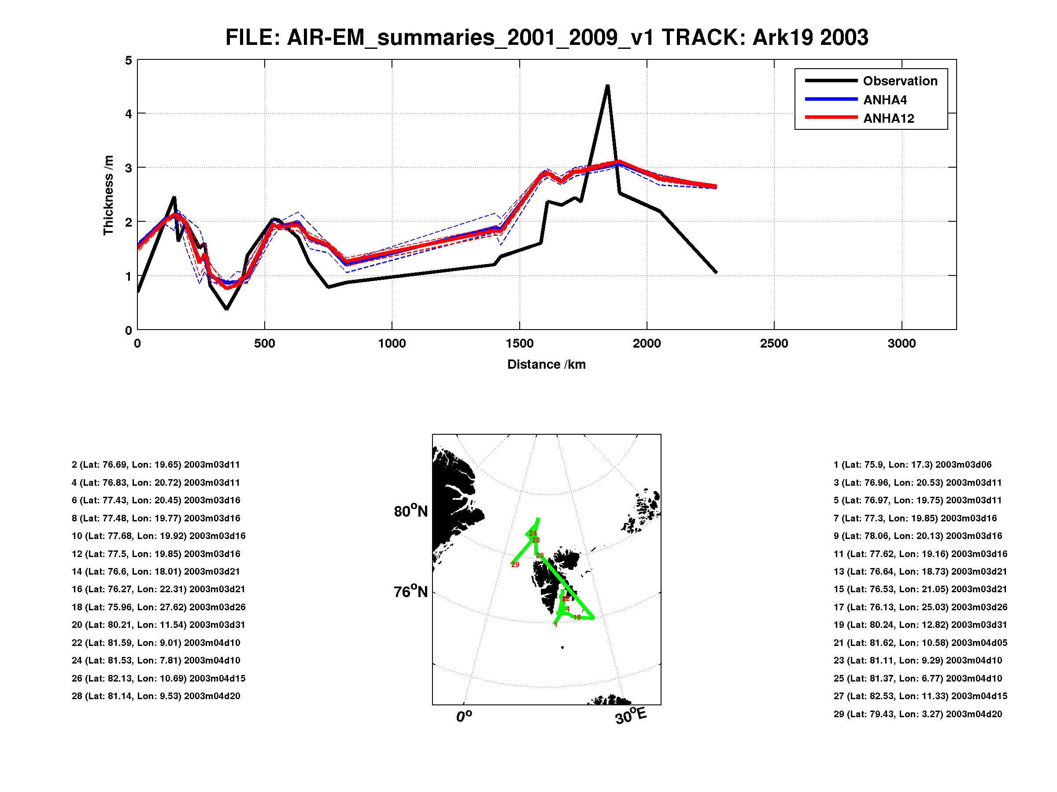
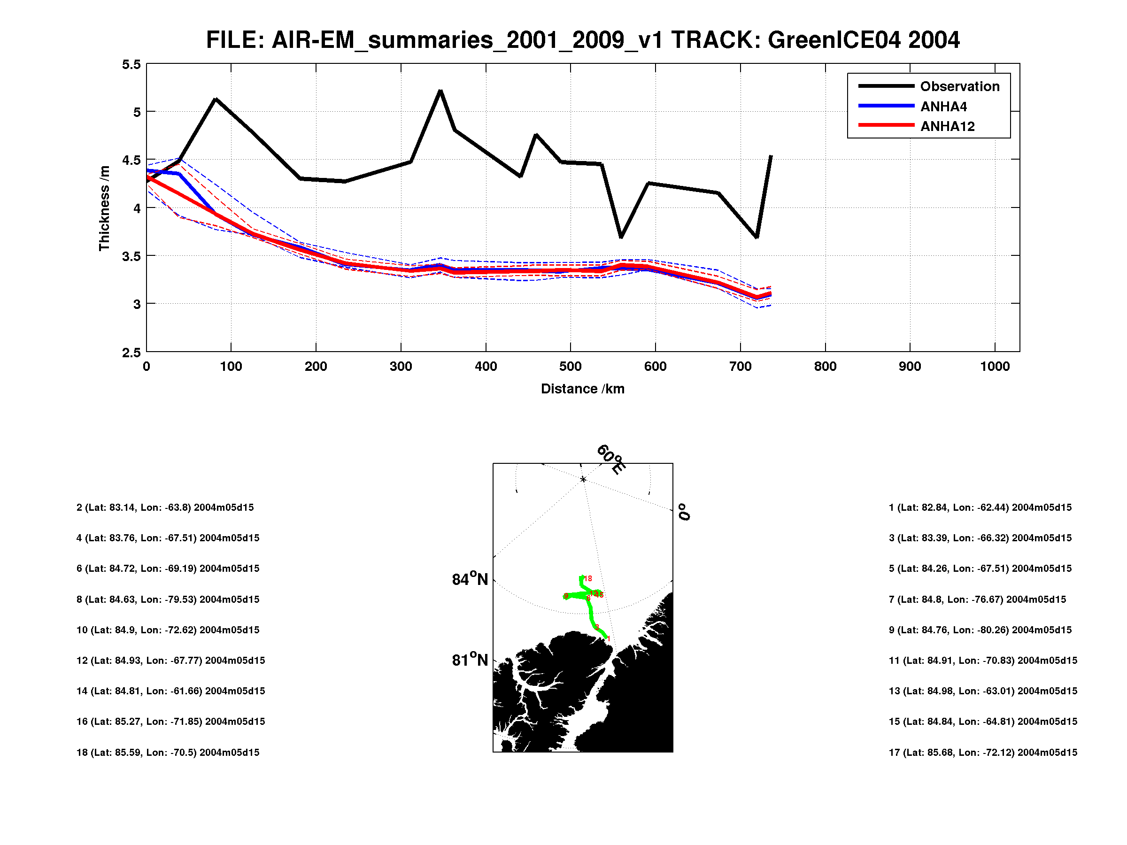
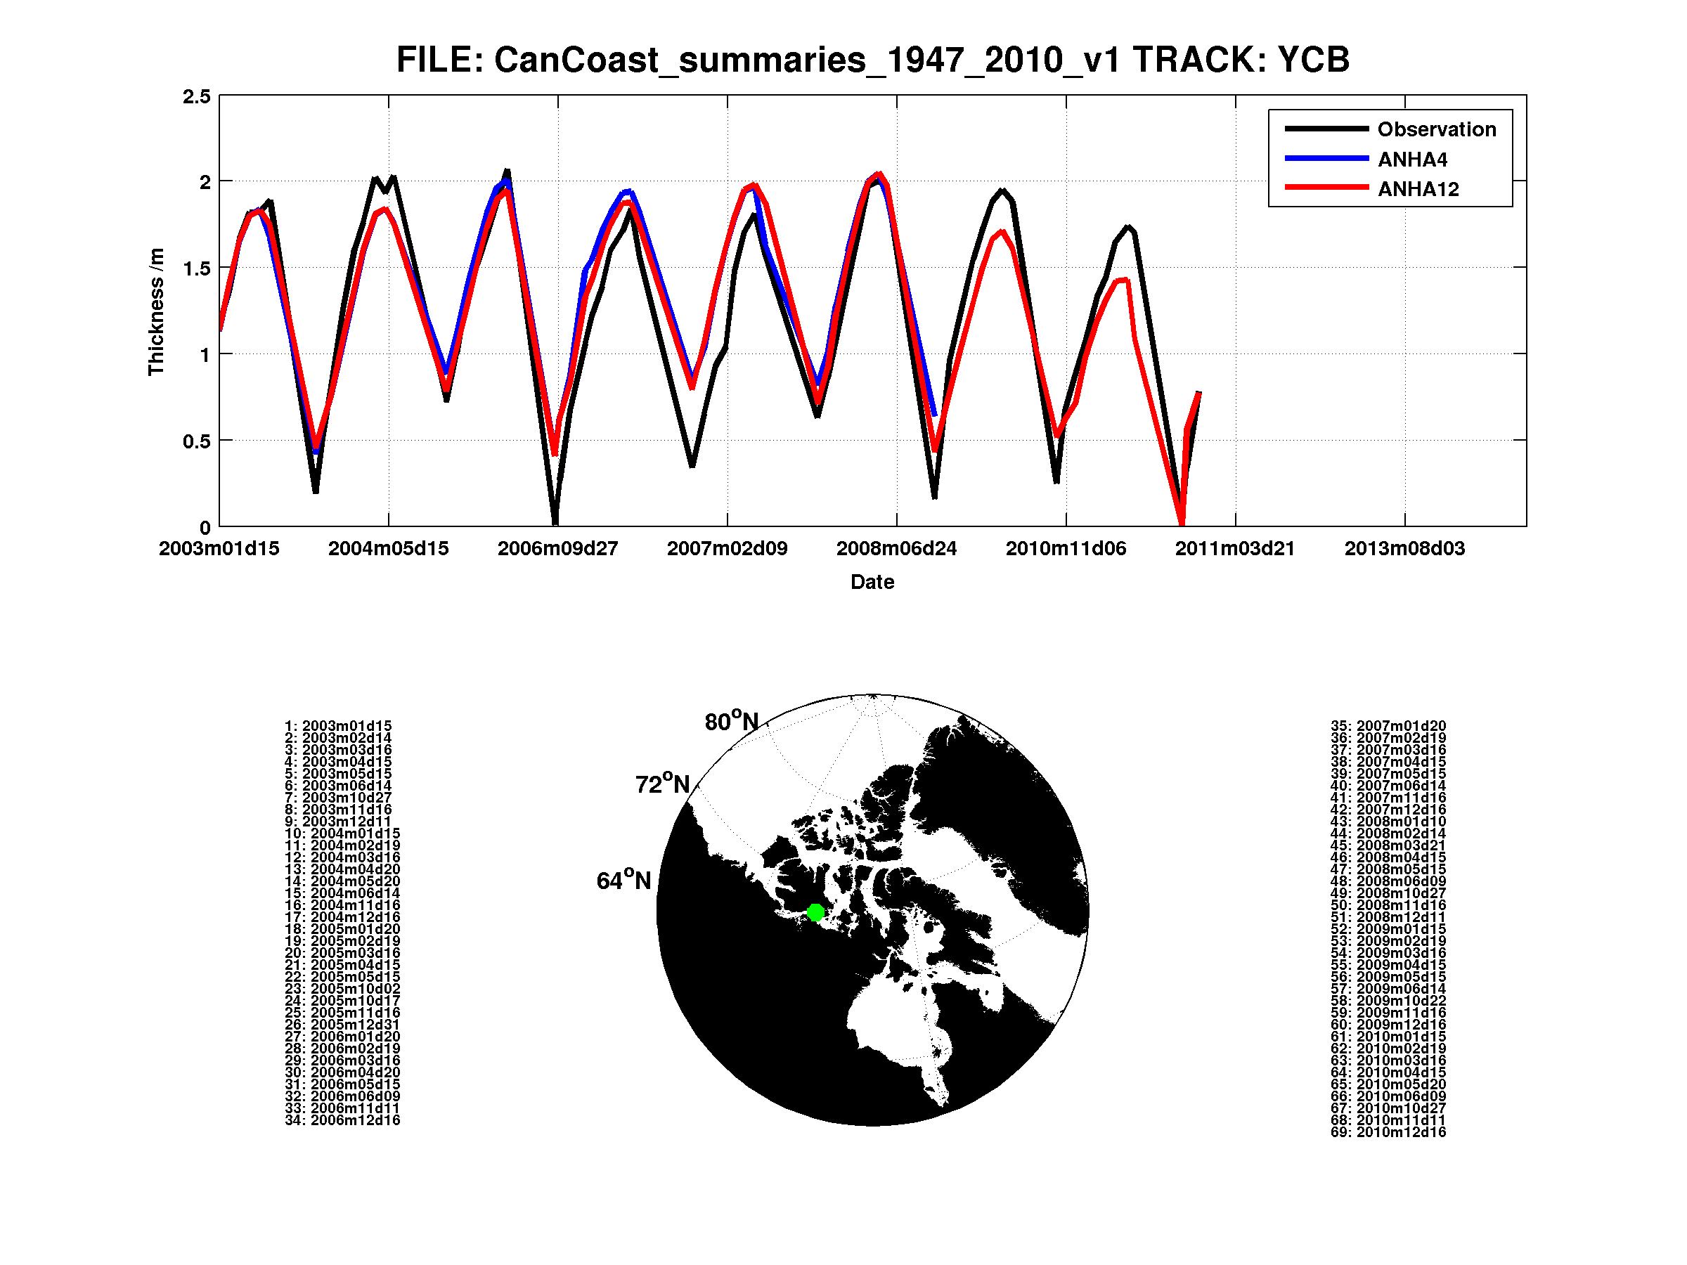
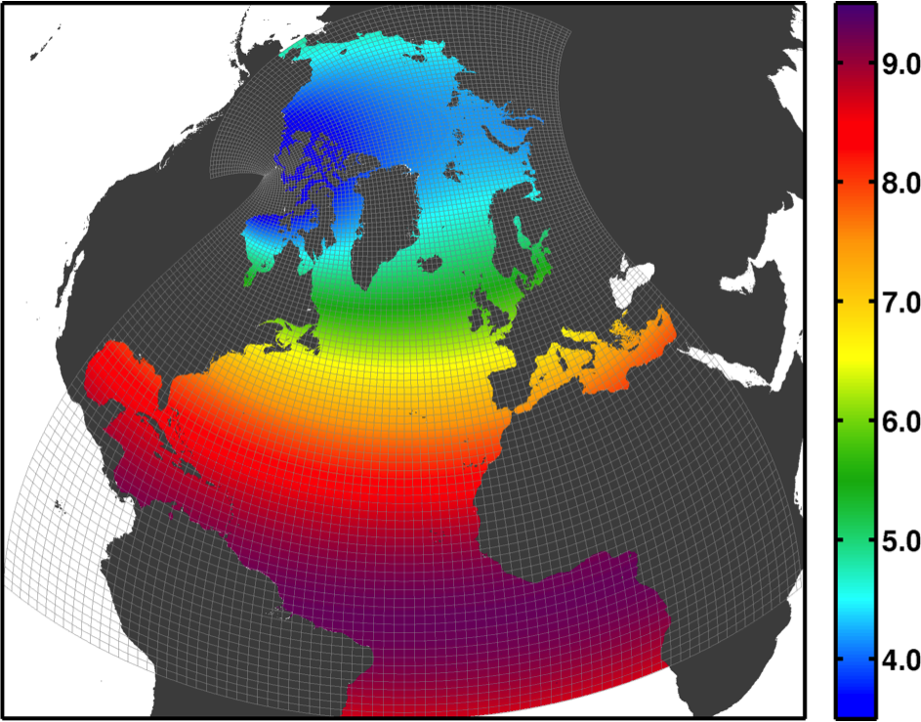
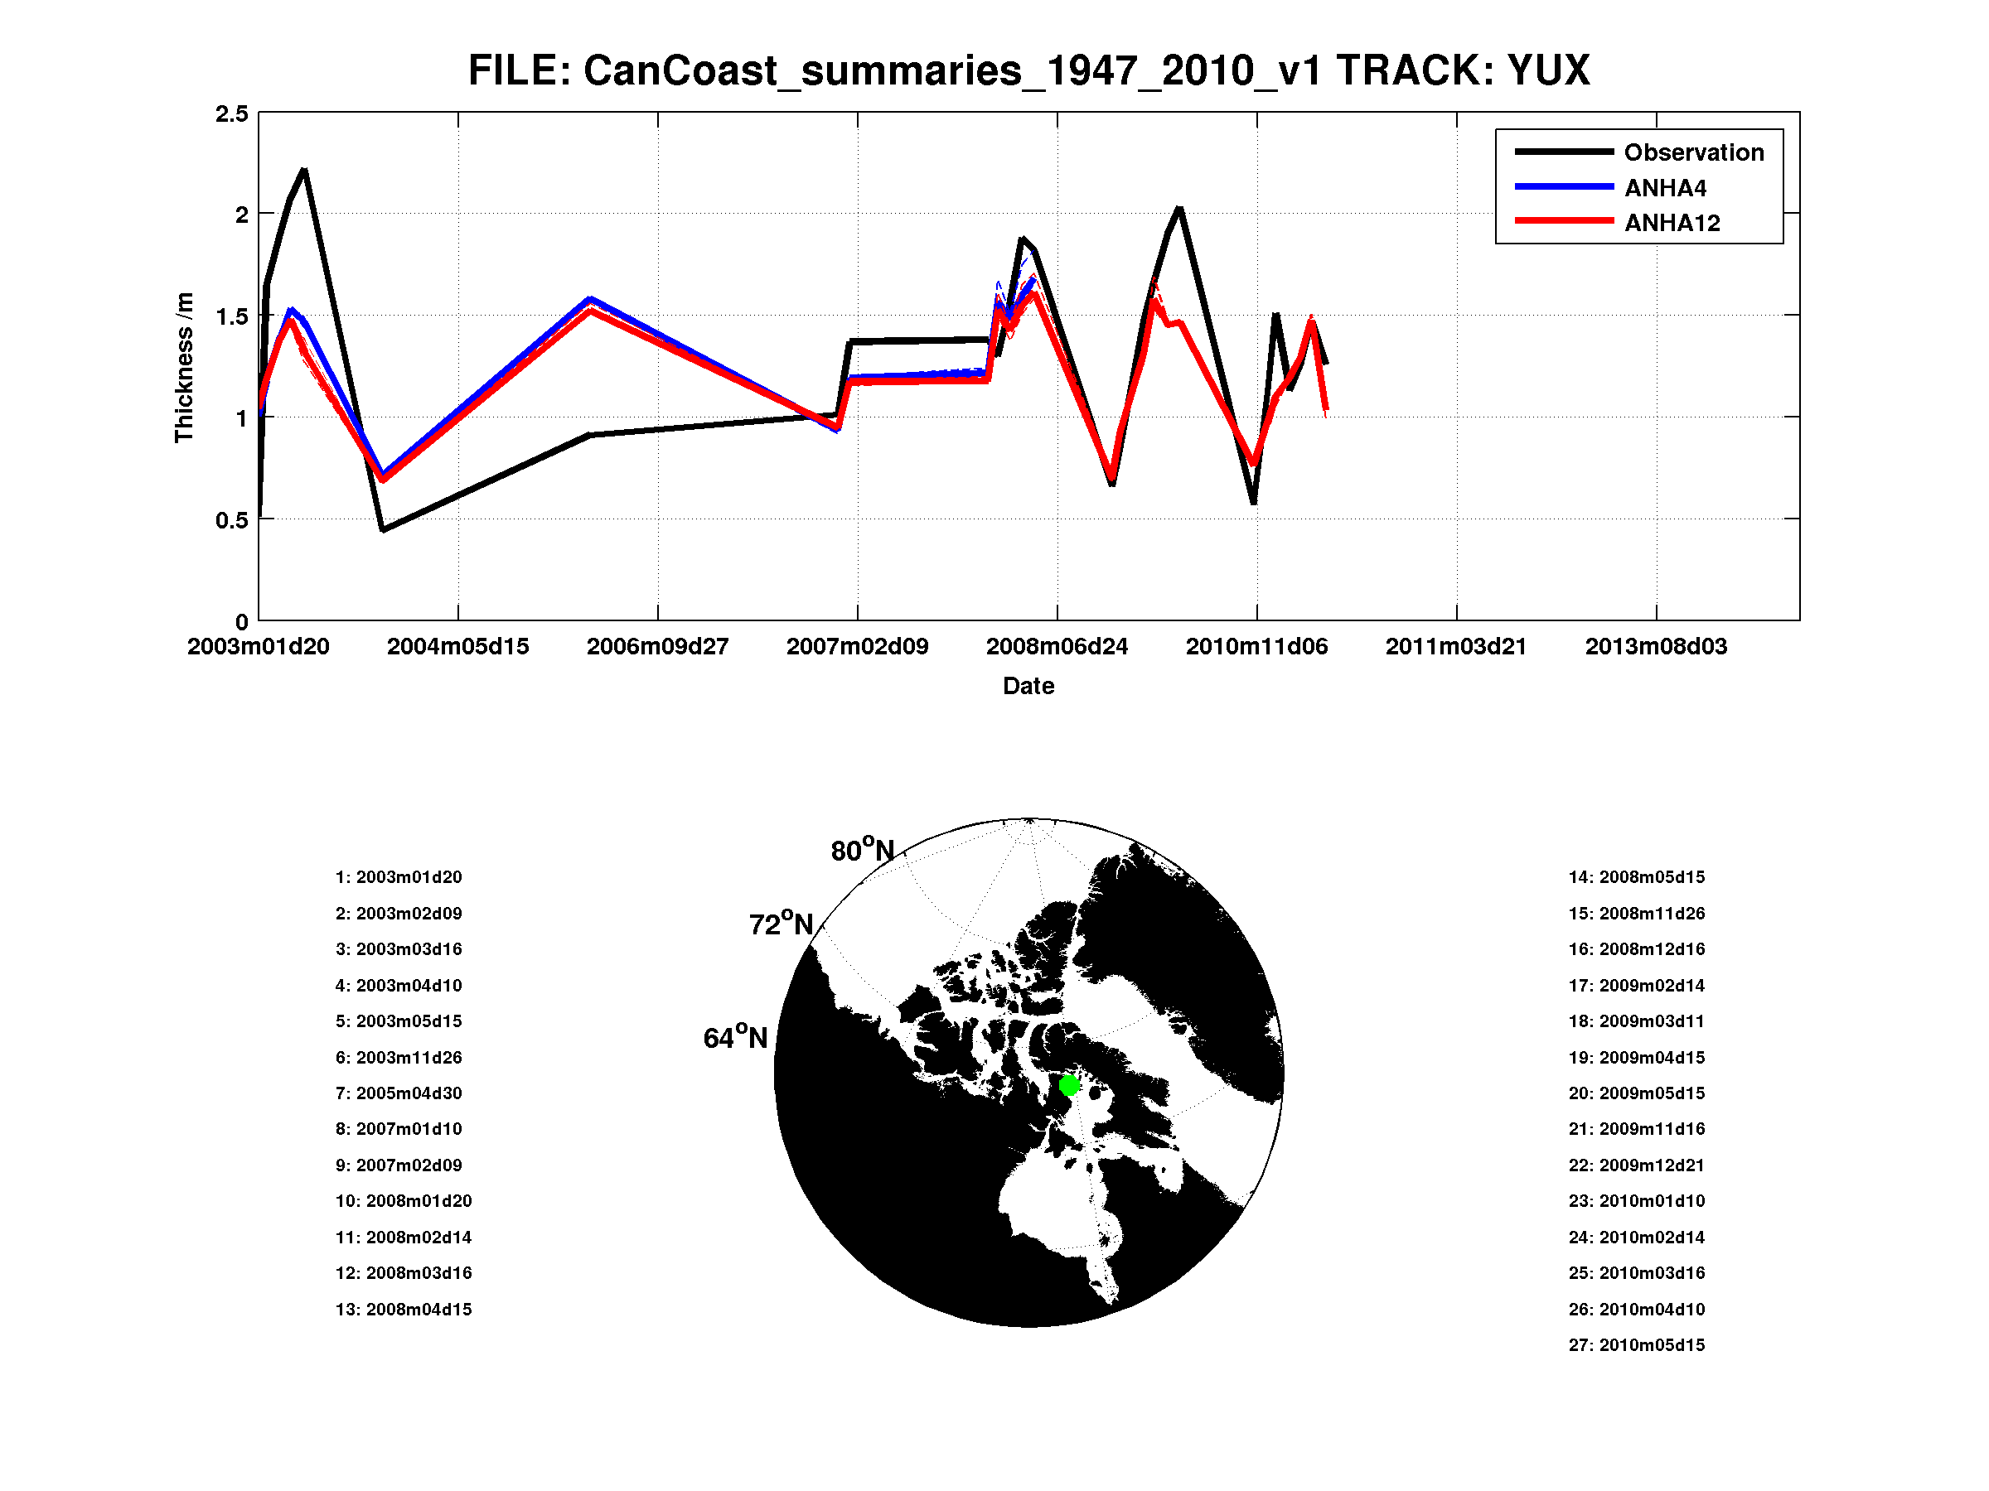
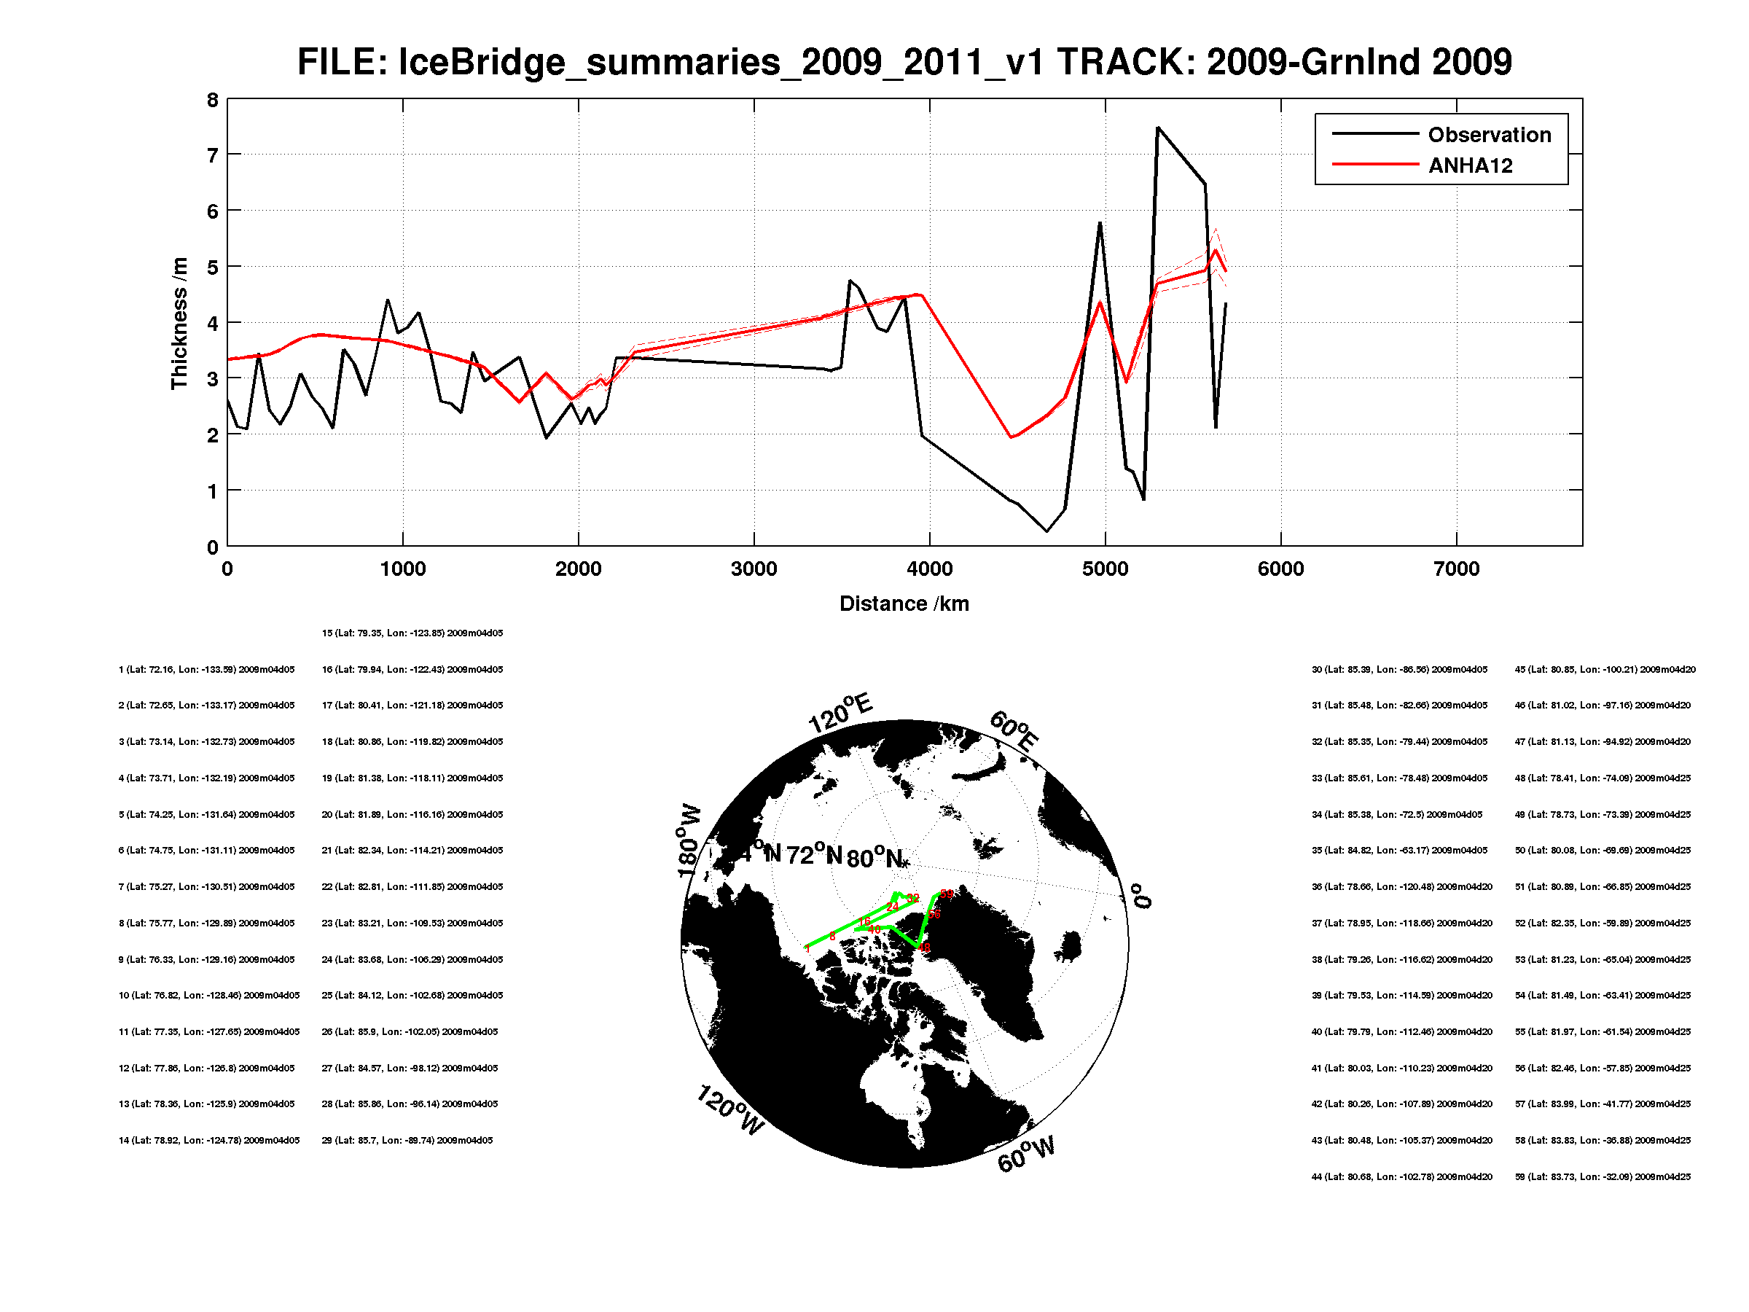
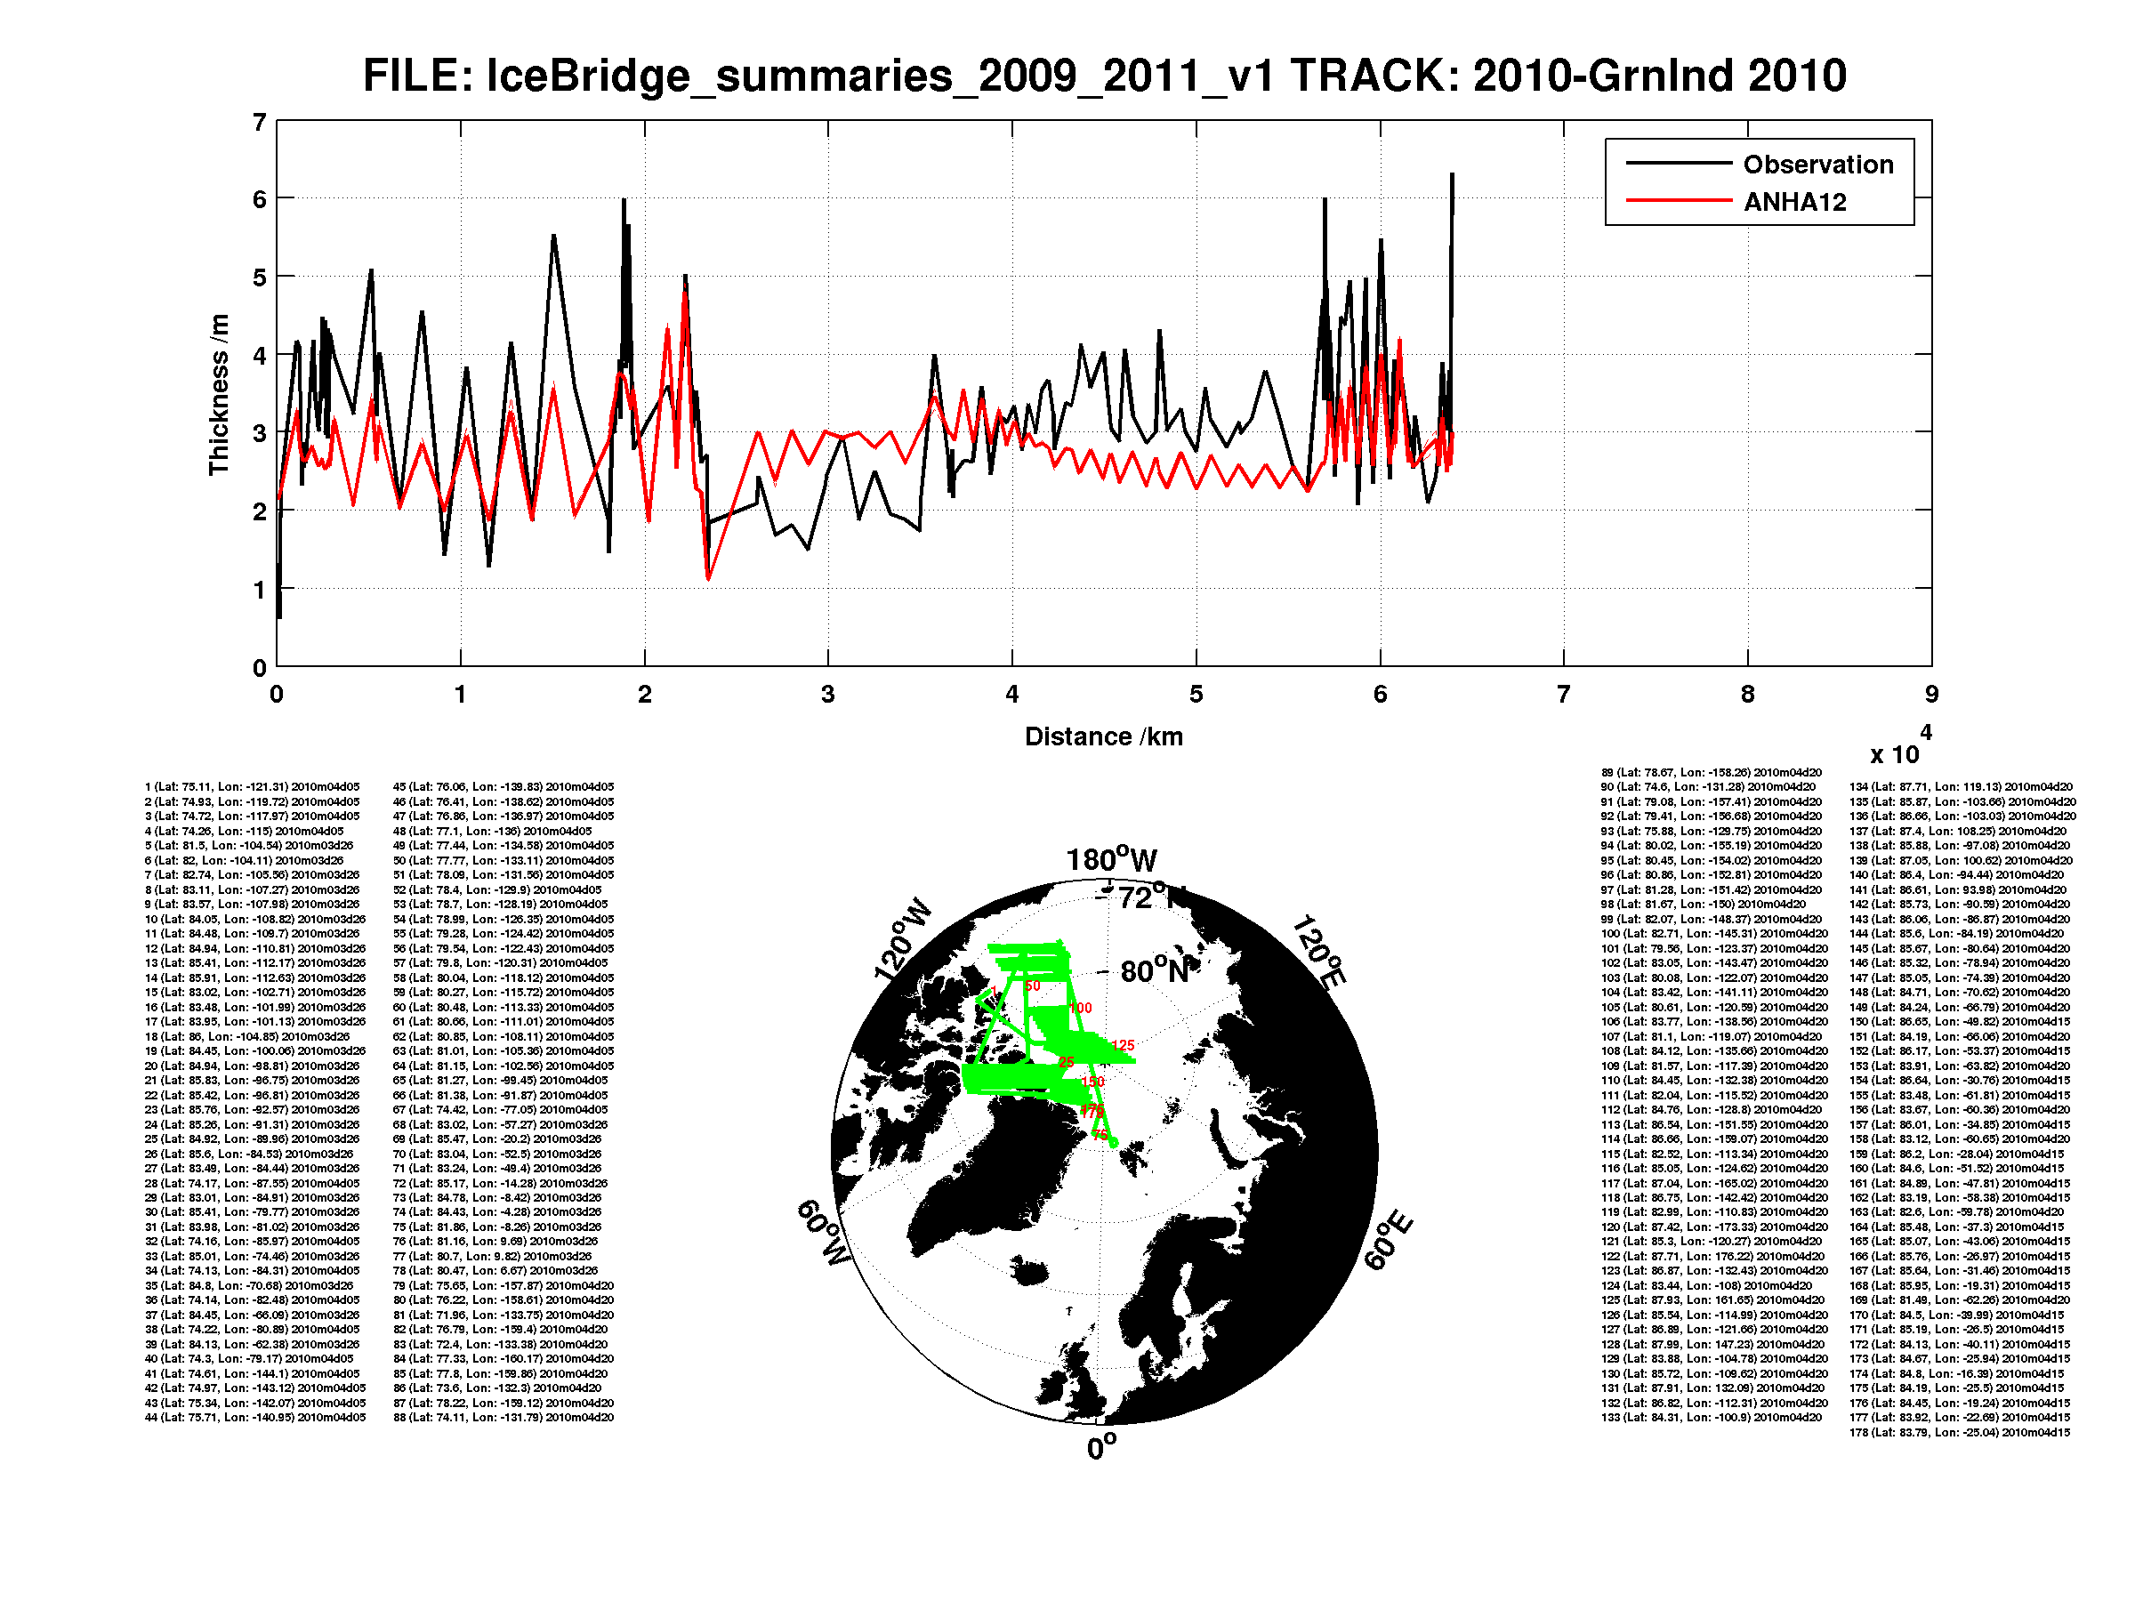
Validation of the Sea-Ice Thickness simulated in an Ocean-Sea Ice Coupled Model
the names and addresses of the associated institutions
INTRODUCTION
GENERAL STATE
THICKNESS DISTRIBUTION
In recent several decades, we witnessed a dramatic decrease in Arctic sea ice in response to atmospheric greenhouse gas (GHG) loading. This rapid decline was also predicted by climate models which play important roles in sea-ice forecasts.
To validate and improve the accuracy and reliability of the model, it is crucial to compare with observations including sea-ice characteristic like ice thickness. The thickness estimates probability of sea ice survival over the melt season and its distribution appears to be undergoing rapid changes. The focus of this research is to validate the model by comparison and finally help refine the model.
OBSERVATION COMPARISON
MODEL DESCRIPTION
FURTHER STUDY
The Arctic and Northern Hemisphere Atlantic (ANHA) model has two versions, ANHA4 and ANHA12, which has different resolution of 1/4 and 1/12 degree respectively.
We are going to figure out the reason why Arctic sea ice change in certain area from both dynamic and thermodynamic perspective. It is a challenge but interesting topic for further study.
FURTHER STUDY
 | ANHA4 | ANHA12
Domain
Horizontal Resolution | 1/4 degree |  | 1/12 degree
Vertical Resolution | 50 levels
Mesh | 544 x 800 |  | 1632 x 2400

