Slide 1

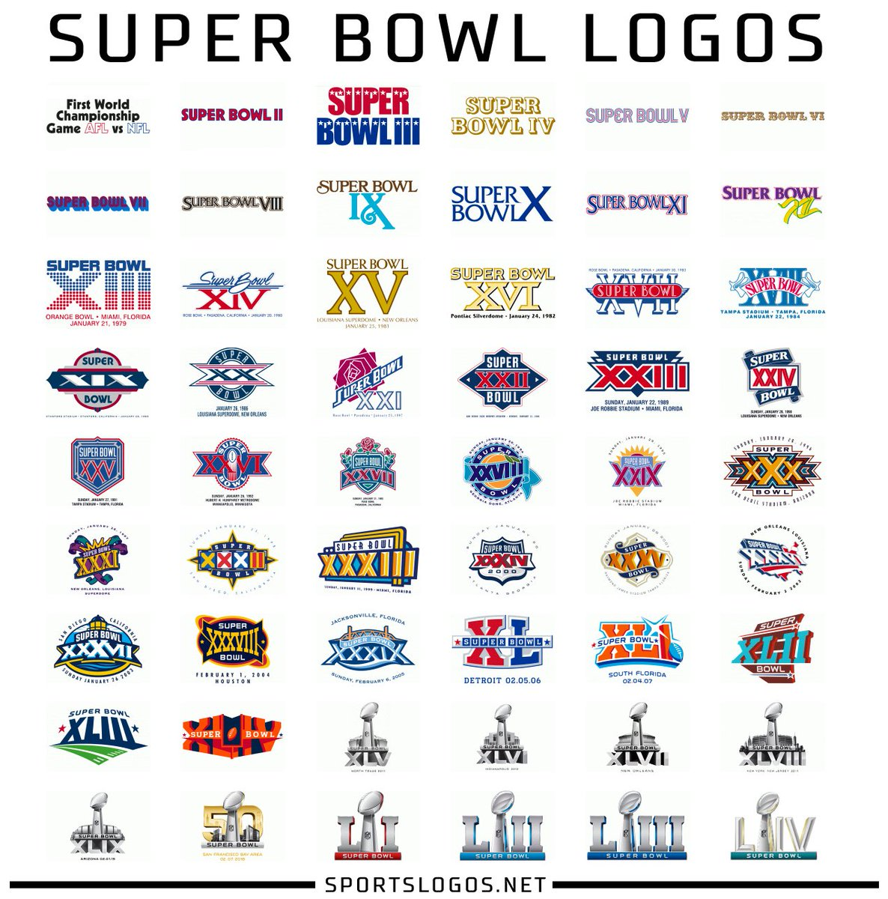
CS 2316 Final Project
Jinghan Chen
Notes:
Image credit:
https://www.clipart.email/clipart/super-bowl-logos-238941.html

Slide 2
From the beginning…
Love of the sport
Base dataset (SuperBowl_base.csv)
Problem faced
Notes:
Interest/ purpose
I want to gain more comprehensive insights on the sport I love.
I found the base dataset from data.world. It only contains 52 Super Bowls, which means I have to complete the dataset by collecting data for the last two Super Bowls.
The other problem I faced from the beginning of this project was the lack of data because there are only 54 Super Bowls played so far.
I am planning on scaping the data from the internet and get more information on each Super Bowl. This ends up being the most tedious and frustrating process for this project because of the difference of the formatting of the Wikipedia website.

Slide 3
Tools
BeautifulSoup
requests
csv
re
pandas
numpy
Excel
Jupyter Notebook
Matplotlib
Seaborn
Notes:
Data cleaning
BeautifulSoup is used to create soup object to pull data out of HTMLs.
Requests module allows me to send HTTP request using python
Csv was used to read and write csv files
Regular expression was used in the web scraping process to get strings or links with certain patterns.
Pandas and numpy was used to manipulate the dataset
Excel was used to store csv files
The visualizations were created through Jupyter Notebook, using matplotlib and seaborn

Slide 4
Data Collection/ Integration
Environment (indoor/ outdoor, temperature)
TV ratings ('Average Viewers', 'Total Viewers', 'TV_rating', 'TV_share’)
30-second ads cost
Competitiveness score
Winning/ losing team season stats (season winning percentage, points score, points allow, end of the season winning streak or losing streak)
https://www.profootballhof.com/news/super-bowl-game-time-temperatures/
https://en.wikipedia.org/wiki/Super_Bowl_television_ratings
https://en.wikipedia.org/wiki/List_of_Super_Bowl_champions
Notes:
https://www.profootballhof.com/news/super-bowl-game-time-temperatures/
https://en.wikipedia.org/wiki/Super_Bowl_television_ratings
https://en.wikipedia.org/wiki/List_of_Super_Bowl_champions
Final dataset before analysis:
(54, 36)

Slide 5
Data Manipulation
Added columns: competitive_score (calculated by the average point difference for every quarter)
Winning_streak/ Losing_streak for winning and losing team (generated from the end of the season streak column)

Slide 6
Key questions to answer
General questions on the history of Super
Bowl (contains three small questions)
Playing environment
TV ratings vs competitiveness
TV ratings vs ads cost
Season stats comparison (winner/ loser)

Slide 7
Result to the questions

