Slide 1


Welcome to Slidev
Presentation slides for developers
Press Space for next page
Notes:
The last comment block of each slide will be treated as slide notes. It will be visible and editable in Presenter Mode along with the slide. [Read more in the docs](https://sli.dev/guide/syntax.html#notes)

Slide 2
Slidev is a slide maker and accompanying presentation tool designed for developers. It consists of the following features:
▪
📝 Text-based - focus on the content with Markdown, and apply styles later
▪
🎨 Themable - themes can be shared and used as npm packages
▪
🧑‍💻 Developer Friendly - code highlighting, live coding with autocompletion
▪
🤹 Interactive - embedding Vue components to enhance your slides
▪
🎥 Recording - built-in recording and camera view
▪
📤 Portable - export to PDF, PPTX, PNGs, or even a hostable SPA
▪
🛠 Hackable - virtually anything that’s possible on a webpage is possible in Slidev
Read more about Slidev in Why Slidev?
Notes:
Here is another comment.

Slide 3
Table of contents
<Toc minDepth="1" maxDepth="1"></Toc>
1.
Welcome to Slidev
2.
What is Slidev?
3.
Table of contents
4.
Code
5.
Components
6.
Themes
7.
Animations
8.
LaTeX
9.
Diagrams
10.
Learn More

Slide 4
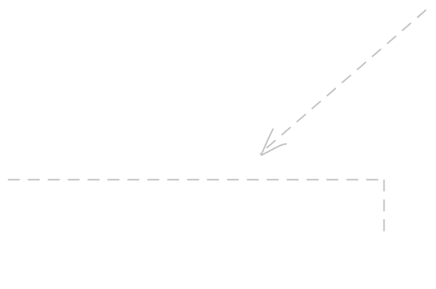

Navigation
Hover on the bottom-left corner to see the navigation’s control panel, learn more
Keyboard Shortcuts
right
/
next animation or slide
space
left
/
previous animation or slide
shift
space
up
previous slide
down
next slide

Slide 5


Code
Use code snippets and get automatic highlighting, and even types hover!^1
// TwoSlash enables TypeScript hover information
// and errors in markdown code blocks
// More at https://shiki.style/packages/twoslash
import { computed, ref } from 'vue'
const count = ref(0)
const doubled = computed(() => count.value * 2)
doubled. = 2
Cannot assign to 'value' because it is a read-only property.

Slide 6
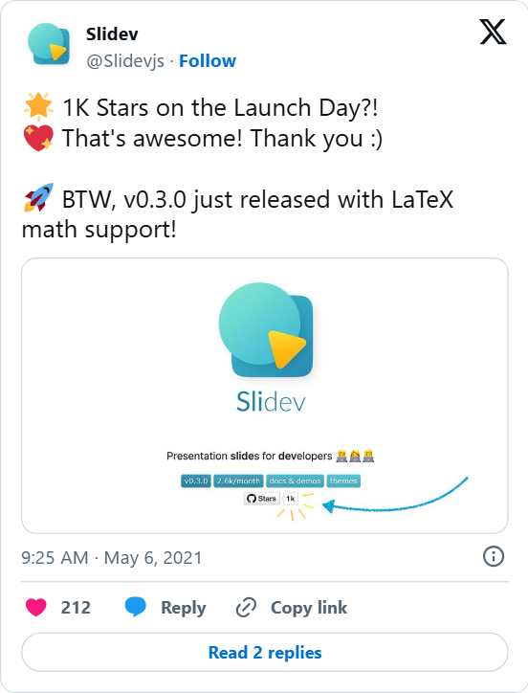
Components
You can use Vue components directly inside your slides.
<Tweet id="1390115482657726468" />
We have provided a few built-in components like <Tweet/> and <Youtube/> that you can use directly. Adding your own custom components is also super easy.
<Counter :count="10" />
-
10
+
Check out the guides for more.
Notes:
Presenter notes with **bold**, *italic*, and ~~strike~~ text.
Also, HTML elements are valid:
<div class="flex w-full">
<span style="flex-grow: 1;">Left content</span>
<span>Right content</span>
</div>

Slide 7


Themes
Slidev comes with powerful theming support. Themes can provide styles, layouts, components, or even configurations for tools. Switch between themes on a per-slide basis with just one change in your frontmatter:
---
theme: default
---
---
theme: seriph
---
Read more about How to use a theme and check out the Awesome Themes Gallery.

Slide 8


Animations
Animations are powered by @vueuse/motion.
<div
v-motion
:initial="{ x: -80 }"
:enter="{ x: 0 }">
Slidev
</div>

Slide 9


LaTeX
LaTeX is supported out-of-box powered by KaTeX.
Inline
Block
Learn more

Slide 10
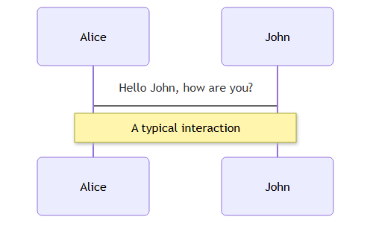
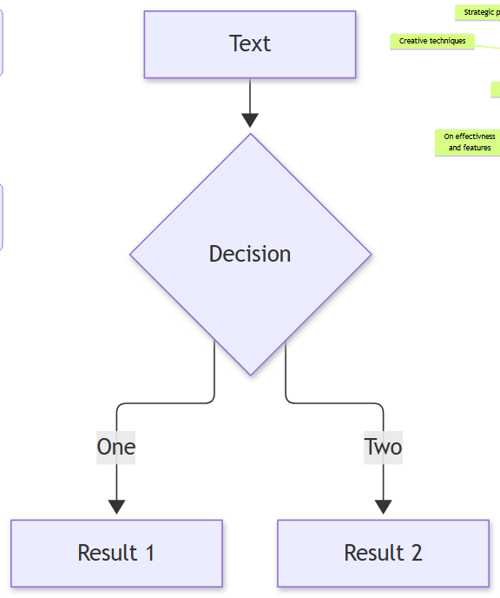
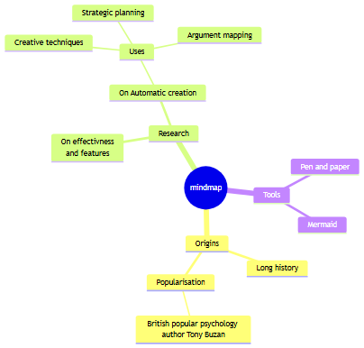
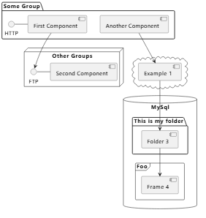
Diagrams
You can create diagrams / graphs from textual descriptions, directly in your Markdown.
Learn More

Slide 11
Learn More
Documentation
·
GitHub
·
Showcases

