Slide 1
TONGJI UNIVERSITY IBM TECH WEB PORTALS
DONGXIANG LI
LIUSHAN YANG
JINGKAI ZHAO
WEI JIANG
PENG HU

Slide 2
Agenda
Supplementary Requirements Specification
Division of work
Progress of project

Slide 3
Supplementary Requirements Specification
A important part of the project:
Mainframe education platform

Slide 4



Mainframe learner
How to get mainframe resource
How to quickly build a learning environment
How to solve problems
Mainframe teacher
？
Mainframe Administrator
How to get enough teaching resources
Allocation of resources complicated
Preparation of teaching environment
Resource recovery complicated
How to update teaching environment
Resource updates complicated

Slide 5


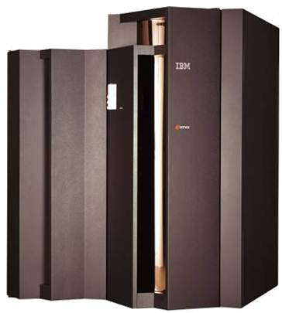




Configure mainframe account
Configure authority
Configure storage volume
Install subsystem
add course experimental automatically
Recover resources automatically

Slide 6
Division of work
PM: DONGXIANG LI
DEV: The entire team
SQA: LIUSHAN YANG & JINGKAI ZHAO

Slide 7
Progress of project
Configure SVN server (svn://10.60.36.90)
Use case diagram
Mockup

