Slide 1
Requirement Analysis& Database Design
Tongji IBM Service System

Slide 2
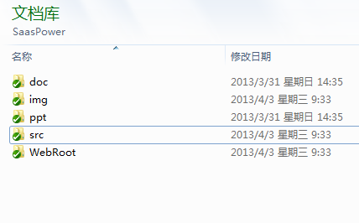
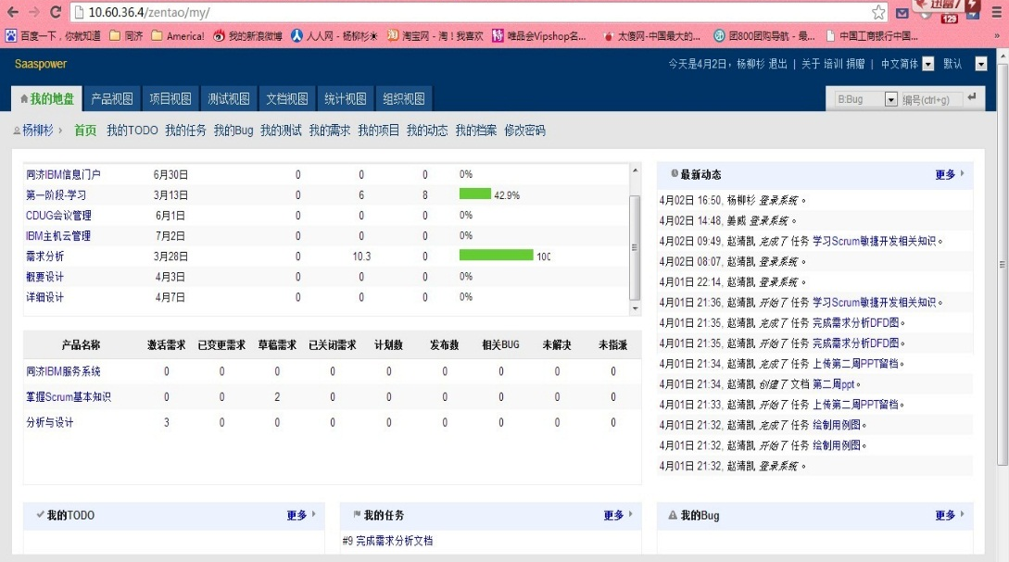
Project Management
SVN
ZenTao

Slide 3
User Analysis
5 Annual CDUG Conference
More Than 100 Mainframe Users Took Part
Banks & Universities
985 University, 26 IBM Club
Approximately Hundreds of Teachers & Ten Thousands of Students

Slide 4
Use Case Design
Information Publish Use Case
CDUG Conference Manage Use Case
IBM Mainframe Resources Distribution

Slide 5
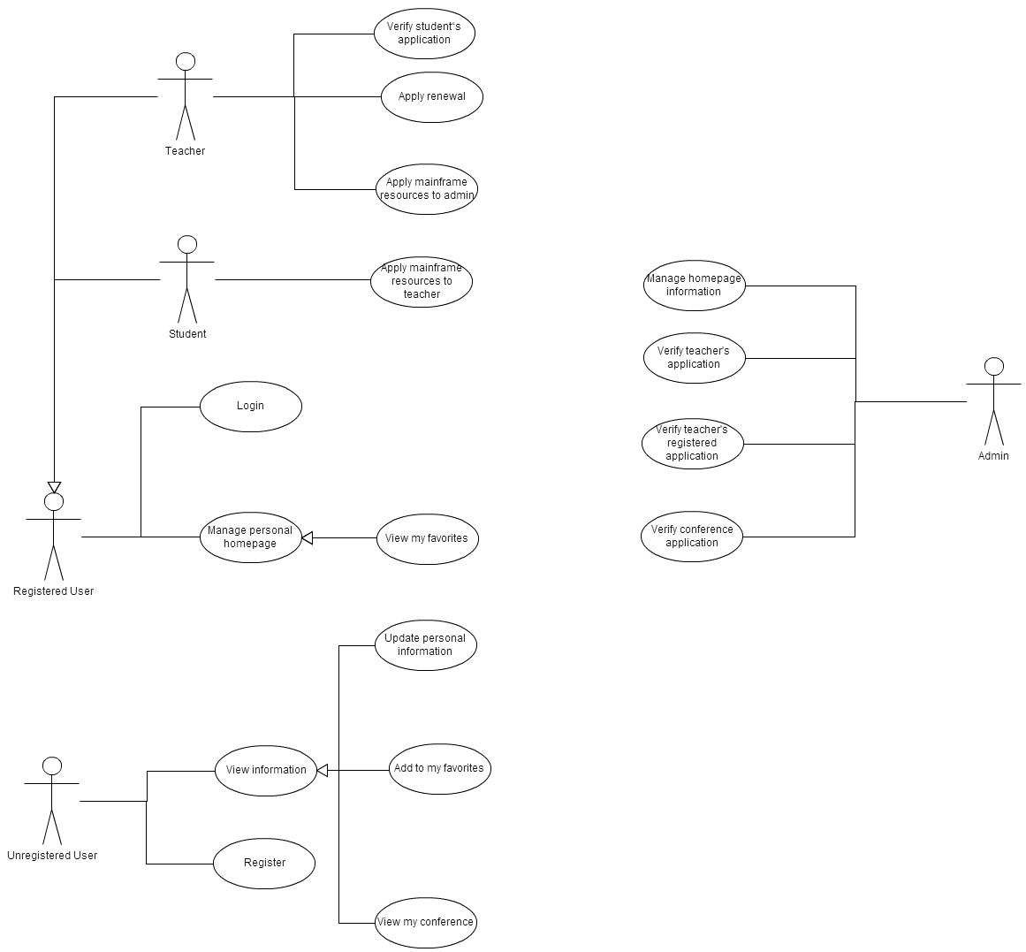

Slide 6
Functional Requirement
DFD Diagram
DFD0
DFD1
DFD2
Specification
Data Dictionary
Process Specification

Slide 7
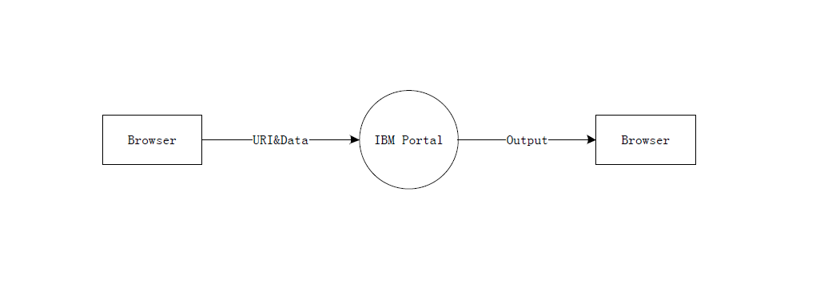
DFD0

Slide 8
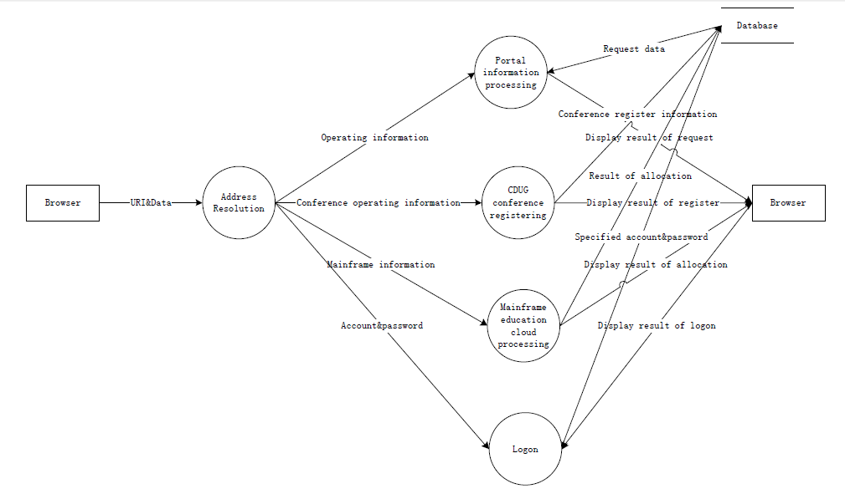
DFD1

Slide 9
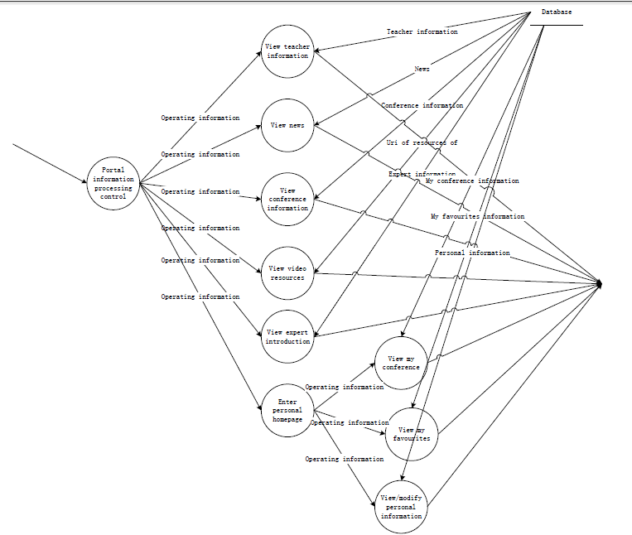
DFD2 Portal Info

Slide 10
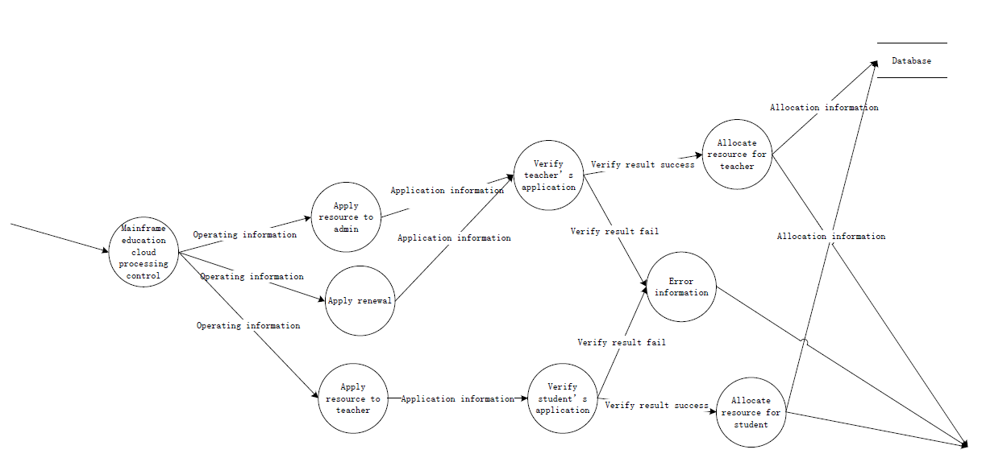
DFD2 Mainframe

Slide 11
Class & Database Design
Class Diagrams
Hibernate Configuration File
Database Tables

Slide 12
Other Requirement
Performance Requirement
Design Constraint
Attributes
Supplementary

Slide 13
Going To Do
Preliminary Design
Database Establishment
Beginning of Info Section Develop

Slide 14
Thank You !

