Slide 1
Week 7
Review and plan

Slide 2
What we have done this week
UML class diagrams (Data level)
POJO (processing)
Hibernate configure files (processing)
DAO (processing)
Mockups (update)

Slide 3
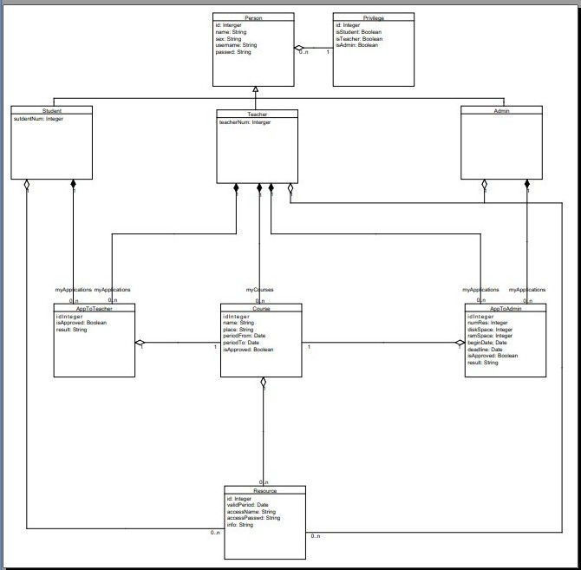
UML class diagrams (Data level)
UML class diagrams of two subsystems which are CDUG and MF

Slide 4
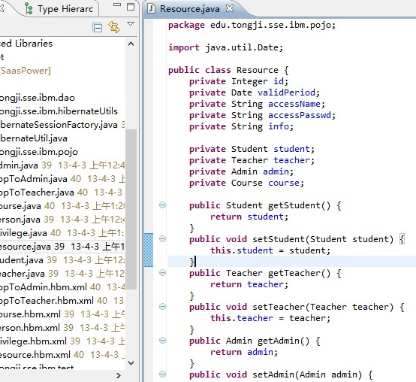
POJO
Some JavaBeans

Slide 5
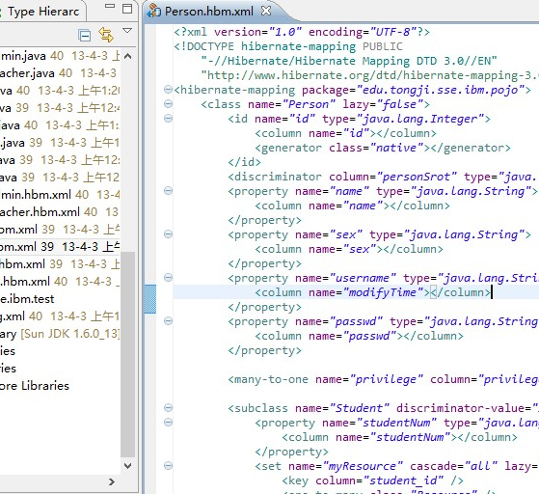
Hibernate configure files
Hibernate configure files

Slide 6
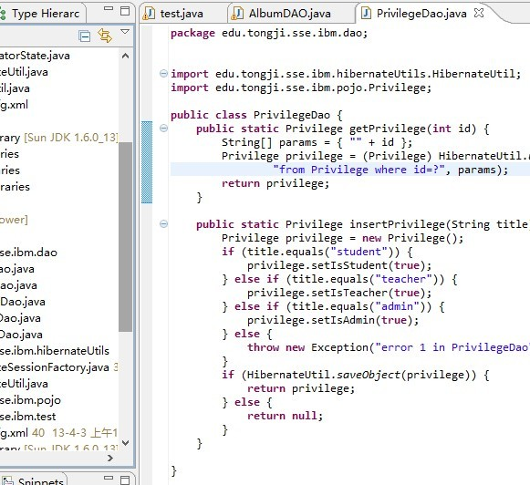
DAO
Data access object

Slide 7
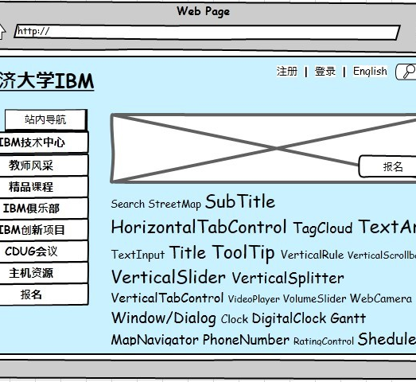
Mockups
Update some mockups

Slide 8
Plan for next week
HTML files
DAO
POJO

Slide 9
Ta ta

