Slide 1
Analytic Program
Final Project Presentation
Jiaqi Min
Jingmin Chen
Yusen Wu

Slide 2
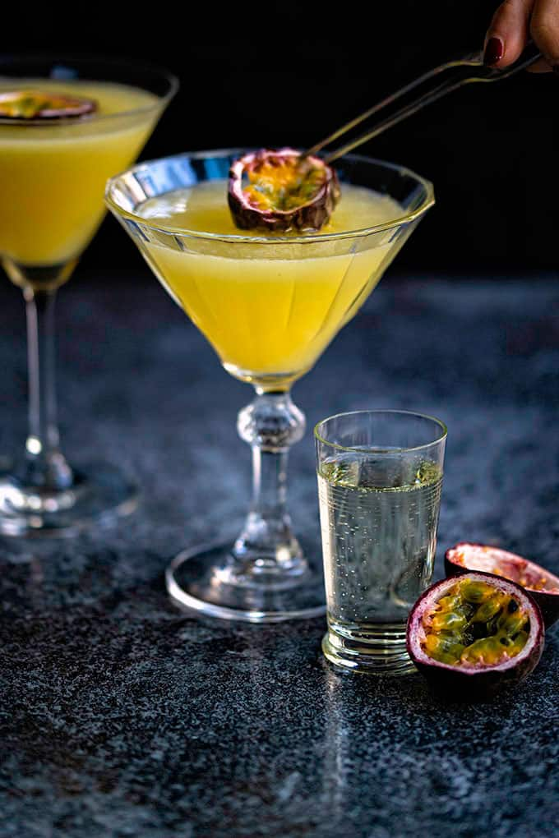
The correlation between alcohol consumption and economy in different regions
Research Question:
-Consumption changes with economy
-Alcohol is optional consumption
Perspective: Liquor store/company

Slide 3
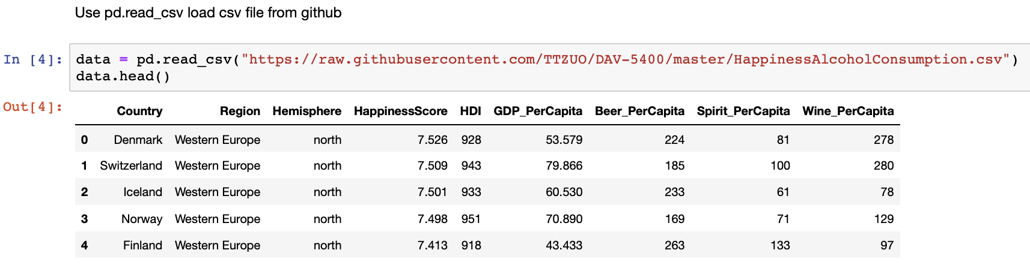
First Dataset
Happiness and Alcohol Consumption
Economy
HDI(Human Development Index)
GDP_Per Capita
Happiness Score
Alcohol Consumption

Slide 4
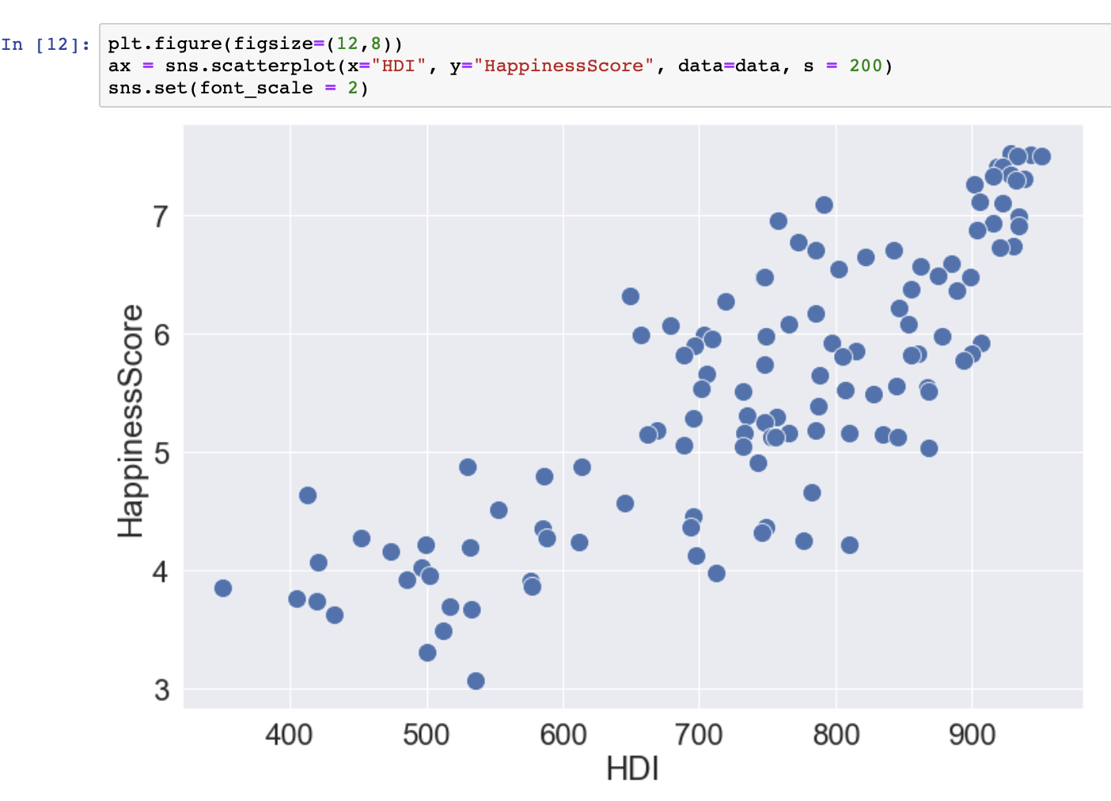
HDI and Happiness

Slide 5
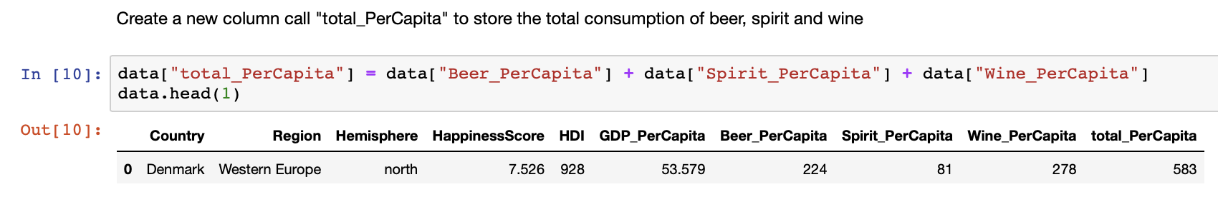
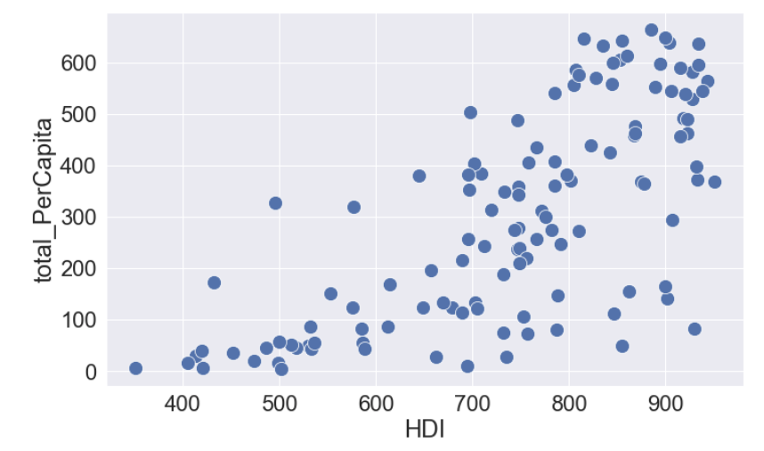
HDI and Total Consumption
HDI Higher
Alcohol Consumption Higher

Slide 6
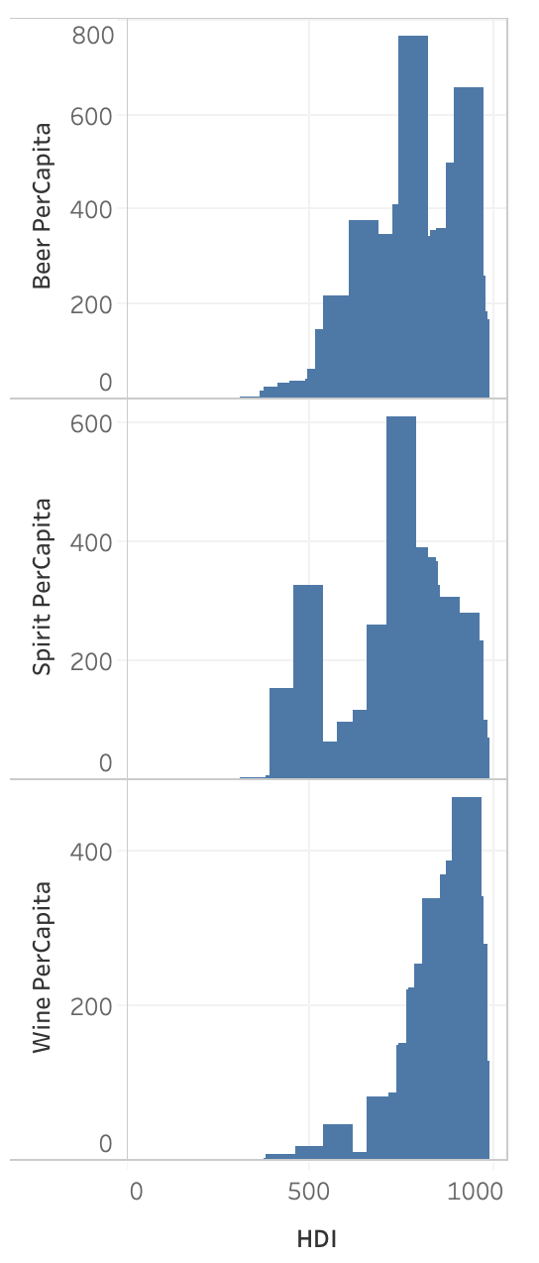
Wine and HDI
In each Category Comparison
-Spirit goes up and down
-Beer has not big difference
-Wine goes up as HDI goes up

Slide 7
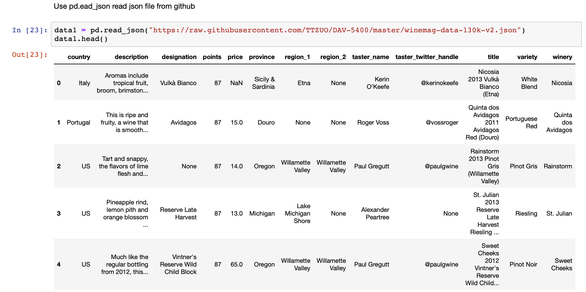
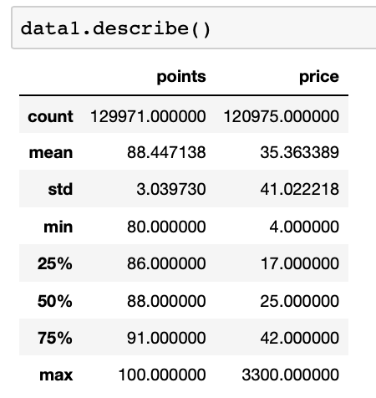
Second Dataset
Wine price and review

Slide 8
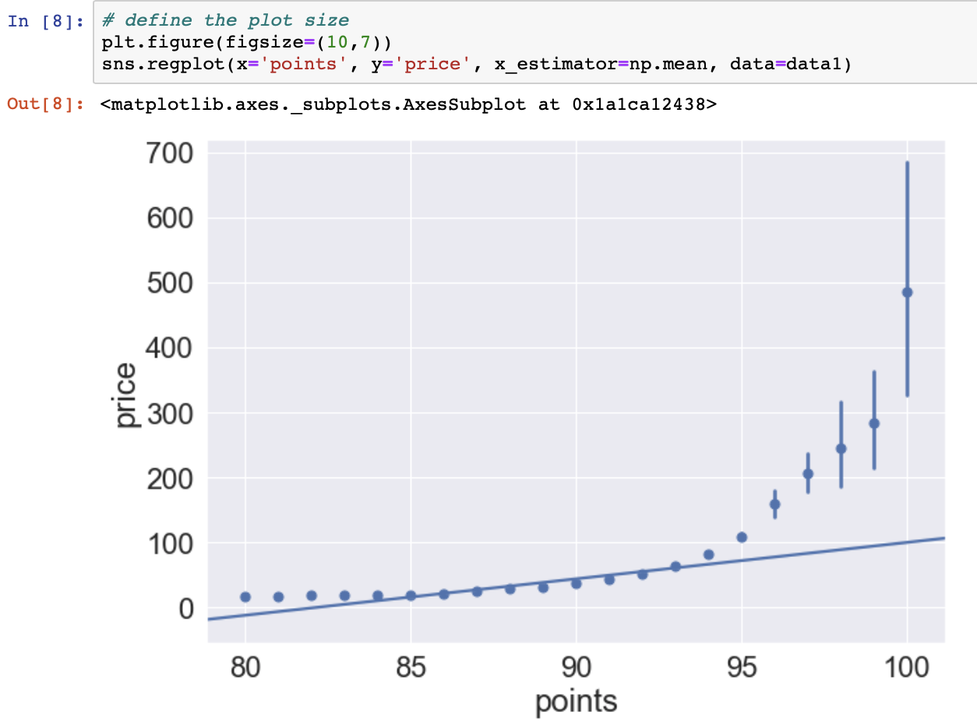
Price and Points

Slide 9
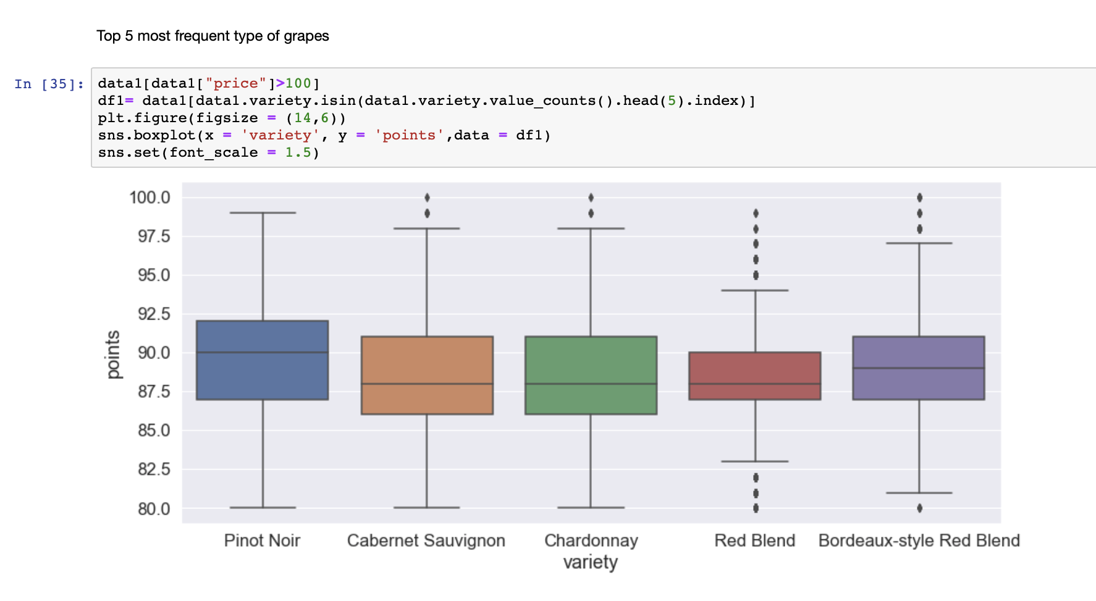
Top Grape Types

Slide 10
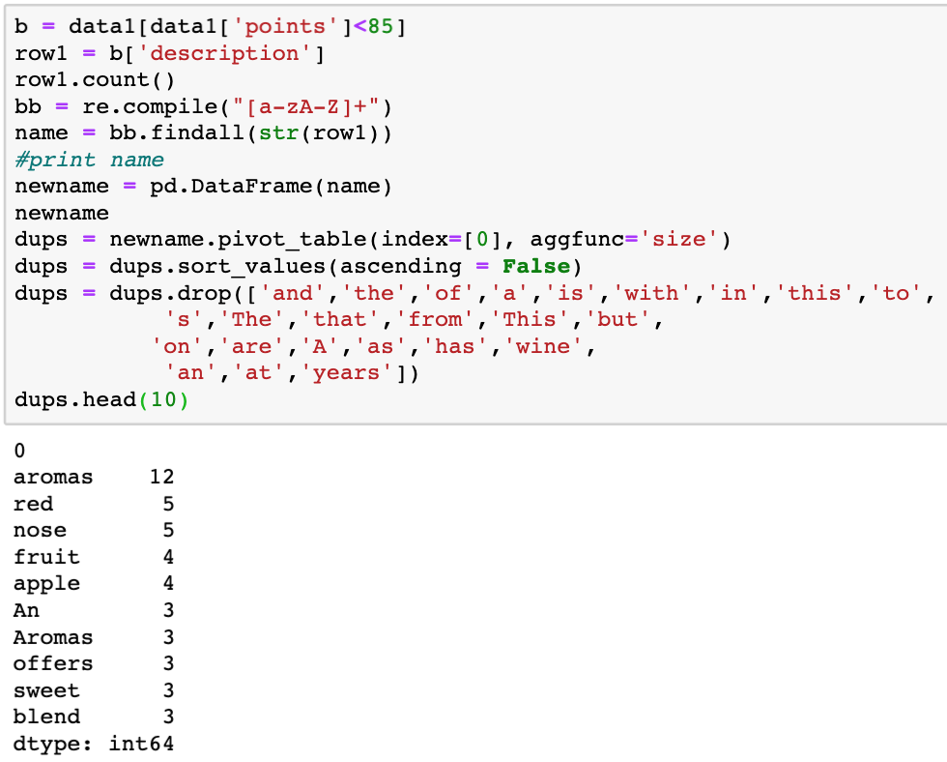
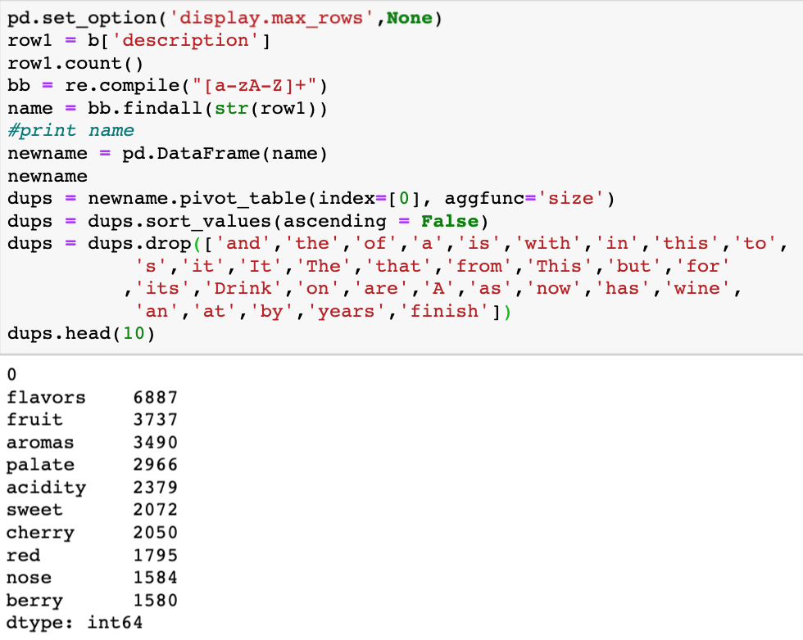
Challenge

Slide 11
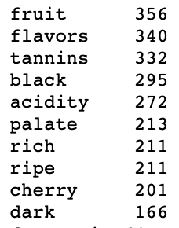
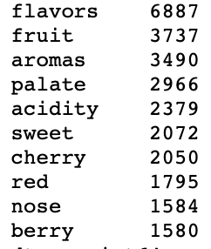

Key Words
95+
85+

Slide 12
Summary
-Higher HDI, Higher Alcohol Consumption, Higher Wine Consumption
-Higher rated wine generally have a higher price
-Adjust your inventory according to your target clients
-Features of higher rated wine, grape type, flavor, etc

