Slide 1
Reactive 3D Navigation
Jing Lu, Manuel Ruder

Slide 2
Motivation
Limited capability of laser scan
  Can only see in one plane
  May miss obstacles slightly above or below this plane
Kinect camera can see much more
  But limited visual angle
Our project:
Navigation based on Kinect camera

Slide 3
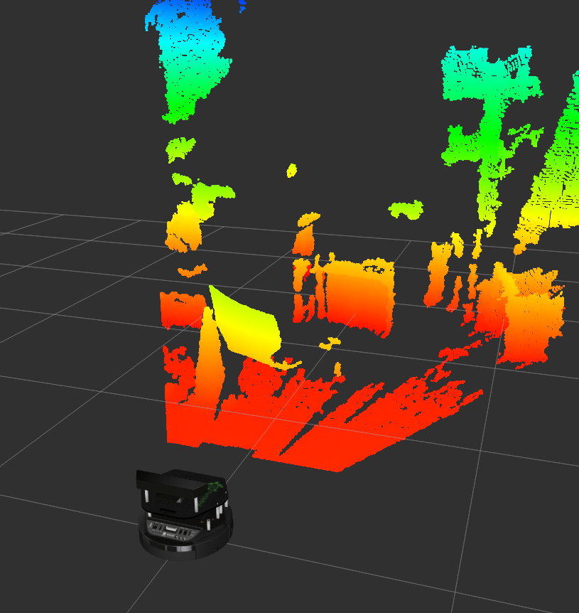
Kinect point cloud

Slide 4
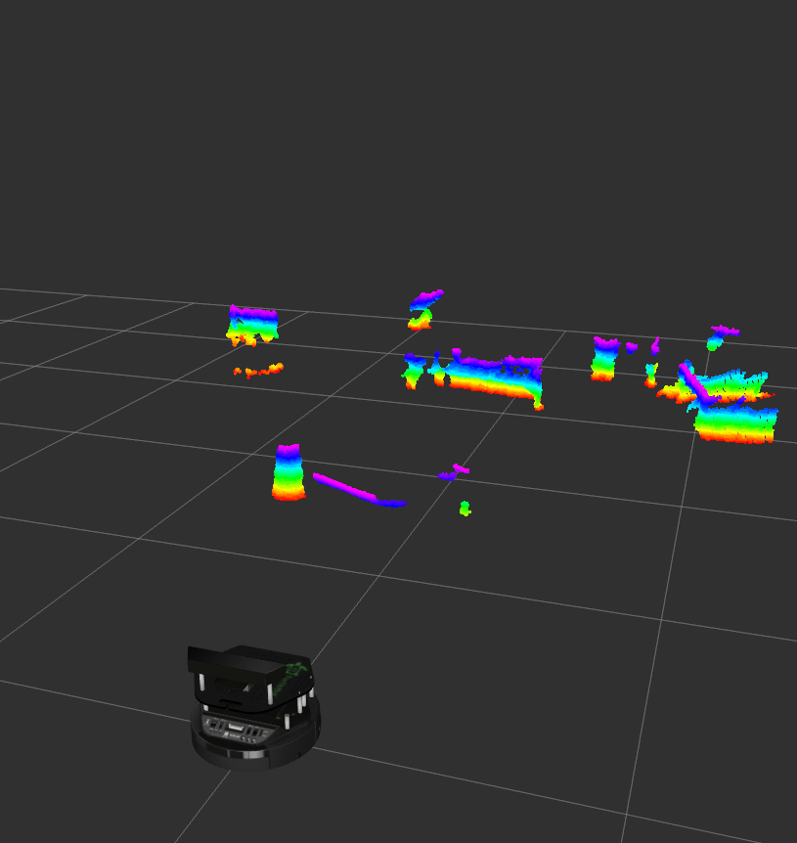
Kinect point cloud ground filtered
Min height:
0.2 m
Max height: 0.4 m

Slide 5
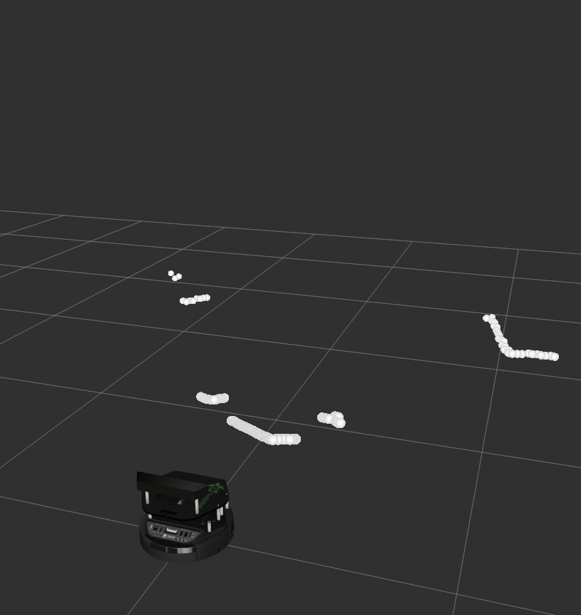
Point cloud to laser scan

Slide 6
Limited viewing angle
Create local map of the environment
Based on a circular buffer

Slide 7

Circular buffer
External view | -4 | -3 | -2 | -1 | 0 | 1 | 2 | 3 | 4
Array index | 0 | 1 | 2 | 3 | 4 | 5 | 6 | 7 | 8
External view | 4 | -4 | -3 | -2 | 1 | 0 | 1 | 2 | 3
Array index | 0 | 1 | 2 | 3 | 4 | 5 | 6 | 7 | 8

Slide 8
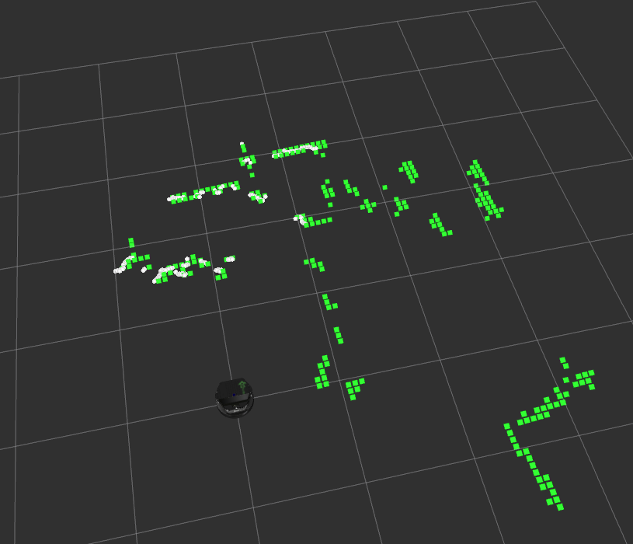
Occupancy map

Slide 9
Navigation
Create distance map to navigate around obstacles

Slide 10
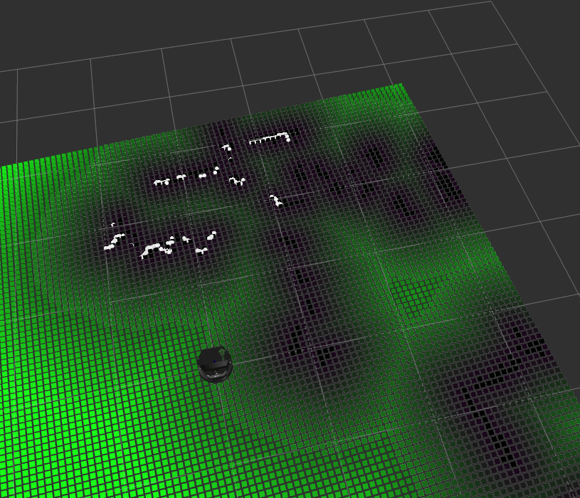
Distance map

Slide 11
Navigation algorithm

Slide 12
Navigation algorithm
Find path with lowest distance to goal
For each path require at least 35 cm distance to obstacles

Slide 13
Thank you for your attention!

