Slide 1
GrowHaus Project
Jinru Ma & Moran Wang

Slide 2

Introduction
A non-prot urban greenhouse company who focus on food production, distribution, and education.
The company is located in northern Denver and provide lots of their services for Denver areas.
The project shows data of three years. (2015,2016,2017)
Website: https://www.thegrowhaus.org/

Slide 3
Objective
Understand production
Predict revenue or food box
To help key stakeholders, we have created revenue KPI as references.

Slide 4
Data
Selected 3 out of 12 sheets from Growhaus’ Data
Service Learning
Students‘ education
Revenue
Food box
Type
Places
Revenue
Market
Zones Total Sales
Revenue
Notes:
Basic boxes
Family boxes

Slide 5
Data
Data Cleaning activity (in R):
converting date from factor to date format to manipulate the date and draw time series graph
removing all $ signs from original data.
removing all redundant string information
About missing values:
checking missing values
deleting missing values when each row is missing

Slide 6
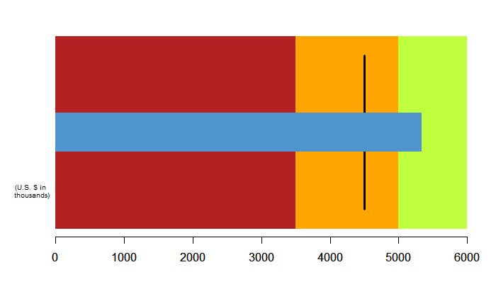
Service Learning
Service Learning Revenue KPI : reference point is 4500 and the three levels of background are 3500,5000 and 6000.

Slide 7
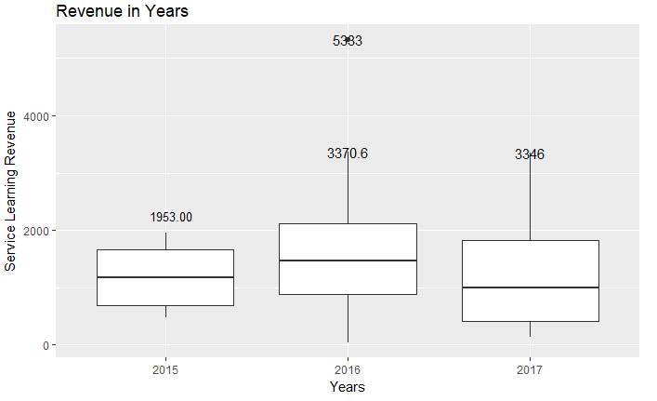
Service Learning
Service Learning Revenue in 2015
Min. 1st Qu. Median Mean 3rd Qu. Max.
479.5 682.0 1178.0 1147.0 1660.0 1953.0
Service Learning Revenue in 2016
Min. 1st Qu. Median Mean 3rd Qu. Max.
40.0 885.8 1464.0 1731.0 2110.0 5333.0
Service Learning Revenue in 2017
Min. 1st Qu. Median Mean 3rd Qu. Max.
140.0 409.0 991.5 1225.0 1819.0 3346.0
The residual is the point 5333 in Nov 2016.

Slide 8
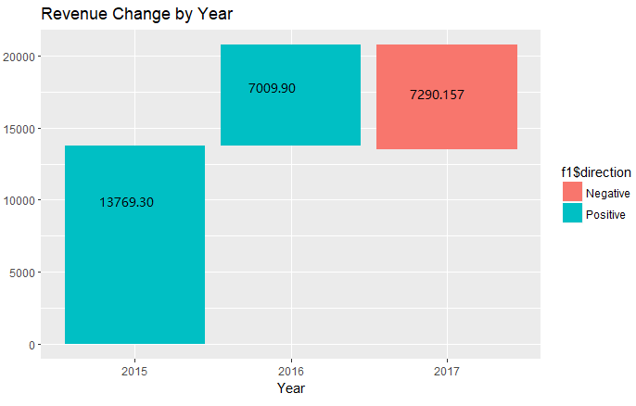
Service Learning
Notes:
And we found the total number of students decrease 494 from 2015 to 2016, less students but more revenue. We wondering if total number of students decide the service learning revenue.
Missing value on 2017 December. August 0 revenue. June and July low revenue.

Slide 9
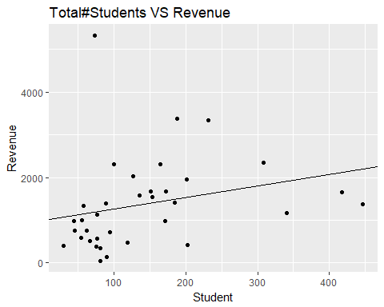
Service Learning Revenue
The linear square line is y = 2.686 x + 991.115
The adjusted r square is 0.03.

Slide 10
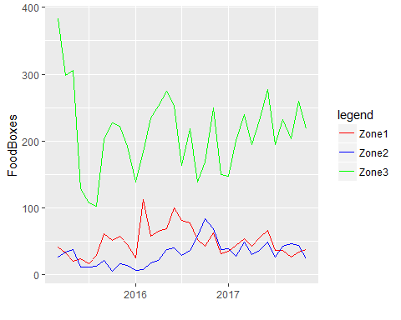
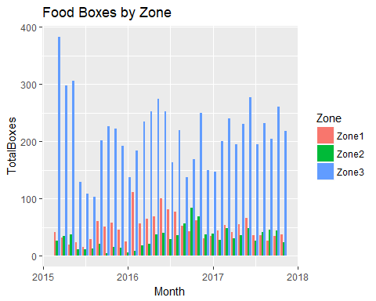
Food Box
Notes:
People in Zone3 are more free on picking up boxes

Slide 11
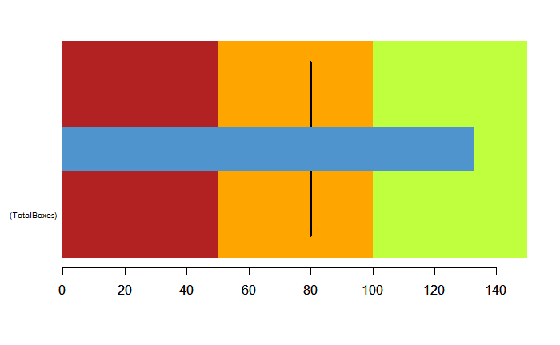
Food Box
Total Food Boxes : The reference point is 80. The three levels of background are 50,100 and 150. The blue bar reach to the green level which is the excellent level. The critical black line is the target value. The target value is 80

Slide 12
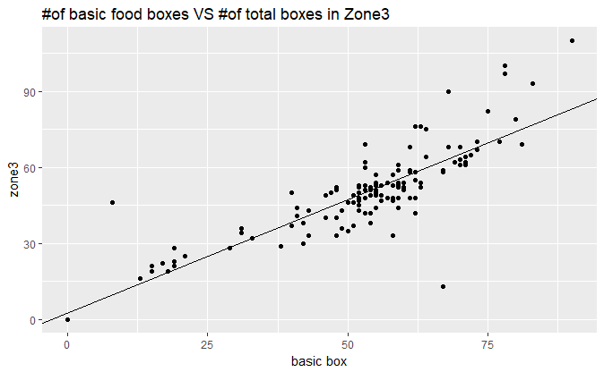
Food Box
Hypothesis test:
is zone3 total boxes linearly related to number of basic boxes?
The linear fitted line is y = 0.89559 x + 2.51331.
Adjusted R square is 0.7367.
Notes:
The R square is good. the number of family boxes can predict the number of boxes in zone 3 well. All the x variables (the number of basic boxes) can explain 73.67% variation in number of boxes in zone 3.

Slide 13
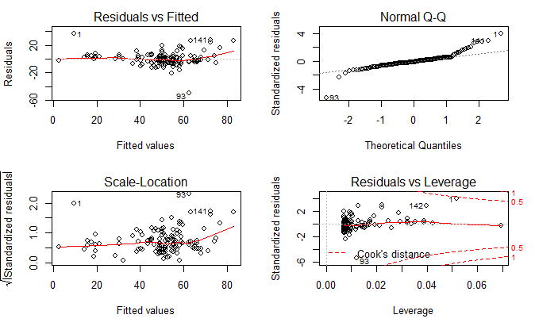
Food Box
There is no obvious pattern in the residuals & fitted graph. This means the number of basic boxes has linear relationship with total boxes in zone 3.
The residuals looks like normal distribution by looking the Normal QQ plot

Slide 14
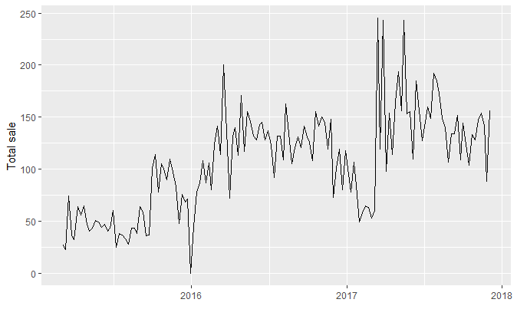
Market
Total Sales change by Month year

Slide 15
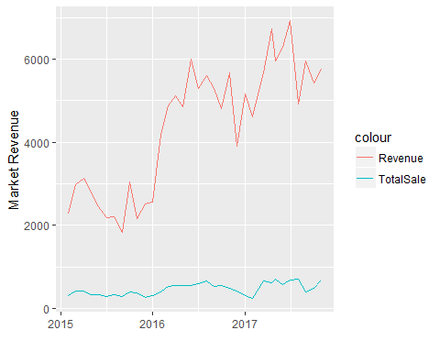
Market -- Total Sale VS Revenue
Notes:
By checking their website, we found that around 75% of their income is from contribution.

Slide 16
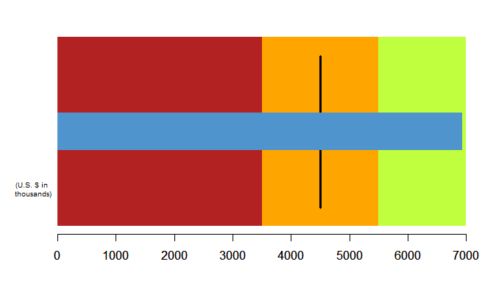
Market
The reference point of this graph is 4500, the three levels of background are 3500,5500 and 7000. The blue bar reach to the green level which is the excellent level. The critical black line is the target value. The target value is 4500.

Slide 17
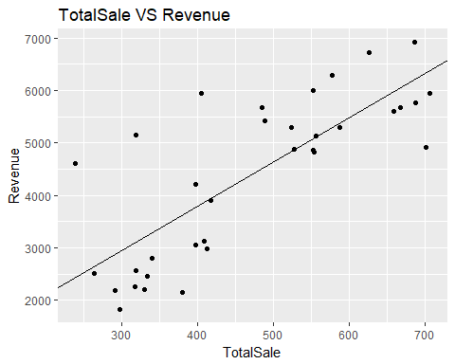
Market
Is total sale linearly related to revenue?
y = 8.431 x + 419.221.
Adjusted R square is 0.5983

Slide 18
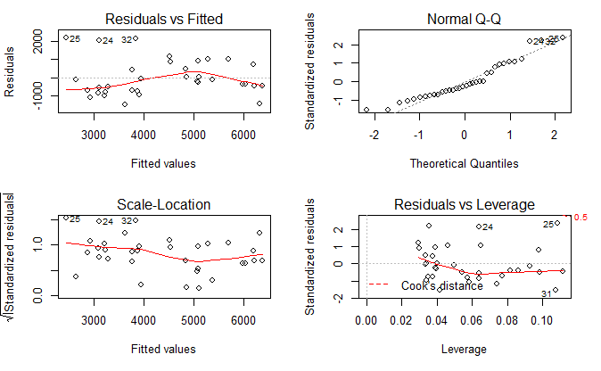
Market
There is no obvious pattern in residuals vs fitted graph. The relation between total sales and revenue are linear. From the Normal Q-Q graph, the residual is not normal distribued.

Slide 19
Conclusion
Number of basic food box can be used to predict the number of total boxes delivering to zone3.
Use total sales to predict revenue.

