Slide 1

InterventionROP-Edge: Do-Calculus-Constrained Threshold-Aware Orchestration for ROP Triage in Neonatal Edge-IoT
Causal urgency estimation, masked deep Q-learning, and digital twin counterfactuals for neonatal intensive care networks
Notes:
This talk presents InterventionROP-Edge, a framework that schedules retinal imaging, offloading, and bandwidth in a neonatal intensive care unit according to the interventional urgency of each infant. The results are reported honestly, including where the strongest baseline wins.

Slide 2
Treatment timing decides ROP outcomes
Once an infant crosses the ICROP treatment threshold, every hour of delay matters.
Incubator sensors and retinal cameras generate data continuously, but a 250 kb/s link shared by many incubators cannot move every image at once.
The scheduler must decide whose image goes first, where it is analyzed, and how much bandwidth it receives.
188
484
infants in the public Ostrava cohort
screening series with ICROP diagnoses
20
180 s
incubator nodes on 3 gateways
triage deadline per image
Notes:
The clinical problem is timing. The network problem is a low-rate shared link. The orchestration problem connects the two.

Slide 3




Four coupled challenges block threshold-aware orchestration
C1 Confounded priorities
C2 Low-rate wireless links
Oxygen exposure drives both treatment and spontaneous regression, so association-based priorities misrank infants.
Images of 200 to 600 kB cross an 802.15.4 link with fading, shadowing, and interference bursts.
C3 Battery coupling
C4 No clinical guarantee
Capture, transmission, and local inference drain incubator nodes, linking decisions across rounds.
Learning orchestrators optimize generic rewards and can starve a high-risk infant during exploration.
Notes:
These challenges compound. Removing confounding needs an interventional estimate, that estimate must change transport decisions, and protecting high-risk infants costs energy.

Slide 4




Contributions
System model and problem
20-node NICU network with O-QPSK packet errors, shadowing, interference, three compute tiers, and batteries; joint control proven NP-hard.
GA-stratified causal urgency
Back-door set {GA, oxygen, stage} found by d-separation search; counterfactual effects mapped to a monotone urgency score.
Masked orchestration
Double DQN with urgency-weighted replay, digital twin counterfactuals, and an action mask giving high-risk infants at least twice the bandwidth share.
Honest held-out validation
Five re-implemented baselines, 10 held-out seeds, paired Wilcoxon tests, and an ablation of every component.
Notes:
Four contributions: the model, the causal urgency, the masked controller, and a validation that reports the metrics where the strongest baseline remains ahead.

Slide 5
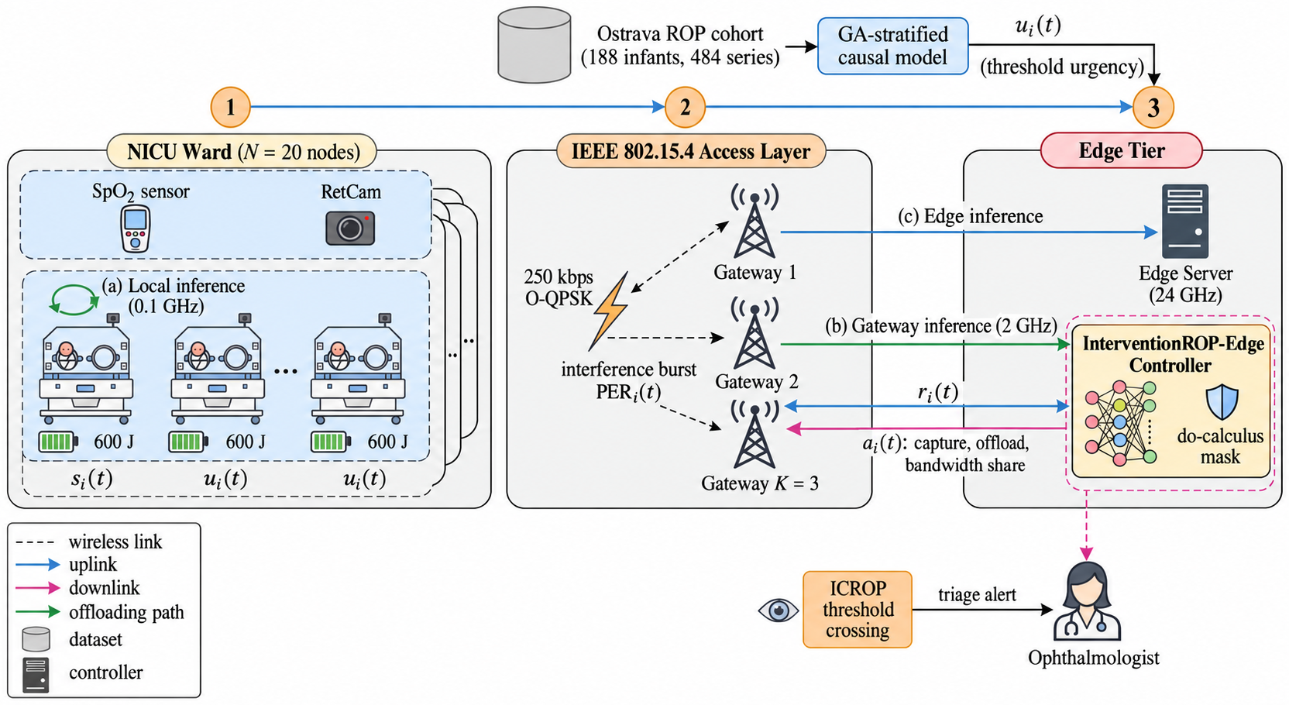
System model: a NICU edge network with three compute tiers
Each round (60 s) the controller chooses per node:
Capture level: 0.5x, 1x, or 1.6x
Offload: local 0.1 GHz, gateway 2 GHz, or edge 24 GHz
Bandwidth priority with weight 1, 2, or 4
Objective: clinical reward that penalizes crossing delay, pending crossings, and energy
Notes:
Nodes attach to the nearest of three gateways. Bandwidth shares are the normalized priority weights per gateway. Local inference costs 2.4 J and 40 s, so offloading saves energy when the link allows.

Slide 6
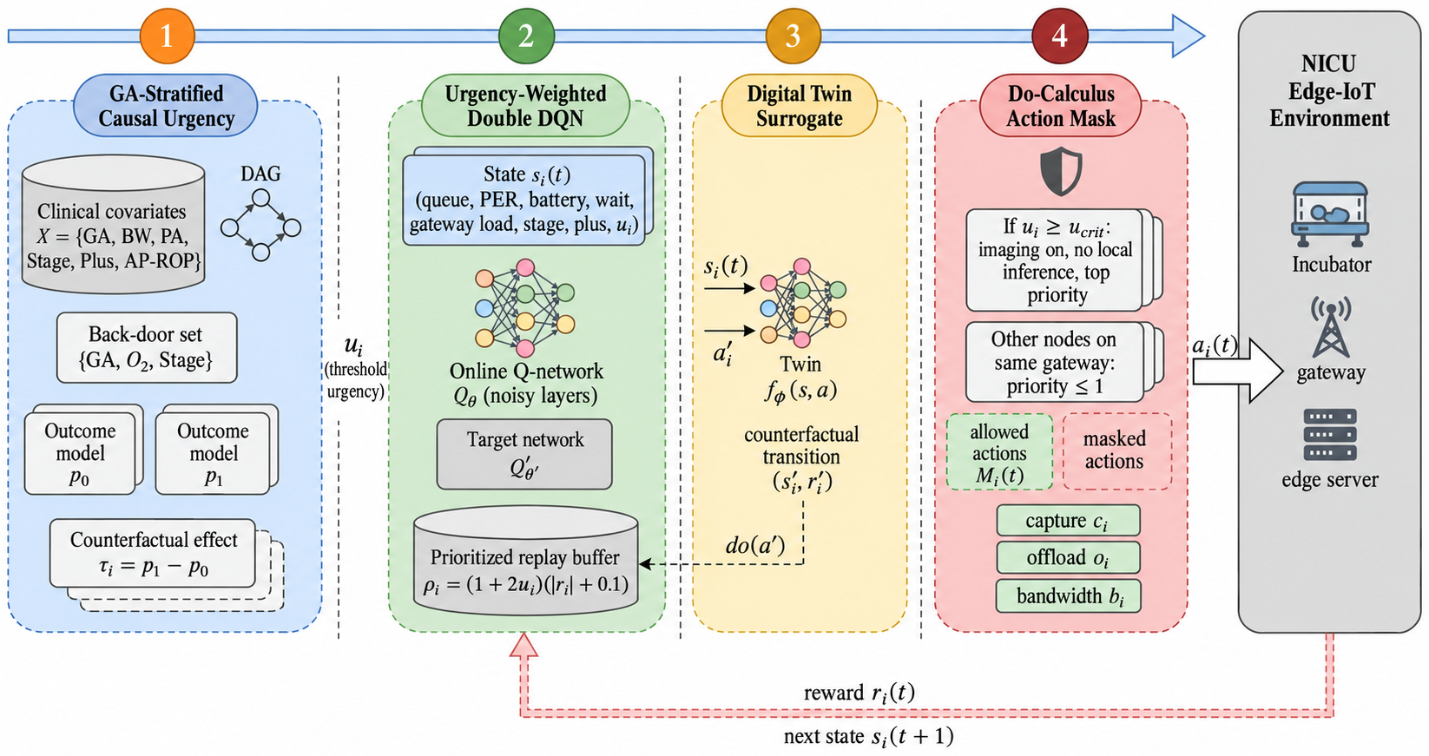
InterventionROP-Edge works in four stages
1
Causal urgency per infant
2
Urgency-weighted double DQN
3
Digital twin counterfactuals
4
Do-calculus action mask
Notes:
Stage 1 runs offline on the clinical table. Stages 2 to 4 run every round. The mask applies both when acting and inside the learning target.

Slide 7
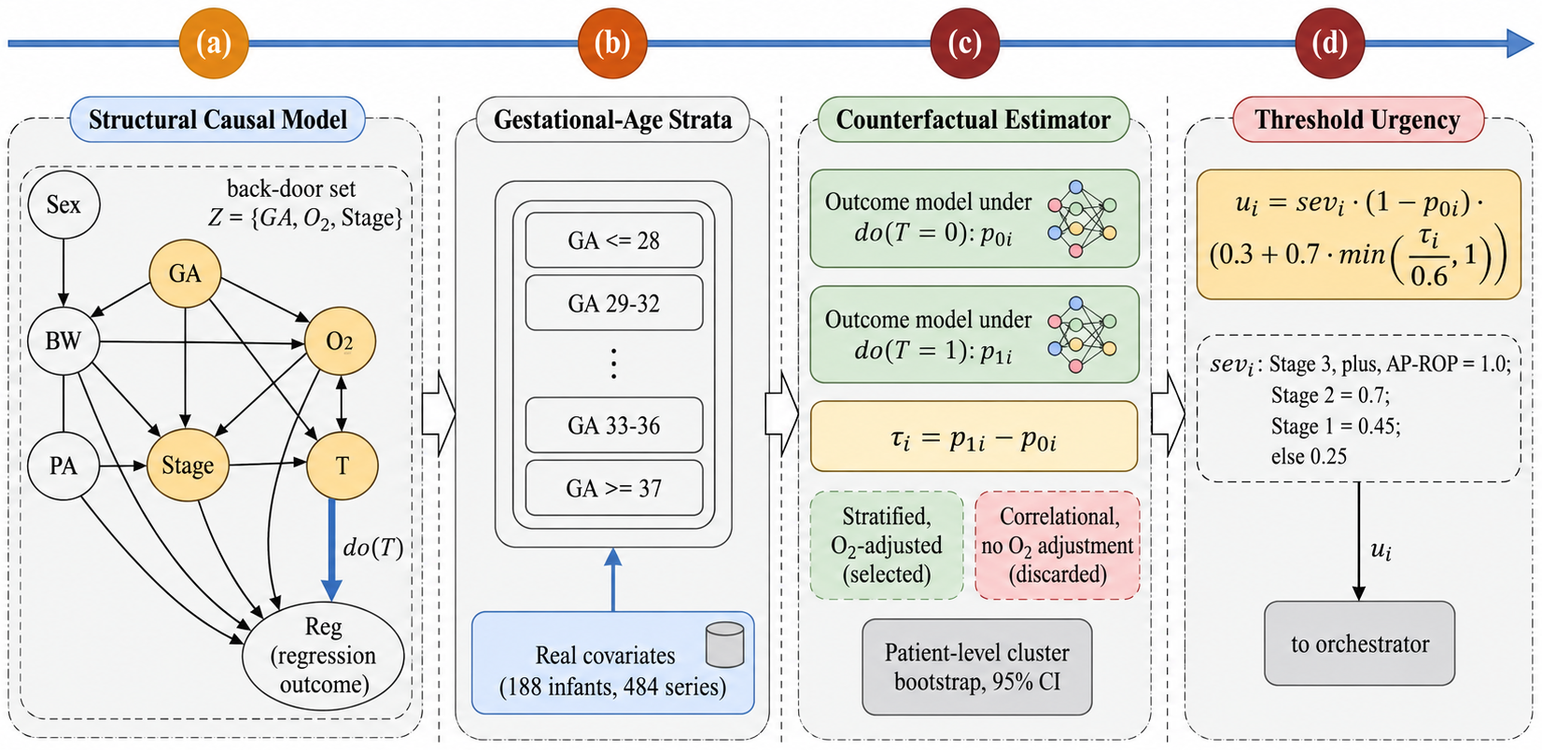
Stage 1: GA-stratified counterfactual urgency
Notes:
The structural causal model has oxygen as a confounder of treatment and regression. The minimal back-door set is gestational age, oxygen, and stage. Two outcome models estimate regression under do(T=0) and do(T=1), and the urgency combines severity, untreated risk, and benefit. The mapping is monotone, which we prove as a lemma.

Slide 8
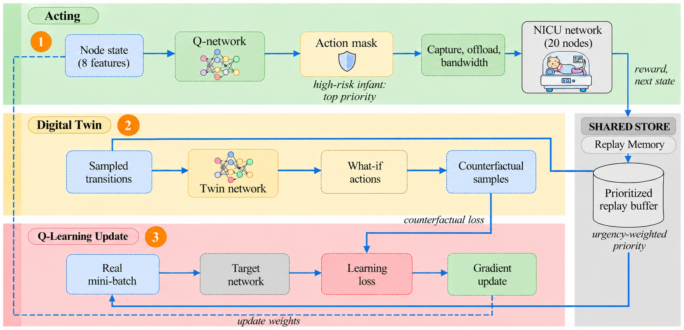
Stages 2 to 4: masked Q-learning and twin
Mask guarantee
A high-risk infant (urgency at least 0.15) always keeps imaging on, never falls back to slow local inference, and receives at least 2x the bandwidth share of any other infant on its gateway.
27 joint actions: 4 allowed for a high-risk infant, 18 for its gateway neighbors
Notes:
The bandwidth bound holds for any network weights, including the untrained initialization, so protection does not depend on training quality. The price is fewer energy-saving options.

Slide 9
Evaluation protocol
Aspect | Setting
Clinical data | Real covariates of 188 infants (484 series); semi-synthetic oxygen, treatment, and outcomes
Causal set-up | 457 series, 27 treated; oxygen confounding strength 1.5; 200 cluster bootstrap replicates
Network | 20 nodes, 3 gateways, 250 kb/s, O-QPSK, 4 dB shadowing, 10% interference bursts
Training | 100 episodes of 200 rounds; batch 128; buffer 60,000; target sync every 200 rounds
Evaluation | Held-out seeds 6000 to 6009 (400 rounds); lifetime seeds 8000 to 8002 with 300 J
Baselines | HGAT-PPO, PPO-RA, PD-NoisyDQN, DT-QMIX, JOFO-FedDQN on the same action space and urgency input
Notes:
Design checks used validation seeds 9000 to 9004, which never enter the reported numbers. Outcomes are semi-synthetic because counterfactuals are never observed in real data.

Slide 10
Urgency ranking is reliable; effect magnitudes are not
Only 5 infants are treatment-indicated, so effects are identifiable mainly in the GA 28 weeks or younger stratum (24 of 27 treated series).
Notes:
All three estimators reach attribution precision 0.800 and AUROC 0.775 against an oracle of 0.889 and 0.875. Oxygen adjustment does not lower the estimation error on this cohort.

Slide 11
Head-to-head on 10 held-out seeds
25.2% lower crossing latency than the baseline mean, yet PD-NoisyDQN is stronger in latency, QoS (86.77 vs 78.49), and deadline rate (0.989 vs 0.920).
Notes:
Our controller sits between the strongest and weakest learners. HGAT-PPO has the lowest energy at the cost of high latency.

Slide 12
Where the gains are significant
Baseline | Latency | Energy | QoS | Deadline
HGAT-PPO | -34.3% (p=0.002) | +50.0% (p=0.002) | +2.1% (p=0.322) | +8.3% (p=0.002)
PPO-RA | +8.9% (p=0.695) | -12.7% (p=0.002) | -4.4% (p=0.037) | +2.0% (p=0.193)
PD-NoisyDQN | +31.5% (p=0.049) | +7.3% (p=0.002) | -9.5% (p=0.002) | -7.0% (p=0.002)
DT-QMIX | +26.6% (p=0.322) | -3.1% (p=0.027) | -4.8% (p=0.027) | -4.8% (p=0.002)
JOFO-FedDQN | -62.8% (p=0.006) | +41.3% (p=0.002) | +8.2% (p=0.014) | +16.2% (p=0.002)
Green significant gain Red worse Gray not significant (paired Wilcoxon, 10 seeds)
Notes:
Latency and energy are relative changes, negative is better. QoS and deadline, positive is better. With 10 pairs the smallest attainable p value is 0.002.

Slide 13
Best in small wards and clean channels, weaker at scale
JOFO-FedDQN omitted for scale (up to 2964 s). Five-seed means.
Notes:
At 10 nodes we reach the lowest crossing latency, 190.5 s versus 220.0 s for PD-NoisyDQN. At 40 nodes the fixed mask threshold protects too many nodes per gateway. On degraded channels the mask forbids local inference for high-risk infants, which hurts.

Slide 14
Premature-heavy wards and battery lifetime
Lowest crossing latency under the shift (within 0.6% of DT-QMIX, inside seed spread) and 25.1% longer lifetime than PD-NoisyDQN.
Notes:
The shifted ward samples infants of 28 weeks or younger four times more often. HGAT-PPO and JOFO-FedDQN live longer because they spend less energy per round.

Slide 15


Ablation: what each component contributes
Helps
GA stratification: without it latency +12.4%, energy +56.8%, QoS -7.31. Urgency replay: lowers energy by 16.6%.
Trades off
Mask, twin, and oxygen adjustment shift one metric against another without a net gain in this setting.
Notes:
Removing the mask lowers energy by 5.0% and raises QoS by 3.36 points at 2.3% higher latency. Removing the twin lowers latency by 12.5% at 10.8% higher energy.

Slide 16



Limitations to state openly
Semi-synthetic outcomes
Few treated infants
Effect sizes are modeling assumptions calibrated to treatment and regression rates.
Five treatment-indicated infants confine identification to the youngest stratum.
No image processing
Simulated network
Retinal images are not analyzed; inference enters only as a compute cost.
Baselines re-implement each line's core mechanism, not the original code.
Notes:
These limits bound every conclusion of the study and are listed in the paper.

Slide 17
Takeaways and next steps
25.2% lower threshold-crossing latency than the baseline mean; up to 62.8% against individual baselines
Provable bandwidth protection for high-risk infants; stratification and urgency replay carry the gains
Next: learn the mask threshold with constrained RL, make offloading channel-aware, validate on larger treated cohorts and real images
Notes:
The strongest baseline, a prioritized noisy DQN, still leads in latency and service quality, which points to the mask threshold and offloading clause as the components to redesign next.

