Slide 1
IEEE TRANSACTIONS ON MOBILE COMPUTING
RematSplit
Recompute or Transmit Activation Management for Memory Constrained Split Fine Tuning of LLMs on Mobile Devices
1.46× longer sequences than checkpointing 31.8% lower energy 3.1% memory prediction error
Notes:
Introduce RematSplit: per sublayer activation management for split LoRA fine tuning on memory constrained mobile devices, evaluated with Mistral 7B, LongAlpaca 12k and real 5G traces.

Slide 2
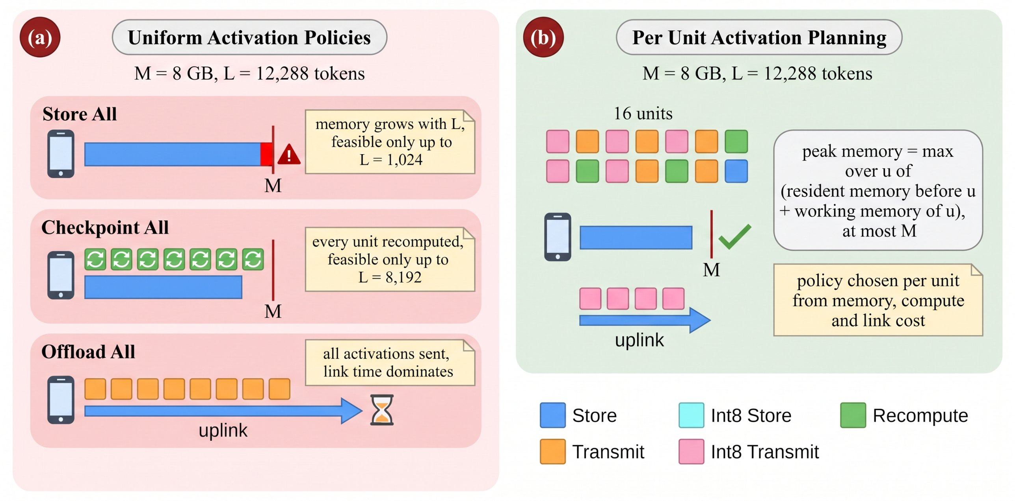
MOTIVATION
Activations cap the trainable context
RematSplit | IEEE TMC
2
Notes:
In split fine tuning the device keeps its layers' activations until the gradient returns. At L = 2048 the eight device layers of Mistral 7B already hold 4.67 GB of activations; this grows linearly with context and exceeds phone memory long before weights do. Recompute costs device compute and energy; transmitting costs link time. The right choice differs per sublayer and per link state.

Slide 3
PROBLEM
Four challenges in activation management
C1 Exact peak memory
C2 Combinatorial choice
Peak is set by forward, window and backward phases jointly; a sum of sizes is not enough to guarantee the budget.
Five policies per sublayer over 2K units; the minimum energy plan is NP hard.
C3 Time varying link
C4 Convergence with 8 bit
5G downlink fluctuates; the best plan at one rate is poor at another.
Quantized activations bias the gradient; the effect on training must be bounded.
RematSplit | IEEE TMC
3
Notes:
Each challenge maps to one component: C1 and C2 to the prefix sufficient planner, C3 to the online Hedge selector, C4 to the biased gradient analysis.

Slide 4
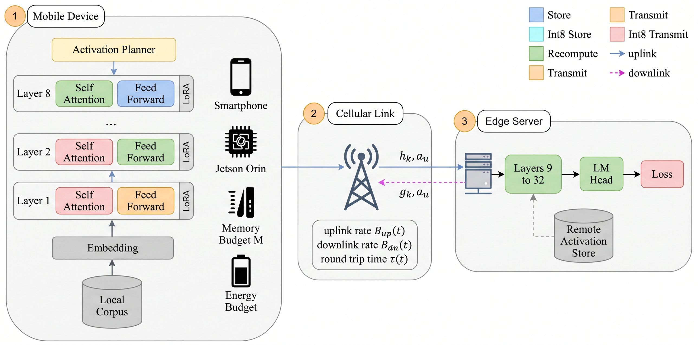
SYSTEM
System model: device, 5G link and edge server
RematSplit | IEEE TMC
4
Notes:
The device runs the first K = 8 of 32 Mistral layers with LoRA adapters; the server runs the rest and the loss. The cellular link carries smashed data, gradients, and optionally activations sent to a server side store and fetched back during backward.

Slide 5
METHOD
Five policies per activation unit
Each attention and feed forward sublayer is one activation unit.
Policies: store S, 8 bit store Q, recompute R, transmit T, 8 bit transmit TQ.
Each policy has measured resident memory, window memory, time and link bytes.
R and T are nearly exact; Q and TQ keep cosine above 0.9996.
Policy | Device MB | Link MB | Grad. error
Store S | 4777.1 | 0.0 | 0.0000
8 bit store Q | 1673.9 | 0.0 | 0.0276
Recompute R | 256.0 | 0.0 | 0.0100
Transmit T | 0.0 | 4777.1 | 0.0102
8 bit transmit TQ | 0.0 | 1673.9 | 0.0276
Uniform policies on Mistral 7B at L = 2048 (relative gradient error vs. store).
RematSplit | IEEE TMC
5
Notes:
Values from the gradient fidelity table. Recompute cuts device activation memory from 4.78 GB to 0.26 GB; transmit moves it all to the link; 8 bit halves both sides at a small gradient bias.

Slide 6
METHOD
Prefix sufficient optimal planner
NP hardness
Prefix sufficiency
Closed forms
Minimum energy plan under the forward, window and backward peak constraints reduces from multiple choice knapsack.
Feasibility of each policy depends on the past only through prefix resident memory, giving a DP over G = 400 memory bins that never violates the budget.
Pairwise dominance thresholds on downlink rate (T vs R, TQ vs T) and a closed form maximum trainable length.
RematSplit | IEEE TMC
6
Notes:
The DP is optimal for the discretized problem; bins are rounded conservatively so every returned plan is feasible on the device. At G = 400 the energy gap is at most 3.1 percent and planner time is 1.3 to 2.6 ms.

Slide 7
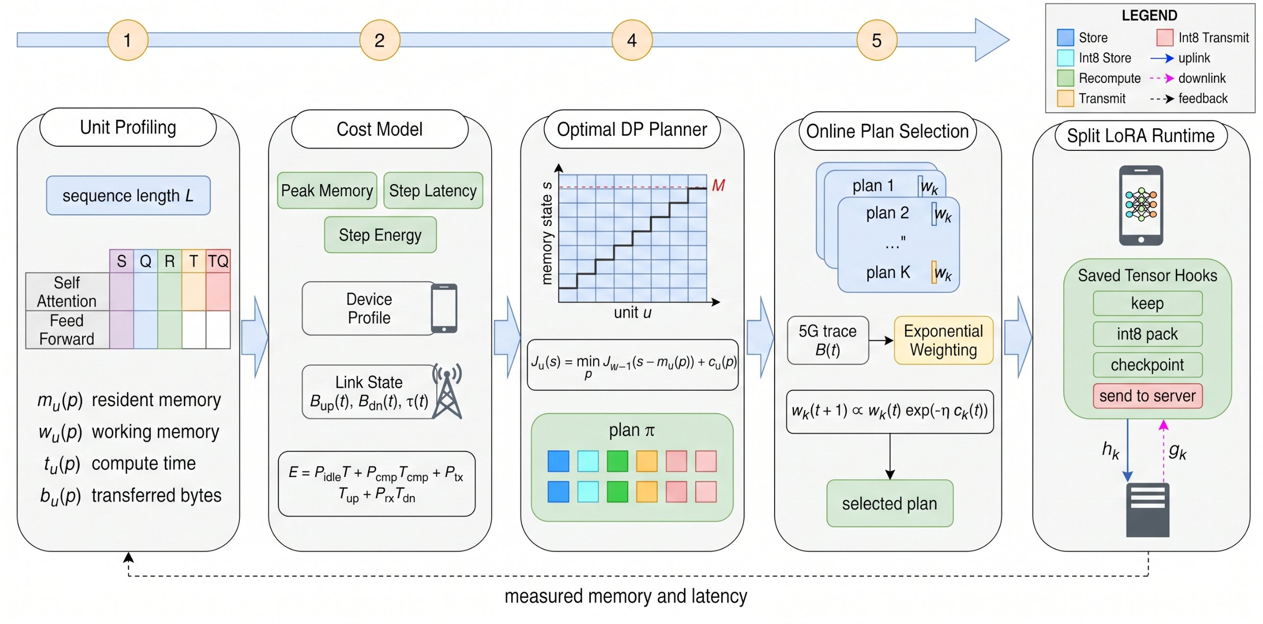
METHOD
RematSplit framework
RematSplit | IEEE TMC
7
Notes:
Offline profiling produces per unit memory and time; the planner builds a candidate plan set across link rates; the online selector picks a plan each step; the runtime enforces it with saved tensor hooks and non reentrant checkpointing.

Slide 8
THEORY
Online selection and convergence guarantees
Hedge plan selection (C3)
Biased gradient analysis (C4)
Exponential weights over candidate plans driven by observed step energy.
Regret against the best fixed plan grows as O(√Γ) on any link sequence, so average regret vanishes.
8 bit policies add a bounded per unit gradient bias.
Stationarity rate O(1/√Γ) and a linear rate under gradient domination, each with a floor proportional to the squared bias.
RematSplit | IEEE TMC
8
Notes:
Both results are adversarial or worst case; empirically the Hedge gap is 0.53 percent and RematSplit perplexity stays within 0.5 percent of both baselines.

Slide 9
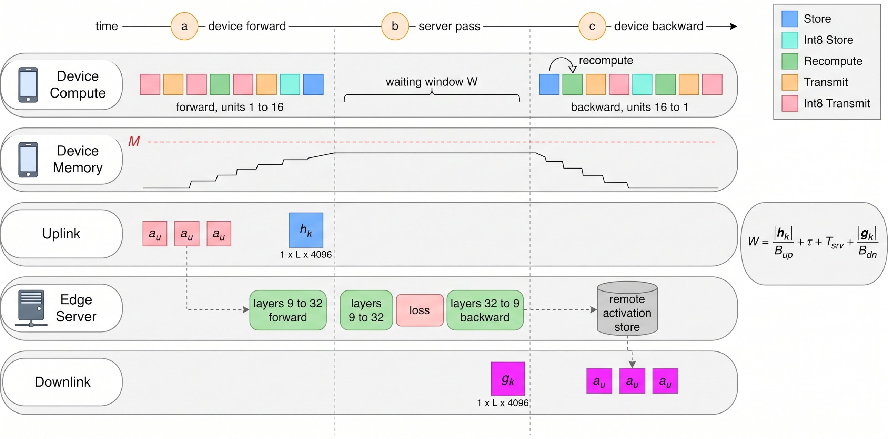
SYSTEM
Runtime: overlapping recompute and transfer
RematSplit | IEEE TMC
9
Notes:
Timeline of one step. Transmitted activations go to the server store during forward and are prefetched when the gradient returns; recompute runs in backward only for units assigned R.

Slide 10
EVALUATION
Experimental setup
Model
Mistral 7B, 32 layers, split K = 8, LoRA rank 16, bfloat16
Data
LongAlpaca 12k, 300 steps, AdamW 2e-4
Link
Real 5G traces: 43,208 records, median 12.07 Mbps, RTT 75 ms
Devices
Jetson Orin and smartphone profiles, budgets 6 to 16 GB
Baselines
Split LoRA (store), checkpoint all, offload all, greedy
RematSplit | IEEE TMC
10
Notes:
Real fine tuning ran on an A100; device energy and latency are emulated from measured unit profiles and replayed 5G traces. Sequence lengths range from 1024 to 32,768.

Slide 11
RESULTS
Longest trainable sequence at equal memory
1.46×
longer than full checkpointing
9.3×
longer than split LoRA
Store is infeasible at 6 GB.
RematSplit | IEEE TMC
11
Notes:
RematSplit matches offload all on length but at far lower energy. Removing transmit drops it to the checkpointing frontier, showing the gain comes from moving activations to the server store.

Slide 12
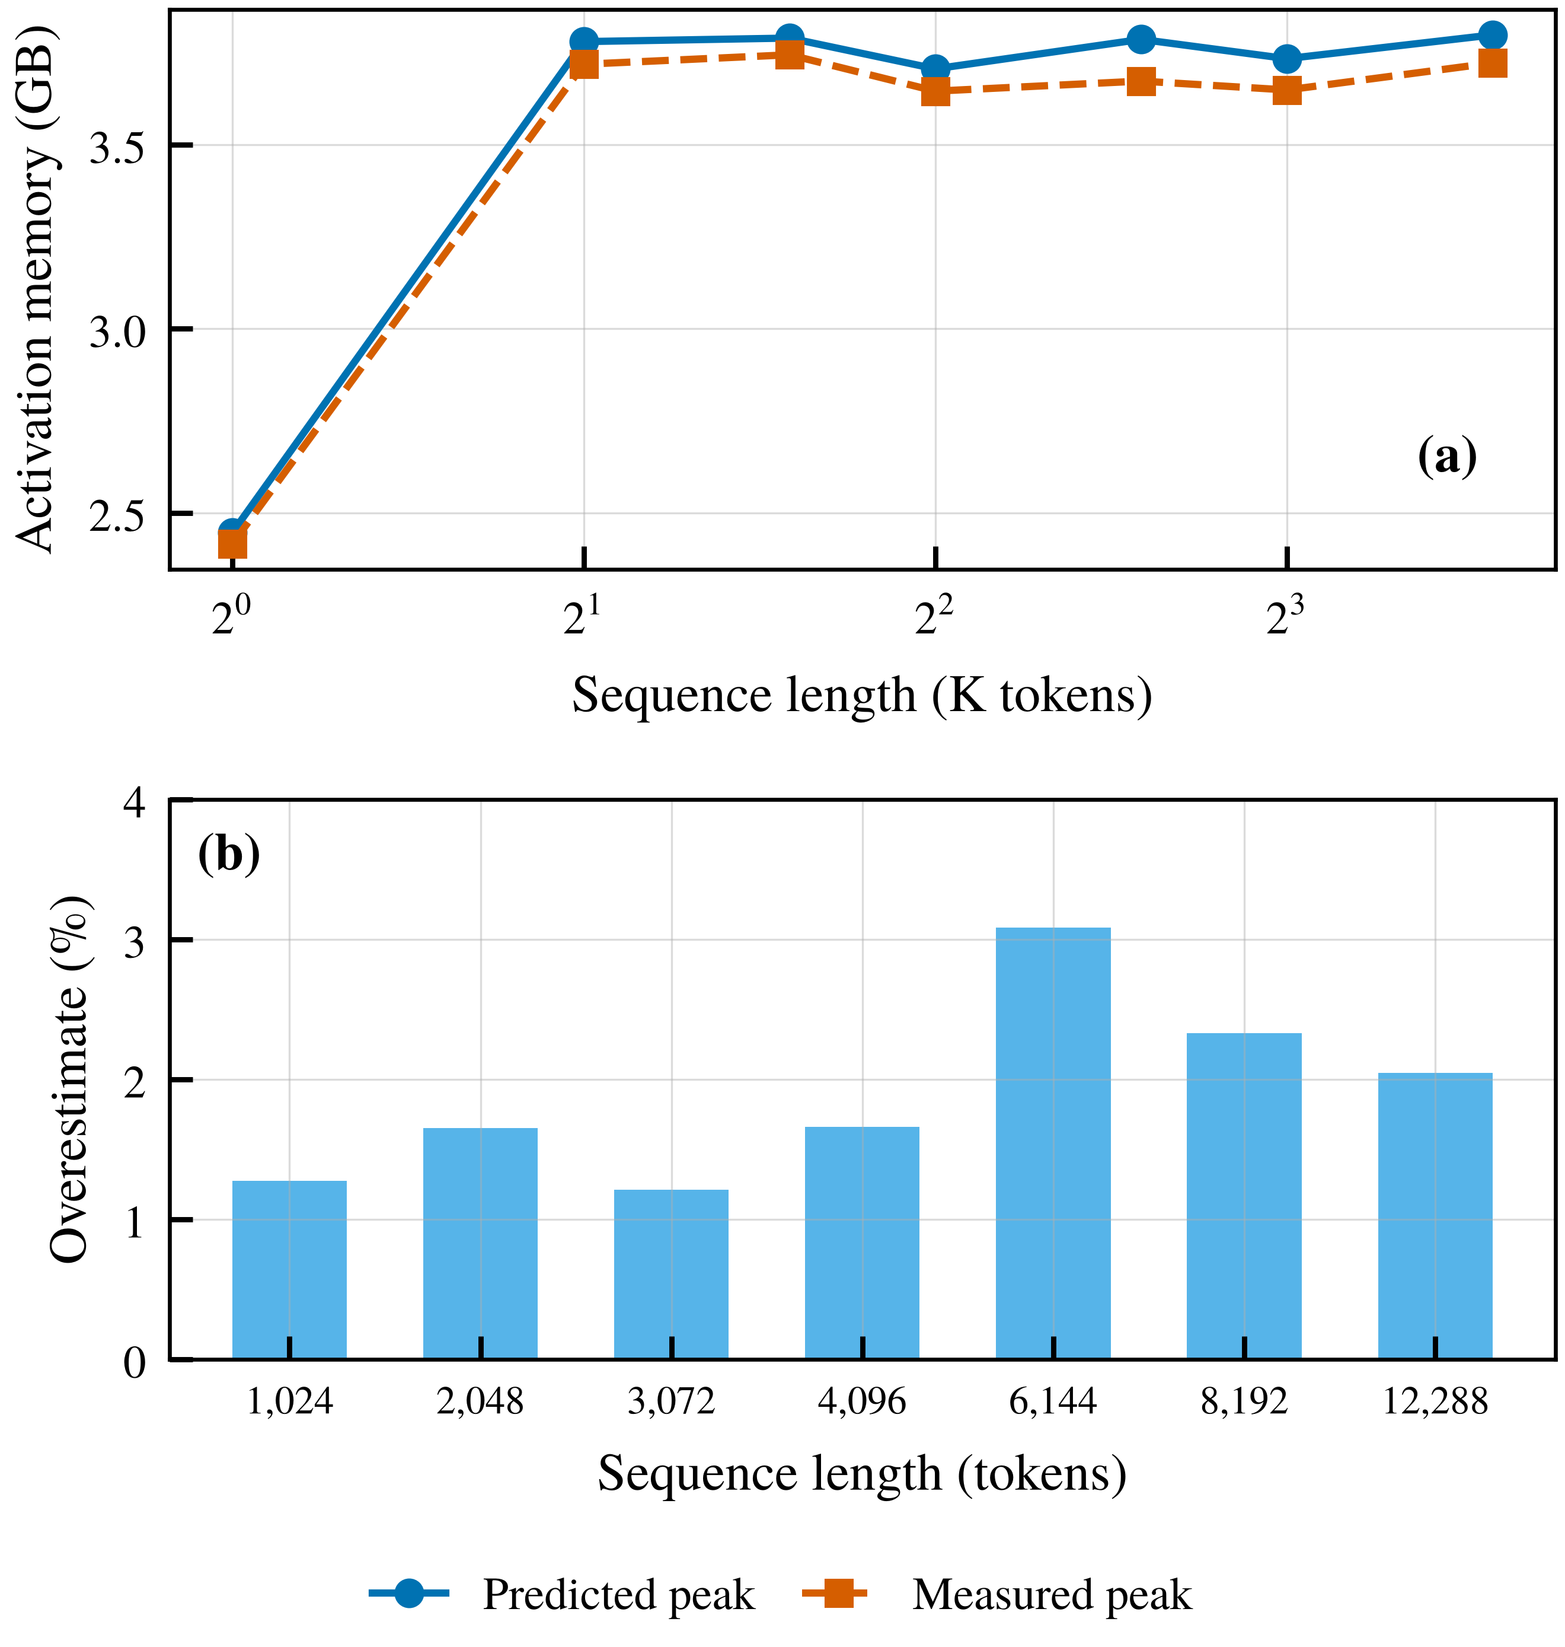
RESULTS
Peak memory model matches measurement
≤ 3.1%
error between predicted and measured peak memory
Forward, window and backward phases modeled jointly.
Budget never exceeded by any returned plan.
Activation memory 45.3% below store at L = 2048.
RematSplit | IEEE TMC
12
Notes:
This validates C1: the planner's feasibility check is trustworthy on real hardware.

Slide 13
RESULTS
Energy savings across split points and lengths
31.8%
max saving vs checkpointing
33 to 96%
saving vs offload all beyond the checkpoint limit
At 12,288 tokens: 3.79 kJ vs 7.14 kJ (offload all).
RematSplit | IEEE TMC
13
Notes:
Savings peak at K = 6 (26.8 percent) and shrink as K grows to 16 (4.2 percent).

Slide 14
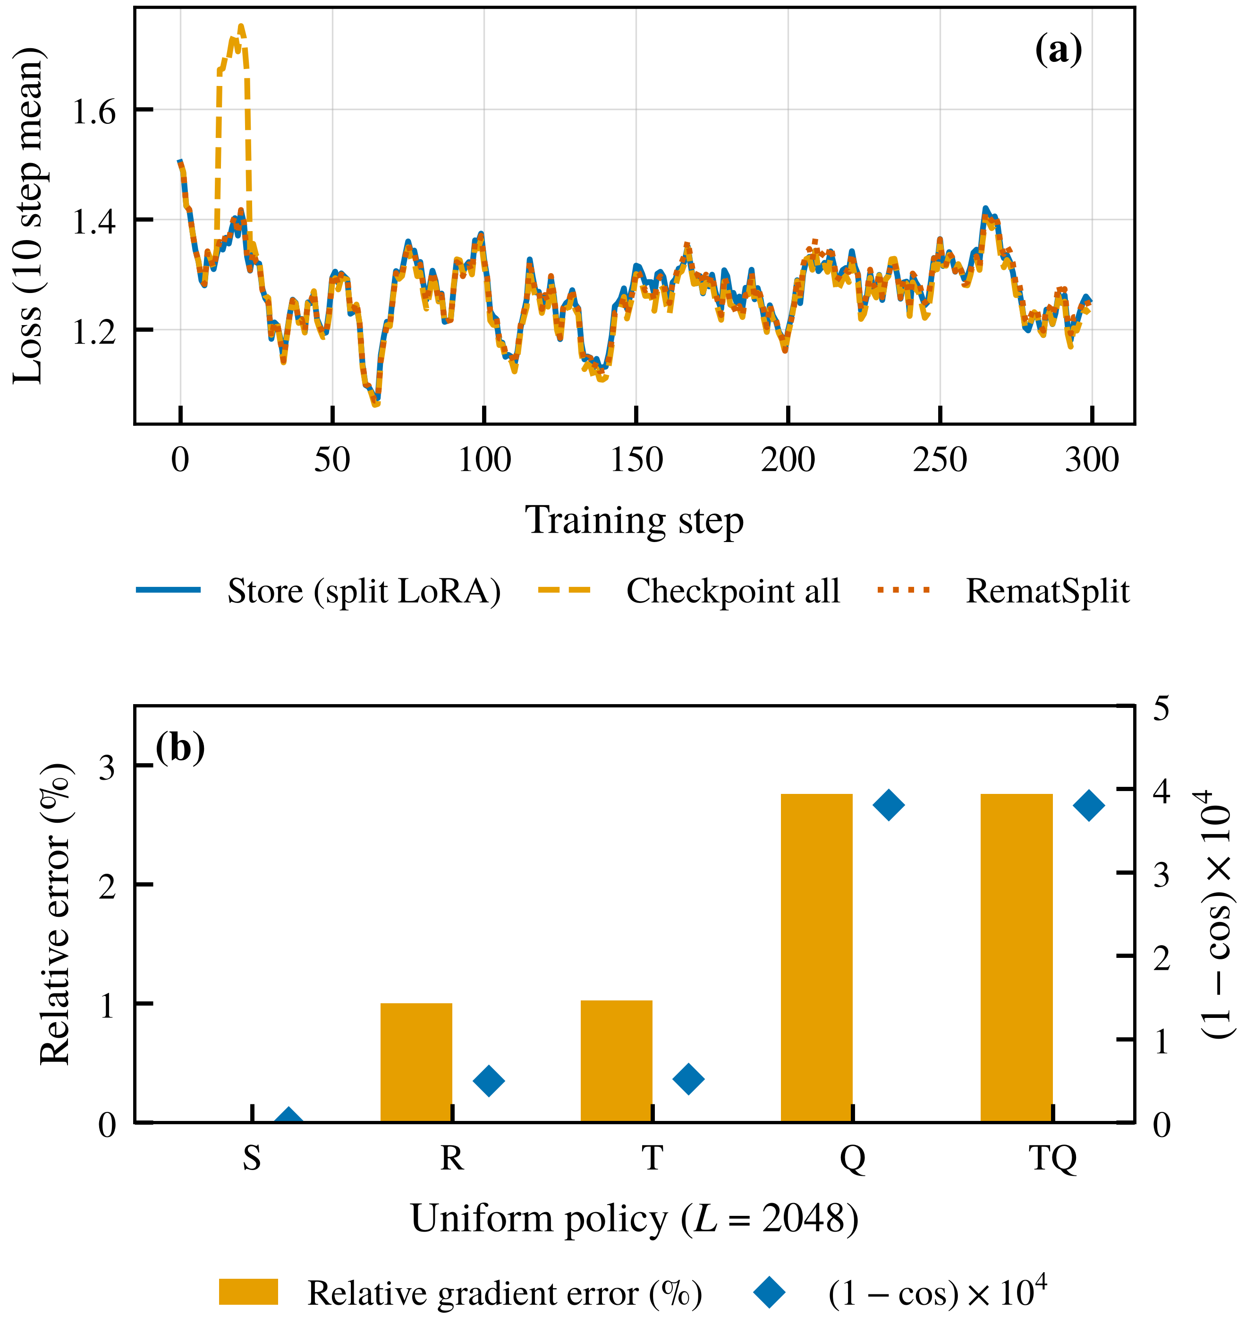
RESULTS
Fine tuning quality is preserved
Metric | Split LoRA | Checkpoint all | RematSplit
Perplexity after 300 steps | 4.147 | 4.110 | 4.130
Mean training loss | 1.2679 | 1.2710 | 1.2684
Device activation memory (GB) | 4.67 | 0.25 | 2.55
Device backward time (s) | 0.0808 | 0.1411 | 0.1109
Mistral 7B, LongAlpaca 12k, L = 2048; perplexity before fine tuning 4.344.
RematSplit | IEEE TMC
14
Notes:
RematSplit lowers device backward time by 21 percent relative to checkpoint all while reaching matched perplexity.

Slide 15
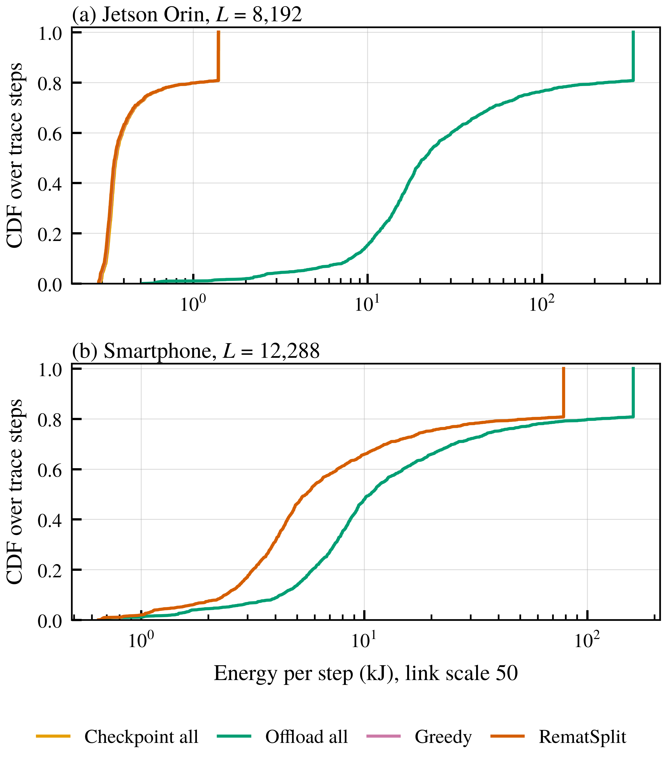
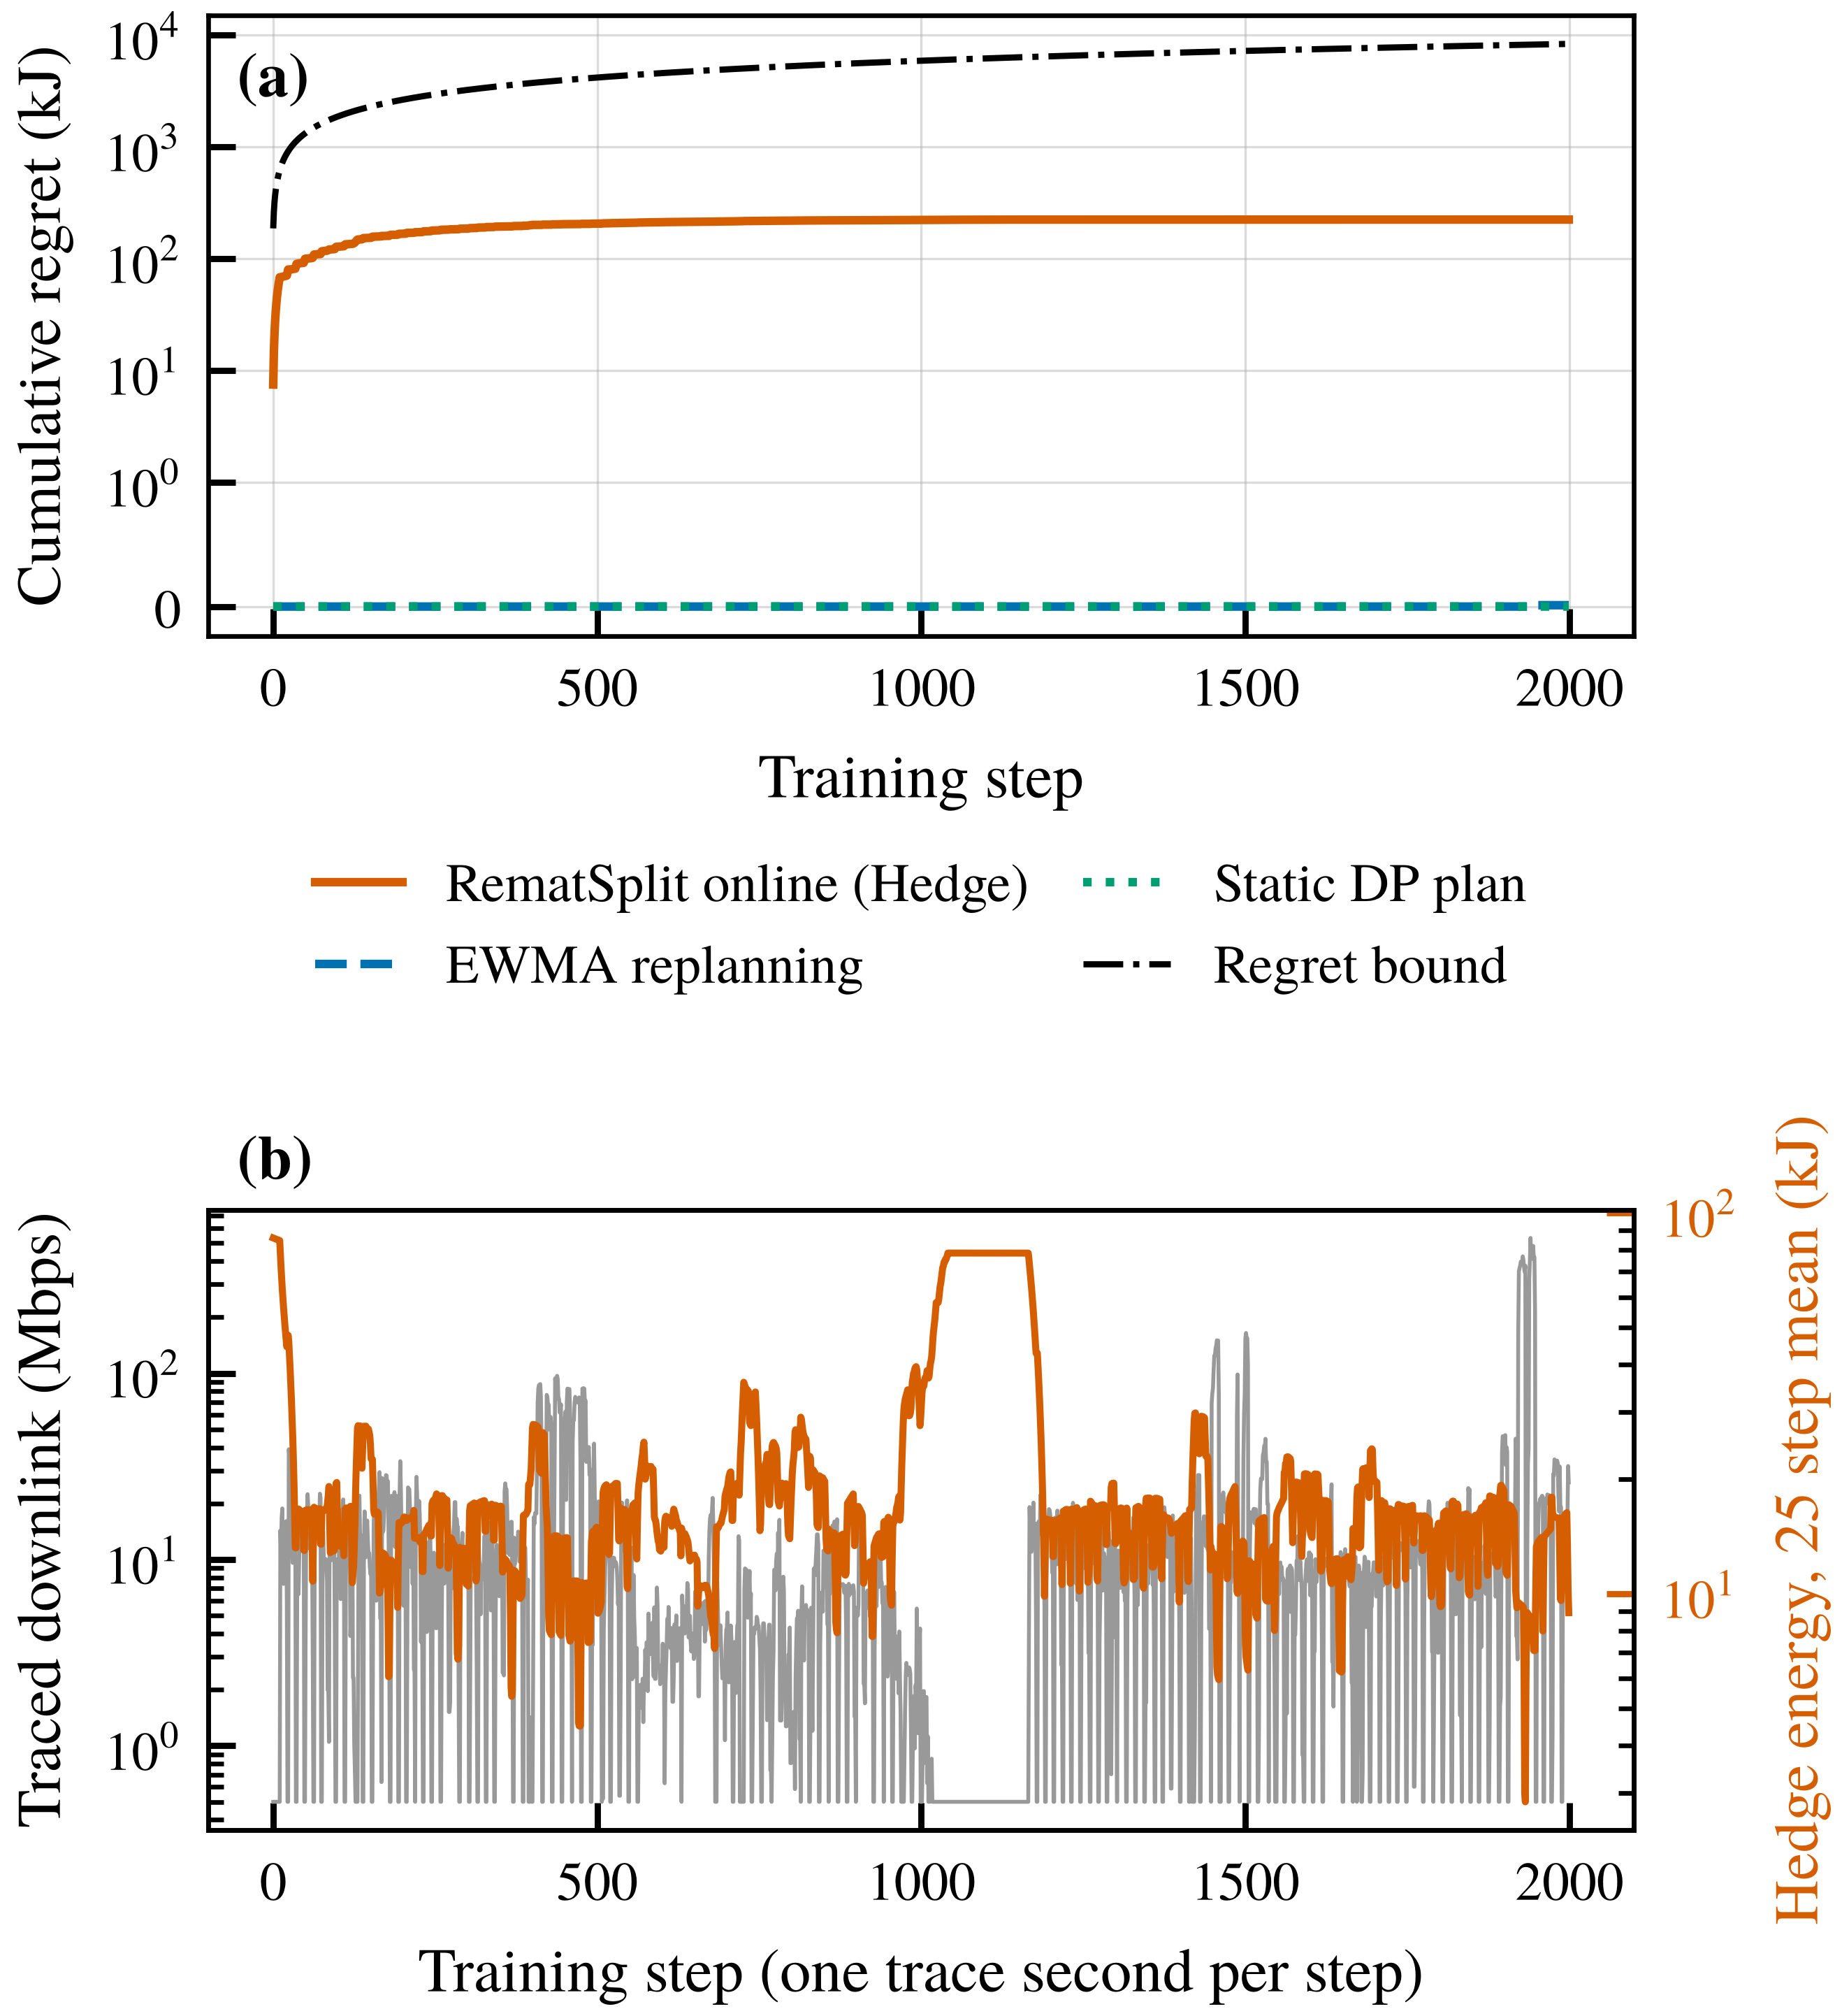
RESULTS
Adapting to the 5G link
0.53%
Hedge gap to per step oracle over 2000 steps
Measured regret 224 kJ, far below the 8367 kJ bound.
RematSplit | IEEE TMC
15
Notes:
Smartphone at L = 12,288. Cumulative regret flattens after a few hundred steps and ends 37 times below the bound; static and EWMA plans are within 0.0001 percent of the oracle on this trace.

Slide 16
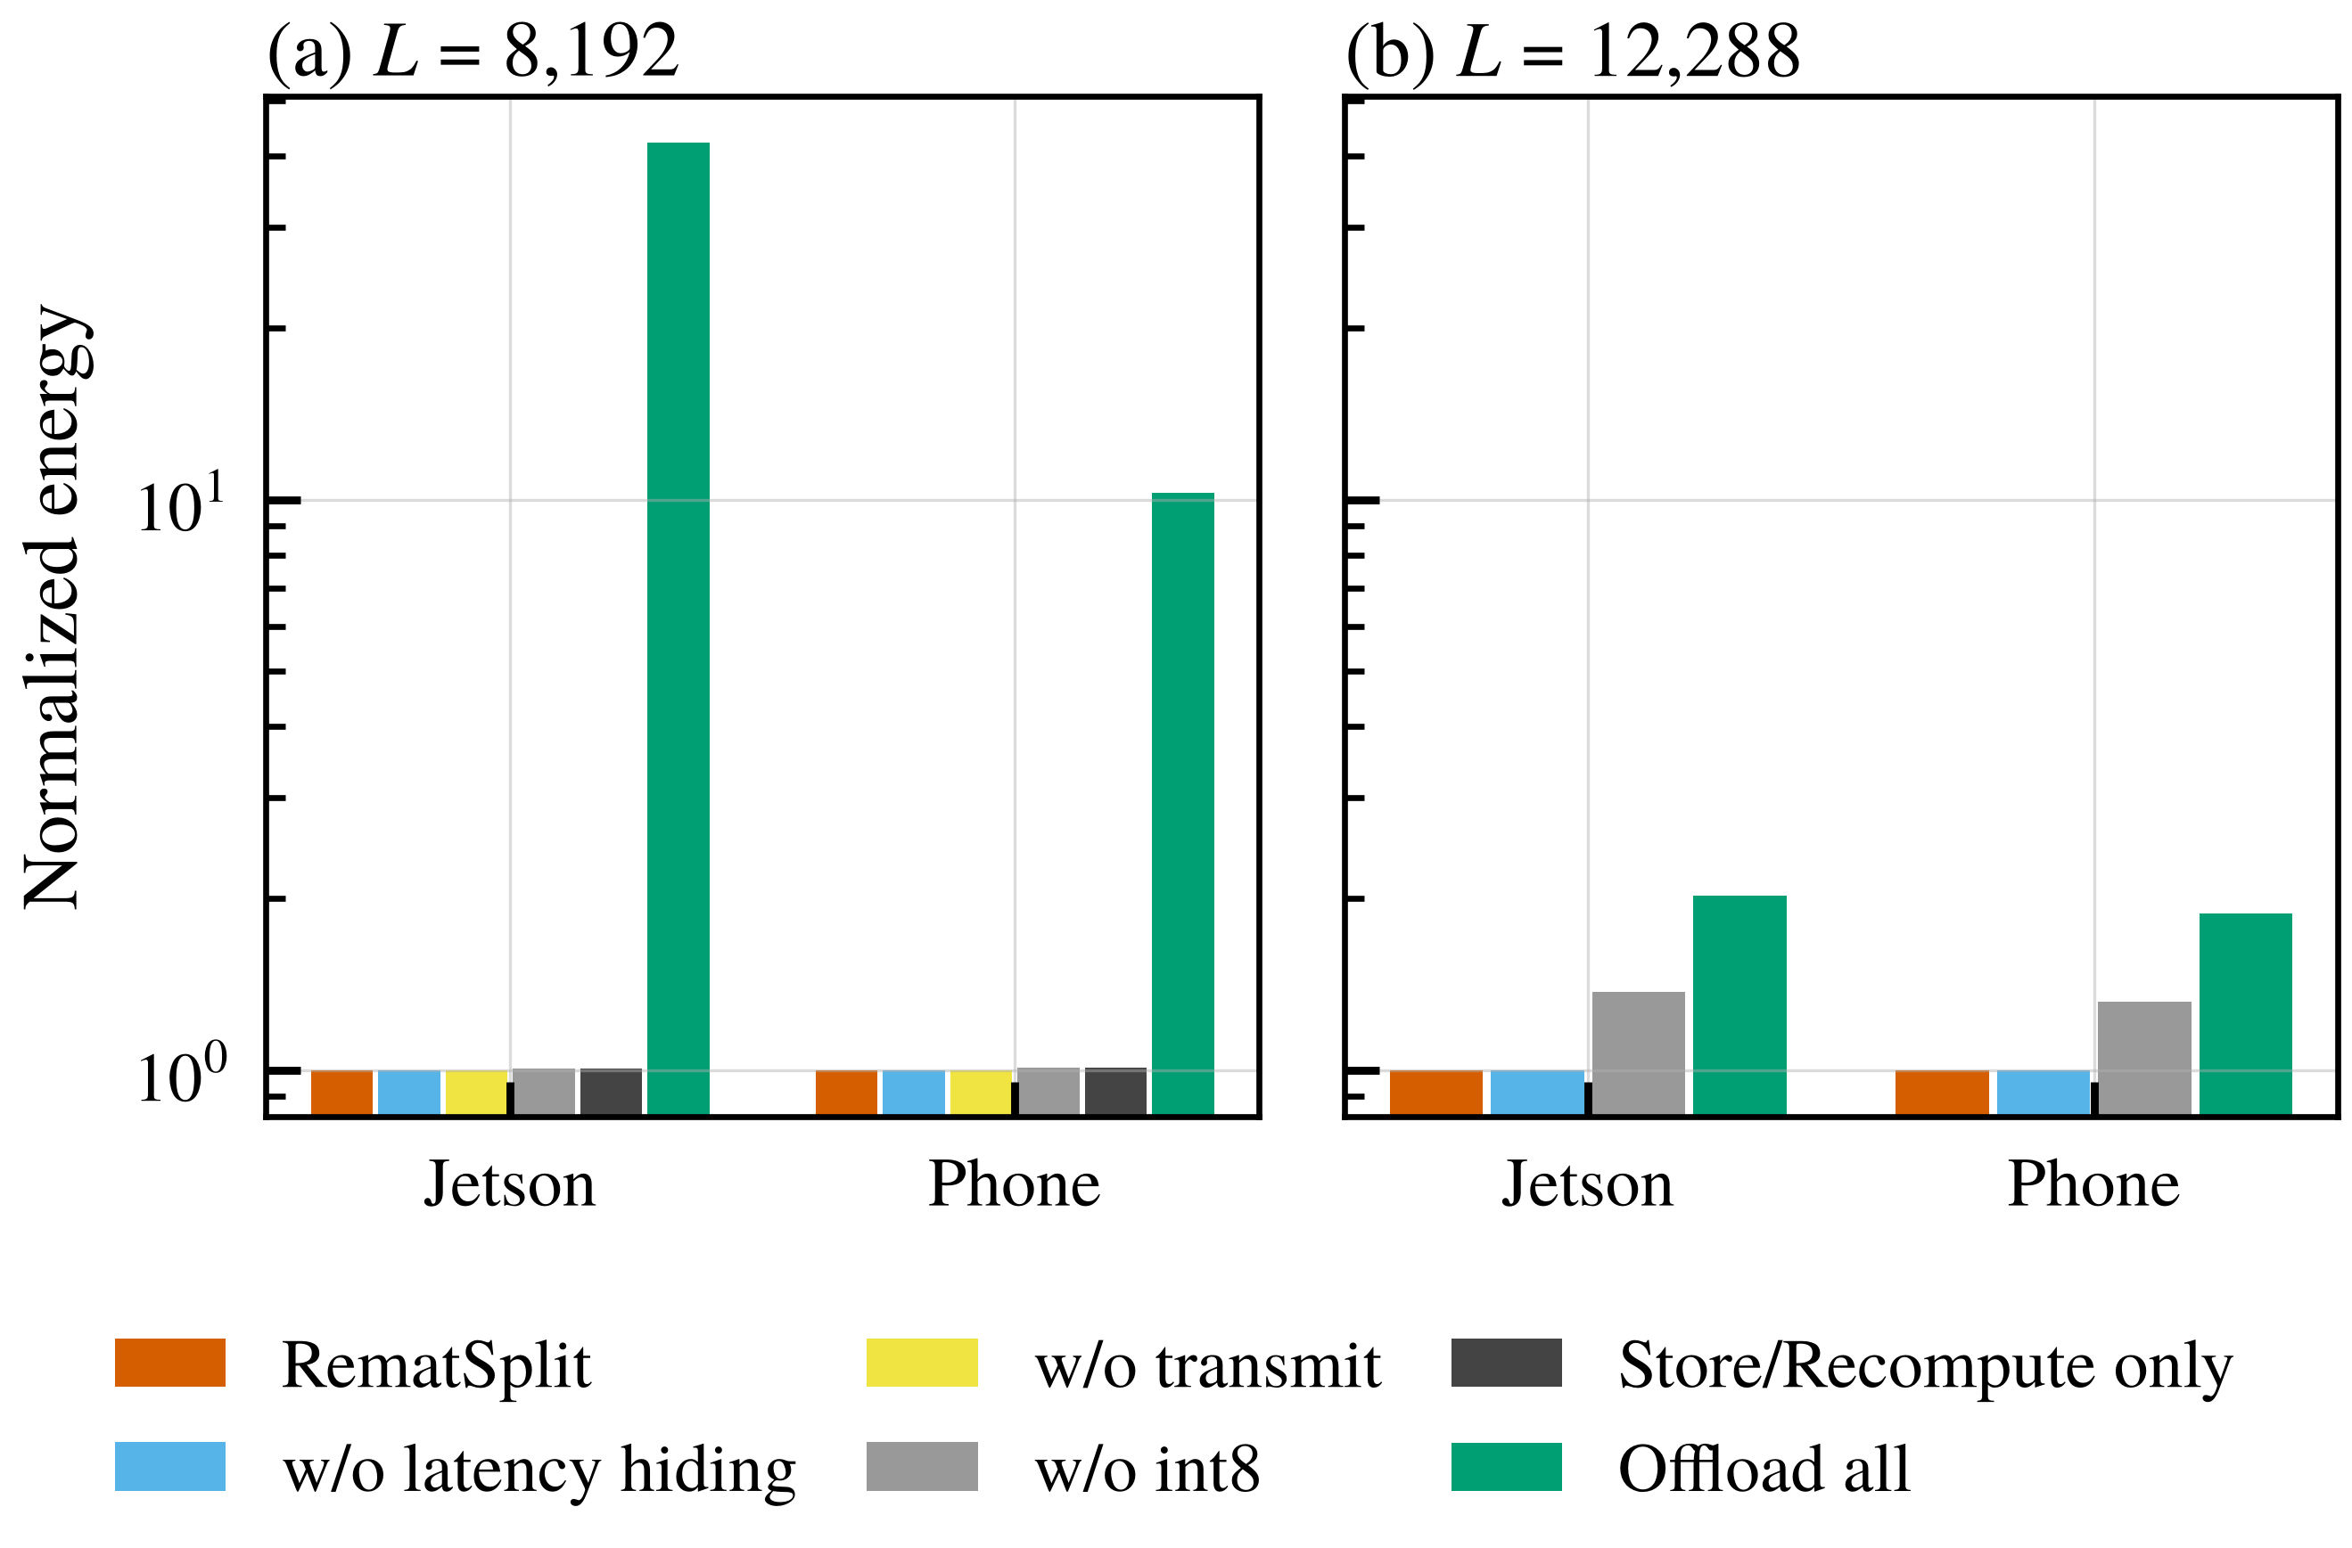
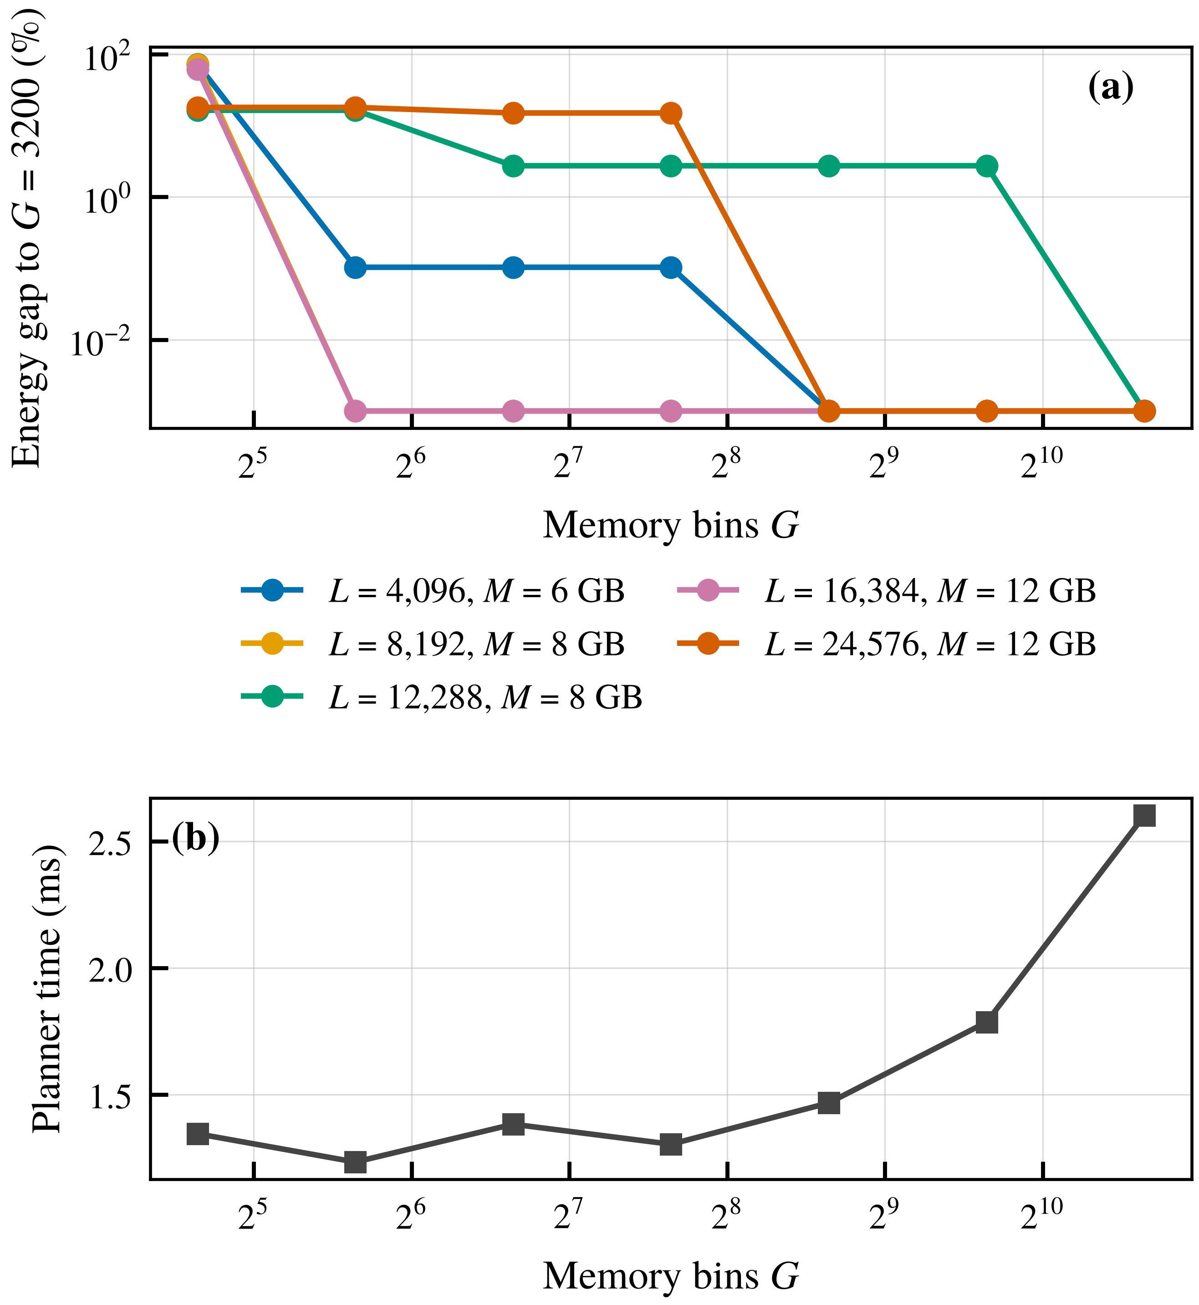
RESULTS
Ablation and planner granularity
RematSplit | IEEE TMC
16
Notes:
Without transmit, length falls to the checkpointing frontier. Without 8 bit, length is unchanged but smartphone energy at 12,288 tokens rises from 3.79 to 5.01 kJ. From G = 400 the gap is at most 3.1 percent and it vanishes from G = 1600.

Slide 17
SUMMARY
Conclusion and future work
Per sublayer choice among store, 8 bit store, recompute and transmit under an exact peak memory model.
Prefix sufficient DP never violates the budget; Hedge gives O(√Γ) regret; 8 bit bias bounded in convergence.
1.46× longer sequences than checkpointing, 9.3× than split LoRA, up to 31.8% less energy.
Future work
Measure the policies on physical devices, extend the planner to multiple devices sharing one cell, and optimize the split layer jointly with the plan.
RematSplit | IEEE TMC
17
Notes:
Close with the three results and the open directions.

