Slide 1
ThermoRoute
>92%
less throttling time than full expert, static pruning, and learned baselines
22%
Thermal throttling aware expert scheduling for smartphone mixture of experts inference
lower energy per token than reactive DVFS
37%
Paper overview, results, and reproduction guide
lower p95 latency than reactive DVFS
SoC A, agent workload, 35 °C ambient
Notes:
ThermoRoute is a model predictive controller that decides, every second, how many experts an MoE language model activates, at which frequency, and on which processor cluster, so that a smartphone stays below its skin limit while it decodes. The three numbers on the right are the headline results at 35 °C ambient on the flagship SoC with the agent workload.

Slide 2
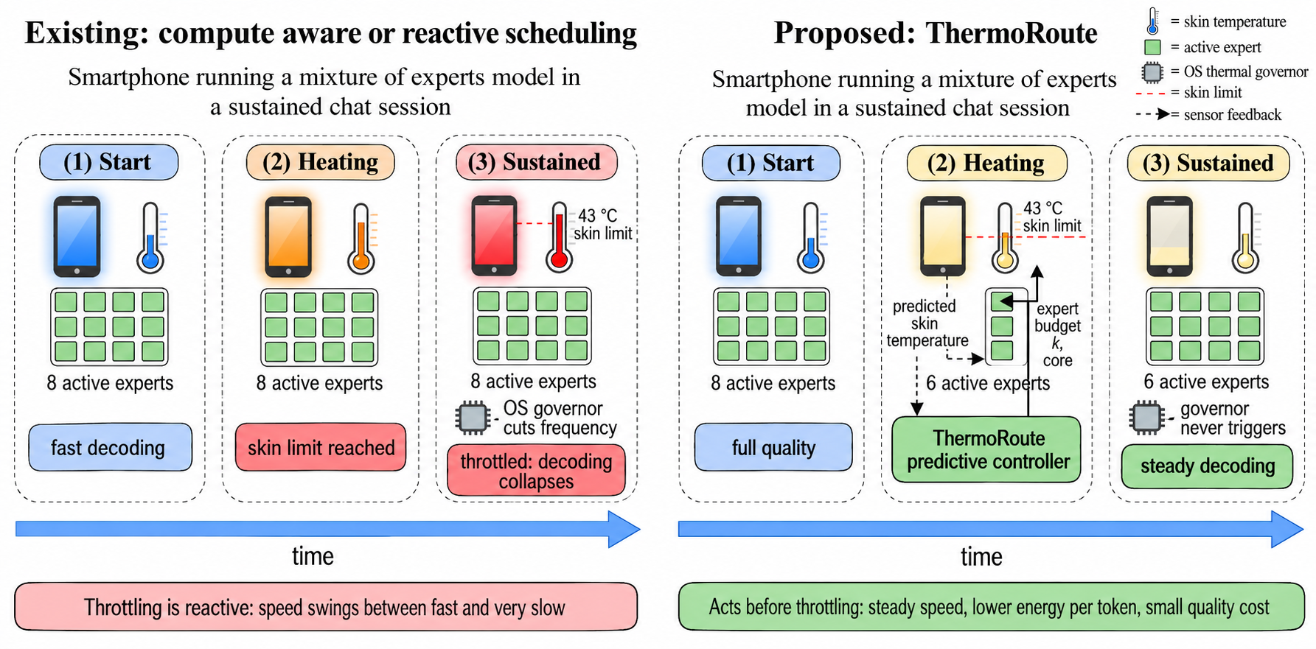
Sustained MoE decoding heats the phone until it throttles
Left: full budget decoding reaches the 43 °C skin limit and the OS governor cuts frequency. Right: ThermoRoute lowers the expert budget before the limit, so decoding stays steady.
Notes:
A phone has no fan, and every joule spent on decoding ends up as heat in a sealed case. In a sustained chat or agent session the device heats, the governor cuts frequency, throughput collapses, the device cools, and the cycle repeats. ThermoRoute predicts the skin trajectory and acts before the governor has to.

Slide 3




Existing remedies control only part of the loop
Static expert pruning
Reactive DVFS
Fixed budget either wastes quality when the phone is cool or still throttles when it is hot.
Cools the device but treats the model as a black box, so every response slows down.
Learned DVFS (FiDRL)
Offloading and bandwidth systems
Learns frequency policies but cannot trade a small quality loss for a large heat reduction.
Reduce bytes per token but assume the device runs at constant speed.
Notes:
The knobs interact: the expert budget sets bytes per token, the frequency sets bandwidth and dynamic power, and together they set how long the device stays busy and how much heat it absorbs over minutes. No prior system controls the number of active experts against a predicted temperature trajectory.

Slide 4



Four contributions
Problem formulation
Memory bound MoE decoding, per budget power, a two node die and skin RC network with a progressive OS governor, and a closed loop chat workload, posed as a constrained rolling horizon problem.
ThermoRoute controller
Filters noisy sensors, corrects model bias online, rolls every candidate forward, and adds a closed form 180 s skin lookahead. A theorem shows fewer experts never raise average power or steady skin temperature.
Measured model and workload profile
OLMoE 1B 7B perplexity for every budget, router expert union over consecutive tokens, and real request lengths from LMSYS Chat 1M.
Validation
Two SoC classes, three ambients, two workloads, and 20 test seeds, with Holm corrected Wilcoxon tests against six methods.
Notes:
These four contributions follow the paper structure: system model and formulation in Section 3, the controller in Section 4, the measured profile in Sections 5.1 and 6.1, and the validation in Section 6.

Slide 5
Method
System model, controller design, and the key theoretical insight

Slide 6
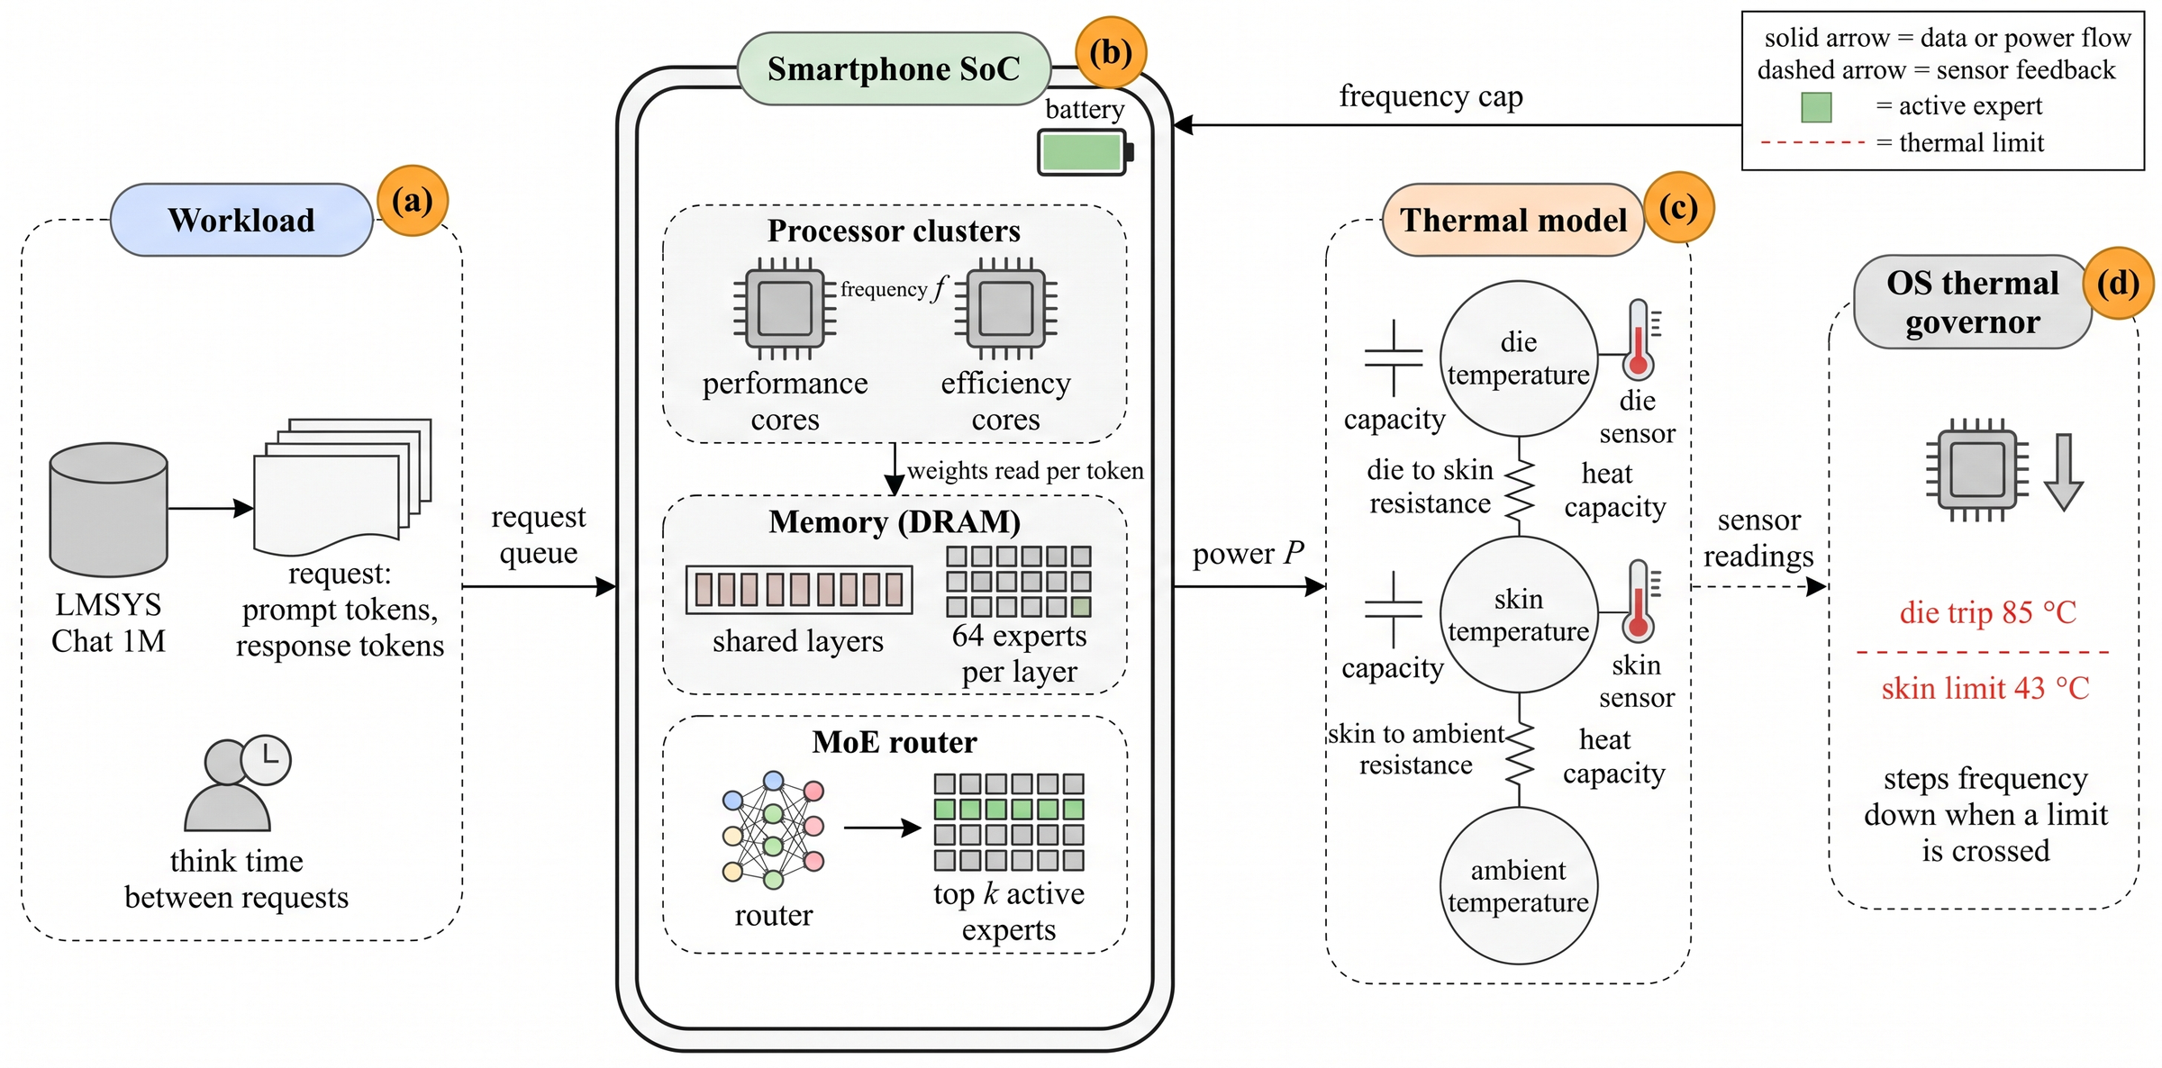
Memory bound decoding meets a two node thermal plant
Bytes per token β(k) = b (Nsh + k·Nex)
Decoding rate r(u) = B(f, c) / β(k)
Active power Pa(u) = Pidle + κc f³ + eB B(f, c)
Thermal plant die and skin temperatures follow a two node RC network, discretized every 1 s
Governor steps frequency down when the die passes 85 °C or the skin passes 43 °C
Workload from LMSYS Chat 1M lengths, SoC with two clusters, MoE router with 64 experts per layer, die and skin RC network, and the OS governor.
Notes:
Decoding at batch size one is limited by memory traffic. Each token reads the shared weights plus k expert slots, so the rate falls as k grows. Power at a fixed frequency does not depend on k because the memory system is saturated; k changes how many tokens each byte yields. The die responds in about 20 s and the skin in about 300 s.

Slide 7
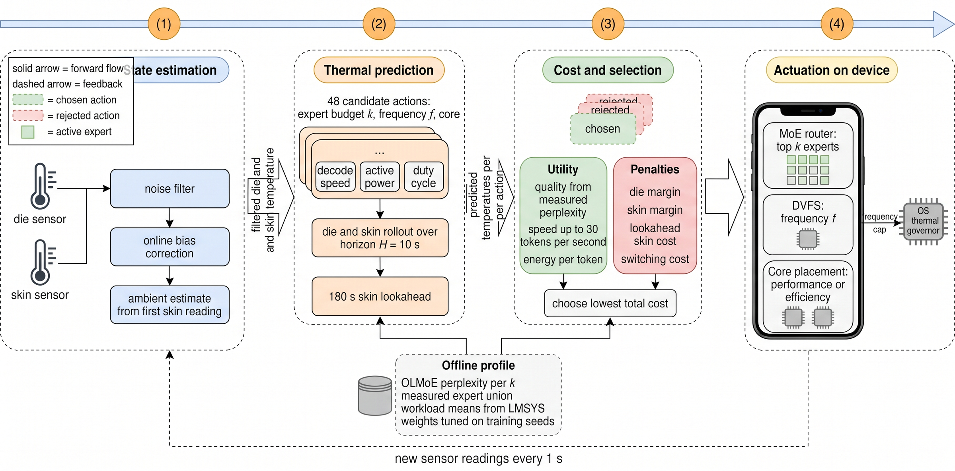
ThermoRoute runs a four stage loop every second
1
State estimation
First order filters on die and skin sensors and bounded online bias correction.
2
Thermal prediction
Each of 48 actions is rolled over a 10 s horizon plus a 180 s closed form skin lookahead.
3
Cost and selection
Quality, speed, and energy utility minus soft thermal penalties and a switching cost.
An offline profile supplies measured quality Q(k), the expert union, workload means, and tuned weights.
4
Actuation
Router top k, DVFS level, and cluster are applied; only the first step of each plan is used.
Notes:
The filter gains are 0.5 for the die and 0.15 for the skin. The bias correction uses a forgetting factor of 0.9 and is clipped to 2 °C for the die and 0.5 °C for the skin. The whole action set is small enough to enumerate exactly.

Slide 8
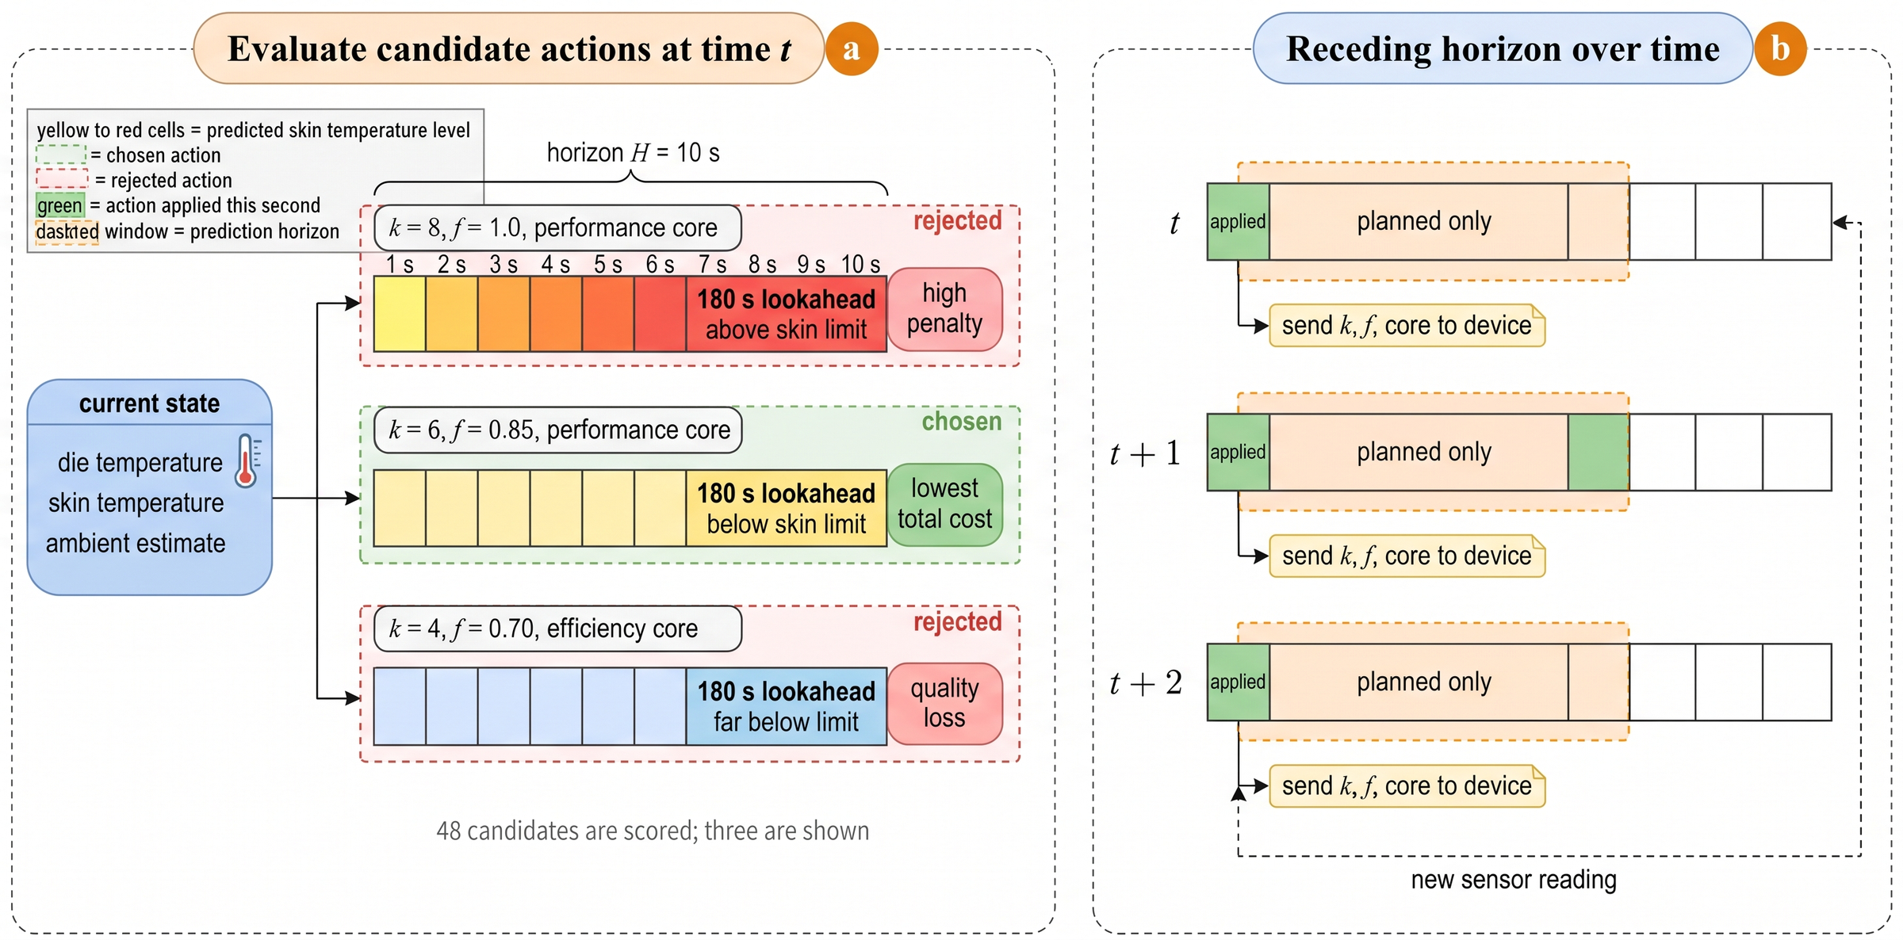
Every second, 48 candidate actions are scored
Total cost
J(u) = −H ω g(u) + Jpen + Jterm + Jsw
g(u) quality, speed up to 30 tok/s, and energy per token
Jpen squared die and skin violations over the horizon
Jterm violation of the 180 s lookahead
Jsw cost of changing the action
In this example the full budget is rejected for exceeding the skin limit in the lookahead, k = 4 loses too much quality, and k = 6 at f = 0.85 wins.
Notes:
The decision costs |U| times (H plus 1) elementary updates, 528 for 48 actions and a 10 s horizon, which runs in about 1 ms in unoptimized Python. Weights (wq, we, ws) = (10, 2, 6) were chosen on training seeds only, never on test seeds.

Slide 9
Key insight: fewer experts cool the phone through the duty cycle
≈300 s
Theorem 1
At a fixed frequency and cluster, a larger expert budget strictly lowers the decoding rate and strictly raises average power, steady state skin temperature, and energy per token.
skin time constant RsaCs, which reacts to decisions made minutes earlier
Lowering k finishes each response sooner and lengthens the cool idle share of each request cycle.
Lowering frequency cuts instantaneous power but lengthens the busy share.
ThermoRoute exploits both effects jointly.
≈20 s
die time constant RdsCd, which a short horizon already protects
Notes:
This is why a lookahead term is needed in addition to the short horizon: the skin limit is the binding constraint in sustained sessions, and it moves on a time scale of minutes. Lemma 1 gives the closed form lookahead from a quasi static die assumption.

Slide 10
Experiments and results
Calibrated simulation of two smartphone SoC classes with a measured model profile

Slide 11
Experimental setup
Item | Setting
Model | OLMoE 1B 7B, 16 layers, 64 experts, top 8
Quality data | WikiText 103 test, 60 chunks of 1024 tokens
Workload | LMSYS Chat 1M, 9456 request pairs
SoC A / SoC B | 67.2 / 51.2 GB/s peak bandwidth
Ambients | 25, 30, 35 °C
Think time | chat 3 to 12 s, agent 0.5 to 2 s
Sessions | 1800 s, 20 test and 20 training seeds
Statistics | 95% t intervals, Wilcoxon with Holm
Compared methods
EdgeMoE full budget, OS governor only
EdgeLLM adds speculative decoding
StaticK4 fixed k = 4
ReactiveDVFS two threshold hysteresis
FiDRL tabular Q learning DVFS
ThermoRoute+Spec with speculative decoding
Oracle true parameters, no noise
Notes:
All baselines share the same plant, governor, and workload and are reimplemented at the mechanism level inside one simulator. The default plant mismatch is 10%. Phone weights are stored at 0.56 bytes per parameter, corresponding to 4 bit group quantization.

Slide 12
Six experts cost only 5.3% perplexity
−17.1%
bytes read per token at k = 6 compared with k = 8
+0.6%
speculative decoding speedup at k = 8, against +16.8% at k = 2
Five consecutive tokens select 23.89 distinct experts per layer at k = 8, three times a plain step, so verification erodes the speculative gain.
Notes:
Perplexity rises gently from 8.93 at k = 8 to 9.40 at k = 6, then sharply to 11.53 at k = 4 and 27.38 at k = 2. The measured union of 23.89 is below the 31.17 expected from independent routing, which shows correlation between neighboring tokens, but it is still three times the eight experts of a plain step.

Slide 13
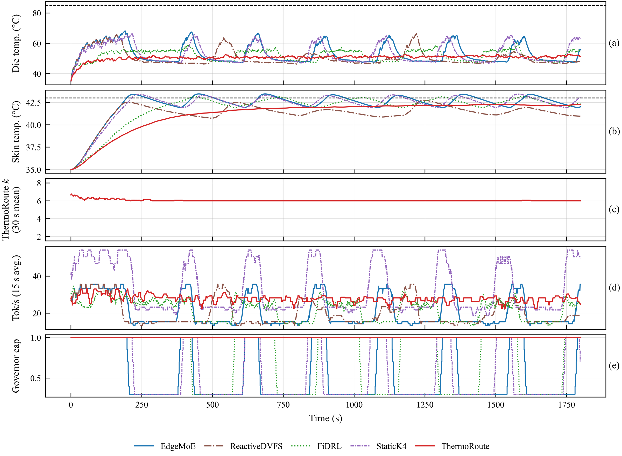


ThermoRoute decodes steadily without a governor intervention
Baselines hit the limit in about 200 s
EdgeMoE swings between 15 and 35 tok/s and StaticK4 between 22 and 55 tok/s as the governor cycles.
DVFS keeps the die cool but slows
FiDRL and ReactiveDVFS collapse toward 15 tok/s for long stretches.
ThermoRoute settles at k = 6
It approaches the skin limit from below, keeps the die near 50 °C, and decodes at 25 to 33 tok/s.
Notes:
This trace is SoC A at 35 °C, agent workload, seed 0. Panels show die temperature, skin temperature, the ThermoRoute expert budget, decoding rate, and the governor cap. The steady behavior comes from the lookahead, which charges the skin violation that a sustained full budget would cause minutes later.

Slide 14
At 35 °C ThermoRoute removes more than 92% of throttling
95.4%
less throttling than EdgeMoE (63.0 s against 1358.1 s)
p = 0.69
ReactiveDVFS throttles as little, but it slows every response
Reductions: 95.5% against EdgeLLM, 92.6% against FiDRL, 95.2% against StaticK4.
Notes:
ThermoRoute limits throttling to 63.0 s of the 1800 s session. ReactiveDVFS reaches 9.4 s and the difference is not significant after Holm correction, but it achieves this by slowing every response: its p95 latency is 28.50 s against 17.99 s and its violation rate is 57.5% against 2.1%.

Slide 15
Full comparison: SoC A, agent workload, 35 °C
Method | Throttle (s) | PPL eff | p95 latency (s) | SLO violation (%) | Energy per token (J) | Tokens per charge (10³)
EdgeMoE | 1358.1 | 8.93 | 28.80 | 54.5 | 0.1436 | 482.8
EdgeLLM | 1413.6 | 8.93 | 29.46 | 58.5 | 0.1483 | 467.7
ReactiveDVFS | 9.4 | 8.93 | 28.50 | 57.5 | 0.1251 | 554.3
FiDRL | 849.4 | 8.93 | 26.20 | 34.9 | 0.1318 | 526.1
StaticK4 | 1299.2 | 11.53 | 19.09 | 0.0 | 0.0978 | 708.9
ThermoRoute | 63.0 | 9.40 | 17.99 | 2.1 | 0.0969 | 715.5
ThermoRoute+Spec | 90.1 | 9.40 | 18.23 | 3.3 | 0.0981 | 706.3
Oracle | 102.3 | 9.40 | 17.89 | 3.3 | 0.0975 | 710.8
ThermoRoute lowers p95 latency by 37% and energy per token by 22% against ReactiveDVFS, and delivers 29.1% to 53.0% more tokens per charge than the thermally unaware and DVFS baselines.
Notes:
Values are means over 20 seeds from results/summary_all_conditions.csv and Table 5 of the paper. Against StaticK4 the energy difference is not significant, but ThermoRoute removes 95.2% of its throttling and reduces its perplexity by 18.4%. The Oracle throttles for 102.3 s, so knowing the true parameters gives no measurable advantage.

Slide 16
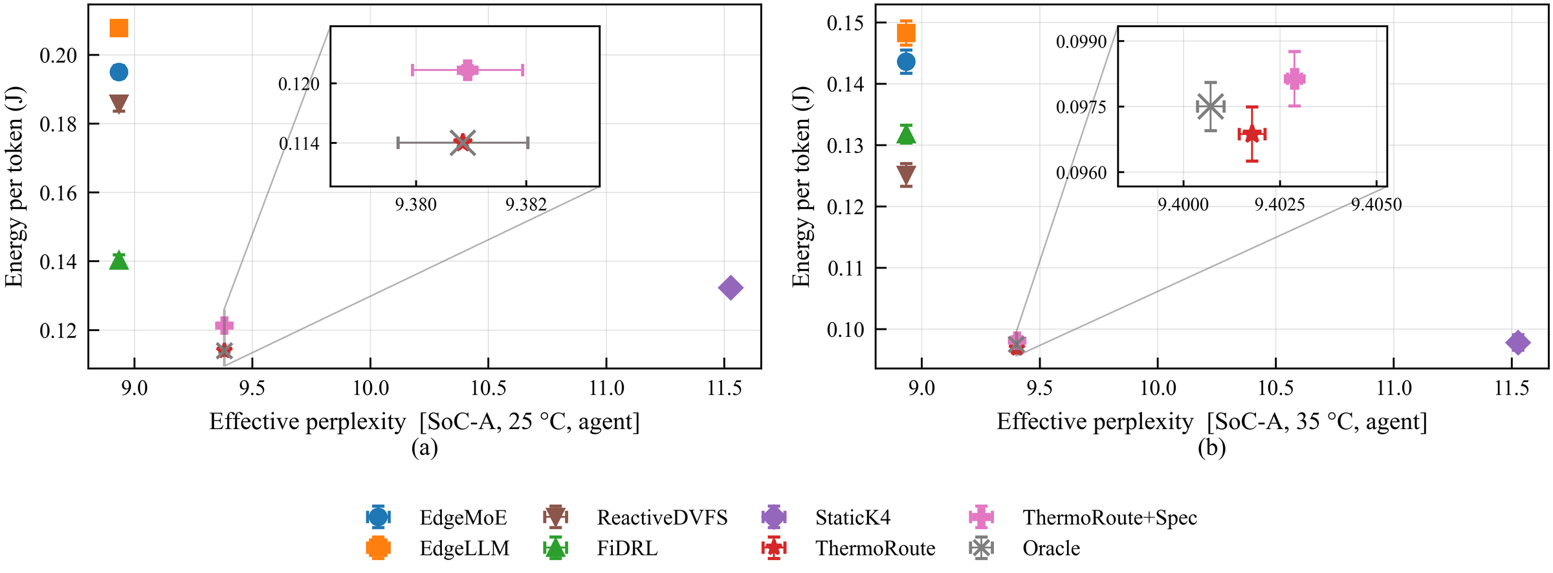
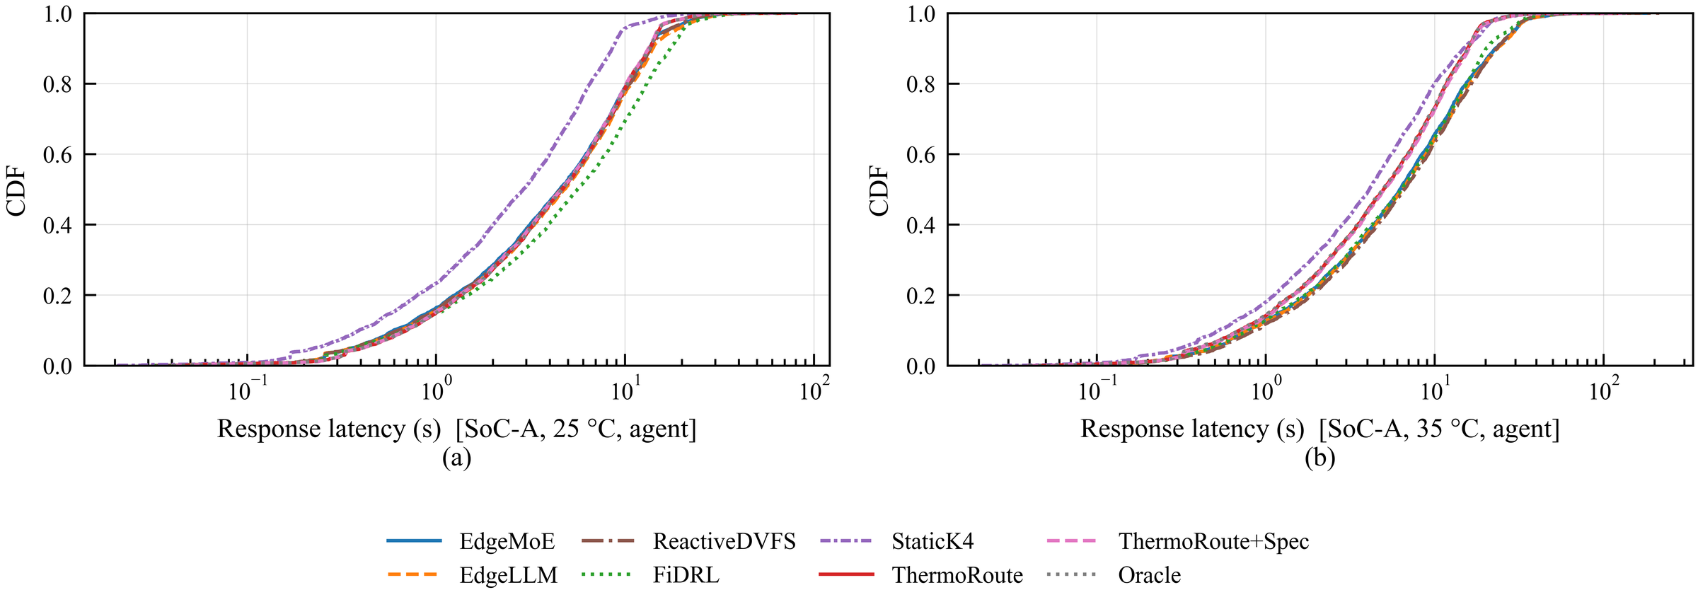
ThermoRoute sits in the efficient corner of quality and energy
Energy versus perplexity. Full budget methods have the lowest perplexity but the highest energy; StaticK4 saves energy only at a 29% perplexity penalty. ThermoRoute, ThermoRoute+Spec, and the Oracle form the efficient corner at 25 °C (a) and 35 °C (b).
Latency distribution. At 35 °C ThermoRoute shifts the upper tail to the left, while the throttled baselines extend toward much longer responses.
Notes:
At 25 °C ThermoRoute attains the lowest energy per token, 0.1140 J, which is 41.5%, 38.6%, 18.7%, and 13.9% lower than EdgeMoE, ReactiveDVFS, FiDRL, and StaticK4, and the most tokens per charge, 607.8 thousand.

Slide 17
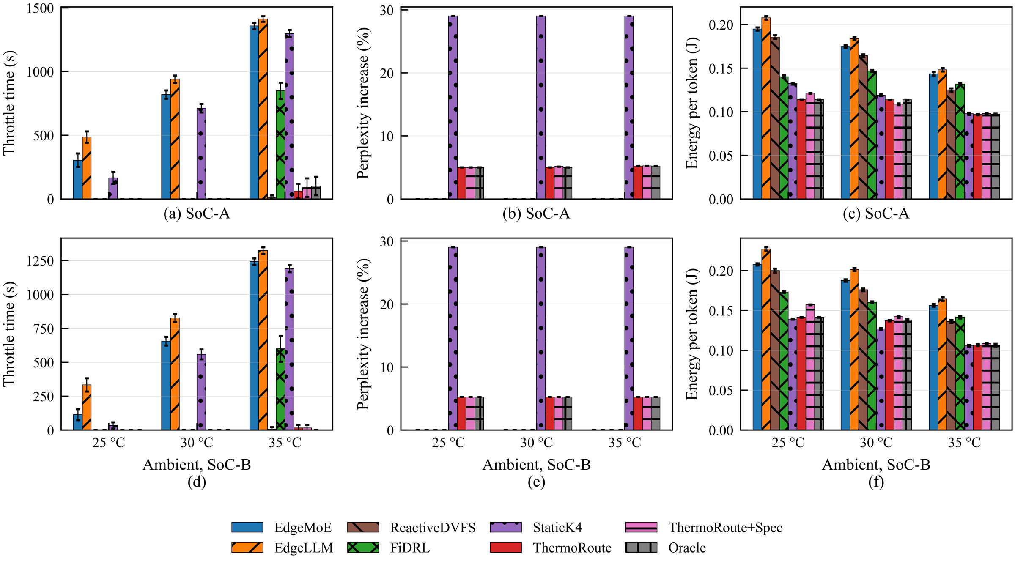
Gains hold across ambient, SoC class, and workload
9 of 12
conditions with zero ThermoRoute throttling
≈5%
perplexity increase in every condition
Limits: on SoC B chat at 35 °C ReactiveDVFS avoids throttling entirely, and on SoC B StaticK4 matches or slightly undercuts ThermoRoute in energy.
Top row SoC A, bottom row SoC B: throttling time, perplexity increase, energy per token.
Notes:
EdgeMoE throttling grows from 305.0 s at 25 °C to 1358.1 s at 35 °C on SoC A. ThermoRoute stays at zero in nine of twelve conditions and at 63.0, 15.8, and 46.3 s in the other three. Wherever EdgeMoE throttles, ThermoRoute removes between 93.8% and 100% of it, while keeping perplexity at most 9.40 against 11.53 for StaticK4.

Slide 18
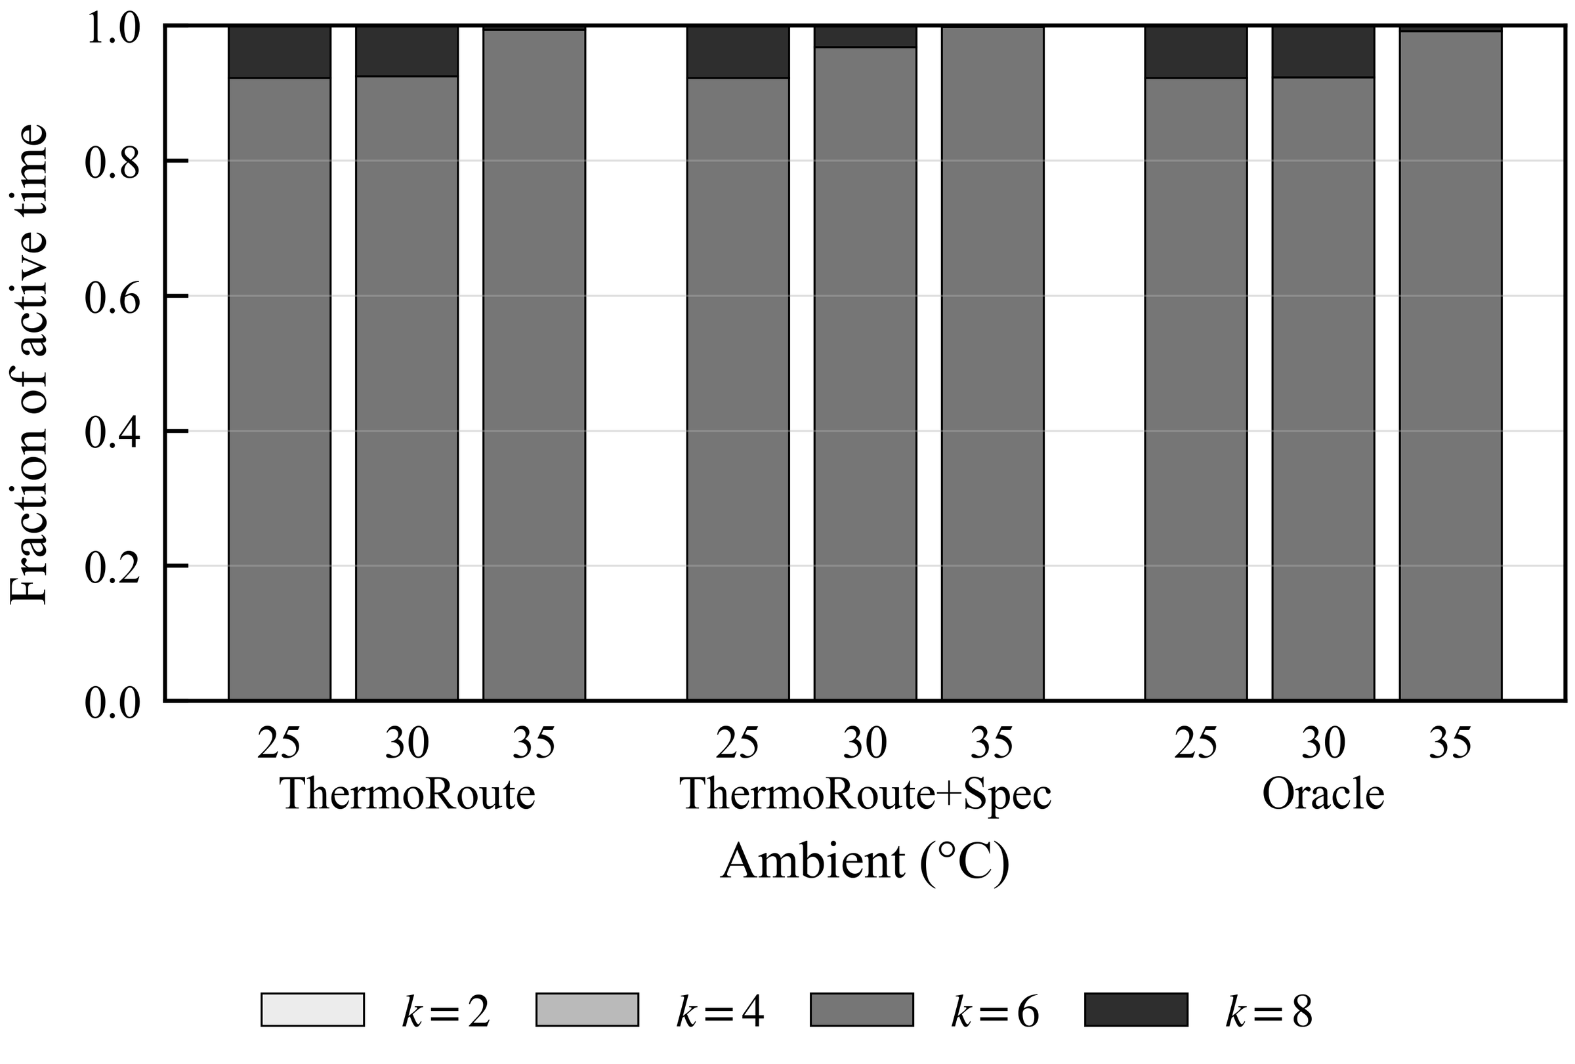
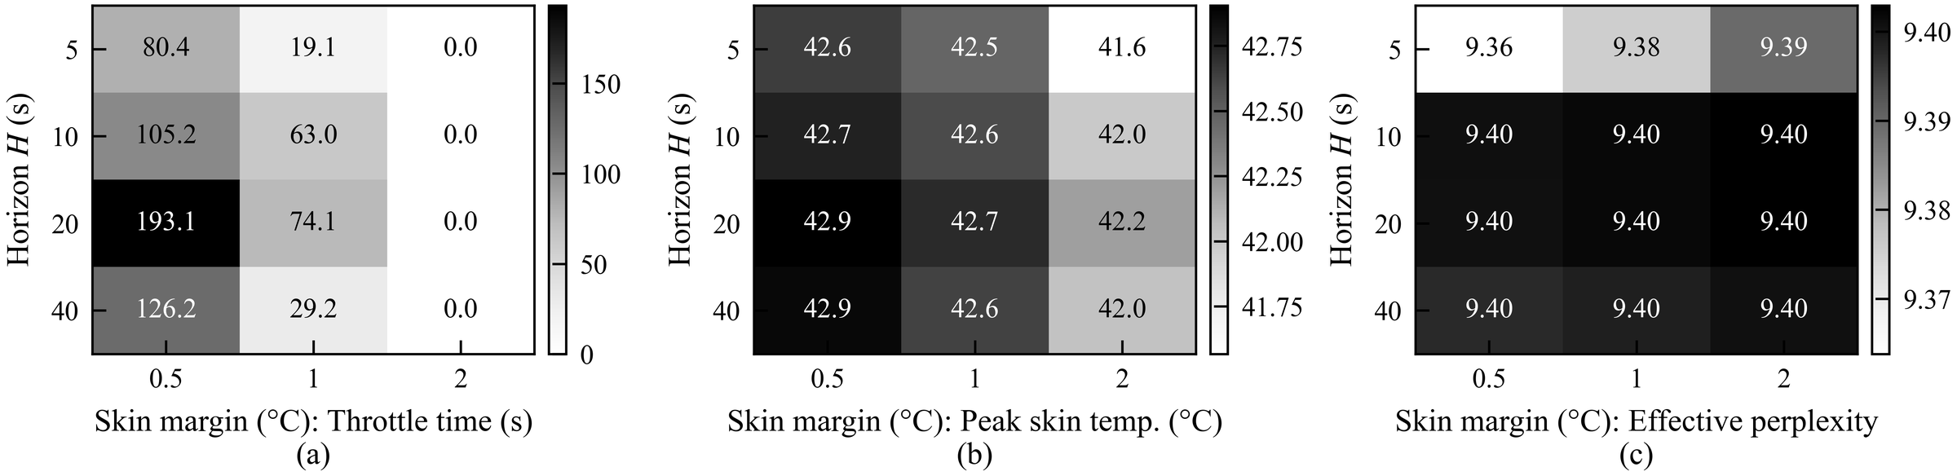
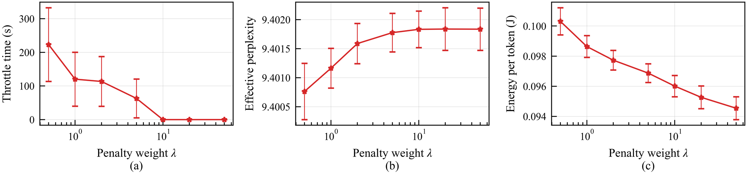
Six experts dominate, and the skin margin matters most
Horizon H and skin margin: a 2 °C margin removes throttling for every horizon at ≤ 0.03 perplexity.
At 25 and 30 °C, k = 6 covers 92.3% of busy time; at 35 °C it covers 99.4%. k = 2 and k = 4 are never chosen.
Penalty weight λ: throttling falls from 223.0 s at λ = 0.5 to zero for λ ≥ 10, with < 0.002 perplexity change.
Notes:
Throttling does not fall consistently with the horizon: for a 1 °C margin it is 19.1, 63.0, 74.1, and 29.2 s for H of 5, 10, 20, and 40 s, because the lookahead already covers the slow skin dynamics. A conservative choice of λ = 10 or a 2 °C margin removes throttling at 35 °C entirely, at a p95 latency 1.3% and 4.7% higher than the defaults.

Slide 19
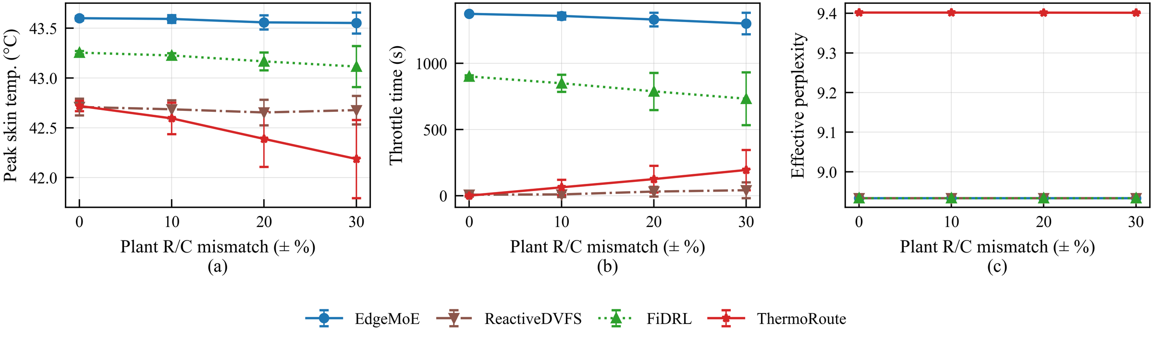
Robust up to moderate mismatch, with negligible overhead
1.0 ms
median decision time per slot in unoptimized Python, 0.1% of one core
528
Plant mismatch δ from 0 to 0.3: peak skin temperature, throttling time, and effective perplexity.
Throttling grows from 0.0 s without mismatch to 125.2 s at δ = 0.2 and 194.0 s at δ = 0.3, while ReactiveDVFS stays below 41.1 s.
ThermoRoute keeps p95 latency at most 18.38 s against at least 25.10 s for every baseline, and 0.097 J per token at every level.
rollout and lookahead updates per decision
Notes:
Large parameter errors are the main weakness of a model based controller, and the clipping bounds of the bias correction limit how much error can be absorbed online. A larger skin margin or online identification of the thermal parameters would recover the margin lost to mismatch.

Slide 20


Limitations and future work
Calibrated simulation
Response lengths
Thermal and power parameters are representative, not identified on a specific handset.
Lengths come from the models that served LMSYS, led by Vicuna 13B, rather than OLMoE.
Single foreground model
Mismatch beyond 20%
Contention with other applications is not modeled.
Erodes the throttling advantage and motivates online parameter identification.
Future work: identify thermal parameters online on commercial handsets, handle several concurrent models, add per expert placement on heterogeneous clusters, and combine scheduling with expert caching and offloading.

Slide 21
How to run it
Repository layout, notebook pipeline, and quick start commands

Slide 22


Repository layout
sim/
ThermoRoute/
ThermoRoute.ipynb
requirements.txt
sim/
config.py plant.py
workload.py controllers.py
runner.py stats_tables.py
figs.py model_profile.py
data/
results/
raw_runs.zip
figures/
Simulator package; every constant lives in config.py.
data/
Measured k profile, expert union, OLMoE config, and 9456 request lengths (no text).
results/
All runs, summaries, Wilcoxon tests, LaTeX tables, tuned weights, FiDRL tables.
figures/
Final figures A to K at 900 dpi.
Notes:
raw_runs.zip holds the per session samples and traces used by the dynamics, latency CDF, and overhead figures. Unzip it inside results before regenerating figures.

Slide 23
Notebook pipeline: Steps 0 to 7
0
Setup
1
Model profile
2
Request lengths
3
Sanity checks
packages, fonts, Hugging Face login
OLMoE perplexity per k, router union
LMSYS Chat 1M with OLMoE tokenizer
simulator numbers before the grid
any, 3 to 5 min
GPU, 20 to 40 min
any, 5 to 15 min
CPU, 1 min
4
Experiments
5
Statistics
6
Figures
7
Claim check
weight tuning, FiDRL training, full grid
LaTeX tables, Wilcoxon with Holm
PNG and PDF; Step 6b final versions
abstract claims against the tests
CPU, 30 to 60 min
CPU, 1 min
CPU, 2 min
CPU, 1 min
Blue steps are already done: their outputs ship in data/, so you can start at Step 3.
Notes:
Run the notebook from the repository root, top to bottom. Each step saves its outputs and is skipped on a rerun, so a Colab disconnect only costs the step that was running. Step 1 needs a GPU such as a Colab T4. Step 2 needs accepting the LMSYS Chat 1M terms and a Hugging Face read token.

Slide 24

Quick start: regenerate tables and figures
Minimal dependencies
git clone <repository URL>
cd ThermoRoute
pip install -r requirements.txt
cd results && unzip raw_runs.zip && cd ..
export TR_ROOT=$PWD
export TR_FIG_DIR=$PWD/figures_new
cd sim
python -c "import stats_tables; stats_tables.main()"
python -c "import figs; figs.make_all()"
numpy, scipy, pandas, and matplotlib are enough to rerun the simulator and redraw figures.
On Windows
Use set TR_ROOT=%cd% instead of export, or run the notebook from the repository root.
Full rerun
Open ThermoRoute.ipynb and run Steps 3 to 7 on CPU in about one hour.
Notes:
The regenerated LaTeX tables match the archived ones exactly. transformers is pinned to 4.51.3 so OLMoE experts stay nn.Linear layers for 8 bit loading in Step 1. Figures use Times New Roman; on Linux install ttf-mscorefonts-installer.

Slide 25
Takeaways
1
The expert budget is a thermal knob
In the memory bound regime it acts through the duty cycle, not instantaneous power.
2
Lookahead beats a longer horizon
Predict the skin, then trade a little quality for a lot less heat
The 180 s closed form skin projection matters more than the horizon length.
3
Small cost, large gain
5.2% perplexity for over 92% less throttling, 22% less energy, and 37% lower p95 latency.

