Slide 1
ISIT315 - Assignment 4
Anime and Manga Ontology

Slide 2
Group Members
Daniel Barnes 5053511
Hoang Duong Nguyen 5177832
Minh Tan Le 5142179
Jingwang Teh 5238699

Slide 3
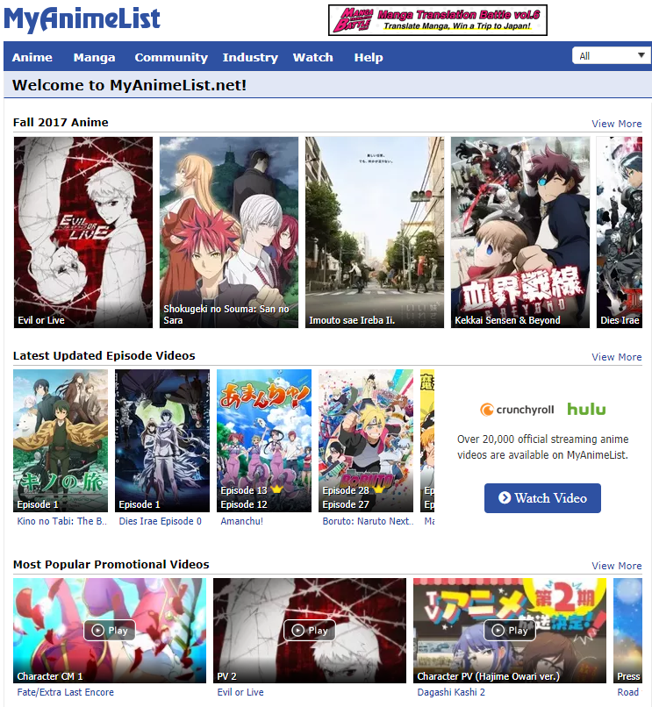
Domain
The ontology is about anime and manga
Based off of ‘MyAnimeList.net’, which is the world’s largest database and social community for anime and manga
The group choose this domain because it was familiar to the majority of group members
We also choose the domain because it provided us with flexibility when designing the ontology due to the large amount of possible class, property and instance options.

Slide 4
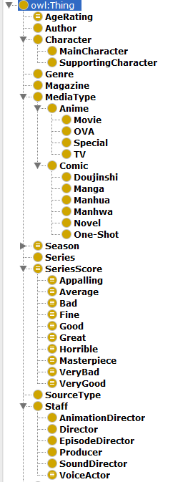
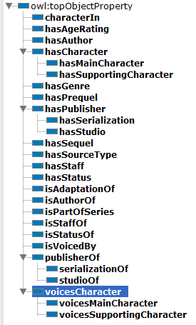
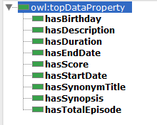
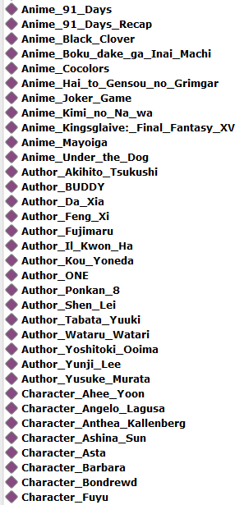

Classes, Properties & Individuals

Slide 5

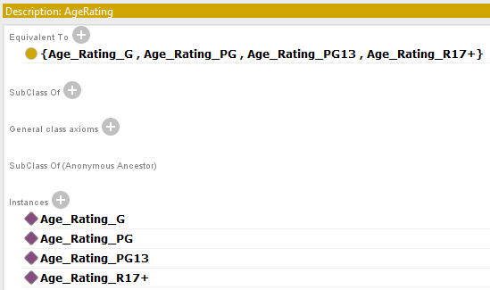

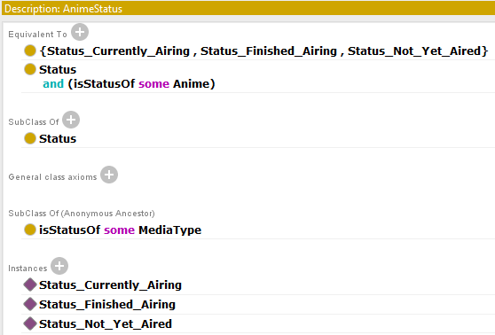
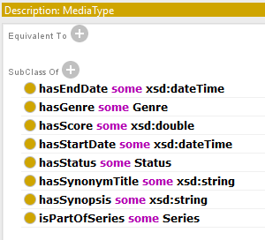
Classes
Season
AgeRating
SeriesScore
AnimeStatus
MediaType

Slide 6
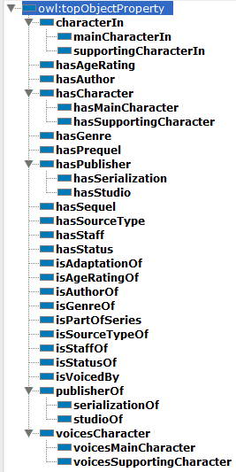
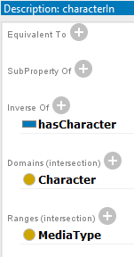
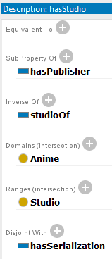
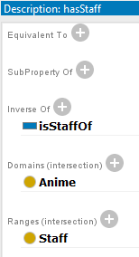
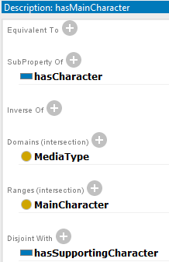
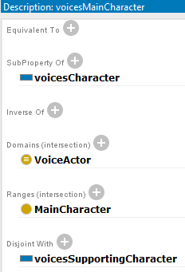
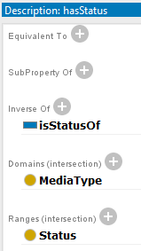
Object Properties
characterIn
hasStudio
hasStaff
hasMainCharacter
voicesMainCharacter
hasStatus

Slide 7

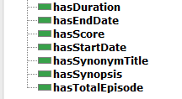
Data Properties
Domain: Staff
Domain: MediaType

Slide 8
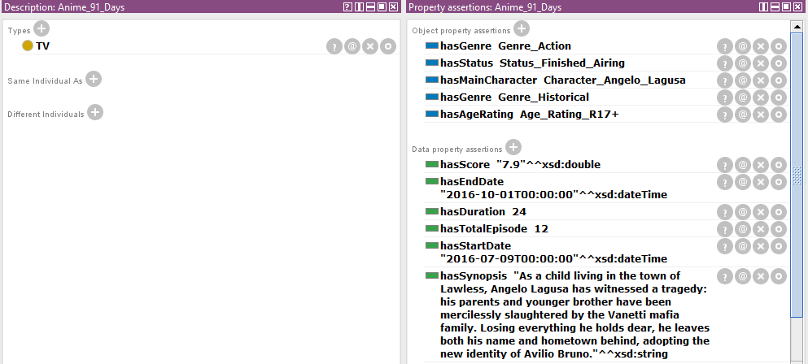
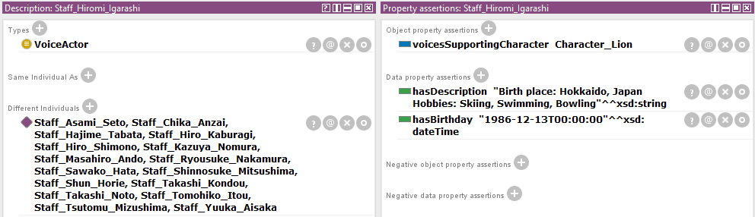
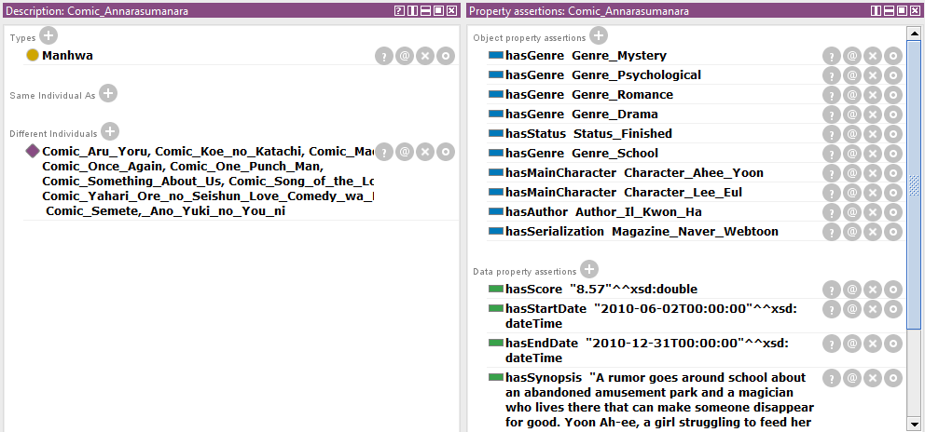
Individuals
All instances are prefixed by the class they belong to for convenience
Anime_91_Days
Staff_Hiromi_Igarashi
Comic_Annarasumanara

Slide 9
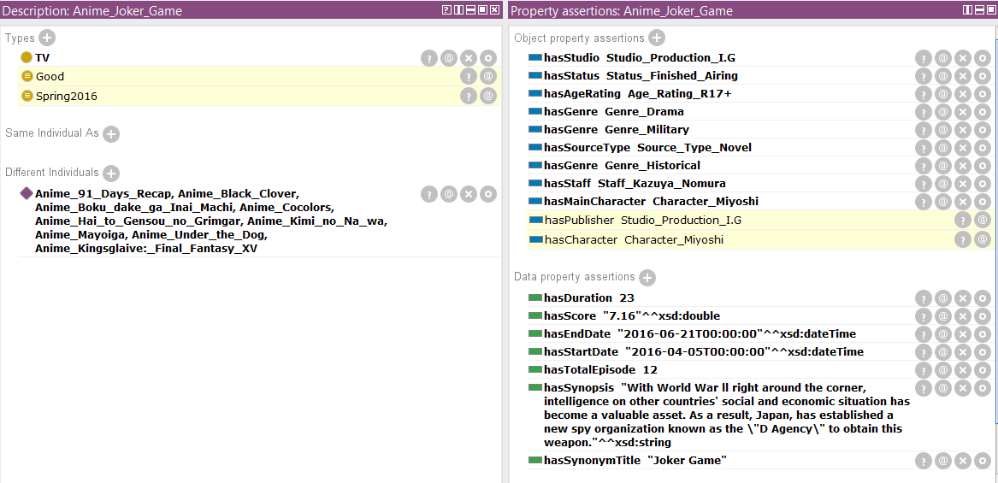
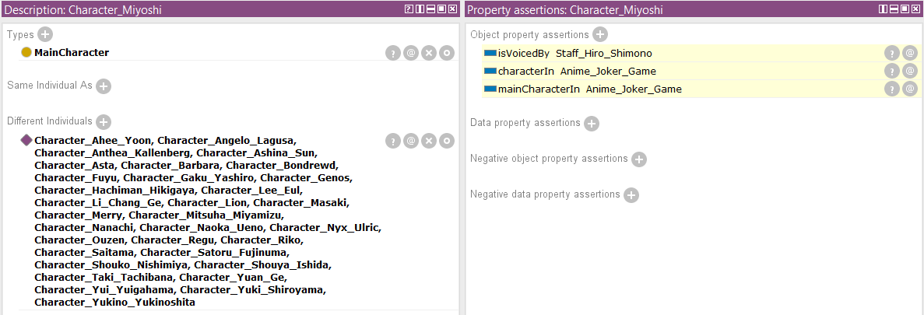
Demonstration of Inferencing
Anime_Joker_Games (Season and Rating Inference)
Character_Miyoshi (characterIn and VoiceBy Inference)

Slide 10
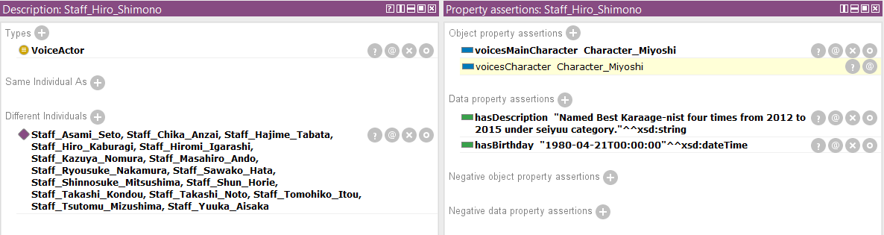
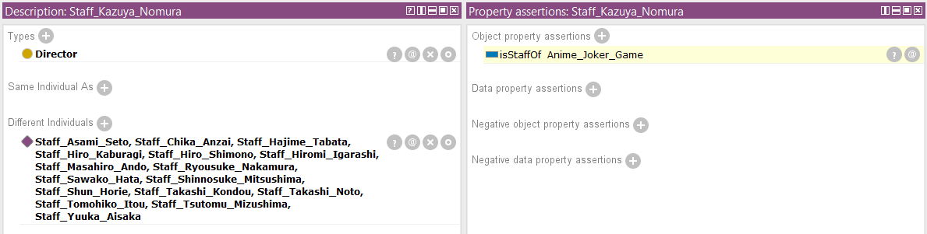
Demonstration of Inferencing
Staff_Hiro_Shimono (voicesCharacter Inference)
Staff_Kazuya_Nomura (staff Inference)

Slide 11
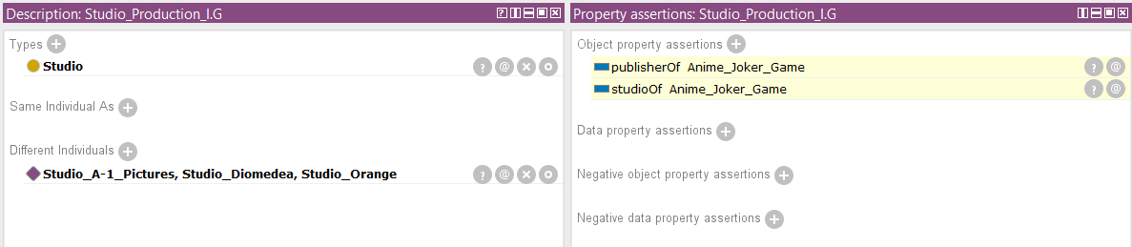
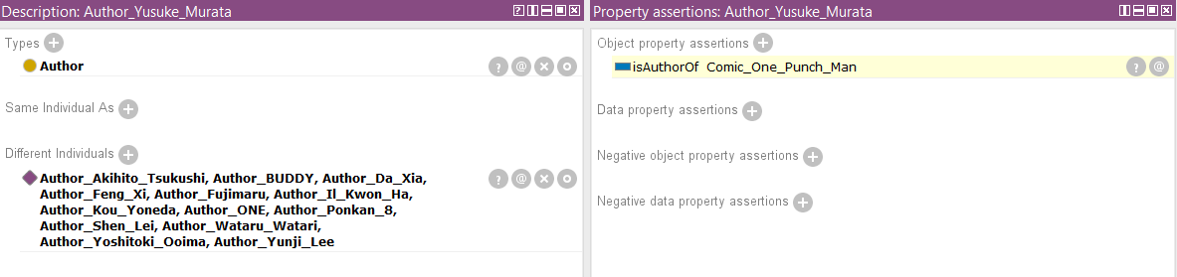
Demonstration of Inferencing
Studio_Production_I.G (studio Inference)
Author_Yusuke_Murata (author Inference)

Slide 12
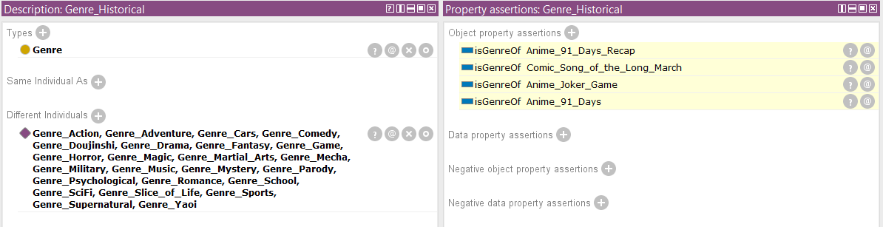
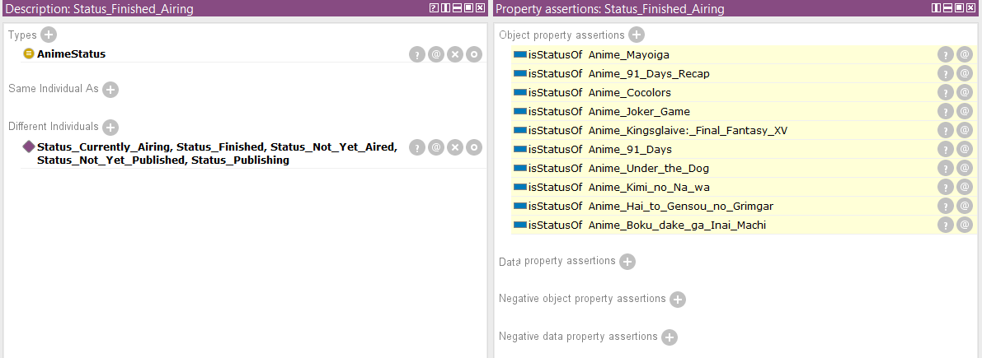
Demonstration of Inferencing
Genre_Historical (Genre Inference)
Status_Finished_Airing (Status Inference)

Slide 13
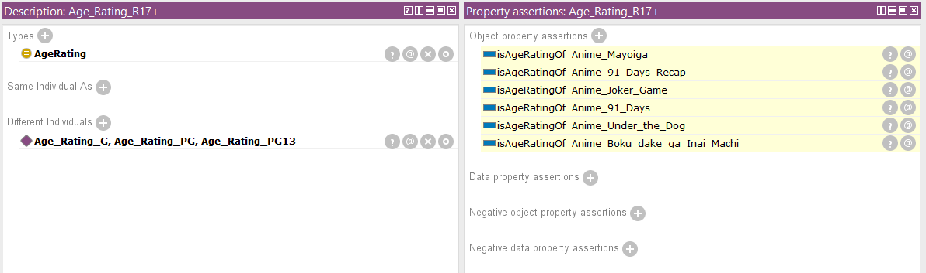
Demonstration of Inferencing
Age_Rating_R17+ (Age Rating Inference)

Slide 14
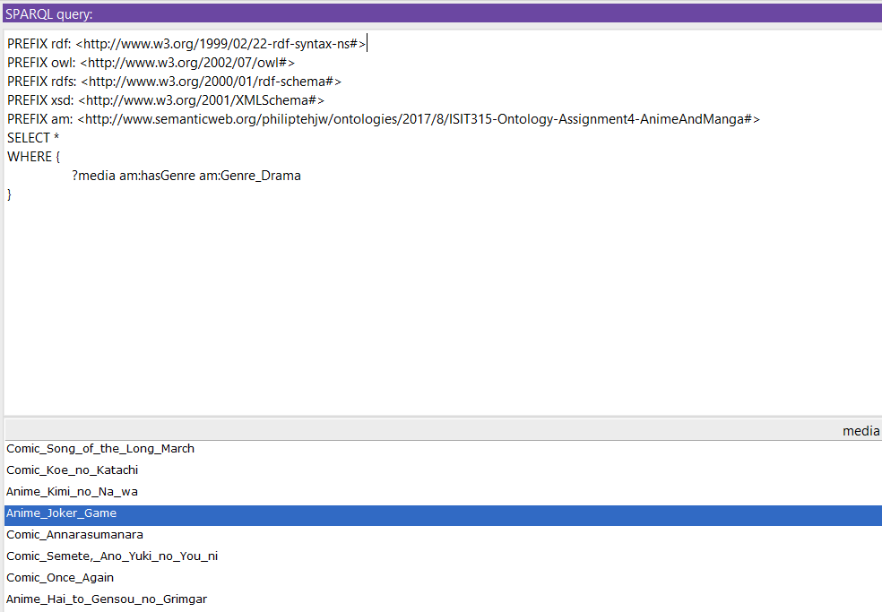
Demonstration of SPARQL
Find Media (anime/manga) that has the drama genre

Slide 15
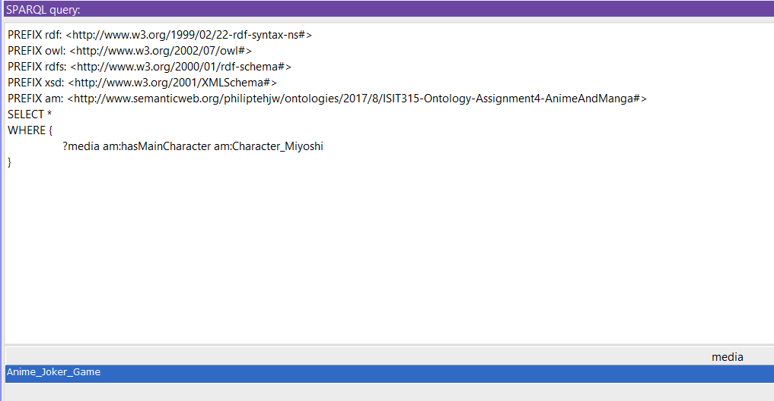
Demonstration of SPARQL
Find the media (Anime/Manga) where the character is found in

Slide 16
Thank You

