Slide 1
Optimize traffic fatalities prediction to make the transportation system safer
-Jingwen Yao

Slide 2
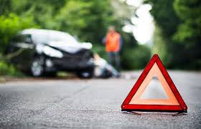
Introducuction
Transportation problems—traffic accidents
traffic fatality--threatening personal safety
randomness affected by factors such as driver and passenger characteristics, vehicle types, traffic conditions, and geometric design characteristics

Slide 3
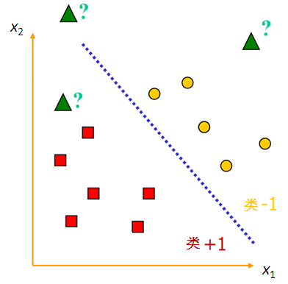
Method: support vector machine
a kind of supervised learning model based on statistical learning theory that is trying to minimize risk and be accurate
does not get trapped in a local optimum
maps the data in the nonlinear low-dimensional space into linear high-dimensional space

Slide 4
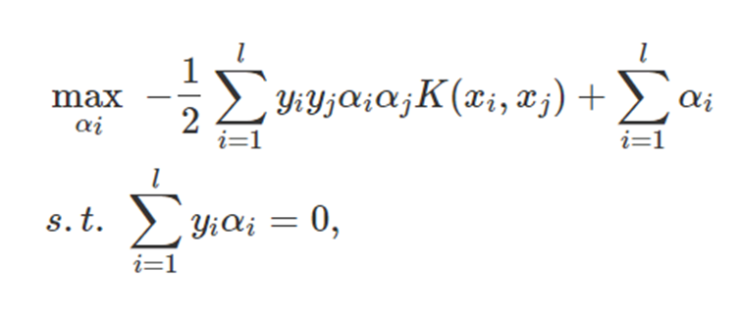
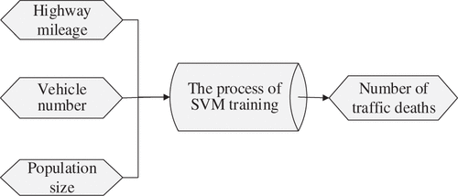
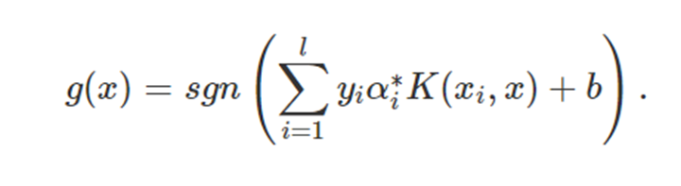
Method: support vector machine
Three principles: representation, testability, and comparability
Three basic factors: people, vehicle and road
Impact factors: highway mileage, vehicle number, lane width, average daily flow, and population

Slide 5
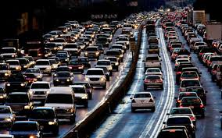
Gap and Plan
road traffic accident statistics has not been completed yet
Include more index
take impact factors into account as much as possible in the prediction

Slide 6
Thanks for listening

