Slide 1
Computer vision for biomedical images
Sören Lukassen

Slide 2
Feeding images to fully-connected neural networks

Slide 3
Feeding images to fully-connected neural networks

Slide 4
Feeding images to fully-connected neural networks

Slide 5
Feeding images to fully-connected neural networks

Slide 6
Feeding images to fully-connected neural networks

Slide 7
Feeding images to fully-connected neural networks

Slide 8
Let‘s build a zero-detector
1 | 1 | 1 | 0 | 0
1 | 0 | 1 | 0 | 0
1 | 1 | 1 | 0 | 0
0 | 0 | 0 | 0 | 0
0 | 0 | 0 | 0 | 0

Slide 9
Let‘s build a zero-detector
1 | 1 | 1 | 0 | 0
1 | 0 | 1 | 0 | 0
1 | 1 | 1 | 0 | 0
0 | 0 | 0 | 0 | 0
0 | 0 | 0 | 0 | 0
1 | 1 | 1
1 | 0 | 1
1 | 1 | 1
1 | 1 | 1
1 | -1 | 1
1 | 1 | 1
*
= 8
kernel

Slide 10
Let‘s build a zero-detector
1 | 1 | 1 | 0 | 0
1 | 0 | 1 | 0 | 0
1 | 1 | 1 | 0 | 0
0 | 0 | 0 | 0 | 0
0 | 0 | 0 | 0 | 0
1 | 1 | 0
0 | 1 | 0
1 | 1 | 0
1 | 1 | 1
1 | -1 | 1
1 | 1 | 1
*
= 3

Slide 11
Let‘s build a zero-detector
1 | 1 | 1 | 0 | 0
1 | 0 | 1 | 0 | 0
1 | 1 | 1 | 0 | 0
0 | 0 | 0 | 0 | 0
0 | 0 | 0 | 0 | 0
1 | 0 | 0
1 | 0 | 0
1 | 0 | 0
1 | 1 | 1
1 | -1 | 1
1 | 1 | 1
*
= 3

Slide 12
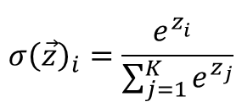
Let‘s build a zero-detector
1 | 1 | 1 | 0 | 0
1 | 0 | 1 | 0 | 0
1 | 1 | 1 | 0 | 0
0 | 0 | 0 | 0 | 0
0 | 0 | 0 | 0 | 0
score
ratio
softmax
8 | 3 | 3
3 | 1 | 2
3 | 2 | 1
.307 | .115 | .115
.115 | .038 | .077
.115 | .077 | .038
.967 | .007 | .007
.007 | .001 | .002
.007 | .002 | .001
$$σ{\left(\vec{z}\right)}_{i}=\frac{e^{z_{i}^{}}}{\sum_{j=1}^{K}{e^{z_{j}}}}$$

Slide 13
Let‘s build a zero-detector
0 | 1 | 1 | 1 | 0
0 | 0 | 0 | 1 | 0
0 | 0 | 1 | 0 | 0
0 | 1 | 0 | 0 | 0
0 | 1 | 1 | 1 | 0
score
ratio
softmax
3 | 5 | 2
2 | 1 | 2
2 | 5 | 3
.120 | .200 | .080
.080 | .004 | .080
.080 | .200 | .120
.054 | .410 | .020
.020 | .007 | .020
.020 | .410 | .054
$$σ{\left(\vec{z}\right)}_{i}=\frac{e^{z_{i}^{}}}{\sum_{j=1}^{K}{e^{z_{j}}}}$$

Slide 14
Let‘s build a zero-detector
1 | 1 | 1 | 0 | 0
1 | 0 | 1 | 0 | 0
1 | 1 | 1 | 0 | 0
0 | 0 | 0 | 0 | 0
0 | 0 | 0 | 0 | 0
score
8 | 3 | 3
3 | 1 | 2
3 | 2 | 1

Slide 15
Let‘s build a zero-detector
0 | 0 | 0 | 0 | 0 | 0 | 0
0 | 1 | 1 | 1 | 0 | 0 | 0
0 | 1 | 0 | 1 | 0 | 0 | 0
0 | 1 | 1 | 1 | 0 | 0 | 0
0 | 0 | 0 | 0 | 0 | 0 | 0
0 | 0 | 0 | 0 | 0 | 0 | 0
0 | 0 | 0 | 0 | 0 | 0 | 0
score
1 | 3 | 1 | 2 | 0
3 | 8 | 3 | 3 | 0
1 | 3 | 1 | 2 | 0
2 | 3 | 2 | 1 | 0
0 | 0 | 0 | 0 | 0
zero padding

Slide 16
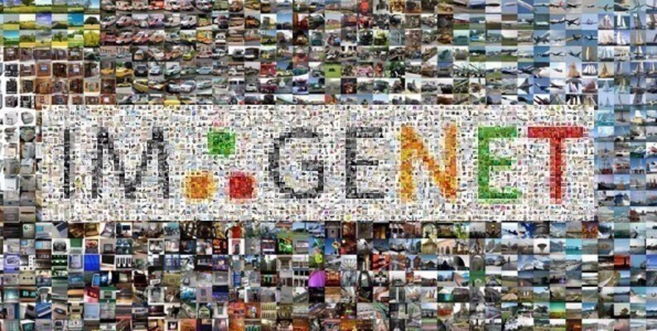
Stepping things up
ImageNet-1k:
1,000 classes
Image size: 224 * 224
1,281,167 training images

Slide 17
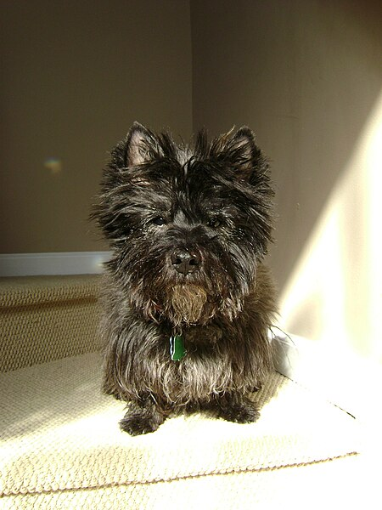
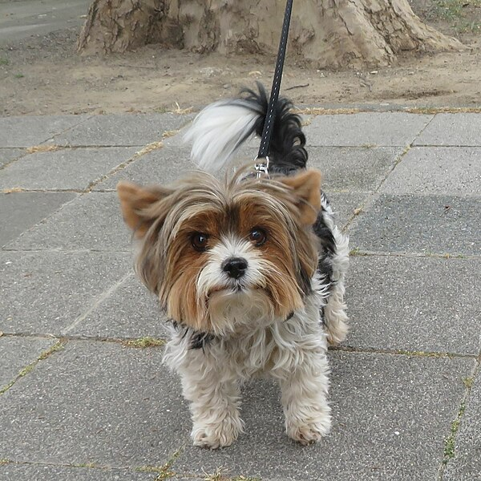
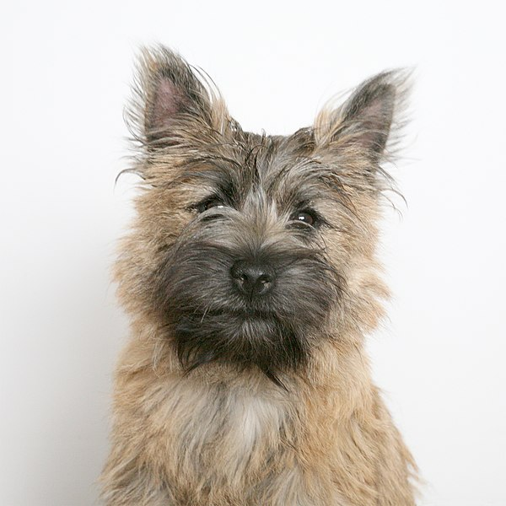
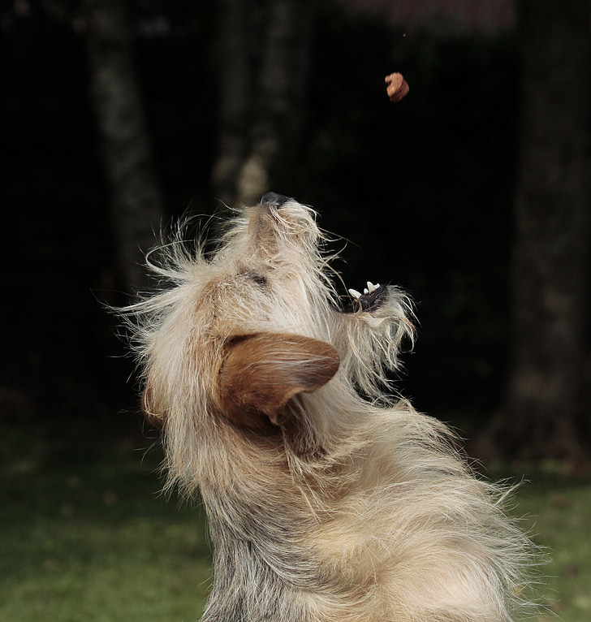
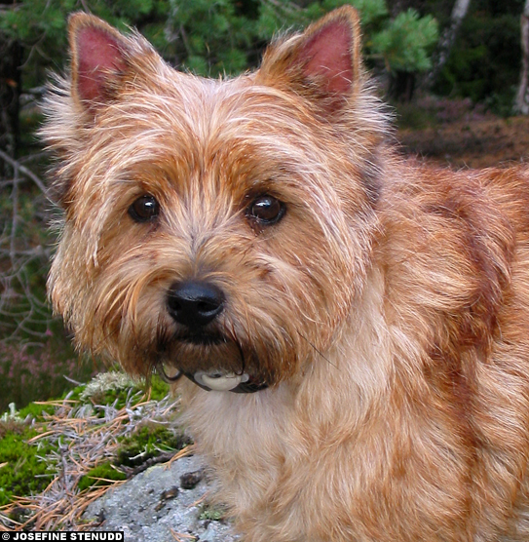
ImageNet example class 192: cairn terrier
© John, CC-BY-2.0
© Josefine S., CC-BY-NC-ND-2.0
© Rockytopscott, CC-BY-3.0

Slide 18
Detecting patterns vs detecting objects
b

Slide 19
Detecting patterns vs detecting objects
b

Slide 20
Detecting patterns vs detecting objects
b
-1 | 1 | -1
-1 | 1 | -1
-1 | 1 | -1
1 | 1 | 1
1 | -1 | 1
1 | 1 | 1

Slide 21
Let‘s build a b-pattern-detector
-2 | 2 | -2 | 0 | 0
-3 | 2 | -2 | 0 | -1
-3 | 2 | -4 | -1 | -2
-3 | 1 | -4 | 1 | -3
-2 | 1 | -3 | 1 | -2
-1 | 1 | -1
-1 | 1 | -1
-1 | 1 | -1
0 | 0 | 0 | 0 | 0 | 0 | 0
0 | 0 | 1 | 0 | 0 | 0 | 0
0 | 0 | 1 | 0 | 0 | 0 | 0
0 | 0 | 1 | 1 | 1 | 0 | 0
0 | 0 | 1 | 0 | 1 | 0 | 0
0 | 0 | 1 | 1 | 1 | 0 | 0
0 | 0 | 0 | 0 | 0 | 0 | 0
2 | 0 | 2 | 0 | 0
3 | 2 | 5 | 2 | 1
3 | 2 | 4 | 1 | 2
3 | 3 | 8 | 3 | 3
2 | 1 | 3 | 1 | 2
1 | 1 | 1
1 | -1 | 1
1 | 1 | 1

Slide 22
Detecting patterns vs detecting objects
b
d

Slide 23
b
-2 | 2 | -2 | 0 | 0
-3 | 2 | -2 | 0 | -1
-3 | 2 | -4 | -1 | -2
-3 | 1 | -4 | 1 | -3
-2 | 1 | -3 | 1 | -2
1 | -1 | -1
1 | -1 | -1
1 | -1 | 0
-14 | 14 | -6
-12 | 16 | -7
-4 | 15 | -7
-29 | 18 | -17
-31 | 20 | -24
-21 | 19 | -24
2 | 0 | 2 | 0 | 0
3 | 2 | 5 | 2 | 1
3 | 2 | 4 | 1 | 2
3 | 3 | 8 | 3 | 3
2 | 1 | 3 | 1 | 2
-1 | 1 | -1
-1 | 1 | -1
-1 | 1 | -1
-15 | 4 | -11
-19 | 4 | -17
-17 | 4 | -17

Slide 24
d
0 | 0 | -2 | 2 | -2
-1 | 0 | -2 | 2 | -3
-2 | -1 | -4 | 2 | -3
-3 | 1 | -4 | 1 | -3
-2 | 1 | -3 | 1 | -2
1 | -1 | -1
1 | -1 | -1
1 | -1 | 0
2 | 3 | -9
0 | 4 | -9
0 | 9 | -9
-9 | 7 | -24
-17 | 8 | -28
-17 | 13 | -26
0 | 0 | 2 | 0 | 2
1 | 2 | 5 | 2 | 3
2 | 1 | 4 | 2 | 3
3 | 3 | 8 | 3 | 3
2 | 1 | 3 | 1 | 2
-1 | 1 | -1
-1 | 1 | -1
-1 | 1 | -1
-11 | 4 | -15
-17 | 4 | -19
-17 | 4 | -17

Slide 25
Detecting patterns vs detecting objects
b
d
-29 | 18 | -17
-31 | 20 | -24
-21 | 19 | -24
-9 | 7 | -24
-17 | 8 | -28
-17 | 13 | -26

Slide 26
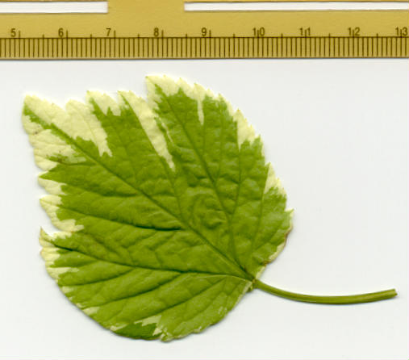
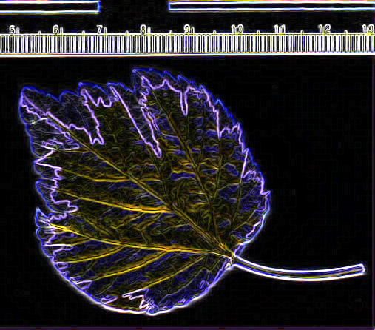
Common kernels
1 | 0 | -1
2 | 0 | -2
1 | 0 | -1
Sobel: edge detection
-1 | -1 | -1
-1 | 12 | -1
-1 | -1 | -1
1 | 1 | 1
1 | 1 | 1
1 | 1 | 1
sharpening
Box blur

Slide 27
Pytorch implementation
import torch.nn as nn
import torch.nn.functional as F
class CNN(nn.Module):
def __init__(self):
super().__init__()
self.conv1 = nn.Conv2d(3, 6, 5)
self.conv2 = nn.Conv2d(6, 16, 5)
self.fc1 = nn.Linear(16 * 24 * 24, 120)
self.fc2 = nn.Linear(120, 84)
self.fc3 = nn.Linear(84, 10)
def forward(self, x):
x = F.relu(self.conv1(x))
x = F.relu(self.conv2(x))
x = torch.flatten(x, 1)
x = F.relu(self.fc1(x))
x = F.relu(self.fc2(x))
x = self.fc3(x)
return x
model = CNN()
Conv2D: 2D convolutional layer; essentially a stack of kernels
in_channels: number of (color-)channels or kernels of the input
out_channels: number of kernels (→ outputs) of the layer
kernel_size: size of the kernels, square or tuple of sizes
Other arguments:
stride: shift in kernel passes
padding: whether/how to pad

Slide 28
Pytorch implementation
import torch.nn as nn
import torch.nn.functional as F
class CNN(nn.Module):
def __init__(self):
super().__init__()
self.conv1 = nn.Conv2d(3, 6, 5)
self.conv2 = nn.Conv2d(6, 16, 5)
self.fc1 = nn.Linear(16 * 24 * 24, 120)
self.fc2 = nn.Linear(120, 84)
self.fc3 = nn.Linear(84, 10)
def forward(self, x):
x = self.pool(F.relu(self.conv1(x)))
x = self.pool(F.relu(self.conv2(x)))
x = torch.flatten(x, 1)
x = F.relu(self.fc1(x))
x = F.relu(self.fc2(x))
x = self.fc3(x)
return x
model = CNN()
Conv2D: 2D convolutional layer; essentially a stack of kernels
in_channels: number of (color-)channels or kernels of the input
out_channels: number of kernels (→ outputs) of the layer
kernel_size: size of the kernels, square or tuple of sizes
Other arguments:
stride: shift in kernel passes
padding: whether/how to pad
Question: What size are the input images? Hint: default is no padding, stride of 1

Slide 30
Pooling
1 | 2 | 3 | 8
0 | 1 | 1 | 2
0 | 0 | 2 | 0
1 | 1 | 1 | 1
2x2
max pooling
2x2
average pooling
2 | 8
1 | 2
1 | 3.5
0.5 | 1

Slide 31
2D convolution, 5x5 kernel, no padding
2x2 pooling
2D convolution, 5x5 kernel, no padding
2x2 pooling

Slide 32
2D convolution, 5x5 kernel, padding
2x2 pooling
2D convolution, 5x5 kernel, padding
2x2 pooling

Slide 33
Pytorch implementation
import torch.nn as nn
import torch.nn.functional as F
class CNN(nn.Module):
def __init__(self):
super().__init__()
self.conv1 = nn.Conv2d(3, 6, 5)
self.conv2 = nn.Conv2d(6, 16, 5)
self.pool = nn.MaxPool2d(2, 2)
self.fc1 = nn.Linear(16 * 5 * 5, 120)
self.fc2 = nn.Linear(120, 84)
self.fc3 = nn.Linear(84, 10)
def forward(self, x):
x = self.pool(F.relu(self.conv1(x)))
x = self.pool(F.relu(self.conv2(x)))
x = torch.flatten(x, 1)
x = F.relu(self.fc1(x))
x = F.relu(self.fc2(x))
x = self.fc3(x)
return x
model = CNN()
Pooling window size is given (usually square, doesn‘t have to be)
Max pooling is much more common than average pooling, as it preserves high activations for small details better

Slide 34
Competitive architectures: VGG16
Input (3,224,224)
Conv-block 1 (64, 112, 112):
Conv2D(3, 64, 3)
Conv2D(64, 64, 3)
Maxpool
Conv-block 2 (128, 56, 56):
Conv2D(64, 128, 3)
Conv2D(128, 128, 3)
Maxpool
Conv-block 3 (256, 28, 28):
Conv2D(128, 256, 3)
Conv2D(256, 256, 3)
Conv2D(256, 256, 3)
maxpool
Conv-block 4 (512, 14, 14):
Conv2D(256, 512, 3)
Conv2D(512, 512, 3)
Conv2D(512, 512, 3)
Maxpool
Conv-block 5 (512, 7, 7):
Conv2D(512, 512, 3)
Conv2D(512, 512, 3)
Conv2D(512, 512, 3)
Maxpool
Linear(512*7*7, 4096)
Linear(4096, 4096)
Linear(4096, 1000)
softmax

Slide 35
Exercises
Create a CNN classifier for the MNIST dataset
What accuracy can you get?
Now try the same with the chestMNIST dataset (https://medmnist.com/). Modify your MNIST architecture to work with multiclass, multilabel data to do so
What changes do you have to make?
Do you get the same accuracy?
What performance do you get if you always predict „no finding“?
Extend the architecture to chestMNIST+, 224x224 size, to use for pretraining your semester project model

