Slide 1


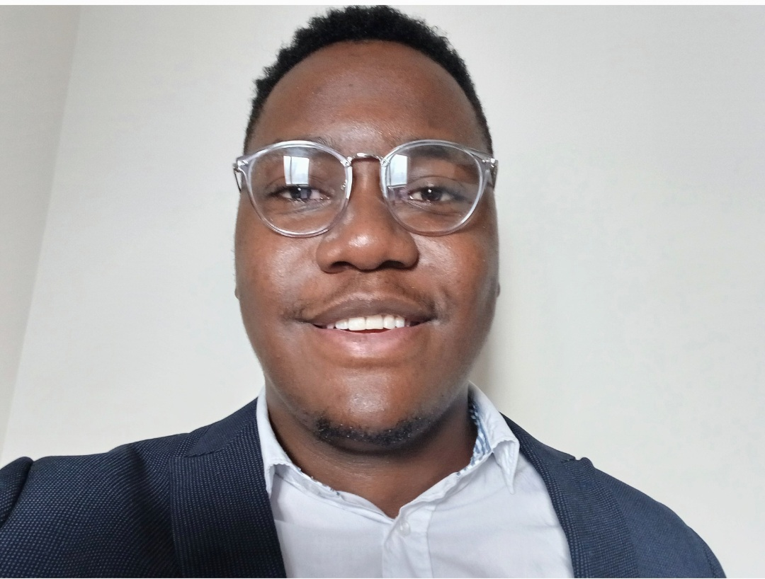

Quick Bites
Jingxi Li
Stavia Allwood
Francis Chapoterera
Zoher D

Slide 2
Problem Statement
• Problem: Food delivery can be inconvenient with difficulty comparing options and tracking orders. Restaurants struggle to reach new customers and manage online orders efficiently.
1
• Target Audience: Busy people who want convenient food delivery and restaurants that want to reach more customers.
2
• Challenges: Finding the right restaurant, comparing menus/prices/reviews, real-time order tracking, manual order processing for restaurants, limited customer reach for restaurants.
3
• Solution: QuickBites app connects users with local restaurants.
4
• Benefits: Users get a curated list of restaurants, easy ordering, real-time tracking, secure payment, optional loyalty programs. Restaurants gain wider reach, streamlined online ordering, platform to showcase offerings, access to customer data.
5

Slide 3

Overview
Show drafts
• Concept: QuickBites is a app for convenient food delivery from various local restaurants. It connects users, facilitates ordering, and offers real-time delivery tracking.
• Target Audience: Busy individuals and families who value convenience and a user-friendly interface for food delivery.
• Key Features for Users: Browse restaurants, explore menus, customize orders, track deliveries, read reviews, access order history, benefit from promotions.
• Benefits for Users: Convenience, variety, transparency, customization, efficiency.
• Benefits for Restaurants: Increased reach, simplified ordering, marketing opportunities, data & analytics.

Slide 4
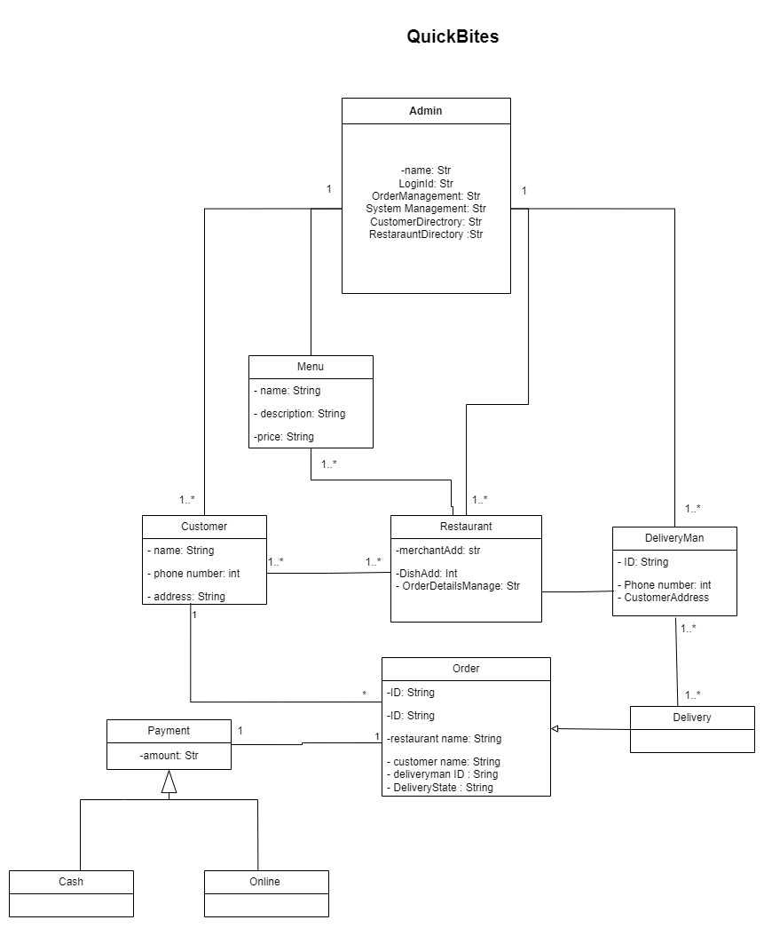
Class Diagram

Slide 5
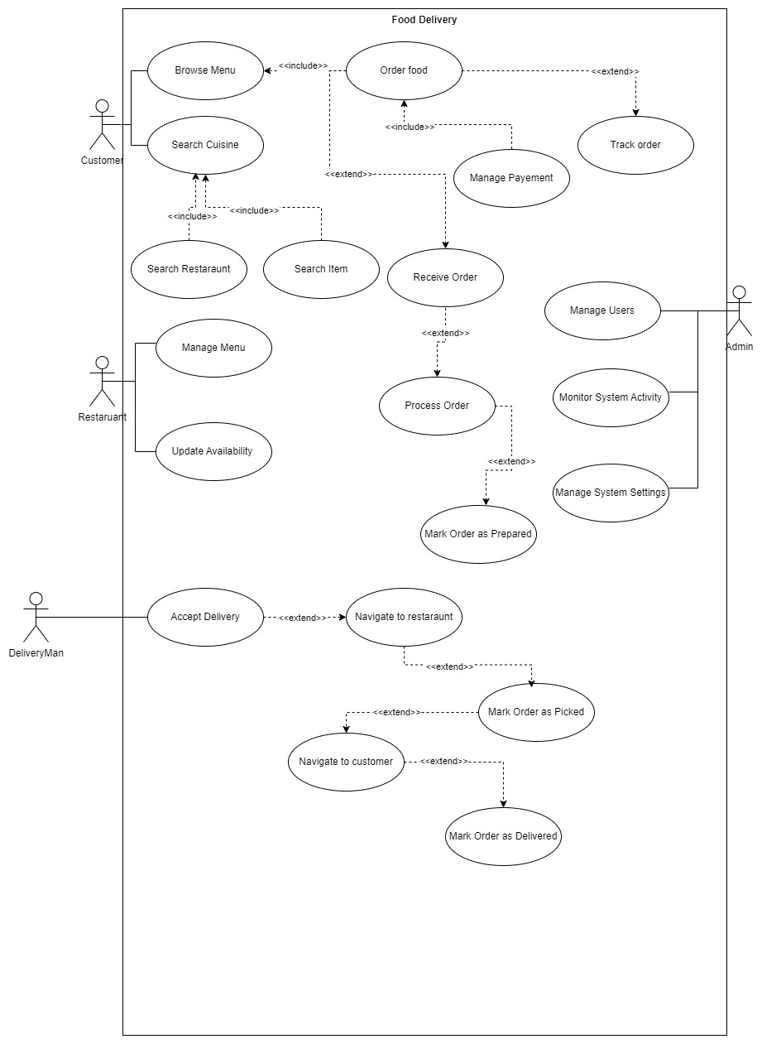
Use Case Diagram

Slide 6
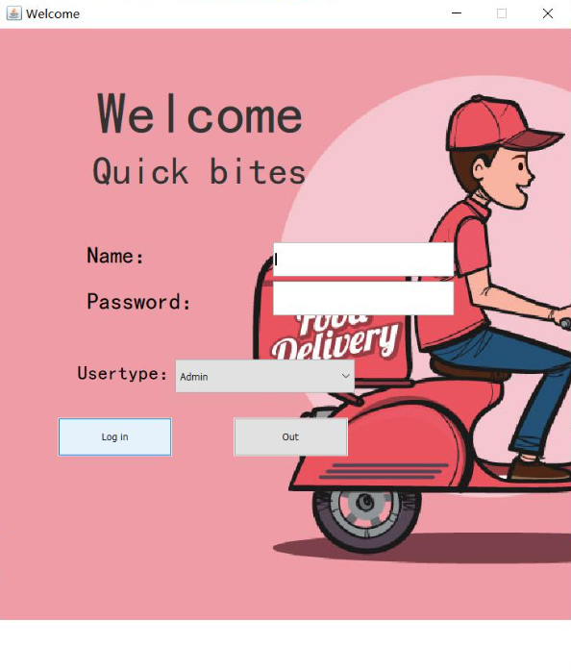
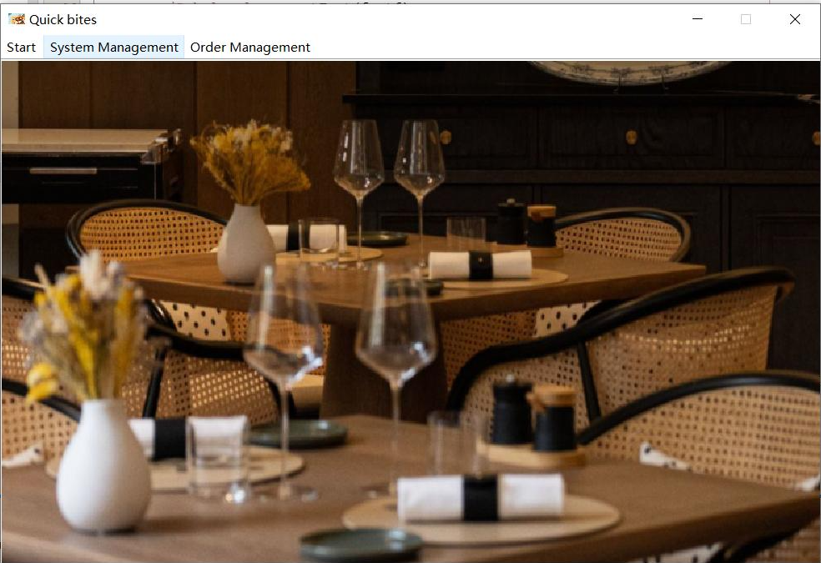
Start

Slide 7
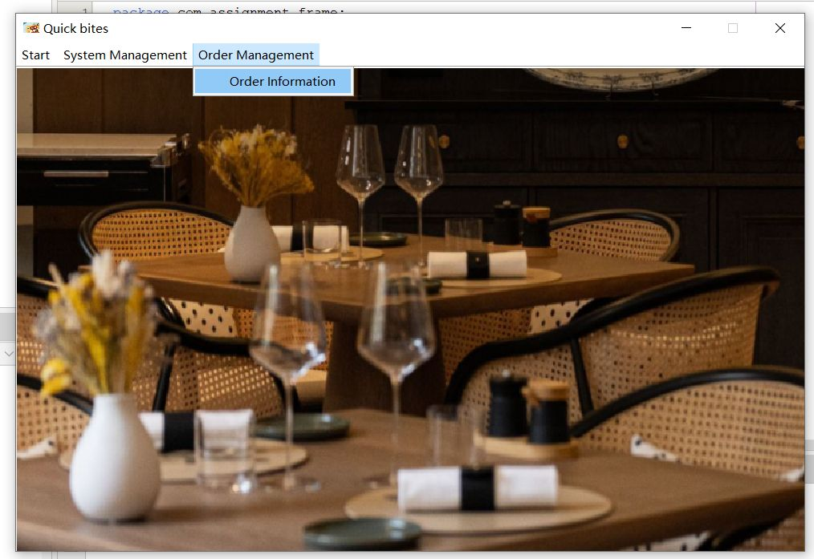
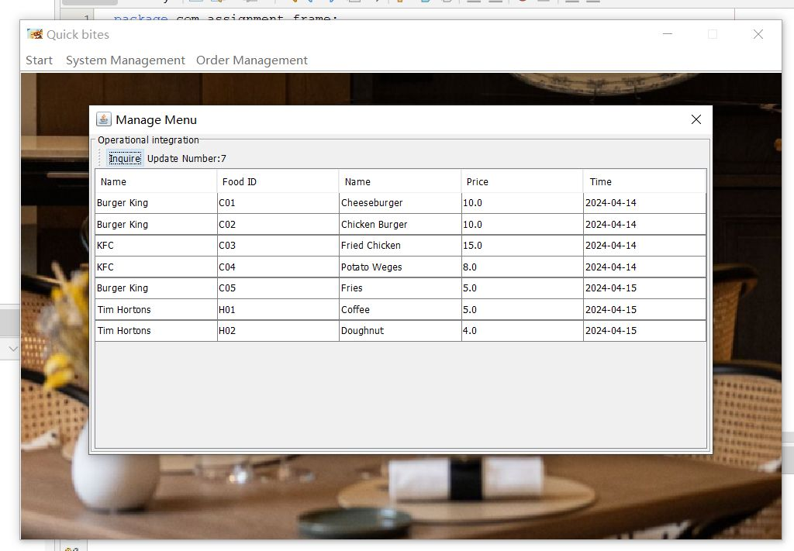
Admin

Slide 8
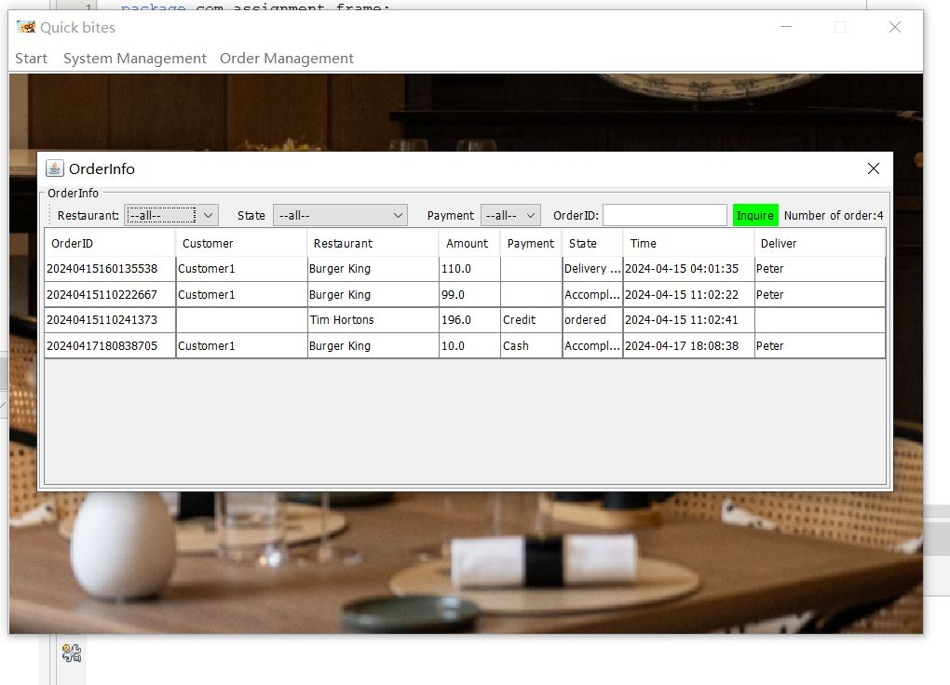
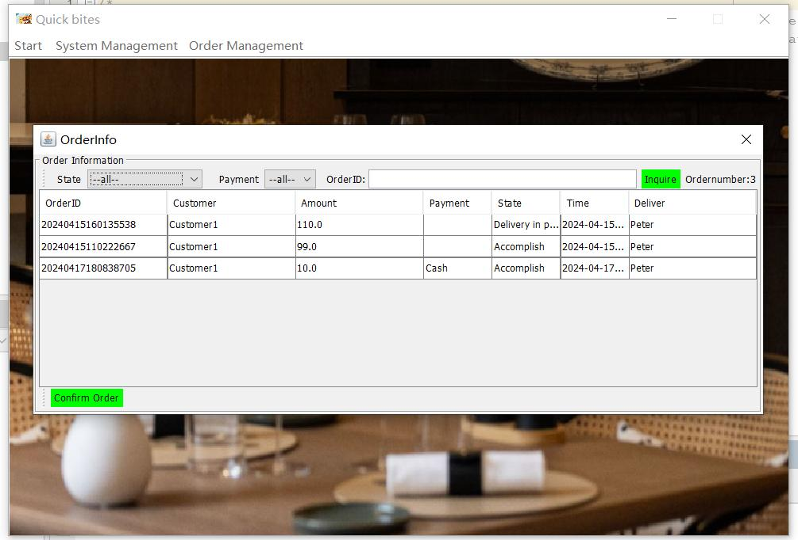
Customer

Slide 9
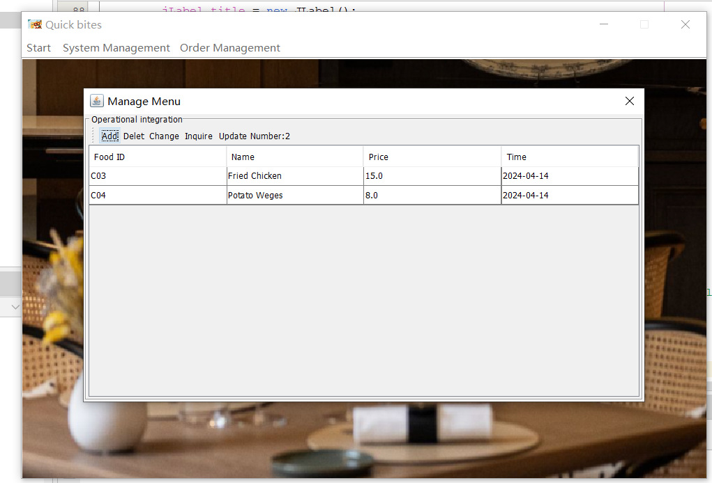
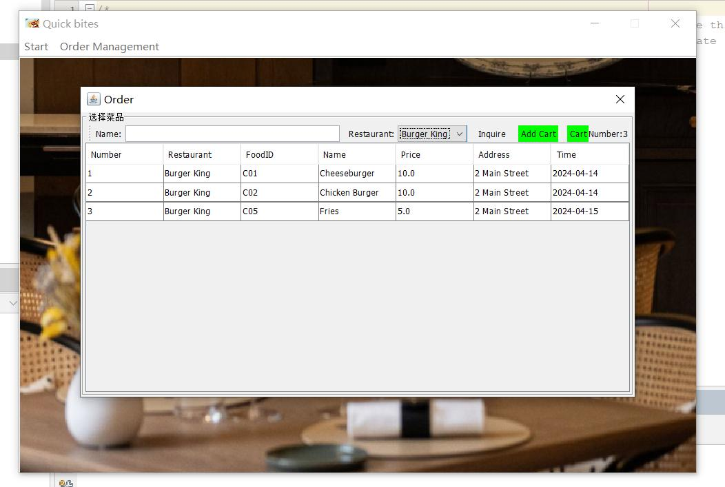
Restaurant

Slide 10
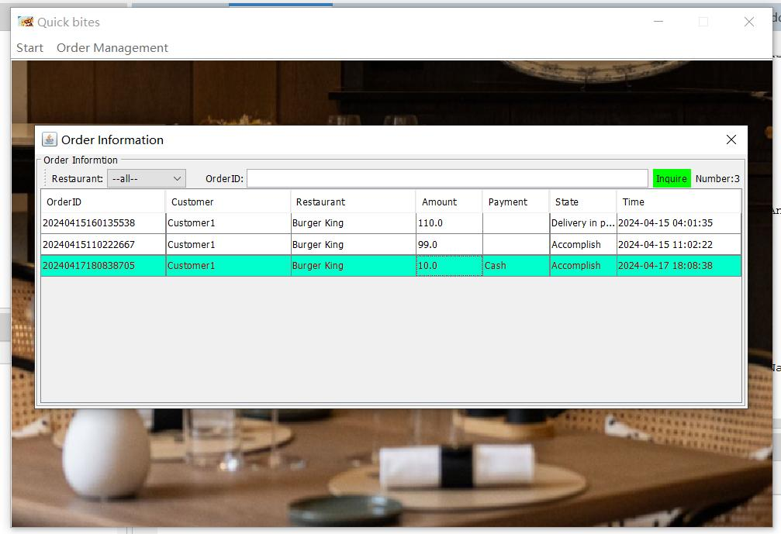
DeliveryMan

Slide 11
Thank You

