Slide 1
New Mexico Oil and Gas Production and Injection,
and Spill Incidents Study
Jing Xiang
jing.xiang6@gmail.com
https://github.com/jingxiang6

Slide 2
Problem statement
Analyze the oil, gas, water and CO2 production and injection patterns from various formations and well types in New Mexico.
The spill incidents are analyzed through inferential statistics and machine learning skills.
The goal of this project is to provide oil and gas companies with useful information for further research on water flooding and well type design to enhance oil and gas recovery, and how to avoid major spill incidents.

Slide 3
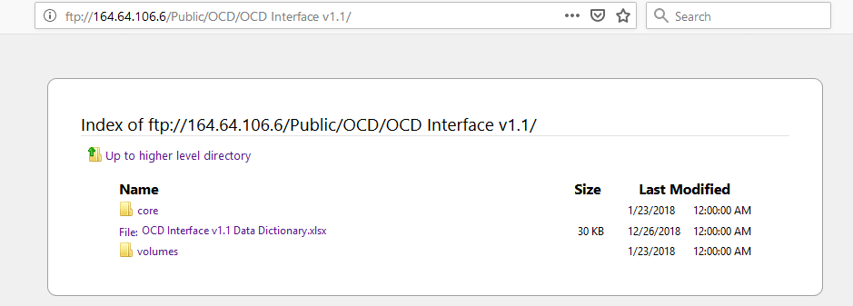
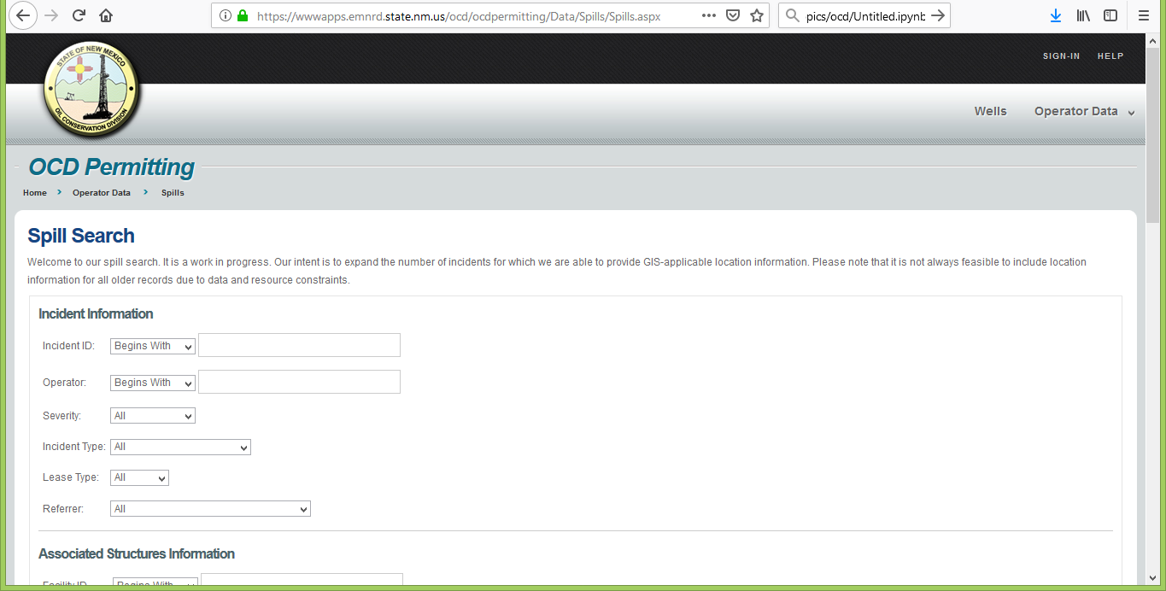
Datasets
convert XML files (about 65GB) to flat files (CSVs)
ftp://164.64.106.6/Public/OCD/OCD%20Interface%20v1.1/
https://wwwapps.emnrd.state.nm.us/ocd/ocdpermitting/Data/Spills/Spills.aspx

Slide 4
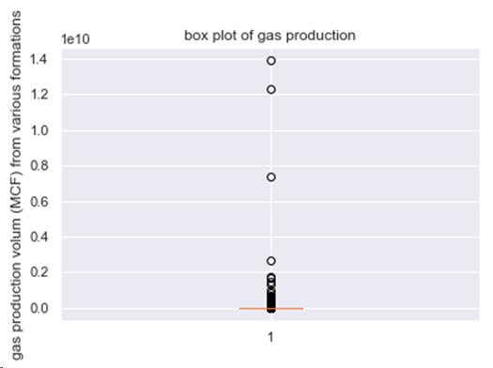
Data Wrangling
pool, wchistory, wellhistory, wcinjection, wcproduction, spills
Combine related columns into one column, api
Convert date to datetimeindex
Select columns for further analysis
Remove trailing spaces
Replace missing values as NaNs, and fill the NaNs
Check ‘outliers’

Slide 5
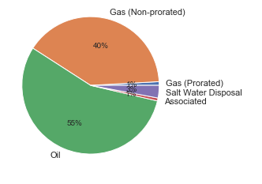
Exploratory Data Analysis
Total 4978 formations (pools):
2761(56%) are oil formations
1993(40%) are gas (non-prorated)
147(3%) are salt water disposal formations.
43(1%) formations are gas(prorated)
34(1%) are associated formations

Slide 6
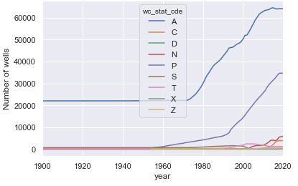
The number of active wells has increased linearly from around 22k to 65k, since 1970s until the year around 2010, and the number has been stable since 2010.
A: Active
C: Cancelled
D: Dry Hole
N: New, Not Drilled
X: Never Drilled
T: Temporary Abandonment
P: Zone Permanently Plugged
Z: Zones Temporarily Plugged

Slide 7
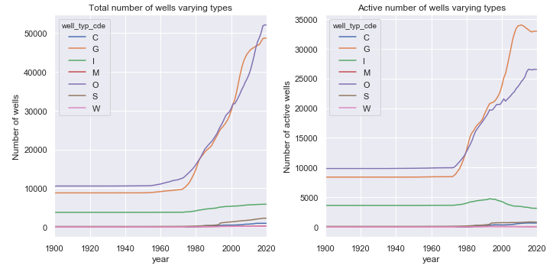
The total number of gas wells and total number of oil wells are both increasing linearly since 1980s
The number of active oil wells keeps constant since 2012
Current number of active oil wells around 27k
The number of active gas wells has dropped from around 34.3k to 33k since 2010
The number of active injection wells started to reduce in early 1990s
Current number of injection wells around 3k.
C: CO2
G: Gas
I: Injection
M: Miscellaneous
O: Oil
S: Salt Water Disposal
W: Water

Slide 8
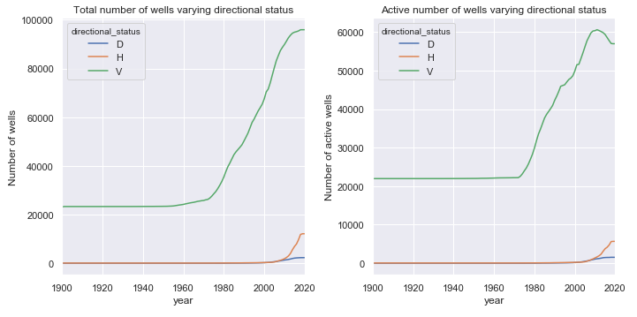
The vertical wells are dominate among both all kinds of wells and active wells in the history
The number of active vertical wells has grown linearly from 22k to 60k since 1970s, and it decreased about 3k since 2010
while the active horizontal wells have increased from 0 to 5.5k since 2000.
while the active directional wells have increased from 0 to 1.5k since 2000.
D: Directional
H: Horizontal
V: Vertical

Slide 9
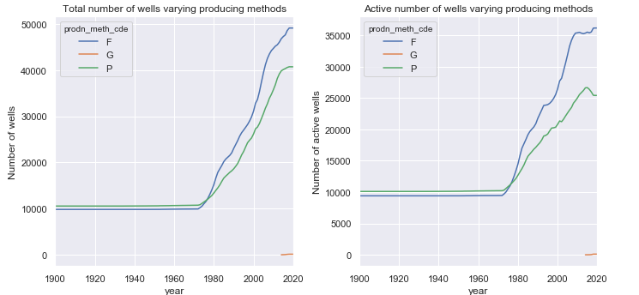
The Flowing and pumping are two dominate producing methods
Flowing has been more popular than pumping since 1970s when they started to increase linearly
The growth of active flowing producing method started to slow down since 2008, with 36k wells currently
The active pumping (current 25k well) started to drop in 2012 when gas lift was introduced onsite.
P: Pumping
F: Flowing
G: Gas Lift

Slide 10
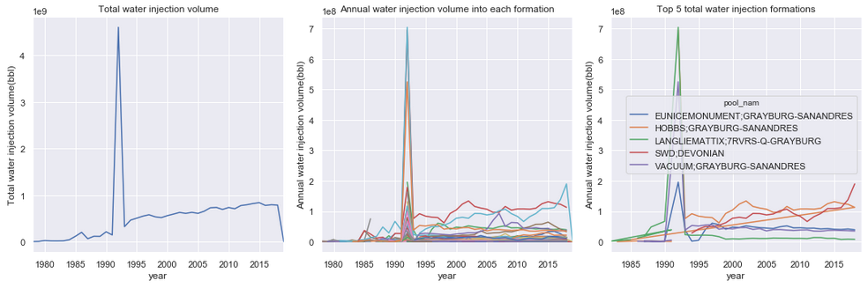
The peak of water injection happened in early 1990s, about 4.7e9 bbls/year
After the peak point, the total water injection volume increases linearly below 1.0e9 bbls/year
The top 5 formations which have the most total water injection volume are:
HOBBS;GRAYBURG-SANANDRES, with total injection volume 3.42e9 bbls
SWD;DEVONIAN, with total injection volume 2.16e9 bbls
VACUUM;GRAYBURG-SANANDRES, with total injection volume 1.61e9 bbls
EUNICEMONUMENT;GRAYBURG-SANANDRES, with total injection volume 1.30e9 bbls
LANGLIEMATTIX;7RVRS-Q-GRAYBURG, with total injection volume 1.26e9 bbls

Slide 11
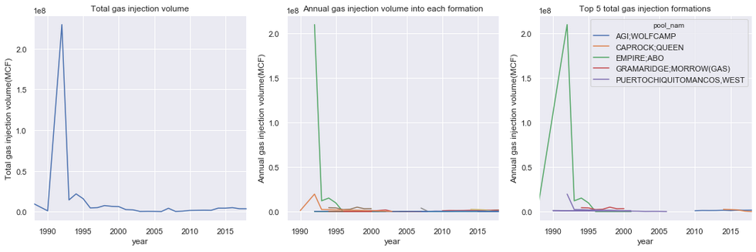
The peak of gas injection happened in early 1990s, about 2.3e8 MCF/year.
After the peak point, the total gas injection volume keeps below 1e7 MCF/year.
The top 5 formations which have the most total gas injection volume are:
EMPIRE;ABO, with total injection volume 2.57e8 MCF
PUERTOCHIQUITOMANCOS,WEST, with total injection volume 3.56e7 MCF
GRAMARIDGE;MORROW(GAS), with total injection volume 2.47e7 MCF
AGI;WOLFCAMP, with total injection volume 1.17e7 MCF
CAPROCK;QUEEN, with total injection volume 7.07e6 MCF

Slide 12
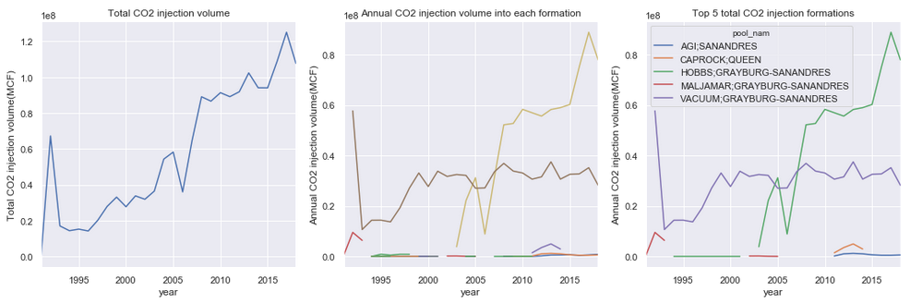
The peak of CO2 injection happens in early 1990s, about 6.7e7 MCF/year.
After the peak point, the total CO2 injection volume increases linearly with low peak at 2006, about 3.9e7 MCF/year.
The top 5 formations which have the most total CO2 injection volume are:
VACUUM;GRAYBURG-SANANDRES, with total injection volume 7.98e8 MCF
HOBBS;GRAYBURG-SANANDRES, with total injection volume 7.92e8 MCF
MALJAMAR;GRAYBURG-SANANDRES, with total injection volume 1.62e7 MCF
CAPROCK;QUEEN, with total injection volume 1.30e7 MCF
AGI;SANANDRES, with total injection volume 5.44e6 MCF

Slide 13
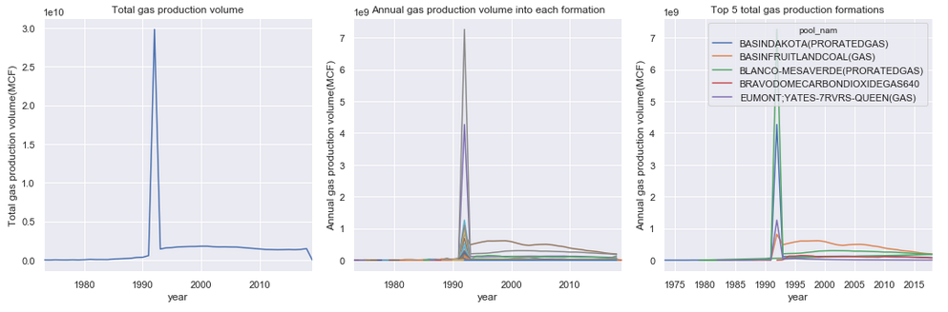
The annual gas production reaches peak in early 1990s, around 3e10 MCF/year
and then keeps stable between 2e9 MCF/year and 3e9 MCF/year
The individual formation follows the similar pattern
The top 5 gas production formations are :
BLANCO-MESAVERDE(PRORATEDGAS), with total production volume 1.39e10 MCF
BASINFRUITLANDCOAL(GAS), with total production volume 1.23e10 MCF
BASINDAKOTA(PRORATEDGAS), with total production volume 7.39e9 MCF
BRAVODOMECARBONDIOXIDEGAS640, with total production volume 2.69e9 MCF
EUMONT;YATES-7RVRS-QUEEN(GAS), with total production volume 1.75e9 MCF

Slide 14
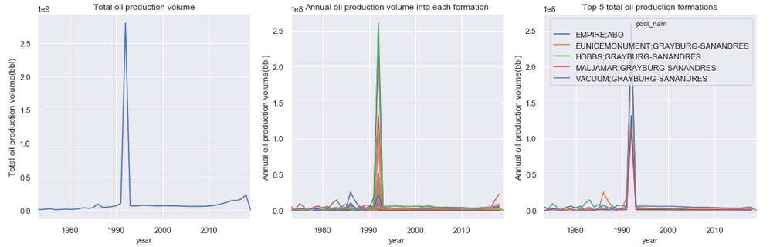
The annual total oil production reaches peak in early 1990s, around 2.8e9 bbls/year
and then keeps stable around 1e9 bbls/year until 2010
and the total annual production has increased to about 2e9 bbls/year since 2010
The individual formation follows this pattern that the production reaches peak in early 1990s
The top 5 formations which produce the most oil are:
VACUUM;GRAYBURG-SANANDRES, with total production volume 3.97e8 bbls
HOBBS;GRAYBURG-SANANDRES, with total production volume 3.89e8 bbls
EUNICEMONUMENT;GRAYBURG-SANANDRES, with total production volume 3.70e8 bbls
EMPIRE;ABO, with total production volume 2.15e8 bbls
MALJAMAR;GRAYBURG-SANANDRES, with total production volume 1.55e8 bbls

Slide 15
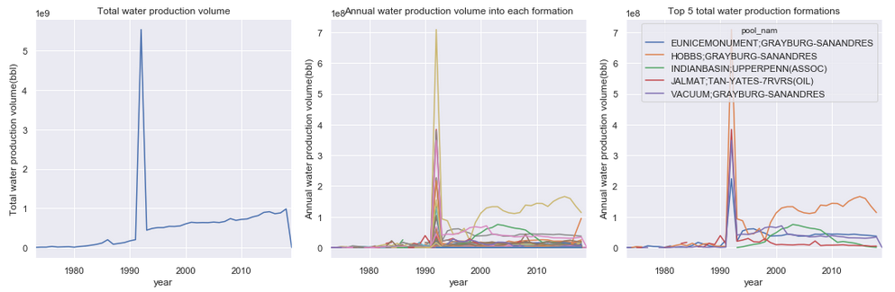
The peak annual total water production happens in early 1990s, around 5.7e9 bbls/year
after that the water production volume increases linearly from 4e8 bbls/year to 1e9 bbls/year
The individual formation follows similar pattern
The top 5 formations which produce the most water are:
HOBBS;GRAYBURG-SANANDRES, with total production volume 3.78e9 bbls
VACUUM;GRAYBURG-SANANDRES, with total production volume 1.47e9 bbls
EUNICEMONUMENT;GRAYBURG-SANANDRES, with total production volume 1.43e9 bbls
INDIANBASIN;UPPERPENN(ASSOC), with total production volume 8.19e8 bbls
JALMAT;TAN-YATES-7RVRS(OIL), with total production volume 8.13e8 bbls

Slide 16
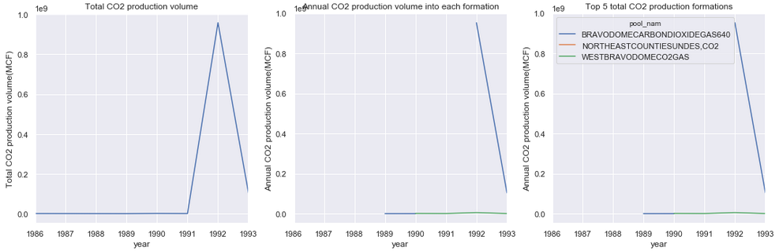
The annual CO2 production reaches peak in 1992, around 9.5e8 MCF/year.
There are three formations produced CO2 from late 1980s to early 1990s,
the total CO2 production from each formation is:
BRAVODOMECARBONDIOXIDEGAS640, with total production volume 1.06e10 MCF
WESTBRAVODOMECO2GAS, with total production volume 7.37e6 MCF
NORTHEASTCOUNTIESUNDES,CO2, with total production volume 5.30e5 MCF

Slide 17
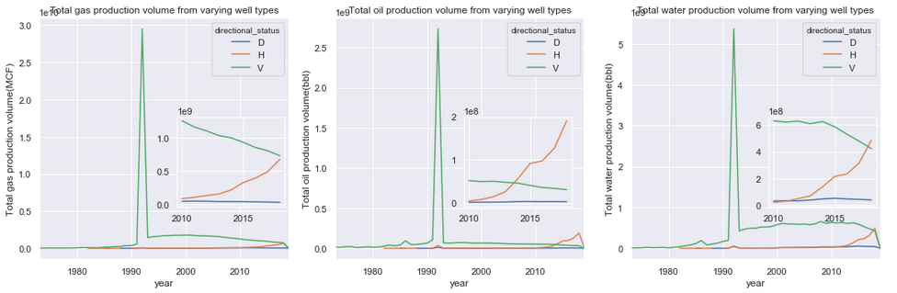
It shows that the vertical wells dominate the production in the history until 2010s when horizontal wells started to apply in oil and gas fields.
The gas production from horizontal wells is very close to the production from vertical wells in 2018, with the tendency to exceed in coming year.
The oil production from horizontal wells has exceeded the production from vertical well in 2013, and the production volume from horizontal wells is about four times of the production from vertical wells.
At the same time, water production from horizontal wells increases and exceeds the production from vertical wells in 2017.

Slide 18
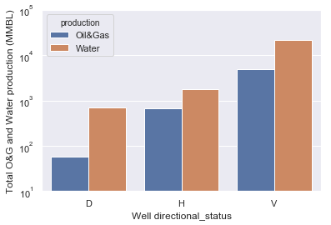
Converting the production gas to barrel of oil equivalent (BOE):
The barrel of oil equivalent (BOE) is a unit of energy based on the approximate energy released by burning one barrel (42 U.S. gallons or 158.9873 litres) of crude oil
The USGS gives a figure of 6,000 cubic feet (170 cubic meters) of typical natural gas are equivalent to one BOE
Vertical wells lead both oil/gas (5e3 MMBL) and water (2e4 MMBL) production
total 7e2 MMBL oil and gas, and 1.8e3 MMBL water are produced from horizontal wells
total 56 MMBL oil and gas, and 7e2 MMBL water are produced from directional wells

Slide 19
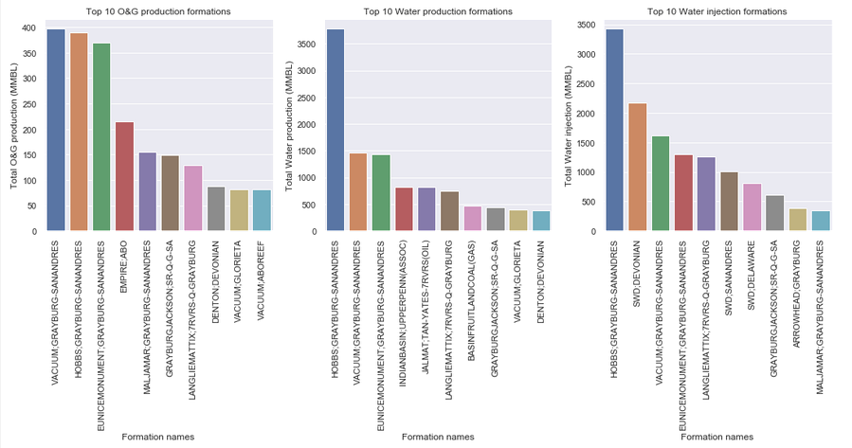
There is a high correlation between production and injection generally, meaning more injection and more production, HOBBS;GRAYBURG-SANANDRES
The No.2 water injection formation SWD;DEVONIAN doesn't production corresponding oil and gas, which is out of top 10 oil and gas and water production formations
The No.4 oil and gas production formation EMPIRE;ABO is out of the top 10 water production and injection, which is a signal of high water flooding efficiency.

Slide 20
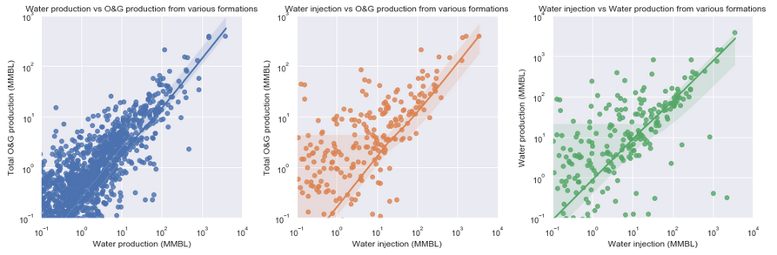
Positive linear relationships between water production and oil/gas production, water injection and oil/gas production, and water injection and water production from various formations.

Slide 21
Conclusion
Among the total 4978 formations (pools), 43(1%) formations are gas(prorated), 1993(40%) are gas (non-prorated), 2761(56%)* are oil formations, 34(1%) are associated formations, and 147(3%) are salt water disposal formations.
The number of active wells has increased linearly from around 22k to 65k, since 1970s until the year around 2010, and the number has been stable since 2010.
The total number of gas wells and total number of oil wells are both increasing linearly since 1980s, but the increase of active oil wells has slowed down since 2000, with current number of active oil wells around 27k. The number of active gas wells has dropped from around 34.3k to 33k since 2010. The number of active injection wells started to reduce in early 1990s, with current number of injection wells around 3k.
The vertical wells are dominate among both all kinds of wells and active wells in the history. The number of active vertical wells has grown linearly from 22k to 60k since 1970s, and it decreased about 3k since 2010, while the active horizontal and directional wells has increased from 0 to 5.5k and 1.5k since 2010.
Flowing and pumping are two dominate producing methods, and flowing has been more popular than pumping since 1970s when they started to increase linearly. The growth of active flowing producing method started to slow down since 2008, with 36k wells currently applying flowing producing method. The active pumping (current 25k well) started to drop in 2012 when gas lift was introduced onsite.
Both the injection (water, gas, CO2) and production (gas, oil, water, and CO2) reach peak in 1992.

Slide 22
The vertical wells dominate the production in the history until 2010s when horizontal wells started to apply in oil and gas fields. The gas production from horizontal wells is very close to the production from vertical wells in 2018, with the tendency to exceed in coming year. The oil production from horizontal wells has exceeded the production from vertical well in 2013, and the production volume from horizontal wells is about four times of the production from vertical wells. At the same time, water production from horizontal wells increases and exceeds the production from vertical wells in 2017.
Converting gas to barrel of oil equivalent, the vertical wells lead both total oil/gas (5e3 MMBL) and total water (2e4 MMBL) production; total 7e2 MMBL oil and gas, and 1.8e3 MMBL are produced from horizontal wells; total 56 MMBL oil and gas, and 7e2 MMBL water are produced from directional wells.
There is a positive linear relationships between water production and oil/gas production, water injection and oil/gas production, and water injection and water production from various formations. In reality, we prefer high oil and gas production and low water production with either high or low water injection, and trying to avoid the opposite. The No.2 water injection formation SWD;DEVONIAN doesn't production corresponding oil and gas, which is out of top 10 oil and gas production formations; and the formation is out of top 10 water production either, thus it's interesting to further study on the real formations which water injection into. The No.4 oil and gas production formation EMPIRE;ABO is out of the top 10 water production and injection, which is a signal of high water flooding efficiency.
The efficiency of water flooding is good in some formations which have high oil and gas production, such as
HOBBS;GRAYBURG-SANANDRES,
VACUUM;GRAYBURG-SANANDRES,
EUNICEMONUMENT;GRAYBURG-SANANDRES,
EMPIRE;ABO,
MALJAMAR;GRAYBURG-SANANDRES

Slide 23
Future Work:
The influence of production methods on production;
Further water, gas and CO2 flooding efficiency study on certain formations;
As the horizontal well starts to dominate production in the past 5 years, it's interesting to further study on horizontal well completion methods, such as hydraulic fracturing.
The time schedule from drilling, completion to start production to optimize well planning

Slide 24
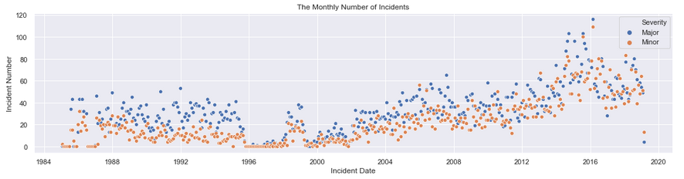
Inferential statistics analysis
There are more major incidents in the history.
The monthly number of incidents is stable around 20/month from 1986 to 1995
goes down to below 10/month from 1996 to 1998
goes up to around 20/month in 1999
then goes down to below 10/month in 2000
after that it keeps increasing to around 60/month in 2018
and the maximum number of major and minor incident happens in 2016 which is more than 100/month.

Slide 25
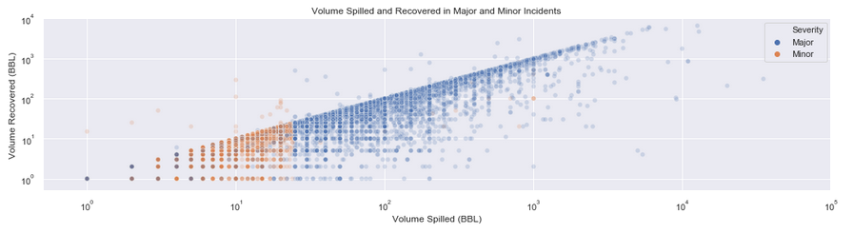
the volume spilled in minor incidents is below 50 barrels with few exceptions
and the volume spilled in major incidents ranges widely up to 60,000 barrels.
The volume recovered is less or equal to the volume spilled with few exceptions.

Slide 26
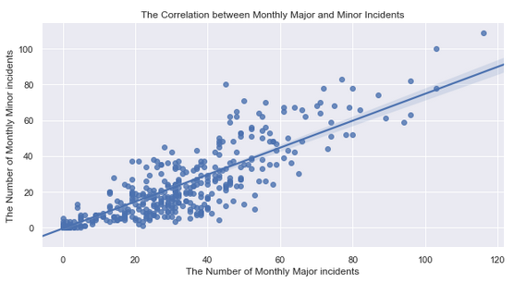
a positive linearly relationship between major and minor incidents
To reduce the number of incidents, we should try to avoid both of them

Slide 27
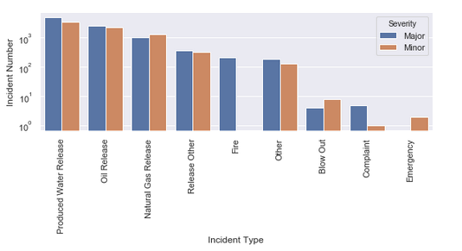
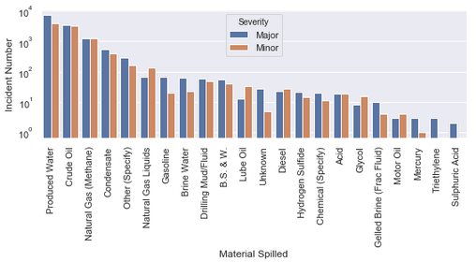
The top three incident types are produced water release, oil release and natural gas release which is corresponding to the top three spilled materials;

Slide 28
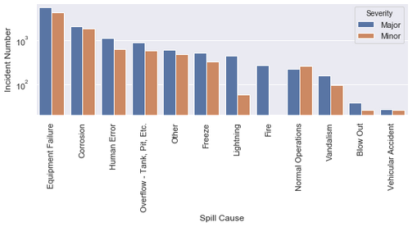
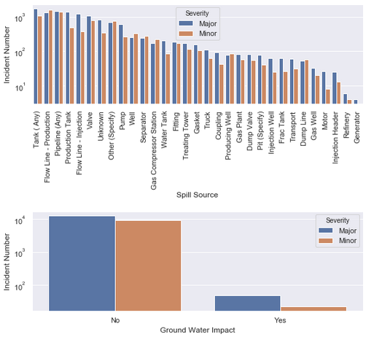
The top three spill causes are equipment failure, corrosion and human error;
and the top three spilled sources are tank (any), flow line - production, and pipeline (any).
We need to pay special attention to fire, triethylene and sulphuric acid spill, and generator, since they are related to major incident only.

Slide 29
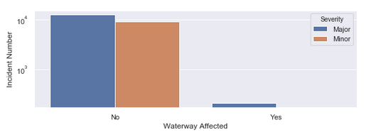
groundwater is more likely impacted by major incidents,
and the waterway are 100% affected by major incidents.
There is a loose correlation (0.7%) between groundwater impact and waterway affected.

Slide 30
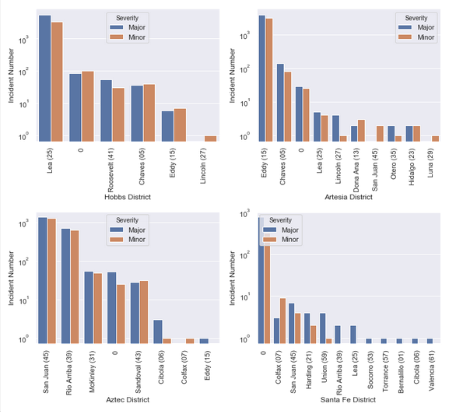
The most of major and minor incidents happens in county Lea in Hobbs, Eddy in Artesia, San Juan in Aztec, and 0 (missing county name probably) in Santa Fe.
The following counties have major incidents happened only: Eddy in Aztec, county Rio Arriba, Lea, Socorro, Torrance, Bernalillo, Cibola and Valencia in Santa Fe.

Slide 31
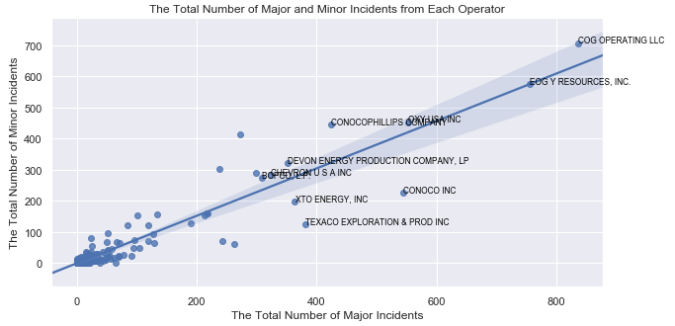
positive linear relationship between the total number of major and minor incidents from each operator.
The top 10 operators which have the most major and minor incidents are marked out in the plot.
COG OPERATING LLC and EOG Y RESOURCES,INC. are the first two operators cause most of incidents in New Mexico.

Slide 32
Assumption:
Null hypothesis: the probability of an incident is a major incident is equal in facilities and wells;
Alternative hypothesis: the probability of an incident is a major incident in wells is larger than in facilities.
Assume significance level 𝑎𝑙𝑝ℎ𝑎= 5%.
In the bootstrap test:
the differences between the number of major incidents and minor incidents in the sample is calculated;
then conduct the bootstrap test 10000 times, reorganize the severity data, calculate the difference between the number of major incidents and minor incidents each time.
The p value of the bootstrap difference is large than the sample difference is 0.5% assuming 5% significance.
So we reject the null hypothesis that since p value is less than 5%, and accept the alternative hypothesis that the probability that an incident is a major incident in wells is larger than in facilities.
In the z proportion test:
the probabilities of major incidents happen in facility and well are calculated,
and the probability of major incidents of the sample is p, and then the standard error, z score, and p value are calculated.
p value 0.2% which is less than 5%,
so the null hypothesis is rejected and alternative hypothesis is accepted.

Slide 33
Conclusion
The probability that an incident is a major incident in wells is larger than in facilities.
There are more major incidents in the history since 1980s. The monthly number of incidents has increased to around 60/month in 2018.
The volume spilled in minor incidents (below 50 barrels) is much less than the volume spilled in major incidents (up to 100,000 barrels).
The correlation between monthly major and minor incidents indicates a positive linearly relationship between major and minor incidents.
The top three incident types are produced water release, oil release and natural gas release which is corresponding to the top three spilled materials; The top three spill causes are equipment failure, corrosion and human error; and the top three spilled sources are tank (any), flow line - production, and pipeline (any). Fire, triethylene and sulphuric acid spill, and generator have 100% probability to cause major incident.
The groundwater is more likely impacted by major incidents than minor incidents, and the waterway are 100% affected by major incidents.
The most of major and minor incidents happens in county Lea in Hobbs, Eddy in Artesia, San Juan in Aztec, and 0 (missing county name probably) in Santa Fe.
There is a positive linear relationship between the total number of major and minor incidents from each operator. COG OPERATING LLC and EOG Y RESOURCES,INC. are the first two operators cause most of incidents in New Mexico.

Slide 34
Machine Learning
4183 the missing values of incident severity out of 26454 rows
KNeighborsClassifier to conduct the supervised classification machine learning
train_test_split
GridSearchCV
Features:
whether the incident happened in a facility or well,
the incident type,
material spilled,
volume spilled,
spill cause,
spill source,
waterway affected or not,
groundwater impacted or not.

Slide 35
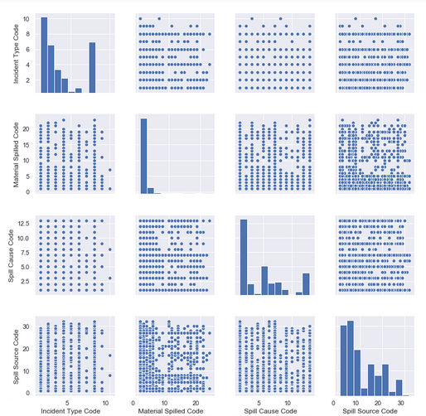

Slide 36
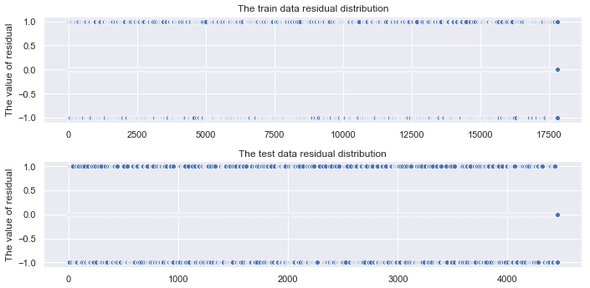
92.5% accuracy score for train data and 82.1% accuracy score for test data
with the best n_neighbors=2

Slide 37
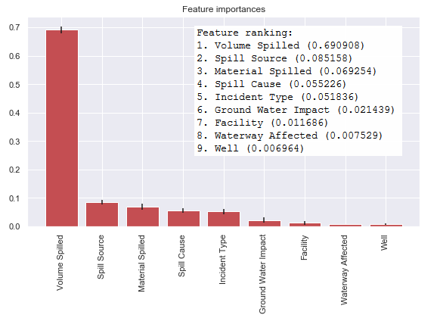
Incident feature importance

Slide 38
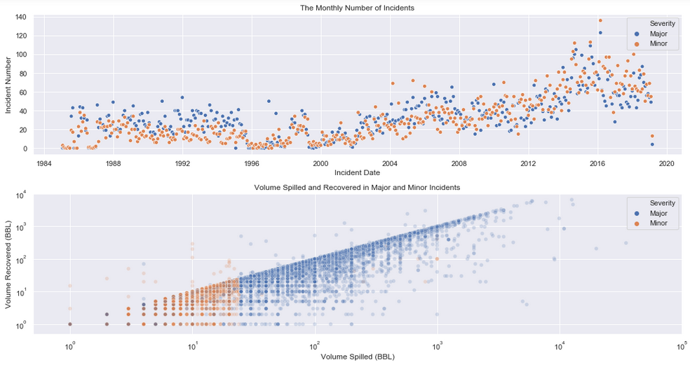
The monthly number of incidents increases by 10 to 20/month after 2008
and maximum number of major and minor incidents is more than 120/month in 2016 with more minor incidents than major incidents.

Slide 39
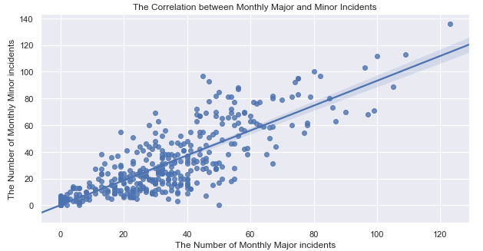
the maximum monthly number of minor incidents is more than major incidents after updating

Slide 40
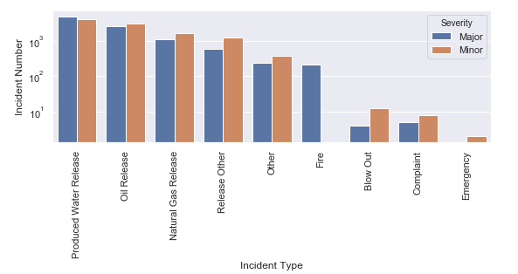
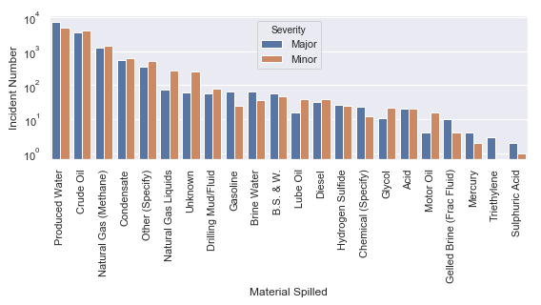
the number of minor and major incidents of each category is adjusted slightly and reordered.

Slide 41
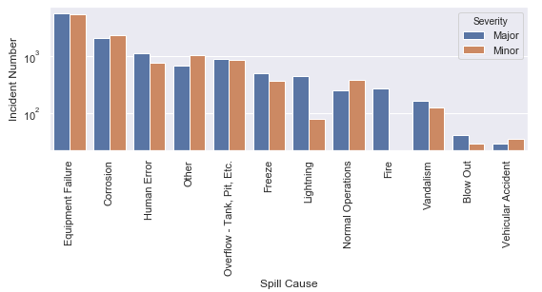
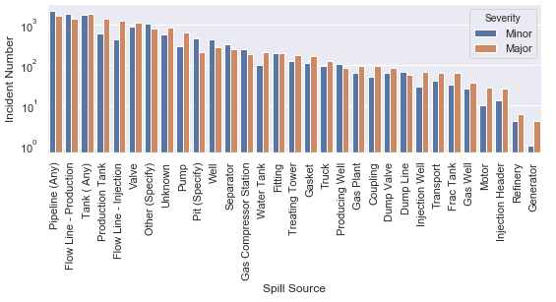
the number of minor and major incidents of each category is adjusted slightly and reordered.

Slide 42
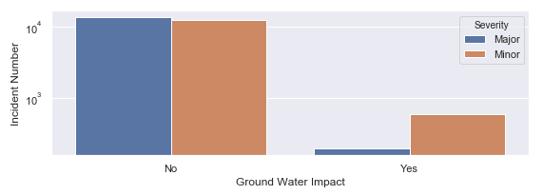
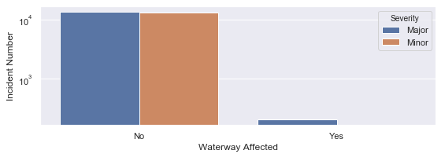

Slide 43
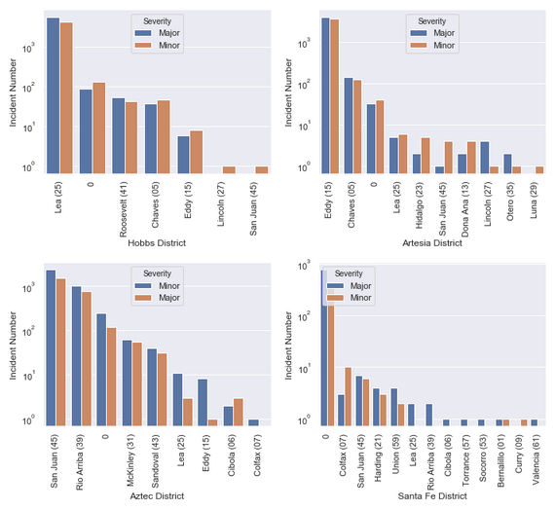

Slide 44
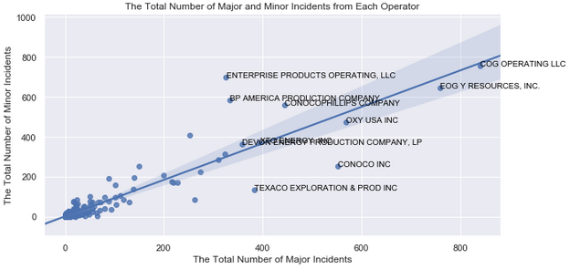
The total number of minor incidents caused by operator increases after updating the data, for example, COG OPERATING LLC, ENTERPRISE PRODUCTS OPERATING LLC, BP AMERICA PRODUCTION COMPANY

Slide 45
Conclusion
Assuming independent features of the incidents, the KNeighborsClassifier model is applied to conduct the supervised classification machine learning. After tuning and cross validating the parameter n_neighbors, I get 92.5% accuracy score for train data and 86.1% accuracy score for test data, with the best n_neighbors=2.
The volume spilled is the most important feature to decide the incidents is whether major or minor.
From the plots of the train data residual distribution and the test data residual distribution, we can see the residual distribution uniformly in 1 and -1 around 0, which further validates the model.
Then apply the trained model to predict the missing incident severity data, and update the initial spills table, and the correlations are re-evaluated among the monthly number of incidents, volume spilled and recovered, severity, incident type, material spilled, cause, source, waterway and groundwater impacted, location distribution, and operators.
After updating, there monthly number of incidents increases by 10 to 20/month after 2008, and maximum number of major and minor incidents is more than 120/month in 2016 with more minor incidents than major incidents.
The maximum monthly number of minor incidents is more than major incidents after updating the table.
The correlation between the number of major and minor incidents and incident type, material spilled, spill cause and spill source is adjusted slightly and reordered on each category.
The number of incidents in each district and county is adjusted slightly.
The total number of minor incidents caused by operator increases after updating the data, for example, COG OPERATING LLC, ENTERPRISE PRODUCTS OPERATING LLC, BP AMERICA PRODUCTION COMPANY.

Slide 46
Future Work:
Does minor incident tends to lead major incident without correction
Incident per bbl or MFC oil /gas production

