Slide 1
Progress on Breed Prediction Pipelines
Jingxuan Chen

Slide 2
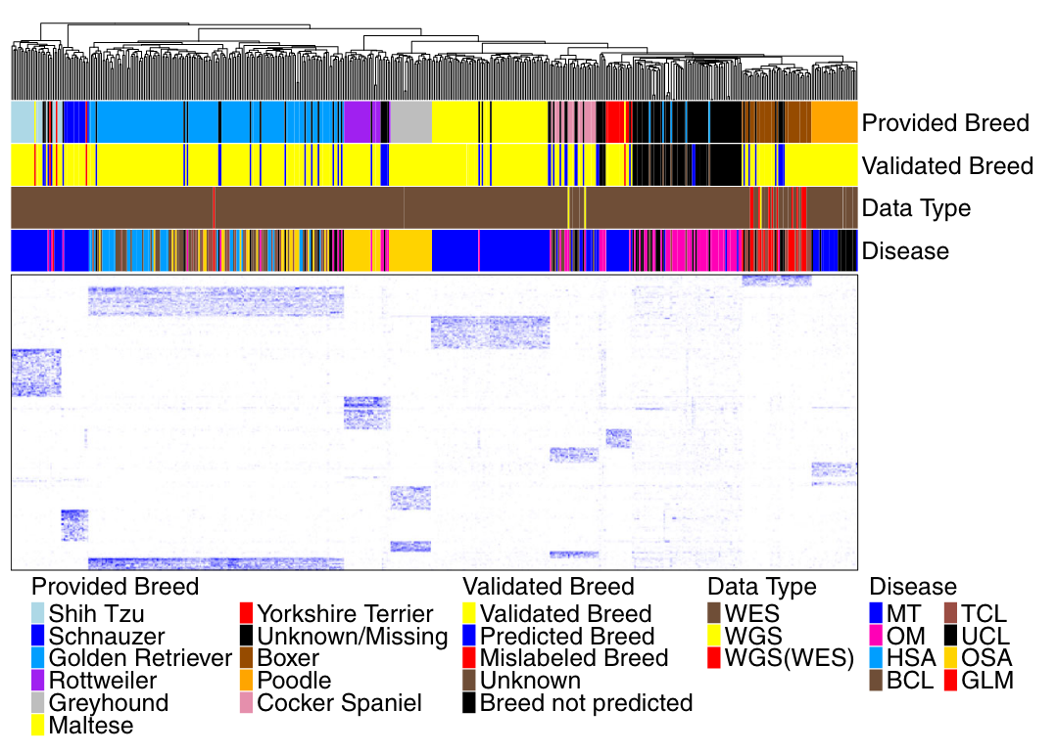
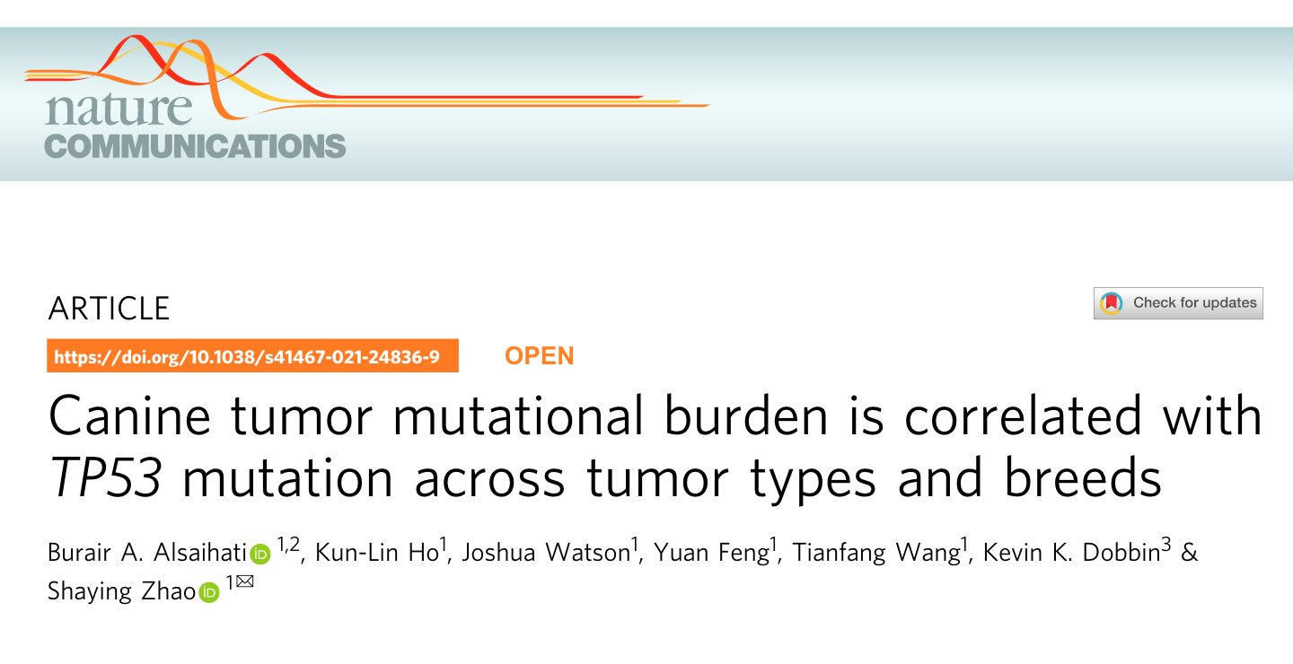
Dogs n=505 (107 unknown)
Variants n=5,363
Breeds n=10

Slide 3
Source code retrieved from Github & Kunlin

Slide 4
Outline
Expand WES datasets for breed prediction pipeline.
Apply phylogenetic methods using germline variants from WES data.
Identify breed specific variants from WGS SNPs (Dog10K data).

Slide 5
Expand WES datasets for breed prediction pipeline
Re-engineer computation-intensive parts with Snakemake.
Add dogs:
Newly published datasets (after 2021).
Expand number of dogs by including unpaired samples.
Expand number of dogs by including non-Tumor study.
Paired only
Paired + unpaired

Slide 6
Quality control for WES datasets
A
B
C
D
E
F

Slide 7
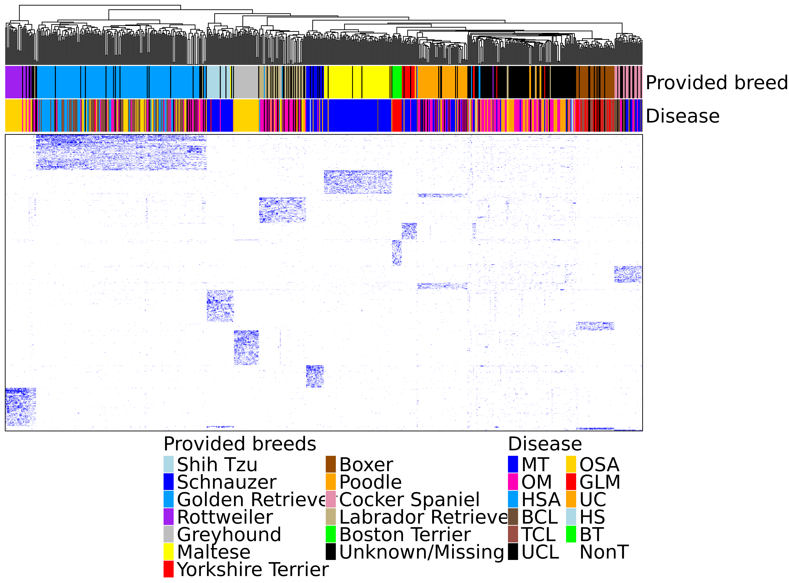
Breed prediction pipeline
Dogs n=680 (182 unknown)
Variants n=2,783
Breeds n=12
Breed clustering based on VAF values of selected variants

Slide 8
Apply phylogenetic methods on WES germline variants
Breed clustering based on nucleotide sequences of all variants in CDS regions
Breed clustering based on nucleotide sequences of selected variants

Slide 9
Clustering of variants in CDS region
Rooted with Shih Tzu.
Essentially all 12 breed cluster as expected, except for Poodle

Slide 10
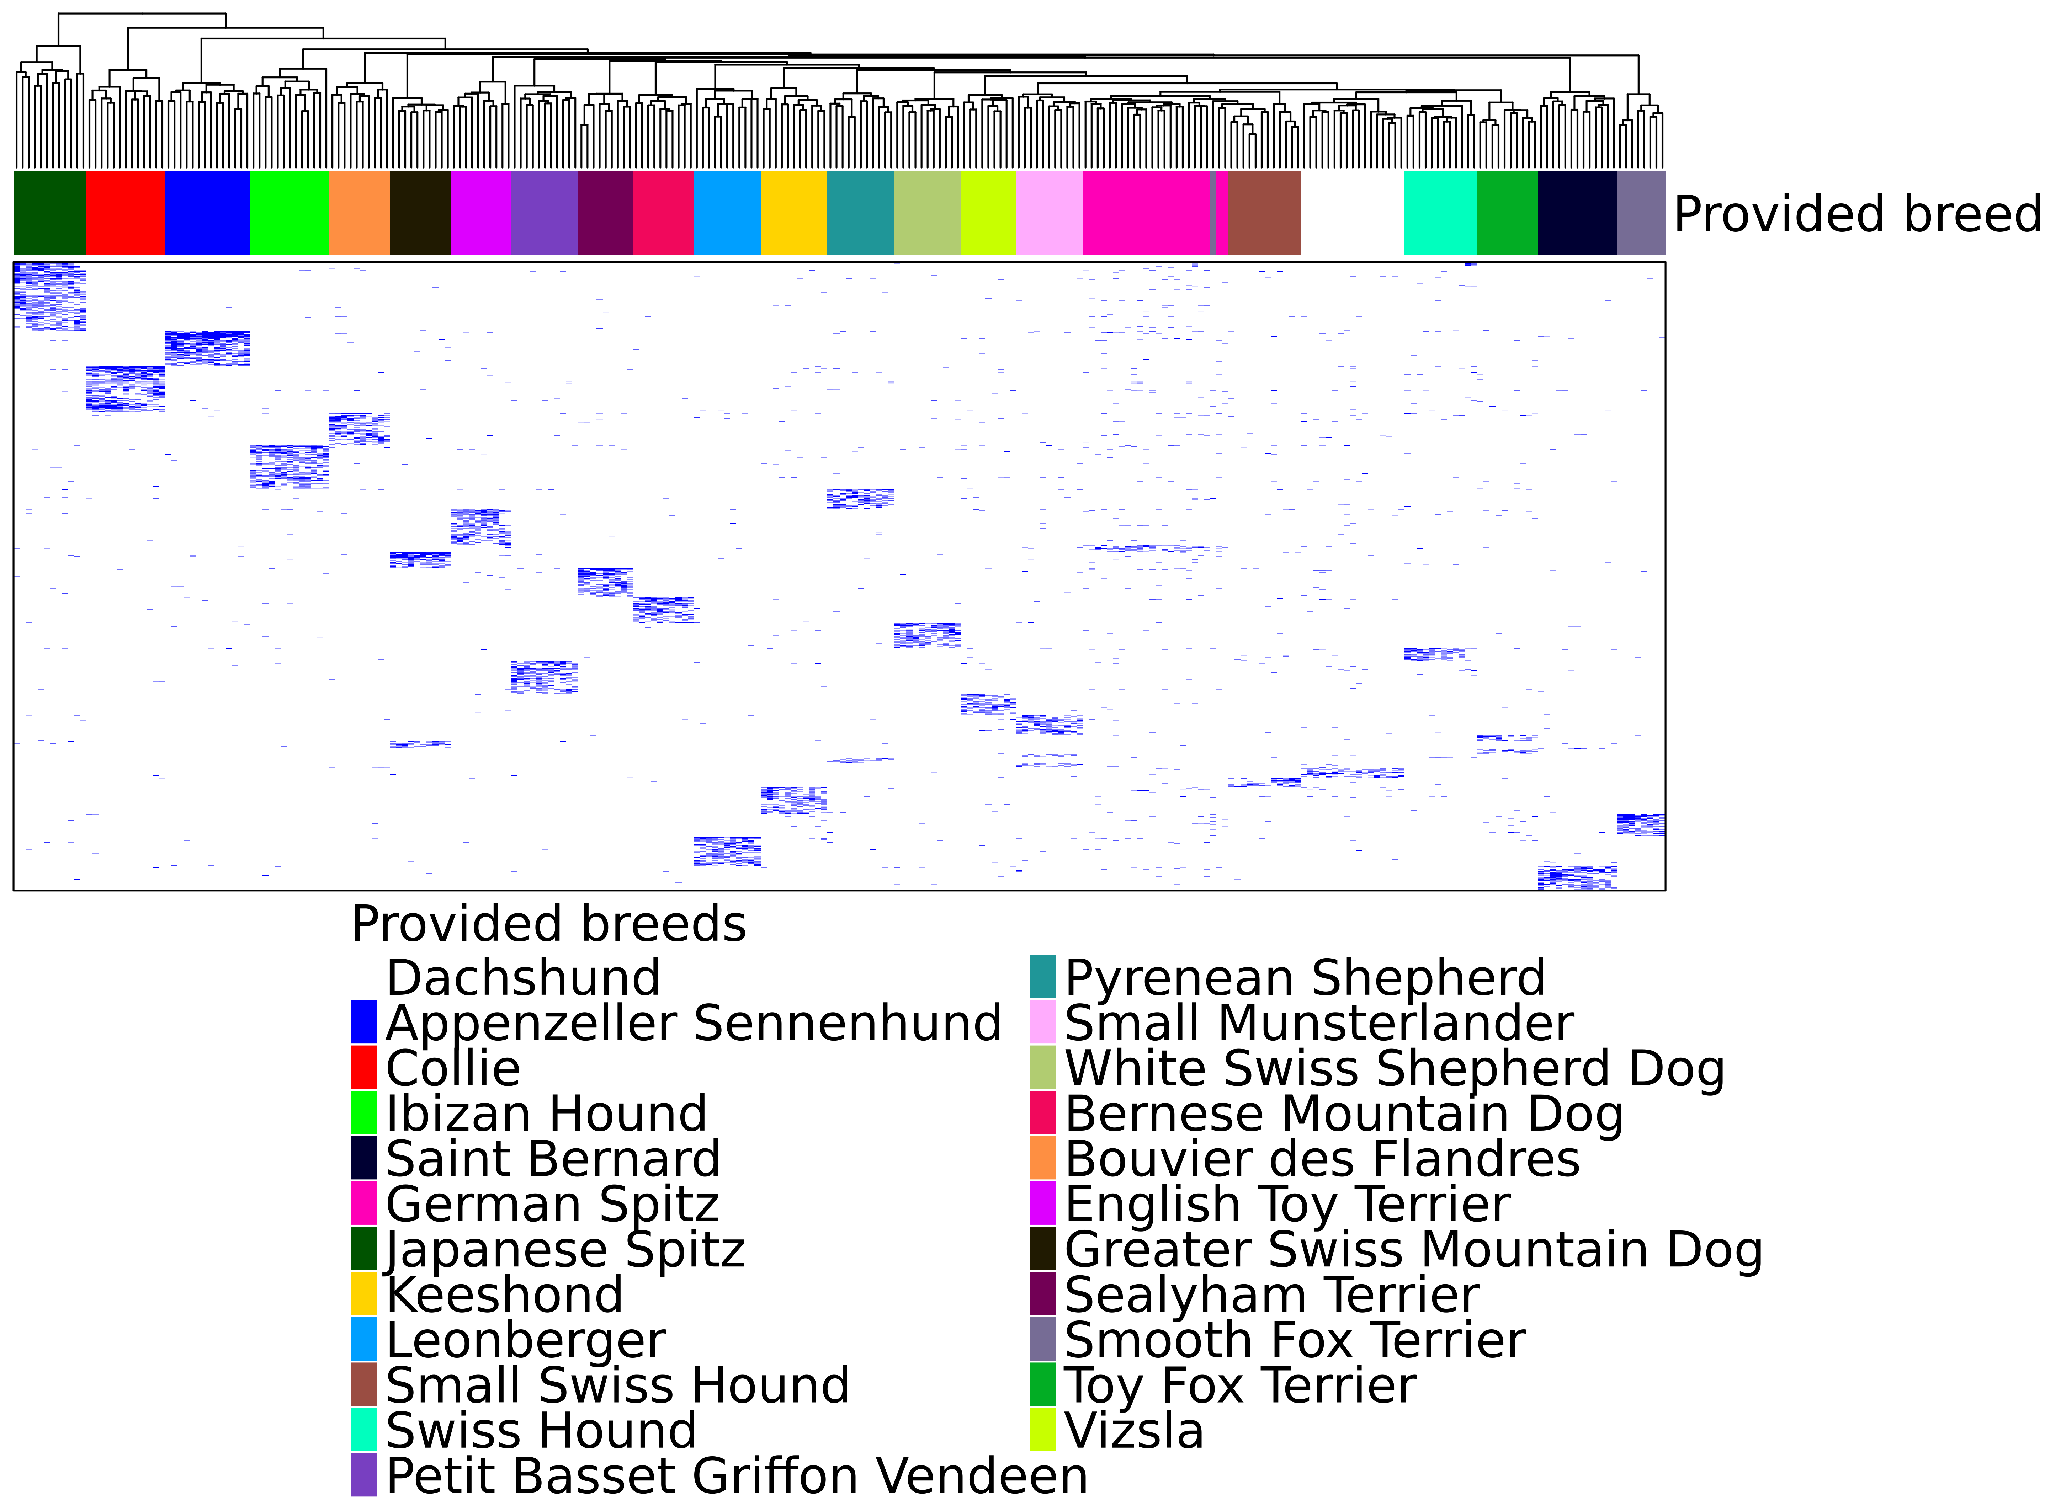
Breed specific variants from WGS-CDS only
Dogs n=272
Variants n=6,364
Breeds n=23

