Slide 1
Progress on Breed Prediction Pipelines
Jingxuan Chen

Slide 2
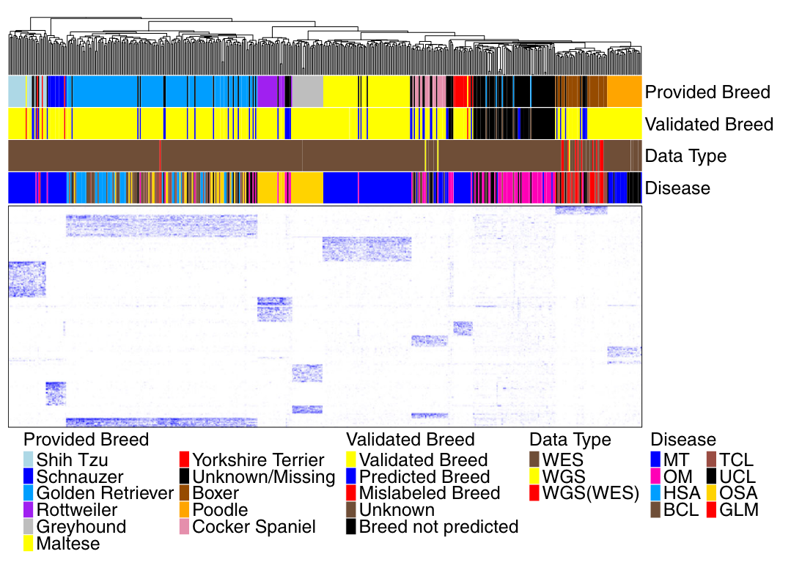
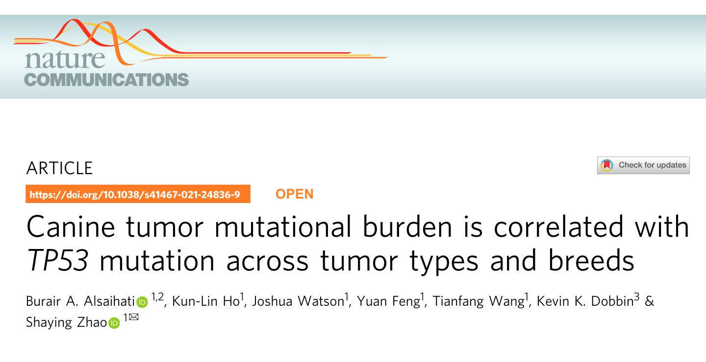
Dogs n=505 (107 unknown)
Variants n=5,363
Breeds n=10

Slide 3
Source code retrieved from Github & Kunlin

Slide 4
Outline
Expand WES datasets to previous breed prediction pipeline.
Reconstruct neighbor-joining trees using germline variants from WES data.
Identify breed specific variants from WGS SNPs (conducted on Dog10K results).

Slide 5
Expand WES datasets to previous breed prediction pipeline.
Newly published datasets (after 2021).
Expand number of dogs by including unpaired samples.
Expand number of dogs by including non-Tumor study.

Slide 6
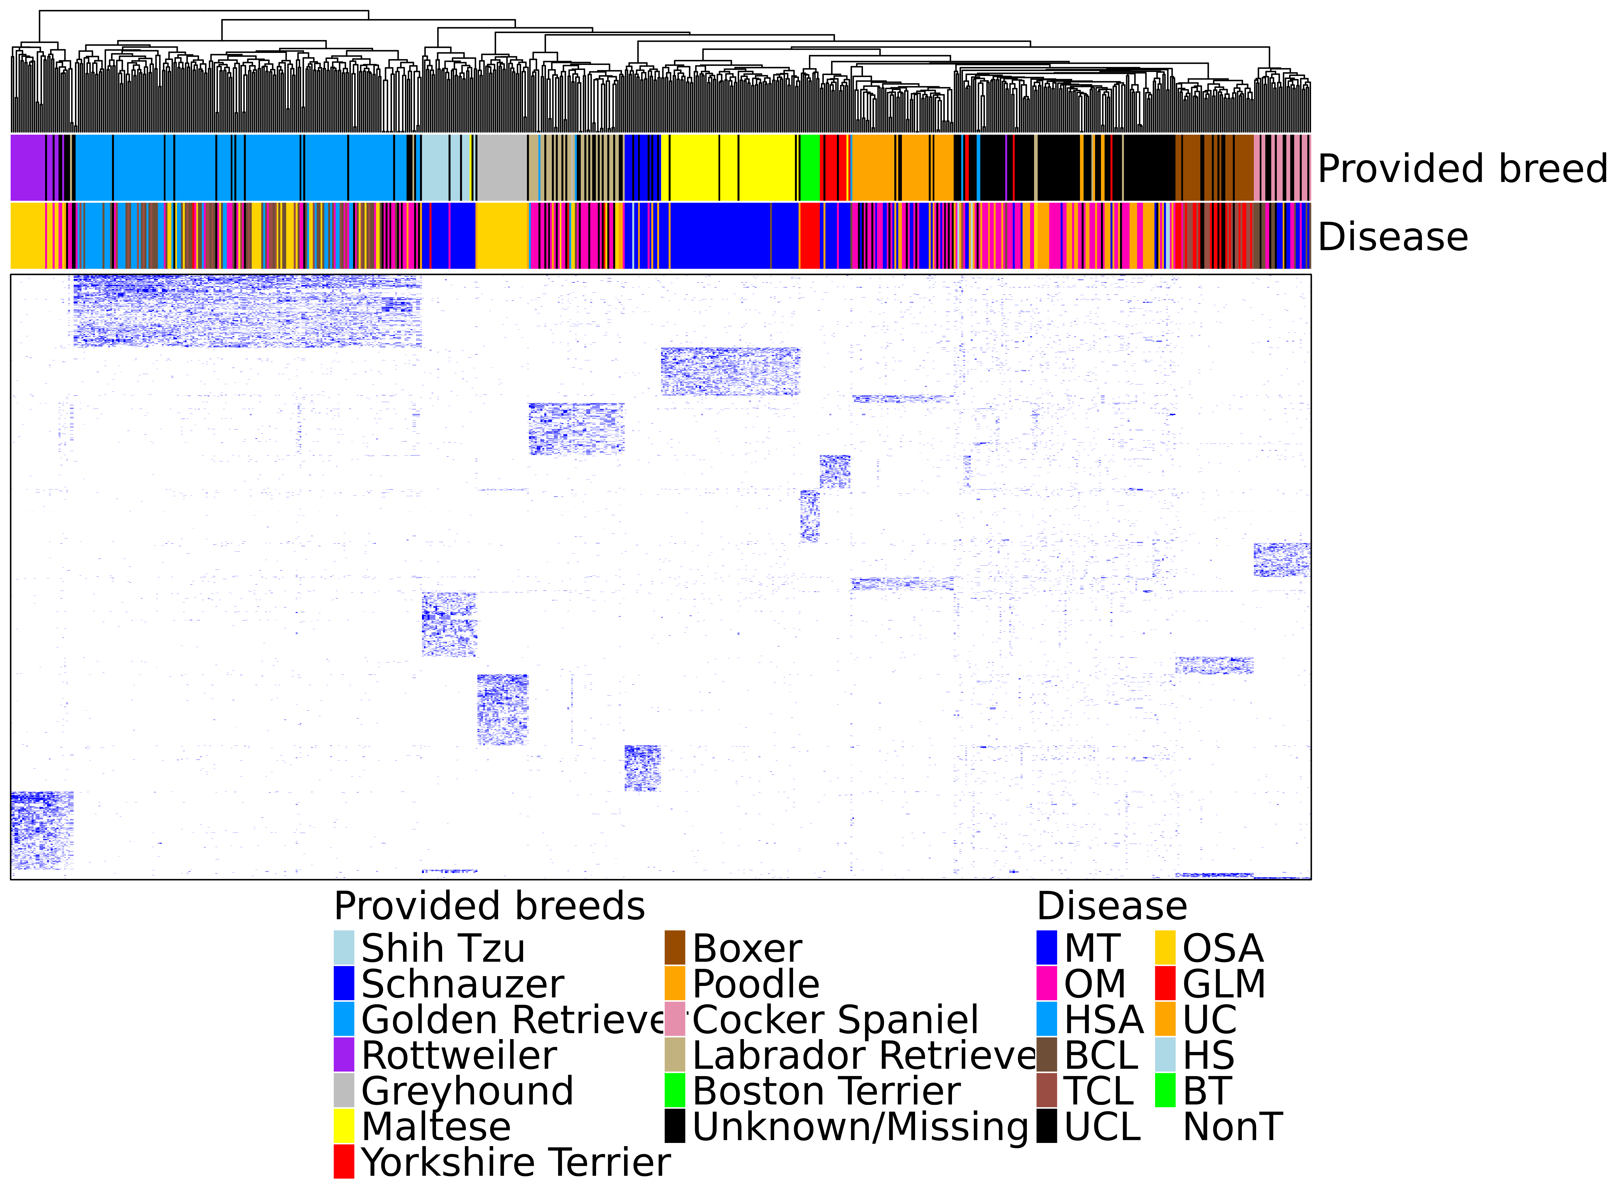
Breed prediction pipeline
Dogs n=680 (182 unknown)
Variants n=2,783
Breeds n=12

Slide 7
Neighbor-joining tree based on nucleotide sequences of breed specific variants

Slide 8
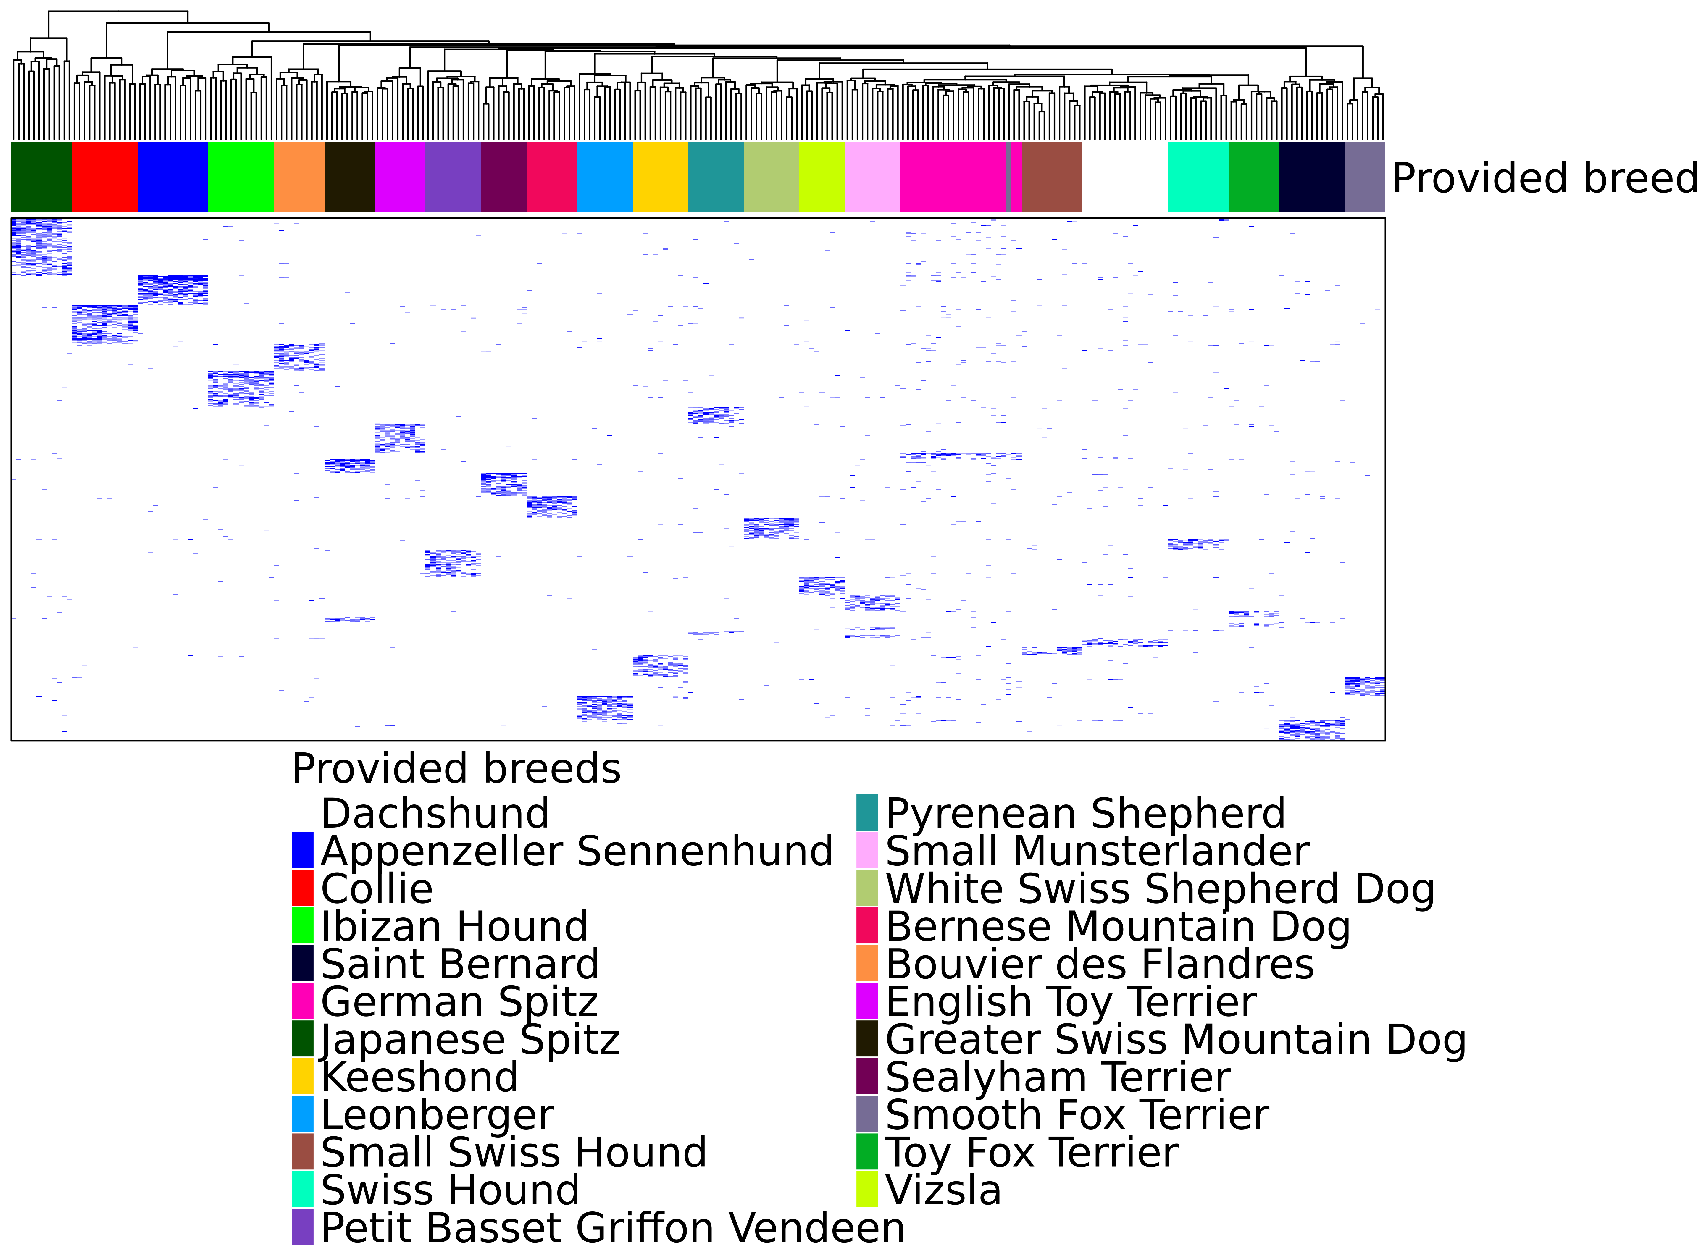
Breed specific variants from WGS-CDS only
Dogs n=272
Variants n=6,364
Breeds n=23

