Slide 1
Progress on Breed Prediction Pipelines
Jingxuan Chen
Dec 1, 2023

Slide 2
Overview
Results sections:
Expand WES datasets for breed prediction pipeline.
Apply phylogenetic methods using germline variants from WES data.
Identify breed specific variants from WGS SNPs (Dog10K data).
All codes/results are available on Github/Google drive.
https://github.com/JingxuanChen7/canine_tumor_wes
https://drive.google.com/drive/folders/1--zGLInuDFIIvo7c6-6qVdu9Rp0qwulQ?usp=sharing
Future directions.

Slide 3
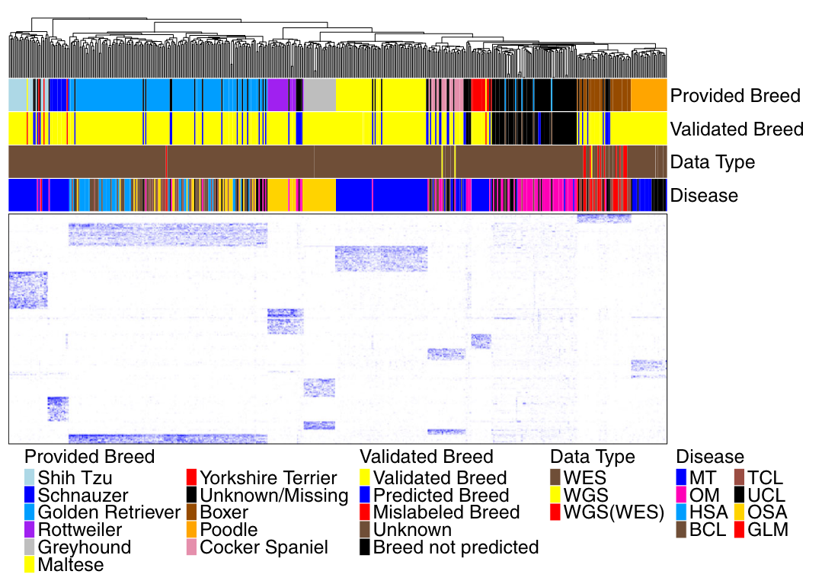
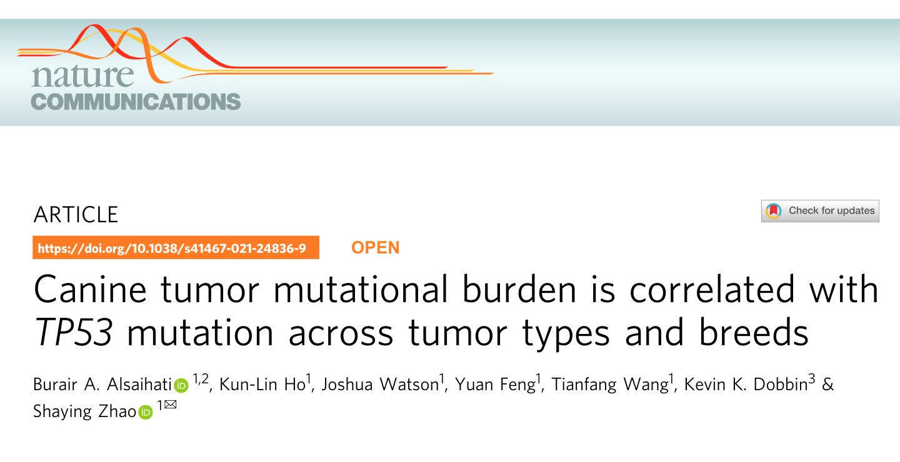
Published breed prediction pipeline
Dogs n=505 (107 unknown)
Variants n=5,363
Breeds n=10

Slide 4
Source code retrieved from Github & Kunlin

Slide 5
Expand WES datasets for breed prediction pipeline
Re-engineer computation-intensive parts with Snakemake.
Add dogs:
Newly published datasets (after 2021).
Expand number of dogs by including unpaired samples.
Expand number of dogs by including non-Tumor study.
Paired only
Ensembl gene annotations
Paired + unpaired
Result files under results/QC and results/breed_prediction
Codes under scripts/per_case, scripts/sum_cases, scripts/qc, scripts/breed_prediction
Individual results backed up on cluster /project/szlab/Jingxuan_Chen

Slide 6
Bioprojects newly included in WES analysis
Bioproject ID | Tumor Type | Paired cases (matched normal & tumor samples) | Year | Submitter
PRJEB53653 | Mammary neoplasia (MT) | 53(106); 5 unpaired | 2022 | Uppsala Uuniversity
PRJDB10211 | Histiocytic sarcoma (HS) | 5(10) | 2022 | The University of Tokyo
PRJNA786469 | oral melanoma (OM) | 72(144); 1 unpaired | 2021 | CNRS - University Rennes1
PRJNA752630 | diffuse large B-cell lymphoma (DLBCL) | 77(154) | 2021 | University of Padua
PRJNA701141 | Osteosarcoma (OSA) | 1(2) | 2021 | University of Padua
PRJNA695534 | B-Cell Lymphoma (BCL) | 71(142) | 2021 | Cornell University
PRJNA680382 | Osteosarcoma (OSA) | 4(8) | 2020 | University of Missouri
PRJNA677995 | splenic angiosarcoma (hemangiosarcoma) (HSA) | 4(8) | 2020 | Translational Genomics Research Institute
PRJDB16014 | inflammatory colorectal polyp | 4 unpaired | 2023 | National Institute for Physiological Sciences
PRJNA891496 | Multiple non-tumor diseases | 49 unpaired | 2022 | Ghent University
PRJNA630029 | fearfulness | 16 unpaired | 2020 | University of Helsinki
PRJNA616374 | Primary bladder tumor | 11 unpaired | 2020 | Colorado State University
PRJNA613479 | Osteosarcoma (OSA) | 27 unpaired | 2020 | Colorado State University
PRJEB57227 | Urothelial carcinoma (UC) | 87(174) | 2022 | Wellcome Sanger Institute

Slide 7
Quality control for WES datasets
A
B
C
D
E
F

Slide 8
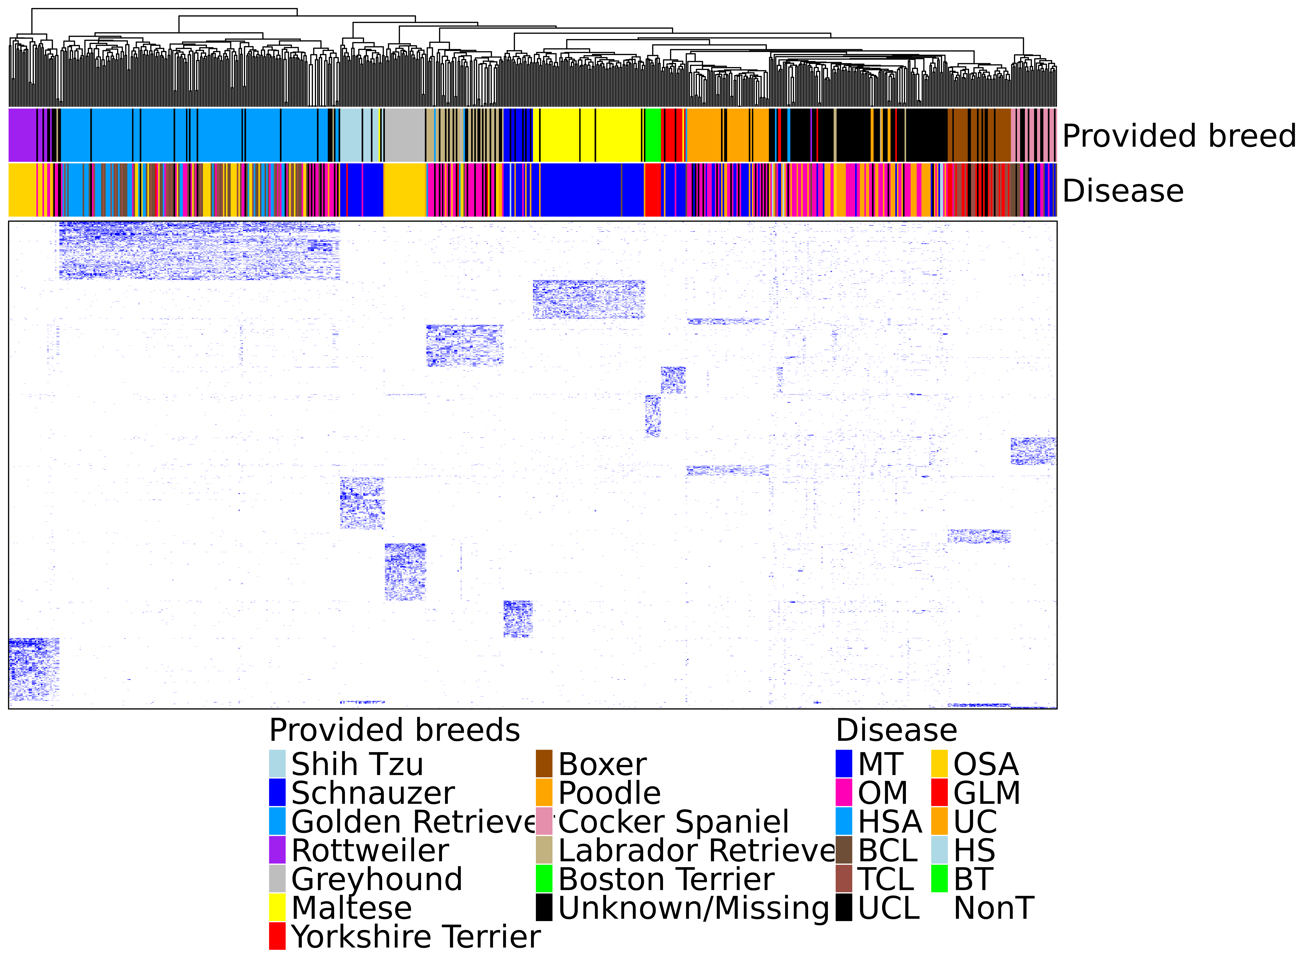
Breed prediction with expanded WES datasets
Dogs n=680 (182 unknown)
Variants n=2,783
Breeds n=12
Breed clustering based on VAF values of selected variants

Slide 9
Apply phylogenetic methods on WES germline variants
* Only Normal samples
Breed clustering based on nucleotide sequences of all variants in CDS regions
Breed clustering based on nucleotide sequences of selected variants
Result files under results/phylogenetics
Codes under scripts/phylogenetic

Slide 10
Clustering of all variants in CDS region
Samples for 12 breeds.
Rooted with Shih Tzu.
Essentially all 12 breeds cluster as expected, except for Poodle.
“Doodle”: An extremely long branch of several “Poodle” and “Golden Retriever” dogs.

Slide 11
Clustering of all variants in CDS region (Consensus of 100 subsamples)
Samples for 12 breeds.
Rooted with Shih Tzu.
10% variants are randomly selected for 100 times. A consensus tree is computed for 100 trees.
Branch lengths are removed.

Slide 12
Clustering of breed specific variants
Samples for 12 breeds.

Slide 13
Clustering of breed specific variants
Samples for 12 breeds + unknown.
Cross-validation with breed validation/prediction results from VAF heatmap.

Slide 14
Identify breed specific variants from WGS SNPs (Dog10K)
Select breeds with >10 dogs
Breed specific n=639,848
Breed unique n=249,455
Currently CDS-only
Result files under results/WGS
Codes under scripts/wgs

Slide 15
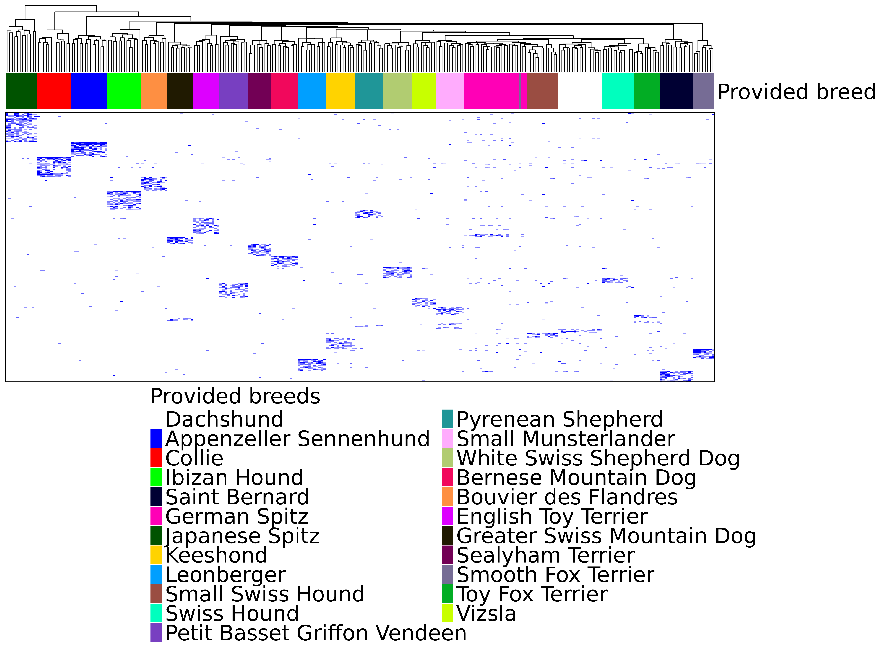
Breed specific variants from WGS-CDS only
Dogs n=272
Variants n=6,364
Breeds n=23

Slide 16
Future directions
Long-term goal: Conduct breed prediction/validation on as much dog breeds as possible.
Keep adding future WES datasets to the breed prediction pipeline.
Use breed specific variants identified from Dog10K WGS data to classify unknown breed dogs in WES dataset.
Perform germline variant calling and DepthOfCoverage on WGS data (Time consuming).

