Slide 1
UVA Coupon
CS 6750 Database Systems - Final Presentation
Team Members: Mengyu Gong, Jingyi Luo, Kai Luo, Weihan Lyu, Mengyao Zhang
Apr. 25th, 2019

Slide 2

Project Idea
Develop a website where users can browse and post coupon information
Website consisting of two main pages
Online coupons
Local coupons
A point system to encourage users to click online coupons and post local coupons
Benefit
Provide a channel for users to get coupon information timely
Increase revenue for local businesses

Slide 3
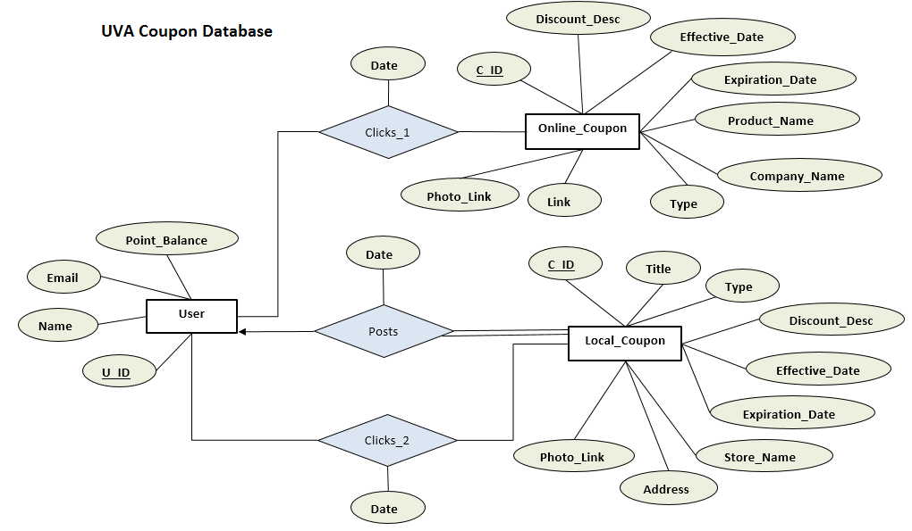
ER Diagram

Slide 4
Sample Queries
Insert local_coupon information:
INSERT INTO local_coupon VALUES(610, ‘$3off any whole pizza’, ‘food’, ‘with purchase of 3 topping pizza’, ‘2019/02/15’, ‘2019/03/15, ‘LELO’S PIZZA’, ‘1880 Abbey Rd’, ‘s3.example.jpg’)
Update Title and Discount_Desc for l_id=611:
UPDATE local_coupon
SET title = ‘80% off dinner’
WHERE l_id = 611
Select users and coupon info posted by the users:
SELECT u_id, l_discount_desc, store_name
FROM User NATURAL JOIN post NATURAL JOIN local_coupon
WHERE l_type = ‘food’
ORDER BY store_name

Slide 5
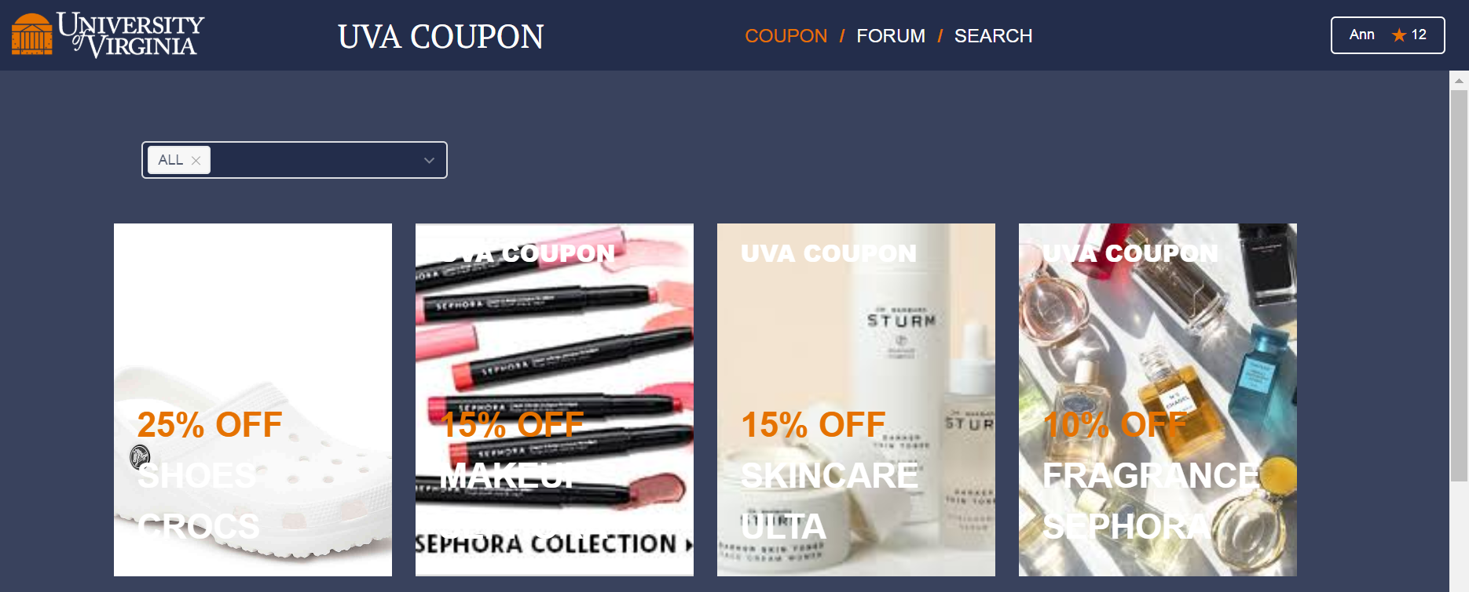
Live Demo

Slide 6
Thank You!

