Slide 1

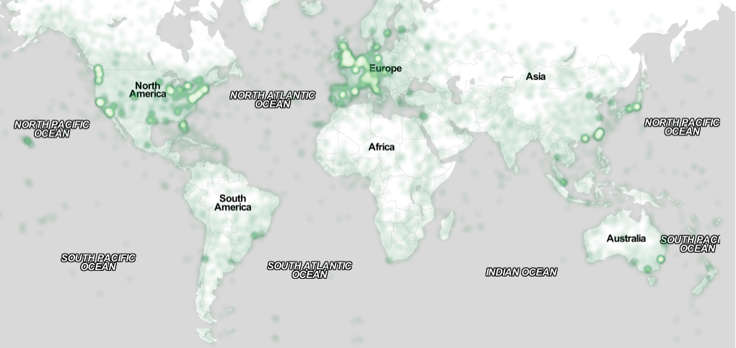
Most Awesome Title With Interesting Subtitle
Logo?
Anonymous Authors and Affiliations
Motivation
We want to get you started by providing you a template. But please be as creative as you wish.
Tips for a Good Poster
Have a good title
The poster should summarize the most important points and help you to present.
Do not copy and paste the contents of your extended abstract.
Use enough whitespace
“A picture is worth a thousand words”
Have a clear focus
Don’t have more than one line per bullet point
Discussion
Those tips are from the top of my head and subjective
Maybe consider looking at previous AutomotiveUI posters or Search for “good poster design”
The chosen images are not well placed
Future Work
Put some examples online
Consider sending the raw source of your previous Automotive-UI posters for reference
Maybe even just a pdf/jpg/png
Use Captions
Logos & Links?

