Slide 1

E6893 Big Data Analytics:
AD Targeting for Apple Products on Twitter
Project ID: 20181-20
Team Members:
Yuanqing Hong: yh2866
Fangbing Liu: fl2476
Jingyi Wang: jw3592

Slide 2

Introduction
Twitter provides all of the tools business owners need to put highly tailored ads in front of the people most likely to click on them. In this project, we will discuss ways to target audience for Apple more effectively with Twitter ads.
What is the goal?
Ad targeting helps a company to cut the marketing cost by reducing wasted advertising, attract new customers, and increase sells.
Apple already have their user-portrait. By exploring tweets related to their products, we hope to discover new information and expand the current user-portrait.
Motivation for this project?
Notes:
a lot people still don't know know how good sonew apple pro they are

Slide 3


Agenda
Before we dig into the tips for Twitter ad targeting, we need to know the steps to create a new ad campaign on twitter. The really powerful thing about Twitter ad campaign is in our ability to layer targeting options on top of one another, gradually making the audience more and more specific.
01. Twitter Advertising Channels
Introducing the options have to be addressed in creating an AD campaign on Twitter
02. Methods & Algorithms
Introducing the methods and algorithms we used to collect information for each specific options
03. Visualization & Examples
Visualizing our results on a website and show an AirPods ad campaign as an example

Slide 4






Project Structure
Visualization
LDA & Sentiment Analysis
Centrality Measures
User- Portrait
Algorithms
Popular tags
Identify the user’s interests/preference
Hashtag
Text
Influencer
Location
Time
DataSet

Slide 5
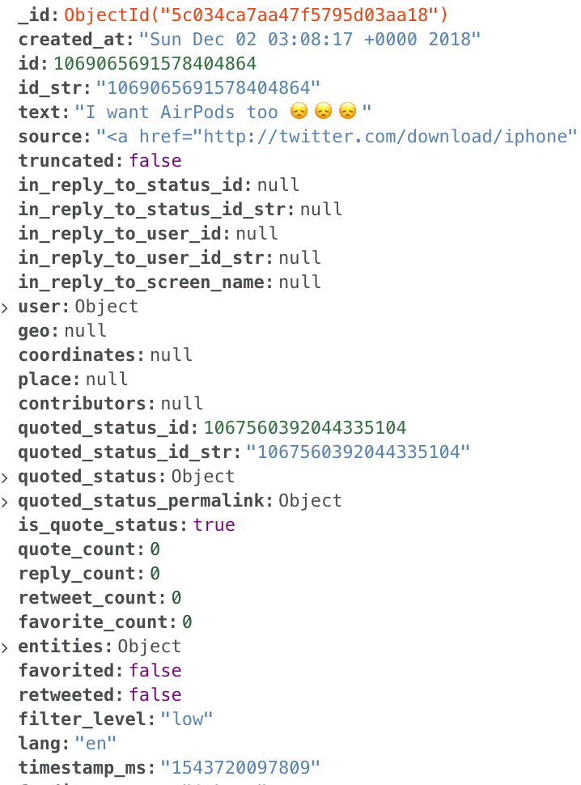
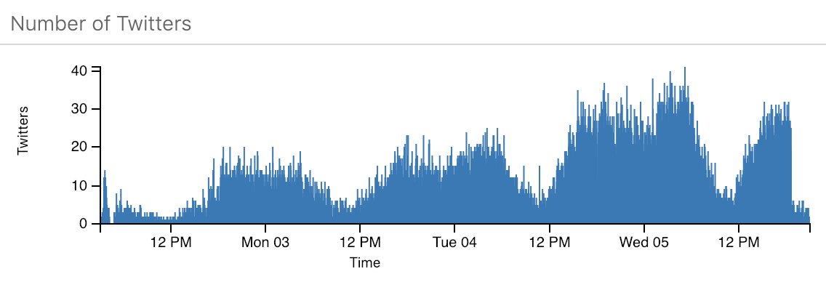
Data Collection
Data Source:
We fetched more than 240K tweets metadata related to Apple products (Airpods, iPhone, iPad and Apple Watch) using Twitter API.
Data Size: 1.43 GB (>240,000 tweets)
Data Preprocessing: Tokenization, Location Validation
Fields Data Contains: 20+
(hashtag, text, location, time, users, re-twitters)

Slide 6

Algorithms
Option
01
Latent Dirichlet Allocation (LDA)
Option
02
Sentiment Analysis
Option
03
Social Network Analysis: Centrality Measures

Slide 7
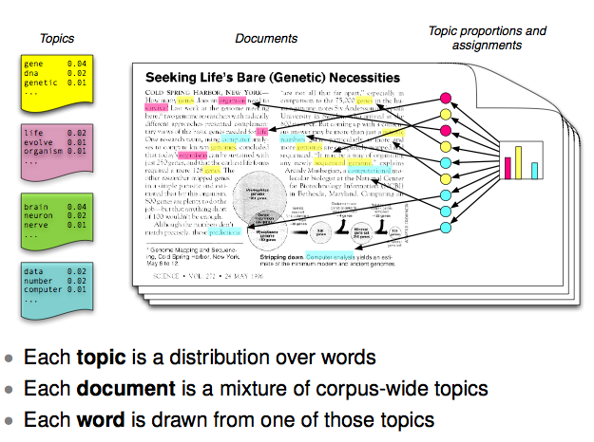
What is LDA?
How can we get a sense of what someone tweets about? We’ll use an unsupervised machine learning technique called Latent Dirichlet Allocation (LDA). LDA provides a thematic summary of a set of tweets by discovering ‘topics’, and telling us the proportion of each topic found in a tweet. To do so, LDA attempts to model how a tweet was ‘generated’ by assuming that a tweet is a mixture of different topics, and assuming that each word is ‘generated’ by one of the topics.
We’ll use tweets containing the product name as the running example, which will be our corpus, with each tweet representing a ‘document’. Then, we’ll run LDA on the corpus in order to discover 4 topics and the top 30 words associated with each topic. Next, we will infer the topic distribution over the entire set of tweets. Hence we’ll be able to see topics and the degree to which they appear in AirPods tweets. Then we’ll create visualizations for the topics based on the words that define them. We now have the words that make up the most prominent topics, along with the frequency of each word.
Notes:
Always Users will tweet about specific aspects of the product they are interested in. in order to know What type of advertisement we would like to focus on, We want to check out the topic in those tweets and find out the unique pain points of the target audience to create a carefully crafted ad.

Slide 8
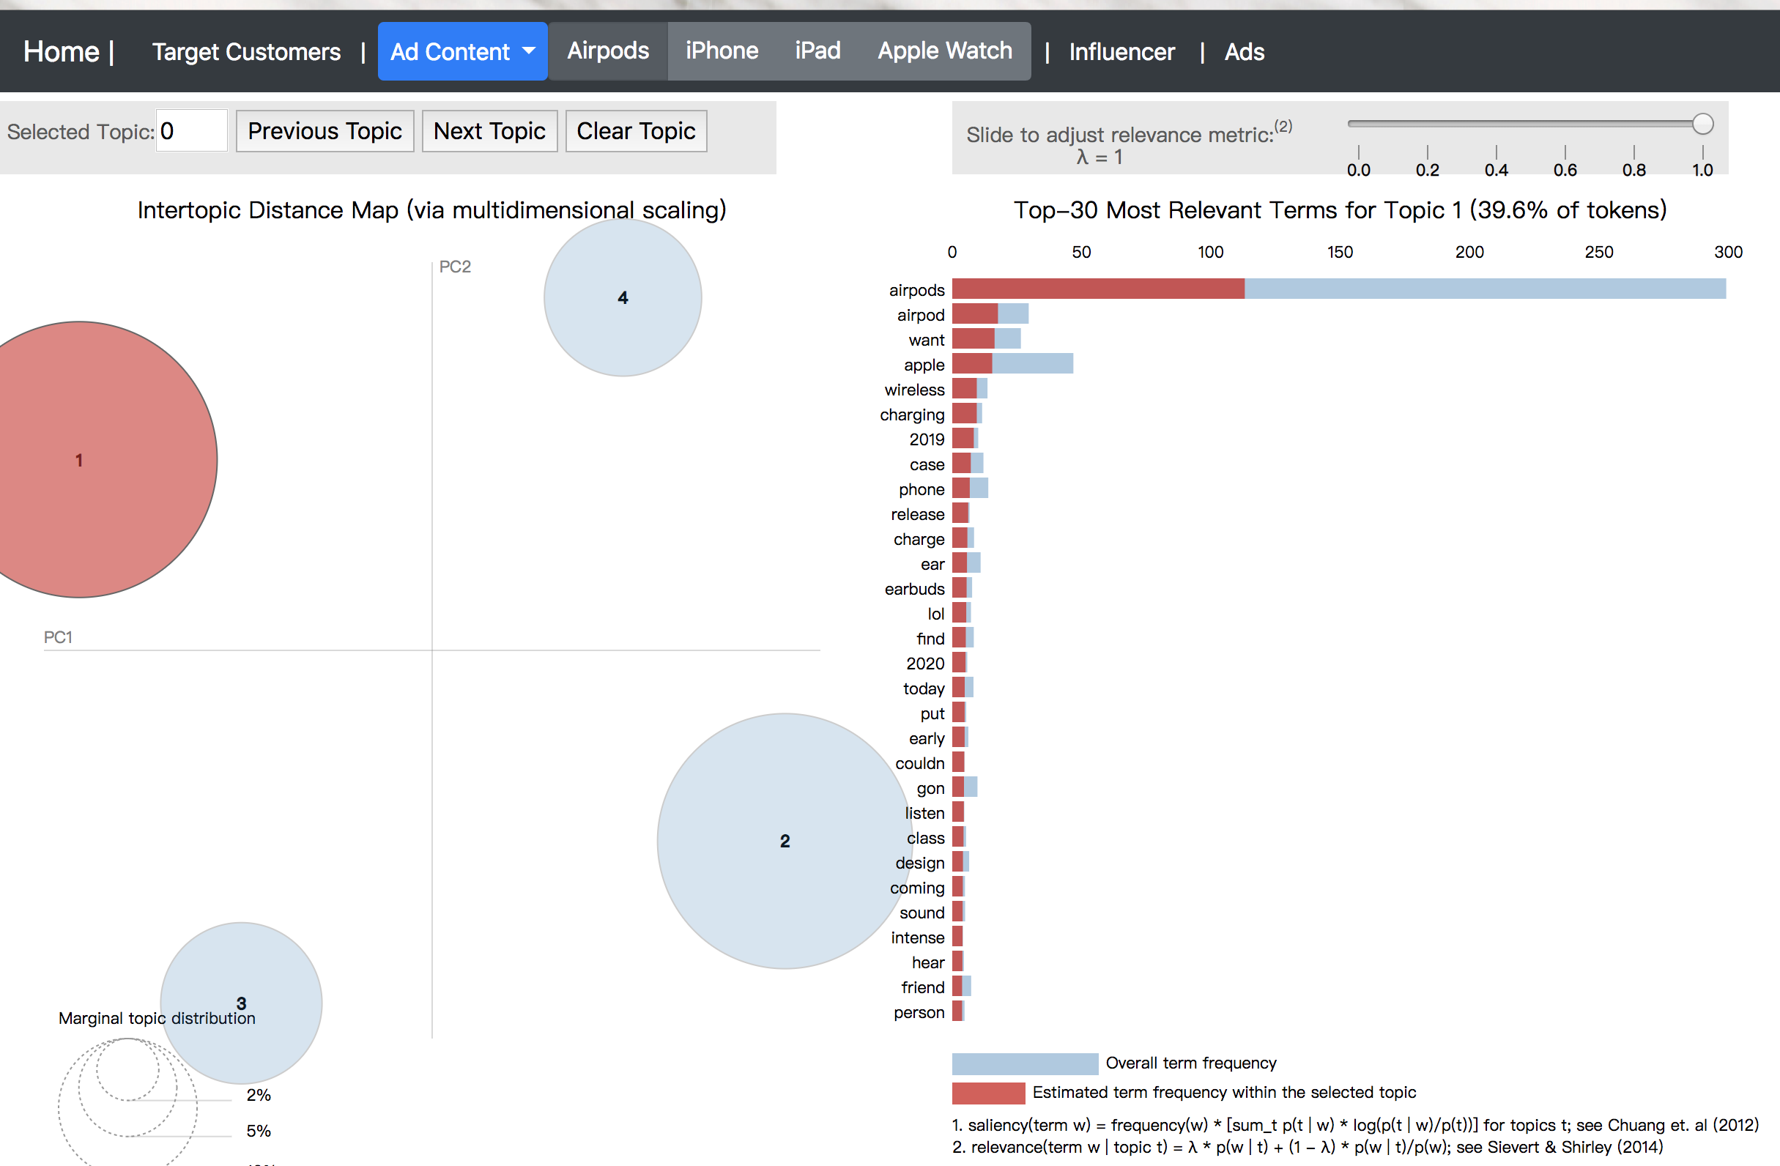
Notes:
精简第二段？具体讲每个 topic

Slide 9
Sentiment Analysis
TextBlob is a Python library for processing textual data. It provides a simple API for diving into common (NLP) tasks such as part-of-speech tagging, noun phrase extraction, sentiment analysis, classification, translation, and more.
For estimating the sentiment of text, we just need to take the text, run it through the TextBlob and the program will spit out if the text is positive, neutral, or negative by analyzing the language used in the text.
Polarity > 0 —> Positive
Polarity < 0 —> Negative
Polarity = 0 —> Neutral
Tweets | Polarity | Sentiment
I GOT AIRPODS IM SO HAPPY | 0.800000 | Positive
I am Thankful for my airpods that I have because I own airpods.\nMy airpods (that I own) bring me joy and your staying… | 0.666667 | Positive
I lost one of my AirPods :( | -0.750000 | Negative
@AppleSupport the USB cable that came with my Airpods just exploded.... sparks flew! Crazy! Help? | -0.750000 | Negative
I want AirPods too 😞😞😞 | 0.0 | Neutral
I needa get some AirPods | 0.0 | Neutral
Notes:
And the reason why we are doing sentiment analysis is we want to see what twitter users think about one product, what are the positive and negative aspects of one product. By doing the sentiment analysis, we use TextBlob which is a ...

Slide 10
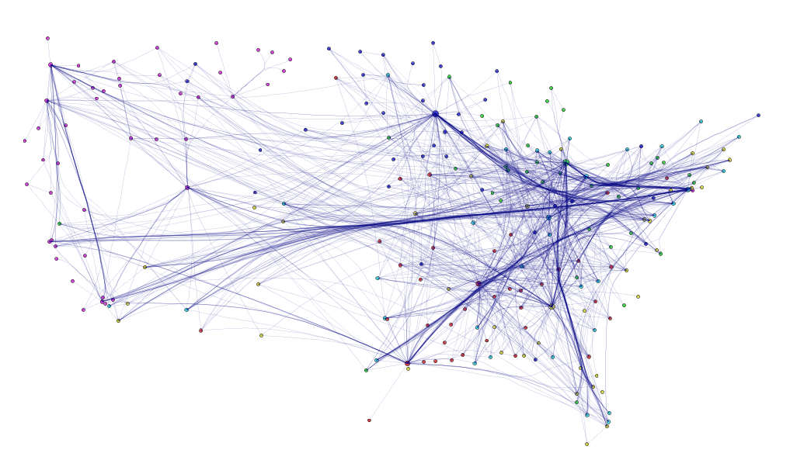
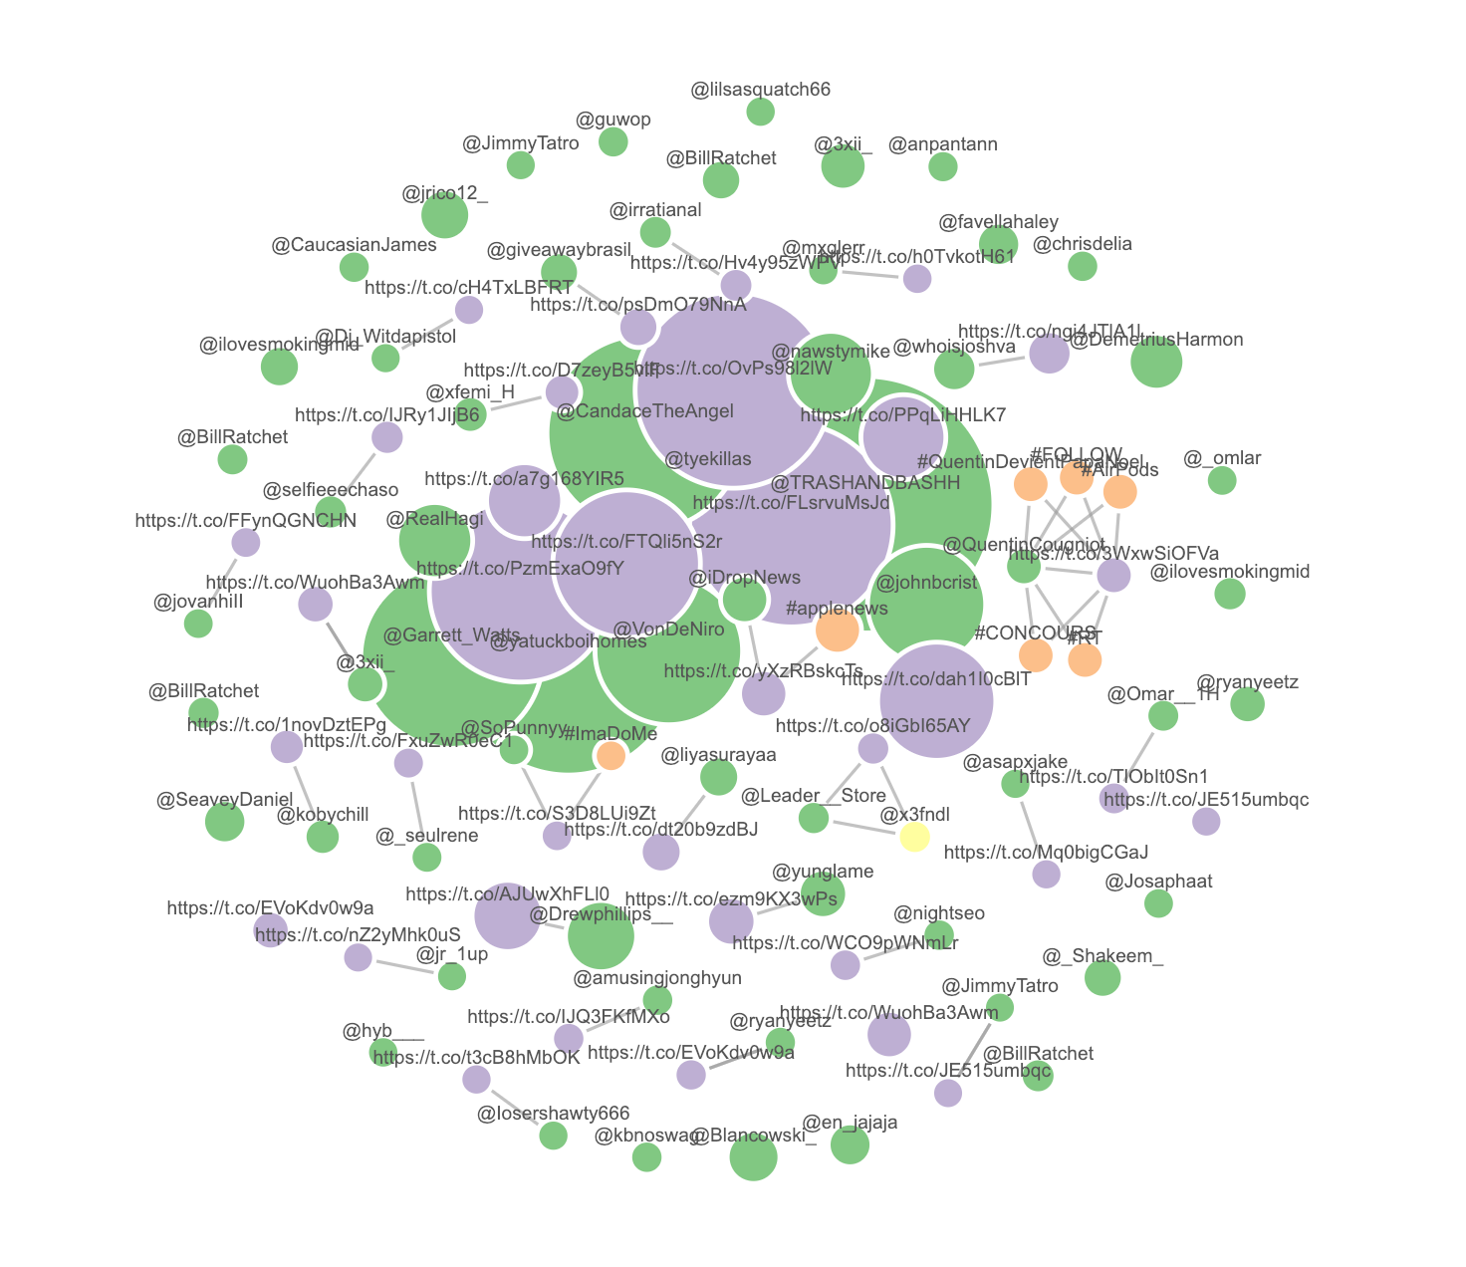



Social Relationships (Find The Influencer)
Centrality Measures
Betweenness centrality:
Assume important nodes are those who connect other nodes. Betweenness centrality quantifies the number of times a node acts as a bridge along the shortest path between two other nodes.
Degree centrality:
Degree is a simple centrality measure that counts how many neighbors a node has, and it assumes important nodes have many connections.
Closeness Centrality:
Closeness centrality measures the mean distance from a node to other nodes, and it assumes important nodes are close to other nodes.
Notes:
We want to identify influential users as the advertiser. tweets with retweet count >1000 , people, hashtags, and URLs are drawn in a graph to show important actors in the tweet set, and any relationship they have to one another. We then calculates betweenness, closeness, degree centrality measures to provide different perspectives on the social relationships within the network。 We should be able to find the important nodes help us engage with the target audience
Nodes: Green - Users who created the most retweeted tweets
Entities: Purple - Important URLs; Orange - Hashtags; Yellow - The user commonly mentioned
Edges: Entities are connected to green nodes if they are mentioned in the tweets
Nodes size: proportional to the retweeted count of the tweets the nodes is related to.

Slide 11
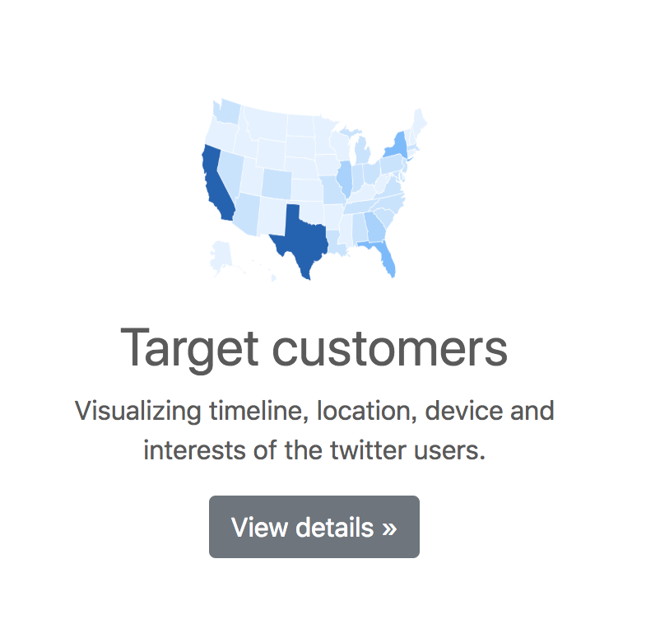
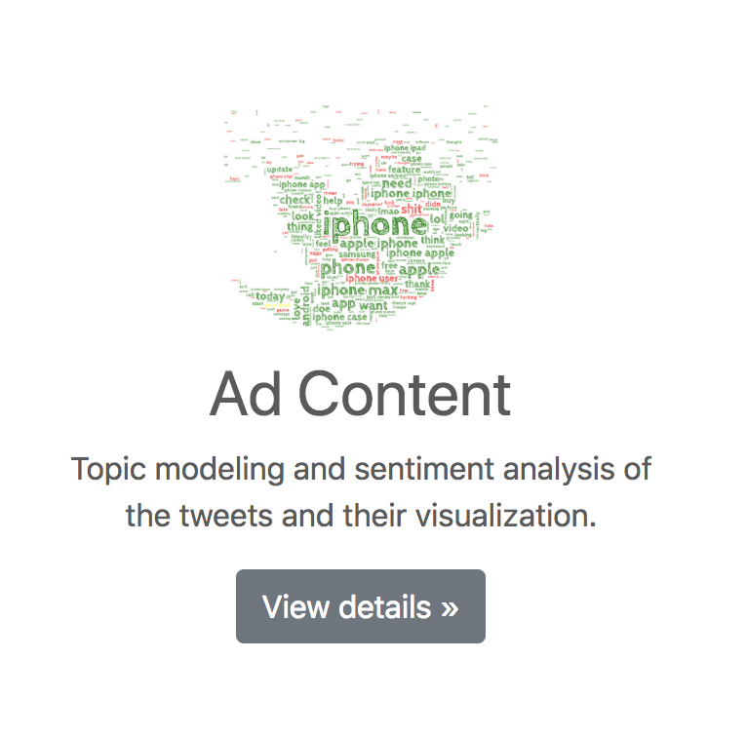
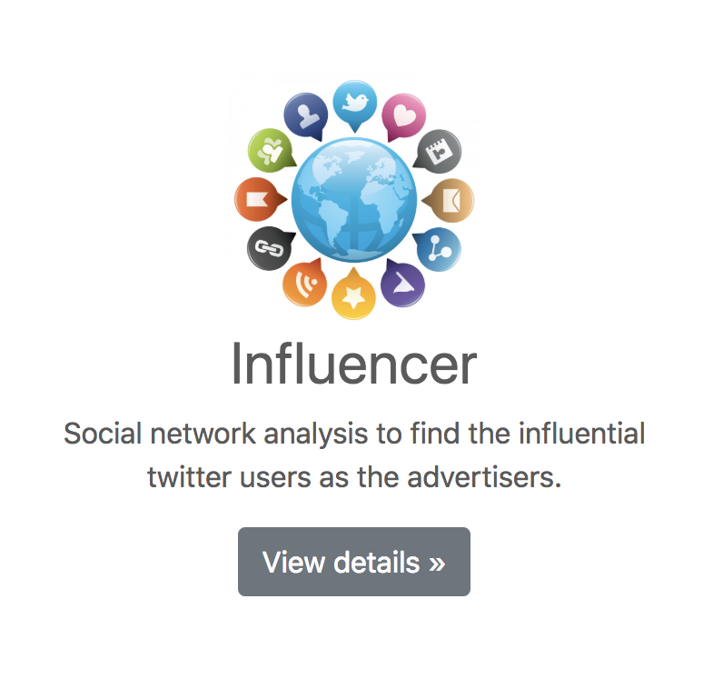
Website Visualization
Website Outline
Target customers Visualizing timeline, location, device and interests of the twitter users.
Ad Content Topic modeling and sentiment analysis of the tweets and their visualization.
Influencer Social network analysis to find the influential twitter users as the advertisers.
Go To Website

Slide 12
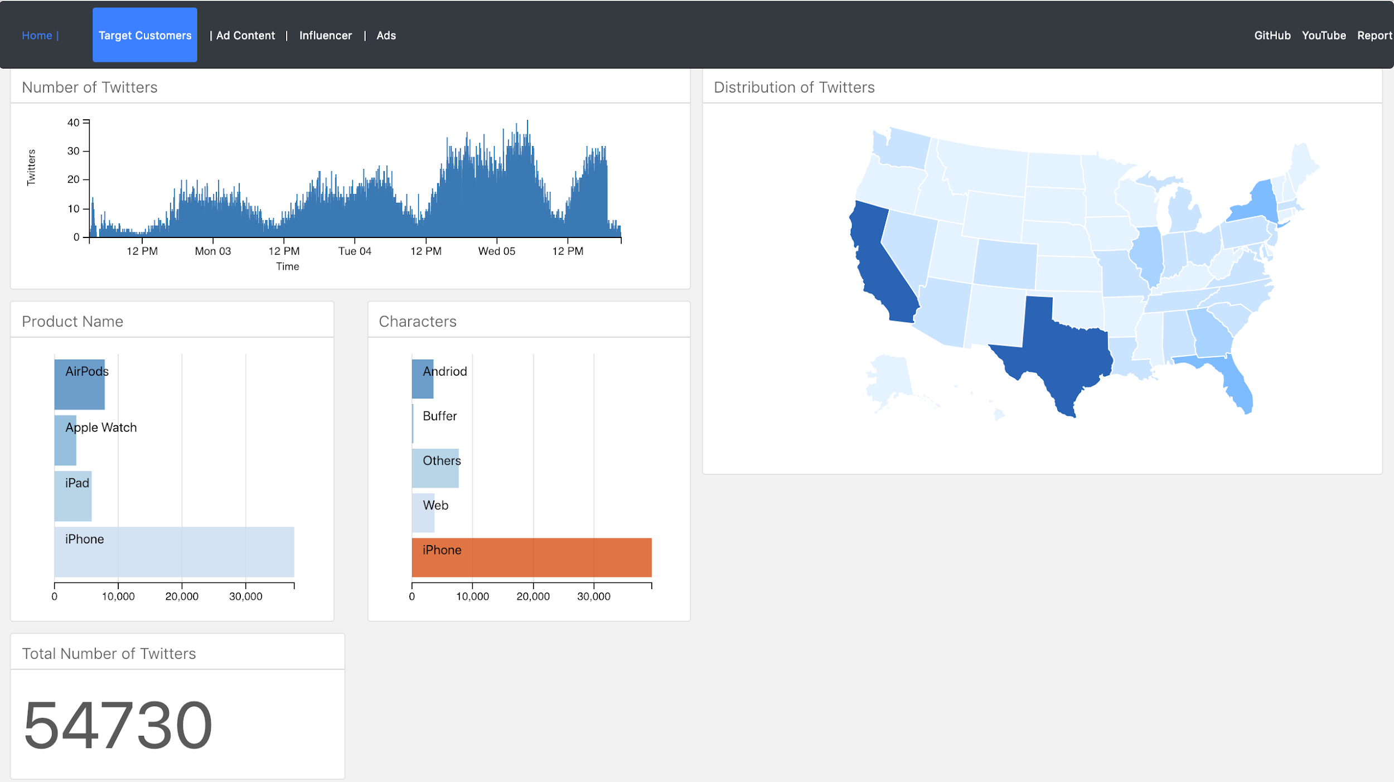

Slide 13


Project Record
YouTube Link:

Slide 14

Thank you
E6893 Big Data Analytics
AD Targeting for Apple Products on Twitter
Project ID: 20181-20
Team Members:
Yuanqing Hong: yh2866
Fangbing Liu: fl2476
Jingyi Wang: jw3592

