Slide 1
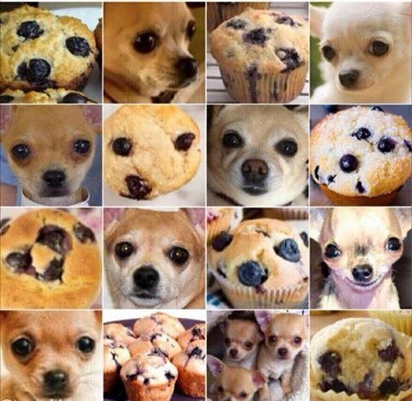
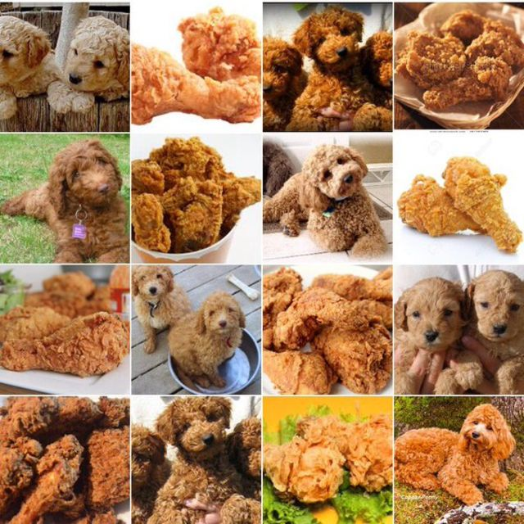
Model Selection —— Dogs, Fried Chicken or Blueberry Muffins?
Group 9
Fan Yang
Yiran Jiang
Xueyao Li
Jingyi Wang

Slide 2
Introduction
In this project, we carry out model evaluation and selection for predictive analytics on image data.
The training image data consists a set of 3000 images of dogs (poodles and Chihuahuas), fried chicken and blueberry muffins.
The baseline model uses boosted decision stumps on SIFT features.
The goal is to propose a feasible improvement over the current practice in terms of running cost (storage, memory and time) and prediction accuracy.

Slide 3
Baseline Model
1
SIFT + GBM

Slide 4
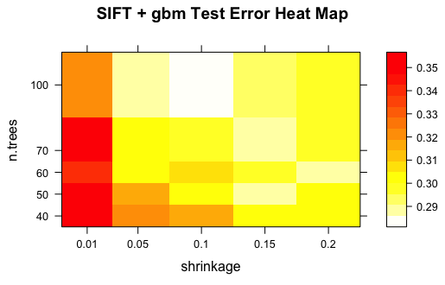
Parameter Tuning
n.trees: Number of trees (the number of gradient boosting iteration) i.e. Increasing N reduces the error on training set, but setting it too high may lead to over-fitting.
Shrinkage (Learning Rate):
Shrinkage is used for reducing the impact of each additional fitted tree. It reduces the size of incremental steps and thus penalizes the importance of each consecutive iteration.
Parameters Chosen:
n.trees = 100
shrinkage = 0.1

Slide 5
Performance
Test Error : 30%
Running Time: 44.32s

Slide 6
Advanced Model
2
SIFT, GIST, RGB
SVM, CNN, XGBoost, AdaBoost

Slide 7
Feature Extraction Method
 | advantages | disadvantages | Applications
SIFT | Invariant to image scaling and rotation, and partially invariant to change in illumination and 3D camera viewpoint. | Mathematically complicated and computationally heavy. | Image matching tasks, image classification.
GIST | Perform well for transformations such as scaling, JPEG compression and limited cropping. Stable behavior independently on the descriptor size | Heavy computational cost | Visual scene classification, image search and image completion.
RGB | Faster to compute, robustness with respect to geometric changes of projected objects and ,invariant to translation and rotation around the viewing axis and vary slowly with changes of view angle, scale, and occlusion | Information about object location, shape, and texture is discarded. When the dataset is large, sometimes matches wrong part of the image. | Image search engine, image classification, works well on hard to be cropped image.

Slide 8
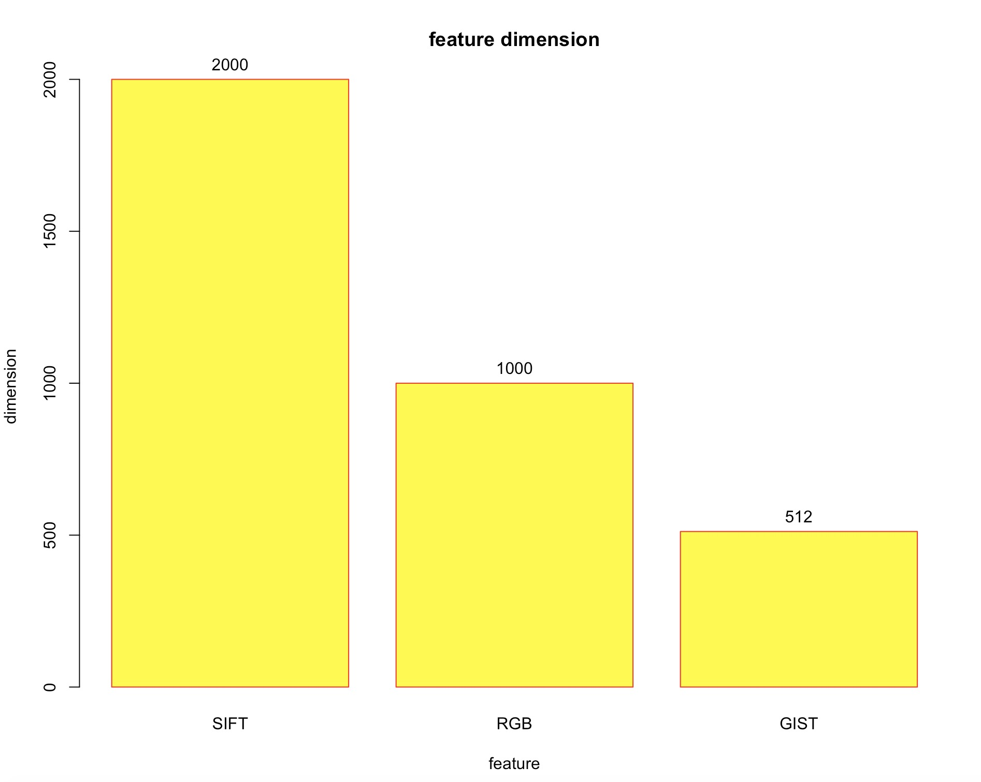
Feature Dimension Comparison
SIFT
2000 features
RGB
1000 features
1440 features
512 features
GIST
512 features
800 features
1152 features
2548 features

Slide 9
Model Selection
GBM
A technique for regression and classification problems, which produces a prediction model in the form of an ensemble of weak prediction models. The statistical framework cast boosting as a numerical optimization problem where the objective is to minimize the loss of the model by adding weak learners using a gradient descent like procedure.
SVM
A set of supervised learning methods used for classification, regression and outliers detection. Analysis can efficiently perform a non-linear classification using Kernel trick.
AdaBoost
A machine learning method of training a boosted classifier. The weak learners in AdaBoost are decision trees with a single split. It works by weighting the observations, putting more weight on difficult to classify instances and less on those already handled well.
CNN
A class of deep, feed-forward artificial neural networks that has successfully been applied to analyzing visual imagery. It uses a variation of multilayer perceptrons designed to require minimal preprocessing.
XGBoost
An implementation of gradient boosted decision trees designed for speed and performance. It uses a more regularized model formalization to control over-fitting, which gives it better performance.

Slide 10
Model Evaluation
3

Slide 11
 |  | SIFT | GIST | RGB
GBM | Test Error | 30% | 27.87% | 13.2 %
 | Time | 44.32 s | 13.82 s | 21.28 s
SVM Linear | Test Error | 29.6% | 25.1% | 24.3%
 | Time | 24.98 s | 8.388 s | 15.024 s
SVM RBF | Test Error | 23.3% | 23.6% | 23.1%
 | Time | 29.08 s | 13.486 s | 15.219 s
XGBoost | Test Error | 27.4% | 25.2% | 9.77%
 | Time | 49.2 s | 13.2 s | 79.62 s
AdaBoost | Test Error |  | 27.4% | 11.78%
 | Time | > 60 m | 35.32 m | 41.28 m
CNN | Test Error | 1.7%
 | Time | 106 m
Notes: Test Error got by first randomly select 30% image in training set as “test set”, then calculate test set estimates of the misclassification rate
Notes:
Test Error got by first randomly select 25% image in training set as “test set”, then calculate test set estimates of the misclassification rate

Slide 12
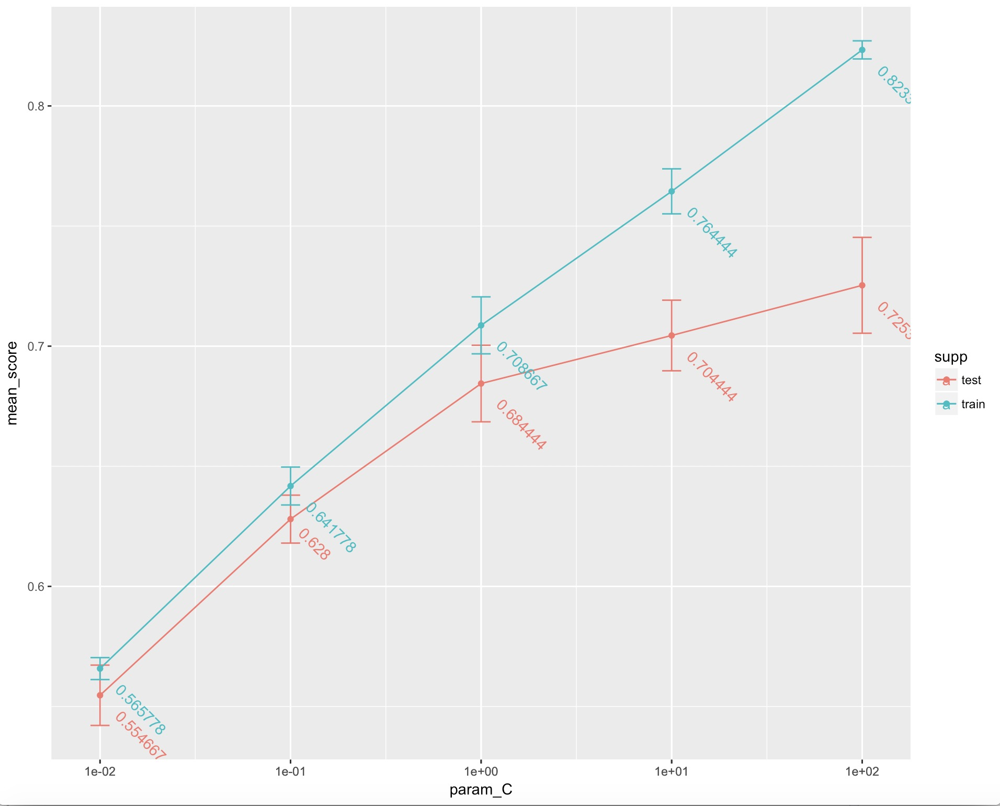
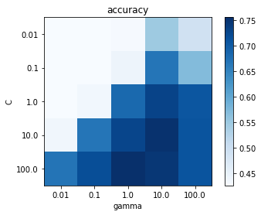
Tune Parameter
linear SVM
RBF SVM

Slide 13
XGBoost
 |  | SIFT | GIST | RGB
feature dimension |  | 2000 | 512 | 1000
XGBoost | CV Error | 29.29% | 25.64% | 9.13%
 | CV sd | 0.0145 | 0.0213 | 0.0064
 | CV Time | 104.05 | 49.138 | 48.467
 | Test Error | 27.4% | 25.2% | 9.77%
Notes:
用线性图表示？

Slide 14
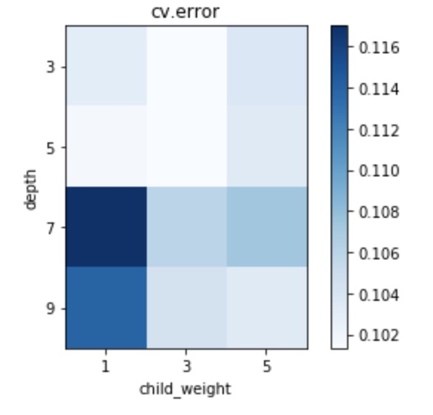
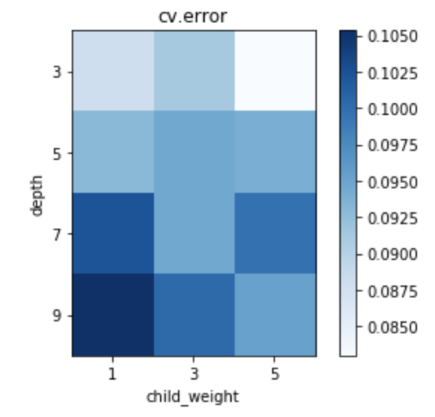
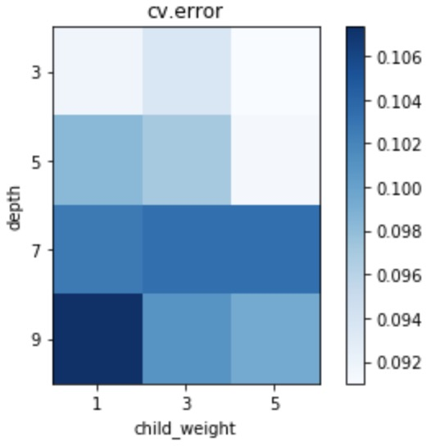
Tune Hyper parameter
RGB - 8:8:8
RGB – 10:10:10
RGB – 10:12:12

Slide 15
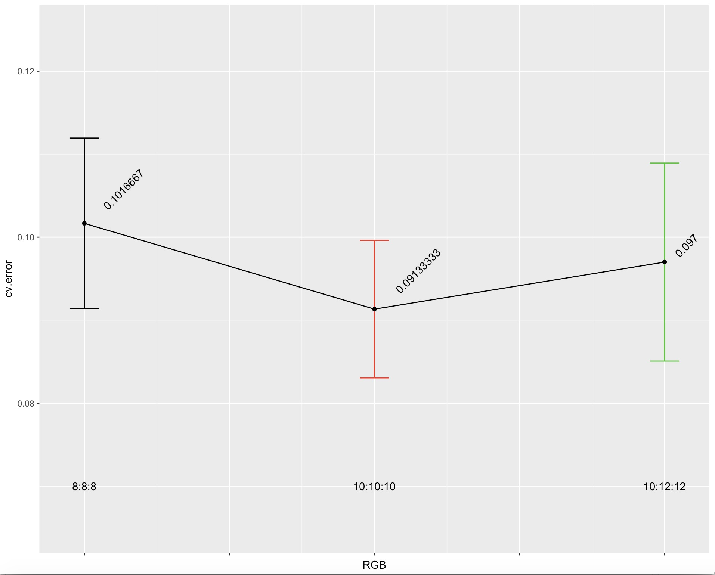
Tune Hyper parameter

Slide 16
Combine Features
4

Slide 17
XGBoost
 |  | SIFT | GIST | RGB | RGB + GIST | GIST + SIFT | SIFT + RGB + GIST
feature dimension |  | 2000 | 512 | 1000 | 1512 | 2512 | 3512
XGBoost | CV Error | 29.29% | 25.64% | 9.13% | 9.02% | 17.24% | 8.93%
 | CV sd | 0.0145 | 0.0213 | 0.0064 | 0.0086 | 0.0158 | 0.00776
 | CV Time | 104.05 | 49.138 | 48.467 | 83.249 | 154.025 | 166.637
 | Test Error | 27.4% | 25.2% | 9.77% | 8.10% | 16.17% | 7.67%
 | Memory | 41.8 kB | 3.82 kB | 37.8 kB | 30.1 kB | 61.3 kB | 69.8 kB
Notes:
用线性图表示？

Slide 18
Conclusion
Final Model:
Feature Extraction: RGB
dimension = 1000
Classification Model: XGBoost
max.depth = 3, min_child_weight = 5, eta = 0.3,
nround = 100 ,gamma = 0, lambda = 0
Test Error : 9.77%
Running Time: 48.467s

Slide 19
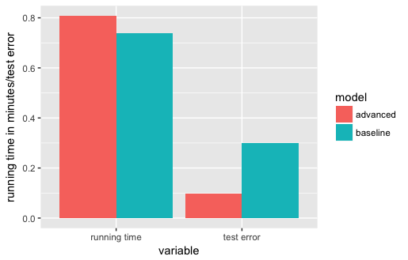

Slide 20
THANKS!
Any questions?
You can find me at
Fan Yang: fy2232@columbia.edu
Jingyi Wang: jw3592@columbia.edu
Yiran Jiang: yj2462@columbia.edu
Xueyao Li: xl2719@columbia.edu

