Slide 1


BUCK-MAN
Nick Zhang, Jane Yan, Rachel Milio, aiden Brewer, Emily eggers
Notes:
Aiden can introduce

Slide 2
Who are we?
Aiden Brewer – Product Owner
Rachel Milio – Scrum Master
Nick Zhang – Developer
Jane Yan – Developer
Emily Eggers – Ethics and Justice Leader
Notes:
Aiden introduces the members, we explain what we contributed

Slide 3
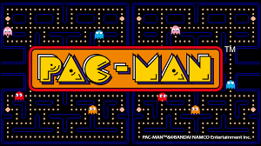


Our Project
Buck-Man!
Same gameplay as Pac-Man, but with Bucknell visuals
Notes:
Rachel explains what Pac-Man is and our game design

Slide 4
Demo!
Notes:
Jane can do demo

Slide 5
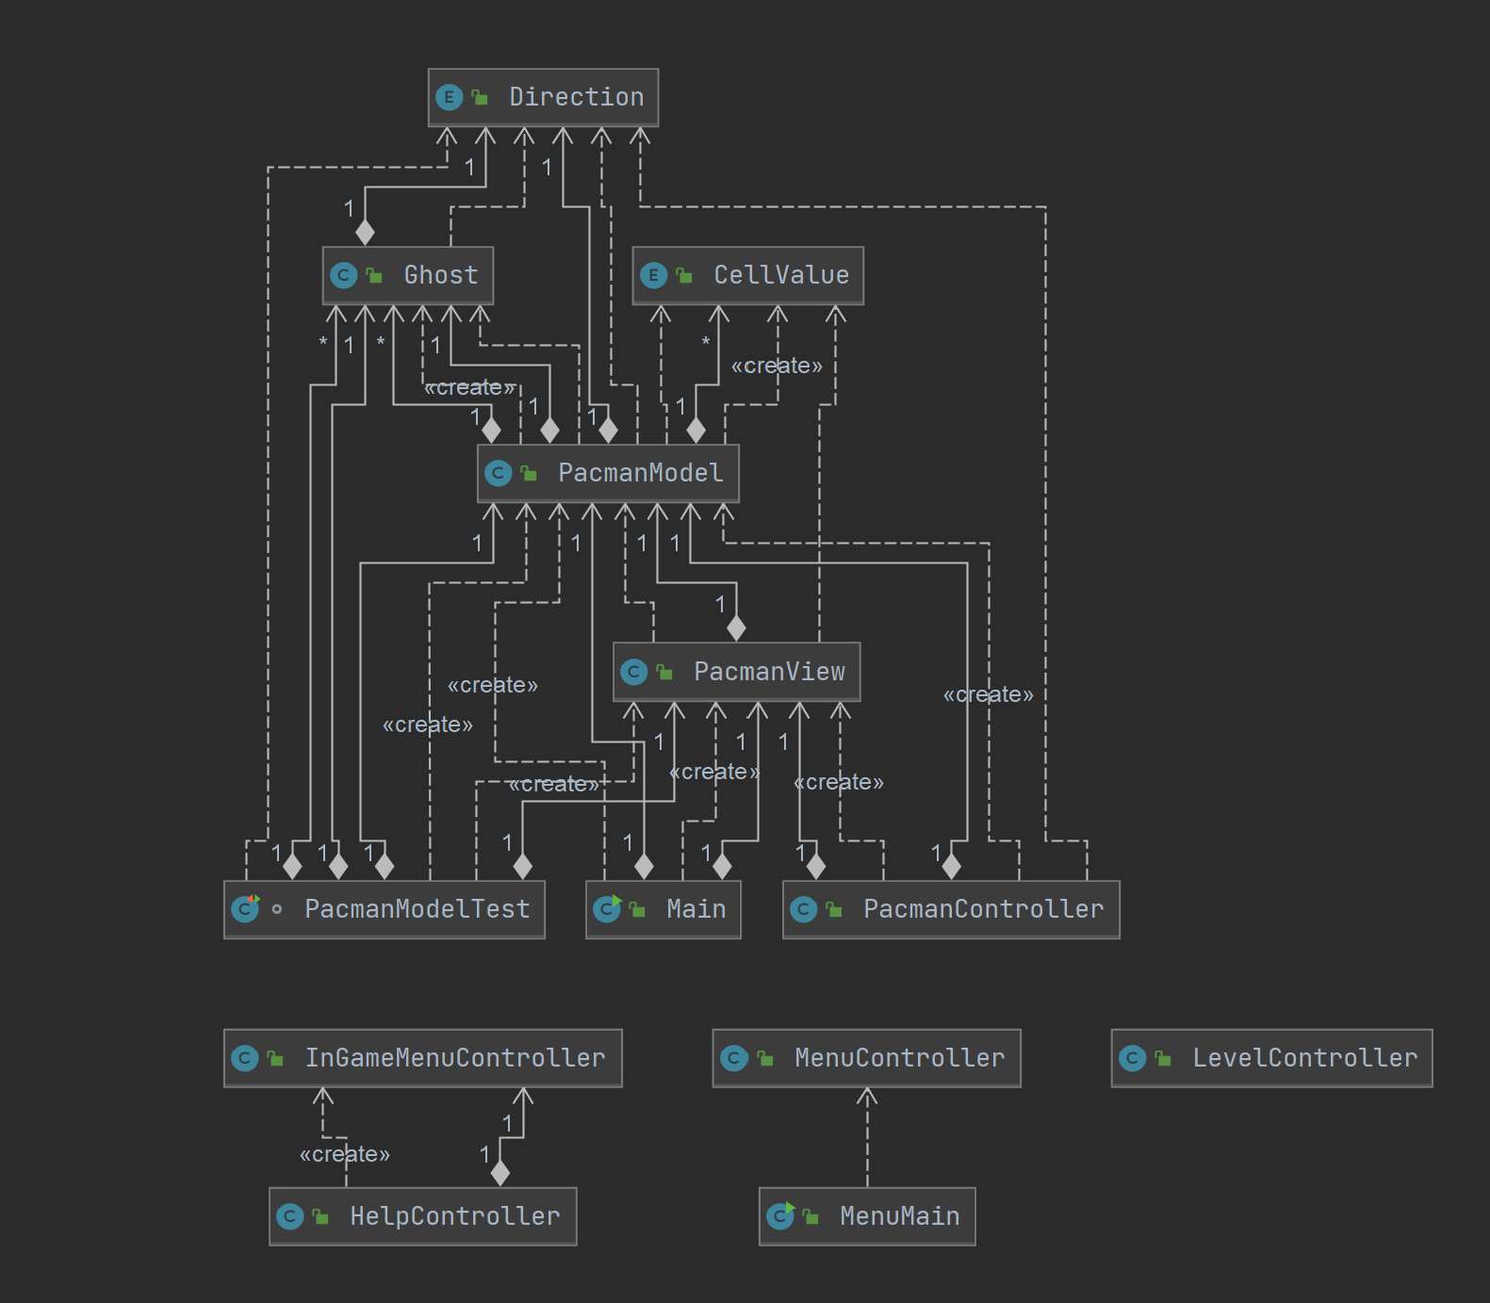
Implementation
MVC JavaFX Design
Menus are separate from the in-game features
Use of Enum classes to store direction and maze cell values
https://lucid.app/lucidchart/1789d4fd-35c0-4b8a-bf09-7c142b0d353f/edit?page=0_0#
Notes:
Nick explains implementation

Slide 6
Reflection
Strengths:
MVC Implementation
Challenges:
Timing, starting slow and having to crunch at the end
Successes:
Teamwork, communication (especially in the crunch at the end)
When one person had a problem, another could usually fix it
What we would include in version 2.0:
Bertrand Library level
Ghost “Personalities”
Notes:
Emily can reflect

