Slide 1


BUCK-MAN
Nick Zhang, Jane Yan, Rachel Milio, aiden Brewer, Emily eggers

Slide 2
Who are we?
Aiden Brewer – Product Owner
Rachel Milio – Scrum Master
Nick Zhang – Developer
Jane Yan – Developer
Emily Eggers – Ethics and Justice Leader

Slide 3


Our Project
Buck-Man!

Slide 4
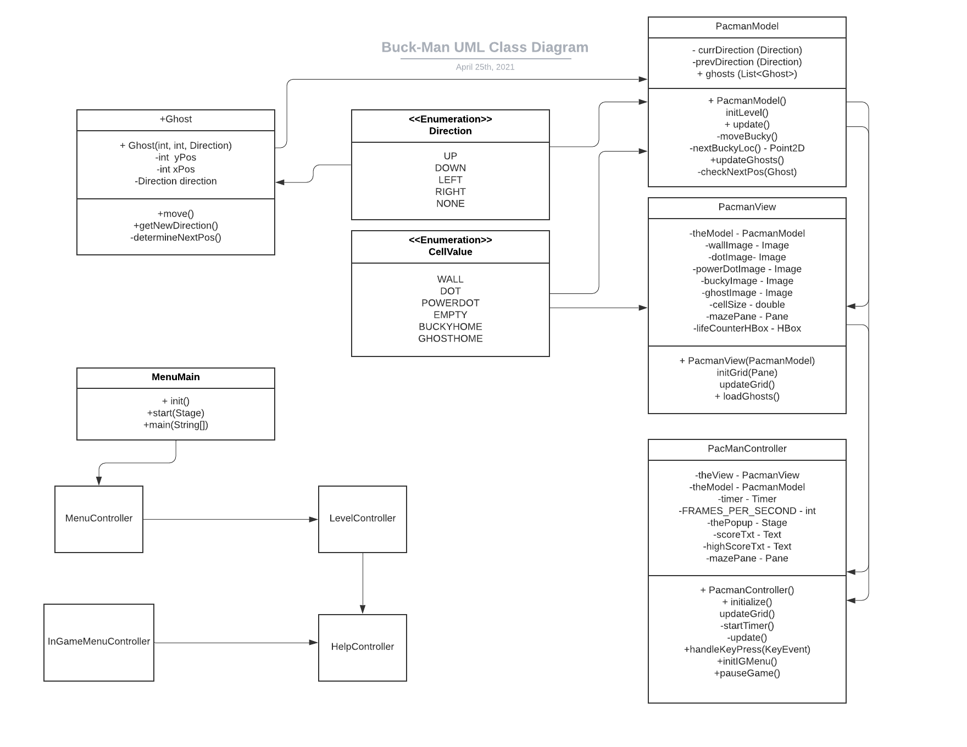
Implementation

Slide 5
Demo!

Slide 6
Reflection
Challenges
What we wish we had finished

