Slide 1
Graphical abstract
Illustration should fit within the confines of this page and ideally should be sized to the edges of the page. The graphic will be presented at this size and scaled down as needed for other use, such as in the table of contents. Text should be used sparingly. Maximum and minimum text sizes are those used in this text box. Font must be Arial.
Requirements:
Graphical abstracts must be comprised of a single graphic. The graphic should present the most important finding(s) of your study. Avoid excessive detail or clutter. No legends or tables are allowed. All content should be graphical.
The graphic must be original; material reproduced from other sources may not be used. Do not include trade names, logos, or images of trademarked items.
There some example of good Graphical Abstracts attached to this document. Any images used must be high-resolution. Large images can be scaled down to fit. Small images that need to be scaled up are not acceptable.
Multiple panels may be used in the graphic, but the focus is simplicity and ease of understanding. It must not be densely packed with information.
Text can be used sparingly. When needed, text must be sized large enough to be legible. Font must be Arial. Headers and footers are not allowed.
For ease of browsing, the graphic should have a clear start and end, preferably "reading" from top to bottom or left to right.
The graphic should be included in the manuscript at time of submission or revision at the end of the manuscript file with label “Graphical Abstract”. The image file should also be uploaded as a figure file under that label.

Slide 2
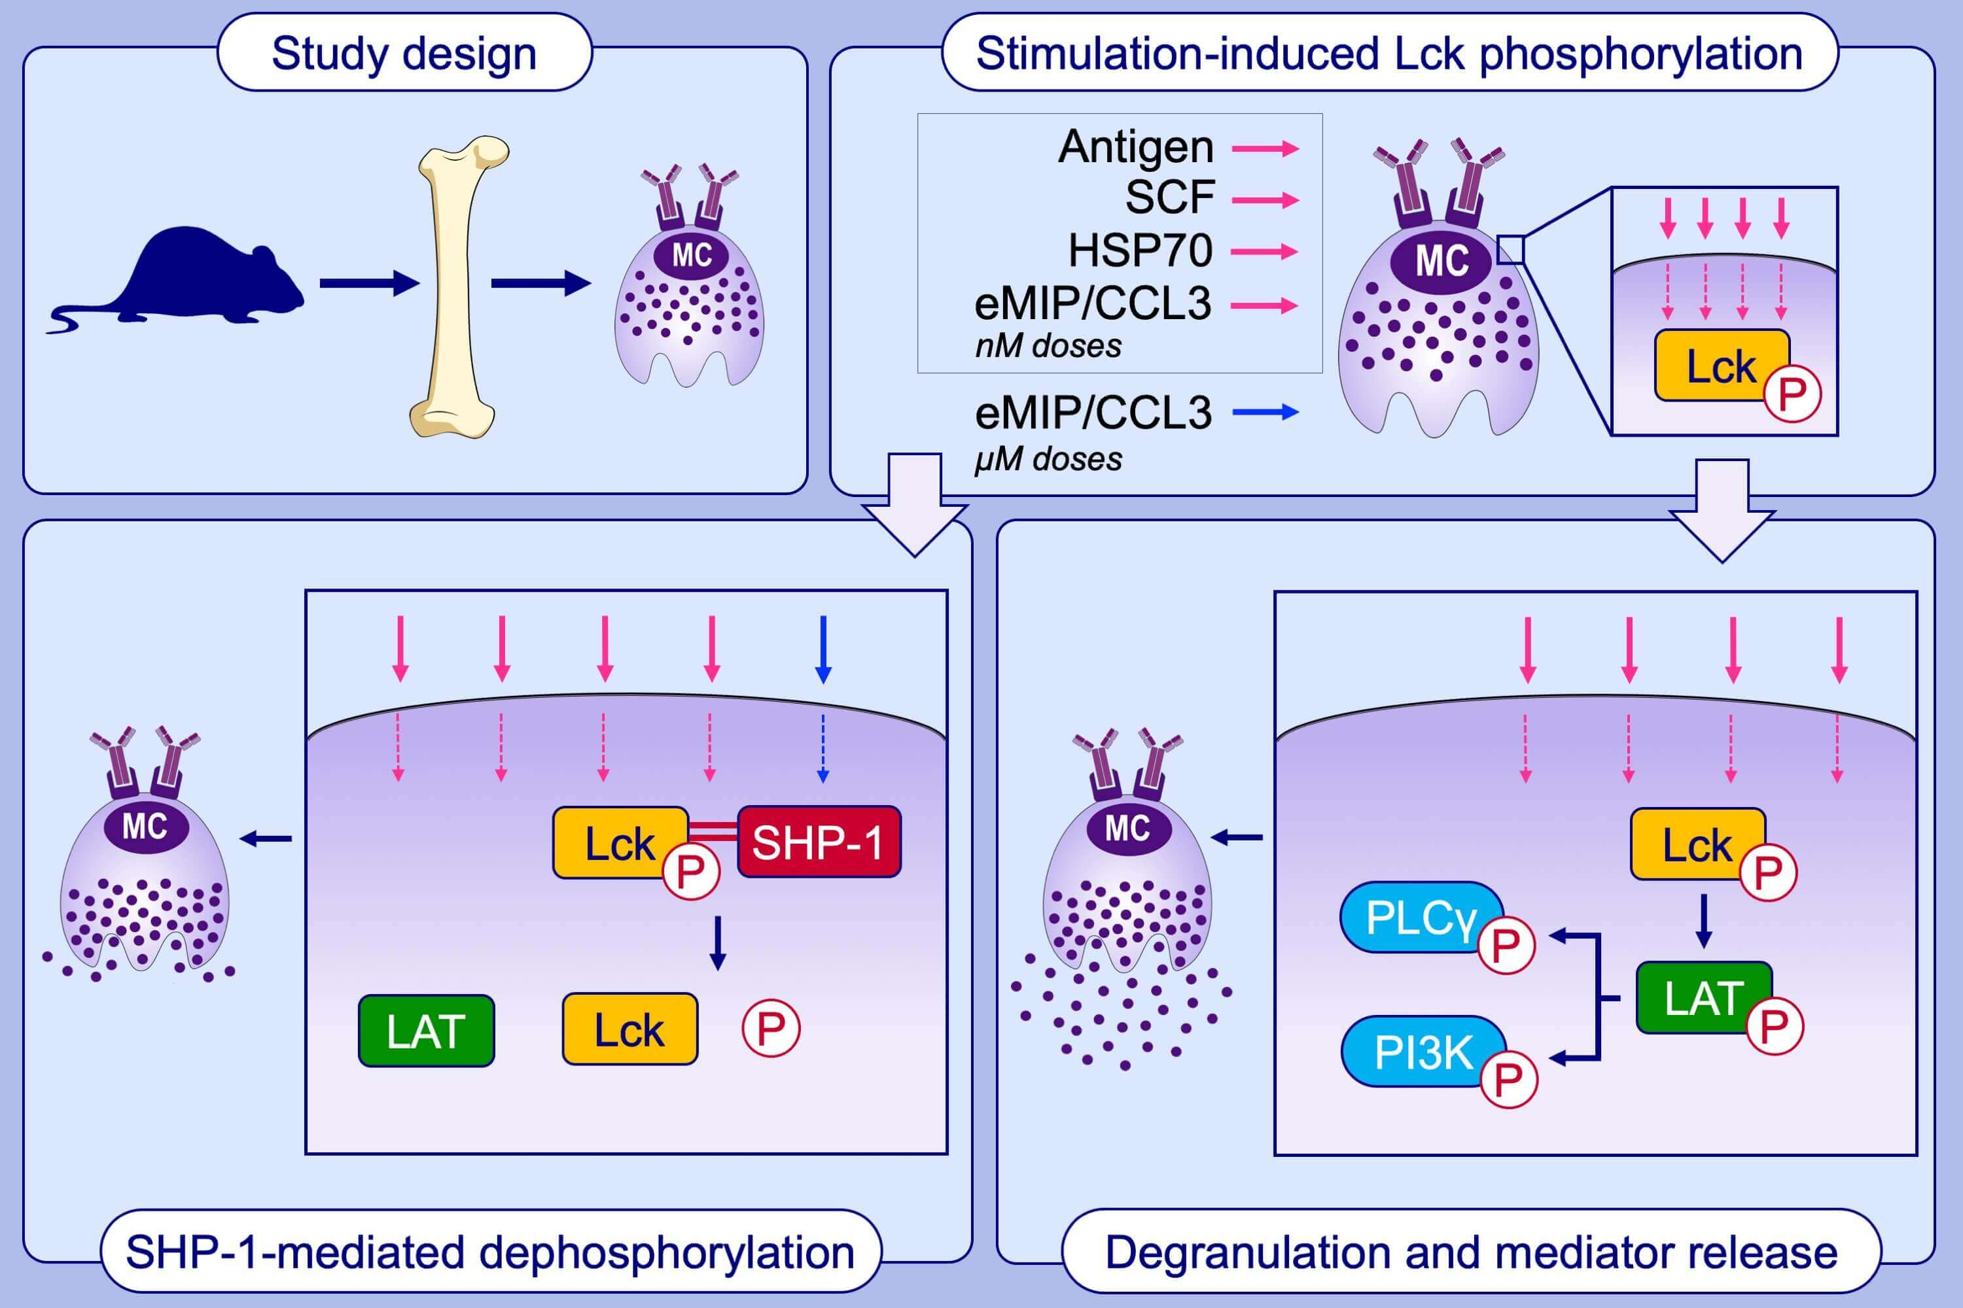

Slide 3


Slide 4
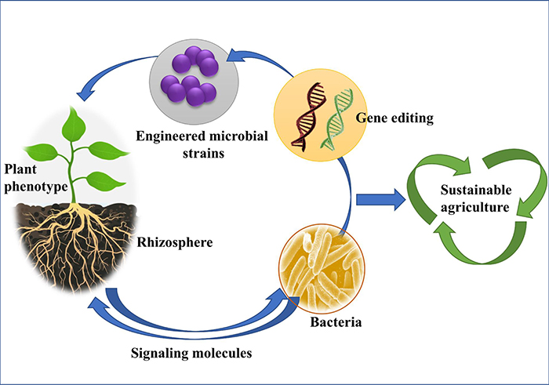

Slide 5
