Slide 1


Smart Bank
Smart Bank: The goal of this application is to create a small interactive financial application to manage one’s everyday banking needs.
Team Members
Jingyu An
Hyunju Roh
Patrick Loutfi
INVEST IN YOUR FUTURE

Slide 2



Business Concept
Possible Solutions
Banking applications seek to serve all the banking needs of the consumer, which can involve many features. The problem that may arise is too many features which results in a chaotic user experience.
Similar to when you have too many items on the menu, you don’t know what to choose, stack overflow.
Create a pleasant experience for both users: customer and banking employee.
Reduce the number of features, keeping to the core of personal banking operations.
Simplify the functionality of the application.
Create tutorials/training for all users
Cut the time required to setup account, use the application.
And many more…

Slide 3

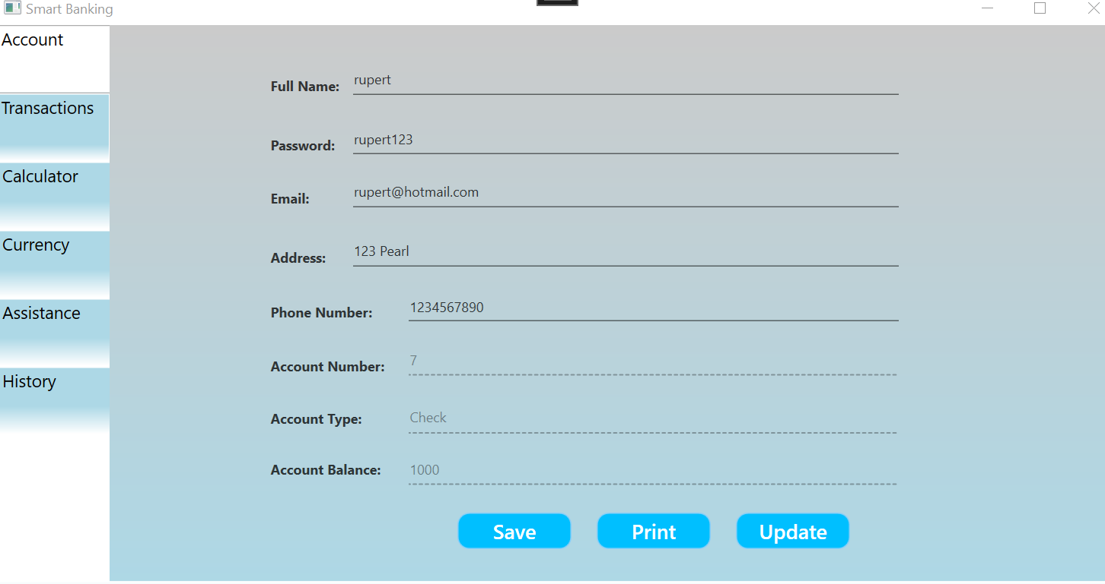
Challenges:
API for currency and display data in LiveChart
Keeping track of user, originally used "Using"

Slide 4
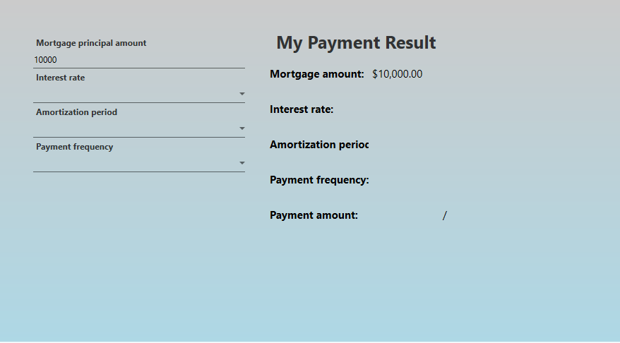
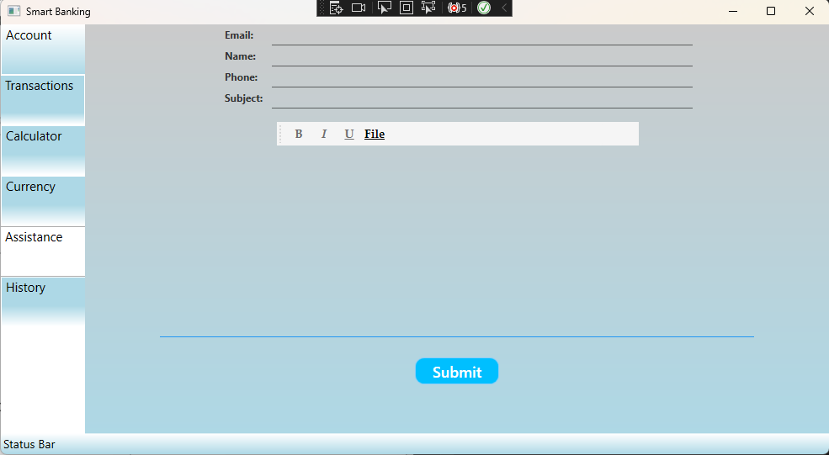
Mortgage Calculator
From customers perspective, there is no ambiguity in each operation(click).
The less clicks, the merrier
Customer Service
Using System.Net.Mail
Need to set gmail security
Send with employee's information of customer

Slide 5
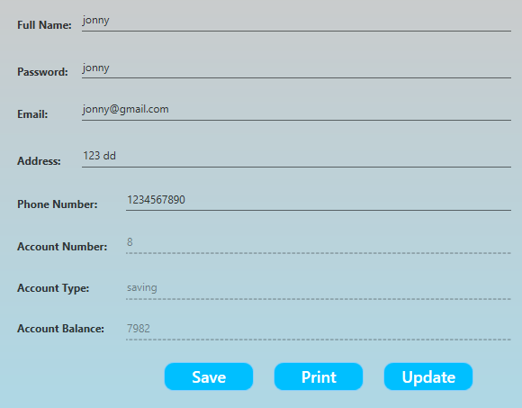
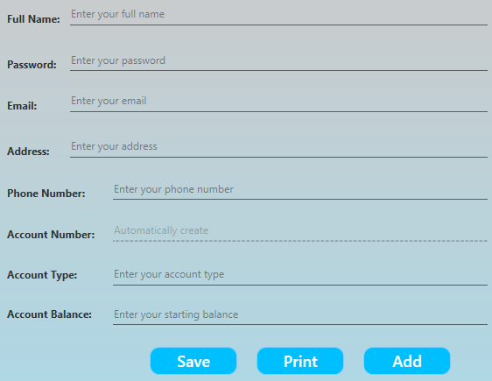
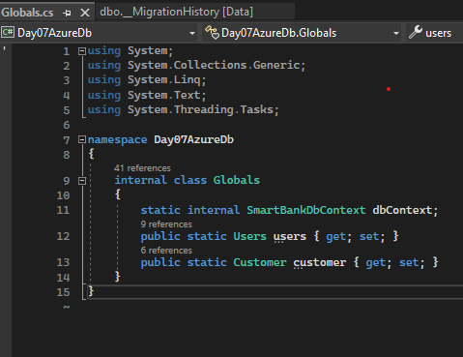
Challenge and Solution
Auth Control
Need to check who login
When login, check it
Only employees can register customers
Customers can only update information
Solution
Use global variable
On login, check who logged in and store global variable
Enable/disable function by distinguishing users and customers

Slide 6
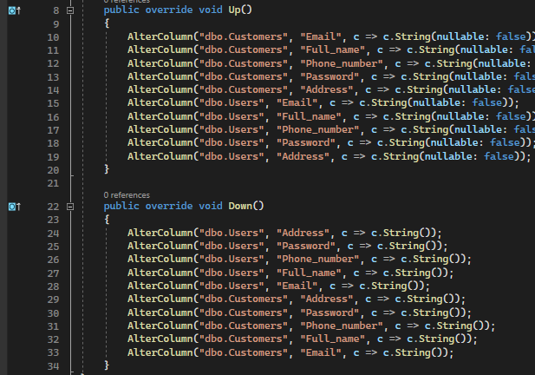
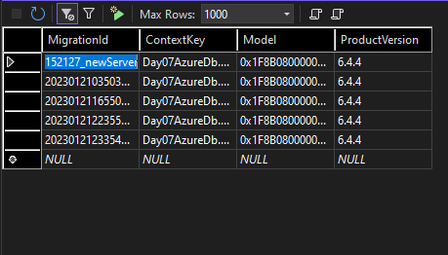
Learned
Database Migration
Need to migrate whenever Entity changed
Need to understand migration code
Up()
New database we want to update
Need to check each line is correct
Down()
Old database to be restored in case of update failure

Slide 7
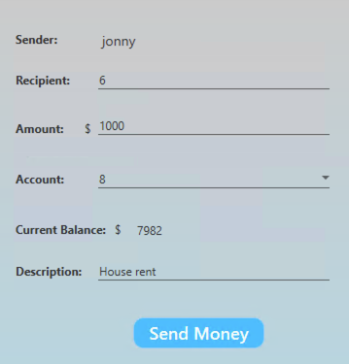
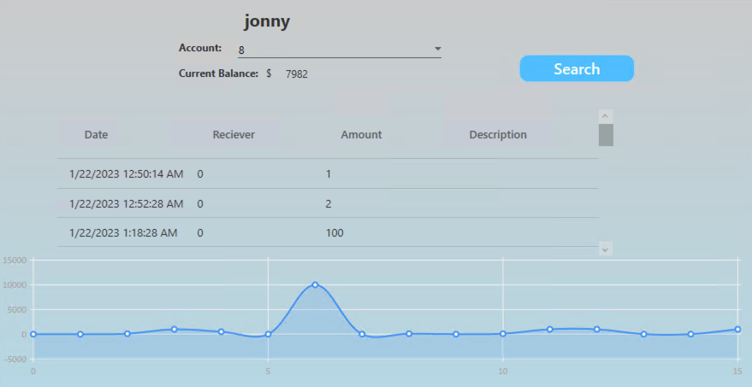
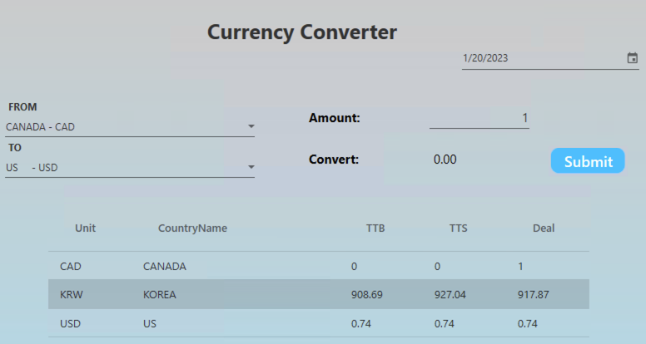
Transactions
Currency Convert
Using Currency API
Show the currency list (Cad standard)
CAD , KRW, US
Calculate currency
US-CAD , US-KRW, KRW-CAD
Transactions History
- Transact money between customers
Sender : Current Login User
Recipient : Find exist user
Account : check balance
Account money <= Current Balance
Current Balance : show current user’s balance
- Track transaction history using accountID
Name of Account
Account : Choose account
Current Balance : Show Current balaance
Account money <= Current Balance
Current Balance : show current user’s balance
Show Live chart

Slide 8
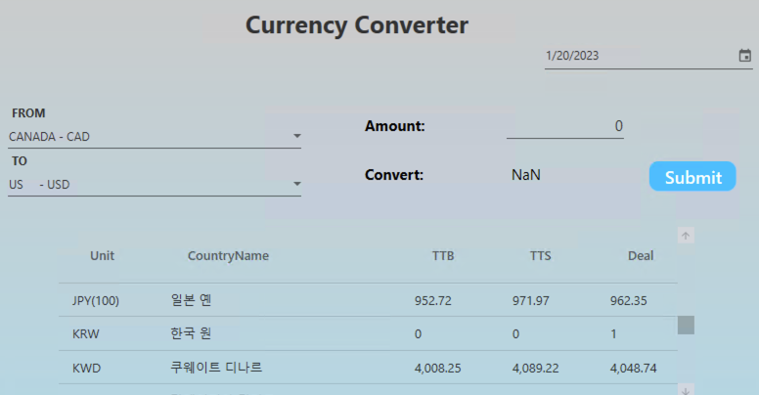
Challenge
Currency API
Paid API
Using Export-Import bank of Korea
API provided in Korean.
KRW is standard
Viewable only on business days
Using currency API

Slide 9
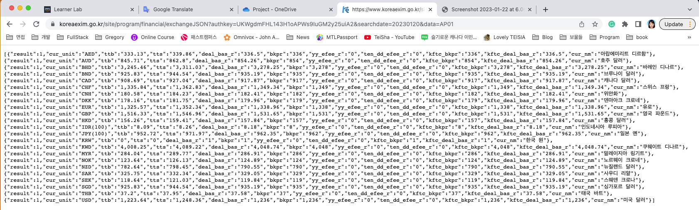
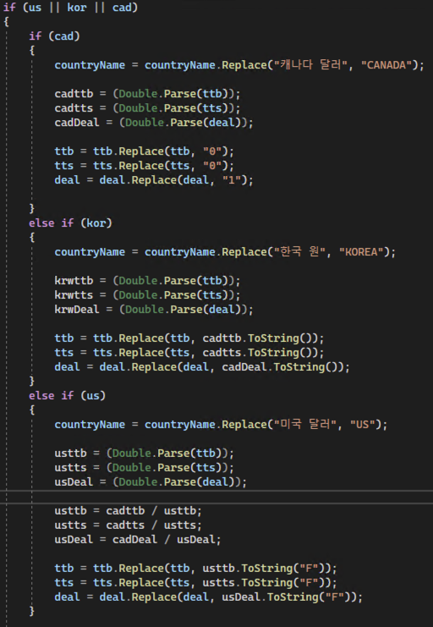
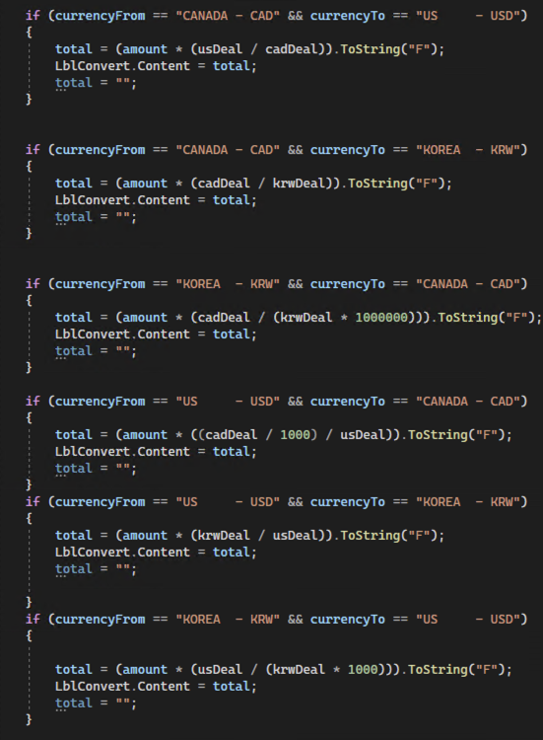
Solutions
List of data
Calculate Data
Classify the data

Slide 10
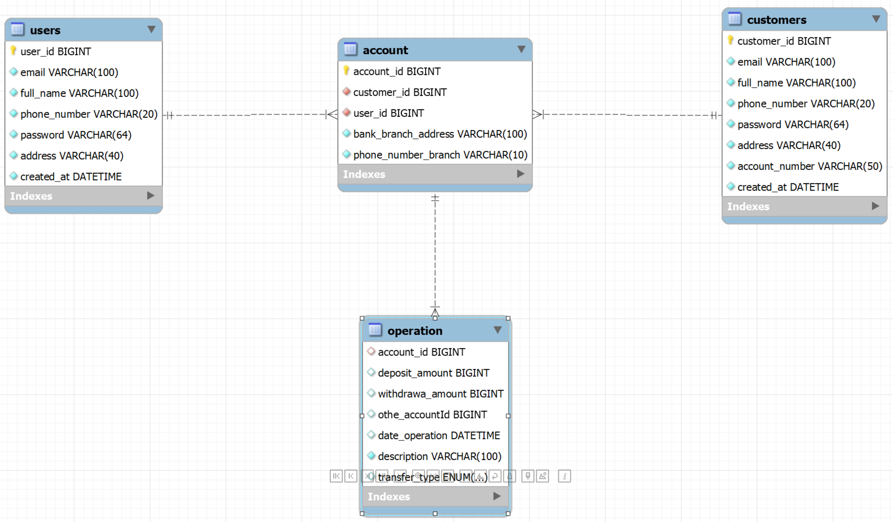
Original Database Structure

Slide 11
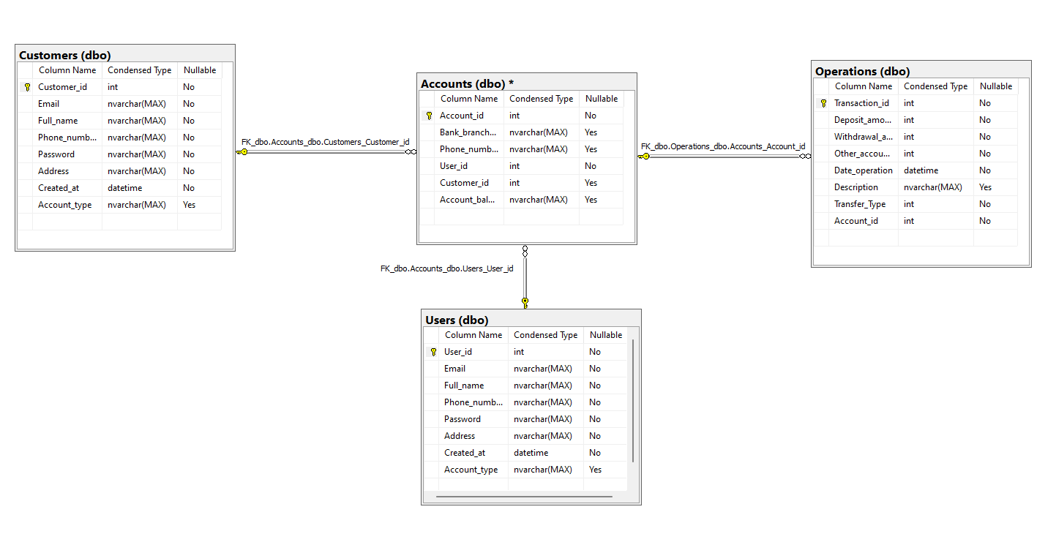
Final Database

Slide 12
Possible Future Implementations
More Features
Charting: more accurate and reliable (only had transactions and account balance to work with)
Security Features: very easy to crack our database
Micro Service: Separate all the functions into sperate files/folders. Important for troubleshooting and low coupling.
Overall cleaner code.

