Slide 1

Double/debiased machine learning with regression calibration (improved version)
Zuoheng (Anita) Wang, PhD
Department of Biostatistics
Yale School of Public Health

Slide 2
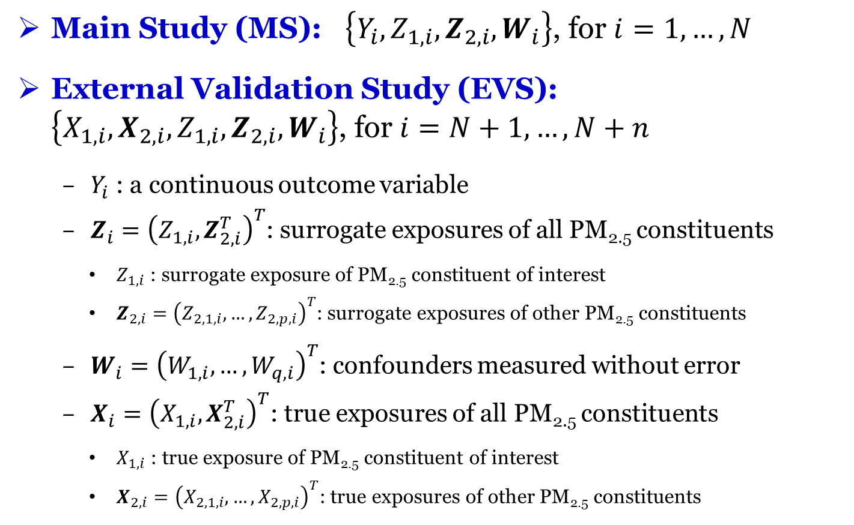
Study design and notations
Main Study (MS): $\left\{Y_{i},Z_{1,i},Z_{2,i},W_{i}\right\}$, for $i=1,…,N$
External Validation Study (EVS): $\left\{X_{1,i},X_{2,i},Z_{1,i},Z_{2,i},W_{i}\right\}$, for $i=N+1,…,N+n$
$Y_{i}$ : a continuous outcome variable
$Z_{i}={\left(Z_{1,i},Z_{2,i}^{T}\right)}^{T}$: surrogate exposures of all PM_{2.5} constituents
$Z_{1,i}$ : surrogate exposure of PM_{2.5} constituent of interest
$Z_{2,i}={\left(Z_{2,1,i},…,Z_{2,p,i}\right)}^{T}$: surrogate exposures of other PM_{2.5} constituents
$W_{i}={\left(W_{1,i},…,W_{q,i}\right)}^{T}$: confounders measured without error
$X_{i}={\left(X_{1,i},X_{2,i}^{T}\right)}^{T}$: true exposures of all PM_{2.5} constituents
$X_{1,i}$ : true exposure of PM_{2.5} constituent of interest
$X_{2,i}={\left(X_{2,1,i},…,X_{2,p,i}\right)}^{T}$: true exposures of other PM_{2.5} constituents

Slide 3
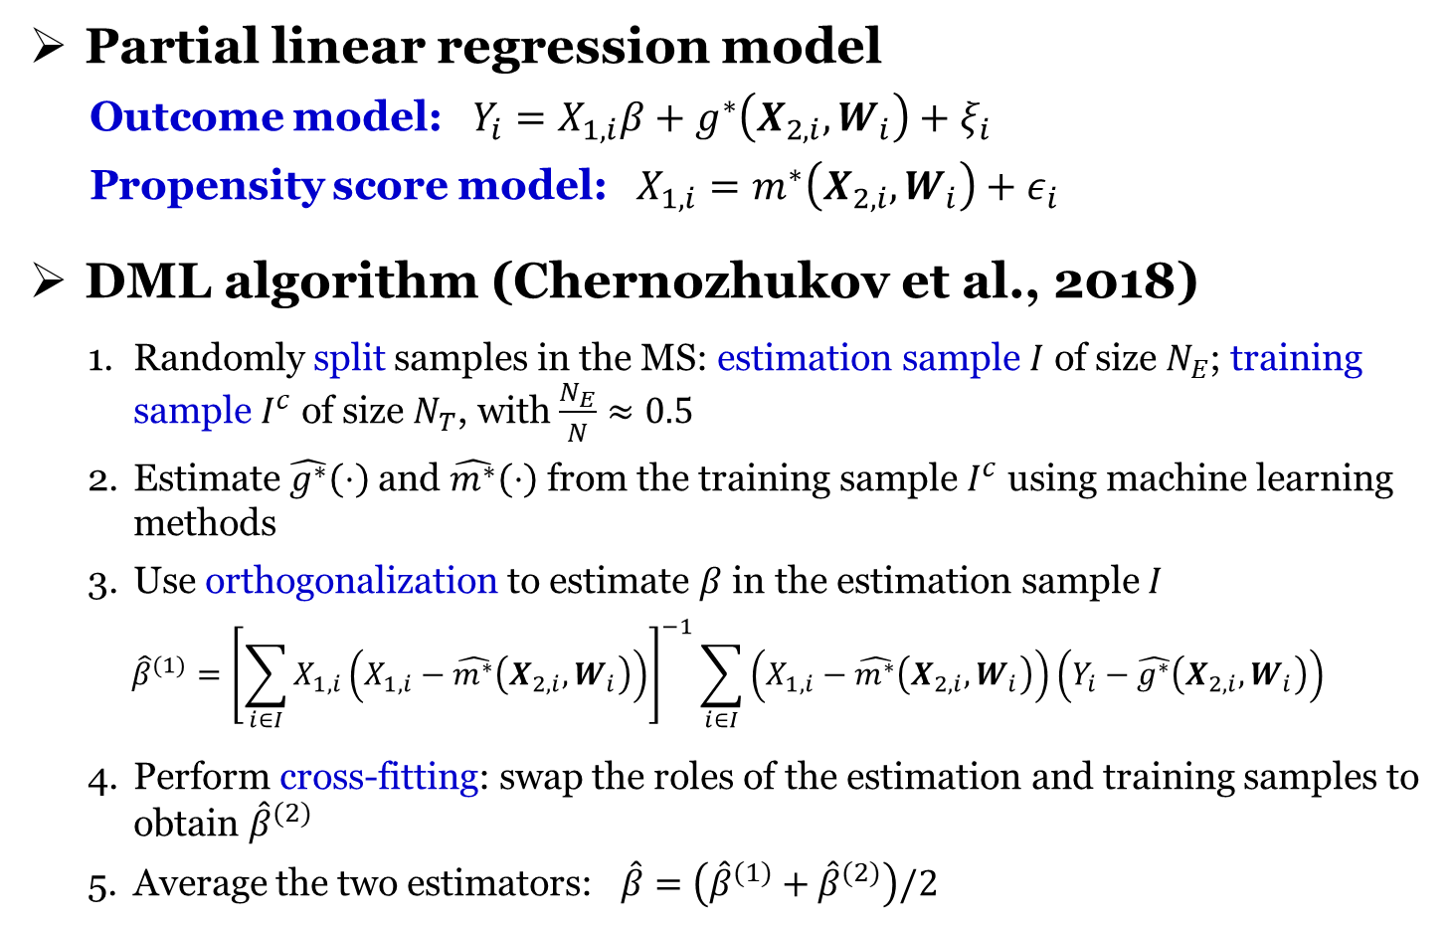
Double/debiased machine learning (DML)
Partial linear regression model
Outcome model: $Y_{i}=X_{1,i}β+g^{∗}\left(X_{2,i},W_{i}\right)+ξ_{i}$
Propensity score model: $X_{1,i}=m^{∗}\left(X_{2,i},W_{i}\right)+ε_{i}$
DML algorithm (Chernozhukov et al., 2018)
Randomly split samples in the MS: estimation sample $I$ of size $N_{E}$; training sample $I^{c}$ of size $N_{T}$, with $\frac{N_{E}}{N}≈0.5$
Estimate $\hat{g^{∗}}\left(⋅\right)$ and $\hat{m^{∗}}\left(⋅\right)$ from the training sample $I^{c}$ using machine learning methods
Use orthogonalization to estimate $β$ in the estimation sample $I$
$${\hat{β}}^{(1)}={\left[\sum_{i∈I}{X_{1,i}\left(X_{1,i}−\hat{m^{∗}}\left(X_{2,i},W_{i}\right)\right)}\right]}^{−1}\sum_{i∈I}{\left(X_{1,i}−\hat{m^{∗}}\left(X_{2,i},W_{i}\right)\right)\left(Y_{i}−\hat{g^{∗}}\left(X_{2,i},W_{i}\right)\right)}$$
Perform cross-fitting: swap the roles of the estimation and training samples to obtain ${\hat{β}}^{(2)}$
Average the two estimators: $\hat{β}=\left({\hat{β}}^{(1)}+{\hat{β}}^{(2)}\right)/2$

Slide 4
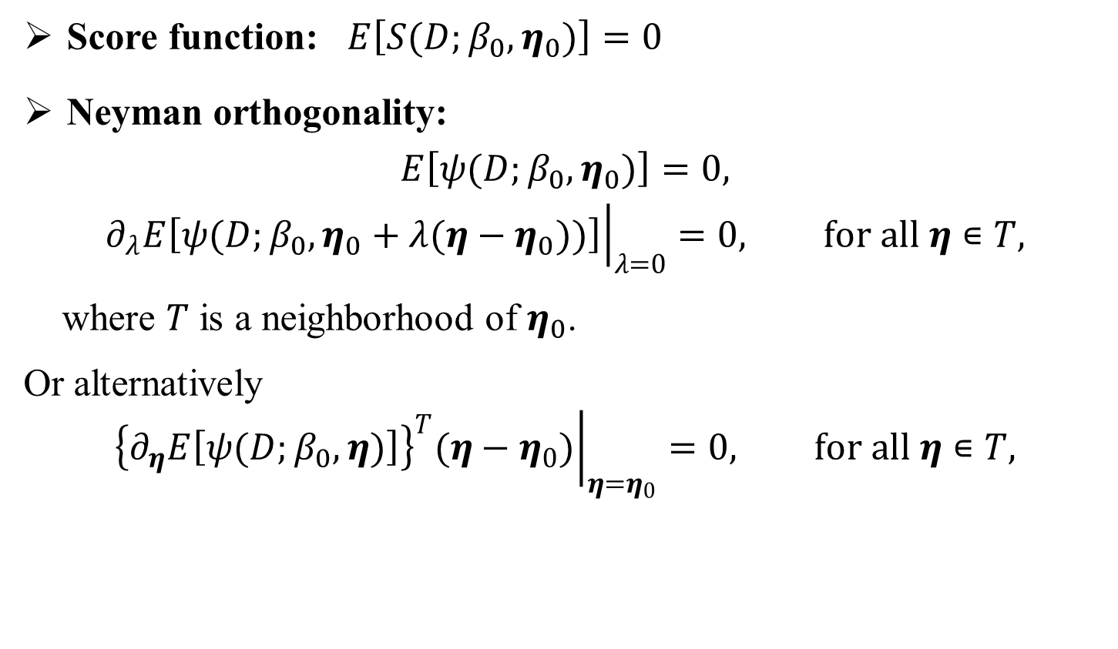
Neyman orthogonality
Score function: $E\left[S(D;β_{0},η_{0})\right]=0$
Neyman orthogonality:
$$E\left[ψ(D;β_{0},η_{0})\right]=0,$$
$${\left.∂_{λ}E\left[ψ(D;β_{0},η_{0}+λ(η−η_{0}))\right]\right|}_{λ=0}=0, for all η∊T,$$
where $T$ is a neighborhood of $η_{0}$.
Or alternatively
$${\left.{\left\{∂_{η}E\left[ψ(D;β_{0},η)\right]\right\}}^{T}(η−η_{0})\right|}_{η=η_{0}}=0, for all η∊T,$$

Slide 5
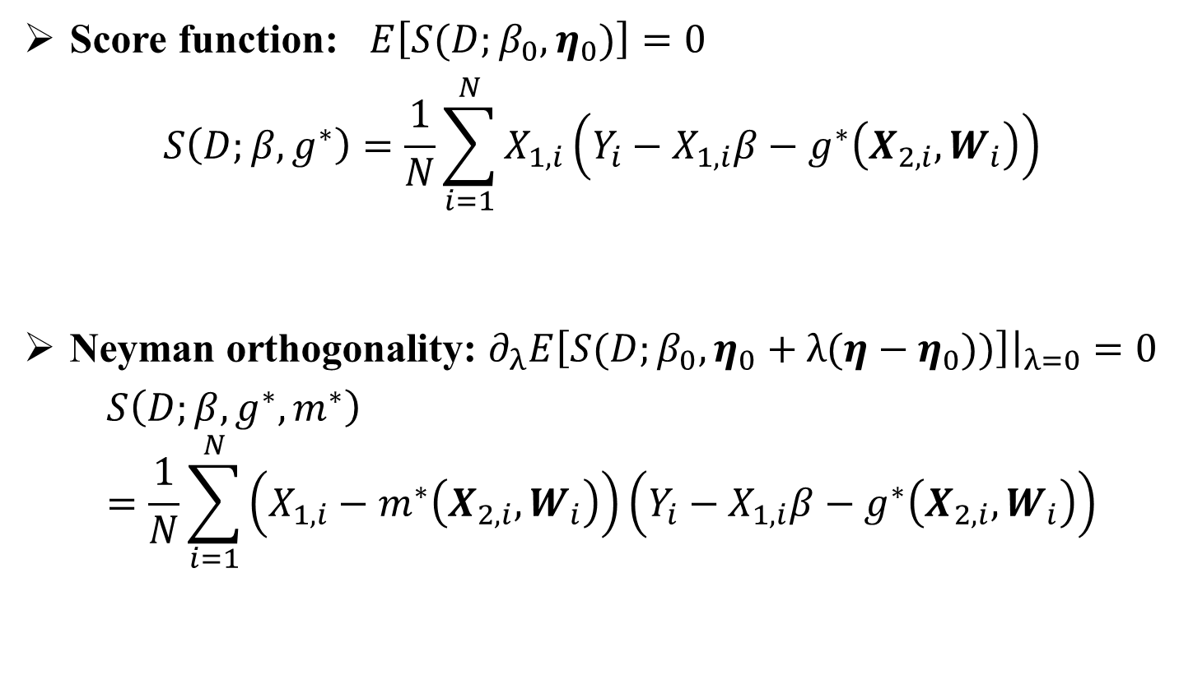
Double/debiased machine learning (DML)
Score function: $E\left[S(D;β_{0},η_{0})\right]=0$
$$S\left(D;β,g^{∗}\right)=\frac{1}{N}\sum_{i=1}^{N}{X_{1,i}\left(Y_{i}−X_{1,i}β−g^{∗}\left(X_{2,i},W_{i}\right)\right)}$$
Neyman orthogonality: ${\left.∂_{λ}E\left[S(D;β_{0},η_{0}+λ(η−η_{0}))\right]\right|}_{λ=0}=0$
$$S\left(D;β,g^{∗},m^{∗}\right)=\frac{1}{N}\sum_{i=1}^{N}{\left(X_{1,i}−m^{∗}\left(X_{2,i},W_{i}\right)\right)\left(Y_{i}−X_{1,i}β−g^{∗}\left(X_{2,i},W_{i}\right)\right)}$$

Slide 6
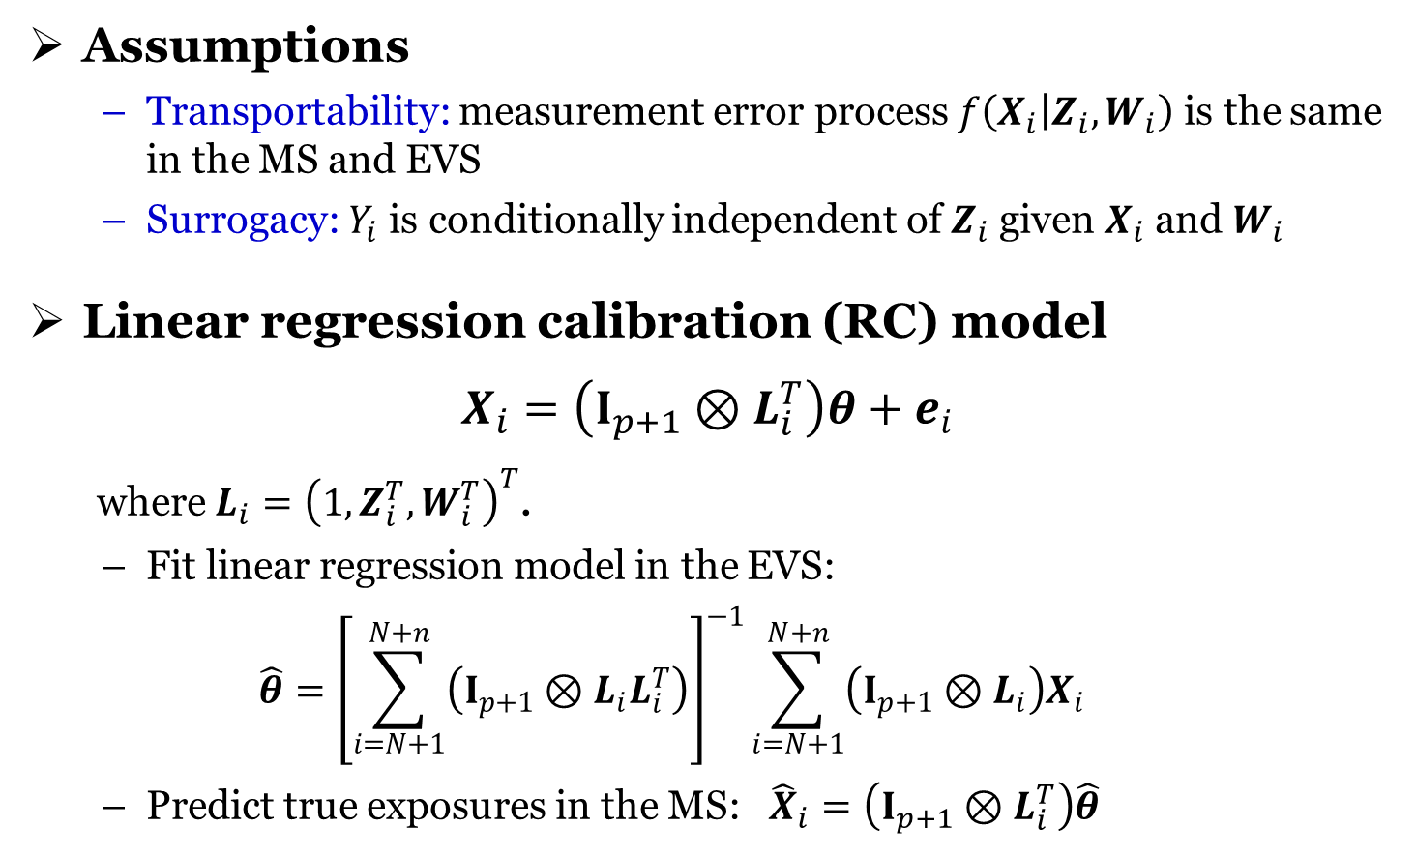
Measurement error correction
Assumptions
Transportability: measurement error process $f\left(X_{i} | Z_{i},W_{i}\right)$ is the same in the MS and EVS
Surrogacy: $Y_{i}$ is conditionally independent of $Z_{i}$ given $X_{i}$ and $W_{i}$
Linear regression calibration (RC) model
$$X_{i}=\left(I_{p+1}⊗L_{i}^{T}\right)θ+e_{i}$$
where $L_{i}={\left(1,Z_{i}^{T},W_{i}^{T}\right)}^{T}$.
Fit linear regression model in the EVS:
$$\hat{θ}={\left[\sum_{i=N+1}^{N+n}{\left(I_{p+1}⊗L_{i}L_{i}^{T}\right)}\right]}^{−1}\sum_{i=N+1}^{N+n}{\left(I_{p+1}⊗L_{i}\right)X_{i}}$$
Predict true exposures in the MS: ${\hat{X}}_{i}=\left(I_{p+1}⊗L_{i}^{T}\right)\hat{θ}$

Slide 7
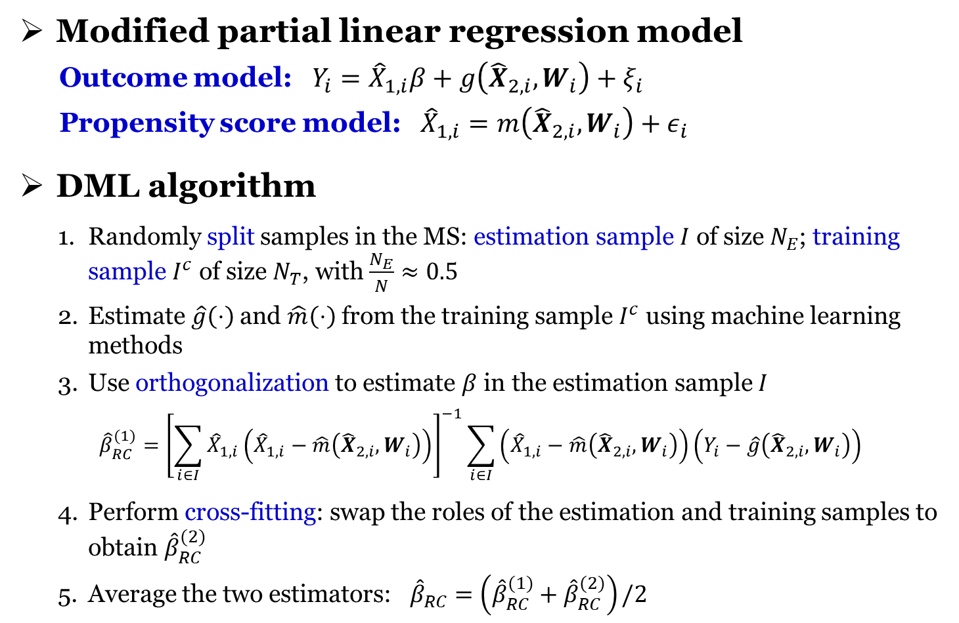
DML-RC
Modified partial linear regression model
Outcome model: $Y_{i}={\hat{X}}_{1,i}β+g\left({\hat{X}}_{2,i},W_{i}\right)+ξ_{i}$
Propensity score model: ${\hat{X}}_{1,i}=m\left({\hat{X}}_{2,i},W_{i}\right)+ε_{i}$
DML algorithm
Randomly split samples in the MS: estimation sample $I$ of size $N_{E}$; training sample $I^{c}$ of size $N_{T}$, with $\frac{N_{E}}{N}≈0.5$
Estimate $\hat{g}\left(⋅\right)$ and $\hat{m}\left(⋅\right)$ from the training sample $I^{c}$ using machine learning methods
Use orthogonalization to estimate $β$ in the estimation sample $I$
$${\hat{β}}_{RC}^{(1)}={\left[\sum_{i∈I}{{\hat{X}}_{1,i}\left({\hat{X}}_{1,i}−\hat{m}\left({\hat{X}}_{2,i},W_{i}\right)\right)}\right]}^{−1}\sum_{i∈I}{\left({\hat{X}}_{1,i}−\hat{m}\left({\hat{X}}_{2,i},W_{i}\right)\right)\left(Y_{i}−\hat{g}\left({\hat{X}}_{2,i},W_{i}\right)\right)}$$
Perform cross-fitting: swap the roles of the estimation and training samples to obtain ${\hat{β}}_{RC}^{(2)}$
Average the two estimators: ${\hat{β}}_{RC}=\left({\hat{β}}_{RC}^{(1)}+{\hat{β}}_{RC}^{(2)}\right)/2$

Slide 8
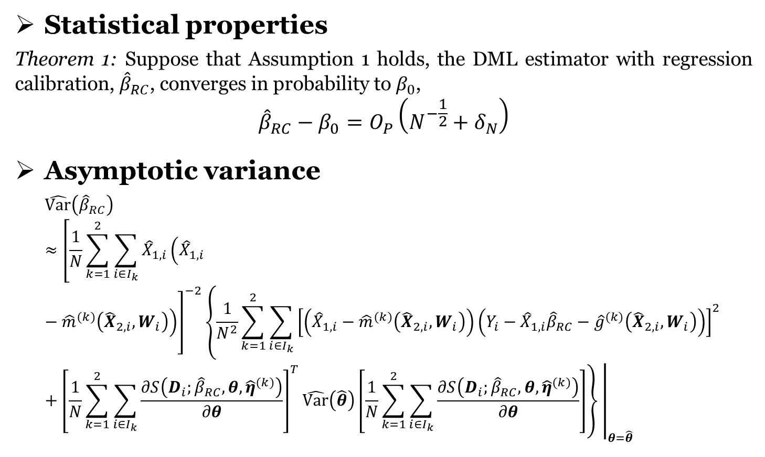
DML-RC
Statistical properties
Theorem 1: Suppose that Assumption 1 holds, the DML estimator with regression calibration, ${\hat{β}}_{RC}$, converges in probability to $β_{0}$,
$${\hat{β}}_{RC}−β_{0}=O_{P}\left(N^{−\frac{1}{2}}+δ_{N}\right)$$
Asymptotic variance
$$\hat{Var}\left({\hat{β}}_{RC}\right)≈{\left.{\left[\frac{1}{N}\sum_{k=1}^{2}{\sum_{i∈I_{k}}{{\hat{X}}_{1,i}\left({\hat{X}}_{1,i}−{\hat{m}}^{(k)}\left({\hat{X}}_{2,i},W_{i}\right)\right)}}\right]}^{−2}\left\{\frac{1}{N^{2}}\sum_{k=1}^{2}{\sum_{i∈I_{k}}{{\left[\left({\hat{X}}_{1,i}−{\hat{m}}^{(k)}\left({\hat{X}}_{2,i},W_{i}\right)\right)\left(Y_{i}−{\hat{X}}_{1,i}{\hat{β}}_{RC}−{\hat{g}}^{(k)}\left({\hat{X}}_{2,i},W_{i}\right)\right)\right]}^{2}}}+{\left[\frac{1}{N}\sum_{k=1}^{2}{\sum_{i∈I_{k}}{\frac{∂S\left(D_{i};{\hat{β}}_{RC},θ,{\hat{η}}^{(k)}\right)}{∂θ}}}\right]}^{T}\hat{Var}\left(\hat{θ}\right)\left[\frac{1}{N}\sum_{k=1}^{2}{\sum_{i∈I_{k}}{\frac{∂S\left(D_{i};{\hat{β}}_{RC},θ,{\hat{η}}^{(k)}\right)}{∂θ}}}\right]\right\} \right|}_{θ=\hat{θ}}$$

Slide 9
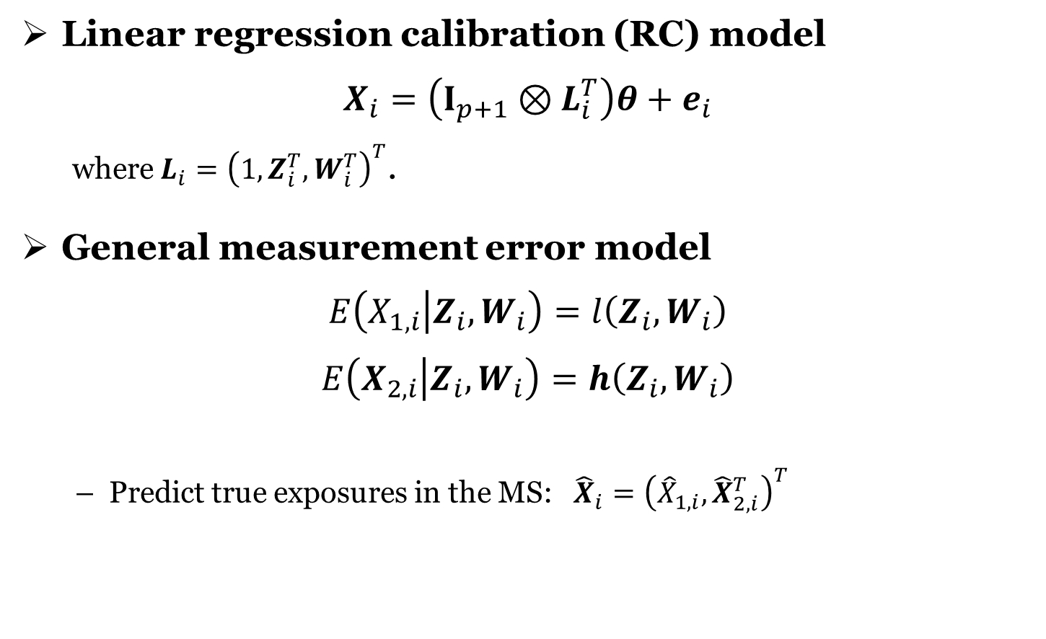
Measurement error correction
Linear regression calibration (RC) model
$$X_{i}=\left(I_{p+1}⊗L_{i}^{T}\right)θ+e_{i}$$
where $L_{i}={\left(1,Z_{i}^{T},W_{i}^{T}\right)}^{T}$.
General measurement error model
$$E\left(X_{1,i} | Z_{i},W_{i}\right)=l\left(Z_{i},W_{i}\right)$$
$$E\left(X_{2,i} | Z_{i},W_{i}\right)=h\left(Z_{i},W_{i}\right)$$
Predict true exposures in the MS: ${\hat{X}}_{i}={\left({\hat{X}}_{1,i},{\hat{X}}_{2,i}^{T}\right)}^{T}$

Slide 10
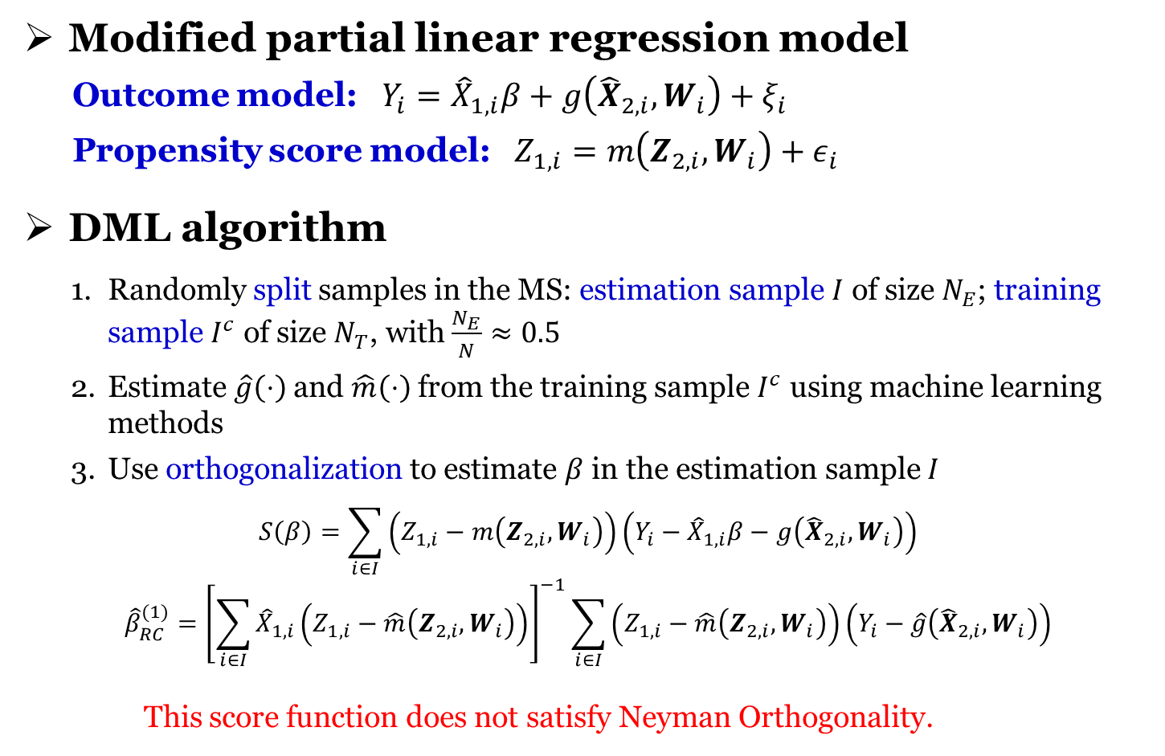
DML-RC (version 1)
Modified partial linear regression model
Outcome model: $Y_{i}={\hat{X}}_{1,i}β+g\left({\hat{X}}_{2,i},W_{i}\right)+ξ_{i}$
Propensity score model: $Z_{1,i}=m\left(Z_{2,i},W_{i}\right)+ε_{i}$
DML algorithm
Randomly split samples in the MS: estimation sample $I$ of size $N_{E}$; training sample $I^{c}$ of size $N_{T}$, with $\frac{N_{E}}{N}≈0.5$
Estimate $\hat{g}\left(⋅\right)$ and $\hat{m}\left(⋅\right)$ from the training sample $I^{c}$ using machine learning methods
Use orthogonalization to estimate $β$ in the estimation sample $I$
$$S\left(β\right)=\sum_{i∈I}{\left(Z_{1,i}−m\left(Z_{2,i}, W_{i}\right)\right)\left(Y_{i}−{\hat{X}}_{1,i}β−g\left({\hat{X}}_{2,i}, W_{i}\right)\right)}$$
$${\hat{β}}_{RC}^{(1)}={\left[\sum_{i∈I}{{\hat{X}}_{1,i}\left(Z_{1,i}−\hat{m}\left(Z_{2,i}, W_{i}\right)\right)}\right]}^{−1}\sum_{i∈I}{\left(Z_{1,i}−\hat{m}\left(Z_{2,i}, W_{i}\right)\right)\left(Y_{i}−\hat{g}\left({\hat{X}}_{2,i},W_{i}\right)\right)}$$
This score function does not satisfy Neyman Orthogonality.

