Slide 1



Measurement Error Models in Action
The Latest Methods and Their Applications in Nutrition and Environmental Health
Presenters: Donna Spiegelman • Molin Wang • Jingyu Cui

Slide 2




Workshop Overview
Exposure measurement error is a pervasive challenge in epidemiologic and public health research. Ignoring it biases exposure–outcome associations — usually attenuating effects toward the null and increasing the risk of false negatives.
Effect of Uncorrected Measurement Error
Bias toward the null
Inflated false-negative rates and underestimated associations between exposures and health outcomes.
What You'll Learn
Conceptual Foundations
Bias-Correction Methods
Hands-On R Practice
Regression calibration and its extensions to survival analysis
How exposure measurement error distorts estimation and inference
Apply methods to published nutrition and air pollution examples

Slide 3



Agenda
June 23rd, 2026 • 1:00 PM – 5:00 PM
1:00–1:30 PM
Impact of Measurement Error & Overview of Correction Methods
Donna Spiegelman
1:30–2:00 PM
Main Study/Validation & Main Study/Reliability Study Designs
Donna Spiegelman
2:00–3:00 PM
Regression Calibration Methods for Adjusting Measurement Error Bias
Molin Wang
3:10–4:00 PM
Hands-On Lab: R Examples in Epidemiology
Jingyu Cui
4:00–4:30 PM
Causal Variable Selection in Measurement Error Models
Molin Wang
4:30–5:00 PM
Case Study
Donna Spiegelman

Slide 4
Impact of Measurement Error and Overview of Correction Methods

Slide 5

The Boundlessness of Measurement Error
Unlike confounding bias, which is more tightly bounded by than by Vanderweele and Ding’s (2017) E-value,
bias due to measurement error has no bounds,
robust methods and software are available to correct for this bias in exposures of interest and potential confounders, empirically eliminating the residual confounding issues
High quality validation and reliability data are available across a range of chronic disease risk factors, permitting empirical adjustment to eliminate this source of bias. This is the focus of this course: design of validation and reliability studies, to then correct analyses for measurement error bias.
VanderWeele, Tyler J., and Peng Ding. 2017. “Sensitivity Analysis in Observational Research: Introducing the E-Value.” Annals of Internal Medicine (July 11). doi:10.7326/m16-2607.

Slide 6
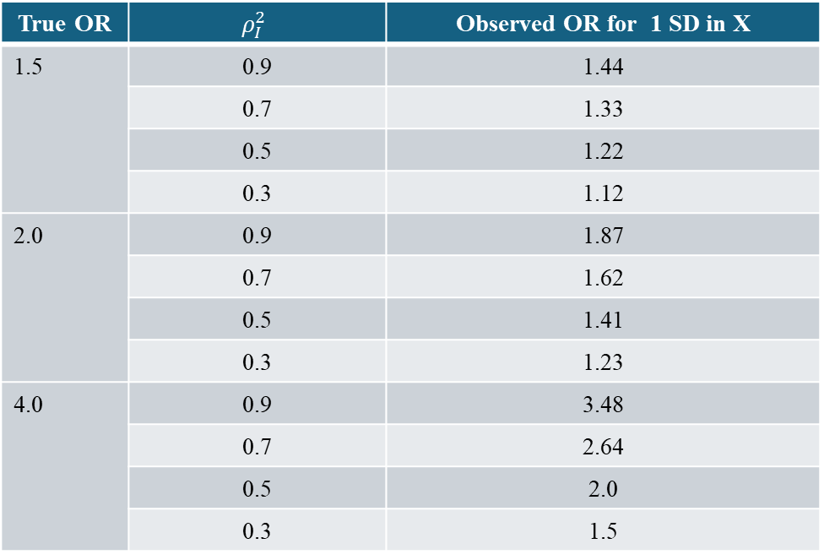
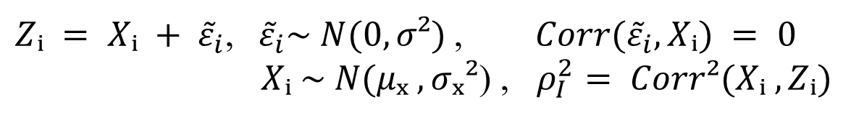
Bias in Point Estimate of Odds Ratio
The case of random measurement error
$Zᵢ = Xᵢ + {\tilde{ε}}_{i}$,${ \tilde{ε}}_{i}\sim N(0, σ²)$, $Corr({\tilde{ε}}_{i}, Xᵢ) = 0$
$Xᵢ \sim N(μₓ , σₓ²$) , $ρ_{I}^{2}= Corr²(Xᵢ , Zᵢ)$
observed gold standard
True OR | $$ρ_{I}^{2}$$ | Observed OR for 1 SD in X
1.5 | 0.9 | 1.44
 | 0.7 | 1.33
 | 0.5 | 1.22
 | 0.3 | 1.12
2.0 | 0.9 | 1.87
 | 0.7 | 1.62
 | 0.5 | 1.41
 | 0.3 | 1.23
4.0 | 0.9 | 3.48
 | 0.7 | 2.64
 | 0.5 | 2.0
 | 0.3 | 1.5
Armstrong BK, White E, Saracci R.
'Principles of Exposure Measurement
in Epidemiology'.
Oxford University Press Inc; 1992.
Yale School of Public Health

Slide 7
Common Approaches to the Measurement Error
Problem in Epidemiology
1. Sensitivity Analysis
Non-differential error bias toward the null - but not always
2. Validation of exposure measurement
Reporting a statistically significant association (through p-value testing) between true and observed does not imply no bias due to measurement error.
3. Quantitative correction of effect estimate
i. DESIGN: Main study/ reliability or validation study
ii. ANALYSIS: measurement error & misclassification methods

Slide 8
Validation Study
Internal validation study – a validation study with data
$$(D_{i}, X_{i}, Z_{i}), i=n_{m}+1,…,n_{m}+n_{v}$$
Typically obtained by sampling from the full study within which the parameter of interest is to be estimated.
External validation study – a validation study with data
$$(X_{i}, Z_{i}), i=n_{m}+1,…,n_{m}+n_{v}$$
Typically obtained from a separate population from the main study.
Yale School of Public Health

Slide 9
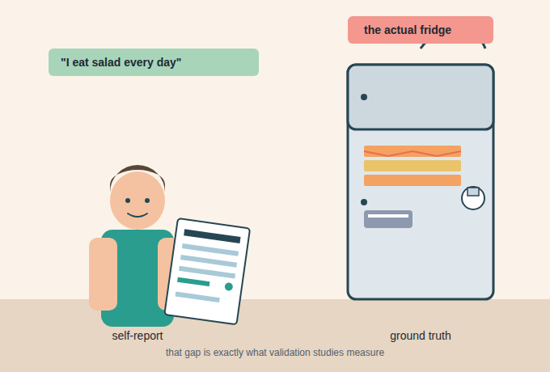

Slide 10
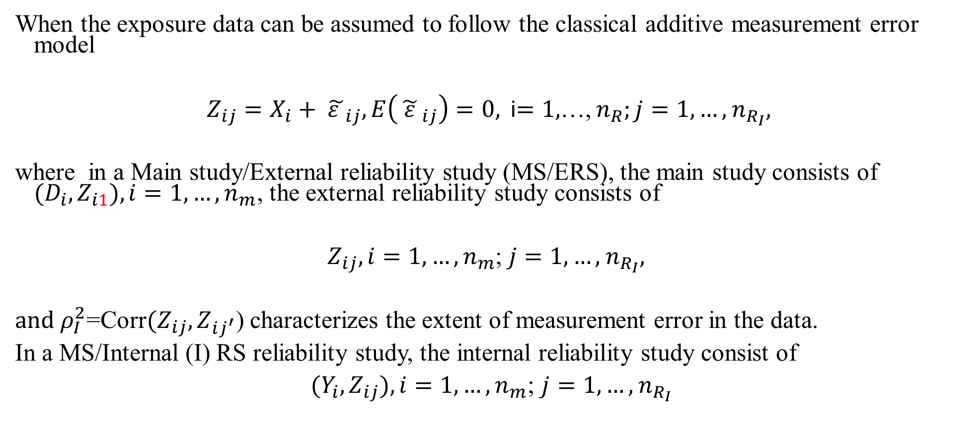
Reliability study
When the exposure data can be assumed to follow the classical additive measurement error model
$Z_{ij}=X_{i}+ {\tilde{ε }}_{ij}, E\left({\tilde{ ε }}_{ij}\right)=0,$i$=1,$…, $n_{R};j=1,…,$ $n_{R_{I}},$
where in a Main study/External reliability study (MS/ERS), the main study consists of ${(D}_{i},Z_{i1}), i=1,…,n_{m}$, the external reliability study consists of
$Z_{ij}, i=1,…,n_{m}$; $j=1,…,$ $n_{R_{I}},$
$and ρ_{I}^{2}$=Corr${(Z}_{ij},Z_{ij^{′}}$) characterizes the extent of measurement error in the data.
In a MS/Internal (I) RS reliability study, the internal reliability study consist of
${(Y_{i},Z}_{ij}), i=1,…,n_{m}$; $j=1,…,$ $n_{R_{I}}$

Slide 11


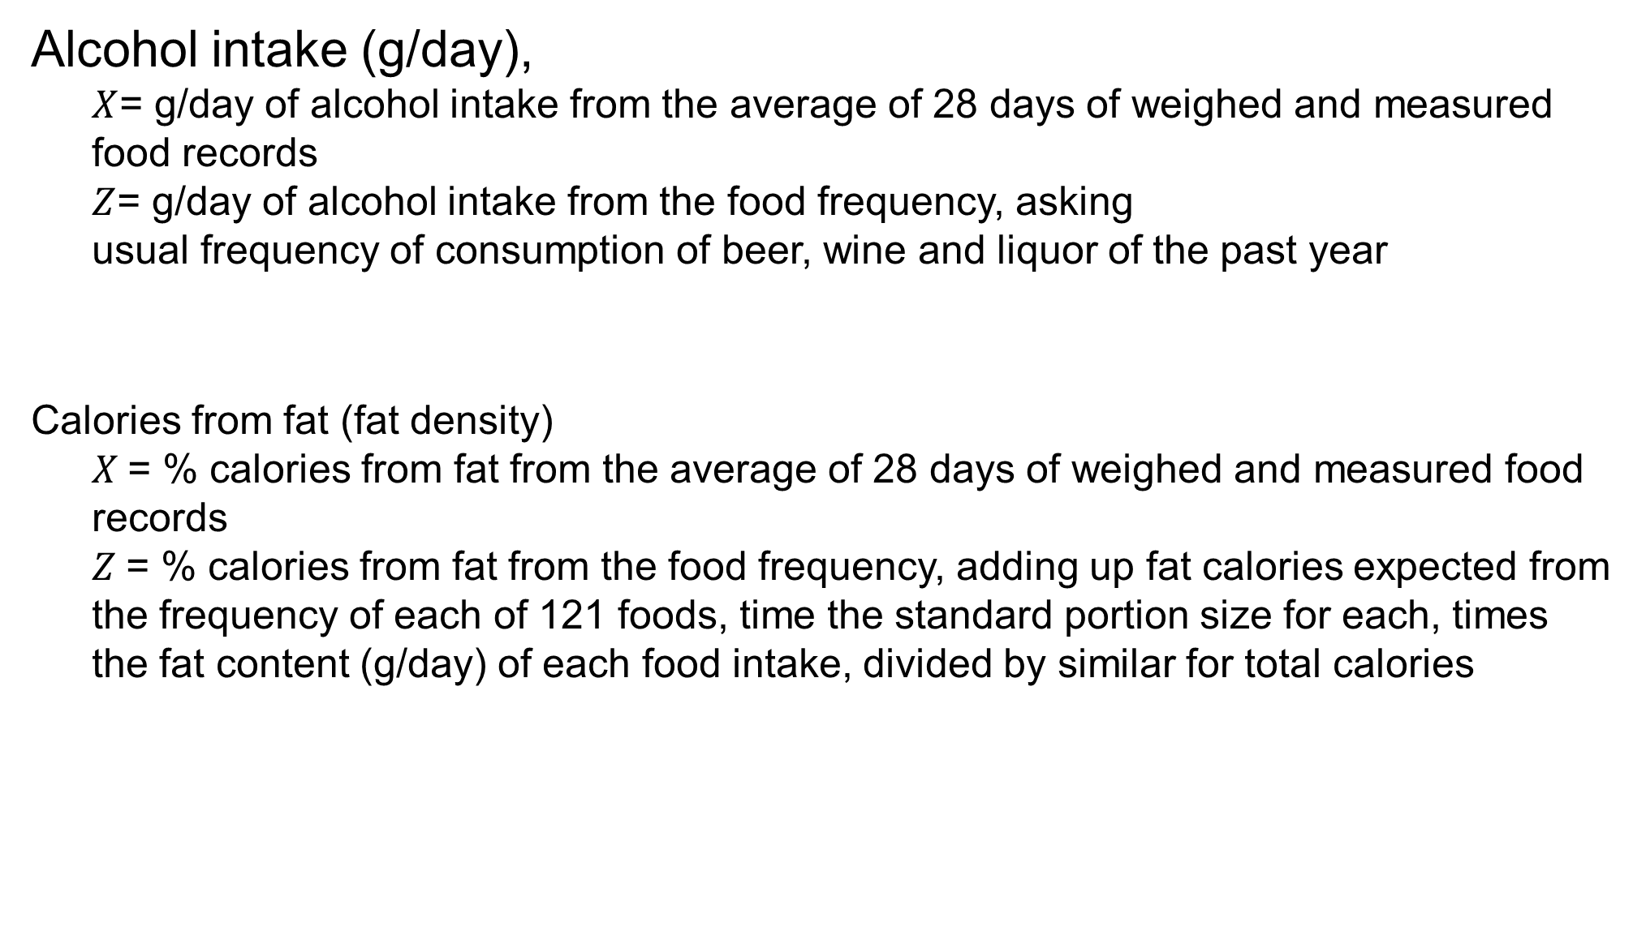
Empirical estimates of measurement error from Harvard’s Nurses’ Health Study validation study
Alcohol intake (g/day),
$X$= g/day of alcohol intake from the average of 28 days of weighed and measured food records
$Z$= g/day of alcohol intake from the food frequency, asking
usual frequency of consumption of beer, wine and liquor of the past year
Calories from fat (fat density)
$X$= % calories from fat from the average of 28 days of weighed and measured food records
$Z$= % calories from fat from the food frequency, adding up fat calories expected from the frequency of each of 121 foods, time the standard portion size for each, times the fat content (g/day) of each food intake, divided by similar for total calories
Willett et al, AJE, 1985

Slide 12
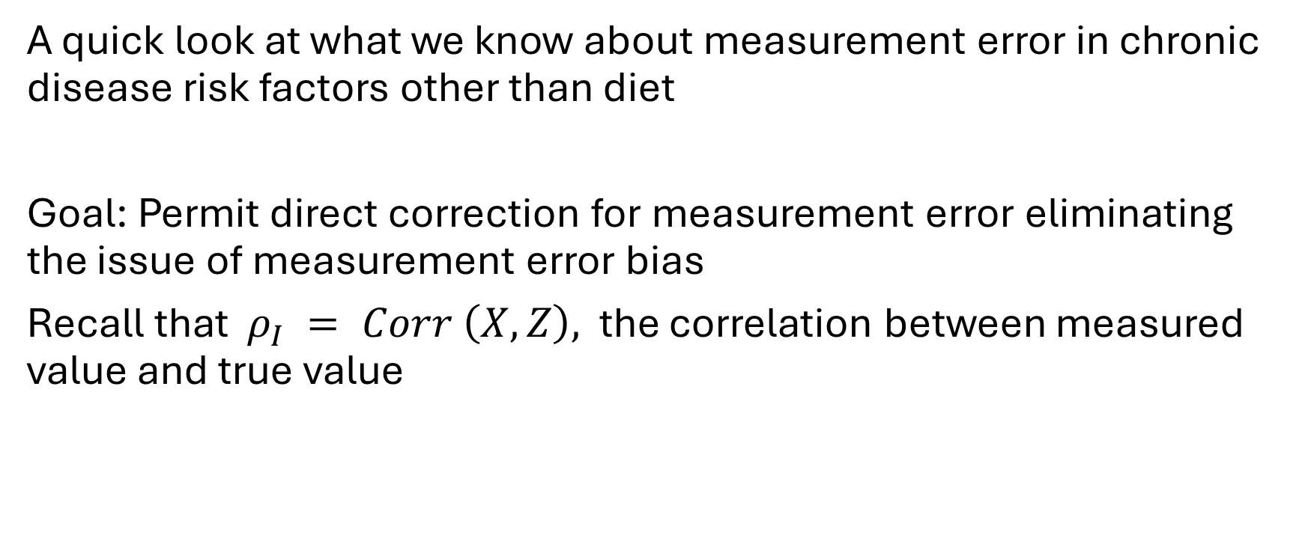
High quality validation and reliability data are available across a range of chronic disease risk factors, permitting empirical adjustment to eliminate this source of uncertainty
A quick look at what we know about measurement error in chronic disease risk factors other than diet
Goal: Permit direct correction for measurement error eliminating the issue of measurement error bias
Recall that $ρ_{I} = Corr \left(X,Z\right),$ the correlation between measured value and true value

Slide 13
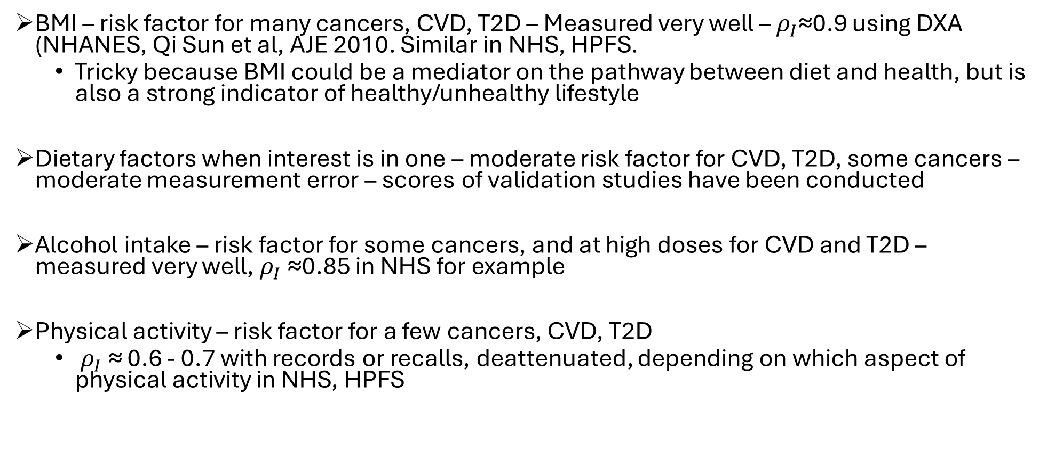
High quality validation and reliability data are available across a range of chronic disease risk factors, permitting empirical adjustment to eliminate bias in estimating effects of interest
BMI – risk factor for many cancers, CVD, T2D – Measured very well – $ρ_{I}$≈0.9 using DXA (NHANES, Qi Sun et al, AJE 2010. Similar in NHS, HPFS.
Tricky because BMI could be a mediator on the pathway between diet and health, but is also a strong indicator of healthy/unhealthy lifestyle
Dietary factors when interest is in one – moderate risk factor for CVD, T2D, some cancers – moderate measurement error – scores of validation studies have been conducted
Alcohol intake – risk factor for some cancers, and at high doses for CVD and T2D – measured very well, $ρ_{I}$≈0.85 in NHS for example
Physical activity – risk factor for a few cancers, CVD, T2D
$ρ_{I}$≈ 0.6 - 0.7 with records or recalls, deattenuated, depending on which aspect of physical activity in NHS, HPFS

Slide 14
Epidemiologists Have Conducted Hundreds of Validation and Reliability Studies
Examples of Nutrient and Food Intake Validation Studies
[1] Eke et al. A Validation Study Comparing Energy and Nutrient Intake Between a Web-Based Food Frequency Questionnaire and a 4-Day Dietary Record. Nutrition, 2024.
[10] Horn-Ross et al. Dietary Assessment in the California Teachers Study: Reproducibility and Validity. Cancer Causes Control, 2008.
[19] Feskanich et al. Simulated Validation of a Brief Food Frequency Questionnaire. Ann Epidemiol, 1994.
[2] Eghtesad et al. Validity and Reproducibility of a Food Frequency Questionnaire Assessing Food Group Intake in the PERSIAN Cohort Study. Front Nutr, 2023.
[11] Thompson et al. Performance of a Food Frequency Questionnaire in the NIH-AARP Diet and Health Study. Public Health Nutr, 2008.
[20] Goldbohm et al. Validation of a Dietary Questionnaire Used in a Large Prospective Cohort Study on Diet and Cancer. Eur J Clin Nutr, 1994.
[3] Allam-Ndoul et al. Validity and Reproducibility of a Food Frequency Questionnaire to Assess Macro- and Micronutrient Intake Among Healthy Adult Qataris. Nutrients, 2021.
[12] Villegas et al. Validity and Reproducibility of the FFQ Used in the Shanghai Men's Health Study. Br J Nutr, 2007.
[21] Feskanich et al. Reproducibility and Validity of Food Intake Measurements From a Semiquantitative FFQ. J Am Diet Assoc, 1993.
[4] Hinojosa-Nogueira et al. Validity and Reproducibility of a Food Frequency Questionnaire to Assess Nutrient Intake of Pregnant Women in Southeast Spain. Nutrients, 2021.
[13] Buchowski et al. Development of a Culturally Sensitive FFQ for the Southern Community Cohort Study. Cell Mol Biol, 2003.
[22] Rimm et al. Reproducibility and Validity of an Expanded Semiquantitative FFQ Among Male Health Professionals. Am J Epidemiol, 1992.
[5] Marshall et al. Relative Validity and Reproducibility of a Short Food Frequency Questionnaire to Assess Nutrient Intakes of New Zealand Adults. Nutrients, 2020.
[14] Hankin et al. Singapore Chinese Health Study: Development, Validation, and Calibration of the FFQ. Nutr Cancer, 2001.
[23] Romieu et al. Food Predictors of Plasma Beta-Carotene and Alpha-Tocopherol: Validation of a Food Frequency Questionnaire. Am J Epidemiol, 1990.
[6] Yuan et al. Relative Validity of Nutrient Intakes Assessed by Questionnaire, 24-Hour Recalls, and Diet Records as Compared With Urinary and Plasma Biomarkers. Am J Epidemiol, 2018.
[15] Flagg et al. Validation of the ACS CPS-II Nutrition Survey Cohort Food Frequency Questionnaire. Epidemiology, 2000.
[24] Salvini et al. Food-Based Validation of a Dietary Questionnaire: Effects of Week-to-Week Variation in Food Consumption. Int J Epidemiol, 1989.
[7] Freedman et al. Evaluation of the 24-Hour Recall as a Reference Instrument for Calibrating Self-Report Instruments: Validation Studies Pooling Project. Am J Epidemiol, 2017.
[16] Byrne et al. Predictors of Dietary Heterocyclic Amine Intake in Three Prospective Cohorts. Cancer Epidemiol Biomarkers Prev, 1998.
[25] Willett et al. Reproducibility and Validity of a Semiquantitative Food Frequency Questionnaire. Am J Epidemiol, 1985.
[8] Yuan et al. Validity of a Dietary Questionnaire Assessed by Comparison With Multiple Weighed Records or 24-Hour Recalls. Am J Epidemiol, 2017.
[17] Garland et al. The Relation Between Dietary Intake and Adipose Tissue Fatty Acid Composition in US Women. Am J Clin Nutr, 1998.
[26] Jain et al. Evaluation of a Self-Administered Dietary Questionnaire for Use in a Cohort Study. Am J Clin Nutr, 1982.
[9] Bassett et al. Validity and Calibration of the FFQ Used in the Melbourne Collaborative Cohort Study. Public Health Nutr, 2016.
[18] Frazier et al. Reproducibility of Recall of Adolescent Diet: Nurses' Health Study. Cancer Causes Control, 1995.

Slide 15
Epidemiologists Have Conducted Hundreds of Validation and Reliability Studies
Examples of Physical Activity Validation Studies
[1] Plante et al. Reliability and Validity of the IPAQ Compared to Calibrated Accelerometer Cut-Off Points for Sedentary Behaviour and Physical Activity in Older Adults. Prev Med Rep, 2023.
[5] Mok et al. Reliability and Validity of the Self- and Interviewer-Administered Versions of the Global Physical Activity Questionnaire (GPAQ). Int J Environ Res Public Health, 2015.
[9] Carter-Nolan et al. Validation of Physical Activity Instruments: Black Women's Health Study. Ethn Dis, 2006.
[2] Matthews et al. Measurement of Active and Sedentary Behavior in the Context of Large Epidemiologic Studies. Med Sci Sports Exerc, 2018.
[6] Singh et al. Reliability and Validity of a New Physical Activity Questionnaire for India. Indian J Med Res, 2015.
[10] Chasan-Taber et al. Reproducibility and Validity of a Self-Administered Physical Activity Questionnaire for Male Health Professionals. Epidemiology, 1996.
[3] Matthews et al. Use of Time and Energy on Exercise, Prolonged TV Viewing, and Work Days. Am J Prev Med, 2018.
[7] Lee et al. Reliability and Validity of the Transport and Physical Activity Questionnaire (TPAQ) for Assessing Physical Activity Behaviour. PLoS ONE, 2014.
[11] Wolf et al. Reproducibility and Validity of a Self-Administered Physical Activity Questionnaire. Int J Epidemiol, 1994.
[4] Chomistek et al. Physical Activity Assessment With the ActiGraph GT3X and Doubly Labeled Water. Med Sci Sports Exerc, 2017.
[8] Murakami et al. Reliability and Validity of the International Physical Activity Questionnaire in Elderly Adults: The Fujiwara-kyo Study. J Epidemiol, 2014.

Slide 16
Epidemiologists Have Conducted Hundreds of Validation and Reliability Studies
Anthropometrics
Reproductive & Life-History Factors
[1] Fayyaz et al. Validity of Measured vs. Self-Reported Weight and Height and Practical Considerations for Enhancing Reliability in Clinical and Epidemiological Studies: A Systematic Review. Nutrients, 2024.
[5] Wen et al. Accuracy of Self-Reported Body Weight, Height and Waist Circumference in a Dutch Overweight Working Population. BMC Med Res Methodol, 2010.
[1] Imai et al. Association Between Women's Birth Weight and Reproductive Characteristics in Adulthood: The JPHC-NEXT Study. J Epidemiol, 2023.
[5] Hunter et al. Reproducibility of Oral Contraceptive Histories and Validity of Hormone Composition Reported in a Cohort of US Women. Contraception, 1997.
[2] Maukonen et al. Statistical Assessment of Reliability of Anthropometric Measurements in the Multi-Site South African National Dietary Intake Survey 2022. BMC Nutr, 2024.
[6] Troy et al. The Validity of Recalled Weight Among Younger Women. Int J Obes Relat Metab Disord, 1995.
[2] Triebner et al. Describing the Status of Reproductive Ageing Simply and Precisely: A Reproductive Ageing Score Based on Three Questions and Validated With Hormone Levels. PLoS ONE, 2020.
[6] Troy et al. Self-Reported Birthweight and History of Having Been Breastfed: An Assessment of Validity. Int J Epidemiol, 1996.
[3] Zhang et al. Accuracy of Self-Reported Height, Weight, and Waist Circumference in a General Adult Chinese Population. Public Health Nutr, 2016.
[7] Rimm et al. Validity of Self-Reported Waist and Hip Circumferences in Men and Women. Epidemiology, 1990.
[3] Kusters et al. Chronic Medical Conditions and Reproducibility of Self-Reported Age at Menopause Among Community-Dwelling Women. Menopause, 2011.
[7] Colditz et al. Reproducibility and Validity of Self-Reported Menopausal Status in a Prospective Cohort Study. Am J Epidemiol, 1987.
[4] Lawlor et al. Validity Over Time of Self-Reported Anthropometric Variables During Follow-Up of a Large Cohort of UK Women. BMC Med Res Methodol, 2015.
[4] Tomeo et al. Reproducibility and Validity of Maternal Recall of Pregnancy-Related Events. Epidemiology, 1999.

Slide 17
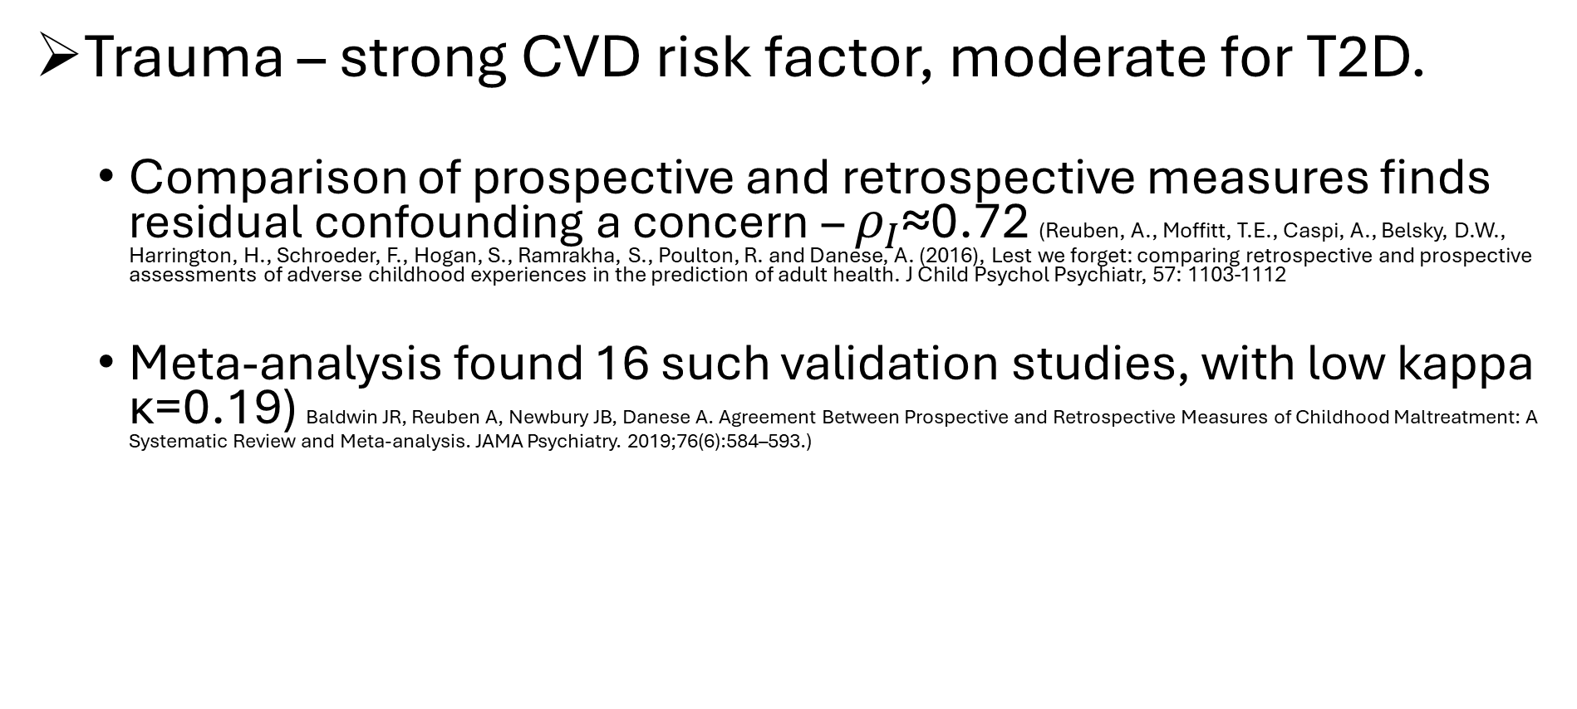
High quality validation and reliability data are available across a range of chronic disease risk factors, permitting empirical adjustment to eliminate this source of uncertainty
Trauma – strong CVD risk factor, moderate for T2D.
Comparison of prospective and retrospective measures finds residual confounding a concern – $ρ_{I}$≈0.72 (Reuben, A., Moffitt, T.E., Caspi, A., Belsky, D.W., Harrington, H., Schroeder, F., Hogan, S., Ramrakha, S., Poulton, R. and Danese, A. (2016), Lest we forget: comparing retrospective and prospective assessments of adverse childhood experiences in the prediction of adult health. J Child Psychol Psychiatr, 57: 1103-1112
Meta-analysis found 16 such validation studies, with low kappa κ=0.19) Baldwin JR, Reuben A, Newbury JB, Danese A. Agreement Between Prospective and Retrospective Measures of Childhood Maltreatment: A Systematic Review and Meta-analysis. JAMA Psychiatry. 2019;76(6):584–593.)

Slide 18
High quality validation and reliability data are available across a range of chronic disease risk factors, permitting empirical adjustment to eliminate this source of uncertainty
Regular high quality preventive health care – strong protective factor for CRC, not breast, for CVD, T2D
The sensitivity of self-reported screening was 96.2% for the FOBT, 94.9% for flexible sigmoidoscopy, 88.7% for colonoscopy, and 96.2% for either endoscopic screening test.
The specificity of self-reported screening was 85.9%for the FOBT, 92.2% for flexible sigmoidoscopy, 96.8% for colonoscopy, and 92.0% for either endoscopic screening test. (Baier M, Calonge N, Cutter G, McClatchey M, Schoentgen S, Hines S, Marcus A, Ahnen D. Validity of self-reported colorectal cancer screening behavior. Cancer Epidemiol Biomarkers Prev. 2000 Feb;9(2):229-32. )

Slide 19
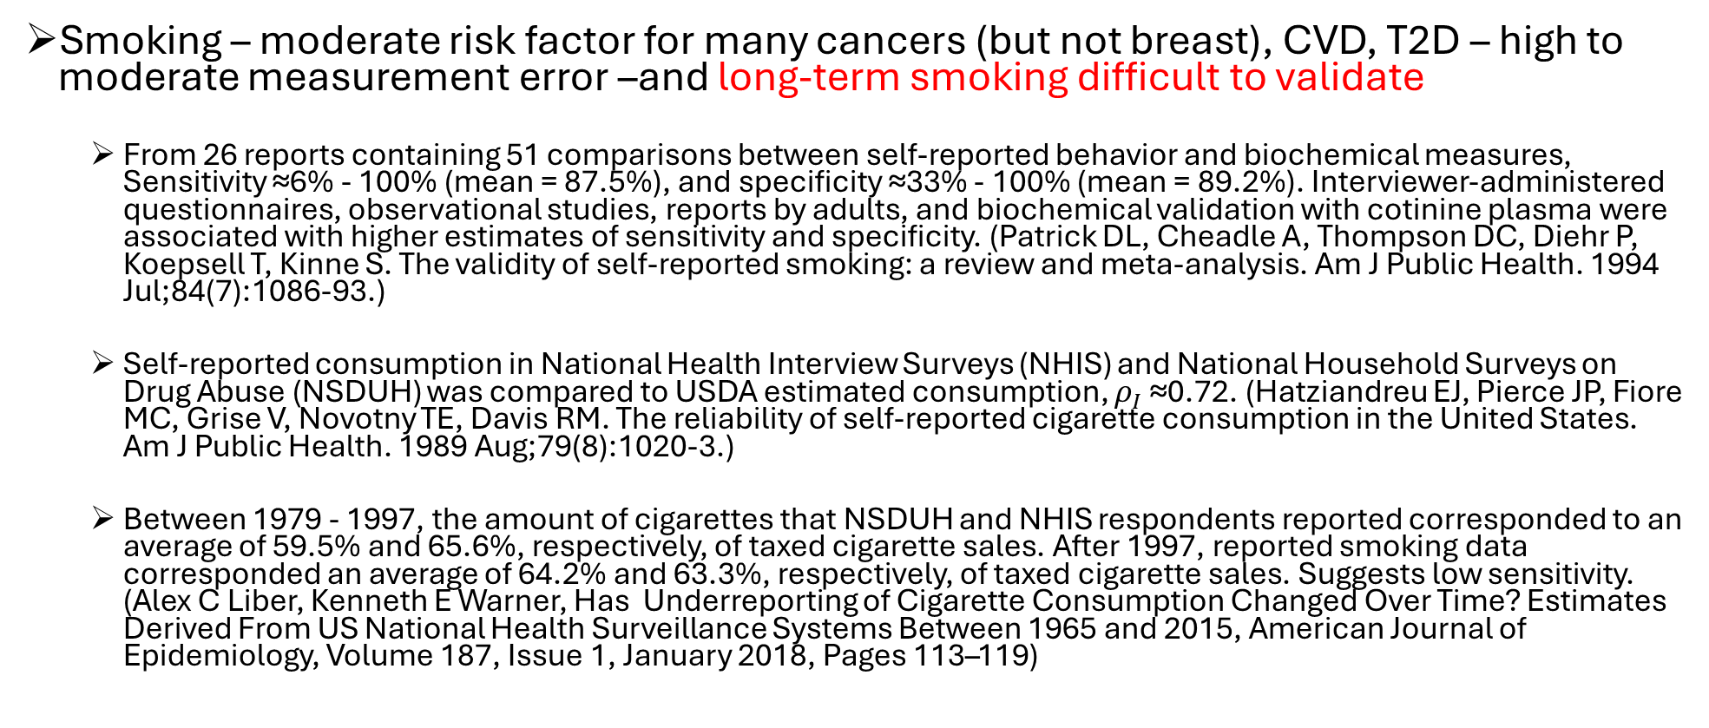
Residual confounding by smoking is problematic
Smoking – moderate risk factor for many cancers (but not breast), CVD, T2D – high to moderate measurement error –and long-term smoking difficult to validate
From 26 reports containing 51 comparisons between self-reported behavior and biochemical measures, Sensitivity ≈6% - 100% (mean = 87.5%), and specificity ≈33% - 100% (mean = 89.2%). Interviewer-administered questionnaires, observational studies, reports by adults, and biochemical validation with cotinine plasma were associated with higher estimates of sensitivity and specificity. (Patrick DL, Cheadle A, Thompson DC, Diehr P, Koepsell T, Kinne S. The validity of self-reported smoking: a review and meta-analysis. Am J Public Health. 1994 Jul;84(7):1086-93.)
Self-reported consumption in National Health Interview Surveys (NHIS) and National Household Surveys on Drug Abuse (NSDUH) was compared to USDA estimated consumption, $ρ_{I}$≈0.72. (Hatziandreu EJ, Pierce JP, Fiore MC, Grise V, Novotny TE, Davis RM. The reliability of self-reported cigarette consumption in the United States. Am J Public Health. 1989 Aug;79(8):1020-3.)
Between 1979 - 1997, the amount of cigarettes that NSDUH and NHIS respondents reported corresponded to an average of 59.5% and 65.6%, respectively, of taxed cigarette sales. After 1997, reported smoking data corresponded an average of 64.2% and 63.3%, respectively, of taxed cigarette sales. Suggests low sensitivity. (Alex C Liber, Kenneth E Warner, Has Underreporting of Cigarette Consumption Changed Over Time? Estimates Derived From US National Health Surveillance Systems Between 1965 and 2015, American Journal of Epidemiology, Volume 187, Issue 1, January 2018, Pages 113–119)

Slide 20
To what extent do trials resolve problems?
Intent to treat estimates are biased towards the null by random non-adherence, and bias could be in either direction due to non-random non-adherence
‘As treated’ and ‘per protocol’ estimates can be biased by confounding and selection bias, respectively, just as in an observational study, but not when non-adherence is random
No bias in p-values under random non-adherence, just as there isn’t for random misclassification in general
Trials of sustained dietary intakes likely suffer from substantial non-adherence
Empirical methods to correct for bias due to non-adherence are not as well developed, particularly for random non-adherence

Slide 21
Empirical correction for measurement error in exposures and confounders
Good news:
– With these validation or reliability data, hundreds of publications provide a robust, flexible set of methods to empirically correct for measurement error in exposures of interest and confounders simultaneously.

Slide 22
Empirical correction for measurement error in exposures and confounders
Seminal textbook and scores of papers by Ray Carroll and colleagues
Carroll, R.J., Ruppert, D., Stefanski, L.A., & Crainiceanu, C.M. (2006). Measurement Error in Nonlinear Models: A Modern Perspective, Second Edition (2nd ed.). Chapman and Hall/CRC. https://doi.org/10.1201/9781420010138
Three key papers from the Harvard/Yale group:
Rosner, B., Willett, W.C. and Spiegelman, D. (1989), Correction of logistic regression relative risk estimates and confidence intervals for systematic within-person measurement error. Statist. Med., 8: 1051-1069.
Rosner B, Spiegelman D, Willett WC. Correction of logistic regression relative risk estimates and confidence intervals for measurement error: the case of multiple covariates measured with error. Am J Epidemiol. 1990 Oct;132(4):734-45.
Rosner B, Spiegelman D, Willett WC. Correction of logistic regression relative risk estimates and confidence intervals for random within-person measurement error. Am J Epidemiol. 1992
1,786 citations March 2026 ; 84% were published in non-statistical journals and 16% in statistical journals.
Other work covers survival data analysis, population attributable risks, principles of modeling, design of MS/VS, misclassification, risk prediction, changepoint analysis, and a wide range of other topics.
Software available here https://ysph.yale.edu/cmips/research/software/

Slide 23
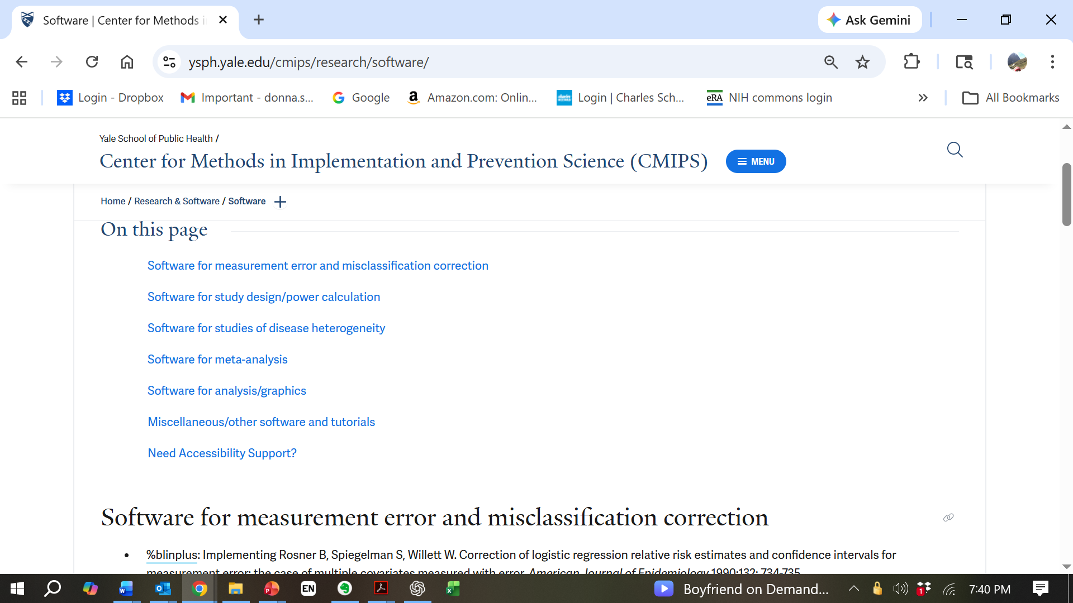


Slide 24
