Slide 1

Azure Machine Learning Challenge Flight Prediction
Notes:
Welcome.
Questions:
Who is doing Predicitve work?
Use Azure?
Use Azure ML?
Beginner/Expert?
Python/R?
Photo shows Helene Dutrieu (1877-1961), Belgian aviator, cyclist, hospital director and journalist. (Source: Flickr Commons project, 2009)
Dutrieu learned to fly using a Santos-Dumont Demoiselle monoplane in early 1910.^{[19]} On 19 April 1910 she reputedly became the first woman pilot to fly with a passenger.
December 1910 she became the first winner of the Coupe Femina (Femina Cup) for a non-stop flight of 167 km in 2 hours 35 minutes.
https://flic.kr/p/4iczFW
Rights Info: No known restrictions on publication.
Repository: Library of Congress, Prints and Photographs Division, Washington, D.C. 20540 USA, hdl.loc.gov/loc.pnp/pp.print

Slide 2
James Sturtevant
jstur@microsoft.com
//jamessturtevant.com
@aspenwilder
Beth Zeranski
beth.zeranski@microsoft.com
//bethz.com
@BethZeranski

Slide 3
Agenda
Intro to Azure ML
Hands on Walkthrough
Improving the Model
Notes:
To day is all about hands on! 20 mins of me talking then get to it!

Slide 4

Microsoft & Machine Learning 15 years of realizing innovation
1999
2004
2005
2008
2010
2012
2014
Computers work on users behalf, filtering junk email
Microsoft search engine built with machine learning
SQL Server enables data mining
Bing Maps ships with ML traffic-prediction service
Microsoft Kinect can watch users gestures
Successful, real-time, speech-to-speech translation
Microsoft launches Azure Machine Learning
Machine learning is pervasive throughout Microsoft products.
“
John Platt, Distinguished scientist at Microsoft Research
”
Notes:
Back in the 90s when the post office was wrestling with this issue, we were also working on Machine Learning, starting in 1991 when Microsoft Research was formed.
As early as 1999 they were using it to help create email filters by predicting which emails were junk, and which were relevant.
And as John Platt mentions—it’s a key technology that Microsoft uses to develop its own software. In 2004. Machine learning was part of Microsoft’s search engine
It is also used in Bing Maps as part of the traffic prediction service.
And many people know about how it was a key technology to make Kinect a reality, letting computers track people’s gestures and sort through what’s relevant and what’s not. Like filtering out a dog in the background to see a player’s movements.
And today, this technology that has been developed over decades is becoming available commercially as part of Azure
It’s this depth of experience with machine learning, testing and refining over years, using it to develop pretty much all Microsoft products, that makes Microsoft’s solution so robust.

Slide 5
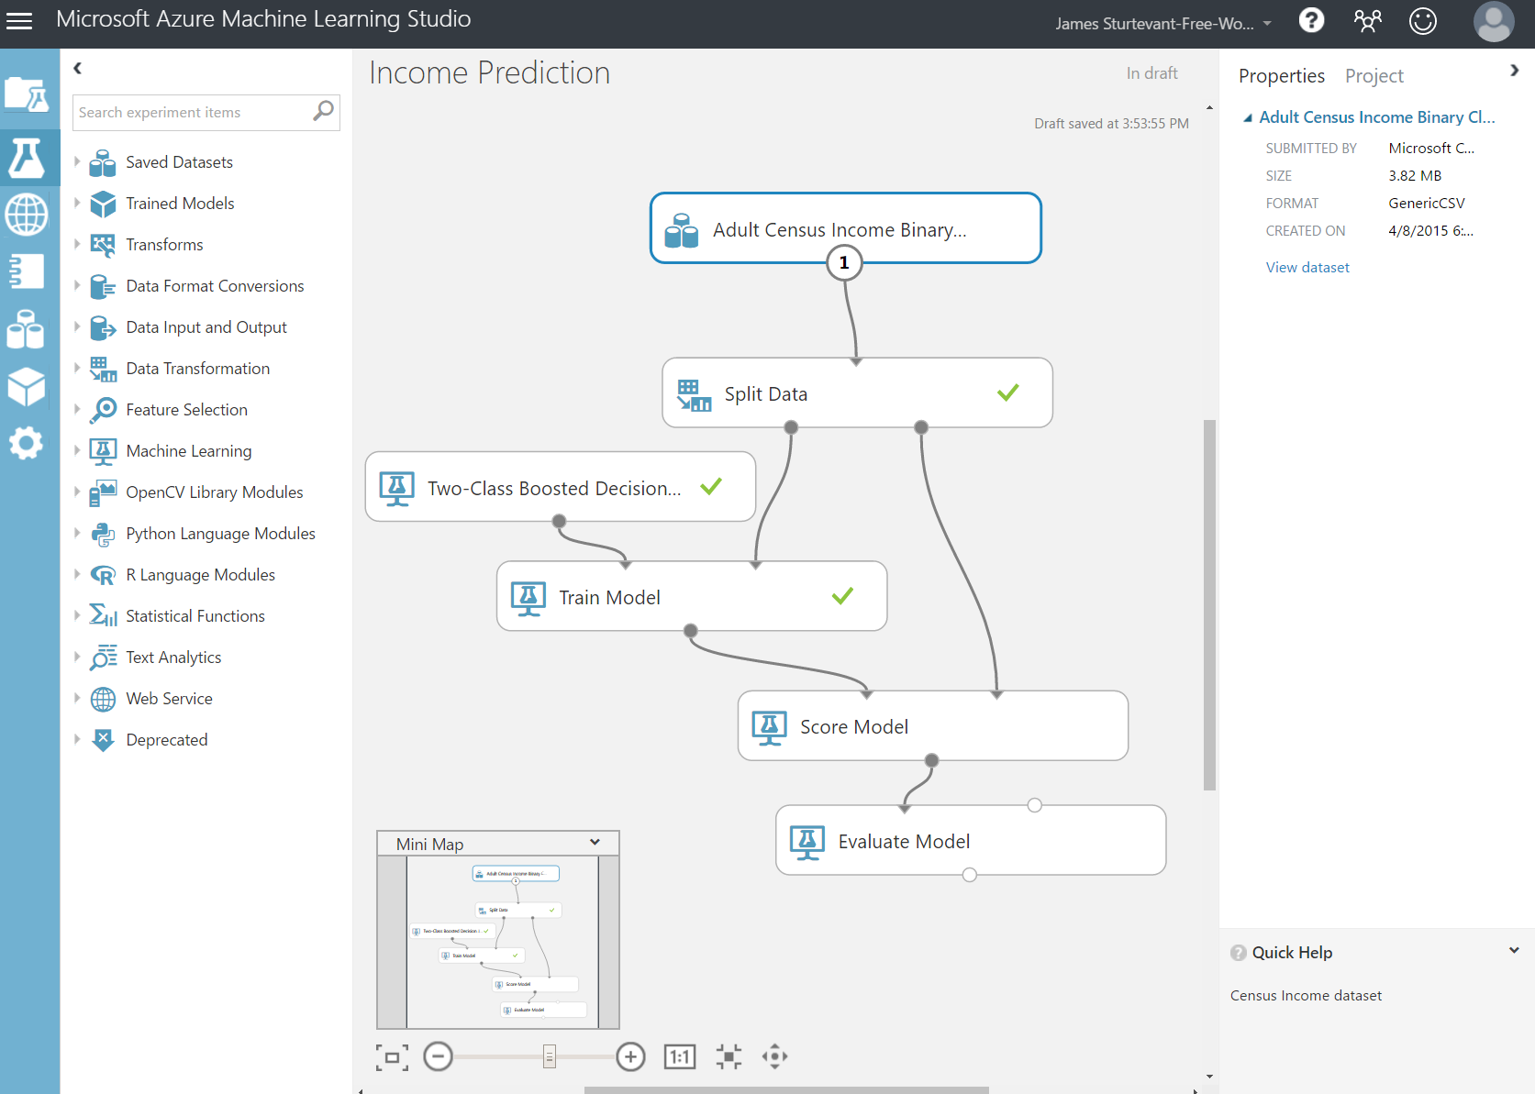
Azure Machine Learning
Cloud Based
ML Studio for composing models
Supports numerous input formats
Supports R and Python
Notes:
ML Studio simplifies machine learning by providing a drag-and-drop model in which you build workflow. With ML Studio and the rich of assortment of modules it offers for modeling workflow, you can often build sophisticated models without writing a single line of code. However, it allows you to insert R and Python code anywhere in the workflow, providing infinite flexibility in what you can model.
Get start for free. Runs for 8 Hours. https://studio.azureml.net

Slide 6
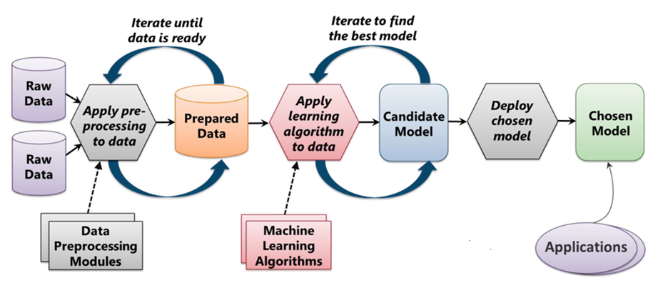
The Machine Learning Process
From "Introduction to Microsoft Azure" by David Chappell
Notes:
Cover this because this is the basis that Azure ML builds on.
ML starts with data, which can come from a variety of sources. The data typically needs to be "cleaned" before it is used, and ML Studio includes modules to help with the cleaning. (Examples of cleaning include:
removing rows with missing data,
replacing missing data algorithmically,
removing duplicate rows,
removing rows containing "outliers."
In practice, cleaning the data can be very time-intensive and often consumes 50% of the time required to build the model.)
Once the data is ready, you select an algorithm and "train" the model by allowing it to iterate over the data and find patterns in it. After that comes scoring and evaluating the model, which tells you how well the model is able to predict outcomes. All of this is performed visually in ML Studio. Once the model is ready, a few button clicks deploy it as a Web service so it can be called from client apps.

Slide 7
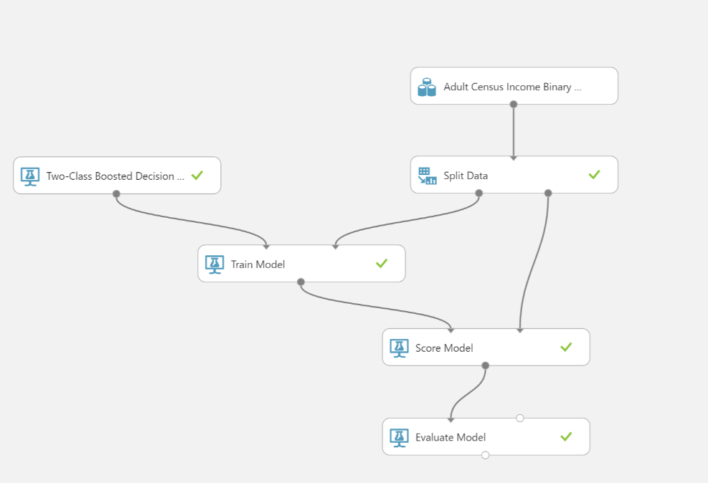
Notes:
This is the simplest form of a workflow in azure ml.
Talk through each module quickly.
Lets take a look at the different algorithms that are in AzureML then finally see how it helps with deployment.

Slide 8
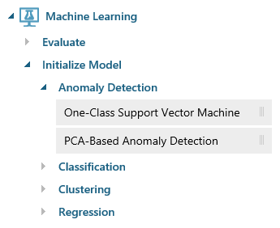
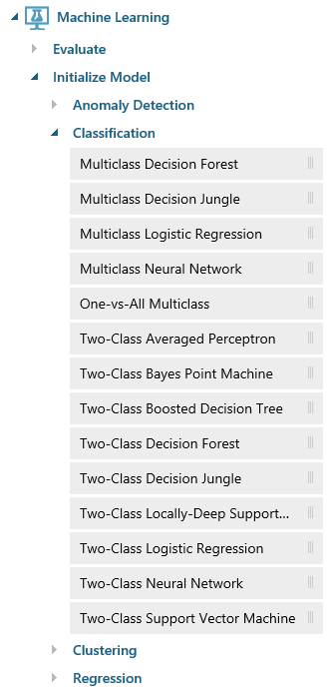
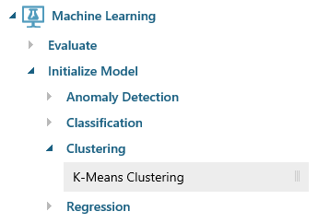
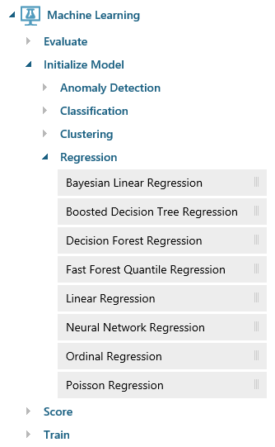
Azure Machine Learning Algorithms
Notes:
ML Studio provides canned implementations of 25 of the classic algorithms used in machine learning. It divides them into four categories.
Anomaly detection is the identification of items, events, or observations which do not conform to an expected pattern or other items in a dataset. A classic example is examining a dataset representing banking transactions and detecting potentially fraudulent transactions in that group.
Regression algorithms seek to establish and quantify relationships between variables. By establishing a relationship between a dependent variable and one or more independent variables, regression analysis can enable the value of a dependent variable to be predicted given a set of inputs with a quantifiable accuracy. A great example can be seen at https://how-old.net/#, a site that lets you upload a photo and then guesses your age with uncanny accuracy. The site uses Azure Machine Learning and combines classic regression with advanced image recognition.
The purpose of classification algorithms is to identify the category to which an observation belongs based on training data consisting of observations which have already been classified (assigned to a category). A great example is determining whether an e-mail belongs to the "spam" category or the "not-spam" category.
Clustering seeks to group a set of objects in such a way that objects in the same group (called a cluster) are more similar to each other than to those in other groups (clusters).

Slide 9
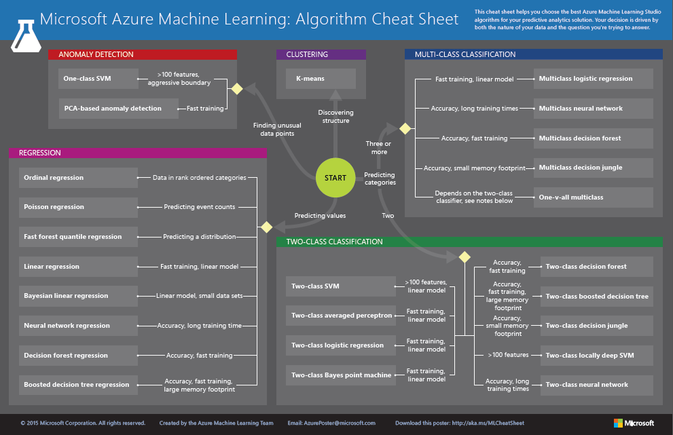
http://aka.ms/MLCheatSheet
Notes:
The Azure ML Cheat Sheet helps you pick the right algorithm for a model, even if you're not a trained data scientist. One example is if you want to use a set of input values to predict an output value from a continuous set of values (e.g., a person's age), use linear regression. But if you're more interested in the distribution of the output, you might use fast forest quantile regression instead. An example of when you would use the latter is using growth charts to assess child development. "Abby's height is in the 10% quantile of the heights of kids her age." Classification algorithms, by contrast, are used to predict a value from a discrete set of values -- for example, classifying an e-mail as spam or not spam.

Slide 10
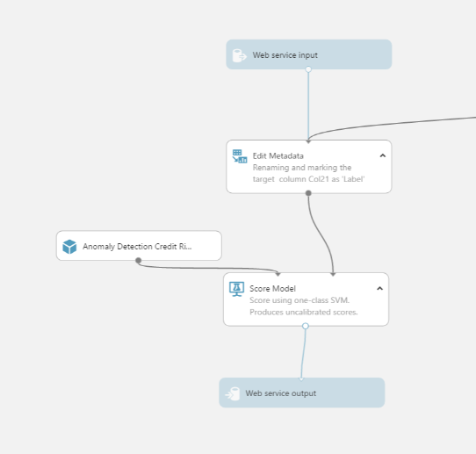
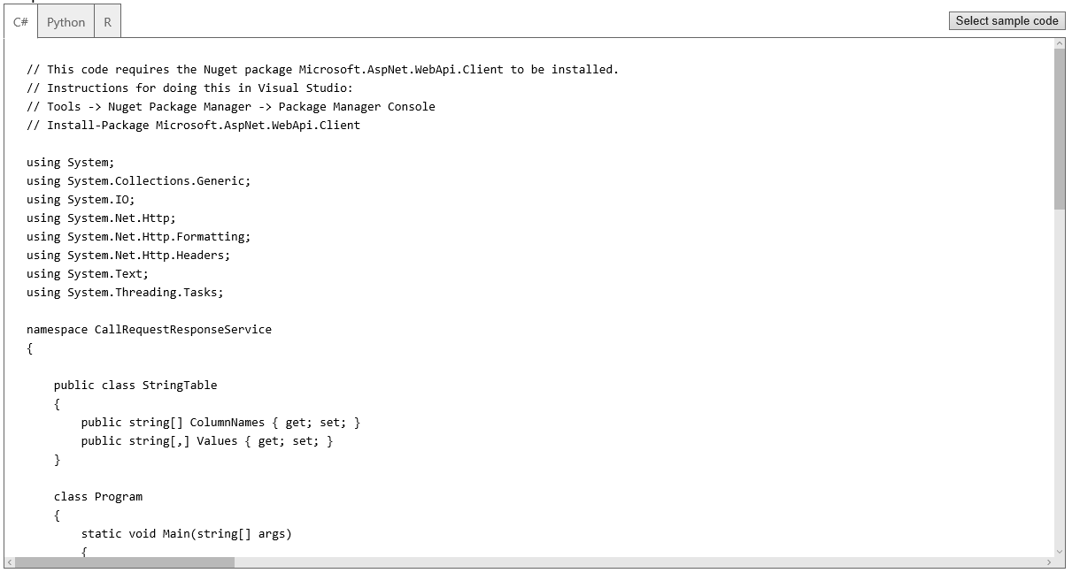
Deploying as a Web Service
Deploy your *entire* Predictive Model with one button click!
Notes:
Once deployed as a Web service, a model can be used with simple REST calls over HTTP. This enables developers to build "smart apps" that get their intelligence from ML. In the next lab, students will build and train an ML model, deploy it as a Web service, and then write a client app that uses it.

Slide 11

Microsoft Cognitive Services
democratizing intelligence
Notes:
So, what are Cognitive Services? Cognitive Services are a collection of artificial intelligence APIs, and we believe in democratizing artificial intelligence. So what that means is, regardless of your skill level -- whether you're a high school student running your first program or working in industry or in a giant enterprise -- that you should be able to use our APIs incredibly quickly in a matter of minutes.
And regardless of your platform -- whether you're on Android or IOS or Windows, or making a website -- all of our APIs are rest APIs, which means you can call them as long as you have an Internet connection. And so that's pretty huge because what we're doing is making it so that everyone can build these smarter, more context-aware applications.
The technology used in our APIs is the same technology that powers our products today. And so, when you think of things like the Bing search APIs, it's the same technology from Bing.
Today I’m going to talk with you about the entire collection spanning vision, speech, language, knowledge, and search.
The other things that I want to point out is that you can get started for free with all of the APIs, but we do have pricing available for a number of them, which are in public preview on Azure.
The other piece is the developer resources. So, all of our documentation is on the website and actually in GitHub as well, so we do welcome community submissions. We have a set of SBKs that are also available on GitHub where we welcome poll requests and post everything on there. The SBKs vary from API to API, but they are all included in this one repository for people to see.
And then we have three different communities that we support. We have our MSDN forums, our Stack Overflow, and we have User Voice that we use for feedback requests.

Slide 12

Cognitive Services API Collection
Vision
Computer Vision | Emotion | Face | Video
Microsoft Cognitive Services
Give your apps a human side
Speech
Bing Speech | Custom Recognition | Speaker Recognition
Language
Bing Spell Check | Language Understanding Linguistic Analysis | Text Analytics | Translator | Web Language Model
Knowledge
Academic Knowledge | Entity Linking | Knowledge Exploration | Recommendations
Search
Bing Autosuggest | Bing Image Search | Bing News Search | Bing Video Search | Bing Web Search
Notes:
At Microsoft, we’ve been offering APIs for a very long time across the company. In delivering Microsoft Cognitive Services API, we started with 4 last year at /build (2015); added 7 more last December, and today (May 2016) we have 22 APIs in our collection.
Cognitive Services are available individually or as a part of the Cortana Intelligence Suite, formerly known as Cortana Analytics, which provides a comprehensive collection of services powered by cutting-edge research into machine learning, perception, analytics and social bots.
These APIs are powered by Microsoft Azure.
Developers and businesses can use this suite of services and tools to create apps that learn about our world and interact with people and customers in personalized, intelligent ways.

Slide 13
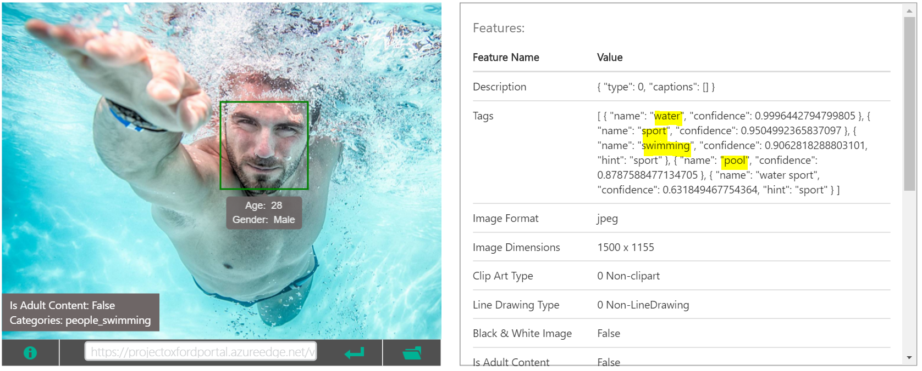
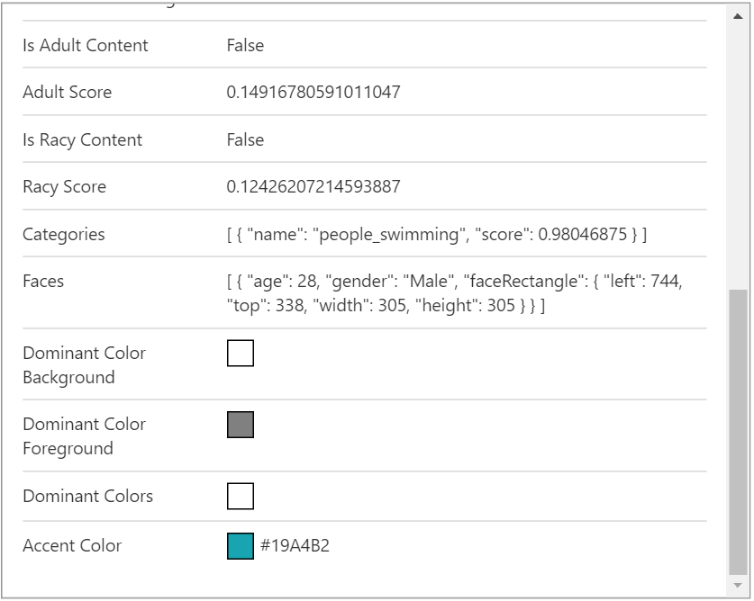

Slide 14
Documentation
https://www.microsoft.com/cognitive-services/en-us/computer-vision-api/documentation
Client SDKs
https://github.com/Microsoft/ProjectOxford-ClientSDK
https://github.com/felixrieseberg/project-oxford (nodejs)
https://github.com/southwood/project-oxford-python
​​​
Example Code
https://github.com/jsturtevant/happy-image-tester-django
https://github.com/jsturtevant/happy-image-tester-nodejs
https://www.microsoft.com/cognitive-services/en-us/SDK-Sample
Join Our Community
https://stackoverflow.com/questions/tagged/microsoft-cognitive
https://social.msdn.microsoft.com/forums/azure/en-US/home?forum=mlapi
https://cognitive.uservoice.com/
Developer Resources
Notes:
Access to strong documentation, sample code and community resources is critical for developers to be able to understand and become users of Cognitive Services. Customize these links based on your own resources or use the ones listed here.

Slide 15
//studio.azureml.net
Notes:
Think back to the time you first where amazed by technology.
For me it was……

Slide 16
Step by Step
https://github.com/bethz/AzureML-FlightPrediction
Notes:
Think back to the time you first where amazed by technology.
For me it was……

Slide 17
Thank you!
James Sturtevant
jstur@microsoft.com
//jamessturtevant.com
@aspenwilder
Beth Zeranski
beth.zeranski@microsoft.com
//bethz.com
@BethZeranski
http://aka.ms/mlworkshop
https://channel9.msdn.com/
https://mva.microsoft.com/
Notes:
What I am about to share with you is extremely valuable. In face Microsoft has been working on this for over 20 years.

