Slide 1
DCDSL
Jingyuan Xu

Slide 2
Background of DataCleaning
Data cleaning is a perivious step of data analysis.
Data Cleaning tasks:
1. Fill in missing values
2. Identify outliners and smooth out noisy data
3. Correct inconsistent data
4. Resolve redundancy caused by data integration

Slide 3





Tools/language for companies used for data cleaning
SQL
R
Python
SPSS
Google Refine
Excel

Slide 4
Feature of DataCleaning DSL
Shallow Embedded Domain Specific Language
Command line programming
Wheels> d1 <- readFile ”input.csv”
*Wheels> let dset1 = input "input.csv" d1
Logical reasonable operators
Can be used in real work environment

Slide 5
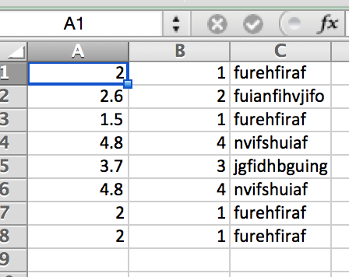
Example

Slide 6
type
type D = String -- one cell content
type Dset = [[D]]--whole spread sheet

Slide 7
Design Guidelines for Operators
search operator
delete operator
duplicate operator
update operator
join operator

Slide 8
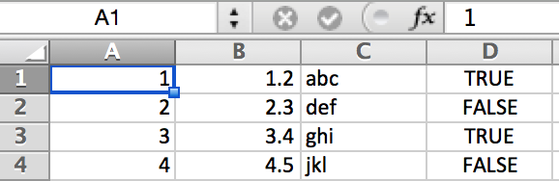
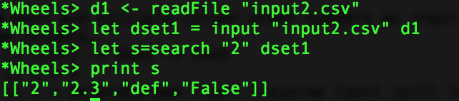
Search operator
search :: D -> Dset -> Dset
search d [] = []
search d (dlist:dset) = case elem d dlist of
True -> dlist : search d dset
False -> search d dset
e.g. search value 2 in the whole spreadsheet , and pick rows which have value 2

Slide 9
Delete operator
delete column
deleteColumn1 :: Int -> Dset -> Dset
deleteColumn1 _ [] = []
deleteColumn1 i (s:ss) = snd (moveEleOut i s) : deleteColumn1 i ss
moveEleOut :: Int -> [a] -> (a,[a])
moveEleOut 1 (x:xs) = (x,xs)
moveEleOut i (x:xs) = (fst (moveEleOut (i-1) xs), [x] ++ snd (moveEleOut (i-1) xs))
Notes:
There are two kind of delete operator: delete column and delete row

Slide 10
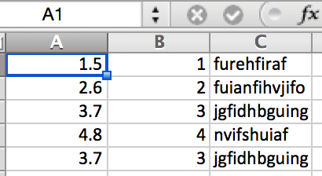
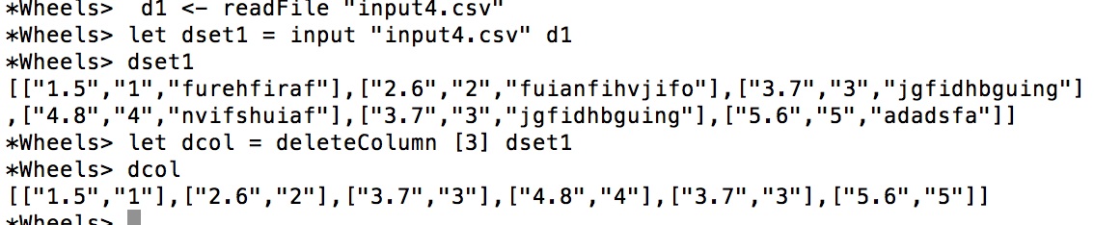
Example

Slide 11
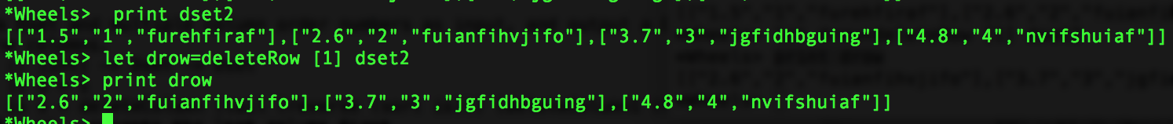
Delete operator
2 delete row
deleteRow1 :: Int -> Dset -> Dset
deleteRow1 i s= snd (moveEleOut i s)

Slide 12
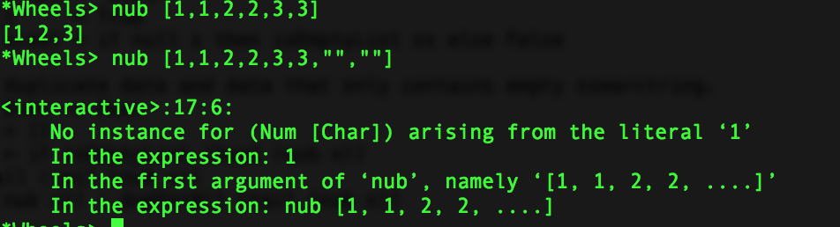
Duplicate operator
What GHCI function “nub” can do:
The nub function removes duplicate elements from a list
So we need another duplicate operator which can deal with “” in a list.

Slide 13
Duplicate operator
Duplicate steps
Step 1. check if two lists can be duplicated
E.g.1: [1,2,3] and [1,2,3] ----True
E.g.2: [1,2,””] and [1,2,””]----True
canBeDup :: [D] -> [D] -> Bool
canBeDup [] _ = True
canBeDup _ [] = True
canBeDup (x:xs) (y:ys) = (x==y || x=="" || y=="") && canBeDup xs ys

Slide 14
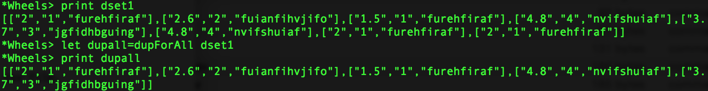
Duplicate operator
Step 2. duplicate the whole dataset
dupForAll :: Dset -> Dset
dupForAll [] = []
dupForAll x = if isEmptyList (head (nub x))
then dupForAll (tail (nub x))
else (head (nub x)) : dupForAll (tail (nub x))

Slide 15
Update operator
Change value by position
Helper functions:
moveEleIn :: Int -> (a,[a]) -> [a]
moveEleIn _ (x,[]) = [x]
moveEleIn 1 (x,ys) = x:ys
moveEleIn i (x,(y:ys)) = y:moveEleIn (i-1) (x,ys)
>changeHelperByPos 3 "zzz" ["abc","def","hig","dig"]=["abc","def","zzz","dig"]
changeHelperByPos :: Int -> D -> [D] -> [D]
changeHelperByPos i d dlist = moveEleIn i (d, snd (moveEleOut i dlist))
Notes:
Two ways to change value: change by position, change value by old value

Slide 16
changeValueByPos1 :: (Int,Int) -> D -> Dset -> Dset
changeValueByPos1 (1,i) d (dlist:dset) = changeHelperByPos i d dlist : dset
changeValueByPos1 (i0,i) d (dlist:dset) = dlist : changeValueByPos1 ((i0-1),i) d dset

Slide 17
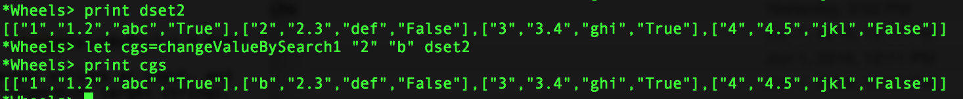
Update operator
2. change value by target value
changeValueBySearch1 :: D -> D -> Dset -> Dset
changeValueBySearch1 _ _ [] = []
changeValueBySearch1 d d1 (dlist:dset) = changeHelperBySearch d d1 dlist : changeValueBySearch1 d d1 dset

Slide 18
Example

Slide 19
Multiple data sets
An data cleaning plan examples list operation steps:
Join operator prepare steps:
1. confirm the key column is unique---duplicate for key
2. join two data sets by key value
3. If more than two datasets, join these data set one by one
4. use basic data cleaning operators

Slide 20
confirm the key column is unique
--dupHelper ["1","","","4"] ["","","3","4"] = ["1","","3","4"]
dupHelper :: [D] -> [D] -> [D]
dupHelper x [] = x
dupHelper [] y = y
dupHelper (x:xs) (y:ys) = if x=="" then y : dupHelper xs ys else x : dupHelper xs ys
dupForKey2 :: Int -> [D] -> [D] -> [D]
dupForKey2 _ [] _ = []
dupForKey2 _ _ [] = []
dupForKey2 i d1 d2 = if d1!!(i-1) == d2!!(i-1) then
case canBeDup d1 d2 of
True -> [d1!!(i-1)] ++ dupHelper (take (i-1) d1 ++ drop i d1) (take (i-1) d2 ++ drop i d2)
otherwise -> [d1!!(i-1)] ++ take (i-1) d1 ++ drop i d1 --only keep first one
else
[d1!!(i-1)] ++ take (i-1) d1 ++ drop i d1
Notes:
--dupHelper ["1","","","4"] ["","","3","4"] = ["1","","3","4"]

Slide 21
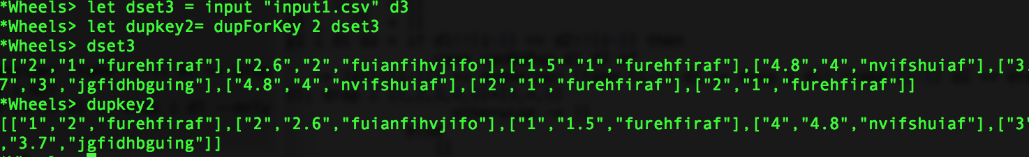
dupForKey :: Int -> Dset -> Dset
dupForKey _ [] = []
dupForKey i (d:dset) = map (dupForKey2 i d) dset ++ dupForKey i dset

Slide 22
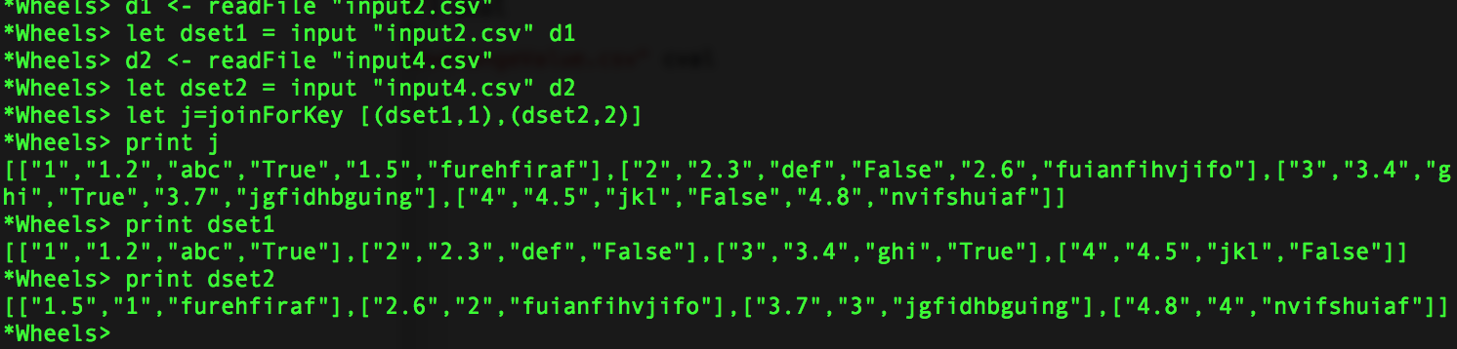
join data sets by key value
joinForKey2 :: (Dset,Int) -> (Dset,Int) -> Dset
joinForKey2 ([],_) _ = []
joinForKey2 _ ([],_) = []
joinForKey2 (d1:dset1,i1) (dset2,i2) = dupForAll (dupForKey 1 ((dupForAll (unfold (map (keymerge2 i1 d1 i2) (dupForAll dset2))) ++ joinForKey2 (dupForAll dset1,i1) (dupForAll dset2,i2))))

Slide 23
Input and output
Haskell liberties we use for parsing CSVdata: Text.CSV
input :: FilePath -> String -> Dset
input = \x -> \y -> dupForAll (fromRight (parseCSV x y))
output :: FilePath -> Dset -> IO ()
output x dset = writeFile x (helper3 (helper2 dset))
reference: https://hackage.haskell.org/package/either-unwrap-1.1/docs/Data-Either-Unwrap.html
fromRight :: Either a b -> b
fromRight (Left _) = error "Either.Unwrap.fromRight: Argument takes form 'Left _'" -- yuck
fromRight (Right x) = x

Slide 24
Run in command line
*Wheels> d1 <- readFile "w1.csv"
*Wheels> d2 <- readFile "w2.csv"
*Wheels> let dset1 = input "w1.csv" d1
*Wheels> let dset2 = input "w2.csv" d2
*Wheels> let j = joinForKey [(dset1,1),(dset2,1)]
*Wheels> let dc= deleteColumn [3,4] j
*Wheels> output "dc1.csv" dc

Slide 25
In .hs file
sample :: IO ()
sample = do
d1 <- readFile "input2.csv"
let dset1 = input "input2.csv" d1
d2 <- readFile "input4.csv"
let dset2 = input "input4.csv" d2
let j=joinForKey [(dset1,1),(dset2,2)]
let s = search "abc" j
output "outputjoin1.csv" j
let cval = changeValueBySearch ["furehfiraf"] ["A"] j
output "outputchange1.csv" cval

Slide 26
Limitation
No data analysis functions
Need to install Haskell library Text.csv
Big data
However what we can do::
Reduce difficulty when users learn host language
Can generate visualize result

Slide 27
Future work
using statistic method to create analysis functions
improve the performance when input a large dataset.

