Slide 1
The Socket API
Yvon Kermarrec
Based on ML Liu’s slides

Slide 2
Introduction
The socket API is an Interprocessing Communication (IPC) programming interface originally provided as part of the Berkeley UNIX operating system.
It has been ported to all modern operating systems, including Sun Solaris, Linux, Mac OS and Windows systems.
It is a de facto standard for programming IPC, and is the basis of more sophisticated IPC interface such as remote procedure call and remote method invocation.
Socket is a term borrowed from early telephony

Slide 3
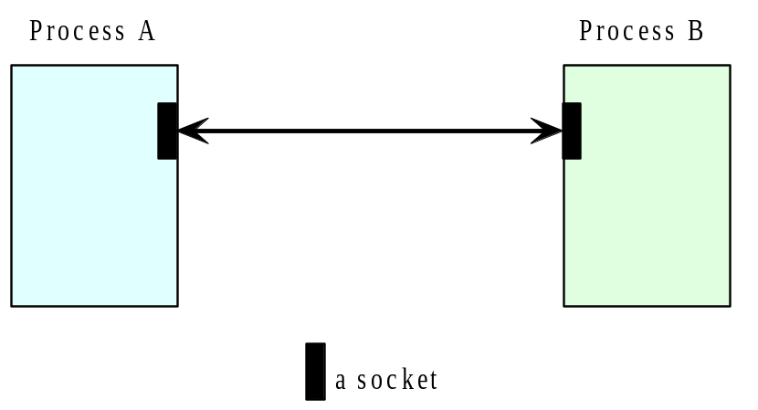
The conceptual model of the socket API

Slide 4
The socket API
A socket API provides a programming construct termed a socket. A process wishing to communicate with another process must create an instance, or instantiate, such a construct
The two processes then issues operations provided by the API to send and receive data.

Slide 5
Connection-oriented & connectionless datagram socket
A socket programming construct can make use of either the UDP or TCP protocol.
Sockets that use UDP for transport are known as datagram sockets, while sockets that use TCP are termed stream sockets.

Slide 6
Connection-oriented & connectionless datagram socket
Datagram sockets (UDP) can support both connectionless and connection-oriented communication at the application layer. This is so because even though datagrams are sent or received without the notion of connections at the transport layer, the runtime support of the socket API can create and maintain logical connections for datagrams exchanged between two processes.
(The runtime support of an API is a set of software that is bound to the program during execution in support of the API.)

Slide 7
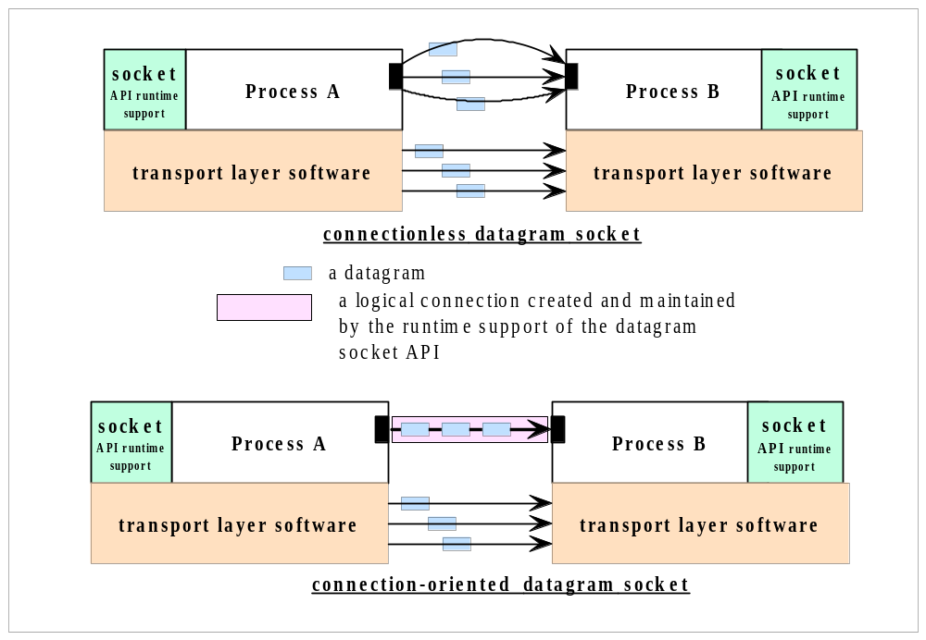
Connection-oriented & connectionless datagram socket

Slide 8
The Java Datagram Socket API
In Java, two classes are provided for the datagram (UDP) socket API:
  the DatagramSocket class for the sockets.
  the DatagramPacket class for the datagram exchanged.
A process wishing to send or receive data using this API must instantiate a DatagramSocket object, or a socket in short.
Each socket is said to be bound to a UDP port of the machine local to the process

Slide 9
The Java Datagram Socket API
To send a datagram to another process, a process:
creates an object that represents the datagram itself. This object can be created by instantiating a DatagramPacket object which carries
  the payload data as a reference to a byte array, and
  the destination address (the host ID and port number to which the receiver’s socket is bound.
issues a call to a send method in the DatagramSocket object, specifying a reference to the DatagramPacket object as an argument

Slide 10
The Java Datagram Socket API
In the receiving process, a DatagramSocket object must also be instantiated and bound to a local port, the port number must agree with that specified in the datagram packet of the sender.
To receive datagrams sent to the socket, the process creates a datagramPacket object which references a byte array and calls a receive method in its DatagramSocket object, specifying as argument a reference to the DatagramPacket object.

Slide 11
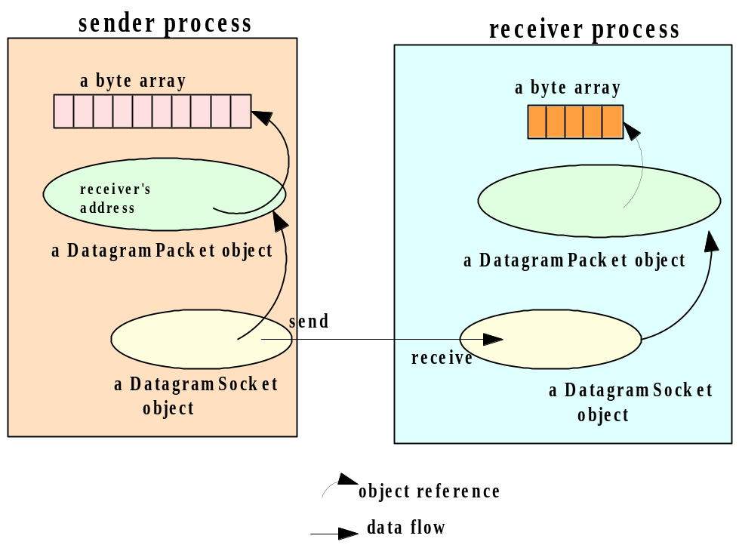
The Data Structures in the sender and receiver programs

Slide 12
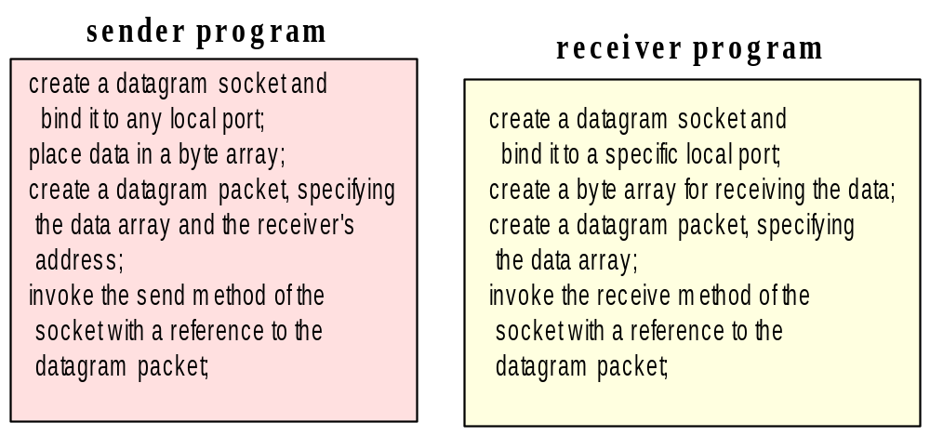
The program flow in the sender and receiver programs

Slide 13
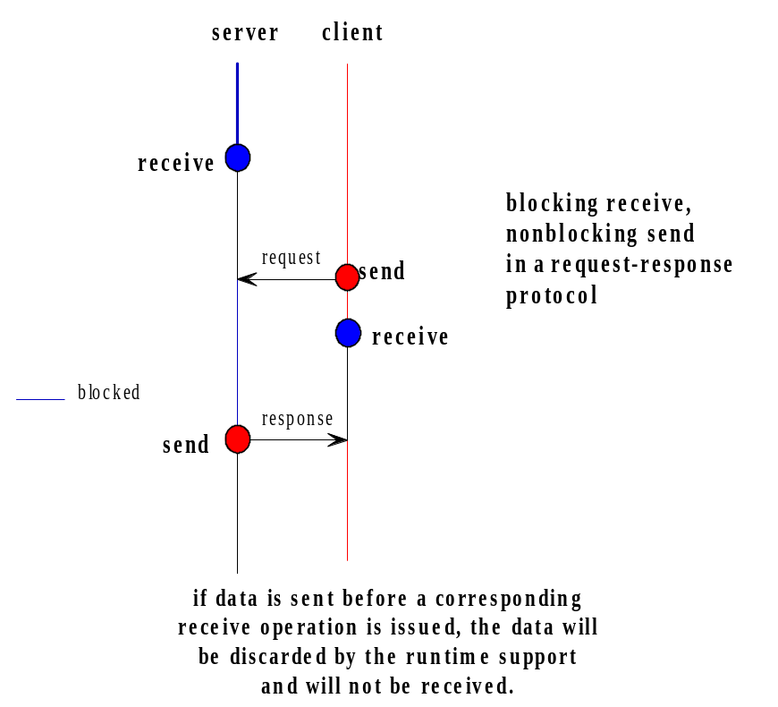
Event synchronization with the connectionless datagram sockets API

Slide 14
Setting timeout
To avoid indefinite blocking, a timeout can be set with a socket object:
  void setSoTimeout(int timeout)
  Set a timeout for the blocking receive from this socket, in milliseconds.
Once set, the timeout will be in effect for all blocking operations.

Slide 15
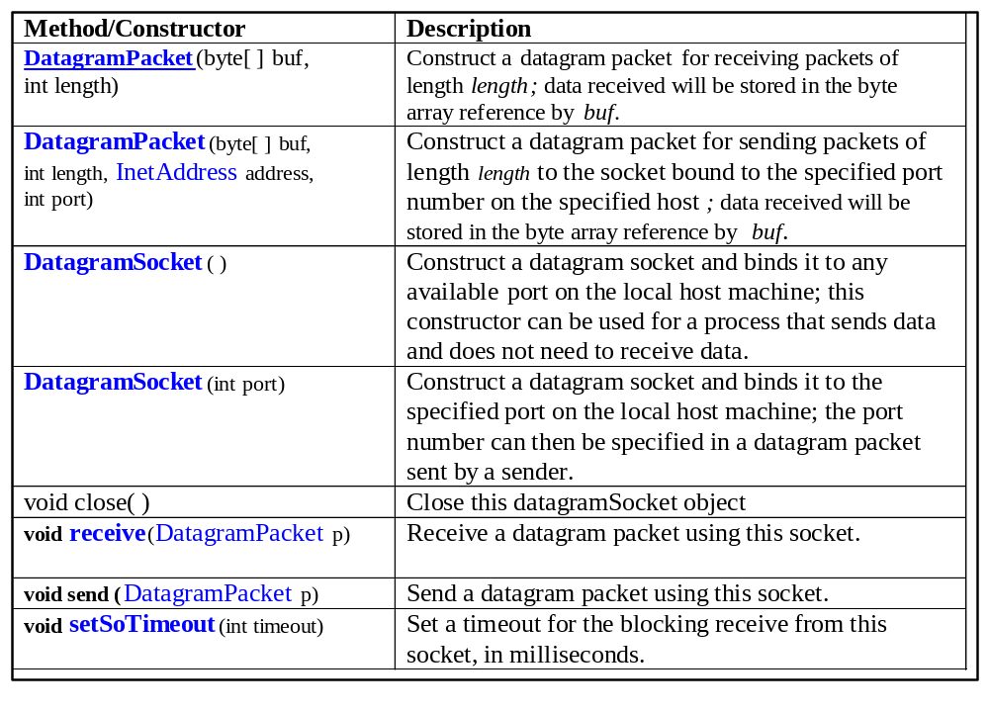
Key Methods and Constructors

Slide 16
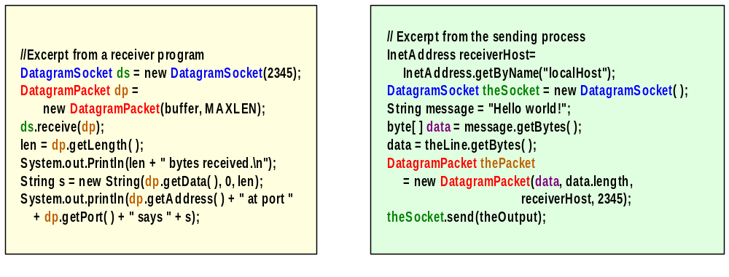
The coding

Slide 17
Connectionless sockets
With connectionless sockets, it is possible for multiple processes to simultaneously send datagrams to the same socket established by a receiving process, in which case the order of the arrival of these messages will be unpredictable, in accordance with the UDP protocol

Slide 18
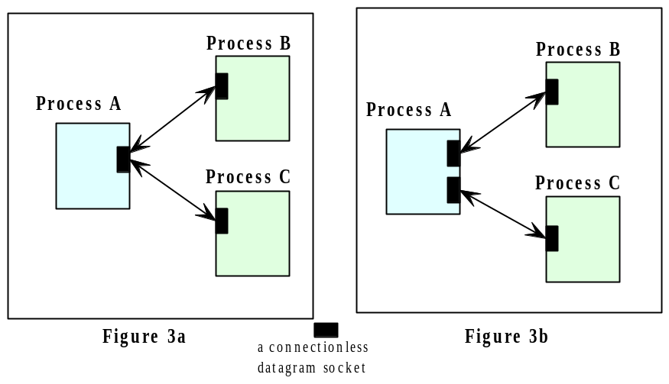
Connectionless sockets

Slide 19
Code samples (receiver side)
DatagramSocket mySocket = new DatagramSocket(port);
// instantiates a datagram socket for receiving the data
byte[ ] buffer = new byte[MAX_LEN];
DatagramPacket datagram =
new DatagramPacket(buffer, MAX_LEN);
mySocket.receive(datagram);
String message = new String(buffer);

Slide 20
Code samples (sender side)
InetAddress receiverHost = InetAddress.getByName(…);
int receiverPort = …;
String message = …;
//instantiates a datagram socket for sending the data
DatagramSocket mySocket =
new DatagramSocket();
byte[ ] buffer = message.getBytes( );
DatagramPacket datagram =
new DatagramPacket(buffer,buffer.length,
receiverHost, receiverPort);
mySocket.send(datagram);
mySocket.close( );

Slide 21
Connection-oriented datagram socket API
It is uncommon to employ datagram sockets for connection-oriented communication; the connection provided by this API is rudimentary and typically insufficient for applications that require a true connection.
Stream-mode sockets are more typical and more appropriate for connection-oriented communication.

Slide 22
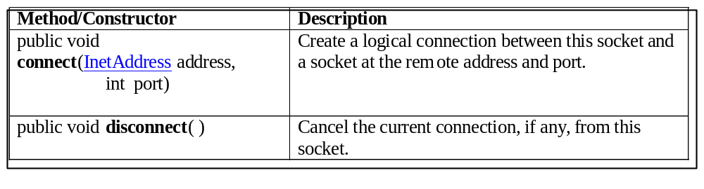
Methods calls for connection-oriented datagram socket
A connection is made for a socket with a remote socket.
Once a socket is connected, it can only exchange data
with the remote socket.
If a datagram specifying another address is sent using
the socket, an IllegalArgumentException will occur.
If a datagram from another socket is sent to this socket,
The data will be ignored.

Slide 23
The Stream-mode Socket API
The datagram socket API supports the exchange of discrete units of data (that is, datagrams).
The stream socket API provides a model of data transfer based on the stream-mode I/O of the Unix operating systems.
By definition, a stream-mode socket supports connection-oriented communication only.

Slide 24
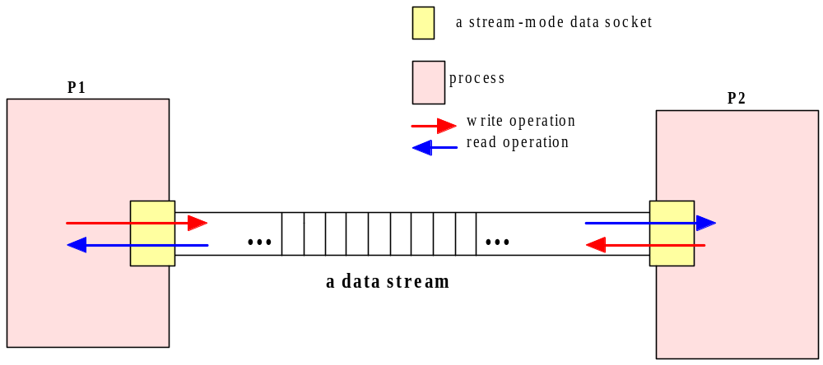
Stream-mode Socket API
(connection-oriented socket API)

Slide 25
Stream-mode Socket API
A stream-mode socket is established for data exchange between two specific processes.
Data stream is written to the socket at one end, and read from the other end.
A stream socket cannot be used to communicate with more than one process.

Slide 26
Stream-mode Socket API
In Java, the stream-mode socket API is provided with two classes:
  Server socket: for accepting connections; we call an object of this class a connection socket.
  Socket: for data exchange; we call an object of this class a data socket.

Slide 27
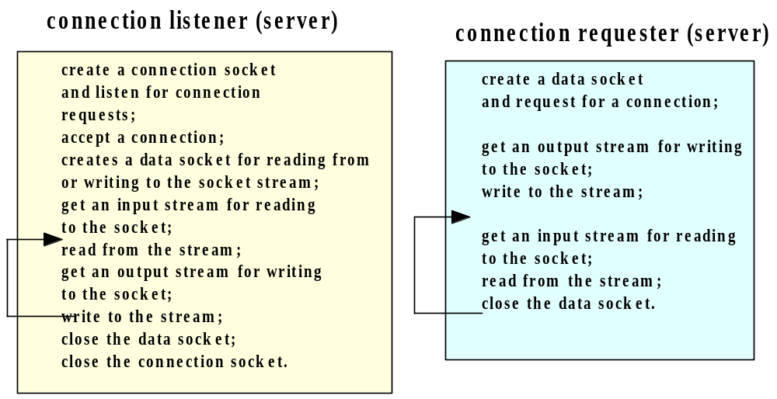
Stream-mode Socket API program flow

Slide 28
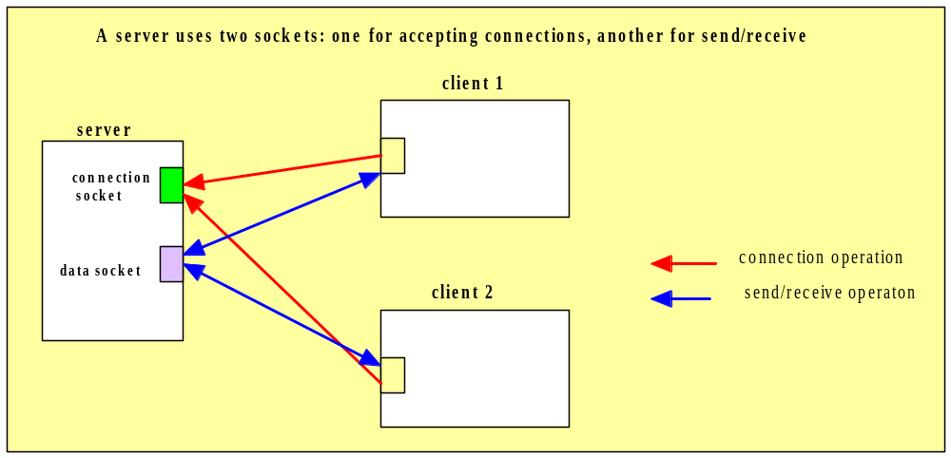
The server (the connection listener)

Slide 29
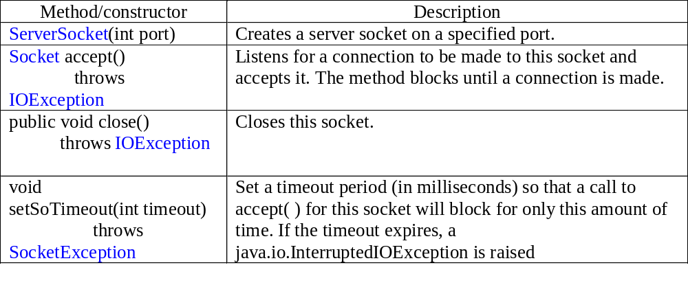
Key methods in the ServerSocket class
Note: Accept is a blocking operation.

Slide 30
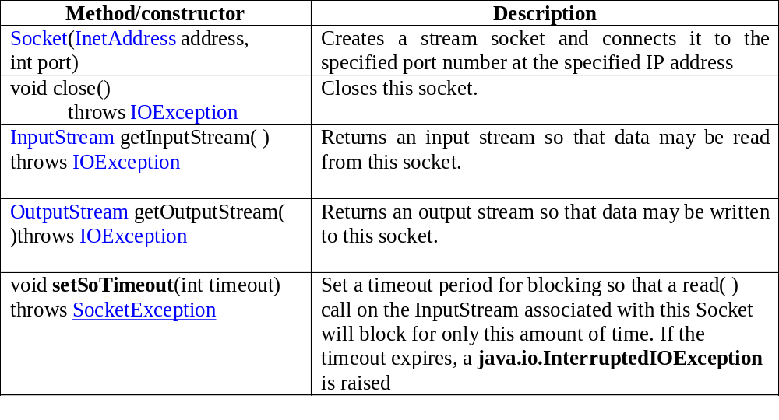
Key methods in the Socket class
A read operation on the InputStream is blocking.
A write operation is nonblocking.

Slide 31
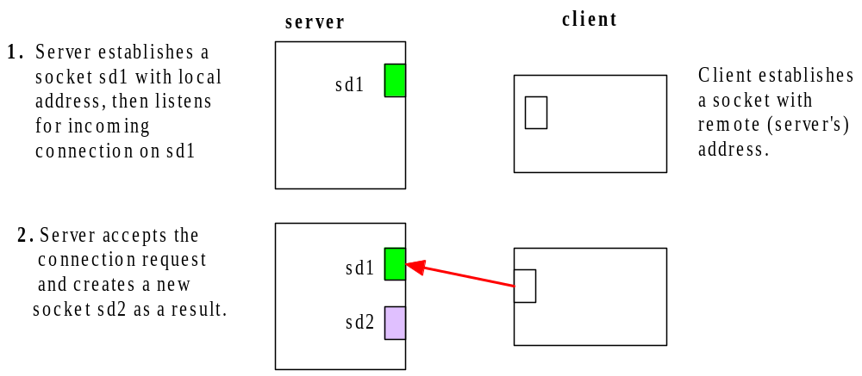
Connection-oriented socket API-3

Slide 32
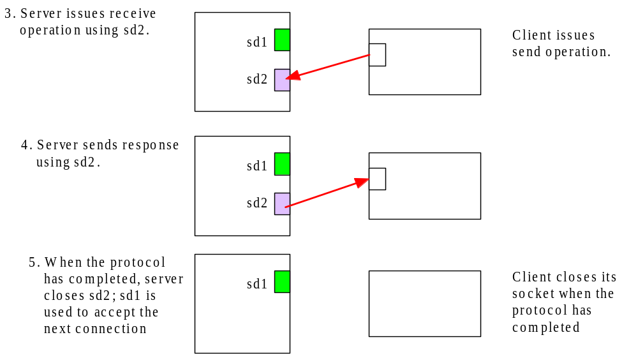
Connection-oriented socket API-3

Slide 33
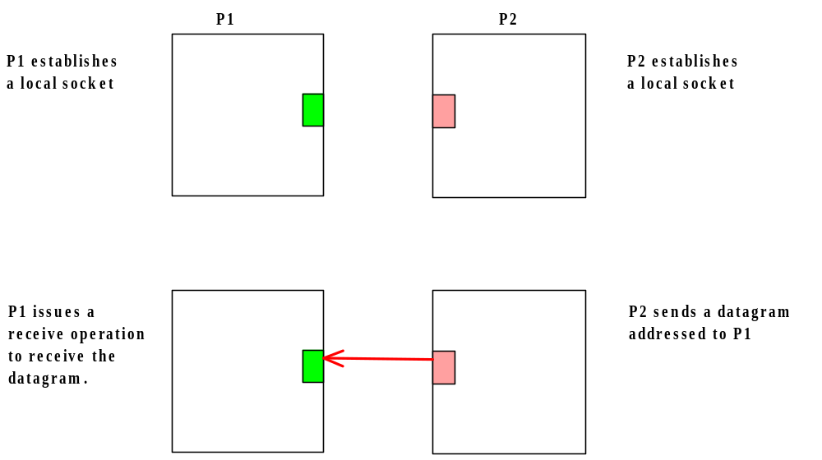
Connectionless socket API

Slide 34
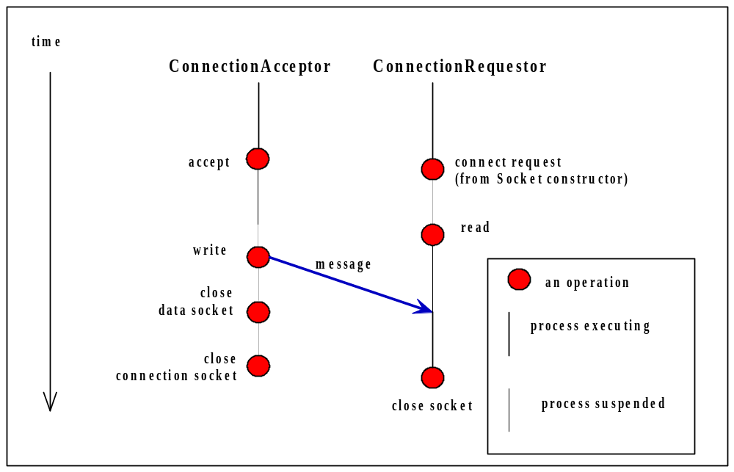
Example 4 Event Diagram

Slide 35
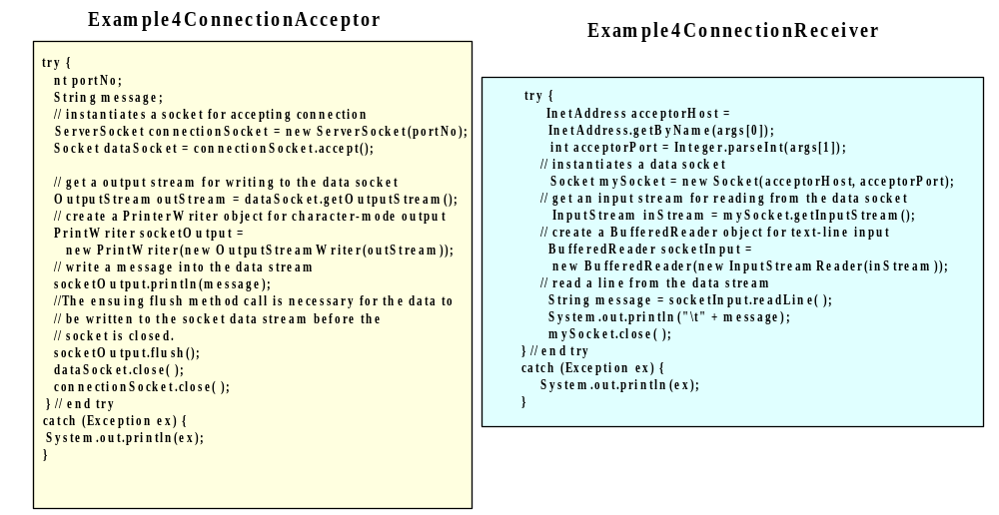
Example

Slide 36
Secure Sockets
http://java.sun.com/products/jsse/
Secure sockets perform encryption on the data transmitted.
The Java Secure Socket Extension (JSSE) is a Java package that enables secure Internet communications.
It implements a Java version of SSL (Secure Sockets Layer) and TLS (Transport Layer Security) protocols
It includes functionalities for data encryption, server authentication, message integrity, and optional client authentication.
Using JSSE, developers can provide for the secure passage of data between a client and a server running any application protocol.

Slide 37
The Java Secure Socket Extension API
Import javax.net.ssl;
Class SSLServerSocket is a subclass of ServerSocket, and inherits all its methods.
Class SSLSocket is a subclass of Socket, and inherits all its methods.
There are also classes for
  Certification
  Handshaking
  KeyManager
  SSLsession

Slide 38
Sockets with non blocking I/O
Basic API socket provides :
  Asynchronous send
  Synchronous receive
To maximize concurrency, threads can be used
A specific API for asynchronous operations
New in Java : java.nio (non blocking i/o to be used with sockets)

Slide 39
Summary
The socket API is widely available as a programming facility for IPC
Low level of abstraction and error prone
Two types of sockets with Java API
  The datagram socket with UDP
  The stream-mode socket with TCP

Slide 40
Group Communication

Slide 41
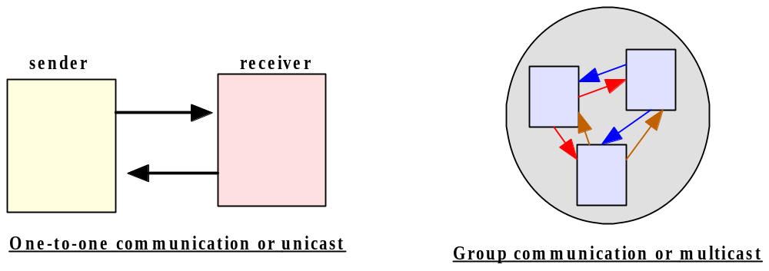
Unicast vs. Multicast

Slide 42
Multicast
Whereas the majority of network services and network applications use unicast for IPC, multicasting is useful for applications such as
  groupware,
  online conferences,
  interactive distance learning,
  online auction
  replication of services for fault tolerance.

Slide 43
Mutlicast group
In an application or network service which makes use of multicasting, a set of processes form a group, called a multicast group.
Each process in a group can send and receive message. A message sent by any process in the group can be received by each participating process in the group.
A process may also choose to leave a multicast group.
One example : a group of processes interoperate using multicasting to exchange audio, video, and/or text data.

Slide 44
An Archetypal Multicast API
Primitive operations:
Join – This operation allows a process to join a specific multicast group.
A process that has joined a multicast group is a member of the group and is entitled to receive all multicast addressed to the group.
A process should be able to be a member of multiple multicast groups at any one time.
For this, a naming scheme is needed to uniquely identify a multicast group.

Slide 45
Multicast API Operations - continued
Leave –This operation allows a process to stop participating in a multicast group. A process that has left a multicast group is no longer a member of the group and is thereafter not entitled to receive any multicast addressed to the group
Send – This operation allows a process to send a message to all processes currently participating in a multicast group.
Receive –This operation allows a member process to receive messages sent to a multicast group.

Slide 46
Reliable Multicast vs. Unreliable Multicast
When a multicast message is sent by a process, the runtime support of the multicast mechanism is responsible for delivering the message to each process currently in the multicast group.
As each participating process may reside on a separate host, the delivery of these messages requires the support of mechanisms running independently on those systems.
Due to factors such as failures of network links and/or network hosts, routing delays, and differences in software and hardware, the time between when a unicast message is sent and when it is received may vary among the recipient processes.

Slide 47
Reliable Multicast vs. Unreliable Multicast
Moreover, a message may not be received by one or more of the processes at all, due to errors and/or failures in the network, the machines, or the runtime support.
Some applications can (or cannot) tolerate an occasional miss or misordering of messages
Therefore, when employing a multicasting mechanism for an application, it is important that you choose one with the characteristics appropriate for your application. Otherwise, measures will need to be provided in the coding of the application in order to handle the anomalies which may occur in message delivery.

Slide 48
Classification of multicasting mechanisms in terms of message delivery
Unreliable multicast:
At its most basic, a multicast system will make a good-faith attempt to deliver messages to each participating process, but the arrival of the correct message at each process is not guaranteed.
Thus, any message sent by a process may be received by zero or more processes.
In the best case, the message is received by all processes. In the worst case, the message may be received by none.
In other cases, the message may be received by some but not all, or the messages may be received by some processes in a corrupted form. Such a system is said to provide unreliable multicast.

Slide 49
Classification of multicasting mechanisms in terms of message delivery - 2
Reliable multicast
A multicast system which guarantees that each message is eventually delivered to each process in the group is said to provide reliable multicast. In such a system, each message sent by a process can be assumed to be delivered in a non-corrupted form to all processes in the group eventually.

Slide 50
Classification of multicasting mechanisms in terms of message delivery - 3
The definition of reliable multicast requires that each participating process receives exactly one copy of each message sent.
However, the definition places no restriction on the order that the messages are delivered to each process: each process may receive the messages in any permutation of those messages.

Slide 51
Classification of reliable multicast
Unordered
An unordered reliable multicast system guarantees the safe delivery of each message, but it provides no guarantee on the delivery order of the messages.
Example: Processes P₁, P₂, and P₃ have formed a multicast group. Further suppose that three messages, m₁, m₂, m₃ have been sent to the group. Then an unordered reliable multicast system may deliver the messages to each of the three processes in any of the 3! = 6 permutations (m₁-m₂-m_{3,} m₁-m₃-m_{2,} m₂-m₁-m_{3,} m₂-m₃-m_{1,} m₃-m₁-m_{2,} m₃-m₂-m_{1).}
Note that it is possible for each participant to receive the messages in an order different from the orders of messages delivered to other participants.

Slide 52
Classification of reliable multicast - 2
FIFO multicast
A system which guarantees that the delivery of the messages adhere to the following condition is said to provide FIFO (first-in-first-out) or send-order multicast:
  If process P sent messages m_{i} and m_{j}, in that order, then each process in the multicast group will be delivered the messages m_{i} and m_{j}, in that order.
Suppose P₁ sends messages m₁, m₂, and m₃ in order, then each process in the group is guaranteed to have those messages delivered in that same order

Slide 53
Classification of reliable multicast - 2
Note that FIFO multicast places no restriction on the delivery order among messages sent by different processes. To illustrate the point, let us use a simplified example of a multicast group of two processes: P₁ and P₂. Suppose P₁ sends messages m₁₁ then m₁₂, while P₂ sends messages m₂₁ then m₂₂. Then a FIFO multicast system can deliver the messages to each of the two processes in any of the following orders:
        m₁₁-m₁₂-m₂₁-m₂₂,
        m₁₁-m₂₁-m₁₂-m₂₂,
        m₁₁-m₂₁-m₂₂-m₁₂,
        m₂₁-m₁₁-m₁₂-m₂₂
        m₂₁-m₁₁-m₂₂-m₁₂
        m₂₁-m₂₂-m₁₁-m₁₂.

Slide 54
Classification of reliable multicast - 3
Causal Order Multicast
A multicast system is said to provide causal multicast if its message delivery satisfies the following criterion:
If message m_{j} causes (results in) the occurrence of message m_{j}, then m_{i} will be delivered to each process prior to m_{j}. Messages m_{i} and m_{j} are said to have a causal or happen-before relationship, denoted m_{i} -> m_{j}. The happen-before relationship is transitory: if m_{i} -> m_{j} and m_{j} -> m_{k}, then m_{i} -> m_{j} -> m_{k}. In this case, a causal-order multicast system guarantees that these three messages will be delivered to each process in the order of m_{i}, m_{j}, then m_{k}.[

Slide 55
Causal Order Multicast – example1
Suppose three processes P₁, P₂, and P₃ are in a multicast group. P₁ sends a message m₁, to which P₂ replies with a multicast message m₂. Since m₂ is triggered by m₁, the two messages share a causal relationship of m₁-> m_{2.} Suppose the receiving of m₂ in turn triggers a multicast message m₃ sent by P₃, that is, m₂-> m_{3.} The three messages share the causal relationship of m₁-> m₂-> m₃. A causal-order multicast message system ensures that these three messages will be delivered to each of the three processes in the order of m₁- m₂₋ m₃.

Slide 56
Causal Order Multicast – example2
As a variation of the above example, suppose P₁ multicasts message m₁, to which P₂ replies with a multicast message m₂, and independently P₃ replies to m₁ with a multicast message m₃. The three messages now share these causal relationships: m₁ -> m₂ and m₁ -> m₃. A causal-order multicast system can delivery these message in either of the following orders:
    m₁- m₂- m₃
    m₁- m₃- m₂
since the causal relations are preserved in either of the two sequences. In such a system, it is not possible for the messages to be delivered to any of the processes in any other permutation of the three messages, such as m₂- m₁- m₃ or m₃- m₁- m₂, the first of these violates the causal relationship m₁ -> m₂ , while the second permutation violates the causal relationship m₁ -> m₃.

Slide 57
Classification of reliable multicast - 4
Atomic order multicast
In an atomic-order multicast system, all messages are guaranteed to be delivered to each participant in the exact same order. Note that the delivery order does not have to be FIFO or causal, but must be identical for each process.
Example:
  P₁ sends m₁, P₂ sends m₂, and P₃ sends m₃.
An atomic system will guarantee that the messages will be delivered to each process in only one of the six orders:
m₁-m₂- m₃, m₁- m₃- m₂, m₂- m₁-m₃,
m₂-m₃-m₁, m₃-m₁- m₂, m₃-m₂-m₁.

Slide 58
Atomic Multicast Example
P₁ sends m₁ then m₂.
P₂ replies to m₁ by sending m₃.
P₃ replies to m₃ by sending m₄.
Although atomic multicast imposes no ordering on these messages, the sequence of the events dictates that P₁ must be delivered m₁ before sending m₂. Likewise, P₂ must receive m₁ then m₃, while P₃ must receive m₃ before m₄. Hence any atomic delivery order must preserve the order m₁₋ m₃₋ m₄. The remaining message m₂ can, however, be interleaved with these messages in any manner. Thus an atomic multicast will result in the messages being delivered to each of the processes in one of the following orders: m₁₋ m₂₋ m₃₋ m_{4,} m₁₋ m₃₋ m₂₋ m_{4,} or m₁₋ m₃₋ m₄₋ m_{2.} For example, each process may be delivered the messages in this order m₁₋ m₃₋ m₂₋ m_{4, .}

Slide 59
The Java Basic Multicast API
At the transport layer, the basic multicast supported by Java is an extension of UDP (the User Datagram Protocol), which, as you recall, is connectionless and unreliable.
For the basic multicast, Java provides a set of classes which are closely related to the datagram socket API.

Slide 60
The Java Basic Multicast API - 2
There are four major classes in the API, the first three of which are in the context of datagram sockets.
InetAddress: In the datagram socket API, this class represents the IP address of the sender or receiver. In multicasting, this class can be used to identify a multicast group
DatagramPacket: As with datagram sockets, an object of this class represents an actual datagram; in multicast, a DatagramPacket object represents a packet of data sent to all participants or received by each participant in a multicast group.

Slide 61
The Java Basic Multicast API - 3
3. DatagramSocket: In the datagram socket API, this class represents a socket through which a process may send or receive data.
4. A MulticastSocket is a DatagramSocket, with additional capabilities for joining and leaving a multicast group. An object of the multicast datagram socket class can be used for sending and receiving IP multicast packets.

Slide 62
IP Multicast addresses
Instead of a single process, a multicast datagram is meant to be received by all the processes that are currently members of a specific multicast group.
Hence each multicast datagram needs to be addressed to a multicast group instead of an individual process.
The Java multicast API uses the Internet Protocol (IP) multicast addresses for identifying multicast groups.
In IPv4a multicast group is specified by
(i) a class D IP address combined with
(ii) a standard UDP port number.

Slide 63
IP Multicast addresses - 2
Class D IP addresses are those with the prefix bit string of 1110, and hence these addresses are in the range of 224.0.0.0 to 239.255.255.255, inclusive.
Excluding the four prefix bits, there are 32-4=28 remaining bits, resulting in an address space of 2²⁸; that is, approximiate 268 million class D addresses are available, although the address 224.0.0.0 is reserved and should not be used by any application.
IPv4 multicast addresses are managed and assigned by the Internet Assigned Numbers Authority (IANA)

Slide 64
IP Multicast addresses - 3
An application which uses the Java multicast API must specifiy at least one multicast address for the application. To select a multicast address for an application, there are the following options:
1. Obtain a permanently assigned static multicast address from IANA: Permanent addresses are limited to global, well-known Internet applications, and their allocations are highly restricted.
2. Choose an arbitrary address, assuming that the combination of the random address and
3. Obtain a transient multicast address at runtime; such an address can be received by an application through the Session Announcement Protocol.

Slide 65
IP Multicast addresses - 4
Some of the most interesting of the assigned addresses:
224.0.0.1 All Systems on this Subnet
224.0.0.11 Mobile-Agents 224.0.1.23 XINGTV
224.0.1.84 jini-announcement
224.0.1.85 jini-request
224.0.1.115 Simple Multicast
224.0.6.000-224.0.6.127 Cornell ISIS Project
224.0.7.000-224.0.7.255 Where-Are-You
224.0.8.000-224.0.8.255 INTV
224.0.9.000-224.0.9.255 Invisible Worlds
224.0.12.000-224.0.12.063 Microsoft and MSNBC
224.0.16.000-224.0.16.255 XingNet
224.0.18.000-224.0.18.255 Dow Jones
224.0.19.000-224.0.19.063 Walt Disney Company
224.0.22.000-224.0.22.255 WORLD MCAST
224.2.0.0-224.2.127.253 Multimedia Conference Calls

Slide 66
IP Multicast addresses - 5
For our examples and exercises, we will make use of the static address 224.0.0.1, with an equivalent domain name ALLSYSTEMS.MCAST.NET, for processes running on all machines on the local area network, such as those in your laboratory; alternatively, we may use an arbitrary address that has not been assigned, such as a number in the range of 239.*.*.* (for example, 239.1.2.3).
In the Java API, a MulticastSocket object is bound to a port address such as 3456, and methods of the object allows for the joining and leaving of a multicast address such as 239.1.2.3

Slide 67
Joining a multicast group
- To join a multicast group at IP address m and UDP port p, a MulticastSocket object must be instantiated with p, then the object’s joinGroup method can be invoked specifying the address m:
// join a Multicast group at IP address 239.1.2.3 and port 3456
  InetAddress group =
  InetAddress.getByName("239.1.2.3");
  MulticastSocket s = new MulticastSocket(3456);
  s.joinGroup(group);

Slide 68
Sending to a multicast group
A multicast message can be sent using syntax similar with the datagram socket API.
  String msg = "This is a multicast message.";
  InetAddress group = InetAddress.getByName("239.1.2.3");
  MulticastSocket s = new MulticastSocket(3456);
  s.joinGroup(group); // optional
  DatagramPacket hi = new
  DatagramPacket(msg.getBytes( ), msg.length( ),group, 3456);
  s.send(hi);

Slide 69
Receiving messages sent to a multicast group
A process that has joined a multicast group may receive messages sent to the group using syntax similar to receiving data using a datagram socket API.
  byte[] buf = new byte[1000];
  InetAddress group =
  InetAddress.getByName("239.1.2.3"); MulticastSocket s = new MulticastSocket(3456); s.joinGroup(group);
  DatagramPacket recv =
  new DatagramPacket(buf, buf.length);
  s.receive(recv);

Slide 70
Leaving a multicast group
A process may leave a multicast group by invoking the leaveGroup method of a MulticastSocket object, specifying the multicast address of the group.
    s.leaveGroup(group);

Slide 71
Setting the “time-to-live”
The runtime support for a multicast API often employs a technique known as message propagation, whereby a packet is propagated from a host to a neighboring host in an algorithm which, when executed properly, will eventually deliver the message to all the participants.
Under some anomalous circumstances, however, it is possible that the algorithm which controls the propagation does not terminate properly, resulting in a packet circulating in the network indefinitely.

Slide 72
Setting the “time-to-live” - 2
Indefinite message propagation causes unnecessary overhead on the systems and the network.
To avoid this occurrence, it is recommended that a “time to live” parameter be set with each multicast datagram.
The time-to-live (ttl) parameter, when set, limits the count of network links or hops that the packet will be forwarded on the network.

Slide 73
Setting the “time-to-live” - 3
String msg = "Hello everyone!";
InetAddress group = InetAddress.getByName("224.0.0.1"); MulticastSocket s = new MulticastSocket(3456); s.setTimeToLive(1); // set time-to-live to 1 hop – a count
// appropriate for multicasting to local hosts
DatagramPacket hi = new DatagramPacket(msg.getBytes( ), msg.length( ),group, 3456); s.send(hi);
The value specified for the ttl must be in the range 0 <= ttl <= 255; an IllegalArgumentException will be thrown otherwise.

Slide 74
Setting the “time-to-live” - 4
The recommended ttl settings are:
0 if the multicast is restricted to processes on the same host
1 if the multicast is restricted to processes on the same subnet
32 if the multicast is restricted to processes on the same site
64 if the multicast is restricted to is processes on the same region
128 is if the multicast is restricted to processes on the same continent
255 is the multicast is unrestricted

Slide 75
Summary - 1
Unicast vs. multicast: unicast is one-to-one communication, while multicast is one-to-many communication.
An archetypal multicast API must provide operations for joining a multicast group, leaving a multicast group, sending to a group, and receiving multicast messages sent to a group.
Basic multicast is connectionless and unreliable; in an unreliable multicast system, messages are not guaranteed to be safely delivered to each participant.

Slide 76
Summary - 2
A reliable multicast system ensures that each message sent to a multicast group is delivered correctly to each participant. Reliable multicasts can be further categorized by the order of message delivery they support:
  Unordered multicast may deliver the messages to each participant in any order.
  FIFO multicast preserves the order of messages sent by each host.
  Causal multicast preserves causal relationships among the messages.
  Atomic multicast delivers the messages to each participant in the same order.

Slide 77
Summary - 3
IP multicast addressing uses a combination of a Class D address and a UDP port number. Class D IP addresses are managed and assigned by IANA. A multicast application may use a static Class D address, a transient address obtained at run time, or an arbitrary unassigned address.
The Java basic multicast API provides unreliable multicast. A MulticastSocket is created with the specification of a port number. The joinGroup and leaveGroup methods of the MulticastSocket class, a subclass of DatagramSocket, can be invoked to join or leave a specific multicast group; and the send and receive methods can be invoked to send and receive a multicast datagram. The DatagramPakcet class is also needed to create the datagrams.
There are existing packages that provide reliable multicast, including the Java Reliable Multicast Service (JRM Service).

