Slide 1

UCL DEPARTMENT OF ELECTRONIC &
ELECTRICAL ENGINEERING
Routing with reinforcement learning
Msc in Telecommunication project
Jinhao Wu

Slide 2
Topic
UCL DEPARTMENT OF ELECTRONIC &
ELECTRICAL ENGINEERING
Literature Review
Reinforcement learning and RL in routing
Proposed RL routing methodology
Deep Q Network
Q-routing
Result to date and further plan
Delay-iteration diagram
TCP packet loss

Slide 3
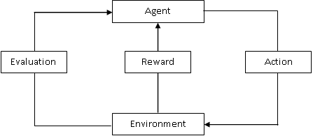
UCL DEPARTMENT OF ELECTRONIC &
ELECTRICAL ENGINEERING
Literature Review
Reinforcement Learning:
Sample, label, objective error function, weight updating method
Agent, environment
(State, action, policy), reward, value function, policy updating method
Supervised learning: classification and regression
Reinforcement learning: dynamic programming

Slide 4
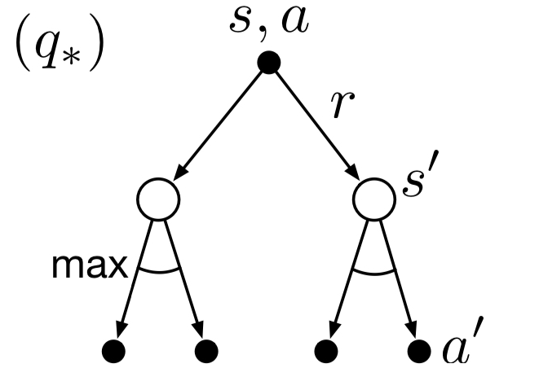
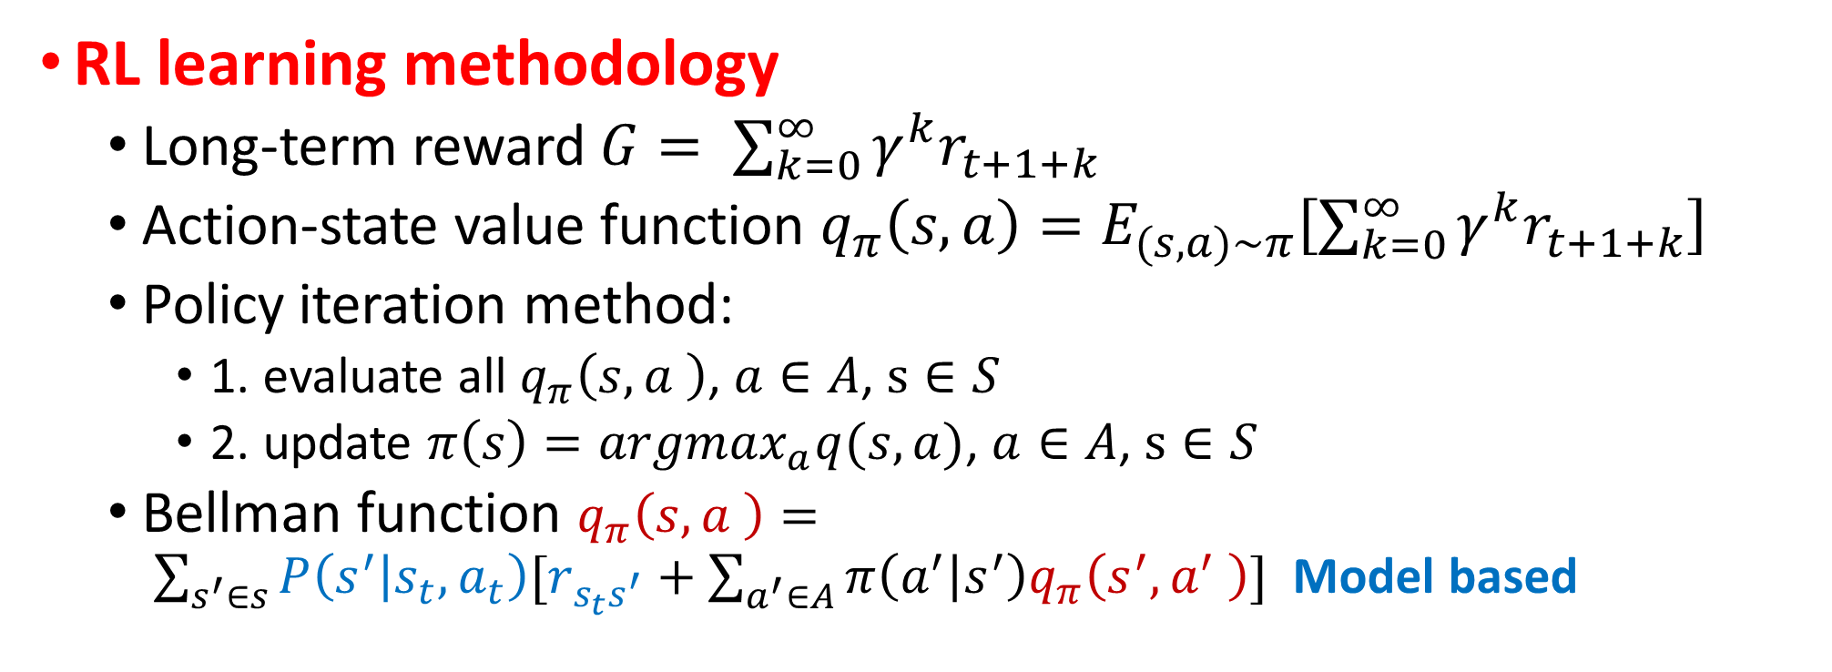
UCL DEPARTMENT OF ELECTRONIC &
ELECTRICAL ENGINEERING
Literature Review
RL learning methodology
Long-term reward $G= \sum_{k=0}^{∞}{γ^{k}r_{t+1+k}}$
Action-state value function $q_{π}\left(s,a\right)=E_{(s,a)\sim π}\left[\sum_{k=0}^{∞}{γ^{k}r_{t+1+k}}\right]$
Policy iteration method:
1. evaluate all $q_{π}\left(s,a \right)$, $a∈A$, $s∈S$
2. update $π\left(s\right)={argmax}_{a}q(s,a)$, $a∈A$, $s∈S$
Bellman function $q_{π}\left(s,a \right)= \sum_{s^{′}∈s}{P\left(s^{′} | s_{t},a_{t}\right)[r_{s_{t}s^{′}}+\sum_{a^{′}∈A}{π\left(a^{′} | s^{′}\right)q_{π}\left(s^{′},a^{′} \right)}]}$ Model based

Slide 5
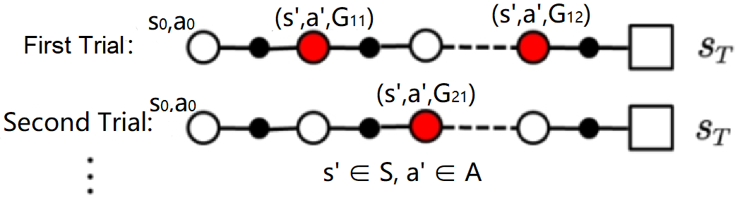
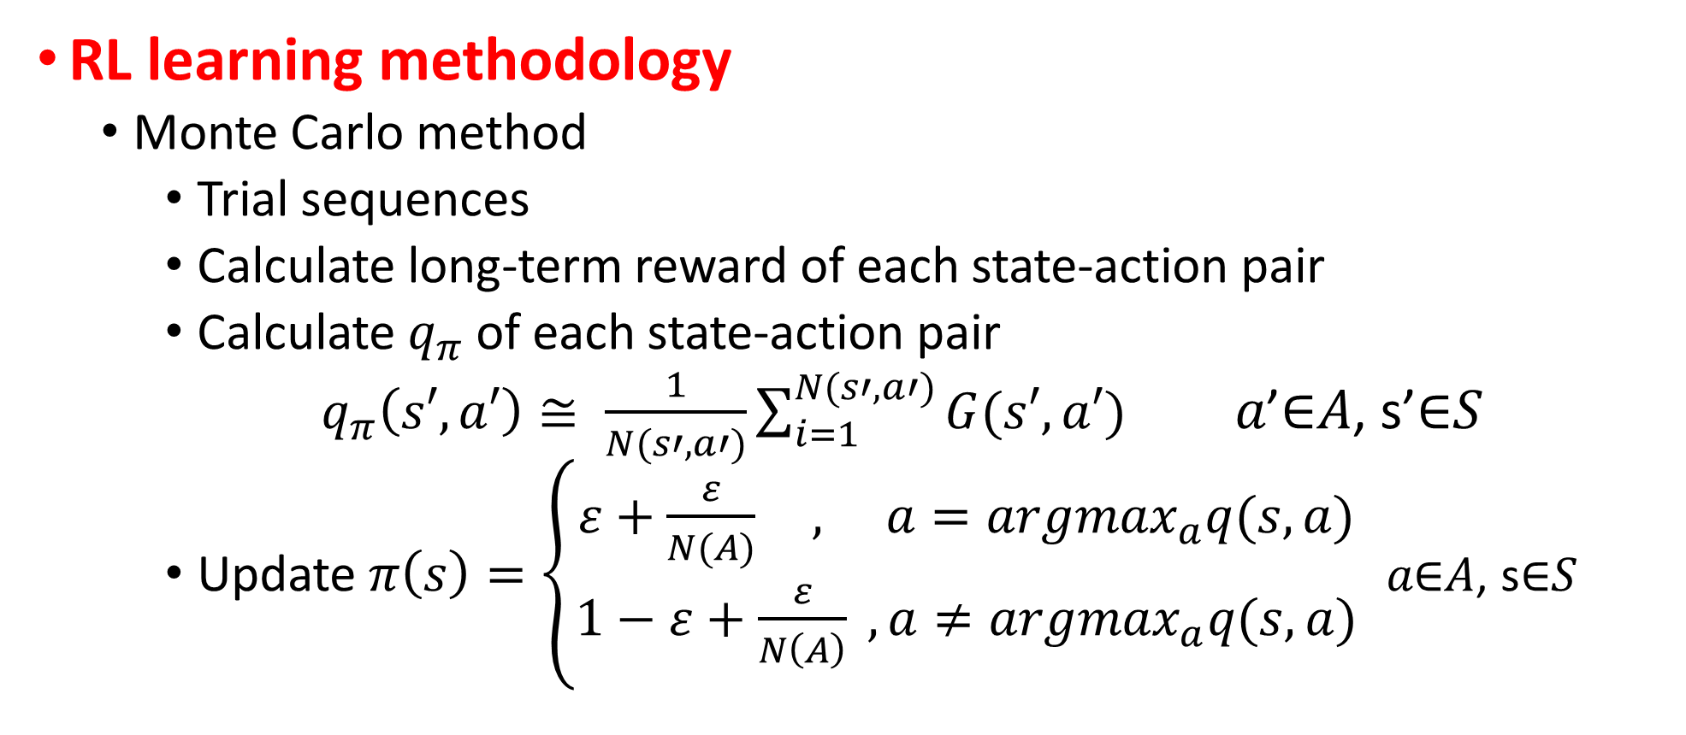
UCL DEPARTMENT OF ELECTRONIC &
ELECTRICAL ENGINEERING
Literature Review
RL learning methodology
Monte Carlo method
Trial sequences
Calculate long-term reward of each state-action pair
Calculate $q_{π}$ of each state-action pair
$q_{π}\left(s′,a′\right)≅ \frac{1}{N(s′,a′)}\sum_{i=1}^{N(s′,a′)}{G(s′,a′)}$ 𝑎’∈𝐴, s’∈𝑆
Update $π\left(s\right)=\left\{\begin{aligned}ε+\frac{ε}{N(A)} , a={argmax}_{a}q(s,a) \\ 1−ε+\frac{ε}{N\left(A\right)} ,a≠{argmax}_{a}q(s,a)\end{aligned}\right.$ 𝑎∈𝐴, s∈𝑆

Slide 6
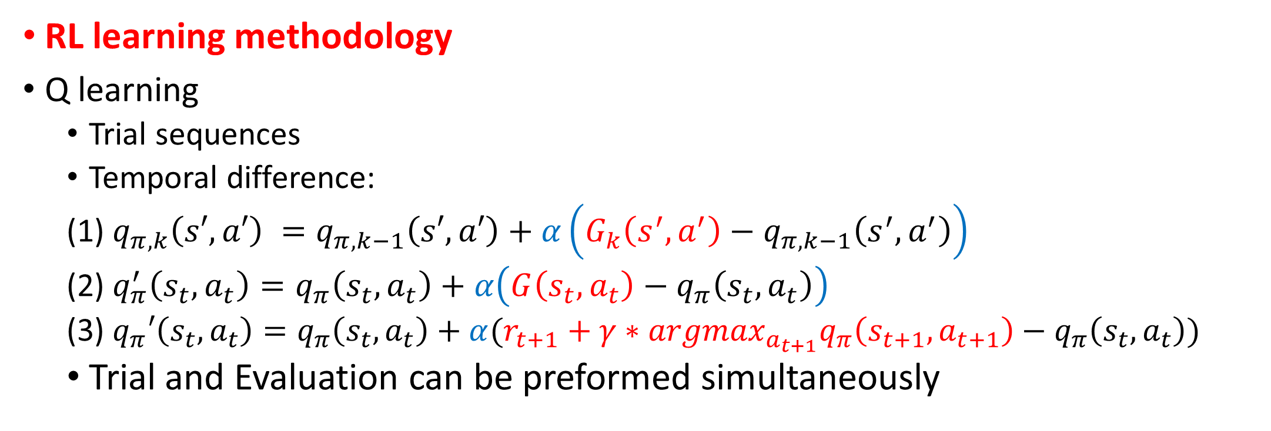

$q_{π,k}\left(s′,a′\right)≅ \frac{1}{k}\sum_{i=1}^{k}{G_{i}\left(s′,a′\right)}$
$$=\frac{1}{k}[G_{k}\left(s′,a′\right)+\sum_{j=1}^{k−1}{G_{j}(s′,a′)]}=\frac{1}{k}\left[G_{k}\left(s′,a′\right)+\left(k−1\right)q_{π,k−1}\left(s′,a′\right)\right]=q_{π,k−1}\left(s′,a′\right)+\frac{1}{k}(G_{k}\left(s′,a′\right)−q_{π,k−1}\left(s′,a′\right))$$
UCL DEPARTMENT OF ELECTRONIC &
ELECTRICAL ENGINEERING
Literature Review
RL learning methodology
Q learning
Trial sequences
Temporal difference:
(1) $q_{π,k}\left(s′,a′\right) =q_{π,k−1}\left(s′,a′\right)+α\left(G_{k}\left(s^{′},a^{′}\right)−q_{π,k−1}\left(s^{′},a^{′}\right)\right)$
(2) $q_{π}^{′}\left(s_{t},a_{t}\right)=q_{π}\left(s_{t},a_{t}\right)+α\left(G\left(s_{t},a_{t}\right)−q_{π}\left(s_{t},a_{t}\right)\right)$
(3) $q_{π}′\left(s_{t},a_{t}\right)=q_{π}\left(s_{t},a_{t}\right)+α(r_{t+1}+γ∗{{argmax}_{a_{t+1}}q}_{π}\left(s_{t+1},a_{t+1}\right)−q_{π}\left(s_{t},a_{t}\right))$
Trial and Evaluation can be preformed simultaneously
Q target

Slide 7
UCL DEPARTMENT OF ELECTRONIC &
ELECTRICAL ENGINEERING
Literature Review
Reinforcement learning in routing
Environment: Network
Agent:
Beamforming: Provide a point-to-point, highly directional connection
Massive MIMO: Increase speed, interference resistance and coverage
Network slicing: Slice a physical network to different virtual networks to provide different services

Slide 8
5G Technology
UCL DEPARTMENT OF ELECTRONIC &
ELECTRICAL ENGINEERING
Stand-along network architecture: New base station, new backhaul links and new core network.
Machine to Machine: Native support for machine to machine communications.
SEFDM: An improvement version of OFDM, which increases the spectral efficiency
Polar and LDPC coding: Polar code is used in control channel and LDPC code is used in data channel, both two codes have low latency and high fault tolerance

Slide 9
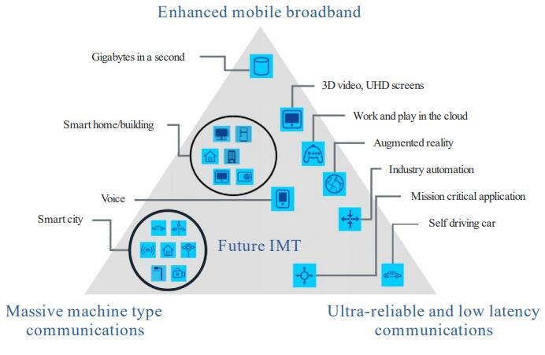
5G Applications
UCL DEPARTMENT OF ELECTRONIC &
ELECTRICAL ENGINEERING
Three application scenarios
Enhanced Mobile Broadband (eMBB)
Provide ultra high speed mobile broadband services
Ultra Reliable low Latency Communications (URLLC)
Provide ultra low latency connections
Massive Machine Type Communications (mMTC)
Internet of everything

Slide 10
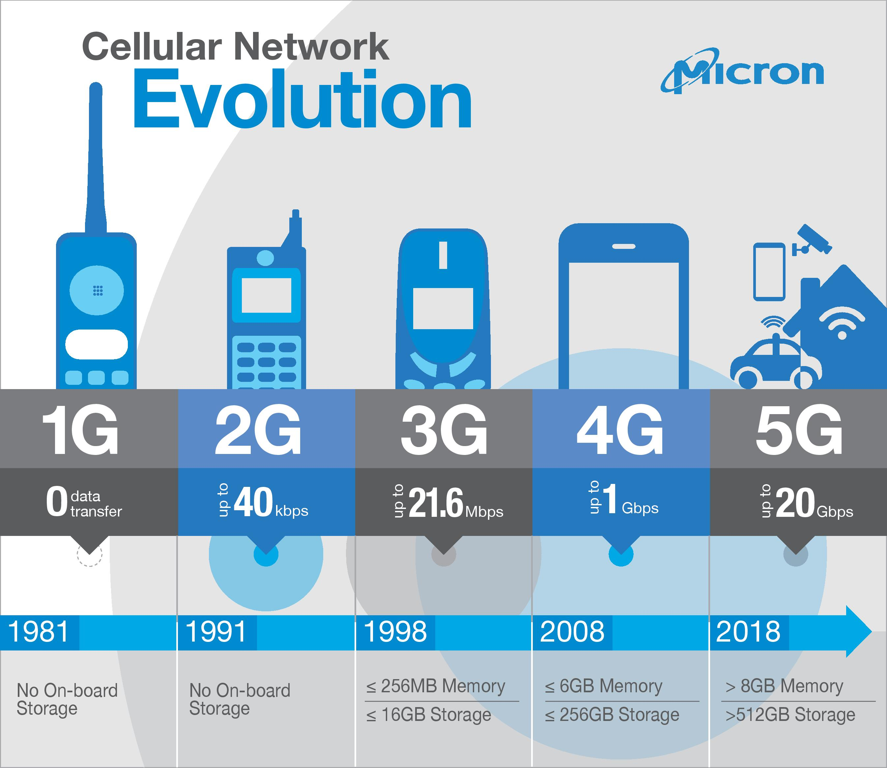
5G Applications
UCL DEPARTMENT OF ELECTRONIC &
ELECTRICAL ENGINEERING
Enhanced Mobile Broadband (eMBB)
Ultra high speed mobile network access
Ultra high speed wireless to the home (WTTH)
Ultra high quality AV on demand
And more…

Slide 11
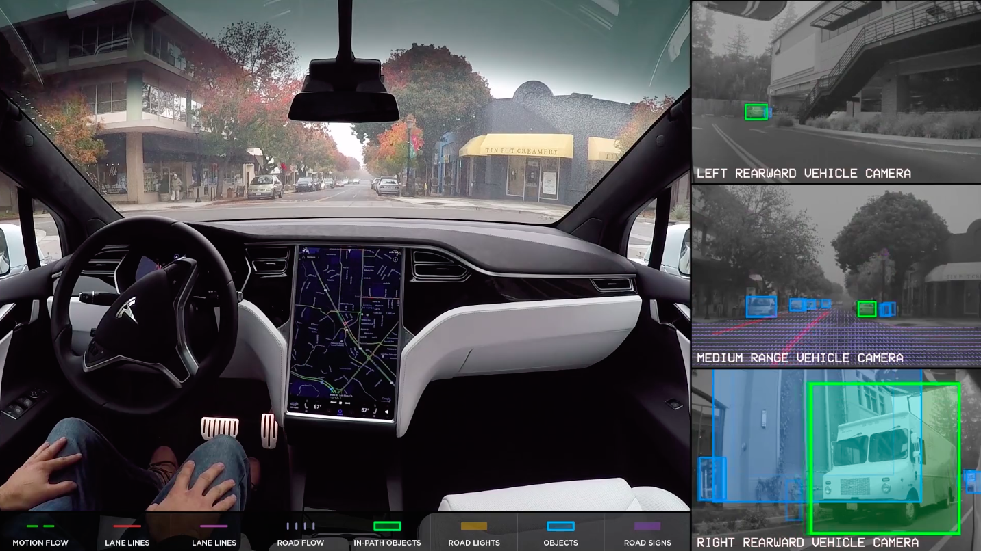
5G Applications
UCL DEPARTMENT OF ELECTRONIC &
ELECTRICAL ENGINEERING
Ultra Reliable low Latency Communications (URLLC)
Reliable telemedicine
Precise automation control in manufacturing
Automatic driving
And more…

Slide 12
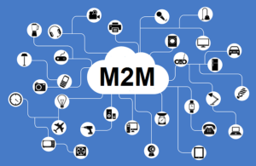
5G Applications
Reference
[1] A. Herman (Oct, 2018), The War For The World's 5G Future [Online] Available: https://www.forbes.com/sites/arthurherman/2018/10/17/the-war-for-the-worlds-5g-future/#1257849a1fe5 [Accessed on 13/05/2019]
[2] LightingBoardband, 5G Fixed Wireless Internet – What Is It, Why Is It Good And Where Can You Get It? [Online] Available: https://www.lightningbroadband.com.au/technology/5g-fixed-wireless-broadband/ [Accessed on 13/05/2019]
[3] International Telecommunication Union Radio communications sector, 2015. IMT Vision – Framework and overall objectives of the future development of IMT for 2020 and beyond [Online]. Available from: https://www.itu.int/dms_pubrec/itu-r/rec/m/R-REC-M.2083-0-201509-I!!PDF-E.pdf [Accessed on 13/05/2019]
[4] Micron, 5G, AI, and the Coming Mobile Revolution [Online] Available: https://in.micron.com/insight/5g-ai-and-the-coming-mobile-revolution [Accessed on 13/05/2019
[5] S. O’Kane, HOW TESLA AND WAYMO ARE TACKLING A MAJOR PROBLEM FOR SELF-DRIVING CARS: DATA [Online] Available: https://www.theverge.com/transportation/2018/4/19/17204044/tesla-waymo-self-driving-car-data-simulation [Accessed on 13/05/2019]
[6] E. Tommasi, Machine to machine (M2M): cos'è, come funziona e a cosa serve [Online] Available: https://www.internet4things.it/industry-4-0/machine-to-machine-m2m-digital-twin-smart-manufacturing-extended-value-chain/ [Accessed on 13/05/2019]
UCL DEPARTMENT OF ELECTRONIC &
ELECTRICAL ENGINEERING
Massive Machine Type Communications (mMTC)
Smart water/electric meter
Smart home/city
Smart wearable devices
Fast tracking and positioning
And more…
Thank you

