Slide 1

UCL DEPARTMENT OF ELECTRONIC &
ELECTRICAL ENGINEERING
Routing with reinforcement learning
Msc in Telecommunication project
Jinhao Wu

Slide 2
Topic
UCL DEPARTMENT OF ELECTRONIC &
ELECTRICAL ENGINEERING
Literature Review
Reinforcement learning and RL in routing
Proposed RL routing methodology
Deep Q Network
Q-routing
Result to date and further plan
Delay-iteration diagram
TCP packet loss

Slide 3
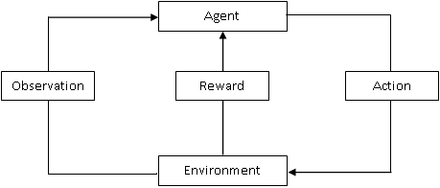
UCL DEPARTMENT OF ELECTRONIC &
ELECTRICAL ENGINEERING
Literature Review
Reinforcement Learning:
Sample, label, objective error function, weight updating method
Agent, environment
(State, action, policy), reward, value function, policy updating method
Supervised learning: classification and regression
Reinforcement learning: dynamic programming

Slide 4
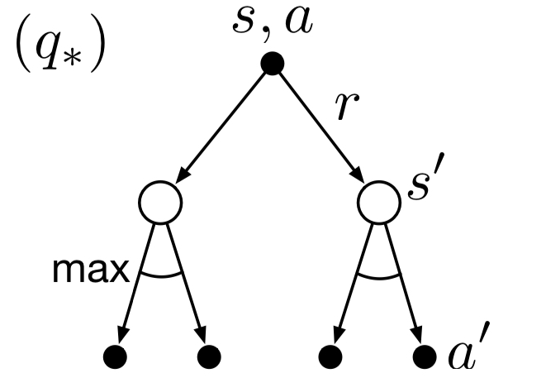
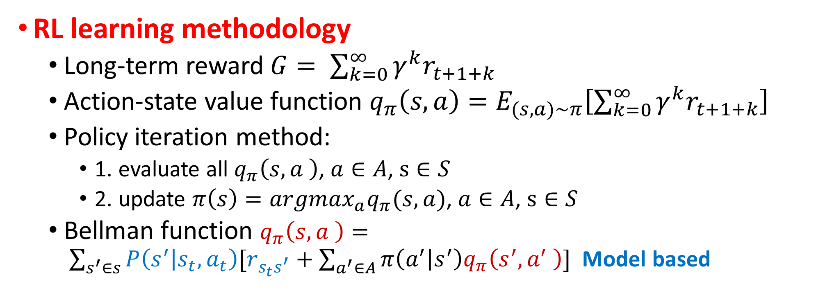
UCL DEPARTMENT OF ELECTRONIC &
ELECTRICAL ENGINEERING
Literature Review
RL learning methodology
Long-term reward $G= \sum_{k=0}^{∞}{γ^{k}r_{t+1+k}}$
Action-state value function $q_{π}\left(s,a\right)=E_{(s,a)\sim π}\left[\sum_{k=0}^{∞}{γ^{k}r_{t+1+k}}\right]$
Policy iteration method:
1. evaluate all $q_{π}\left(s,a \right)$, $a∈A$, $s∈S$
2. update $π\left(s\right)={argmax}_{a}q_{π}(s,a)$, $a∈A$, $s∈S$
Bellman function $q_{π}\left(s,a \right)= \sum_{s^{′}∈s}{P\left(s^{′} | s_{t},a_{t}\right)[r_{s_{t}s^{′}}+\sum_{a^{′}∈A}{π\left(a^{′} | s^{′}\right)q_{π}\left(s^{′},a^{′} \right)}]}$ Model based

Slide 5
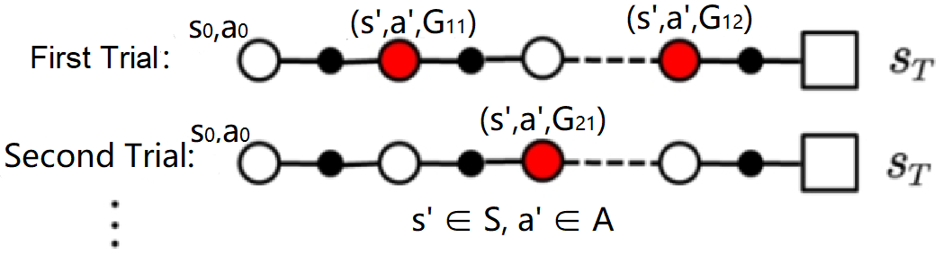
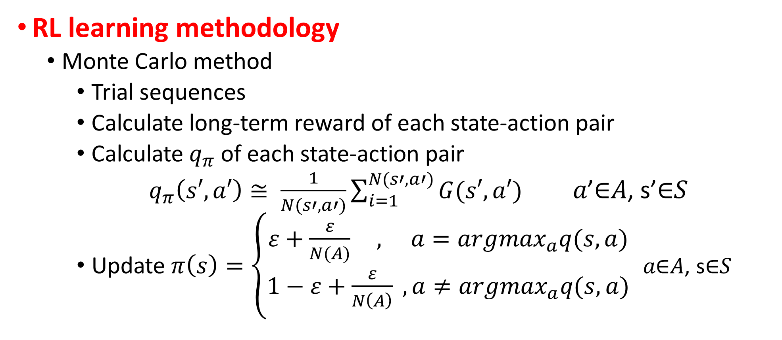
UCL DEPARTMENT OF ELECTRONIC &
ELECTRICAL ENGINEERING
Literature Review
RL learning methodology
Monte Carlo method
Trial sequences
Calculate long-term reward of each state-action pair
Calculate $q_{π}$ of each state-action pair
$q_{π}\left(s′,a′\right)≅ \frac{1}{N(s′,a′)}\sum_{i=1}^{N(s′,a′)}{G(s′,a′)}$ 𝑎’∈𝐴, s’∈𝑆
Update $π\left(s\right)=\left\{\begin{aligned}ε+\frac{ε}{N(A)} , a={argmax}_{a}q(s,a) \\ 1−ε+\frac{ε}{N\left(A\right)} ,a≠{argmax}_{a}q(s,a)\end{aligned}\right.$ 𝑎∈𝐴, s∈𝑆

Slide 6
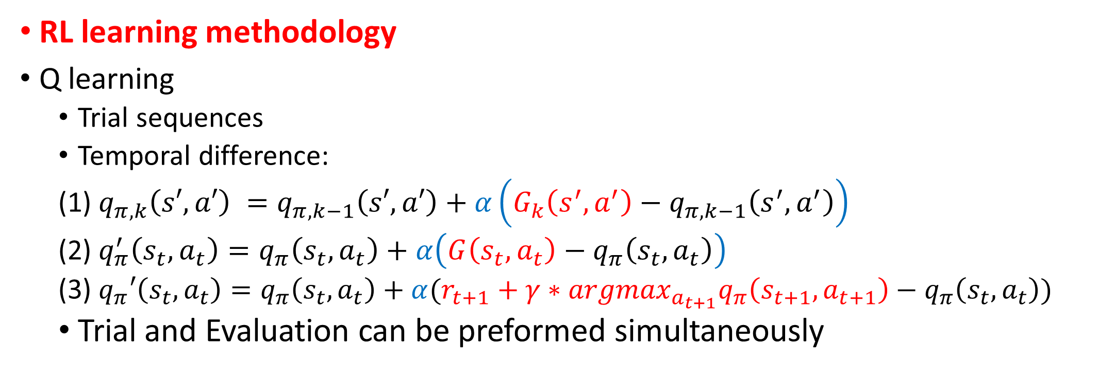

$q_{π,k}\left(s′,a′\right)≅ \frac{1}{k}\sum_{i=1}^{k}{G_{i}\left(s′,a′\right)}$
$$=\frac{1}{k}[G_{k}\left(s′,a′\right)+\sum_{j=1}^{k−1}{G_{j}(s′,a′)]}=\frac{1}{k}\left[G_{k}\left(s′,a′\right)+\left(k−1\right)q_{π,k−1}\left(s′,a′\right)\right]=q_{π,k−1}\left(s′,a′\right)+\frac{1}{k}(G_{k}\left(s′,a′\right)−q_{π,k−1}\left(s′,a′\right))$$
UCL DEPARTMENT OF ELECTRONIC &
ELECTRICAL ENGINEERING
Literature Review
RL learning methodology
Q learning
Trial sequences
Temporal difference:
(1) $q_{π,k}\left(s′,a′\right) =q_{π,k−1}\left(s′,a′\right)+α\left(G_{k}\left(s^{′},a^{′}\right)−q_{π,k−1}\left(s^{′},a^{′}\right)\right)$
(2) $q_{π}^{′}\left(s_{t},a_{t}\right)=q_{π}\left(s_{t},a_{t}\right)+α\left(G\left(s_{t},a_{t}\right)−q_{π}\left(s_{t},a_{t}\right)\right)$
(3) $q_{π}′\left(s_{t},a_{t}\right)=q_{π}\left(s_{t},a_{t}\right)+α(r_{t+1}+γ∗{{argmax}_{a_{t+1}}q}_{π}\left(s_{t+1},a_{t+1}\right)−q_{π}\left(s_{t},a_{t}\right))$
Trial and Evaluation can be preformed simultaneously
Q target

Slide 7
UCL DEPARTMENT OF ELECTRONIC &
ELECTRICAL ENGINEERING
Literature Review
Reinforcement learning in routing
Environment: Network topology
State: Router
Agent: Packet
Action: next hop
Policy: routing table
Reward: ① UDP packet: delay from one router to another router (queuing + transmission)
② TCP packet: link reliability from one router to another router
value function: ① UDP packet: end-to-end delay
② TCP packet: end-to-end packet loss rate
RL routing method: Q routing

Slide 8
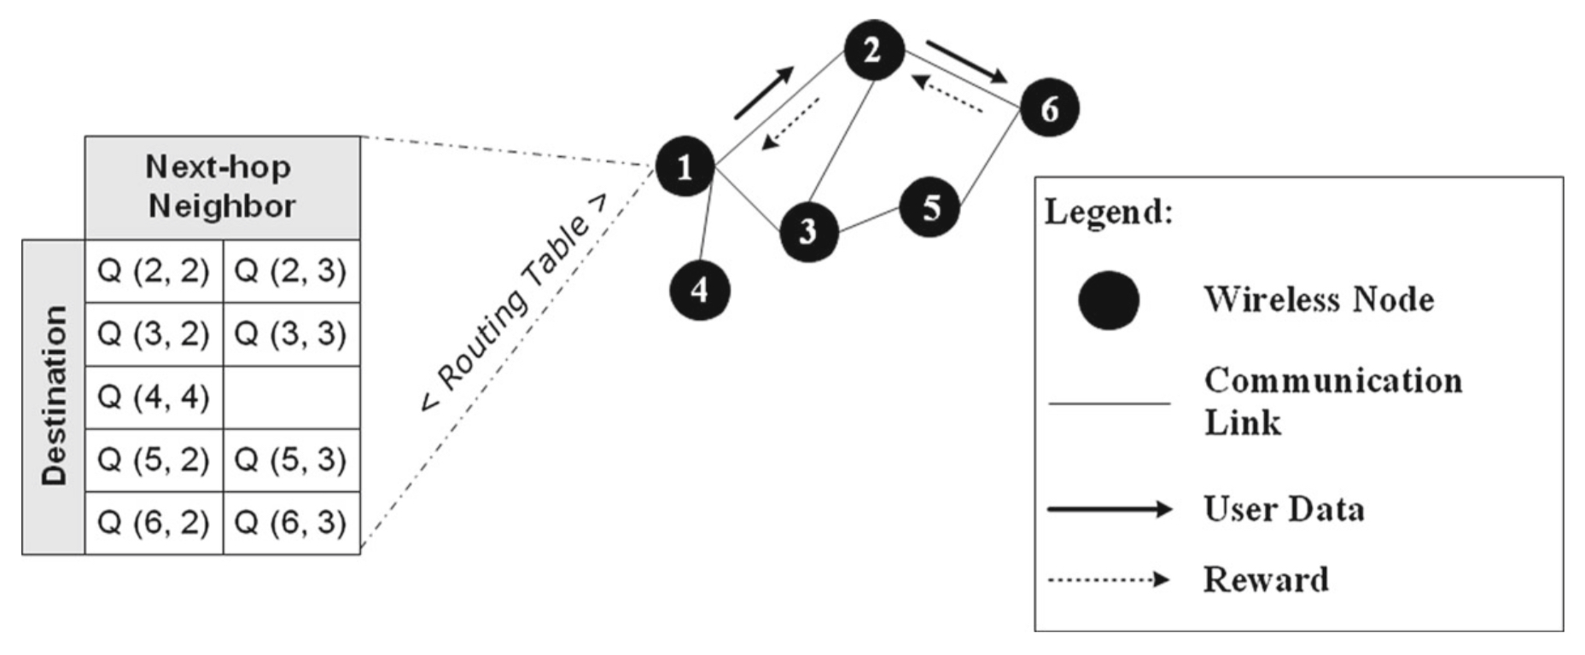
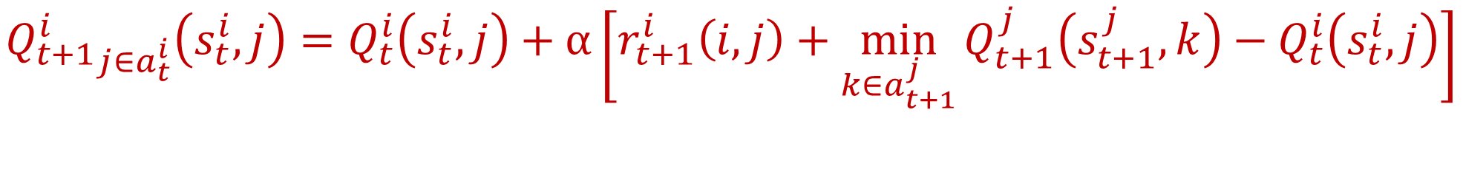
UCL DEPARTMENT OF ELECTRONIC &
ELECTRICAL ENGINEERING
Proposed RL routing methodology
Deep Q routing: Q routing + Deep Q Network
$${Q_{t+1}^{i}}_{j∈a_{t}^{i}}\left(s_{t}^{i},j\right)=Q_{t}^{i}\left(s_{t}^{i},j\right)+α\left[r_{t+1}^{i}\left(i,j\right)+\min_{k∈a_{t+1}^{j}}{Q_{t+1}^{j}\left(s_{t+1}^{j},k\right)}−Q_{t}^{i}\left(s_{t}^{i},j\right)\right]$$

Slide 9
UCL DEPARTMENT OF ELECTRONIC &
ELECTRICAL ENGINEERING
Proposed RL routing methodology
Destination
Deep Q network
Neural network
Replay buffer
Target network
Priority replay
Double Q learning
Duelling Q learning
0
0
1
0
0
0
Next-hop
2
3
4
Node 1 Q routing table
Node 1 Q network

Slide 10
Result to date
UCL DEPARTMENT OF ELECTRONIC &
ELECTRICAL ENGINEERING
Deep Q routing with UDP packet
Routing algorithm to find a path with minimum end-to-end delay
Network topology
Take node 1 as an example:
Node 3 and 4 are its neighbour nodes
Node 2 and 5 are its far-end nodes
Node 1 to node 2 has 4 paths:
1 → 3 → 2
1 → 4 → 2
1 → 3 → 5 → 4 → 2
1 → 4 → 5 → 3 → 2
1
3
2
4
5

Slide 11
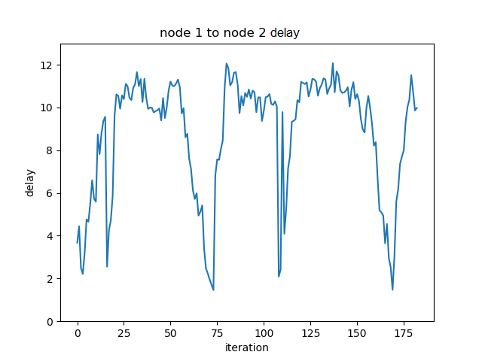
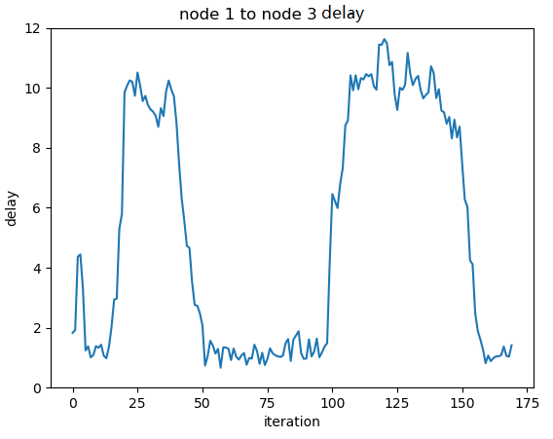
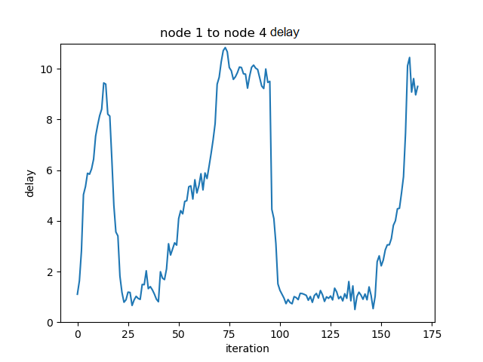
Result to date
Initial stage
Initial stage
UCL DEPARTMENT OF ELECTRONIC &
ELECTRICAL ENGINEERING
Neighbor found
Queuing in node 3
algorithm converged
Min e2e delay found:1 → 3 → 2
1 → 4 → 2
Queue in 3 reduced
1 → 3 → 2 saturated
Min e2e delay found:1 → 4 → 2
1
Initial stage
Neighbor found
Not many packets in the queue
3
1 → 3 → 2
1 → 4 → 2
1 → 3 → 5 → 4 → 2
1 → 4 → 5 → 3 → 2
1 → 3 → 2
1 → 4 → 2
1 → 3 → 5 → 4 → 2
1 → 4 → 5 → 3 → 2
1 → 3 → 2
1 → 4 → 2
1 → 3 → 5 → 4 → 2
1 → 4 → 5 → 3 → 2
2
1 → 4 → 2
Queuing in 4
4
5

Slide 12
Future plan
UCL DEPARTMENT OF ELECTRONIC &
ELECTRICAL ENGINEERING
Deep Q routing with TCP packet
Change the reward from delay to link reliability
Thank you
Packet
loss
rate
Iteration

