Slide 1
END-TO-END DATA ANALYTICS & BI PROJECT
~99K
Olist E-Commerce
Analytics Pipeline
Orders
R$ 13.6M
Total GMV
Brazilian E-Commerce Data · Python · PostgreSQL · Power BI
4 Pages
Python
PostgreSQL
Power BI
Star Schema
Dashboard
6 Tables
Warehouse
By Hadi Assi

Slide 2
Project Overview
Business Problem
Project Scope
Expected Outcomes
Olist marketplace needed clarity on revenue performance, customer retention, and logistics efficiency
End-to-end pipeline: raw data → clean warehouse → interactive dashboard
Automated ETL pipeline in Python with validation
Raw transactional CSV data with no centralised analytics layer
~99,000 orders from Oct 2016 – Sep 2018
PostgreSQL star schema warehouse ready for BI
No KPI visibility for executive decision-making
4 major analytics domains: revenue, customers, products, logistics
4-page Power BI dashboard with 20+ KPIs
Actionable business insights for stakeholders
Portfolio-grade project demonstrating the full data analyst & analytics engineer toolkit

Slide 3
Dataset Overview — Olist Brazilian E-Commerce
About the Dataset
~99,441
~96,096
The Olist dataset is a real-world Brazilian e-commerce dataset published on Kaggle. It covers anonymised orders from the Olist marketplace connector, which allows small merchants to sell through major Brazilian platforms.
Period: October 2016 – September 2018
Total Orders
Unique Customers
~32,951
R$ 13.6M
Products
Gross GMV
Core Tables
olist_customers
olist_orders
olist_order_items
olist_products
~99,441 rows
~99,441 rows
~112,650 rows
~32,951 rows
Customer identities & locations
Order lifecycle & status
Line items, pricing, sellers
Product catalogue & attributes

Slide 4
Architecture & Pipeline Overview
1. Acquire
2. Clean
3. Load
4. Model
5. Visualise
Kaggle API
Programmatic
download
Python / Pandas
Null handling
Validation
PostgreSQL
Staging tables
Raw ingest
Star Schema
Dim & Fact
tables
Power BI
4 Dashboard
pages
Each stage is automated, validated, and documented — production-grade pipeline design
Python 3.11
Pandas
SQLAlchemy
PostgreSQL 15
Power BI Desktop

Slide 5
Data Cleaning & Transformation
What We Found & Fixed
Post-Cleaning Summary
Records Dropped:
< 0.1%
Records Corrected:
Null Timestamps
3–5%
~3,000 undelivered orders had null delivery dates — retained as valid lifecycle nulls
Revenue/Payment Match:
97.4%
Duplicate Rows Found:
0
Category Nulls
~610 products had no category — imputed as 'uncategorized' to preserve revenue data
Impossible Dates
Feature Engineering
~5 rows with estimated delivery before purchase — removed
delivery_duration_days (delivered − purchased)
is_late_delivery (delivered > estimated)
City Name Casing
order_revenue (sum of item prices per order)
Mixed-case city names standardised; whitespace stripped from all string fields
order_freight (sum of freight per order)

Slide 6
PostgreSQL Warehouse Design
STAGING LAYER
DIMENSION TABLES
FACT TABLES
Raw CSV data loaded as-is into PostgreSQL staging tables. No transformations. Acts as an immutable source of truth for replay.
Cleansed, business-friendly lookup tables. Each dimension has a surrogate key (SK) for warehouse integrity.
Two fact tables by grain: order-level for KPIs and item-level for category/product analytics.
stg_customers
dim_customers
fact_orders
stg_orders
dim_products
fact_order_items
stg_order_items
dim_date
stg_products
dim_sellers

Slide 7
Star Schema — Dimensional Model
dim_customers
dim_products
customer_sk (PK)
fact_orders
product_sk (PK)
customer_city
category_name_english
customer_state
order_sk (PK)
avg_price
customer_sk (FK)
purchase_date_key (FK)
order_revenue
order_freight
delivery_duration_days
dim_date
is_late_delivery
dim_sellers
date_key (PK)
seller_sk (PK)
full_date
fact_order_items (item grain)
seller_city
year
Product & category analytics
month
seller_state
quarter

Slide 8
KPI Design — Metrics That Drive Decisions
Revenue
Orders & Customers
Delivery & Ops
Products
Total Revenue (GMV)
Total Orders
On-Time Delivery %
Category Revenue
Average Order Value (AOV)
Unique Customers
Late Delivery %
Category Revenue % of Total
Revenue MoM / YoY Growth
Repeat Purchase Rate
Avg Delivery Duration (days)
Avg Item Price
Revenue YTD
Revenue per Customer
Avg Late vs On-Time Days
Total Items Sold
Total Order Value (incl. freight)
Avg Orders per Customer
Total Delivered Orders
Unique Products Sold
All KPIs implemented as DAX measures in Power BI with semantic model relationships — see DAX_measures.md for full reference

Slide 9
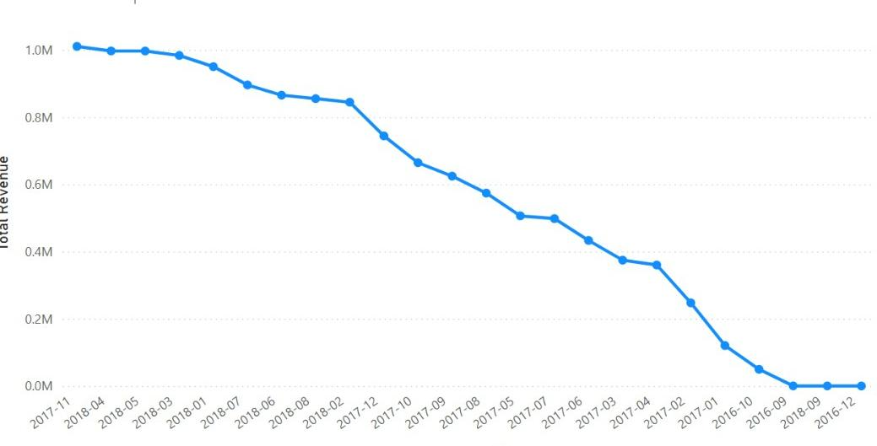
Dashboard — Page 1: Executive Overview
R$ 13.6M
99,441
R$ 137
92.3%
Total Revenue
Total Orders
Avg Order Value
On-Time Delivery
+8.3% avg MoM
Oct 2016 – Sep 2018
Excl. cancelled
−7.7% late
Monthly Revenue Trend
Top Revenue Categories
Health & Beauty
11%
Watches & Gifts
10%
Bed, Bath & Table
9%
Sports & Leisure
8%
Computers & Acc.
7%
Nov 2017 Black Friday spike →
Oct 2016 – Sep 2018 | Monthly revenue in BRL (scaled)
Dashboard includes slicers for: year, quarter, state, category

Slide 10
Dashboard — Page 2: Sales & Products
$ 15.8M
113K
R$ 120
3k
Total Iitem revenue
Items Sold
Avg Item Price
Unique Sellers
All delivered orders
Across all categories
Revenue by Category — Top 10
Seller Insights
Health & Beauty
3,095 unique sellers on platform
11%
Watches & Gifts
10.2%
Top 10% of sellers → ~50% of GMV
Bed, Bath & Table
9.1%
Multi-seller orders: ~1% of all orders
Sports & Leisure
8.3%
Computers & Acc.
7.1%
Furniture & Decor
Product Insights
6.8%
Garden Tools
4.2%
Bottom 10 categories < 2% of GMV
Auto
3.9%
High-volume/low-value: Stationery, Garden
Baby
3.5%
Luxury outliers: orders up to R$ 13,440
Fashion Bags & Acc.
3.1%
~610 products mapped to 'uncategorized'

Slide 11
Dashboard — Page 3: Customer Analytics
99k
1
$137.75
137.75
Unique Customers
Order/Customer
Rev / Customer
AOV
Geographic Revenue Distribution
Customer Behaviour
SP — São Paulo
97% of customers made only ONE purchase — high acquisition dependency
42%
Credit card installments dominant; avg ~3 months
RJ — Rio de Janeiro
13%
Installment buyers have higher AOV than cash buyers
MG — Minas Gerais
12%
RS — Rio Grande do Sul
Retention Opportunity
6%
PR — Paraná
5%
All Customers 96,096
Placed 2nd Order 2,883
All Others
22%
Placed 3rd Order 288
A 2–3% improvement in 90-day repeat rate → +R$ 400–600K GMV

Slide 12
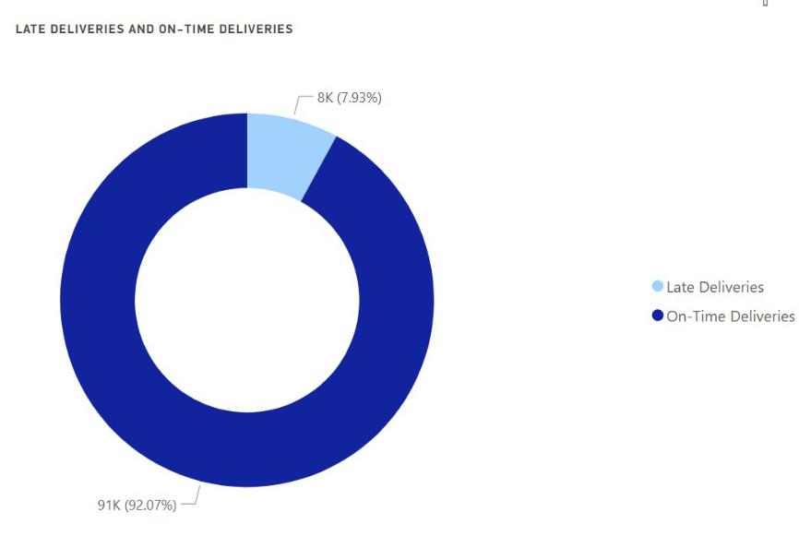
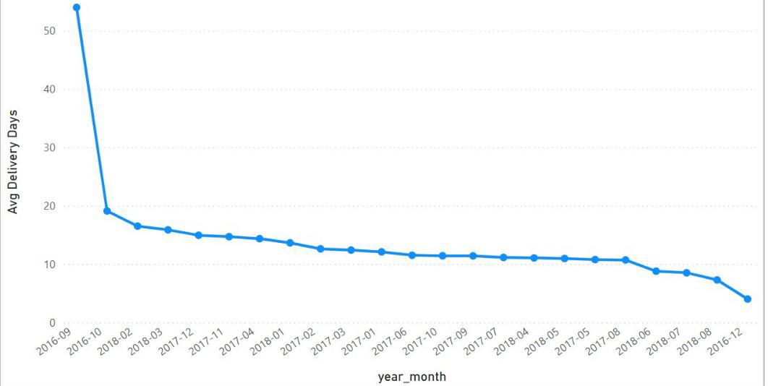
Dashboard — Page 4: Delivery & Logistics
92%
8k
12.09 d
99k
On-Time Rate
Late Delivery
Avg Delivery
Total orders
Benchmark: 95%+
↑ 14% in Nov
All delivered
Delivery Duration Distribution

Slide 13
Key Business Insights
01
Black Friday Dominance
02
São Paulo Concentration Risk
November 2017 revenue was ~2.4× the October baseline — the single largest month in the dataset. Q4 logistics pressure is the biggest operational risk.
42% of all revenue comes from SP. The North & Northeast regions are under-served relative to population — demand exists but freight cost suppresses conversion.
03
Retention Crisis
04
Delivery Is Improving But Lagging
Only 3% of customers return for a second purchase. The business is almost entirely acquisition-driven — a structured post-purchase email programme could add R$ 400–600K to annual GMV.
Avg delivery fell from 15 to 10 days over 2 years. On-time rate of 92.3% remains below the 95%+ e-commerce benchmark, especially in remote regions.
05
Category Concentration
06
Installments Drive Basket Size
Top 5 categories account for ~45% of GMV. Bottom 10 categories generate < 2% combined — candidates for rationalisation to reduce operational overhead.
Credit card installment payments dominate (~3 months avg). Customers using installments show measurably higher AOV — promoting installments in high-value categories could lift revenue.

Slide 14
Challenges & Solutions
Challenge:
Solution:
ETL Pipeline
Timestamp columns stored as VARCHAR in source CSVs. Required explicit parsing with error handling to avoid silent failures.
→
Implemented `pd.to_datetime()` with `errors='coerce'` and post-parse validation to catch and flag unparseable values.
Challenge:
Solution:
Fact Table Grain
Initial design used only order-grain (fact_orders). Product/category analytics were impossible — aggregations crossed the wrong grain.
→
Introduced a second fact table (fact_order_items) at item grain. fact_orders retained for KPI cards; fact_order_items used for all product analytics.
Challenge:
Solution:
Power BI Relationships
fact_order_items needed a date dimension link but shared purchase_date_key with fact_orders, causing ambiguous relationship errors.
→
Used inactive relationships with USERELATIONSHIP() in DAX for item-level date filtering. Bidirectional cross-filter disabled globally to avoid fan-trap issues.
Challenge:
Solution:
Null Strategy
~3,000 null delivery timestamps were initially flagged as errors, threatening to drop valid in-progress or cancelled orders.
→
Reclassified nulls as expected lifecycle states. Null = 'not yet reached this stage'. Delivery KPIs explicitly filtered to `order_status = 'delivered'`.

Slide 15
Technologies & Tools
Data Acquisition
Data Processing
Data Warehouse
BI & Visualisation
Kaggle API
Pandas
PostgreSQL 15
Power BI Desktop
Programmatic dataset download via CLI authentication
DataFrame operations, null handling, feature engineering
Cloud-ready relational warehouse with full SQL analytics
4-page interactive dashboard with slicers and drill-through
Python 3.11
NumPy
SQL (DDL/DML)
DAX
Primary scripting language across all pipeline stages
Numerical operations and array-level validations
Staging, dimension, and fact table creation & population
20+ custom measures: revenue, delivery, customer KPIs
SQLAlchemy
Star Schema
ORM-based PostgreSQL connection and table operations
Dimensional modeling with surrogate keys & relationships
All tools are industry-standard for the modern data analyst & analytics engineer stack

Slide 16
Q & A
Thank you for your time
Dataset
Stack
Docs
Kaggle — Olist Brazilian
E-Commerce Public Dataset
Python · PostgreSQL
Power BI · Star Schema
data_quality_report.md
DAX_measures.md

