Slide 1
TFIDF
Nicholas Fong

Slide 2
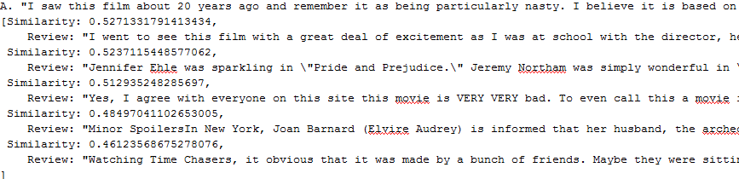
A. Similarity to r*
Output can be seen below, where the first line is r*, and the others are R

Slide 3
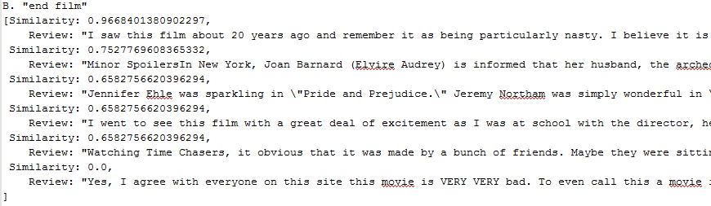
B. Similarity to Q
Output can be seen below, where first line is Q (“end film”) and others are R

Slide 4
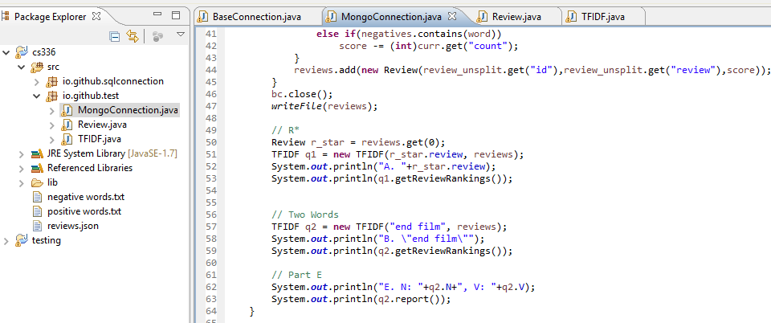
C. Code
Main class continues from mongo project, implemented TFIDF class for computations. See attached in Sakai.

Slide 5
D. Evaluation
I think that this did an acceptable job at finding similarity. This is due to the fact that in my query Q, the similarity was found to be .97 to the review that I extracted it from, while .75 to the next highest review, which had both words as well, though in lesser numbers and the second highest review had a much higher length. The next three also contained the word “film”, while the last one did not have any of the two words at all, receiving a 0.

Slide 6
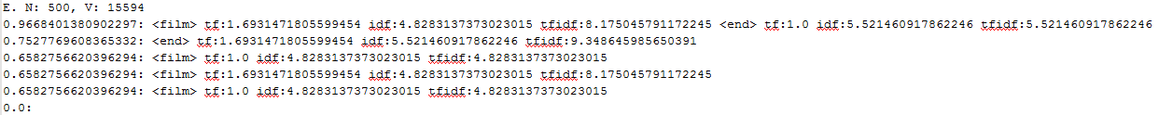
E. Values for Query Q
I have written a method for reporting part E’s results (TFIDF.report()). The data below is for the same query Q, showing similarity score, words matched, tf (weighted), idf, and raw tfidf for that word and review.

