Slide 1


1. $p(k)$ distribution
Erods-Renyi Network $\left\langle k\right\rangle =10$
Barabasi-Albert model $\left\langle k\right\rangle =10$
Slope = 2.98(3)

Slide 2
2. Cluster-size distribution
Erods-Renyi Network $\left\langle k\right\rangle =10$
Barabasi-Albert model $\left\langle k\right\rangle =10$
BA-model의 경우 preferential attachment rule을 쓰기 때문에 giant cluster를 제외한 isolated cluster가 없다.

Slide 3
3. Node to node distance distribution
Erods-Renyi Network $\left\langle k\right\rangle =10$
Barabasi-Albert model $\left\langle k\right\rangle =10$

Slide 4
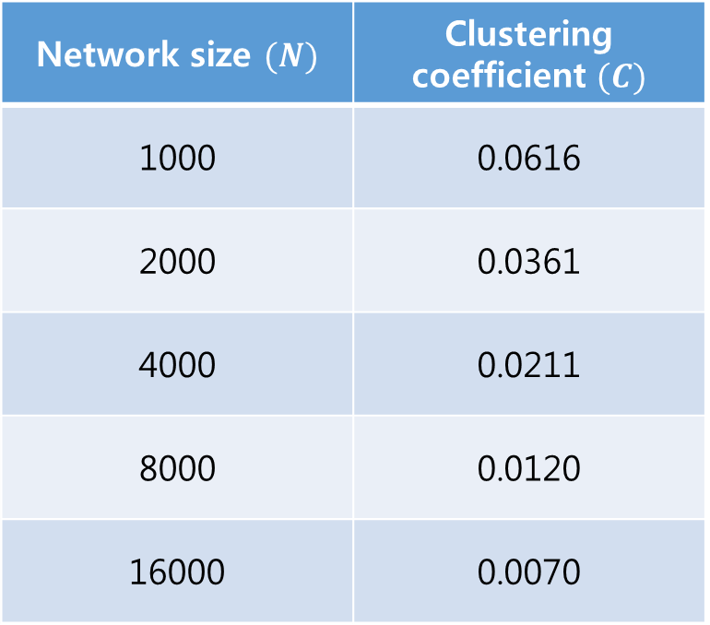
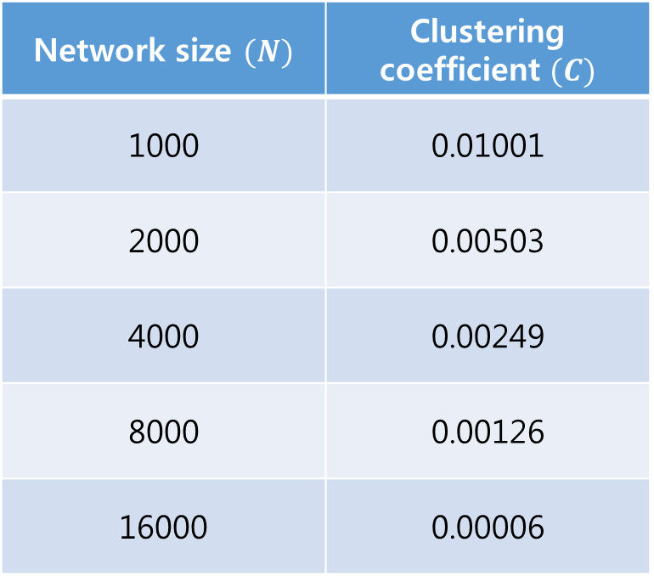
4. Clustering coefficient
Erods-Renyi Network $\left\langle k\right\rangle =10$
Barabasi-Albert model $\left\langle k\right\rangle =10$
Network size $(N)$ | Clustering coefficient $(C)$
1000 | 0.01001
2000 | 0.00503
4000 | 0.00249
8000 | 0.00126
16000 | 0.00006
Network size $(N)$ | Clustering coefficient $(C)$
1000 | 0.0616
2000 | 0.0361
4000 | 0.0211
8000 | 0.0120
16000 | 0.0070

Slide 5
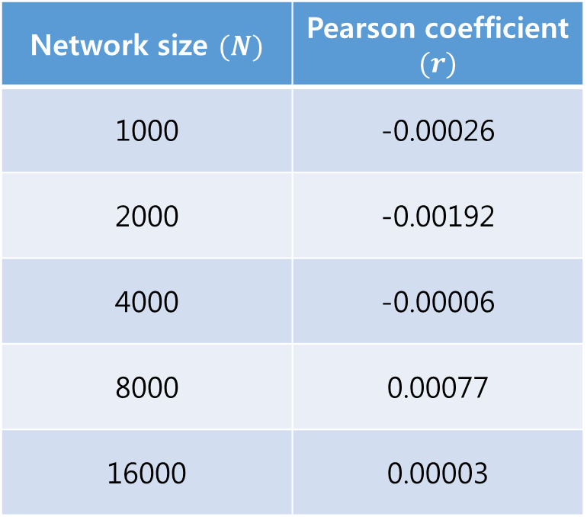
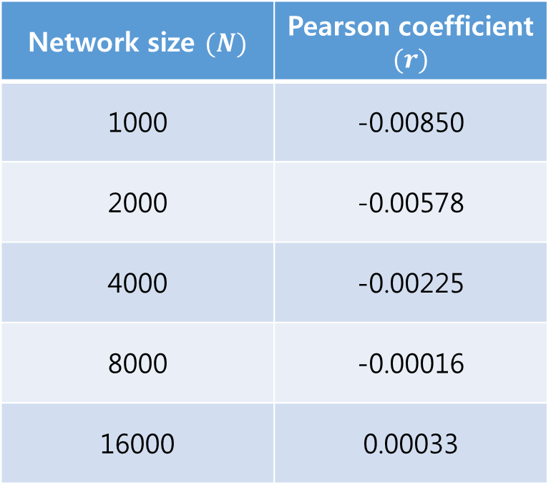
5. Pearson Coefficient
Erods-Renyi Network $\left\langle k\right\rangle =10$
Barabasi-Albert model $\left\langle k\right\rangle =10$
Network size $(N)$ | Pearson coefficient $(r)$
1000 | -0.00026
2000 | -0.00192
4000 | -0.00006
8000 | 0.00077
16000 | 0.00003
Network size $(N)$ | Pearson coefficient $(r)$
1000 | -0.00850
2000 | -0.00578
4000 | -0.00225
8000 | -0.00016
16000 | 0.00033

Slide 6
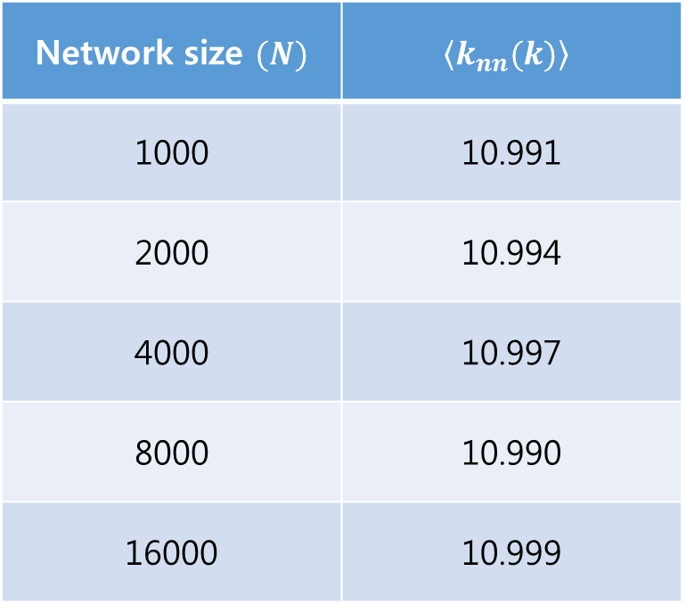
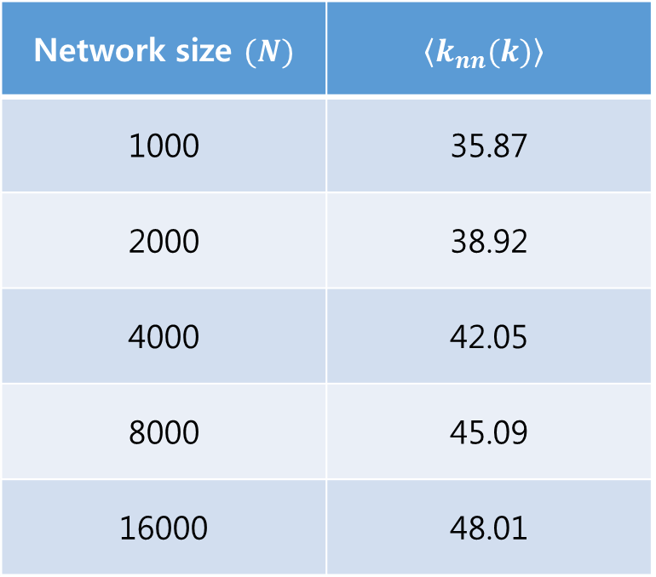
6. Average nearest neighbor degree
Erods-Renyi Network $\left\langle k\right\rangle =10$
Barabasi-Albert model $\left\langle k\right\rangle =10$
Network size $(N)$ | $$\left\langle k_{nn}(k)\right\rangle$$
1000 | 10.991
2000 | 10.994
4000 | 10.997
8000 | 10.990
16000 | 10.999
Network size $(N)$ | $$\left\langle k_{nn}(k)\right\rangle$$
1000 | 35.87
2000 | 38.92
4000 | 42.05
8000 | 45.09
16000 | 48.01

Slide 7
7. Betweenness Centrality
Erods-Renyi Network $\left\langle k\right\rangle =10$
Barabasi-Albert model $\left\langle k\right\rangle =10$

