Slide 1
DLIP Final Project Proposal 2
Korean OCR Recognition Deep Learning Project
2023. 6. 6
한동대학교 기계제어공학부
21800031 국진호
Notes:
탈부착식 차선 도색 로봇암 개발을 위한 차선 인식 및 경계선 검출 알고리즘 연구에 대한 발표를 시작하도록 하겠습니다.
안녕하십니까 저는 한동대학교 기계제어공학부 17학번 송태웅 입니다.

Slide 2

Subject : Korean OCR Recognition Deep Learning Project
1. Why does this topic need to be resolved?
Individuals often need to digitally document, but there are few options for doing so, so images are often typed by hand.
There are many OCR models for English, but the number of models for Korean is very small and the accuracy is not good.
A large amount of intellectual property held by public enterprises can be preserved by digitally documenting it.
Easy access to information for individuals.

Slide 3
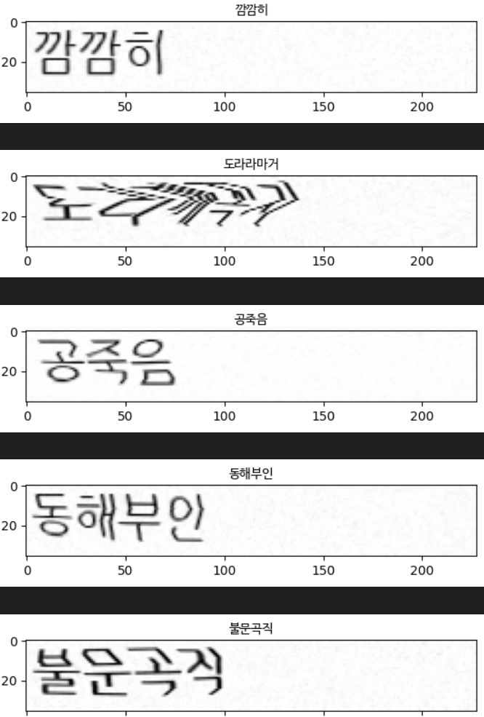
Subject : Korean OCR Recognition Deep Learning Project
2. What is the goals for this project?
Achieved Hangul recognition accuracy of over 90%.
Increase the dataset and modify the hyper-parameters to perform better on the existing researched models.
Made it possible to evaluate and output letters directly through ‘OPENCV’ image processing.

Slide 4
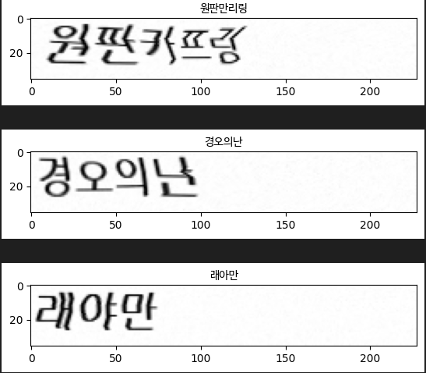
Subject : Korean OCR Recognition Deep Learning Project
Not matched!
3. How evaluate performance?
Due to the nature of JAMOEMBEDDING, it is categorized by the accuracy of consonants and vowels.
So performance is evaluated based on how well consonants and vowels match.
Expected results

Slide 5
Subject : Korean OCR Recognition Deep Learning Project
4. Procedure and current state
Dataset setting
Additional augmentation
Configure SRN model
Modify model parameter
Train with model
Infer model
OPENCV image demo

