Slide 1
DLIP Final Project
Korean OCR Recognition Deep Learning Project
2023. 6. 13
Handong Global University
Mechanical and Control Engineering
21800031 Kook Jinho
Notes:
Hello my name is JINHO KOOK and I introduce about my final deeplearning project in this class.

Slide 2
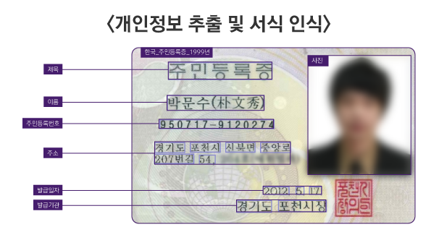
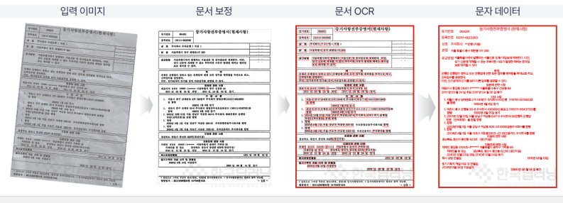
▣ Research background and objectives
Background – Why Hangul OCR need?
There is often a need for individuals to digitally document images such as past problems, but there is almost no method, so in the case of images, direct typing is mainly used.
Numerous intellectual properties held by public corporations can be digitally documented and preserved.
Application example
Notes:
First, I will talking about the background.
As I explained last time, Korean ocr is a device for easy storage of digital documents.
Many public institutions still lose a lot of data because of this problem.
Therefore, Korean ocr is very important in this situation.
There are many uses because documents can be easily digitized not only by public institutions but also by individuals.

Slide 3
▣ Research background and objectives
Previous study
There are currently very few Hangul OCR models, and most of them are already optimized for English. In terms of difficulty, Hangeul is very difficult because consonants and vowels are combined in two dimensions, vertically and horizontally, while English is a one-dimensional array that stretches sideways.
The most representative Hangul OCR API is 'easyOCR', which was launched in 2020 and is still being updated. However, the main consensus is that its performance is much worse than English[1].
OCR Categorizing
Classification criteria | Classification method
Procedure | Text detection | Text recognition
Recognize target | - | Phrase | Syllables
Recognize image | - | Print | Picture
Recognize text style | - | Print writing | Handwriting
[1] 문대정, 황재문, 김지효, 황상흠.(2021).한글 문서 OCR에서의 상용 API 성능 비교 연구
Notes:
In the case of Korean ocr, there are not many previous studies.
Most of them are paid api, and the recognition rate is not excellent due to the complex structure of Hangeul.
OCR is divided by first text detection and second text recognition.
Text detection is literally recognizing where the letters are.
Text recognition is to understand the meaning of the detected letter.
These are used another models each.
So, I selected text recognition for this project.
I'm going to focus on the red box in table.
It is easier than handwriting.

Slide 4
▣ Research background and objectives
Objectives
Achieved over 90% accuracy in Hangul test custom dataset.
Increase the dataset and modify the hyper-parameters to perform better than the previously studied model.
Using OPENCV for text detection.
Evaluate method
Print writing
(50 words)
How many words match?
Test data : 50 words
Print writing in picture
Test 2
Notes:
My research object is 90% accuracy in first test and modify dataset and model.
And Simple implementation of text detection by using opencv library.

Slide 5
▣ Research procedure
Flowchart
Using Hangul word dictionary dataset
Choice dataset
Using CAIRO library
Convert text to image
Configure model
CNN encoder + GRU decoder
Infer model
OPENCV image demo
Training
Min learning rate : 1e-4
Patience : 3
Min delta value : 0.02
Batch size : 128
Epochs : 13 (maximum : 100)
Modify model parameter
Test
Apply custom dataset

Slide 6

▣ Research procedure
Train dataset - Augmentation
Hangul word dictionary
Random select 2 words
Make combination 2 words to 1 word
2~8 character
# data : 270000
Maximum 16-character
# data : 1000000
Train dataset - variation
Infer model
OPENCV image demo
Various variations were applied to the handwriting.
Notes:
I thought the number of words in the existing data was too small.
So to augment that, I created a million word data by randomly combining two words.
And I distorted the word image using the Cairo library.

Slide 7
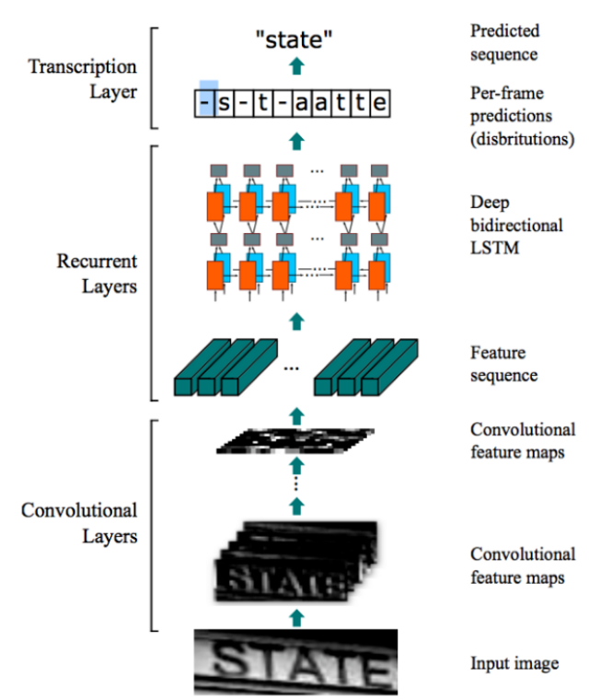
▣ Research procedure
CRNN + GRU
Model structure
Encoding
Input image
Attention
Convolution layer
2D Feature map
Map to Sequence
Infer model
OPENCV image demo
Decoding
1D Sequence
Loss
Attention
GRU layer + teacher forcing
CrossEntropy
Modify model parameter
Weight
State
Class results
Custom dataset
Dense layer classifier
Notes:
This is my model structure.
My model is largely divided into two stages. the encoder and decoder parts.
The encoder portion extracts a feature map using cnn.
However, to separate Hangul into consonants and vowels, change it to 1d scale. And I proceed with decoding using gru.
Attention refers once again to the input word. At this point, focus on the relevant parts and give weight.
Eventually, the class is classified by combining the results. And calculate loss.

Slide 8
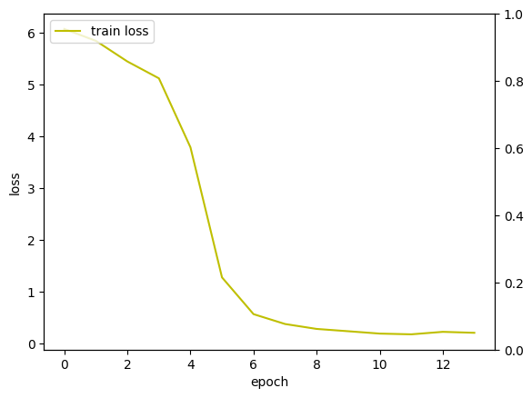
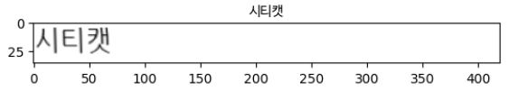
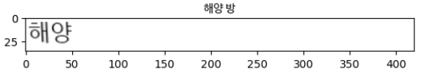

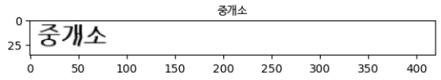
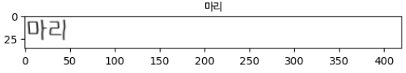
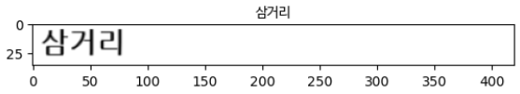
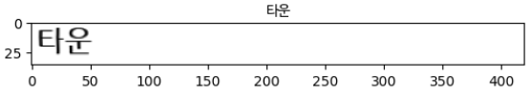
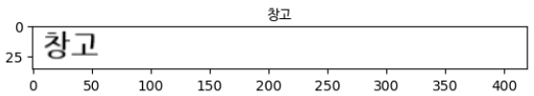
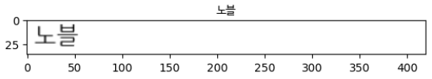
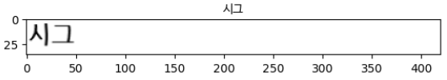









▣ Research results
Test results
 | Dataset number | Error number | loss
Train | 950000 | 1640 | 0.1726[%]
Test | 50 | 5 | 10[%]
Testing words
EV sales up 68% year-over-year in 2022, Korea
80.63 million electric vehicles sold in a year
Error !
Good !
Train loss graph
Notes:
This is my test result. Finally, by word of mouth, there were 5 errors in 50 words.
Therefore, it shows 90% accuracy.

Slide 9
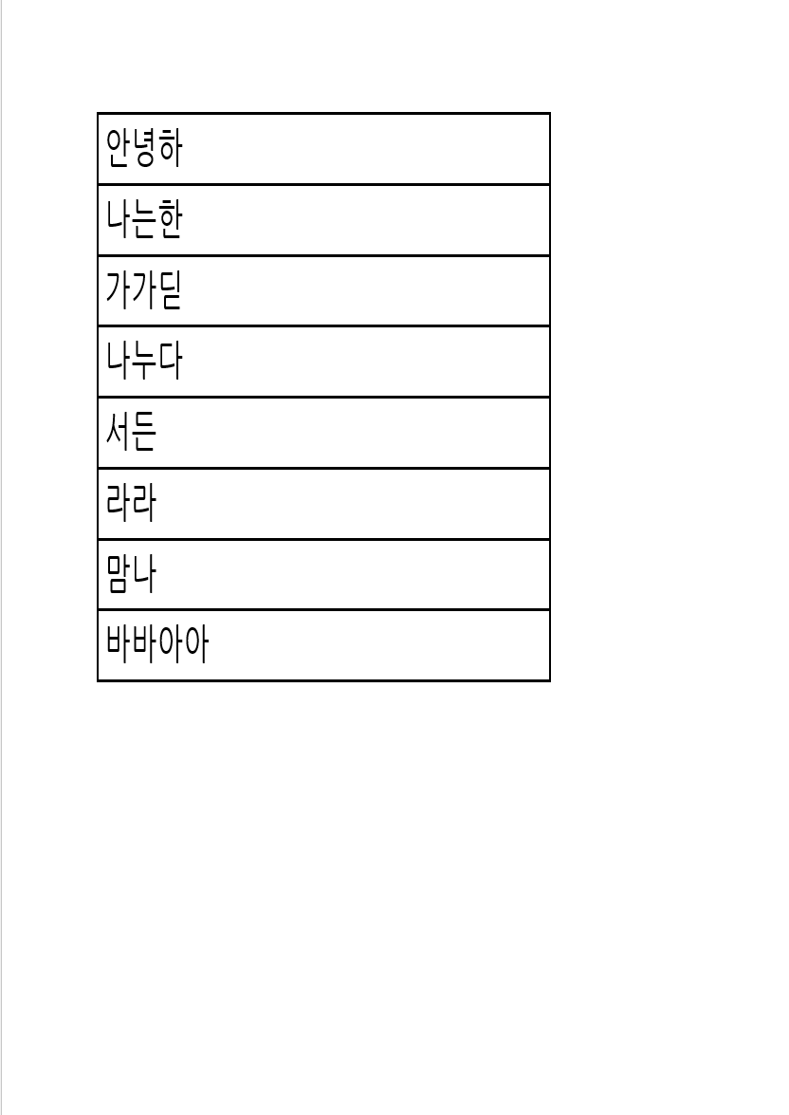
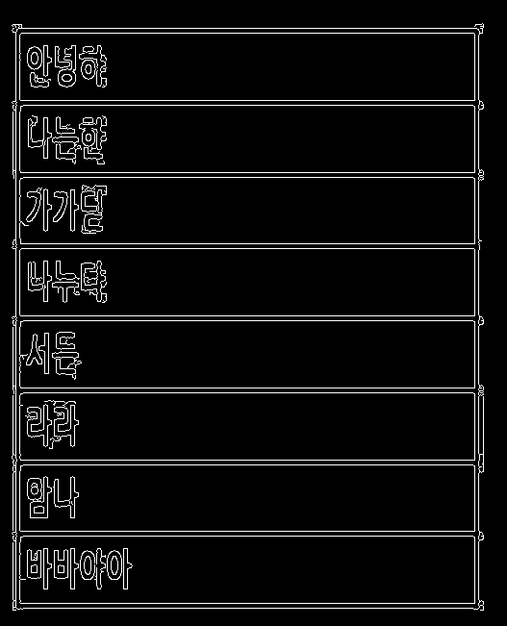
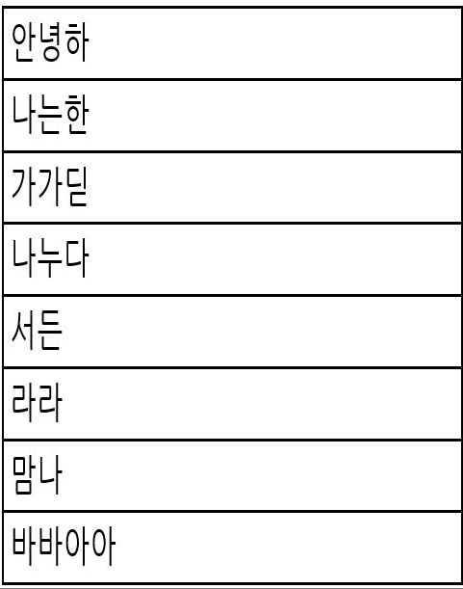
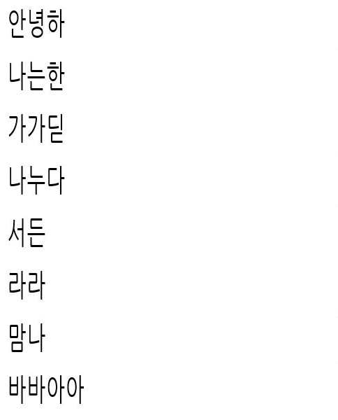
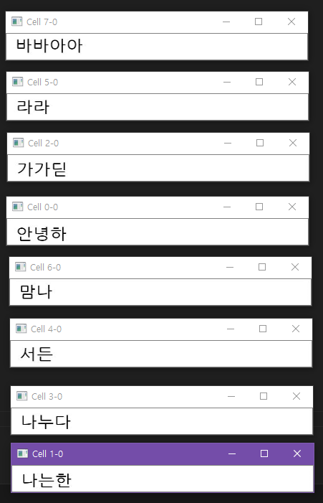
▣ Research results
OPENCV- text detection
EV sales up 68% year-over-year in 2022, Korea
80.63 million electric vehicles sold in a year
Raw image
Canny image
Line recognition image
Eliminated line image
Cropped image for format
But this method did not have a good recognition rate of less than 50%.
Notes:
I did not only the text recognition model, but also the text detection with OPENCV process for other document images.
However, it failed to confirm the high recognition rate through this process.

Slide 10
▣ Research conclusion
Conclusion
I use OCR deep learning with phrase, print writing in Hangul.
I train with CNN + GRU model because Hangul is consist of consonants and vowels.
Test result accuracy is 90%. So the training is successfully performed.
Text detected picture recognition accuracy is not good. So this needs to be improved.
Futher works
If I learn about actual printed pictures, I will have a much higher possibility of application.
This study focused on text recognition, but it would be good to build a complete OCR system by combining the two by strengthening text detection.
Notes:
My conclusion is as follows in the ppt.
Text recognition was performed among Korean ocr, and the recognition was successful, but it is still insufficient to proceed by converging it with detection.
If possible in the future, it will be an additional task to implement a complete ocr model capable of text detection.
Thank you for your attention.

