Slide 1
Predicting Overall Survival Using Early PFS Evidence
Jinjie Chen

Slide 2
1. Motivation
Overall Survival (OS) is the gold standard endpoint in oncology.
However OS often matures much later than PFS.
Typical timeline:
PFS readout: early
OS readout: delayed
Goal:
Estimate the probability that the final OS result will be successful.

Slide 3
2. Decision Quantity
Define success as an OS hazard ratio threshold.
$$HR_{target}$$
On the log scale
$$ℓ_{target}=log(HR_{target})$$
Predictive probability of success:
$$PoS=P(θ_{OS}^{(c)}<ℓ_{target})$$

Slide 4
3. Available Data
Two types of information:
Historical trials
Current trial
Historical trials provide the relationship between OS and PFS.
Current trial provides early evidence.

Slide 5
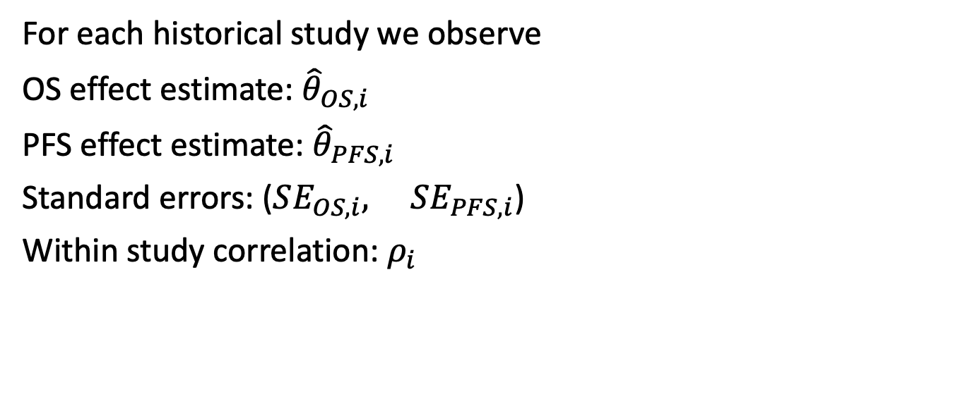
4. Historical Trial Data
For each historical study we observe
OS effect estimate: ${\hat{θ}}_{OS,i}$
PFS effect estimate: ${\hat{θ}}_{PFS,i}$
Standard errors: ($SE_{OS,i}, SE_{PFS,i}$)
Within study correlation: $ρ_{i}$

Slide 6
5. Vector Representation
Define observed estimates
$$y_{i}=\left(\begin{matrix}{\hat{θ}}_{OS,i} \\ {\hat{θ}}_{PFS,i}\end{matrix}\right)$$
True treatment effects
$$θ_{i}=\left(\begin{matrix}θ_{OS,i} \\ θ_{PFS,i}\end{matrix}\right)$$

Slide 7
6. Within Study Sampling Model
Assume asymptotic normality
$$y_{i}|θ_{i}∼N(θ_{i},S_{i})$$
Within study covariance matrix
$$S_{i}=\left(\begin{matrix}SE_{OS,i}^{2} & ρ_{i}SE_{OS,i}SE_{PFS,i} \\ ρ_{i}SE_{OS,i}SE_{PFS,i} & SE_{PFS,i}^{2}\end{matrix}\right)$$

Slide 8
7. Between Study Model
Assume random effects
$$θ_{i}∼N(η,Σ_{0})$$
where
$$η=\left(\begin{matrix}η_{OS} \\ η_{PFS}\end{matrix}\right)$$

Slide 9
8. Between Study Covariance
$$Σ_{0}=\left(\begin{matrix}Σ_{OO} & Σ_{OP} \\ Σ_{OP} & Σ_{PP}\end{matrix}\right)$$
This matrix captures
heterogeneity across trials
correlation between OS and PFS effects

Slide 10

9. Marginal Distribution
Combining levels
$$y_{i}∼N(η,S_{i}+Σ_{0})$$
We estimate $(η,Σ_{0}$)
using multivariate meta analysis.

Slide 11
10. Estimation
Two approaches
REML
Method of Moments
Primary analysis uses REML.
Method of Moments is used as sensitivity analysis.

Slide 12
11. Current Trial Evidence
Current trial provides
PFS estimate
$${\hat{θ}}_{PFS}^{(c)}$$
Standard error
$$SE_{PFS}^{(c)}$$
Goal:
Predict the OS treatment effect.

Slide 13
12. Conditional Prediction
Using multivariate normal theory
$$E(θ_{OS}^{(c)}|θ_{PFS}^{(c)})=η_{OS}+\frac{Σ_{OP}}{Σ_{PP}}(θ_{PFS}^{(c)}−η_{PFS})$$

Slide 14
13. Conditional Variance
$$Var(θ_{OS}^{(c)}|θ_{PFS}^{(c)})=Σ_{OO}−\frac{Σ_{OP}^{2}}{Σ_{PP}}$$

Slide 15
14. Predictive Distribution
Accounting for estimation uncertainty
$$θ_{OS}^{(c)}∼N(μ_{pred},σ_{pred}^{2})$$

Slide 16
15. Probability of Success
Closed form probability
$$PoS=Φ\left(\frac{ℓ_{target}−μ_{pred}}{σ_{pred}}\right)$$

Slide 17
16. OS Interim Information
Sometimes interim OS is available.
Observed interim estimate
$${\hat{θ}}_{OS}^{int}$$
Standard error
$$SE_{OS}^{int}$$

Slide 18
17. Joint Updating
Observed data
$$y=\left(\begin{matrix}{\hat{θ}}_{OS}^{int} \\ {\hat{θ}}_{PFS}^{(c)}\end{matrix}\right)$$

Slide 19
18. Posterior Distribution
Prior
$$θ^{(c)}∼N(η,Σ_{B})$$
Posterior
$$θ^{(c)}|y∼N(m,V)$$

Slide 20
19. Posterior Parameters
$$V=(Σ_{B}^{−1}+S^{−1})^{−1}$$
$$m=V(Σ_{B}^{−1}η+S^{−1}y)$$

Slide 21
20. Summary
Framework
1 Historical evidence informs OS–PFS relationship
2 Current PFS predicts OS
3 Interim OS can refine prediction
4 PoS provides a quantitative decision metric

