Slide 1
Face Detectives v1.0
Mark Jenkins (s1309061)
Saravanabalagi Ramachandran (s1753338)

Slide 2
1. Detection: Method
We used
HoG with cell size 8
LBP with cell size 4
Sliding Windows
Resizing images from a scale of 0.8 to 1
Stride = 8
Then cross validated a SVM
liblinear

Slide 3
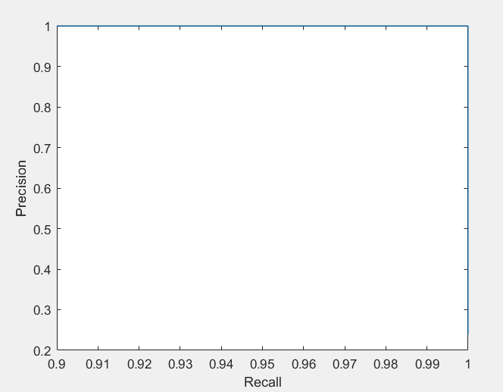
1. Detection: Results
We got 1.0 AP.

Slide 4
2. Recognition/Verification: Method
Recognition:
Deep features
VGG Face Model from Matconvnet: http://www.vlfeat.org/matconvnet/models/vgg-face.mat
PCA: 250 components
We used liblinear SVM
Verification:
LBP with cell size of 8 and Deep features
Euclidean Distance between two image features
PCA: 2 components
We used liblinear SVM

Slide 5
2. Recognition/Verification: Results
We got 91.5% recognition accuracy.
We got 84.30% verification accuracy.

Slide 6
3. Bonus:
Used deep features for recognition and verification
Linked face detector and face recognizer

Slide 7
3. Bonus: Results
Achieved an average precision of 1.0 for face detection
Achieved 91.5% accuracy for recognition
Achieved 84.9% accuracy for verification
Tested on an image with multiple faces
All faces (that the model was not trained on) are detected and identified correctly

Slide 8
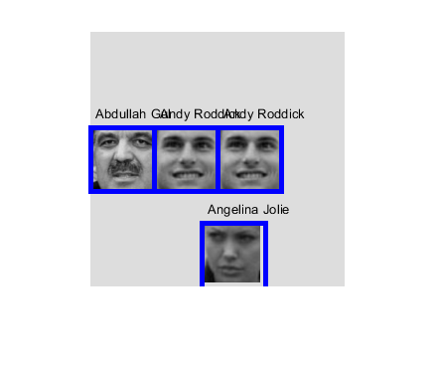
3. Bonus: Results

