Slide 1
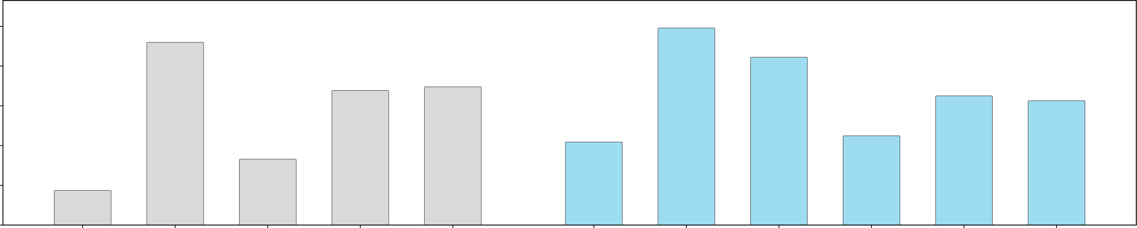
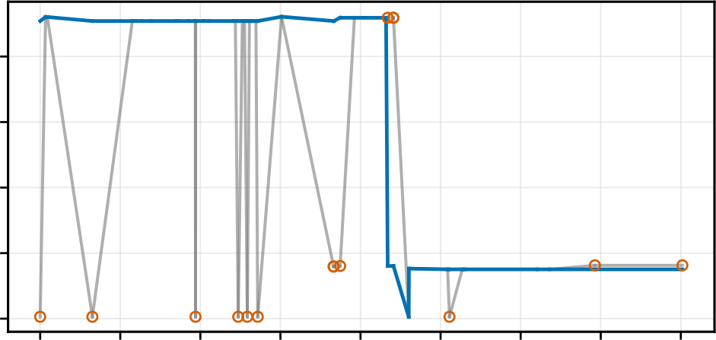
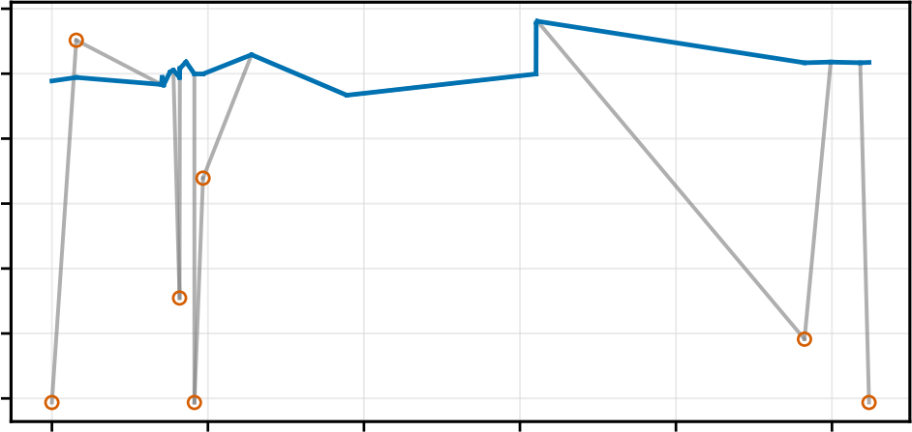
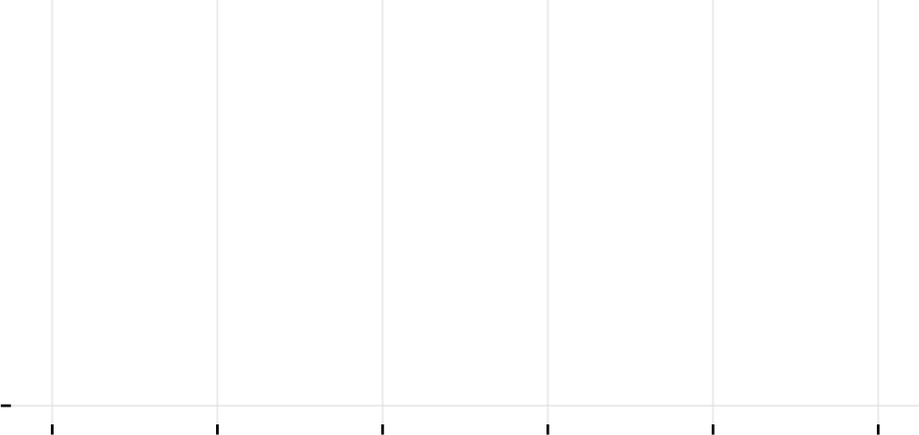
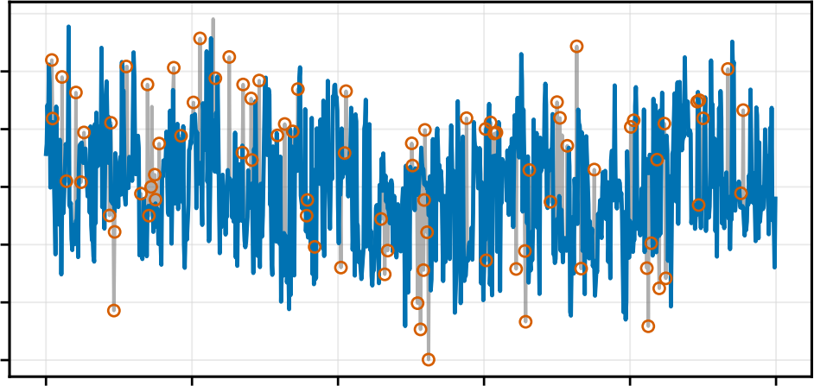
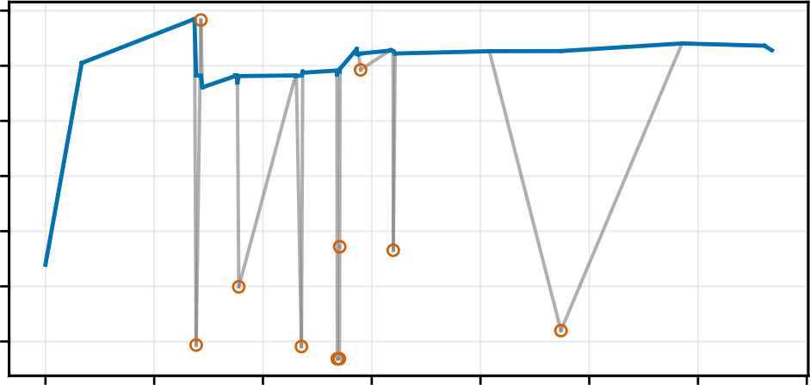
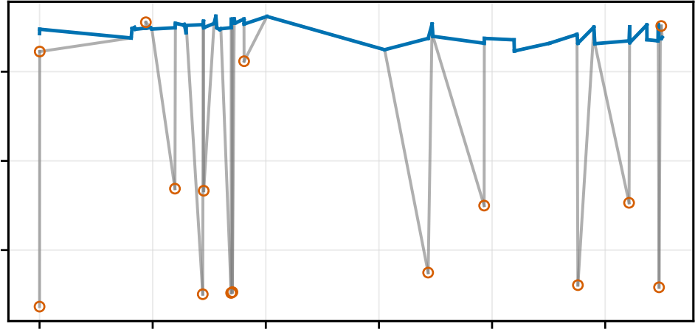
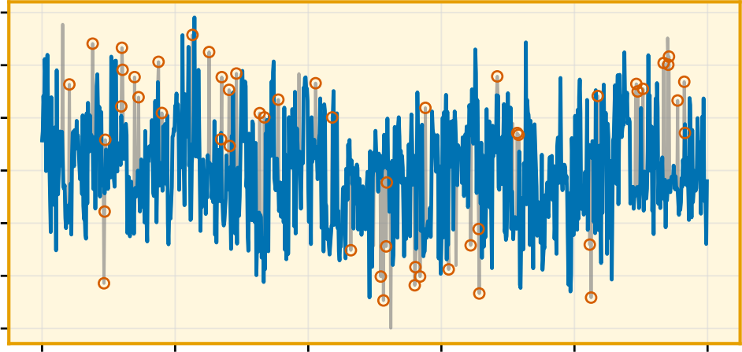
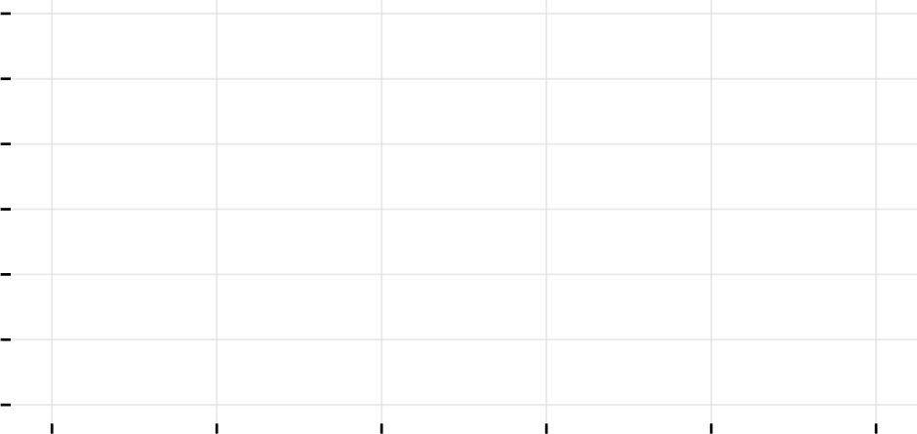
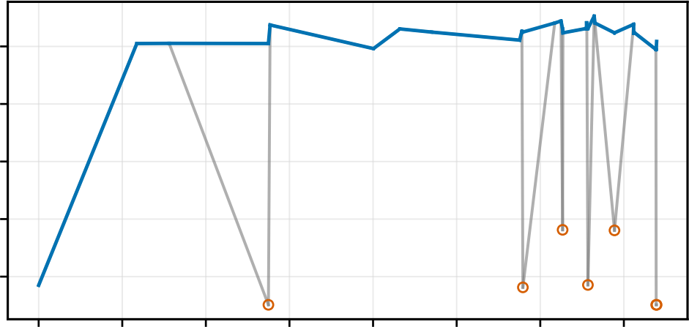
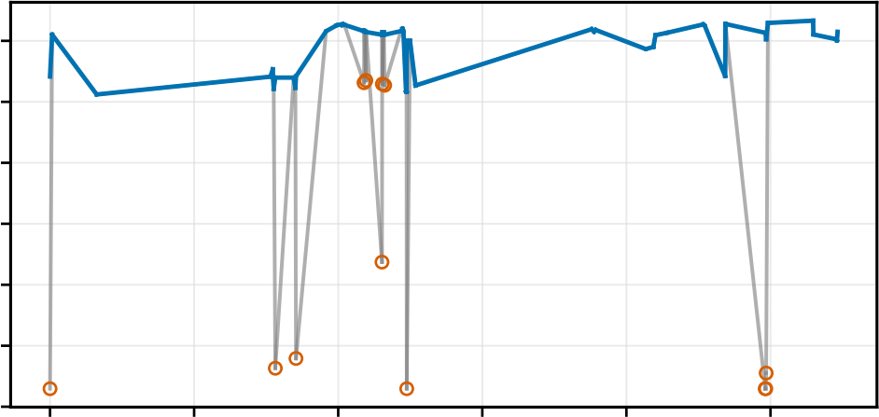
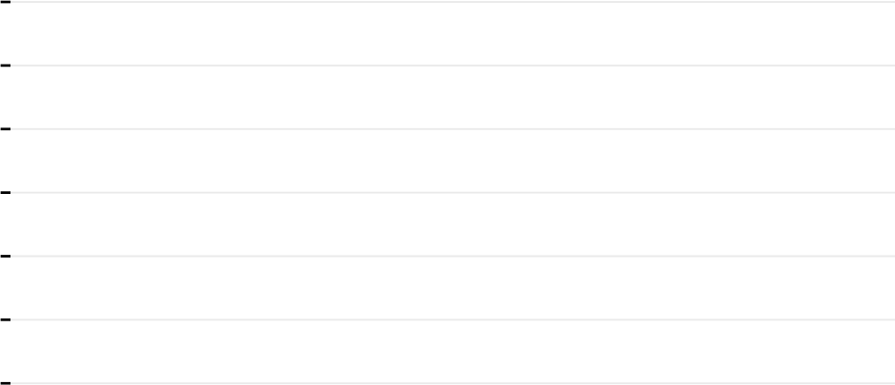
Hampel effect (N = 162) Window coverage (11 frames)
Waveform correlation, r = 0.766
91.85%
84.3%
69.44%
^{64.9%} 62.4%
41.7%
33.05%
17.33%
100%
80%
60%
40%
20%
0%
0.5
0.0
−0.5
−1.0
−1.5
1.0 0.5 0.0 −0.5 −1.0 −1.5 −2.0
0.5
0.0
−0.5
−1.0
−1.5
99.1%
67.63%
Percentage (%)
44.8%
CSI values Frames with ≥1 High-change Temporal Peak intensity Static Walking Fall Sleeping Drinking Sitting / TV
replaced replacement CSI replaced variation removed removed
Raw Hampel Replaced
(a) Aggregate effect and action coverage
Static
Walking
3
2
1
0
−1
−2
−3
3
2
1
0
−1
−2
−3
3
2
1
0
−1
−2
−3
3 frames (15 ms)
5 frames (25 ms)
Fall
Sleep
11 frames (55 ms)
21 frames (105 ms)
Normalized amplitude
Drinking
Watching TV
51 frames (255 ms)
101 frames (505 ms)
0 1 2 3 4 5 6 7
0 1 2 3 4 5
0 1 2 3 4 5
0 1 2 3 4 5
Time (s)
(b) ElderAL actions (11-frame Hampel) (c) XRF55 Hampel windows

