Slide 1
Travelling Salesman PROBlem
Tem: 529
Chenyang Zhao
Jin Li

Slide 2
PROBLEM DESCRIBE
The travelling salesman problem (TSP) asks the following question: "Given a list of cities and the distances between each pair of cities, what is the shortest possible route that visits each city and returns to the origin city?" It is an NP-hard problem in combinatorial optimization, important in operations research and theoretical computer science.
We also explore which chief factors can affect the evolve generation and shortest route of travelling salesman problem?

Slide 3
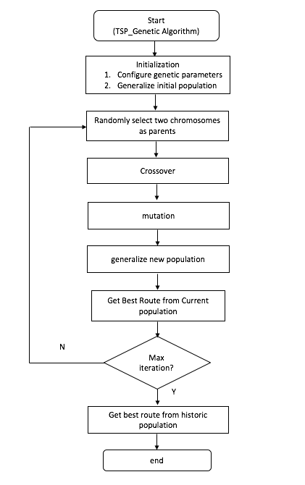
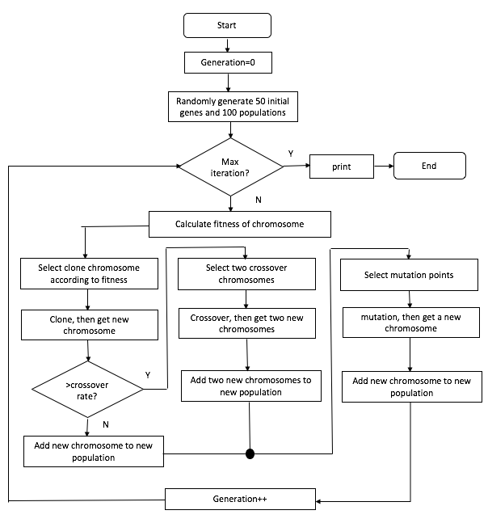
Flow diagram
Detail flow diagram
Overall flow diagram

Slide 4
Gene
(1,1) (3,4) (10,37)
ID: 1, 2, 3
Coordinate: (x, y)
1
2
3

Slide 5

Chromosome

Slide 6

Population
Pop size = 3

Slide 7
Genetic Algorithm
Fitness function
Sort selection
clone
mutation
crossover

Slide 8
Clone
Parent Chromosome: 3 - 4 – 5 – 1 – 7 – 6 - 2
Children Chromosome: 3 - 4 – 5 – 1 – 7 – 6 - 2
PC:
CC:

Slide 9


Crossover
Parent Chromosome 1: 1-2-3-4-5-6-7
Parent Chromosome 2: 4-1-7-6-5-2-3
Children Chromosome 1: 7-6-5-1-2-3-4
Parent Chromosome 2: 3-4-5-1-7-6-2

Slide 10
Mutation
Before mutation: 1-2-3-4-5-6-7
After mutation: 1-5-3-4-2-6-7
1
2
3
4
5
6
7
1
5
3
4
2
6
7

Slide 11
Fitness function & sort
Fitness function:
calculate two neighboring genes distance by their coordinates. Add all two genes distance to get the chromosome distance
Sort:
HashMap to store the route distance as key, and route as value.
Priority Queue to sort the distance, poll the route one by one and add the route to a new ArrayList. Thus, the new ArrayList is sorted by the distance.

Slide 12
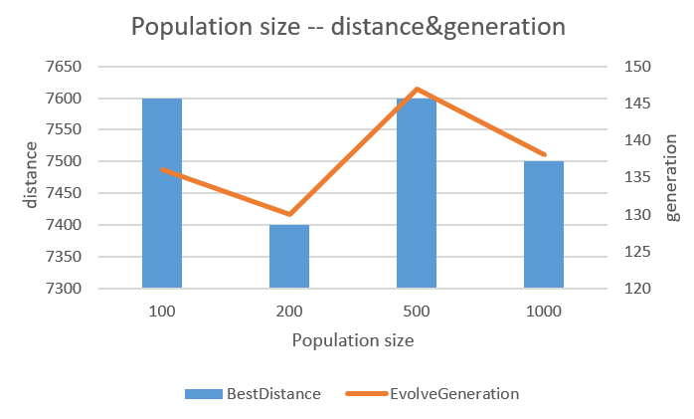
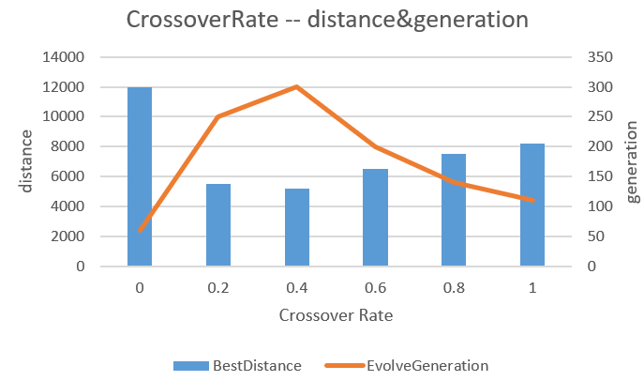
Result & Conclusion
Population size does not influence the best distance and evolution generation much.
The best distance decreases when the crossover rate decreases from 1 to 0.4, but it will be stable when crossover rate less than 0.4. When crossover rate is 0, the evolution progress only contains mutation, the best distance will become much longer, and the evolution speed is much faster. Because the default mutation rate is only 0.1, the routes will not change much.

Slide 13
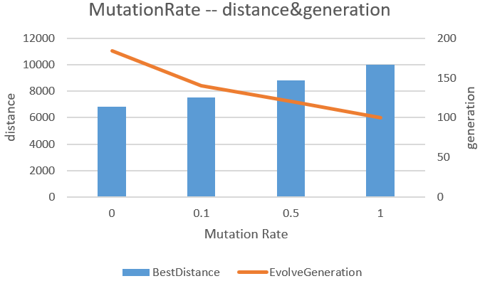
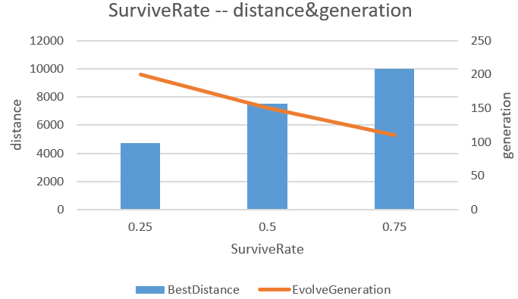
Result & Conclusion
The larger mutation rate, the faster evolved, the longer best distance. Thus, the crossover without mutation will produce the better result.
The little survive rate, the little best distance, and the larger evolution generation.

